Slide 1
Work Shop
Advanced Database Techniques
Presented By-
Prof. S.M. Shedole
Sinhgad College, Pune
Prof. S.M. Shedole SIT, Lonavala

Slide 2
Flow of Workshop
SQL
PLSQL
SQL and NOSQL
MONGODB
LAB
  SQL Lab
  PLSQL Lab
  MONGODB Lab
  JAVA JDBC Connectivity
Prof. S.M. Shedole SIT, Lonavala

Slide 3
Contents
Structured verses unstructured data,
Concept of NOSQL database,
Comparative study of SQL and NOSQL,
Databases types, NOSQL
Data Modeling,
Benefits of NOSQL,
NOSQL using MongoDB- mongoDB shell,
data types, manipulation(insert, update, delete documents),
querying, aggregation, indexing, croudsourcing.
Prof. S.M. Shedole SIT, Lonavala

Slide 4
Structured, Semi Structured and Unstructured Data
Three characterizations:
  Structured Data
  Semi-Structured Data
  Unstructured Data
Structured Data:
  Information stored in databases is known as structured data because it is represented in a strict format.
  The DBMS then checks to ensure that all data follows the structures and constraints specified in the schema.
Prof. S.M. Shedole SIT, Lonavala

Slide 5
Structured data tends to refer to information in “tables”
Employee
Manager
Salary
Smith
Jones
50000
Chang
Smith
60000
Ivy
Smith
50000
Typically allows numerical range and exact match
(for text) queries, e.g.,
Salary < 60000 AND Manager = Smith.
Prof. S.M. Shedole SIT, Lonavala

Slide 6
Structured, Semi Structured and Unstructured Data (contd.)
Semi-Structured Data:
  In some applications, data is collected in an ad-hoc manner before it is known how it will be stored and managed.
  This data may have a certain structure, but not all the information collected will have identical structure. This type of data is known as semi-structured data.
  In semi-structured data, the schema information is mixed in with the data values, since each data object can have different attributes that are not known in advance. Hence, this type of data is sometimes referred to as self-describing data.
Prof. S.M. Shedole SIT, Lonavala

Slide 7
Structured, Semi Structured and Unstructured Data (contd.)
Unstructured Data:
  A third category is known as unstructured data, because there is very limited indication of the type of data.
  A typical example would be a text document that contains information embedded within it. Web pages in HTML that contain some data are considered as unstructured data.
Prof. S.M. Shedole SIT, Lonavala

Slide 8
Why NoSQL?
Databases are no longer one-size-fits-all the needs of modern applications do not always match what relational databases provide.
Every large site (e.g. Google, Facebook, LinkedIn) has developed some sort of custom solution to scale.
Prof. S.M. Shedole SIT, Lonavala

Slide 9
CAP “Theorem”
Consistency: All clients have same view of data
Availability: Each client can always read and write
Partition tolerance: the system works well despite physical network partitions
“CAP theorem” says that you can only have two of these conditions in a DBMS
Prof. S.M. Shedole SIT, Lonavala

Slide 10
NOSQL:
NoSQL DEFINITION: Next Generation Databases mostly addressing some of the points: being non-relational, distributed, open-source and horizontally scalable.
The original intention has been modern web-scale databases.
The movement began early 2009 and is growing rapidly.
Prof. S.M. Shedole SIT, Lonavala

Slide 11
Often more characteristics apply such as: schema-free, easy replication support, simple API, eventually consistent / BASE (not ACID), a huge amount of data and more.
So the misleading term "nosql" (the community now translates it mostly with "not only sql") should be seen as an alias to something like the definition above.
Prof. S.M. Shedole SIT, Lonavala

Slide 12
NoSQL encompasses a wide variety of different database technologies and were developed in response to a rise in the volume of data stored about users, objects and products, the frequency in which this data is accessed, and performance and processing needs.
Relational databases, on the other hand, were not designed to cope with the scale and agility challenges that face modern applications, nor were they built to take advantage of the cheap storage and processing power available today.
Prof. S.M. Shedole SIT, Lonavala

Slide 13
What is “Not Only SQL” (NoSQL)?
A collection of very different products
  Not relational
  No joins
  No/Limited transactions
  Currently not using SQL
Examples
  Key/Value: Redis, Memcached, Voldemort
  Column: Amazon DynamoDB, Apache HBase, Cassandra,
  Graph: GraphDB, Neo4j
  Document: CouchDB, MongoDB
Prof. S.M. Shedole SIT, Lonavala

Slide 14
NoSQL Database Types
Document databases pair each key with a complex data structure known as a document. Documents can contain many different key-value pairs, or key-array pairs, or even nested documents.
Graph stores are used to store information about networks, such as social connections. Graph stores include Neo4J and HyperGraphDB.
Prof. S.M. Shedole SIT, Lonavala

Slide 15
Key-value stores are the simplest NoSQL databases. Every single item in the database is stored as an attribute name (or "key"), together with its value. Examples of key-value stores are Riak and Voldemort. Some key-value stores, such as Redis, allow each value to have a type, such as "integer", which adds functionality.
Wide-column stores such as Cassandra and HBase are optimized for queries over large datasets, and store columns of data together.
Prof. S.M. Shedole SIT, Lonavala

Slide 16
The Benefits of NoSQL
When compared to relational databases, NoSQL databases are more scalable and provide superior performance, and their data model addresses several issues that the relational model is not designed to address:
Large volumes of structured, semi-structured, and unstructured data
Agile sprints, quick iteration, and frequent code pushes
Object-oriented programming that is easy to use and flexible
Efficient, scale-out architecture instead of expensive
Prof. S.M. Shedole SIT, Lonavala

Slide 17
Dynamic Schemas
Relational databases require that schemas be defined before you can add data. For example, you might want to store data about your customers such as phone numbers, first and last name, address, city and state – a SQL database needs to know what you are storing in advance.
This fits poorly with agile development approaches, because each time you complete new features, the schema of your database often needs to change. So if you decide, a few iterations into development, that you'd like to store customers' favorite items in addition to their addresses and phone numbers, you'll need to add that column to the database, and then migrate the entire database to the new schema.
Prof. S.M. Shedole SIT, Lonavala

Slide 18
If the database is large, this is a very slow process that involves significant downtime. If you are frequently changing the data your application stores – because you are iterating rapidly – this downtime may also be frequent. There's also no way, using a relational database, to effectively address data that's completely unstructured or unknown in advance.
NoSQL databases are built to allow the insertion of data without a predefined schema. That makes it easy to make significant application changes in real-time, without worrying about service interruptions – which means development is faster, code integration is more reliable, and less database administrator time is needed.
Prof. S.M. Shedole SIT, Lonavala

Slide 19
Auto-sharding
NoSQL databases, on the other hand, usually support auto-sharding, meaning that they natively and automatically spread data across an arbitrary number of servers, without requiring the application to even be aware of the composition of the server pool.
Data and query load are automatically balanced across servers, and when a server goes down, it can be quickly and transparently replaced with no application disruption.
Prof. S.M. Shedole SIT, Lonavala

Slide 20
Cloud Computing
Cloud computing makes this significantly easier, with providers such as Amazon Web Services providing virtually unlimited capacity on demand, and taking care of all the necessary database administration tasks.
Developers no longer need to construct complex, expensive platforms to support their applications, and can concentrate on writing application code. Commodity servers can provide the same processing and storage capabilities as a single high-end server for a fraction of the price.
Prof. S.M. Shedole SIT, Lonavala

Slide 21
Replication
Most NoSQL databases also support automatic replication, meaning that you get high availability and disaster recovery without involving separate applications to manage these tasks. The storage environment is essentially virtualized from the developer's perspective.
Prof. S.M. Shedole SIT, Lonavala

Slide 22
Integrated Caching
A number of products provide a caching tier for SQL database systems. These systems can improve read performance substantially, but they do not improve write performance, and they add complexity to system deployments. If your application is dominated by reads then a distributed cache should probably be considered, but if your application is dominated by writes or if you have a relatively even mix of reads and writes, then a distributed cache may not improve the overall experience of your end users.
Many NoSQL database technologies have excellent integrated caching capabilities, keeping frequently-used data in system memory as much as possible and removing the need for a separate caching layer that must be maintained.
Prof. S.M. Shedole SIT, Lonavala

Slide 23
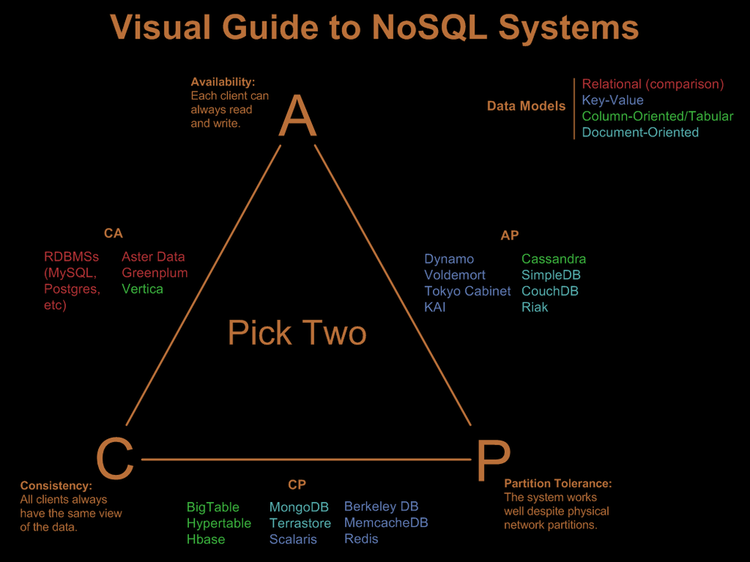
Prof. S.M. Shedole SIT, Lonavala
Nathan Hurst’s Blog

Slide 24
Comparison Between SQL & NOSQL
 | SQL Databases | NoSQL Databases
Types | One type (SQL database) with minor variations | Many different types including key-value stores, document databases, wide-column stores, and graph databases
Development History | Developed in 1970s to deal with first wave of data storage applications | Developed in 2000s to deal with limitations of SQL databases, particularly concerning scale, replication and unstructured data storage
Examples | MySQL, Postgres, Oracle Database | MongoDB, Cassandra, HBase, Neo4j
Data Storage Model | Individual records (e.g., "employees") are stored as rows in tables, with each column storing a specific piece of data about that record (e.g., "manager," "date hired," etc.), much like a spreadsheet. Separate data types are stored in separate tables, and then joined together when more complex queries are executed. For example, "offices" might be stored in one table, and "employees" in another. When a user wants to find the work address of an employee, the database engine joins the "employee" and "office" tables together to get all the information necessary. | Varies based on database type. For example, key-value stores function similarly to SQL databases, but have only two columns ("key" and "value"), with more complex information sometimes stored within the "value" columns. Document databases do away with the table-and-row model altogether, storing all relevant data together in single "document" in JSON, XML, or another format, which can nest values hierarchically.
Prof. S.M. Shedole SIT, Lonavala

Slide 25
Schemas | Structure and data types are fixed in advance. To store information about a new data item, the entire database must be altered, during which time the database must be taken offline. | Typically dynamic. Records can add new information on the fly, and unlike SQL table rows, dissimilar data can be stored together as necessary. For some databases (e.g., wide-column stores), it is somewhat more challenging to add new fields dynamically.
Scaling | Vertically, meaning a single server must be made increasingly powerful in order to deal with increased demand. It is possible to spread SQL databases over many servers, but significant additional engineering is generally required. | Horizontally, meaning that to add capacity, a database administrator can simply add more commodity servers or cloud instances. The database automatically spreads data across servers as necessary
Development Model | Mix of open-source (e.g., Postgres, MySQL) and closed source (e.g., Oracle Database) | Open-source
Prof. S.M. Shedole SIT, Lonavala

Slide 26
Supports Transactions | Yes, updates can be configured to complete entirely or not at all | In certain circumstances and at certain levels (e.g., document level vs. database level)
Data Manipulation | Specific language using Select, Insert, and Update statements, e.g. SELECT fields FROM table WHERE… | Through object-oriented APIs
Consistency | Can be configured for strong consistency | Depends on product. Some provide strong consistency (e.g., MongoDB) whereas others offer eventual consistency (e.g., Cassandra)
Prof. S.M. Shedole SIT, Lonavala

Slide 27
Data Modelling
The primary way in which NoSQL databases differ
from relational databases is the data model. Although
there are arguably dozens of NoSQL databases,
they primarily fall into one of the following three
Categories:
Document Model
Graph Model
Key-Value and Wide Column Models
Prof. S.M. Shedole SIT, Lonavala

Slide 28
List Of NoSQL Databases [currently 150]
Wide Column Store / Column Families
Hadoop / Hbase
API: Java / any writer, Protocol: any write call, Query Method: MapReduce Java / any exec, Replication: HDFS Replication, Written in: Java
Cassandra
massively scalable, partitioned row store, masterless architecture, linear scale performance, no single points of failure, read/write support across multiple data centers & cloud availability zones. API / Query Method: CQL and Thrift, replication: peer-to-peer, written in: Java, Concurrency: tunable consistency,
Prof. S.M. Shedole SIT, Lonavala

Slide 29
Hypertable
API: Thrift (Java, PHP, Perl, Python, Ruby, etc.), Protocol: Thrift, Query Method: HQL, native Thrift API, Replication: HDFS Replication, Concurrency: MVCC, Consistency Model: Fully consistent Misc: High performance C++ implementation of Google's Bigtable
Prof. S.M. Shedole SIT, Lonavala

Slide 30
Accumulo
Accumulo is based on BigTable and is built on top of Hadoop, Zookeeper, and Thrift. It features improvements on the BigTable design in the form of cell-based access control, improved compression, and a server-side programming mechanism that can modify key/value pairs at various points in the data management process.
Prof. S.M. Shedole SIT, Lonavala

Slide 31
Amazon SimpleDB
Cloudata
Google's Big table clone like Hbase
Cloudera
Professional Software & Services based on Hadoop.
Stratosphere
Splice Machine
Prof. S.M. Shedole SIT, Lonavala

Slide 32
Document Store
MongoDB
API: Protocol: C, Query Method: dynamic object-based language & MapReduce, Replication: Master Slave & Auto-Sharding, Written in: C++,Concurrency: Update in Place. Misc: Indexing, GridFS, Freeware + Commercial License
Elasticsearch
API: REST and many languages, Protocol: REST, Query Method: via JSON, Replication + Sharding: automatic and configurable, written in: Java
Prof. S.M. Shedole SIT, Lonavala

Slide 33
RavenDB
.Net solution. Provides HTTP/JSON access. LINQ queries & Sharding supported
MarkLogic Server
(freeware+commercial) API: JSON, XML, Java Protocols: HTTP, RESTQuery Method: Full Text Search, XPath, XQuery, Range, Geospatial Written in: C++ Concurrency: Shared-nothing cluster, MVCC
NeDB
NoSQL database for Node.js in pure javascript. It implements the most commonly used subset of MongoDB's API and is quite fast (about 25,000 reads/s on a 10,000 documents collection with indexing).
Prof. S.M. Shedole SIT, Lonavala

Slide 34
Terrastore
API: Java & http, Protocol: http, Language: Java, Querying: Range queries, Predicates, Replication: Partitioned with consistent hashing, Consistency: Per-record strict consistency
JasDB
Lightweight open source document database written in Java for high performance, runs in-memory, supports Android. API: JSON, Java Query Method: REST OData Style Query language, Java fluent Query API Concurrency: Atomic document writes Indexes: eventually consistent indexes
Prof. S.M. Shedole SIT, Lonavala

Slide 35
NoSQL embedded db
Node.js asynchronous NoSQL embedded database for small websites or projects. Database supports: insert, update, remove, drop and supports views (create, drop, read). Written in JavaScript, no dependencies, implements small concurrency mode
densodb
DensoDB is a new NoSQL document database. Written for .Net environment in c# language. It’s simple, fast and reliable. Source SisoDB
A Document Store on top of SQL-Server. SDB
For small online databases, PHP / JSON interface, implemented in PHP.
Prof. S.M. Shedole SIT, Lonavala

Slide 36
Key Value / Tuple Store
DynamoDB
Automatic ultra scalable NoSQL DB based on fast SSDs. Multiple Availability Zones. Elastic MapReduce Integration. Backup to S3 and much more..
Redis
API: Tons of languages, Written in: C, Concurrency: in memory and saves asynchronous disk after a defined time. Append only mode available. Different kinds of fsync policies. Replication: Master / Slave
Azure Table Storage
Riak
Prof. S.M. Shedole SIT, Lonavala

Slide 37
Graph Databases
Neo4J
API: lots of langs, Protocol: Java embedded / REST, Query Method: SparQL, nativeJavaAPI, JRuby, Replication: typical MySQL style master/slave, Written in: Java, Concurrency: non-block reads, writes locks involved nodes/relationships until commit, Misc: ACID possible
Infinite Graph
(by Objectivity) API: Java, Protocol: Direct Language Binding, Query Method: Graph Navigation API, Predicate Language Qualification, Written in: Java (Core C++), Data Model: Labeled Directed Multi Graph, Concurrency: Update locking on subgraphs, concurrent non-blocking.
Prof. S.M. Shedole SIT, Lonavala

Slide 38
Multimodel Databases
Object Databases
Grid & Cloud Database Solutions
XML Databases
Multidimensional Databases
Multivalue Databases
Event Sourcing
other NoSQL related databases
unresolved and uncategorized
Prof. S.M. Shedole SIT, Lonavala

Slide 39
NoSQL and MongoDB
Prof. S.M. Shedole SIT, Lonavala

Slide 40
The Storage Problem: why relational databases are not meeting the needs of industry
Introduction to MongoDB:
  Data model
  Queries: selection, projection, “semi-join”, aggregates, grouping, “unwind“
Prof. S.M. Shedole SIT, Lonavala

Slide 41
“Big Data” is two problems
The analysis problem
  How to extract useful info, using modeling and stats.
The storage problem
  How to store and manipulate huge amounts of data to facilitate fast queries and analysis
Problems with traditional (relational) storage
  Not flexible
  Hard to partition, i.e. place different segments on different machines
Prof. S.M. Shedole SIT, Lonavala

Slide 42
Example: E-Commerce
Problem: Product catalogs store different types of objects with different sets of attributes.
This is not easily done within the relational model, need a more “flexible schema”
Relational Solutions
  Create a table for each product category
  Put everything in one table
  Use inheritance
  Entity-Attribute-Value
Prof. S.M. Shedole SIT, Lonavala

Slide 43
RDBMS (1): Table per Product
CREATE TABLE `product_audio_album`
( `sku` char(8) NOT NULL, ...
`artist` varchar(255) DEFAULT NULL,
`genre_0` varchar(255) DEFAULT NULL,
`genre_1` varchar(255) DEFAULT NULL, ...
PRIMARY KEY(`sku`)) ...
CREATE TABLE `product_film`
( `sku` char(8) NOT NULL, ...
`title` varchar(255) DEFAULT NULL,
`rating` char(8) DEFAULT NULL, ...
PRIMARY KEY(`sku`)) ...
Prof. S.M. Shedole SIT, Lonavala

Slide 44
RDBMS (2): Single table for all
CREATE TABLE `product`
( `sku` char(8) NOT NULL, ...
`artist` varchar(255) DEFAULT NULL,
`genre_0` varchar(255) DEFAULT NULL,
`genre_1` varchar(255) DEFAULT NULL, ...
`title` varchar(255) DEFAULT NULL,
`rating` char(8) DEFAULT NULL, ...
PRIMARY KEY(`sku`))
Prof. S.M. Shedole SIT, Lonavala

Slide 45
RDBMS (3): Inheritance
CREATE TABLE `product`
( `sku` char(8) NOT NULL,
`title` varchar(255) DEFAULT NULL,
`description` varchar(255) DEFAULT NULL,
`price`, ...
PRIMARY KEY(`sku`))
CREATE TABLE `product_audio_album`
( `sku` char(8) NOT NULL, ...
`artist` varchar(255) DEFAULT NULL,
`genre_0` varchar(255) DEFAULT NULL,
`genre_1` varchar(255) DEFAULT NULL, ...
PRIMARY KEY(`sku`),
FOREIGN KEY(`sku`) REFERENCES `product`(`sku`))
….
Prof. S.M. Shedole SIT, Lonavala

Slide 46
RDBMS (4): Entity Attribute Value
Entity | Attribute | Value
sku_00e8da9b | Type | Audio Album
sku_00e8da9b | Title | A Love Supreme
sku_00e8da9b | … | …
sku_00e8da9b | Artist | John Coltrane
sku_00e8da9b | Genre | Jazz
sku_00e8da9b | Genre | General
Prof. S.M. Shedole SIT, Lonavala

Slide 47
MongoDB Solution
A “collection” can contain heterogeneous “documents”, e.g. for an audio album we could store as
{ sku: "00e8da9b",
type: "Audio Album",
title: "A Love Supreme",
description: "by John Coltrane",
shipping: { weight: 6,
dimensions: { width: 10, height: 10, depth: 1 } },
pricing: { list: 1200, retail: 1100, savings: 100},
details: { title: "A Love Supreme [Original Recording]",
artist: "John Coltrane",
genre: [ "Jazz", "General" ]}
}
Prof. S.M. Shedole SIT, Lonavala

Slide 48
MongoDB
MongoDB is an open-source document database that provides high performance, high availability, and automatic scaling.
  Fast querying & In-place updates
  Full Secondary Index Support
  Replication & High Availability
  Auto-Sharding
Currently used in a number of different applications
  Craigslist, ebay, New York Times, Shutterfly, Chicago Tribune, Github, Disney…
Prof. S.M. Shedole SIT, Lonavala

Slide 49
MondoDB Data Model
A MongoDB deployment hosts a number of databases. A database holds a set of collections. A collection holds a set of documents. A document is a set of key-value pairs.
RDBMS | MongoDB
Table Row(s) Index Join Partition Partition Key | Collection JSON Document Index Embedding & Linking Shard Shard Key
Prof. S.M. Shedole SIT, Lonavala

Slide 50
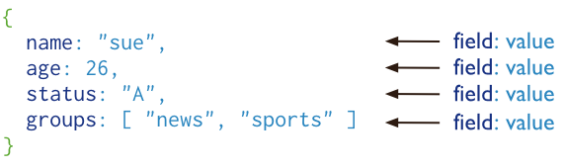
Fig. A MongoDB document.
Prof. S.M. Shedole SIT, Lonavala

Slide 51
The advantages of using documents are:
Documents (i.e. objects) correspond to native data types in many programming languages.
Embedded documents and arrays reduce need for expensive joins.
Dynamic schema supports fluent polymorphism.
Prof. S.M. Shedole SIT, Lonavala

Slide 52
Key Features
High Performance
MongoDB provides high performance data persistence. In particular,
Support for embedded data models reduces I/O activity on database system.
Indexes support faster queries and can include keys from embedded documents and arrays.
Prof. S.M. Shedole SIT, Lonavala

Slide 53
High Availability
To provide high availability, MongoDB’s replication facility, called replica sets, provide:
automatic failover.
data redundancy.
A replica set is a group of MongoDB servers that maintain the same data set, providing redundancy and increasing data availability.
Prof. S.M. Shedole SIT, Lonavala

Slide 54
Automatic Scaling
MongoDB provides horizontal scalability as part of its core functionality.
Automatic sharding distributes data across a cluster of machines.
Replica sets can provide eventually-consistent reads for low-latency high throughput deployments.
Prof. S.M. Shedole SIT, Lonavala

Slide 55
Basic Data Types
Null
Boolean
Integer (32- and 64-bit)
Floating point
String
ObjectId
Date
Code (JavaScript)
Array
Embedded document
Prof. S.M. Shedole SIT, Lonavala

Slide 56
Sample Document
mydoc = {
_id: 1,
name: { first: “John”, last: “Backus” },
birthyear: integer,
contribs: [ “Fortran”, “ALGOL”, “Backus-Naur Form”, “FP” ],
awards: [ { award_id: “NMS001”,
year: 1975 },
{ award_id: “TA99”,
year: 1977} ]
}
> db.people.insert(mydoc)
Always indexed. Can be any BSON data type other than an array
Array of documents
Prof. S.M. Shedole SIT, Lonavala
Notes:
BSON: binary-encoded serialization of JSON-like documents

Slide 57
Core MongoDB Operations
CRUD: create, read, update, and delete
Insert
  One at a time: db.people.insert(mydoc)
  Batch insert (size limitation: less than 16 MB)
Delete
  Documents that match some predicate, e.g. to remove the document just added: db.mydb.remove({“_id”: 1})
  All documents in a collection: db.mydb.remove()
    The collection still remains, with indexes
  Remove a collection (faster): db.people.drop()
Prof. S.M. Shedole SIT, Lonavala

Slide 58
Querying
Use find/findOne functions and a query document
Ranges, set inclusion, inequalities using $ conditionals
Complex queries using $where clause
Queries return a database cursor
Meta-operations on cursor include skipping some number of results, limiting the number of results returned, sorting results.
Prof. S.M. Shedole SIT, Lonavala

Slide 59
In MongoDB a query targets a specific collection of documents. Queries specify criteria, or conditions, that identify the documents that MongoDB returns to the clients. A query may include a projection that specifies the fields from the matching documents to return. You can optionally modify queries to impose limits, skips, and sort orders.
In the following diagram, the query process specifies a query criteria and a sort modifier:
Prof. S.M. Shedole SIT, Lonavala

Slide 60
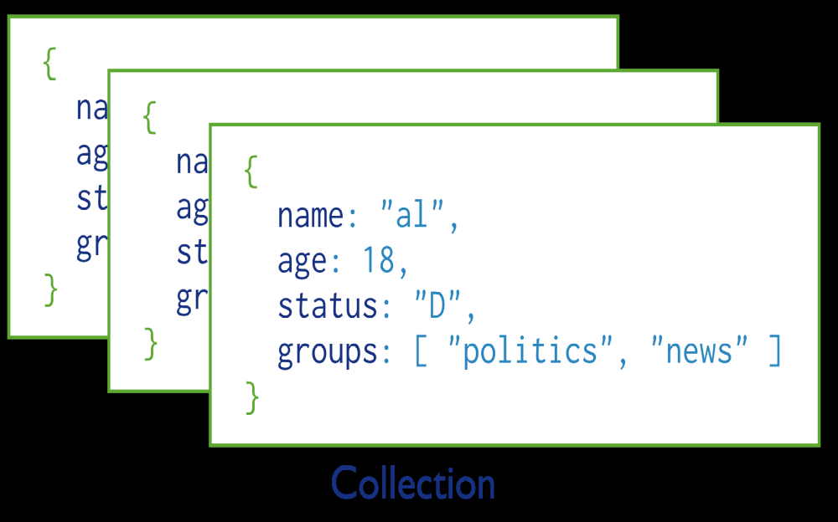
Fig. Collection of MongoDb Documents
Prof. S.M. Shedole SIT, Lonavala

Slide 61
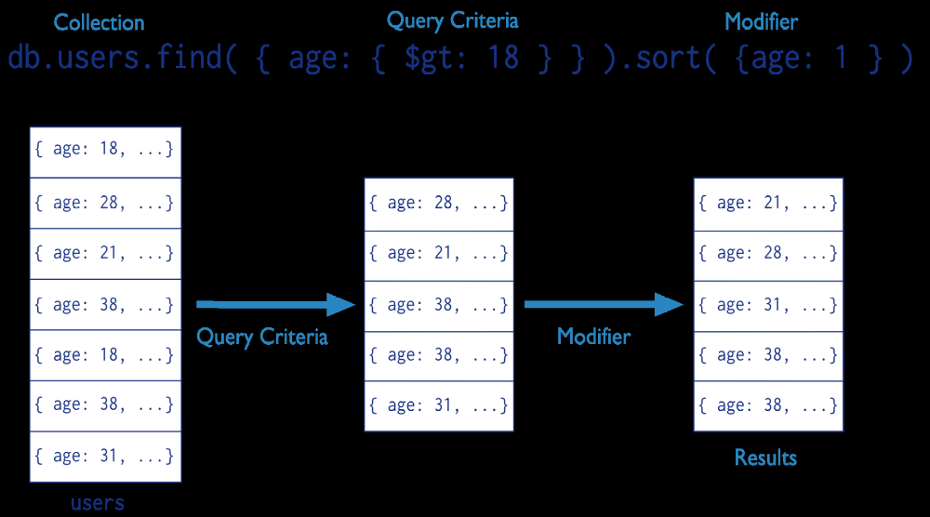
Fig. The stages of a MongoDB query with a query criteria and a sort modifier.
Prof. S.M. Shedole SIT, Lonavala

Slide 62
Another Sample Document
d={
_id : ObjectId(“4c4ba5c0672c685e5e8aabf3”),
author : “Kevin”,
date : new Date(“February 2, 2012”),
text : “About MongoDB...”,
birthyear: 1980,
tags : [ "tech", "databases" ]
}
> db.posts.insert(d)
Prof. S.M. Shedole SIT, Lonavala

Slide 63
Find
db.posts.find()
returns entire collection in posts
db.posts.find({“author”: “Kevin”, “birthyear”: 1980})
{
_id : ObjectId("4c4ba5c0672c685e5e8aabf3"),
author : "Kevin",
date : Date(“February 2, 2012”),
birthyear: 1980,
text : "About MongoDB...",
tags : [ "tech", "databases" ]
}
Prof. S.M. Shedole SIT, Lonavala

Slide 64
Specifying Which Keys to Return
db.mydoc.find({}, {“name”, “contribs”})
db.mydoc.find({}, {“_id”:0, “name”:1})
{
_id: 1,
name: { first: “John”, last: “Backus” },
contribs: [ “Fortran”, “ALGOL”, “Backus-Naur Form”, “FP” ]
}
{
name: { first: “John”, last: “Backus” }
}
Prof. S.M. Shedole SIT, Lonavala

Slide 65
Ranges, Negation, OR-clauses
Comparison operators: $lt, $lte, $gt, $gte
  db.posts.find({“birthyear”: {“$gte”: 1970, “$lte”: 1990}})
Negation: $ne
  db.posts.find({“birthyear”: {“$ne”: 1982}})
Or queries: $in (single key), $or (different keys)
  db.posts.find({“birthyear”: {“$in”: [1982, 1985]}})
  db.posts.find({“$or”: [{“birthyear”: 1982}, {“name”: “John”}]})
Prof. S.M. Shedole SIT, Lonavala

Slide 66
Arrays
db.posts.find({“tags”: “tech”})
  Print complete information about posts which are tagged “tech”
db.posts.find({“tags”: {$all: [“tech”, “databases”]},{“author”:1, “tags”:1})
  Print author and tags of posts which are tagged with both “tech” and “databases” (among other things)
  Contrast this with:
  db.posts.find({“tags”: [“databases”, “tech”]})
Prof. S.M. Shedole SIT, Lonavala

Slide 67
Querying Embedded Documents
db.people.find({“name.first”: “John”})
  Finds all people with first name John
db.people.find({“name.first”: “John”, “name.last”: “Smith”)
  Finds all people with first name John and last name Smith.
  Contrast with (order is now important):
  db.people.find({“name”: {“first”: “John”, “last”: “Smith”}})
Prof. S.M. Shedole SIT, Lonavala

Slide 68
Limits, Skips, Sort, Count
db.posts.find().limit(3)
  Limits the number of results to 3
db.posts.find().skip(3)
  Skips the first three results and returns the rest
db.posts.find().sort({“author”:1, “title”: -1})
  Sorts by author ascending (1) and title descending (-1)
db.people.find(…).count()
  Counts the number of documents in the people collection matching the find(…)
Prof. S.M. Shedole SIT, Lonavala

Slide 69
Revisiting Sample Document
mydoc = {
_id: 1,
name: { first: “John”, last: “Backus” },
birthyear: 1924,
contribs: [ “Fortran”, “ALGOL”, “Backus-Naur Form”, “FP” ],
awards: [ { award_id: “NMS001”,
year: 1975 },
{ award_id: “TA99”,
year: 1977} ]
}
> db.people.insert(mydoc)
Prof. S.M. Shedole SIT, Lonavala
Notes:
BSON: binary-encoded serialization of JSON-like documents

Slide 70
Also assume…
award1=
{_id: “NMS001”,
title: “National Medal of Science” ,
by: “National Science Foundation”}
award2=
{_id: “TA99”,
title: “Turing Award”,
by: “ACM” }
db.awards.insert(award1)
db.awards.insert(award2)
Prof. S.M. Shedole SIT, Lonavala

Slide 71
“SemiJoins”
Suppose you want to print people who have won Turing Awards
  Problem: object id of Turing Award is in collection “awards”, collection “people” references it.
  turing= db.awards.findOne({title: “Turing Award”})
db.people.find({"awards.award_id": turing["_id"]})
Prof. S.M. Shedole SIT, Lonavala

Slide 72
Aggregation
A framework to provide “group-by” and aggregate functionality without the overhead of map-reduce.
Conceptually, documents from a collection pass through an aggregation pipeline, which transforms the objects as they pass through (similar to UNIX pipe “|”)
Operators include: $project, $match, $limit, $skip, $sort, $unwind, $group
Aggregate: The method can still accept the pipeline stages as separate arguments instead of as elements in an array
Prof. S.M. Shedole SIT, Lonavala

Slide 73
Unwind
db.article.aggregate( { $project : { author : 1, tags : 1 }}, { $unwind : "$tags" } )
{ "result" : [ { "_id" : ObjectId("4e6e4ef557b77501a49233f6"),
"author" : "bob",
"tags" : "fun" },
{ "_id" : ObjectId("4e6e4ef557b77501a49233f6"),
"author" : "bob",
"tags" : "good" },
{ "_id" : ObjectId("4e6e4ef557b77501a49233f6"),
"author" : "bob",
"tags" : “jun" } ],
"OK" : 1 }
Unwind : Deconstructs an array field from the input documents to output a document for each element
Prof. S.M. Shedole SIT, Lonavala
Notes:
Assuming the original object of
{"_id" : ObjectId("4e6e4ef557b77501a49233f6"),
"author" : "bob",
"tags" : [“fun”, “good”, “fun”]}

Slide 74
$group
Every group expression must specify an _id field.
For example, suppose you wanted to print the number of people born in each year
> db.people.aggregate( { $group :
{ _id : "$birthyear", birthsPerYear : { $sum : 1}} )
{ "result" : [ { "_id" : 1924, "count" : 1 } ], "ok" : 1 }
Prof. S.M. Shedole SIT, Lonavala

Slide 75
Summary of MongoDB
MongoDB is an example of a document-oriented NoSQL solution
The query language is limited, and oriented around “collection” (relation) at a time processing
  Joins are done via a query language
The power of the solution lies in the distributed, parallel nature of query processing
  Replication and sharding
Prof. S.M. Shedole SIT, Lonavala

Slide 76


THANK YOU!!!
Prof. S.M. Shedole SIT, Lonavala

