Slide 1

STES’s
Unit -2
SQL and PL/SQL
Sambhaji M Shedole,
Sinhgad Institute of Technology

Slide 2
2
Contents
SQL: Characteristics and advantages.
SQL Data Types and Literals.
DDL, DML, DCL, TCL.
SQL Operators.
Tables: Creating, Modifying, Deleting.
Views: Creating, Dropping, Updating using Views, Indexes.
SQL DML Queries: SELECT Query and clauses, Set Operations.
Predicates and Joins, Set membership, Tuple Variables.
Set comparison, Ordering of Tuples.
Aggregate Functions, Nested Queries.
Database Modification using SQL Insert, Update and Delete.
PL/SQL: concept of Stored Procedures & Functions.
Cursors, Triggers, Assertions, roles and privileges.
Embedded SQL, Dynamic SQL.

Slide 3
3
SQL: Characteristics
SQL is an ANSI and ISO standard computer language for creating and manipulating databases.
SQL allows the user to create, update, delete, and retrieve data from a database.
SQL is very simple and easy to learn.
SQL works with database programs like DB2, Oracle, MS Access, Sybase, MS SQL Sever etc.

Slide 4
4
SQL: Advantages and Disadvantages
Advantages
▫ High Speed
▫ Well Defined Standards Exist
▫ No Coding Required
▫ Emergence of ORDBMS
Disadvantages
▫ Difficulty in Interfacing:
▫ More Features Implemented in Proprietary way

Slide 5
5
Difference between SQL and PL/SQL
SQL is a data oriented language for selecting and manipulating sets of data. PL/SQL is a procedural language to create applications.
PL/SQL can be the application language just like Java or PHP can. PL/SQL might be the language we use to build, format and display those screens, web pages and reports.SQL may be the source of data for our screens, web pages and reports.
SQL is executed one statement at a time. PL/SQL is executed as a block of code.
SQL tells the database what to do (declarative), not how to do it. In
contrast, PL/SQL tell the database how to do things (procedural).
SQL is used to code queries, DML and DDL statements. PL/SQL is used to code program blocks, triggers, functions, procedures and packages.
We can embed SQL in a PL/SQL program, but we cannot embed
PL/SQL within a SQL statement.

Slide 6
6
DDL
CREATE: to define new tables or anything else(to define relation schemas)
DROP: to delete table definitions anything else (to delete relation schemas)
ALTER: to change the definitions of existing tables
anything else (to change relation schema)
https://dev.mysql.com/doc/refman/5.5/en/s ql-syntax.html

Slide 7
7
Create Statement
CREATE DATABASE
CREATE EVENT
CREATE FUNCTION
CREATE INDEX
CREATE LOGFILE GROUP
CREATE PROCEDURE and CREATE FUNCTION
CREATE SERVER
CREATE TABLE
CREATE TABLESPACE
CREATE TRIGGER Syntax

Slide 8
8
Alter Statement
ALTER DATABASE
ALTER EVENT
ALTER FUNCTION
ALTER LOGFILE GROUP
ALTER PROCEDURE
ALTER SERVER
ALTER TABLE
ALTER TABLESPACE
ALTER VIEW Syntax

Slide 9
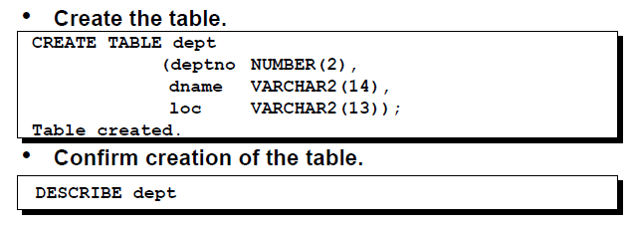
9
Create table

Slide 10
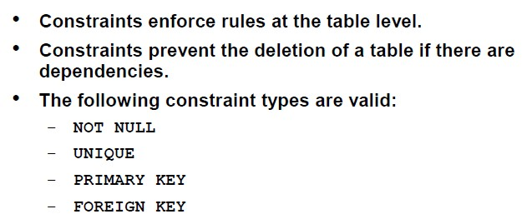
10
Adding Constraints

Slide 11
11
Create table with constraints
CREATE TABLE Persons (
ID int PRIMARY KEY,
LastName varchar(255) NOT NULL, FirstName varchar(255),
Age int,
mobile int unique
);

Slide 12
12
Alter Table
ALTER TABLE - ADD Column ALTER TABLE table_name ADD column_name datatype;
ALTER TABLE - DROP COLUMN
ALTER TABLE table_name
DROP COLUMN column_name;
SQL PRIMARY KEY on ALTER TABLE
ALTER TABLE Persons ADD PRIMARY KEY (ID);

Slide 13
13
DROP and TRUNCATE
DROP TABLE table_name;
TRUNCATE TABLE table_name;

Slide 14
14
DML
Insert
The INSERT INTO statement is used to insert
new records in a table.
Update
The UPDATE statement is used to modify the
existing records in a table.
Delete
The DELETE statement is used to delete existing
records in a table.

Slide 15
15
Insert
Syntax
▫ INSERT INTO table_name (column1, column2, co
lumn3, ...) VALUES (value1, value2, value3, ...);
▫ INSERT INTO table_name
VALUES (value1, value2, value3, ...);

Slide 16
16
Update
Syntax
▫ UPDATE table_name
SET column1 = value1, column2 = value2, ...
WHERE condition;
▫ UPDATE Customers
SET ContactName = 'Alfred Schmidt', City= 'Frankfurt'
WHERE CustomerID = 1;

Slide 17
17
Delete
Syntax
▫ DELETE FROM table_name
WHERE condition;
▫ DELETE FROM Customers
WHERE CustomerName='Alfreds Futterkiste';

Slide 18
18
Select Statement
The SELECT statement is used to select data from a database.
The data returned is stored in a result table,
called the result-set.
SELECT column1, column2, ...
FROM table_name;
SELECT * FROM table_name;

Slide 19
SELECT Statement
Used for queries on single or multiple tables
Clauses of the SELECT statement:
SELECT
List the columns (and expressions) that should be returned from the query
FROM
Indicate the table(s) or view(s) from which data will be obtained
WHERE
Indicate the conditions under which a row will be included in the result
GROUP BY
Indicate columns to group the results
HAVING
Indicate the conditions under which a group will be included
ORDER BY
Sorts the result according to specified columns

Slide 20
19
Set Operators
Union
▫ UNION is used to combine the results of two or more Select statements. However it will eliminate duplicate rows from its result set. In case of union, number of columns and datatype must be same in both the tables.
select * from First
UNION
select * from second

Slide 21
20
Set Operators
Union All
▫ This operation is similar to Union. But it also
shows the duplicate rows.
select * from First
UNION ALL
select * from second

Slide 22
21
Set Operators
Intersect
▫ Intersect operation is
SELECT statements, but
used
to combine two
it only retruns the
records which are common from both SELECT statements. In case of Intersect the number of columns and datatype must be same. MySQL does not support INTERSECT operator.
select * from First
INTERSECT
select * from second

Slide 23
22
Set Operators
Minus
▫ Minus operation combines result of two Select statements and return only those result which belongs to first set of result.
select * from First
MINUS
select * from second

Slide 24
23
Set membership
IN and NOT IN are set membership operators
The IN operator allows you to specify multiple values in a WHERE clause.
The IN operator is a shorthand for multiple OR conditions.
SELECT column_name(s) FROM table_name WHERE column_name
IN/NOT IN (value1, value2, ...);
SELECT * FROM Customers
WHERE Country IN ('Germany', 'France', 'UK');

Slide 25
24
Tuple Variables
Tuple variables can be used in SQL, and are defined in the from clause.
These variables can then be used throughout the expression. Think of it as being something like the rename operator.
select distinct cname, T.loan from borrower as S, loan as T where S.loan# = T.loan#
Note: The keyword as is optional here.

Slide 26
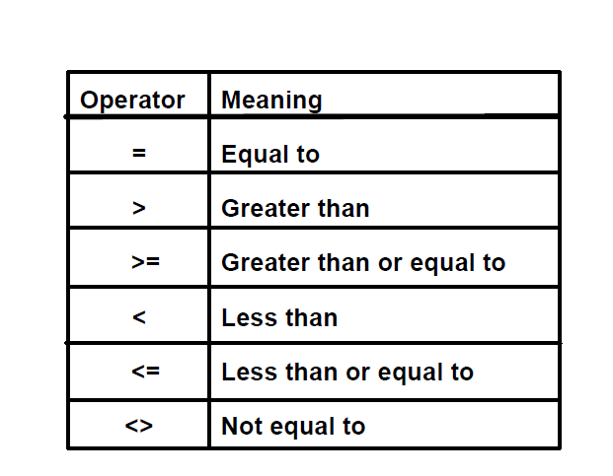
25
Comparison Conditions

Slide 27
26
Comparison Conditions
BETWWEN ….. AND……
The BETWEEN operator selects values within a
given range.
SELECT column_name(s) FROM table_name WHERE column_name
BETWEEN value1 AND value2;
IS NULL

Slide 28
27
LIKE
The LIKE operator is used in a WHERE clause to search for a specified pattern in a column.
There are two wildcards used in conjunction
with the LIKE operator:
% - The percent sign represents zero, one, or
multiple characters
_ - The underscore represents a single character
SELECT * FROM Customers
WHERE CustomerName LIKE 'a%';

Slide 29
28
AND, OR and NOT Operators
SELECT column1, column2, ...
FROM table_name
WHERE condition1 AND condition2 AND condition 3 ...;
SELECT column1, column2, ...
FROM table_name
WHERE condition1 OR condition2 OR condition3
...;
SELECT column1, column2, ...
FROM table_name
WHERE NOT condition;

Slide 30
29
ORDER BY Keyword
The ORDER BY keyword is used to sort the result-set in ascending or descending order.
SELECT column1, column2, ...
FROM table_name
ORDER BY column1, column2, ... ASC|DESC;

Slide 31
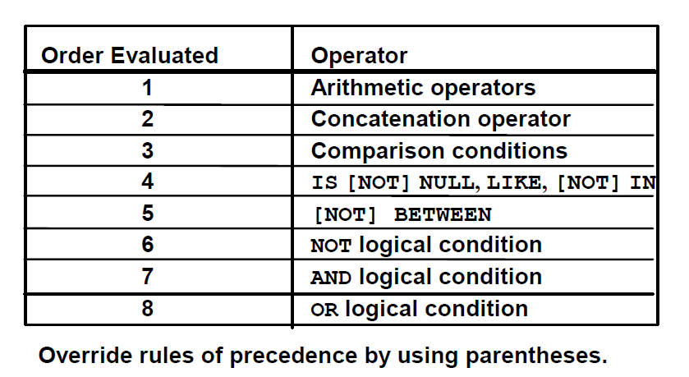
30
Operator Precedence

Slide 32
31
Aggregate Functions
MIN() and MAX() Functions
The MIN() function returns the smallest value of the
selected column.
The MAX() function returns the largest value of the selected column.
SELECT MIN(Price) AS SmallestPrice FROM Products;
SELECT MAX(Price) AS LargestPrice
FROM Products;

Slide 33
32
Aggregate Functions
The COUNT() function returns the number of rows that matches a specified criteria.
SELECT COUNT(ProductID) FROM Products;
The AVG() function returns the average value of a numeric column.
SELECT AVG(Price) FROM Products;
The SUM() function returns the total sum of a numeric column.
SELECT SUM(Quantity) FROM OrderDetails;

Slide 34
Domain Types in SQL
String types
CHAR(n) – fixed-length character data, n characters long Maximum length = 2000 bytes
VARCHAR2(n) – variable length character data, maximum 4000 bytes
LONG – variable-length character data, up to 4GB. Maximum 1 per table
Numeric types
NUMBER(p,q) – general purpose numeric data type
INTEGER(p) – signed integer, p digits wide
FLOAT(p) – floating point in scientific notation with p binary digits precision
Date/time type
DATE – fixed-length date/time in dd-mm-yy form

Slide 35
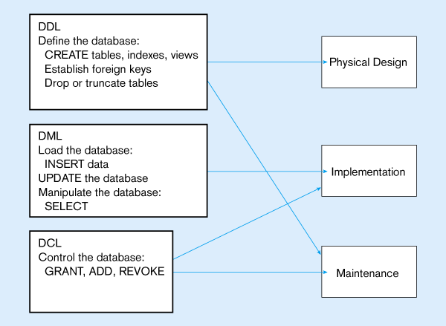

Slide 36
DCL Commands
Data Control Language(DCL) is used to control privilege in Database. To perform any operation in the database, such as for creating tables, sequences or views we need privileges.
DCL defines two commands,
Grant : Gives user access privileges to database.
Revoke : Take back permissions from user.

Slide 37
Dcl commands
Syntax To Allow a User to create Table
grant create tableto username;
Synatax To Grant all privilege to a User
grant sysdba to username
Synatx To take back Permissions
revoke create table from username

Slide 38
joins
SQL Join is used to fetch data from two or more tables, which is joined to appear as single set of data. SQL Join is used for combining column from two or more tables by using values common to both tables.
Join Keyword is used in SQL queries for joining two or more tables. Minimum required condition for joining table,is(n-1) where n, is number of tables. A table can also join to itself known as, Self Join.

Slide 39
Types of join
The following are the types of JOIN that we can use in SQL.
Inner
Outer
Left
Right

Slide 40
Cross JOIN or Cartesian Product
This type of JOIN returns the cartesian product of rows of from the tables in Join. It will return a table which consists of records which combines each row from the first table with each row of the second table.
Cross JOIN Syntax is,
SELECT column-name-list from table-name1 CROSS JOIN table-name2;

Slide 41
Cross JOIN or Cartesian Product
Syntax:
SELECT column-name-list from table-name1 CROSS JOIN table-name2;
Ex: The class table,
ID | NAME
1 | abhi
2 | adam
4 | alex
The class_info table,
ID | NAME
1 | abhi
2 | adam
4 | alex

Slide 42
Cross join
Cross JOIN query will be,
SELECT * from class, cross JOIN class_info;
The result table will look like,
ID | NAME | ID | Address
1 | abhi | 1 | DELHI
2 | adam | 1 | DELHI
4 | alex | 1 | DELHI
1 | abhi | 2 | MUMBAI
2 | adam | 2 | MUMBAI
4 | alex | 2 | MUMBAI
1 | abhi | 3 | CHENNAI
2 | adam | 3 | CHENNAI
4 | alex | 3 | CHENNAI

Slide 43
INNER Join or EQUI Join
This is a simple JOIN in which the result is based on matched data as per the equality condition specified in the query.
Inner Join Syntax is,
SELECT column-name-list from table-name1 INNER JOIN table-name2 WHERE table-name1.column-name = table-name2.column-name;

Slide 44
Example for INNER Join
The class table,
ID | NAME
1 | abhi
2 | adam
3 | alex
4 | anu
The class_info table,
ID | Address
1 | DELHI
2 | MUMBAI
3 | CHENNAI
ID | Address

Slide 45
Example for INNER Join
Inner JOIN query will be,
SELECT * from class, class_info where class.id = class_info.id;
The result table will look like,
ID | NAME | ID | Address
1 | abhi | 1 | DELHI
2 | adam | 2 | MUMBAI
3 | alex | 3 | CHENNAI

Slide 46
Natural JOIN
Natural Join is a type of Inner join which is based on column having same name and same datatype present in both the tables to be joined.
Natural Join Syntax is,
SELECT * from table-name1 NATURAL JOIN table-name2;

Slide 47
Natural join
The class table,
The class_info table,
ID | NAME
1 | abhi
2 | adam
3 | alex
4 | anu
ID | Address
1 | DELHI
2 | MUMBAI
3 | CHENNAI

Slide 48
Example of natural join
Natural join query will be,
SELECT * from class NATURAL JOIN class_info;
The result table will look like,
ID | NAME | Address
1 | abhi | DELHI
2 | adam | MUMBAI
3 | alex | CHENNAI
Note: In the above example, both the tables being joined have ID column(same name and same data type), hence the records for which value of ID matches in both the tables will be the result of Natural Join of these two tables.

Slide 49
Outer join
Outer Join is based on both matched and unmatched data. Outer Joins subdivide further into,
Left Outer Join
Right Outer Join
Full Outer Join

Slide 50
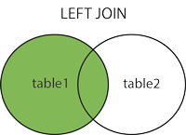
Left outer join
The left outer join returns a result table with the matched data of two tables then remaining rows of the left table and null for the right table's column.
Left Outer Join syntax is,
SELECT column-name-list from table-name1 LEFT OUTER JOIN table-name2 on table-name1.column-name = table-name2.column-name; (or)
select column-name-list from table-name1, table-name2 on table-name1.column-name = table-name2.column-name(+);

Slide 51
Example of Left Outer Join
The class table,
ID | NAME
1 | abhi
2 | adam
3 | alex
4 | anu
5 | ashish
The class_info table,
ID | Address
1 | DELHI
2 | MUMBAI
3 | CHENNAI
7 | NOIDA
8 | PANIPAT

Slide 52
Example of Left Outer Join
Left Outer Join query will be,
SELECT * FROM class LEFT OUTER JOIN class_info ON (class.id=class_info.id);
The result table will look like,
ID | NAME | ID | Address
1 | abhi | 1 | DELHI
2 | adam | 2 | MUMBAI
3 | alex | 3 | CHENNAI
4 | anu | null | null
5 | ashish | null | null

Slide 53
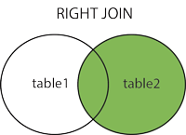
Right Outer Join
The right outer join returns a result table with the matched data of two tables then remaining rows of the right table and null for the left table's columns.
Right Outer Join Syntax is,
select column-name-list from table-name1 RIGHT OUTER JOIN table-name2 on table-name1.column-name = table-name2.column-name; (or)
select column-name-list from table-name1, table-name2 on table-name1.column-name(+) = table-name2.column-name;

Slide 54
Example of Right Outer Join
The class table,
ID | NAME
1 | abhi
2 | adam
3 | alex
4 | anu
5 | ashish
The class_info table,
ID | Address
1 | DELHI
2 | MUMBAI
3 | CHENNAI
7 | NOIDA
8 | PANIPAT

Slide 55
Example of Right Outer Join
Right Outer Join query will be,
SELECT * FROM class RIGHT OUTER JOIN class_info on (class.id=class_info.id);
The result table will look like,
ID | NAME | ID | Address
1 | abhi | 1 | DELHI
2 | adam | 2 | MUMBAI
3 | alex | 3 | CHENNAI
null | null | 7 | NOIDA
null | null | 8 | PANIPAT

Slide 56
Full Outer Join
The full outer join returns a result table with the matched data of two table then remaining rows of both left table and then the right table.
Full Outer Join Syntax is,
select column-name-list from table-name1 FULL OUTER JOIN table-name2 on table-name1.column-name = table-name2.column-name;

Slide 57
Example of Full outer join
The class table,
ID | NAME
1 | abhi
2 | adam
3 | alex
4 | anu
5 | ashish
The class_info table,
ID | Address
1 | DELHI
2 | MUMBAI
3 | CHENNAI
7 | NOIDA
8 | PANIPAT

Slide 58
Example of Full outer join
Full Outer Join query will be like,
ID | NAME | ID | Address
1 | abhi | 1 | DELHI
2 | adam | 2 | MUMBAI
3 | alex | 3 | CHENNAI
4 | anu | null | null
5 | ashish | null | null
null | null | 7 | NOIDA
null | null | 8 | PANIPAT

Slide 59
33
SQL JOINS
(INNER) JOIN: Returns records that have matching values in both tables
LEFT (OUTER) JOIN: Return all records from the left
table, and the matched records from the right table
RIGHT (OUTER) JOIN: Return all records from the right table, and the matched records from the left table
FULL (OUTER) JOIN: Return all records when there
is a match in either left or right table
•

Slide 60
34
JOIN Syntax
SELECT column_name(s)
FROM
table1 <<JOIN NAME >>table2
ON table1.column_name = table2.column_name;

Slide 61
35
GROUP BY Statement
Syntax
SELECT column_name(s) FROM table_name WHERE condition
GROUP BY column_name(s)
ORDER BY column_name(s)

Slide 62
SELECT Example – Categorizing Results Using the GROUP BY Clause
SELECT STATE, COUNT(STATE)
FROM CUSTOMER_V
GROUP BY STATE;
Note: you can use single-value fields with aggregate functions if they are included in the GROUP BY clause

Slide 63
36
Having Clause
The HAVING clause was added to SQL because the WHERE keyword could not be used with aggregate functions.
SELECT column_name(s) FROM table_name WHERE condition
GROUP BY column_name(s)
HAVING condition

Slide 64
SELECT Example – Qualifying Results by Categories Using the HAVING Clause
For use with GROUP BY
SELECT STATE, COUNT(STATE)
FROM CUSTOMER_V
GROUP BY STATE
HAVING COUNT(STATE) > 1;
Like a WHERE clause, but it operates on groups (categories), not on individual rows. Here, only those groups with total numbers greater than 1 will be included in final result

Slide 65
37
SQL - Sub Queries
A Subquery or Inner query or a Nested query is a query within another SQL query and embedded within the WHERE clause.
A subquery is used to return data that will be used in the main query as a condition to further restrict the data to be retrieved.
SELECT * FROM CUSTOMERS WHERE ID IN
(SELECT ID FROM CUSTOMERS WHERE SALARY > 4500) ;

Slide 66
38
Views
VIEW Syntax
CREATE VIEW view_name AS SELECT column1, column2, ... FROM table_name
WHERE condition;
Diff. between Table and View
Dropping a view

Slide 67
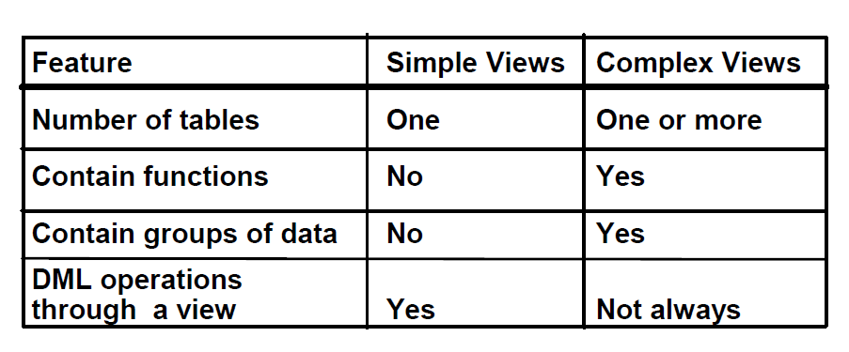
39
Simple and Complex Views

Slide 68
40
View Example
CREATE OR REPLACE VIEW Current_Product_
List
AS
SELECT ProductID, ProductName, Category FROM Products
WHERE Discontinued = No;

Slide 69
41
SQL Procedures
These subprograms do not return a value directly; mainly used to perform an action.
Syntax
CREATE PROCEDURE procedure_name [(parameter_name [IN | OUT | IN OUT] type [, ...])]
{IS | AS}
BEGIN
< procedure_body > END;

Slide 70
42
Functions
A standalone function is created using the CREATE FUNCTION statement.
CREATE [OR REPLACE] FUNCTION
function_name [(parameter_name [IN | OUT | IN OUT] type [, ...])] RETURN return_datatype {IS | AS}
BEGIN < function_body > END;

Slide 71
43
Embedded SQL
SQL is a database language, but not a programming language.
Complex queries (and updates) may be
expressed using rather short SQL commands.
Writing equivalent code in C would take
significantly more time.
SQL, however, is not functionally complete. Not every computable function on the database states is expressible in SQL.

Slide 72
44
Embedded SQL
SQL is used directly for ad-hoc queries or one-time updates of the data.
Repeating tasks have to be supported by application programs written in some PL. Internally, these programs generate SQL commands which are then shipped to the DBMS.
Most database user do not know SQL or are even unaware that they interact with a DBMS.
Even if a user knows SQL, an application program
might be more effective than the plain SQL console.

Slide 73
45
Embedded SQL
Languages/tools widely used for database application programming:
SQL scripts, Like UNIX shell scripting language but interpreted by non-interactive SQL console. . C with Embedded SQL, .
C with library procedure calls (ODBC), .
Java with library procedure calls (JDBC), .
Scripting languages (Perl/DBI, PHP (LAMP), Python/DB-API, . . . ), .
Web interfaces (CGI, Java Servlets, . . . ).

Slide 74
46
Dynamic SQL
Dynamic SQL is a programming methodology for generating and running statements at run- time. It is mainly used to write the general- purpose and flexible programs where the SQL statements will be created and executed at run-time based on the requirement.

