Slide 1
Integrated Coral Epigenetic Regulation
Kathleen Durkin
Roberts Lab · School of Aquatic & Fishery Sciences, University of Washington
E5 Coral working group
Notes:
E5 has a lot of exciting work coming out, so I’ll be providing QR codes to relevant publications in the top corner as they come up

Slide 2
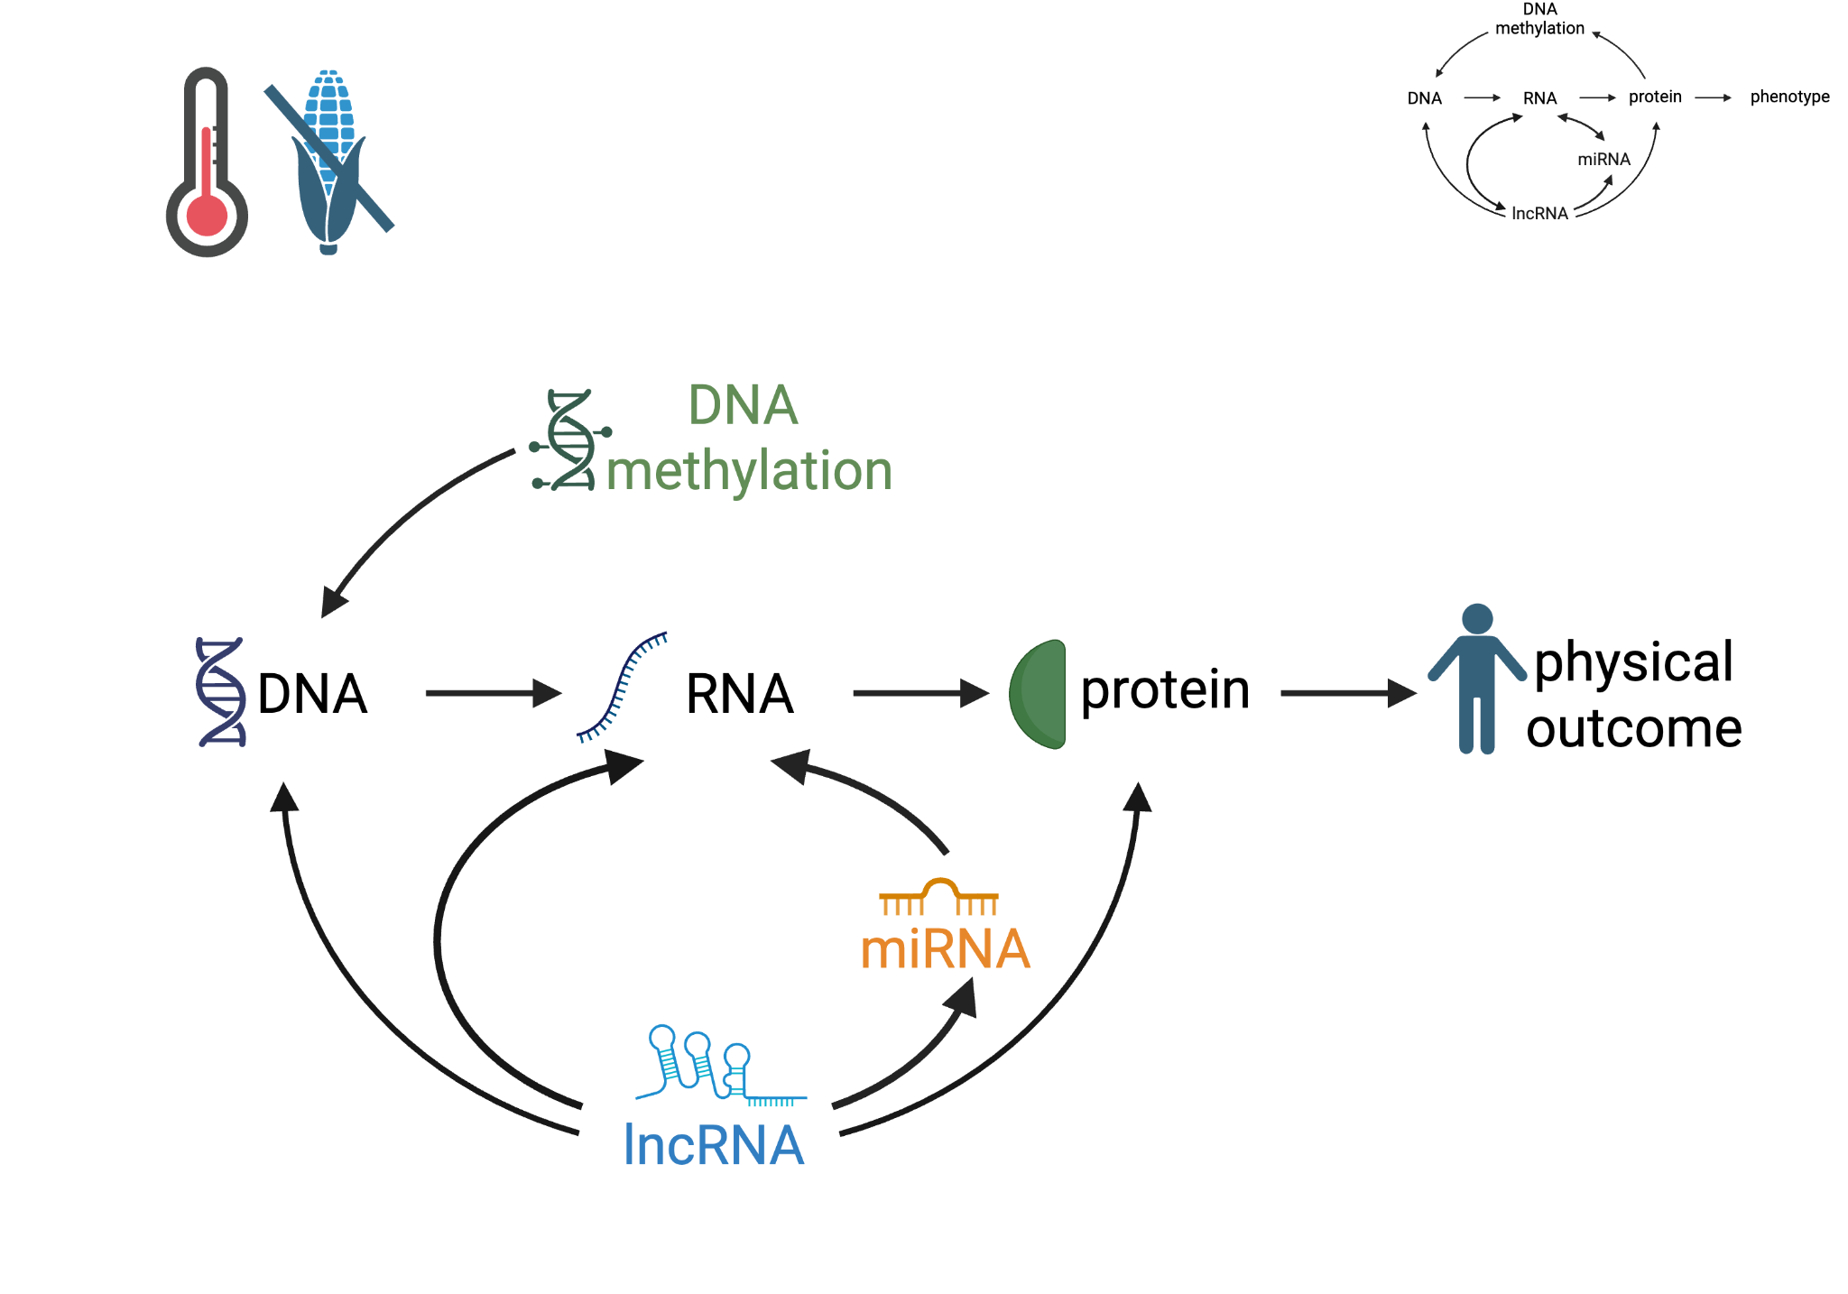
Expression is shaped by a complex epigenome

Slide 3
Expression is shaped by a complex epigenome

Slide 4
Expression is shaped by a complex epigenome

Slide 5
Expression is shaped by a complex epigenome

Slide 6


Expression is shaped by a complex epigenome
environmentally responsive
associated with physiological shifts
Notes:
all 3 environmentally responsive, direct phys changes, reversible

Slide 7

Expression is shaped by a complex epigenome
Layers can also interact!
environmentally responsive
associated with physiological shifts
Notes:
all 3 environmentally responsive, direct phys changes, reversible

Slide 8
Do cross-layer epigenetic interactions exist in cnidarians?
What does that mean for how we study coral epigenetics?

Slide 9
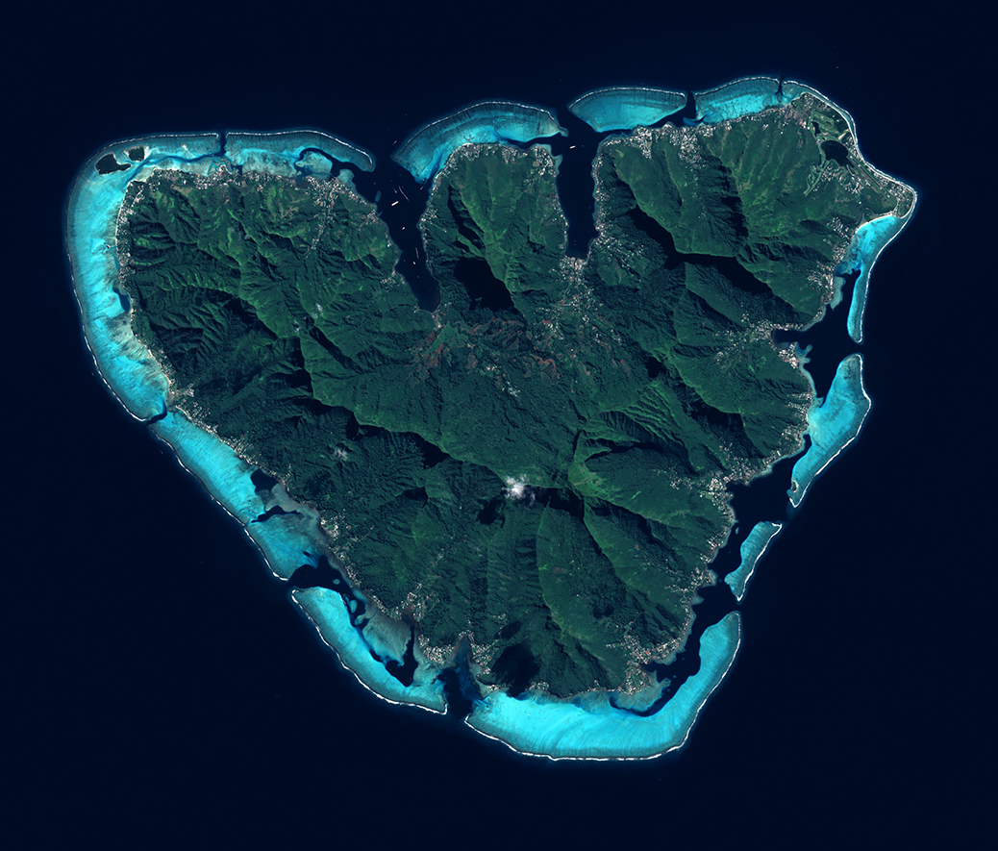
Mo'orea, French Polynesia

Slide 10
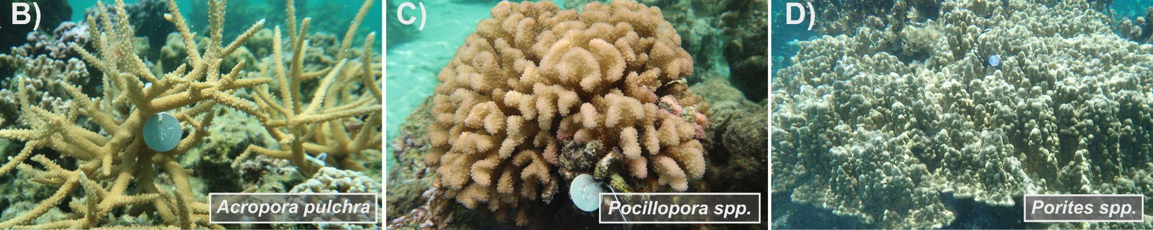
Mo'orea, French Polynesia
Acropora pulchra
Pocillopora tuahiniensis
Porites evermanni
Notes:
These species selected for their diversity across phylogeny, tissue and skeletal morphology, symbiont associations, life history P. evermanni: mounding, thick tissues, vertical symbiont transmission, environmentally tolerant, symbiont specialist P. tuahiniensis: branching, thin tissues, vertical transmission, high recruitment post-disturbance, highly sensitive. Symbiont generalist A. pulchra: branching, thin tissues, horizontal, high sensitivity, symbiont generalist

Slide 11


Mo'orea, French Polynesia
x 10
x 4
Acropora pulchra
Pocillopora tuahiniensis
Porites evermanni

Slide 12
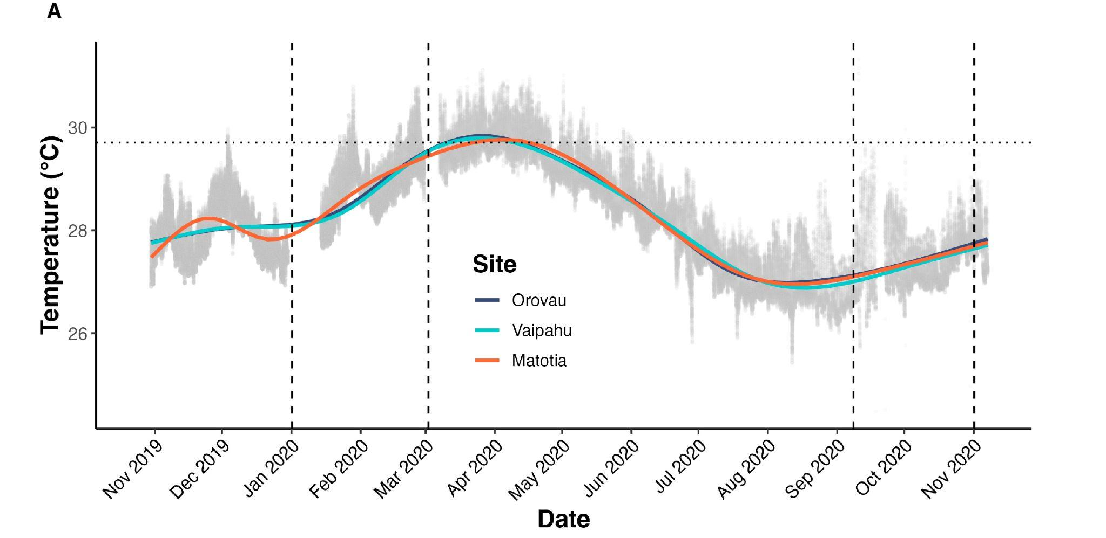
Mo'orea, French Polynesia
x 10
x 4
Acropora pulchra
Pocillopora tuahiniensis
Porites evermanni
Notes:
sampling points selected to cover breadth of annual environmental variation (temperature, solar radiation, rainfall)

Slide 13
Mo'orea, French Polynesia
*Interaction analyses used reduced dataset (single timepoint, n≈5/species)
x 10
x 4
Acropora pulchra
Pocillopora tuahiniensis
Porites evermanni
Notes:
For the next several slides, presenting work done using the data from only a single timepoint

Slide 14

Gene expression
DNA methylation
Chemical DNA tags, debated function
miRNA expression
~22nt molecules, degrade or repress translation of mRNAs
lncRNA expression
Large molecules, complex roles
Epigenetic features

Slide 15


Epigenome varies by species, potentially
underpinning differing physiologies
A. pulchra
P. evermanni
P. tuahiniensis
Durkin et al. 2026
Ashey et al, 2026
miRNAs
39
45
37
4 conserved miRNAs
(miR-100, -2036, -2023, -2025)
lncRNAs
31,491
10,090
16,153
46 conserved lncRNA
Methylation
(GML)
9.9%
7.2%
4.0%
109 orthogroups methylated in all three species
*Description and interaction analyses based on
reduced sample size (single timepoint), n≈5/species
14

Slide 16
Epigenome varies by species, potentially
underpinning differing physiologies
A. pulchra
P. evermanni
P. tuahiniensis
Durkin et al. 2026
Ashey et al, 2026
miRNAs
39
45
37
4 conserved miRNAs
(miR-100, -2036, -2023, -2025)
lncRNAs
31,491
10,090
16,153
46 conserved lncRNA
Methylation
(GML)
9.9%
7.2%
4.0%
109 orthogroups methylated in all three species
*Description and interaction analyses based on
reduced sample size (single timepoint), n≈5/species
14

Slide 17
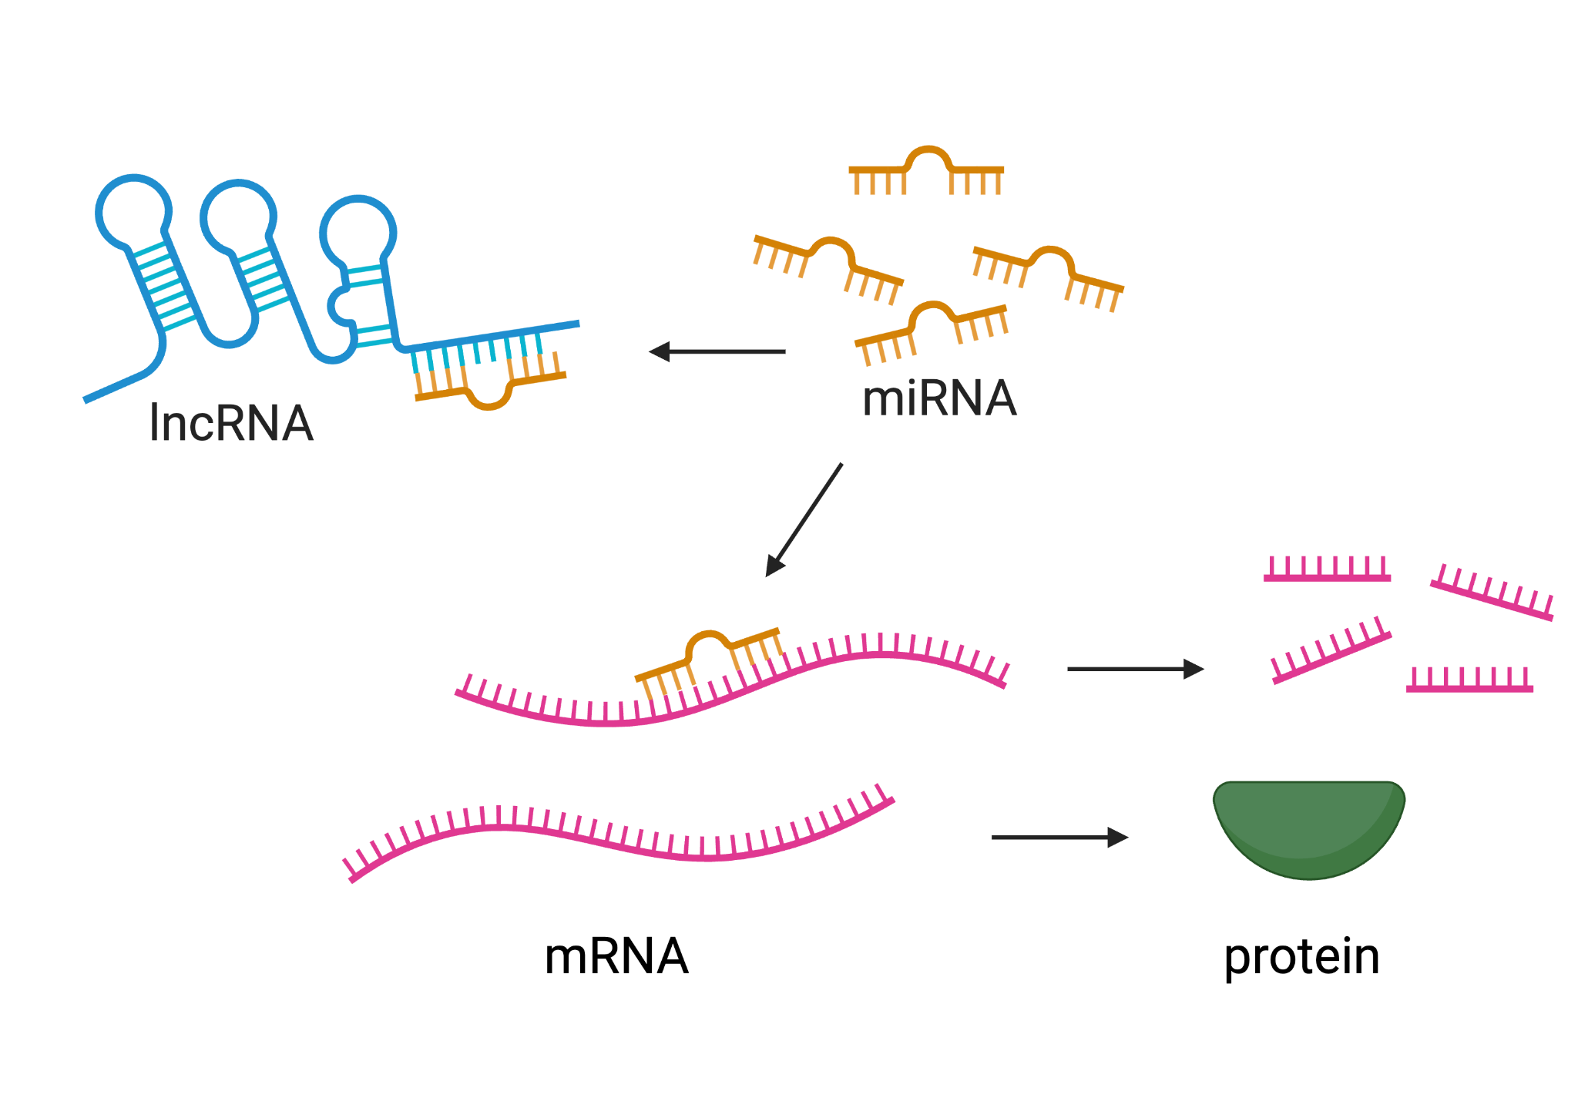
Epi-miRNAs target methylation machinery
epi-miRNAs
miRNAs targeting the foundational machinery of epigenetic pathways
Durkin et al. 2026
miRNA
Interactions supported by:
miRNA - mRNA predicted binding
significantly coexpressed
TET3
initiates DNA demethylation
MBD
methylation reader
PRDM14
indirect demethylation by repressing DNMT3s

Slide 18
Epi-miRNAs target methylation machinery
epi-miRNAs
miRNAs targeting the foundational machinery of epigenetic pathways
Durkin et al. 2026
miRNA
Interactions supported by:
miRNA - mRNA predicted binding
significantly coexpressed
TET3
initiates DNA demethylation
MBD
methylation reader
PRDM14
indirect demethylation by repressing DNMT3s

Slide 19
Epi-miRNAs target methylation machinery
epi-miRNAs
miRNAs targeting the foundational machinery of epigenetic pathways
Durkin et al. 2026
miRNA
Interactions supported by:
miRNA - mRNA predicted binding
significantly coexpressed
TET3
initiates DNA demethylation
MBD
methylation reader
PRDM14
indirect demethylation by repressing DNMT3s

Slide 20
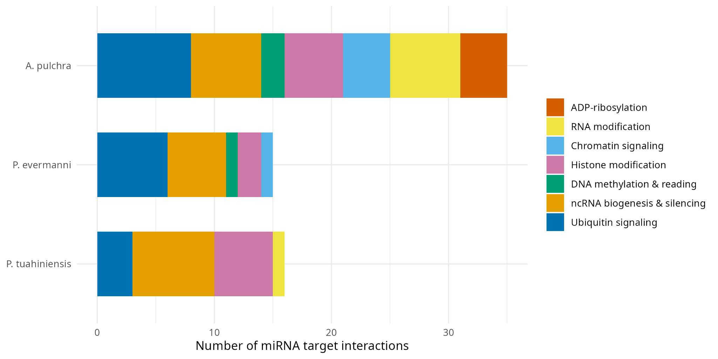
Epi-miRNAs target methylation machinery and more!
epi-miRNAs
miRNAs targeting the foundational machinery of epigenetic pathways
Durkin et al. 2026
35
15
16

Slide 21
LncRNAs sequester miRNAs (ceRNA networks)
ceRNAs
lncRNAs mediating the indirect derepression of miRNAs’ targets
Durkin et al. 2026
For an miRNA-mRNA binding pair, the lncRNA:
putatively binds to the miRNA negatively coexpressed with miRNA positively coexpressed with mRNA

Slide 22
LncRNAs sequester miRNAs (ceRNA networks)
ceRNAs
lncRNAs mediating the indirect derepression of miRNAs’ targets
Durkin et al. 2026
A. pulchra | 564
P. evermanni | 175
P. tuahiniensis | 564
For an miRNA-mRNA binding pair, the lncRNA:
putatively binds to the miRNA negatively coexpressed with miRNA positively coexpressed with mRNA

Slide 23
Do cross-layer epigenetic interactions exist in cnidarians?
What does that mean for how we study coral epigenetics?

Slide 24
Do cross-layer epigenetic interactions exist in cnidarians?
What does that mean for how we study coral epigenetics?
YES
candidate epi-miRNAs and ceRNAs suggest extensive cross-layer interactions
cross-species presence suggests conserved cnidarian feature
so single-layer analyses may miss the full picture

Slide 25
Do cross-layer epigenetic interactions exist in cnidarians?
What does that mean for how we study coral epigenetics?
YES
candidate epi-miRNAs and ceRNAs suggest extensive cross-layer interactions
cross-species presence suggests conserved cnidarian feature
so single-layer analyses may miss the full picture

Slide 26
Do cross-layer epigenetic interactions exist in cnidarians?
What does that mean for how we study coral epigenetics?
YES
candidate epi-miRNAs and ceRNAs suggest extensive cross-layer interactions
cross-species presence suggests conserved cnidarian feature
so single-layer analyses may miss the full picture

Slide 27
Do cross-layer epigenetic interactions exist in cnidarians?
What does that mean for how we study coral epigenetics?
YES
candidate epi-miRNAs and ceRNAs suggest extensive cross-layer interactions
cross-species presence suggests conserved cnidarian feature
so single-layer analyses may miss the full picture

Slide 28
Now the question is…
Does the integrated epigenome predict expression of physiologically relevant genes?

Slide 29
Mo'orea, French Polynesia
*Modeling work uses full dataset (n≈40/species)
x 10
x 4
Acropora pulchra
Pocillopora tuahiniensis
Porites evermanni

Slide 30
Applied an Elastic Net Regression to predict expression from epigenetic state
gene
Elastic Net Regression model (per-gene)
miRNAs
lncRNAs
Scaled
GbM
Leave-one-colony-out CV Stability selection to identify best-supported predictors
Notes:
Linear regression method
arg value meaning
alpha 0.5 equal L1/L2 mix
n_subsamples 50 stability-selection iterations per gene
pi_thr 0.6 selection-probability threshold for "stable"
var_filter_n 2000 top-N most-variable lncRNA & WGBS predictors (unsupervised)

Slide 31
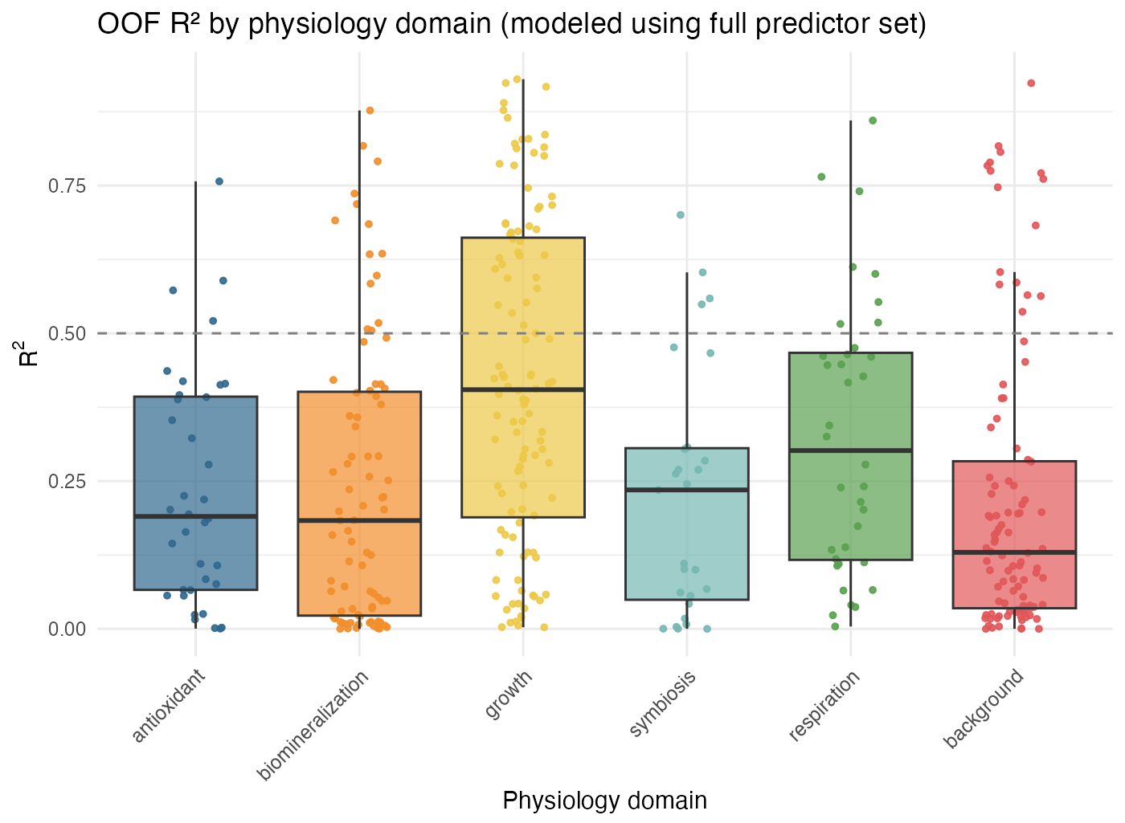
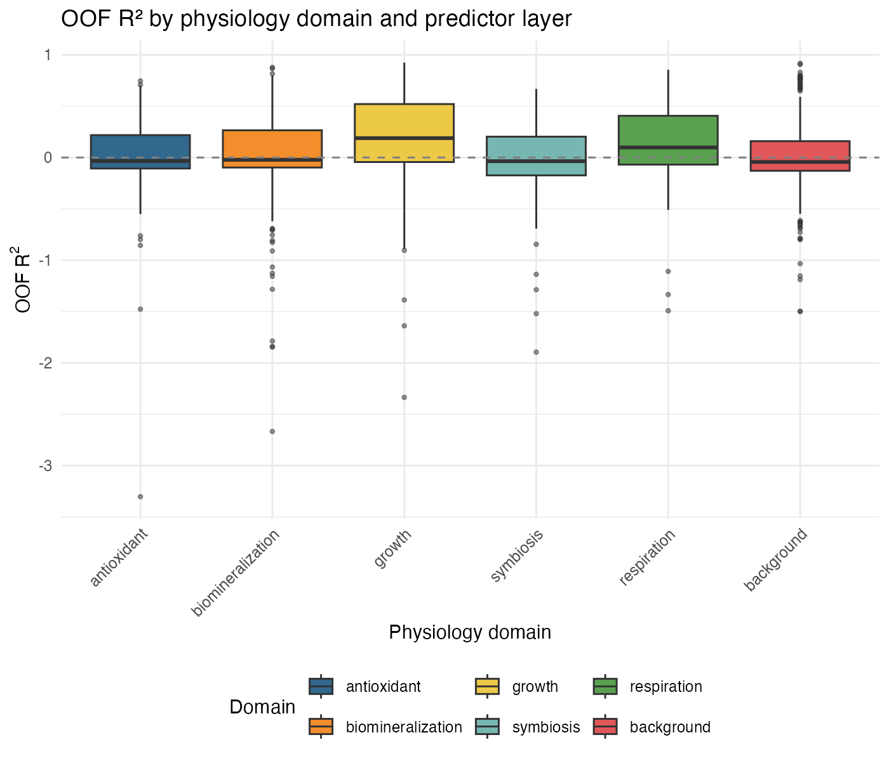
Many genes are well-predicted, across physiological function
(preliminary results from A. pulchra)
Model performance on genes across physiological domains
gene
Function
(literature + GO)
n=36
n=83
n=112
n=27
n=36
n=100
n=100
Notes:
Compiled sets of genes relevant to key physiological processes, relevant for evaluating environmental response (literature + GO)

Slide 32
Many genes are well-predicted, across physiological function
(preliminary results from A. pulchra)
Model performance on genes across physiological functions
gene
Function
(literature + GO)
n=36
n=83
n=112
n=27
n=36
n=100
n=100
Notes:
epigenetic context predicts expression for a subset of genes in every domain

Slide 33
Many genes are well-predicted, across physiological function
(preliminary results from A. pulchra)
Model performance on genes across physiological functions
gene
Function
(literature + GO)
n=36
n=83
n=112
n=27
n=36
n=100
n=100
Notes:
epigenetic context predicts expression for a subset of genes in every domain

Slide 34
Expression predictability differs by physiological function
(preliminary results from A. pulchra)
Model performance on genes across physiological functions
***
**
gene
Function
(literature + GO)
n=36
n=83
n=112
n=27
n=36
n=100
Notes:
and predictability is significantly enriched in growth and respiration
domain -> function

Slide 35
Takeaways
1
Epigenetic layers interact
2
Epigenome predicts expression
First evidence of cross-layer epigenetic regulation in cnidarians (epi-miRNAs and ceRNAs), emphasize we need to consider epigenome integratively
Integrated epigenetic context stably predicts expression for a subset of functionally-relevant genes
+
Contribution is domain-specific
Predictability is significantly enriched in growth- and respiration-associated genes

Slide 36

What’s next?
Surprise!
We also have symbiont and physiology data!
Huffmeyer et al, 2026
Tie features to physiology
Bring in the symbiont
Evaluate relationships between epigenetic state and physiological function, plasticity, etc.
Test whether and how the epigenome mediates symbiotic relationship and function
This is all important because…
Understanding how molecular foundations support physiology and symbiosis will be critical to predicting organismal response and population persistence under climate change
Notes:
could briefly mention that we have phys+symbiont data during initial sampling slides, so people aren’t surprised/suspicious more detaili on how of these nxt steps could shoutout ariana’a phys paper here

Slide 37
What’s next?
Surprise!
We also have symbiont and physiology data!
Huffmeyer et al, 2026
Tie features to physiology
Bring in the symbiont
Evaluate relationships between epigenetic state and physiological function, plasticity, etc.
Test whether and how the epigenome mediates symbiotic relationship and function
This is all important because…
Understanding how molecular foundations support physiology and symbiosis will be critical to predicting organismal response and population persistence under climate change
Notes:
could briefly mention that we have phys+symbiont data during initial sampling slides, so people aren’t surprised/suspicious more detaili on how of these nxt steps could shoutout ariana’a phys paper here

Slide 38
What’s next?
Surprise!
We also have symbiont and physiology data!
Huffmeyer et al, 2026
Tie features to physiology
Bring in the symbiont
Evaluate relationships between epigenetic state and physiological function, plasticity, etc.
Test whether and how the epigenome mediates symbiotic relationship and function
This is all important because…
Understanding how molecular foundations support physiology and symbiosis will be critical to predicting organismal response and population persistence under climate change
Notes:
could briefly mention that we have phys+symbiont data during initial sampling slides, so people aren’t surprised/suspicious more detaili on how of these nxt steps could shoutout ariana’a phys paper here

Slide 39
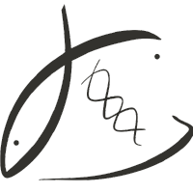







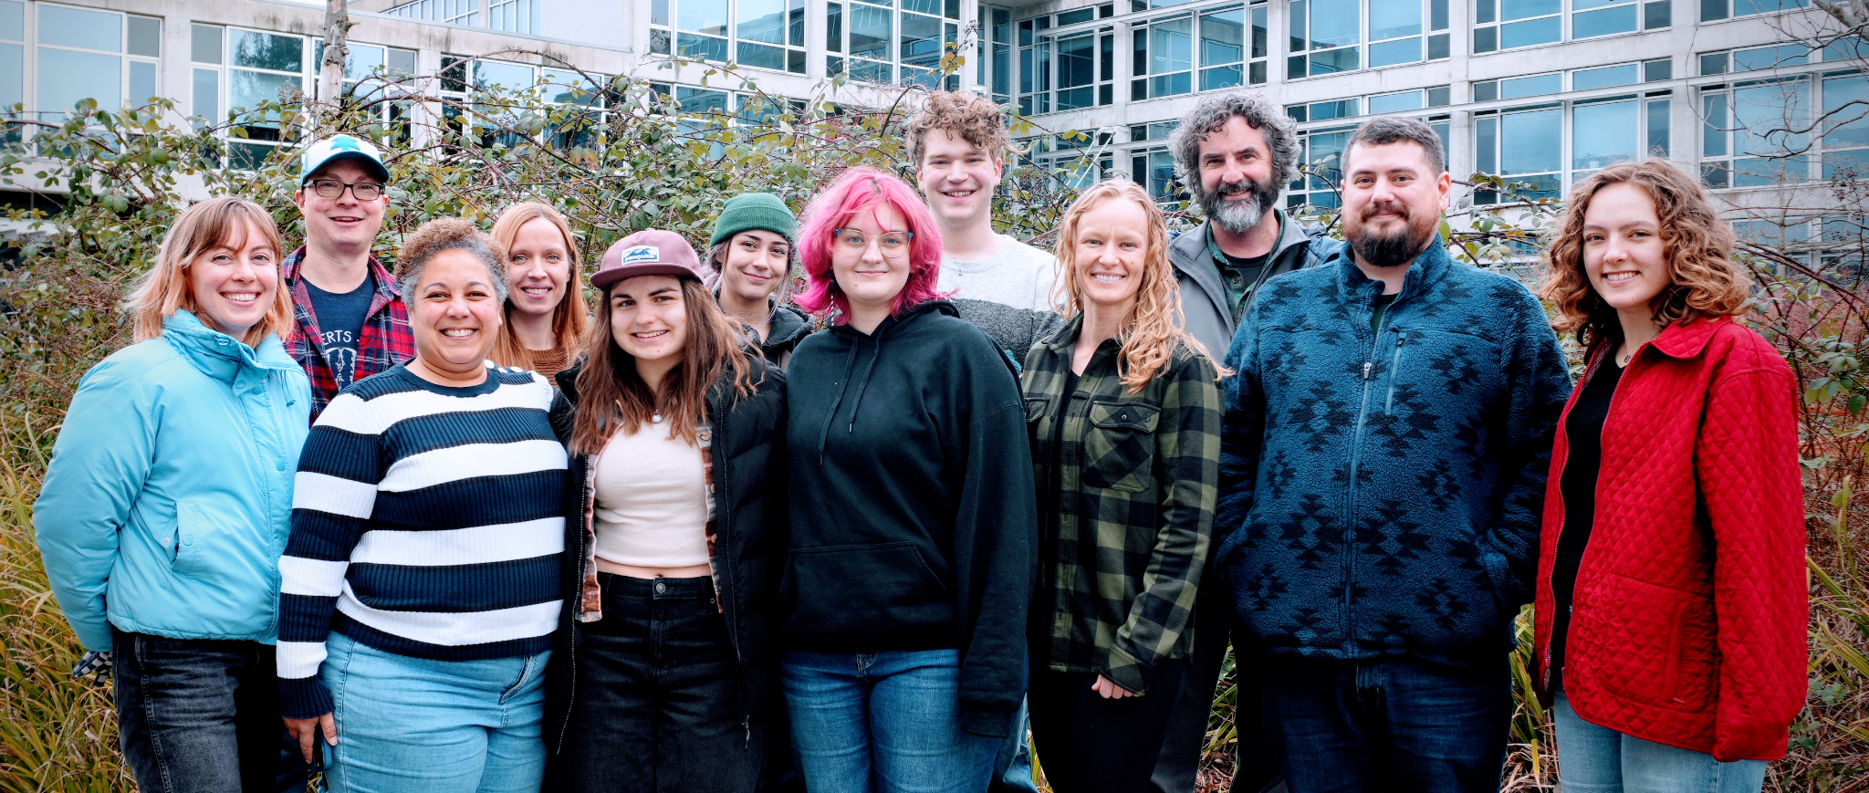
Thank you!
Roberts
Lab
Dr. Jill Ashey
Dr. Steven Roberts
Dr. Hollie Putnam
Dr. Jose M. Eirin-Lopez
Dr. Javier A. Rodriguez-Casariego
Zoe Dellaert
Zachary Bengtsson
Samuel J. White
Dr. Vaughn Iverson
Dr. Ariana Huffmyer
Grace Crandall
Megan Ewing
Epigenetic Network Explorer (CENE) (restricted dataset)
MOSAIC data
explorer
(full timeseries)
Ariana Huffmeyer
Jill Ashey
Sam White
Get in touch!
kdurkin1@uw.edu
Notes:
Please check out two data explorers we’ve recently released to explore these findings in more depth
CENE: Network explorer for limited set (epi-miRNAs, ceRNAs)
MOSAIC: data explorer, includes full timeseries dataset of both molecular features, as well as host and symbiont phys metrics and symbiont composition
Shoutout Jill’s talk tomorrow morning

Slide 40
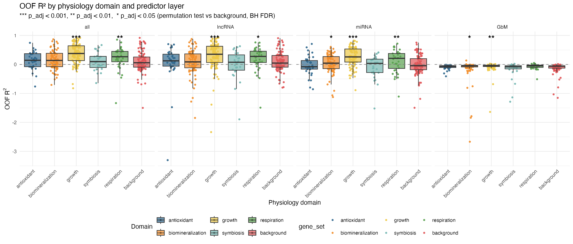
Expression predictability differs by functional domain and layer
(preliminary results from A. pulchra)
Model performance on genes across physiological domains and epigenetic layer
Notes:
epigenetic context predicts expression for a subset of genes in every domain, but predictability is significantly enriched in growth and respiration
be sure to clearly explain the enriched result (significance is from comparison to randomly selected background, use bars to show pairwise comparison) and that ech point is a gene
could use more clear hypothesis-driven throughline for *why* looking at performance across domains

Slide 41
Expression predictability differs by functional domain and layer
(preliminary results from A. pulchra)
Model performance on genes across physiological domains and epigenetic layer
Notes:
epigenetic context predicts expression for a subset of genes in every domain, but predictability is significantly enriched in growth and respiration
be sure to clearly explain the enriched result (significance is from comparison to randomly selected background, use bars to show pairwise comparison) and that ech point is a gene
could use more clear hypothesis-driven throughline for *why* looking at performance across domains

Slide 42
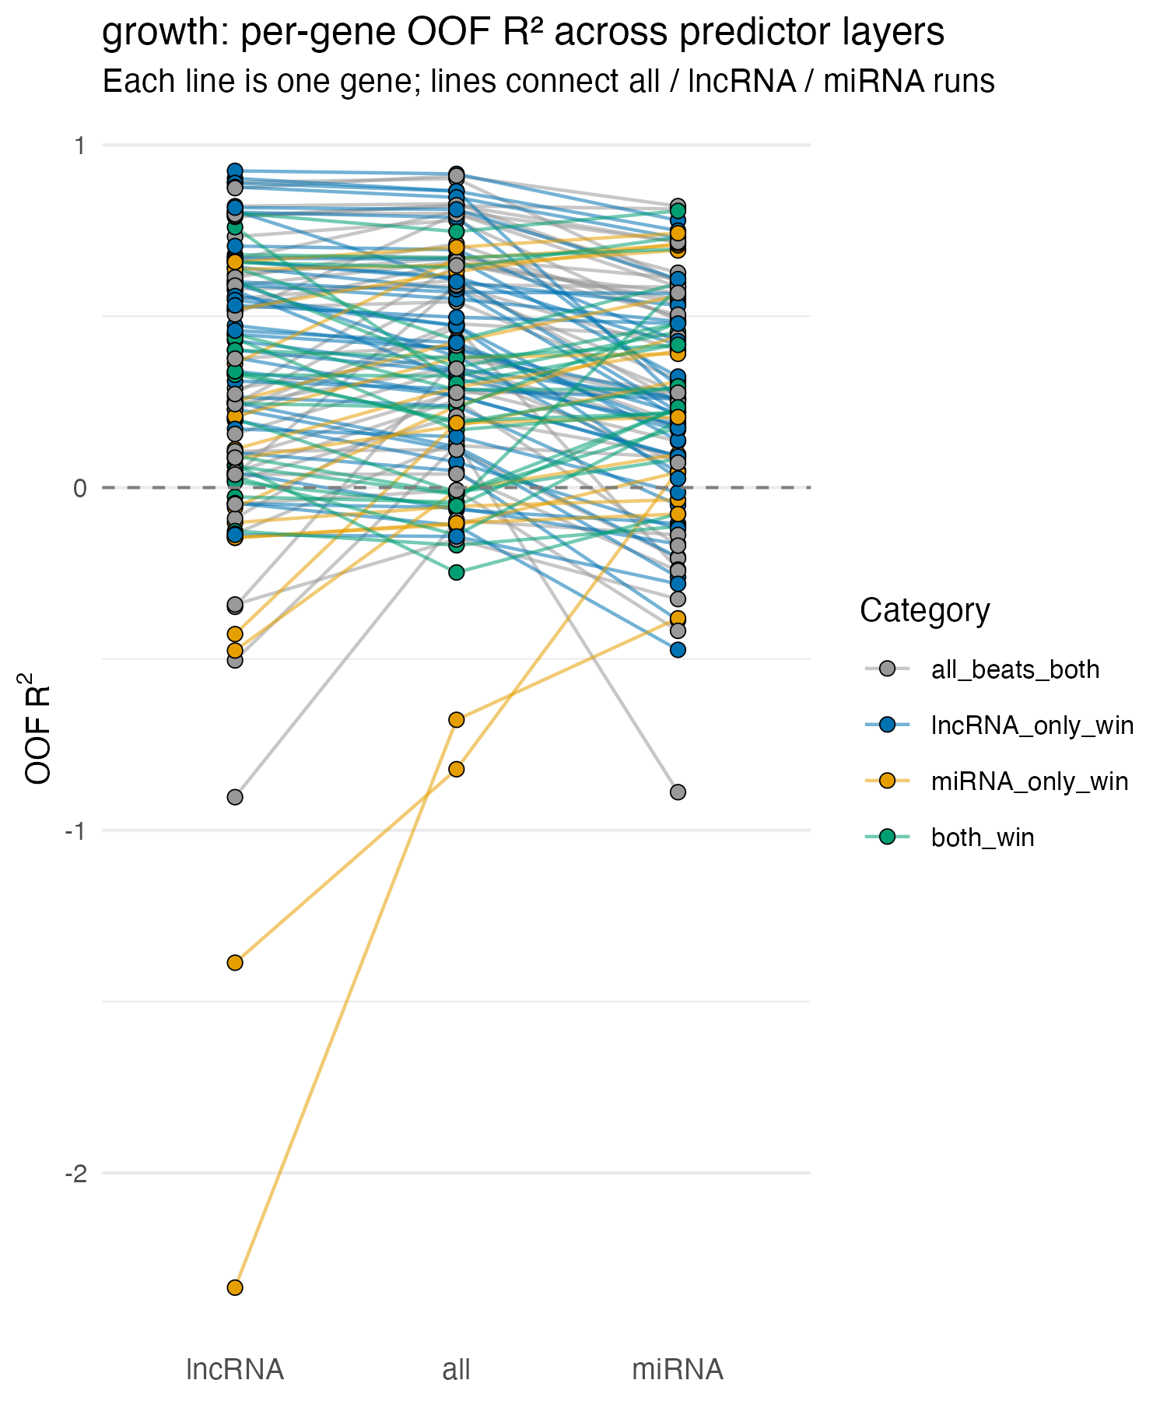
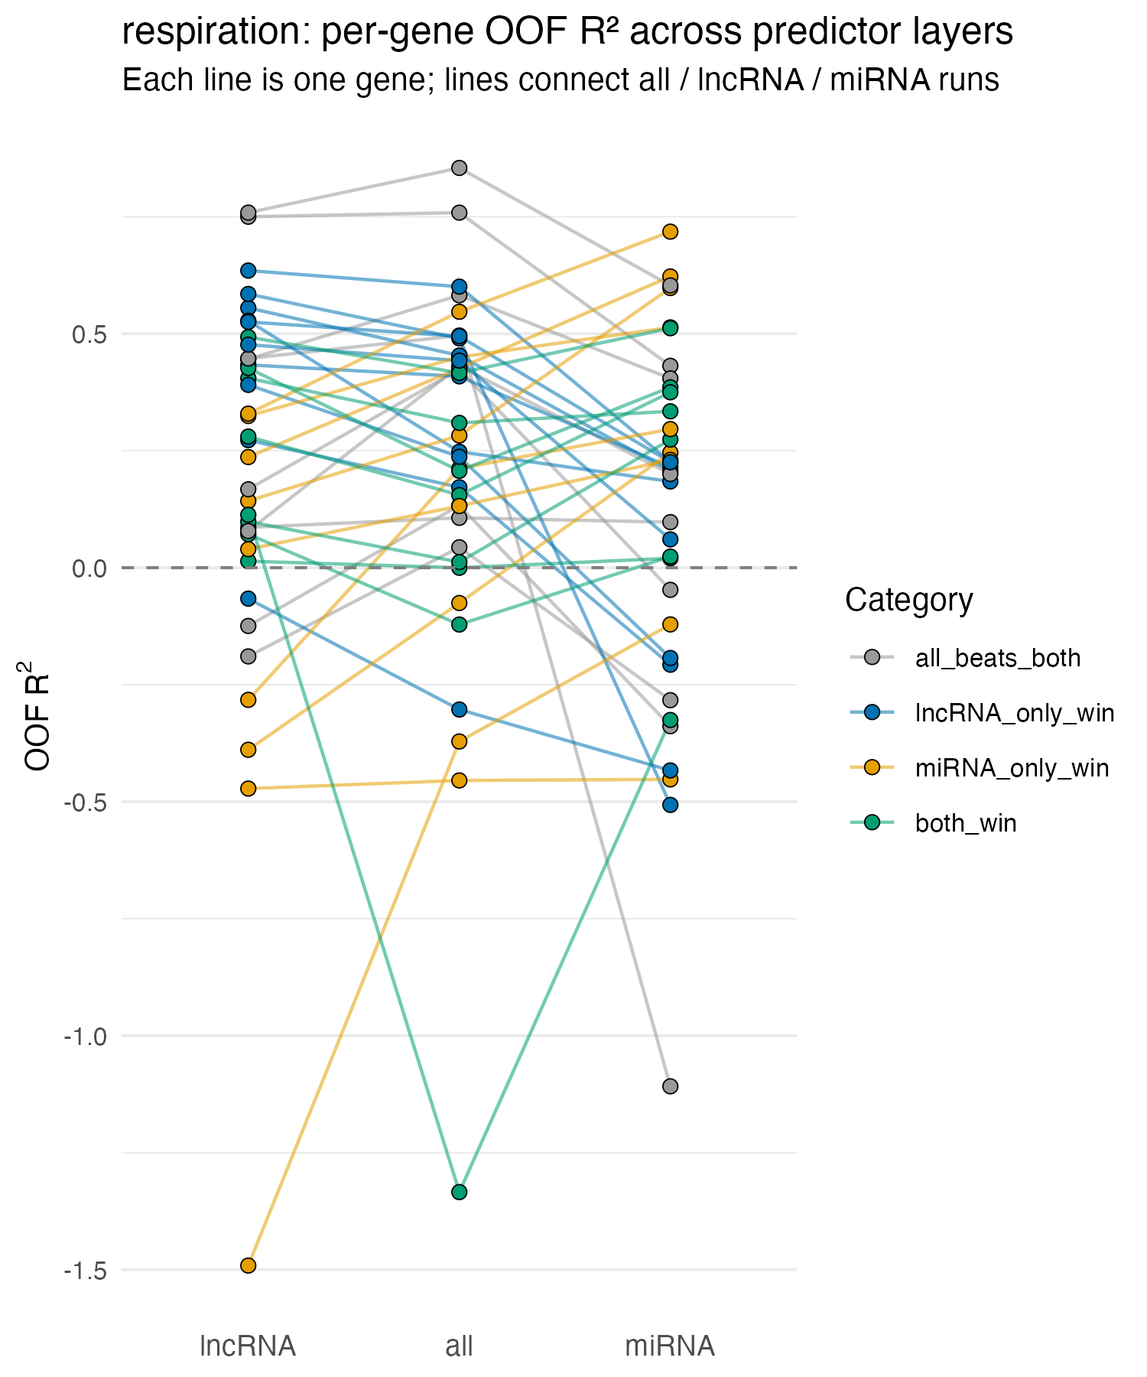
Expression predictability differs by functional domain and layer
(preliminary results from A. pulchra)
Notes:
epigenetic context predicts expression for a subset of genes in every domain, but predictability is significantly enriched in growth and respiration
be sure to clearly explain the enriched result (significance is from comparison to randomly selected background, use bars to show pairwise comparison) and that ech point is a gene
could use more clear hypothesis-driven throughline for *why* looking at performance across domains

Slide 43
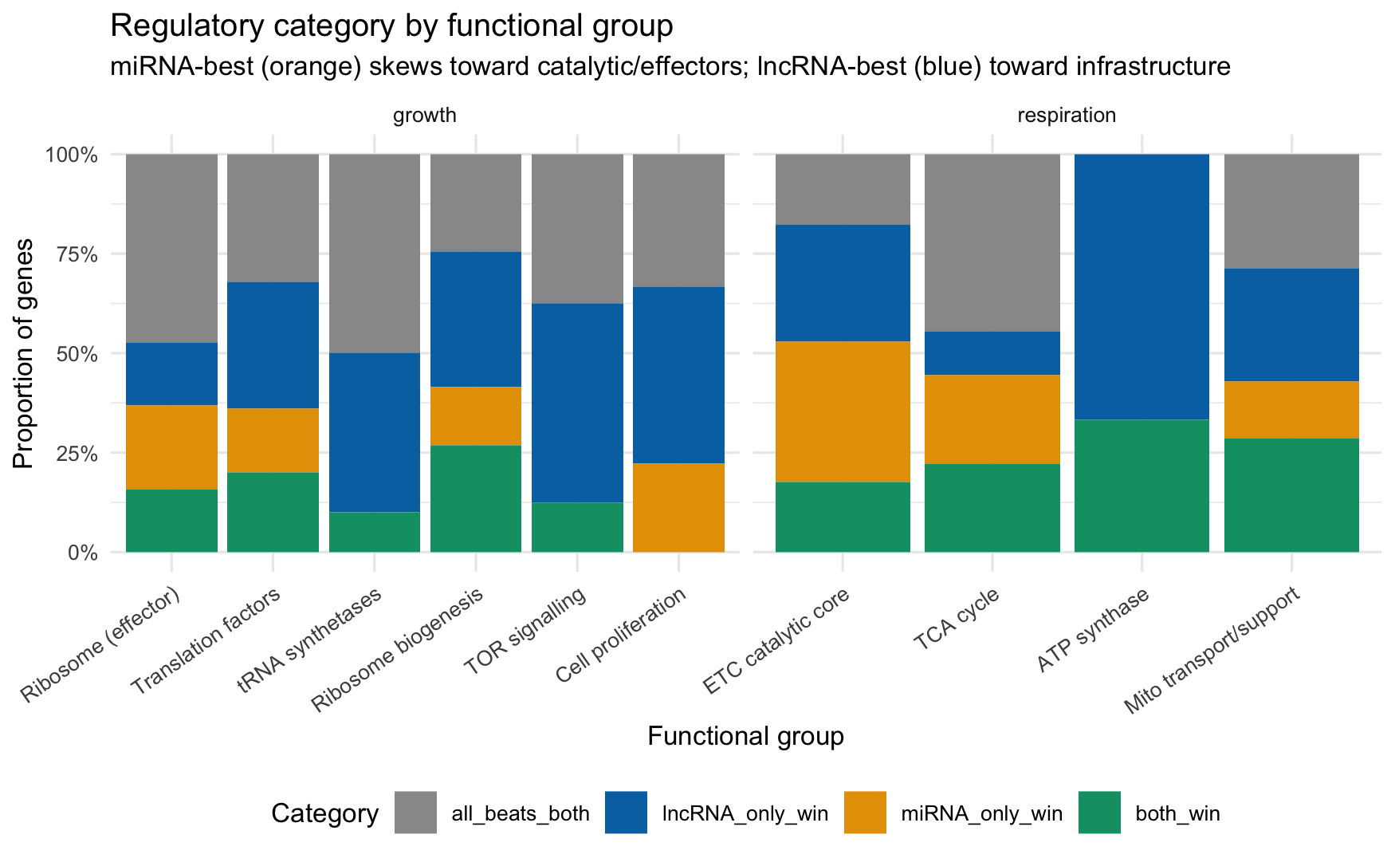
Expression predictability differs by functional domain and layer
(preliminary results from A. pulchra)
Notes:
epigenetic context predicts expression for a subset of genes in every domain, but predictability is significantly enriched in growth and respiration
be sure to clearly explain the enriched result (significance is from comparison to randomly selected background, use bars to show pairwise comparison) and that ech point is a gene
could use more clear hypothesis-driven throughline for *why* looking at performance across domains

Slide 44
Elastic Net Regression
miRNA
lncRNA
GbM
-0.42
0
⋮
0.31
⋮
0
y₁ |  | x₁₁ | x₁₂ | … | x_{1j} | … | x_{1p} |  | Ɛ₁
y₂ |  | x₂₁ | x₂₂ | … | x_{2j} | … | x_{2p} |  | Ɛ₂
⋮ |  | ⋮ | ⋮ |  | ⋮ |  | ⋮ |  | ⋮
y_{n-1} |  | x_{n-1,1} | x_{n-1,2} | … | x_{n-1,j} | … | x_{n-1,p} |  | Ɛ_{n-1}
y_{n} |  | x_{n,1} | x_{n,2} | … | x_{n,j} | … | x_{n,p} |  | Ɛ_{n}
Y (n x 1)
Response matrix: expression of gene g across samples
X (n x p)
Predictor matrix: z-scaled miRNA expression, lncRNA expression, and GbM values per sample
β (p x 1)
EN output. Sparse coefficient vector
Ɛ (n x 1)
Residuals
21

Slide 45
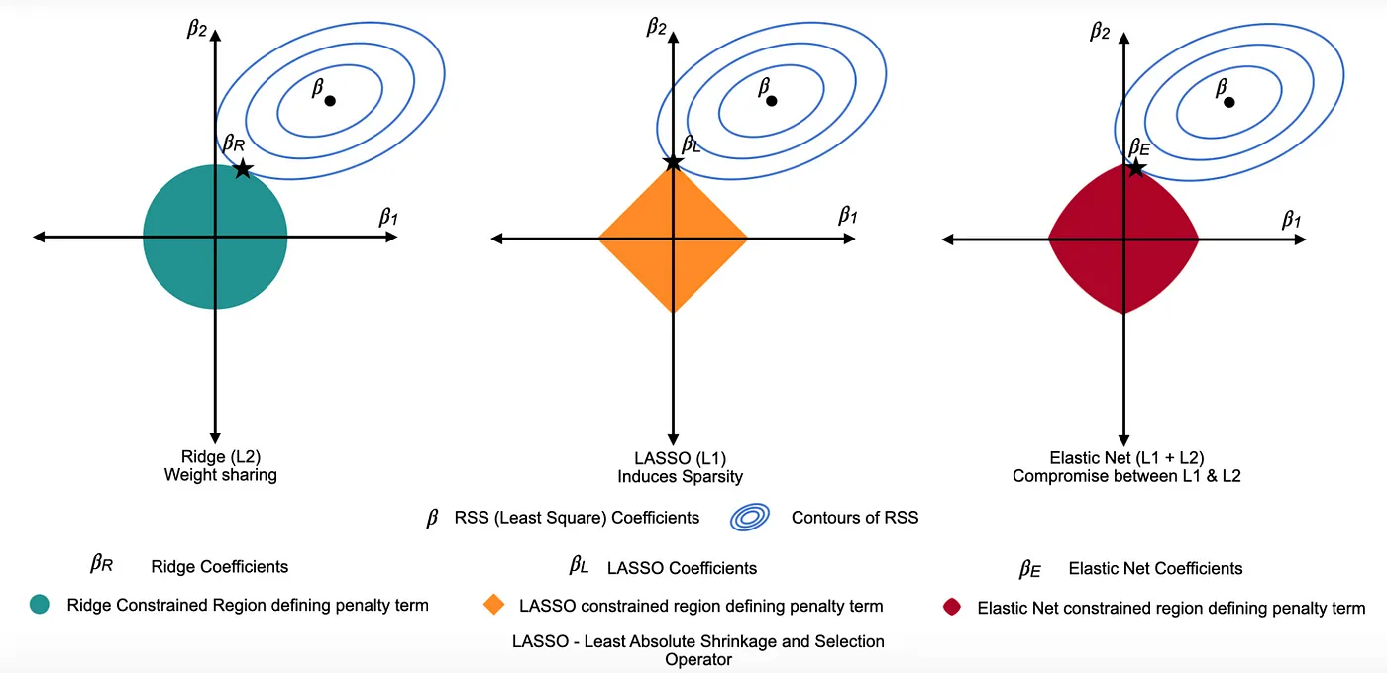
Elastic Net Regression
Lasso (L1) — harsh editor
Ridge (L2) — compromiser
penalizes |B|; drives many coefficients to exactly 0 → sparse, but arbitrary among correlated features.
penalizes B-squared; shrinks correlated predictors together, but keeps everything → not sparse.
medium.com/@tavishi.1402/regularization-techniques-lasso-and-ridge-90d3cc73ca4c
Notes:
Elastic net combines the strengths of both penalties: Sparse, stable under high multicollinearity, and assumption-light

Slide 46
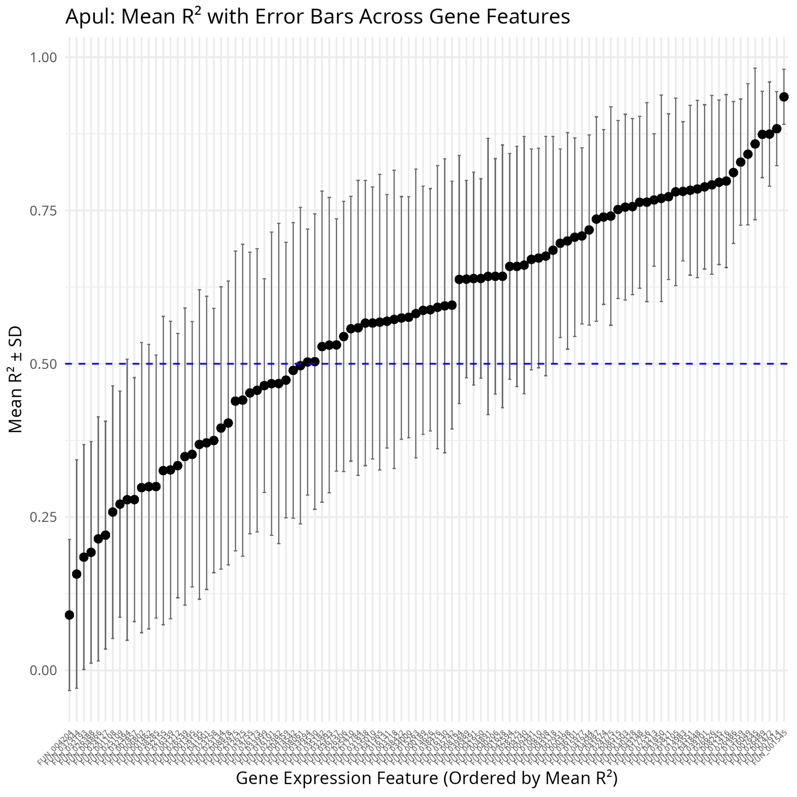
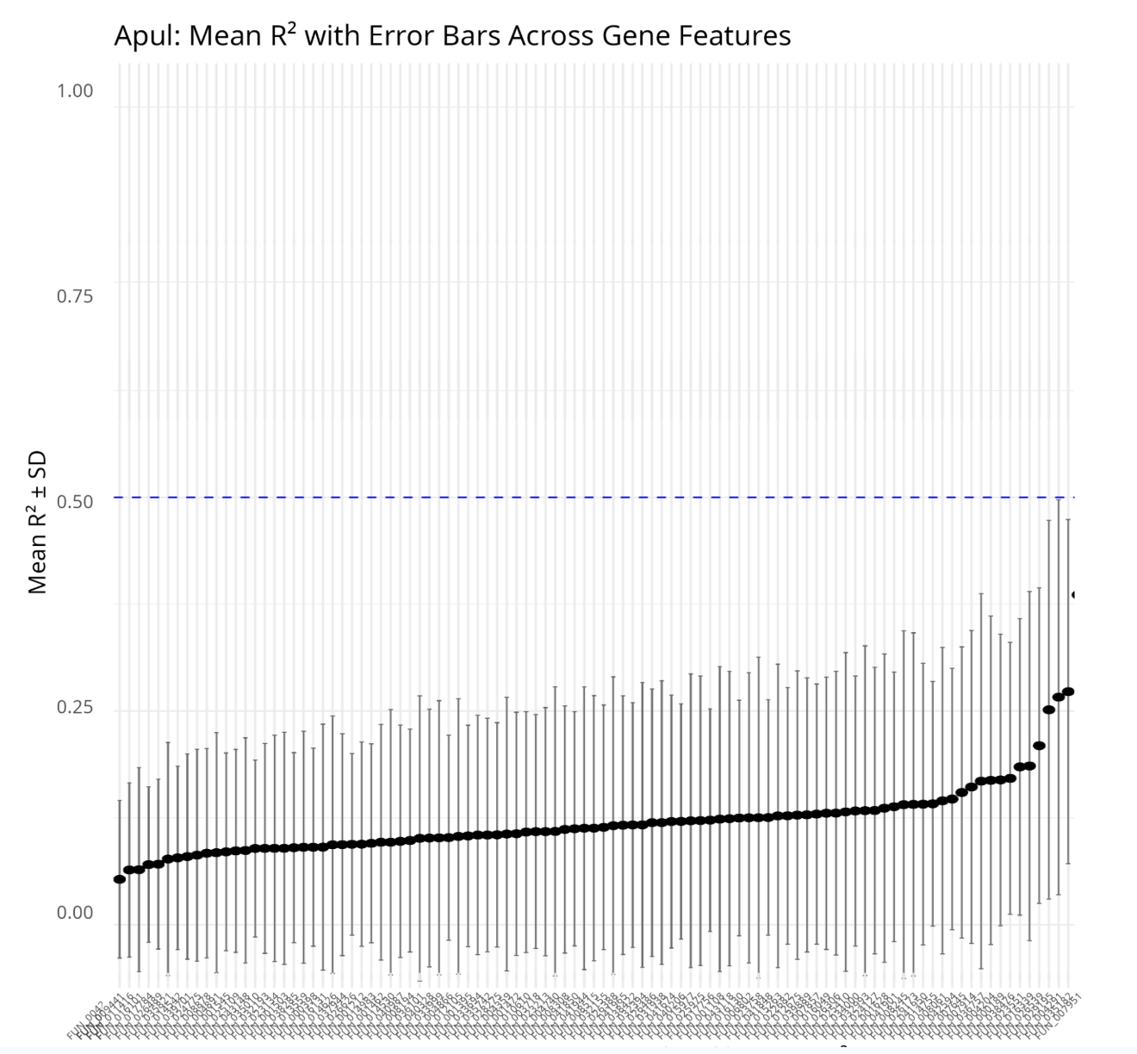
Validated model using noise injection
Real predictor data
Randomized predictor data
Notes:
A critical question is whether the model is capturing real biological signal or just fitting noise.
To test this, ran same pipeline using randomized predictor data — we shuffled the values within each predictor column to break any real associations with gene expression, while preserving the distributional properties of each feature.
Two plots. Predicted genes are along x-axis, R^2 (measure of model performance) on the y. Blue line indicates R^2 = 0.5.
On the left, model performance with real data. many genes are well-predicted
On the right, the noise data — the model essentially produces near-zero R-squared values across almost all genes.
Confirms the model is detecting genuine predictive structure in the real epigenetic data, not just capitalizing on the high-dimensional input.

Slide 47
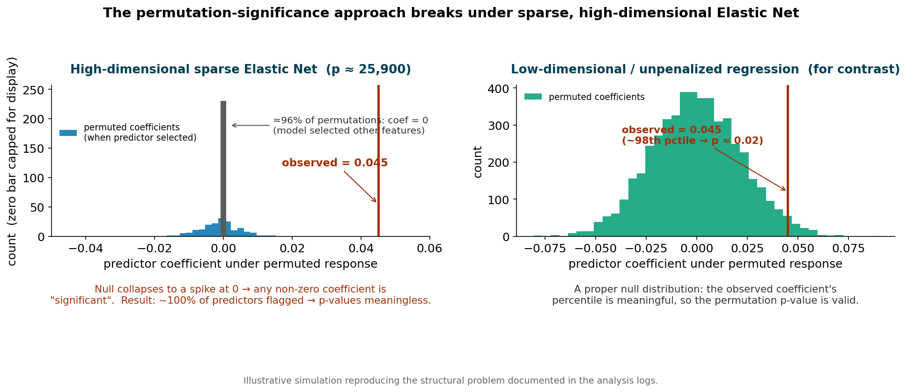
Permutation testing broke under sparse penalized regression
Idea:
permute the response, refit many times, build a null per predictor
BUT each refit selects ~50 predictors (different random set each time
For any one predictor the null becomes a spike at zero
any non-zero coef looks ‘significant’
“proper” null distribution
null under a high-dim, sparse Elastic Net

Slide 48
Permutation testing broke under sparse penalized regression
Idea:
permute the response, refit many times, build a null per predictor
BUT each refit selects ~50 predictors (different random set each time
For any one predictor the null becomes a spike at zero
any non-zero coef looks ‘significant’
“proper” null distribution
null under a high-dim, sparse Elastic Net

Slide 49
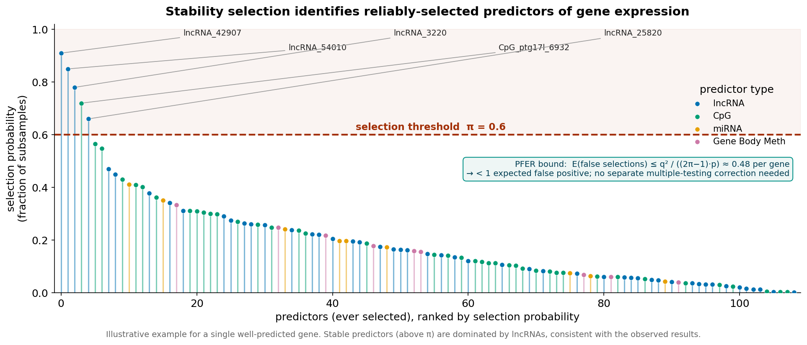
Stability selection identifies reliably-selected predictors
Instead of asking “is this coefficient significant?”, ask “how consistently is it selected?”
Repeatedly subsample ~50% of observations (complementary pairs); refit EN on each
Selection probability = fraction of subsamples in which a predictor is chosen
Predictors above π = 0.6 are declared stable
Meinshausen & Bühlmann, 2010

Slide 50
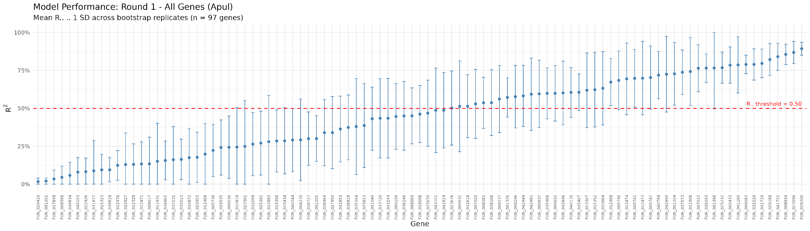
A. pulchra energetic state example:
Epigenetic context predicts expression for many genes
45/97 well-predicted
(poorly-predicted) energetic state genes (well-predicted)

Slide 51
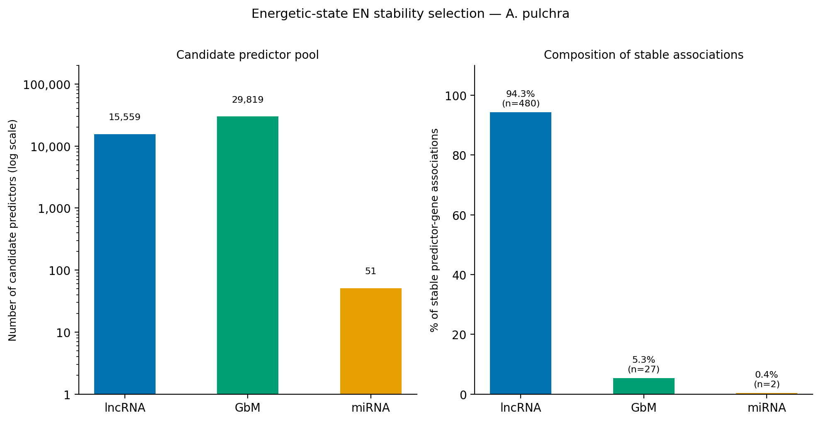
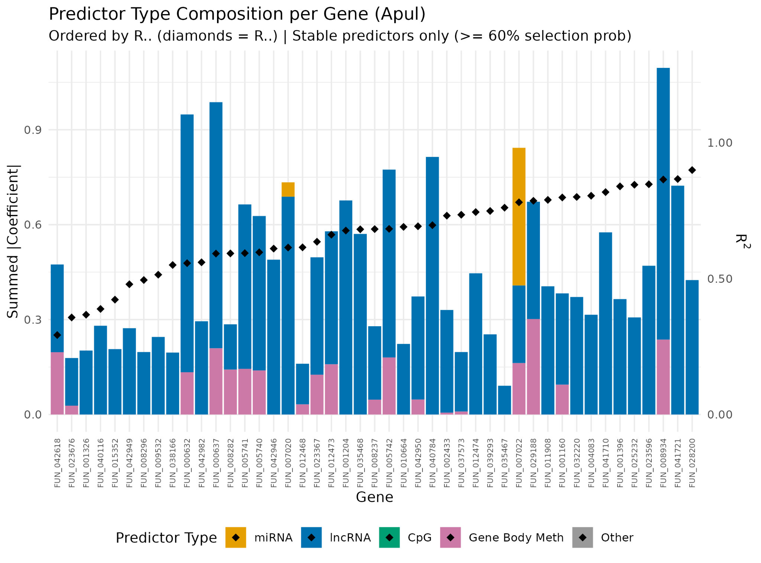
A. pulchra energetic state example:
LncRNA dominate predictor pool
27

Slide 52
A. pulchra energetic state example:
LncRNA dominate predictor pool
27

Slide 53
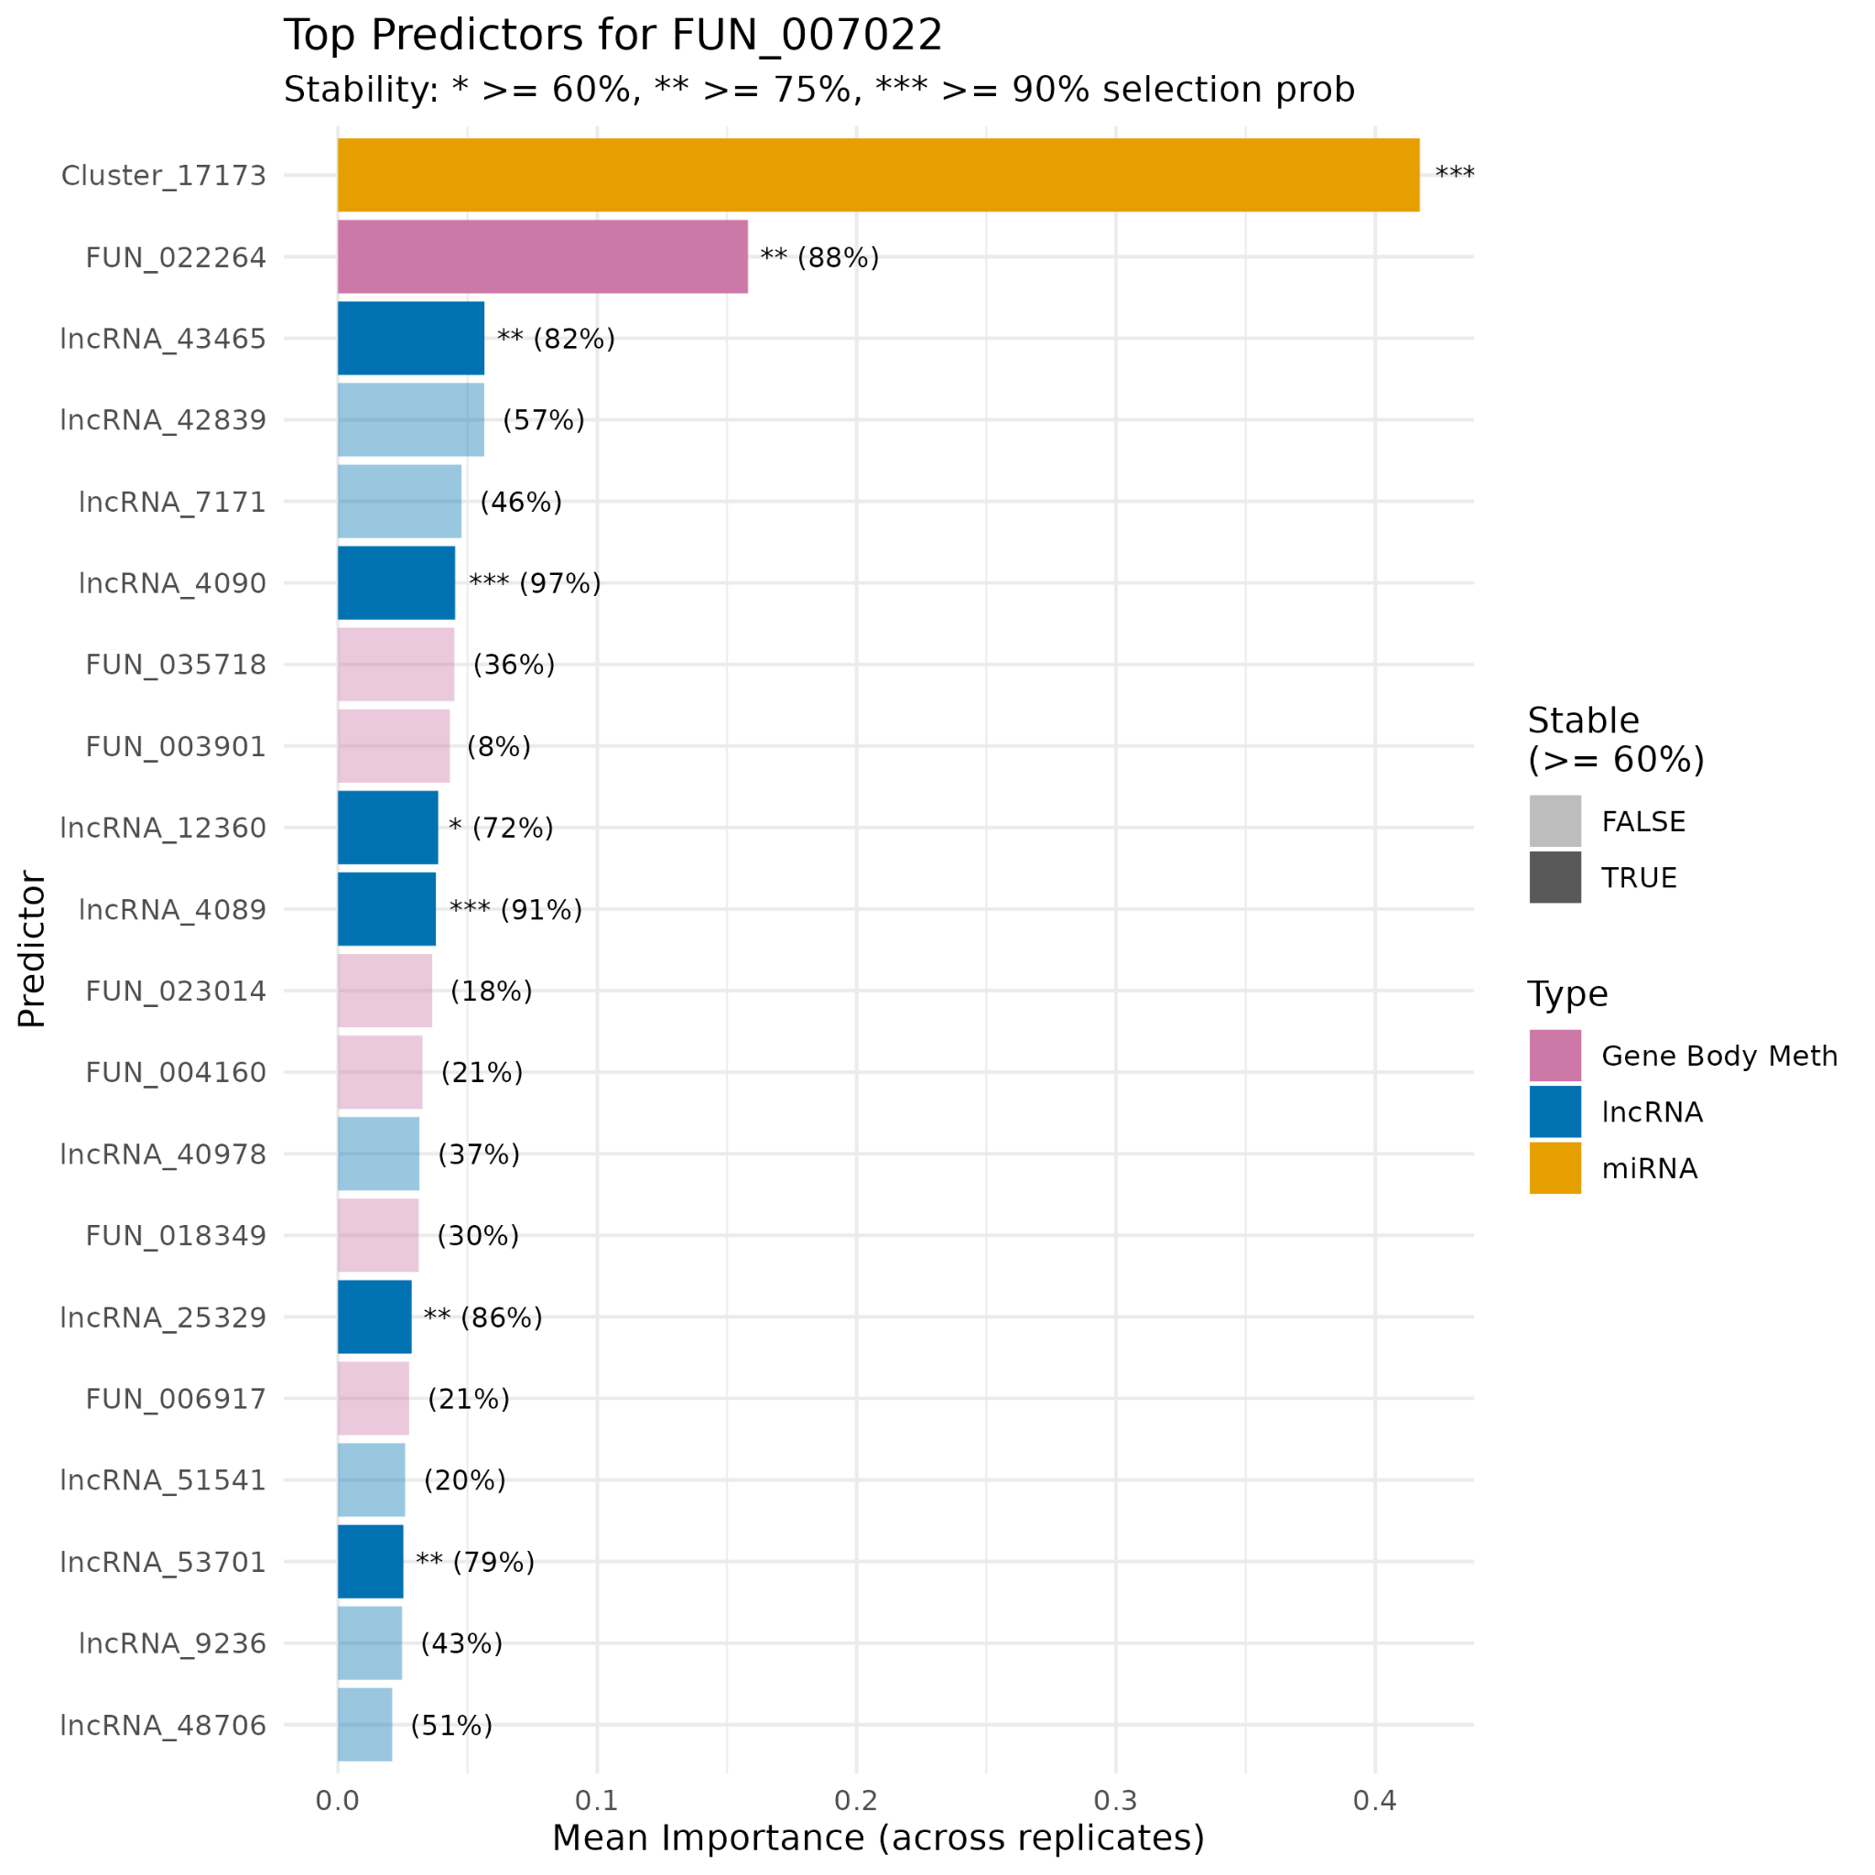
A. pulchra energetic state example:
CRY1 — a circadian clock gene
Notes:
fix pink? figure out what to say about miRNA

Slide 54
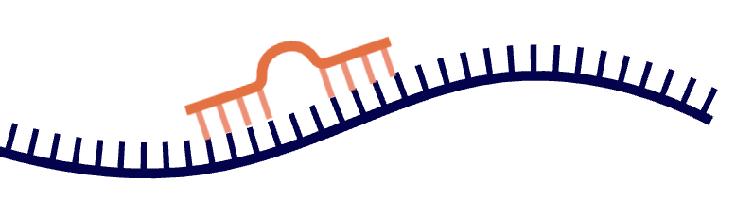

A. pulchra energetic state example:
CRY1 — a circadian clock gene
Structural verification!
miRNA putatively binds to CRY1
Notes:
fix pink? figure out what to say about miRNA

Slide 55

Cross-layer interactions in corals add complexity
epi-miRNAs
miRNAs targeting the foundational machinery of epigenetic pathways
Since epigenetic layers interact, single-layer analyses miss the full picture
Instead, can we model them jointly to predict outcomes?
A. pulchra | 35
P. evermanni | 15
P. tuahiniensis | 16
ceRNAs
lncRNAs mediating the indirect derepressin of miRNA targets
A. pulchra | 564
P. evermanni | 175
P. tuahiniensis | 564
Notes:
Answer to the question of whether layers interact: YES!

Slide 56
Takeaways – where we’re headed
1
Layers interact
2
Epigenome predicts expression
First evidence of cross-layer epigenetic regulation in cnidarians:
miRNAs target epigenetic machinery (epi-miRNAs)
lncRNAs sequester miRNAs (ceRNAs)
Integrated epigenetic context stably predicts expression for a subset of functionally-relevant genes

