Slide 1
Understanding the Technology Value Stream
Presented by: Sheridan Dela Cruz
October 23, 2026
Module 1.2

Slide 2
Understanding the Technology Value Stream
A technology value stream refers to all the activities required to deliver a product or service to a customer. In a software environment, this process begins with a business idea and continues through development, testing, deployment, and ongoing support.
Key Points
Focuses on how value is delivered to customers.
Includes both technical and business activities.
Helps organizations identify delays and inefficiencies.
Provides visibility into every step of the delivery process.
Supports continuous improvement efforts.
Importance
By analyzing the technology value stream, organizations can better understand where time is being lost and how to improve processes.

Slide 3
Lead Time vs. Processing Time
Understanding the difference between lead time and processing time is essential when evaluating the efficiency of a technology value stream.
Lead Time
The total time required to complete a task from start to finish.
Includes both active work and waiting periods.
Measures how quickly value reaches the customer.
Processing Time
The time spent actively working on a task.
Does not include delays or waiting periods.
Represents the portion of work that directly adds value.
Example
A feature may require four days of development work but spend sixteen additional days waiting for approvals and testing.
Processing Time: 4 days
Lead Time: 20 days

Slide 4
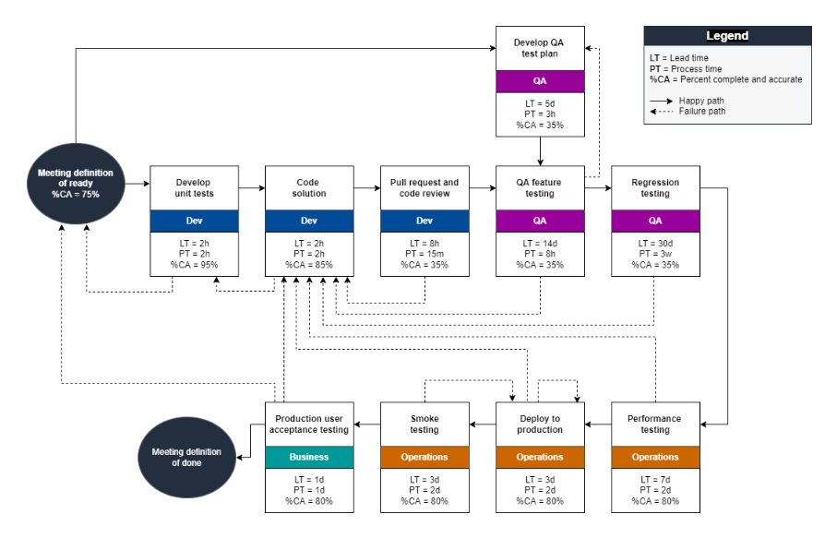
Mapping the Technology Value Stream
The diagram illustrates how work moves through each stage of the software delivery process.
Value stream mapping helps identify delays, bottlenecks, and non-value-added activities.
Organizations can use these insights to reduce lead time and improve delivery performance.
Source: Amazon Web Services. Strategy and Planning for DevOps Value Stream Mapping.

Slide 5
The Common Scenario - Deployment Lead Times Requiring Months
A common situation in which software deployments occur only every few months. This approach was traditionally viewed as normal in many organizations.
Factors Contributing to Long Deployment Times
Large and complex releases.
Manual testing procedures.
Multiple approval requirements.
Limited collaboration between departments.
Manual deployment activities.
Fear of introducing system failures.
Impact on Organizations
Slower delivery of new features.
Increased risk during deployments.
Delayed customer feedback.
Higher costs associated with rework and maintenance.

Slide 6
Bottlenecks Within the Value Stream
A bottleneck occurs when one stage of a process slows the overall flow of work.
Common Bottlenecks
Waiting for management approval.
Security and compliance reviews.
Limited testing resources.
Delays in environment setup.
Poor communication between teams.
Why Bottlenecks Matter
When work accumulates at a bottleneck, lead time increases and value reaches customers more slowly.
Role of Value Stream Management
Value Stream Management helps organizations identify bottlenecks and make improvements that increase efficiency and reduce delays.

Slide 7
The DevOps Ideal - Deployment Lead Times of Minutes
The goal of DevOps is to reduce lead times dramatically by improving the flow of work through automation and collaboration.
Practices That Support Faster Delivery
Continuous Integration (CI)
Continuous Delivery (CD)
Automated testing
Infrastructure as Code
Continuous monitoring
Frequent small updates
Benefits
Faster software releases.
Reduced deployment risk.
Quicker customer feedback.
Improved software quality.
Increased business agility.

Slide 8
Traditional Delivery vs. DevOps Delivery
Traditional Approach | DevOps Approach
Infrequent releases | Frequent releases
Manual testing | Automated testing
Large deployments | Small deployments
Slower feedback | Continuous feedback
Higher deployment risk | Lower deployment risk
Long lead times | Short lead times
Limited collaboration | Cross-functional collaboration
Analysis
The primary difference between these approaches is the focus on flow. DevOps seeks to improve the movement of work through the value stream while reducing delays and unnecessary handoffs.

Slide 9
Findings and Conclusion
Findings
A technology value stream includes all activities involved in delivering value to customers.
Lead time measures the total amount of time required to complete work.
Processing time measures only active work effort.
Many organizations experience long deployment lead times because of delays, bottlenecks, and manual processes.
DevOps practices help reduce these delays through automation and continuous delivery.
Improving the technology value stream allows organizations to deliver value more efficiently.
Conclusion
The Technology Value Stream provides a framework for understanding how work moves through an organization. By reducing bottlenecks and improving flow, DevOps enables faster delivery, greater efficiency, and improved customer outcomes.

Slide 10
References:
Ely, R. (2026, July 1). Value Stream Management: Explained in Plain English. DevOps Institute. https://www.devopsinstitute.com/value-stream-management-explained-in-plain-english/
Kim, G., Debois, P., Humble, J., Willis, J., & Forsgren, N. (2021). The DEVOPS Handbook: How to Create World-Class Agility, Reliability, & Security in Technology Organizations. It Revolution Press.
Takakura, T. (n.d.). What is value stream management (VSM) and why is it important? Atlassian. https://www.atlassian.com/agile/value-stream-management
Team, C. Q. I. A. (2025, November 17). What is value stream management? https://www.ibm.com/think/topics/value-stream-management
Using development value stream mapping to identify constraints to DevOps outcomes - AWS Prescriptive Guidance. (n.d.). https://docs.aws.amazon.com/prescriptive-guidance/latest/strategy-devops-value-stream-mapping/introduction.html

