Slide 1
HDB Resale Market Data Analysis
Sheeba Soosai

Slide 2
Problem Statement
A good understanding of the trends, patterns and key influencing factors of the Singapore HDB resale prices is important for the residents of Singapore. However, it is challenging to discover such valuable information from the HDB resale market data. This requires a structured data analysis approach.

Slide 3
Objectives
1. Analyze long-term market trends (2000–2023)
2. Compare regional-level prices
3. Analyse town-level clusters
4. Identify key factors influencing resale value
5. Provide insights and recommendations for stakeholders.

Slide 4
Data Overview
Dataset: 4 csv files for HDB Resale Prices (2000–2023)
Time Period: Jan 2000 – Dec 2023
Key Variables: Town, Flat Type, Floor Area, Lease Commencement, Resale Price, Sale Date, Street Name, Storey Range
Scope: 23 years of resale transactions across Singapore
Tools: Power BI, DAX, SQL, Power Query(M Language)

Slide 5





Data Preparation
Data Collection: Imported data from 4 csv files
Data Transformation: Created the ‘Remaining Lease’ column using Power Query M language and transformed it into a numeric format for analysis.
Created Date Table: Added Columns: Year, Quarter, Month
Data Modelling: Establish relationships
1. HDB Sales(Fact) -> Date(Dimension)
2. HDB Sales(Fact) -> Region(Dimension) Prepared for Analysis:
Created Calculated Column: Flat age, Flat age group, Price per sqm, Location
Measures: Median Price, Lowest Price, Highest Price, Average Price, Average Price per sqm, Total Transactions, Price YoY Change, Transaction YOY Change

Slide 6
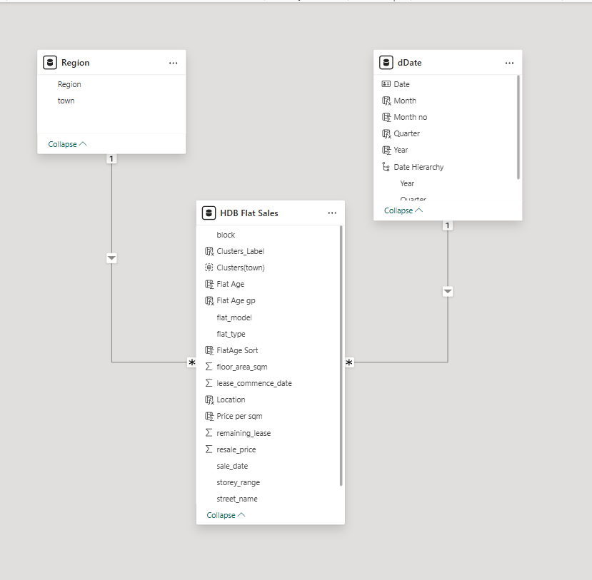
Entity Relationship (ER) Diagram

Slide 7
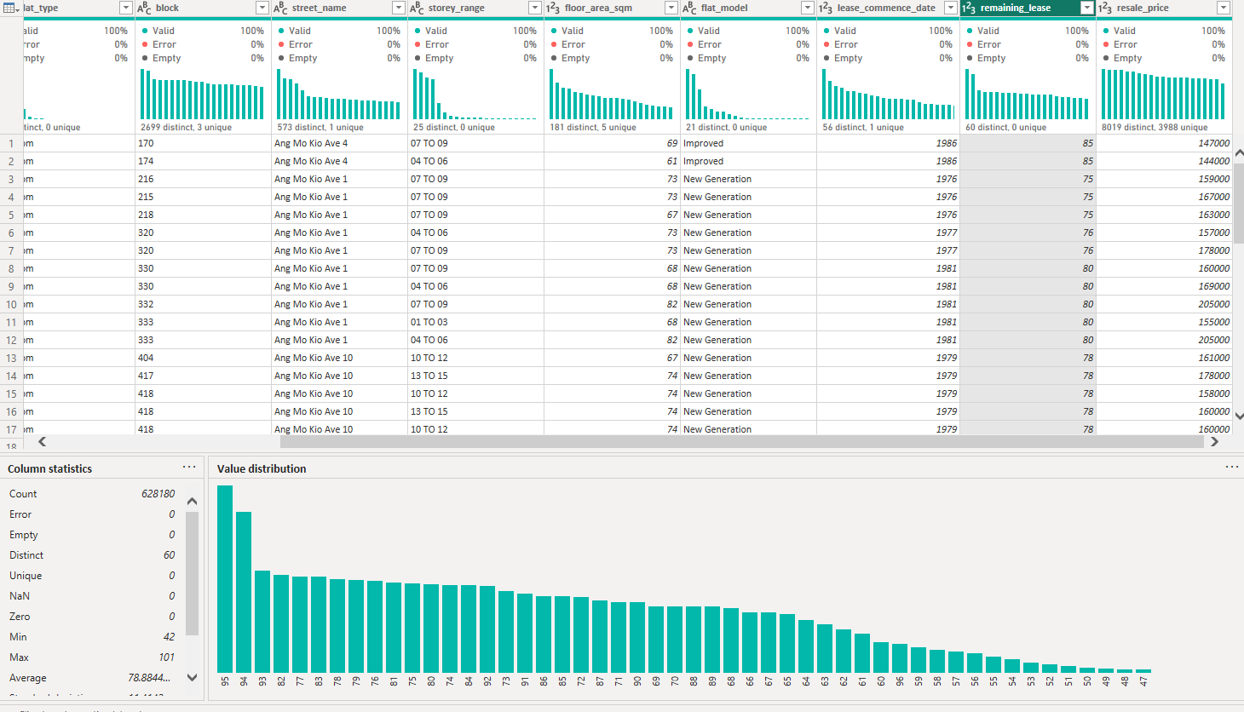
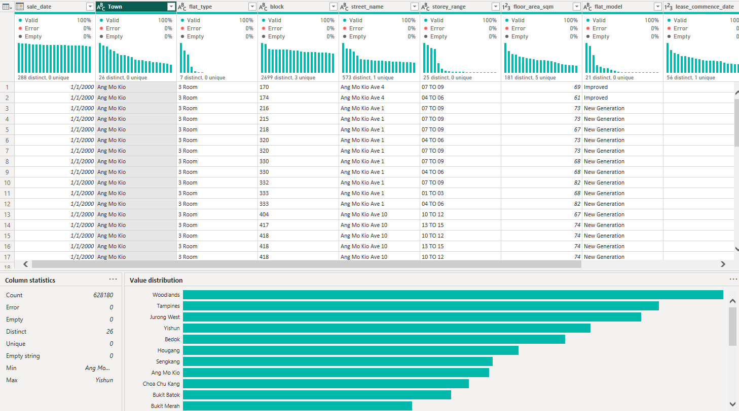
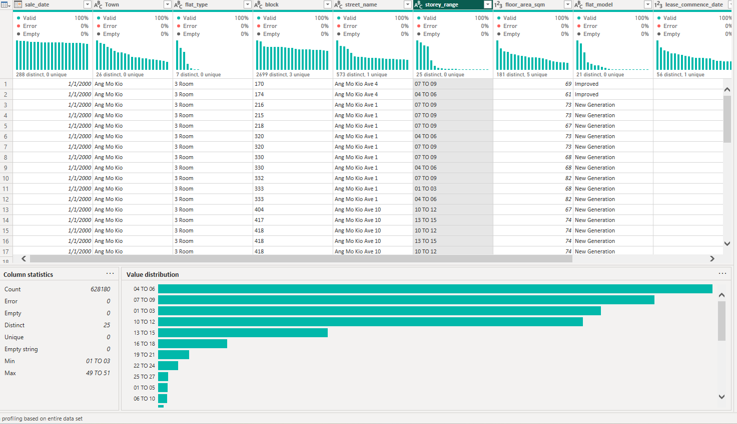
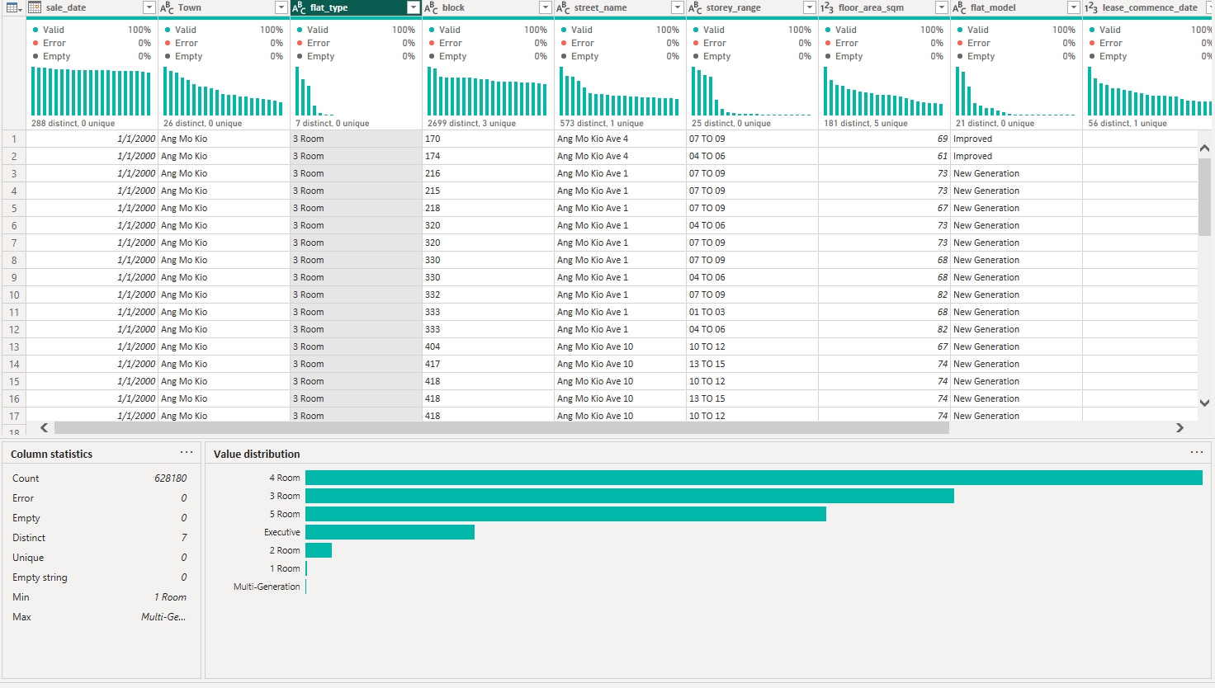
Data Profiling and Quality Overview
Remaining Lease
Town
Storey Range
Flat Type

Slide 8
SQL-Based Analysis

Slide 9
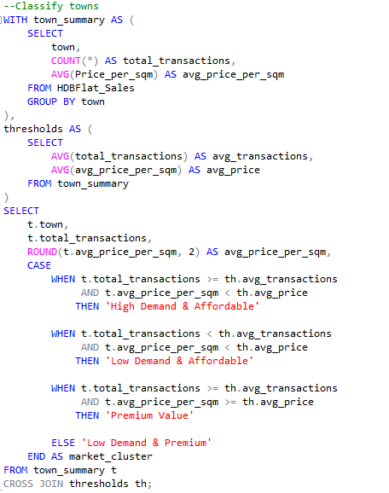
Market Cluster Classification
Segments towns into market clusters by evaluating transaction demand and price affordability.

Slide 10
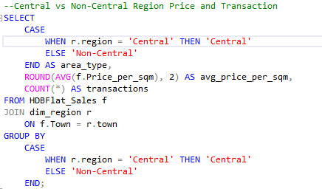
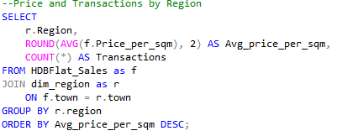
Central vs Non-Central Market Comparison
Regional Pricing and Demand Ranking
Compares housing prices and transaction volume between Central and Non-Central regions.
Ranks regions by average price per sqm and transaction volume to highlight pricing and demand differences

Slide 11
Power BI Visual Insights

Slide 12
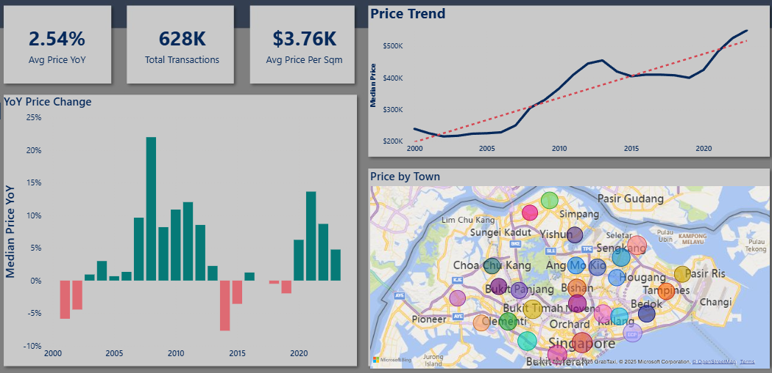
HDB Sales Market Overview
Steady Price Growth:
Median HDB prices rose steadily from ~$200K to over $500K over a 23-year period.
Consistent Upward Trend:
The trend line shows a long-term increase despite short-term fluctuations.
Positive Market Performance: Average 2.54% yearly growth with over 628K transactions.
Location Insight:
Central and mature towns reflect higher prices per sqm than outer regions.

Slide 13
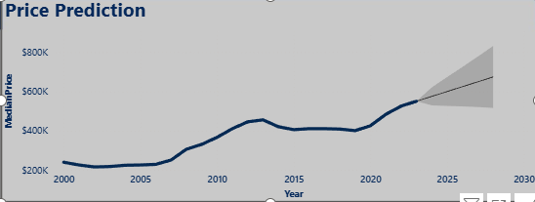
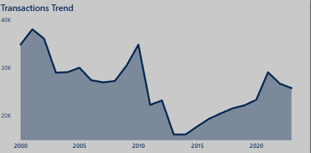
Long-Term Market Trends
Price Trend
2000 - 2007: Relatively stable prices
2008 - 2013: Strong recovery after 2008 recession
2013 - 2015: Prices drop due to cooling measures
2015 - 2020: Relatively stable prices
2020 - 2023: Prices rise after the pandemic
2024 - 2028: Forecast: Moderate growth
Transaction Trend
2000 - 2008: Mostly decreasing trend
2008 - 2010: Sharp increase after recession
2010 - 2013: Steep drop due to cooling measures
2015 - 2020: Increasing trend

Slide 14
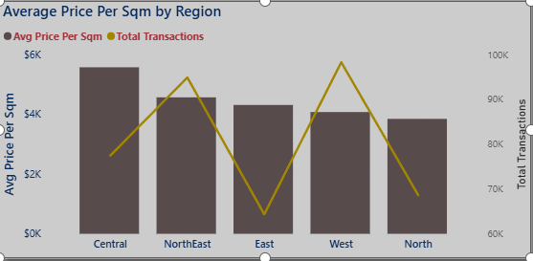
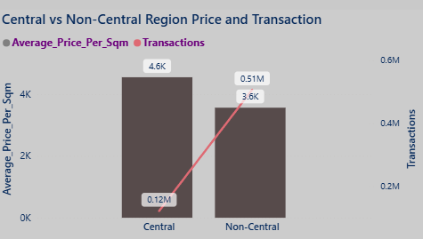
Regional-Level Insights
• The Central region has significantly higher prices, while Non-Central regions record higher transaction volume. North region records the lowest prices
• Higher prices but lower transaction volume in Central region compared to Non-Central regions.

Slide 15
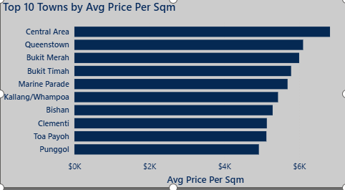
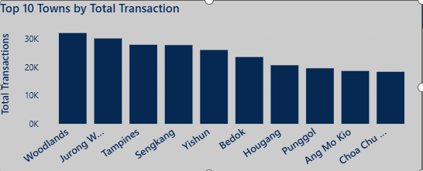
Town-Level Insights
• Towns in the central region such as Central Area and Queenstown lead in terms of average price per sqm
• Relatively, towns such as Woodlands and Jurong West record the highest total transactions

Slide 16
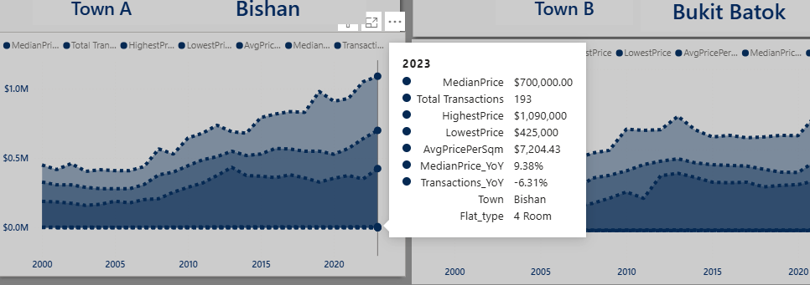
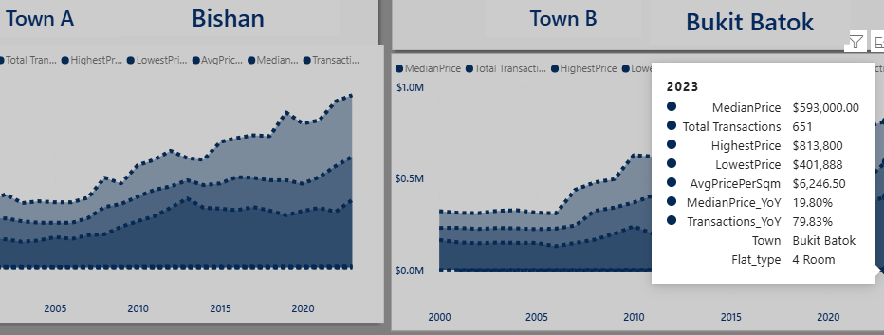
Town Comparison
• Added the ability to do side-by-side comparison of two towns allowing users to compare trends across multiple metrics. • Case Study (Bishan vs. Bukit Batok):
In 2023 Bishan shows higher resale prices overall compared to Bukit Batok due to its central location and mature-town demand
Bukit Batok typically has more resale transactions because of a larger supply of flats
Price growth in both towns is positive, but Bukit Batok has higher price growth compared to Bishan

Slide 17
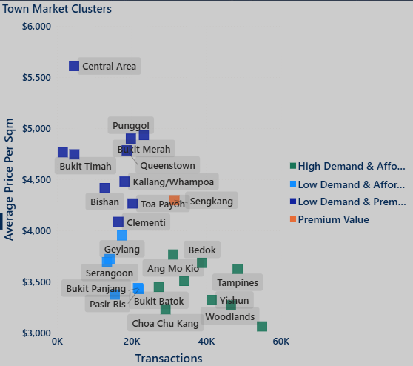
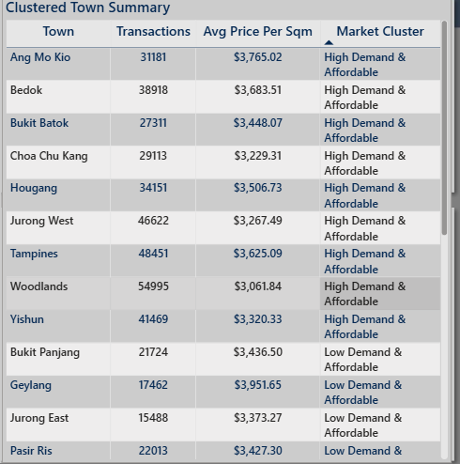
Town Clusters
• Premium Value:
Sengkang
• High Demand & Affordable:
Tampines, Woodlands, Yishun, Jurong West, Bukit Batok
•Low Demand & Affordable:
Geylang, Serangoon, Pasir Ris Bukit Panjang, Jurong East
•Low Demand & Premium:
Clementi, Toa Payoh, Bukit Timah, Queenstown, Punggol

Slide 18
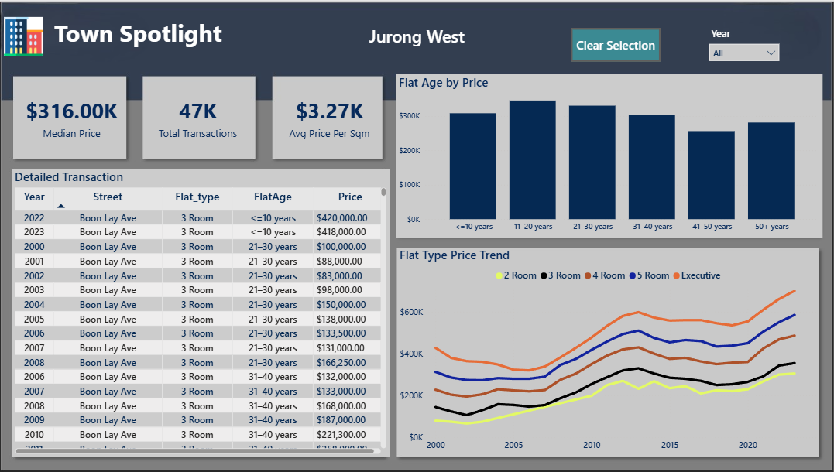
Town Spotlight : Jurong West
• Jurong West’s Median Price is $316K. It is very close to the overall market average of $338K.
• Average Price per Sqm is $3.27K, making it a more affordable option compared to mature estates.
• Jurong West is a high-volume market as it has 47K total transactions

Slide 19
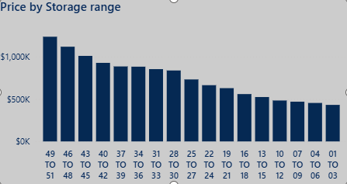
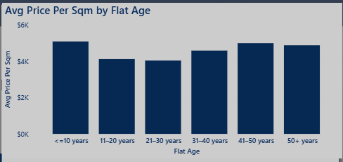
Price Drivers
• Flats at a higher stories tend to have a higher resale price
• Newer flats tend to have a higher median price

Slide 20
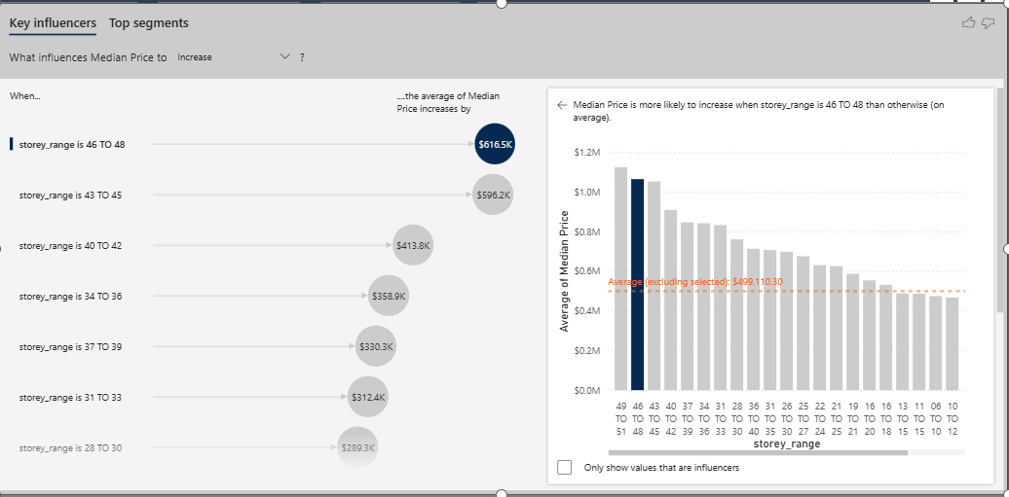
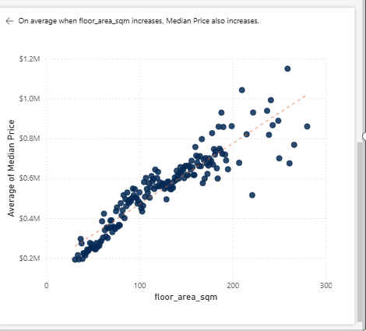
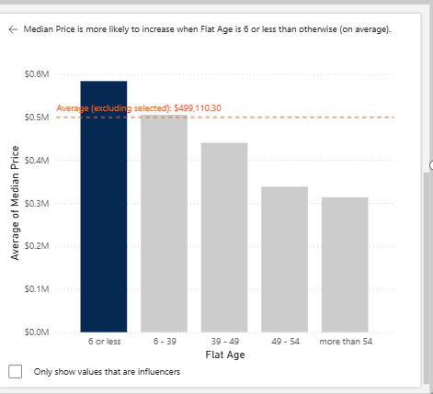
Price Drivers
What influences the Median Price to increase?
• Storey Range
Higher floors are generally priced higher
Median prices of flats in 46-48 storeys are ~$616K higher than flats in all other floors
• Flat Age
Older flats show a gradual price decline
Flat Age 6 or less leads to ~$84K increase in median price
• Floor Area
Strong positive link between flat size and price
A ~33 sqm increase in floor area leads to ~$120K increase in median price
Newer, larger, and higher-floor flats command higher market value.

Slide 21
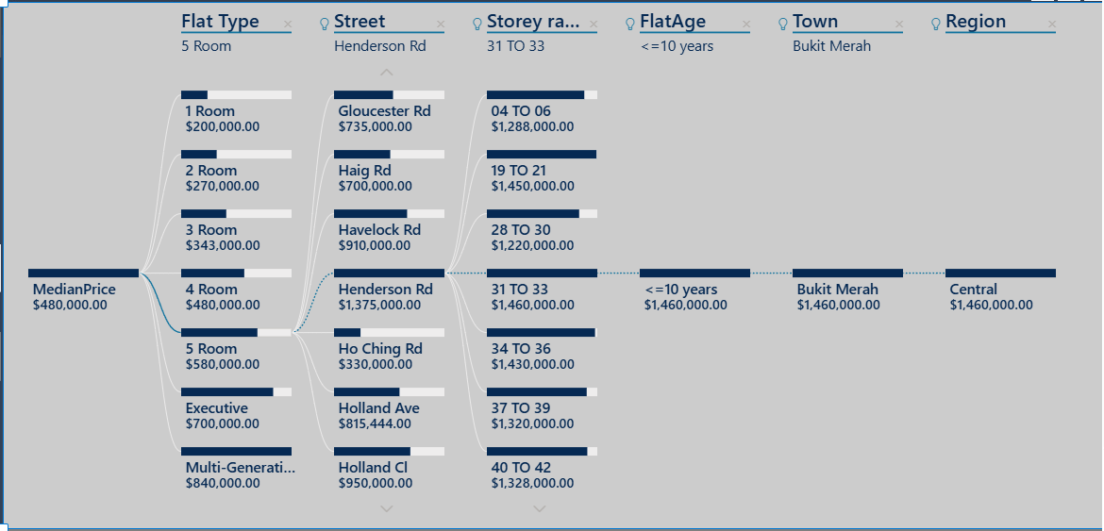
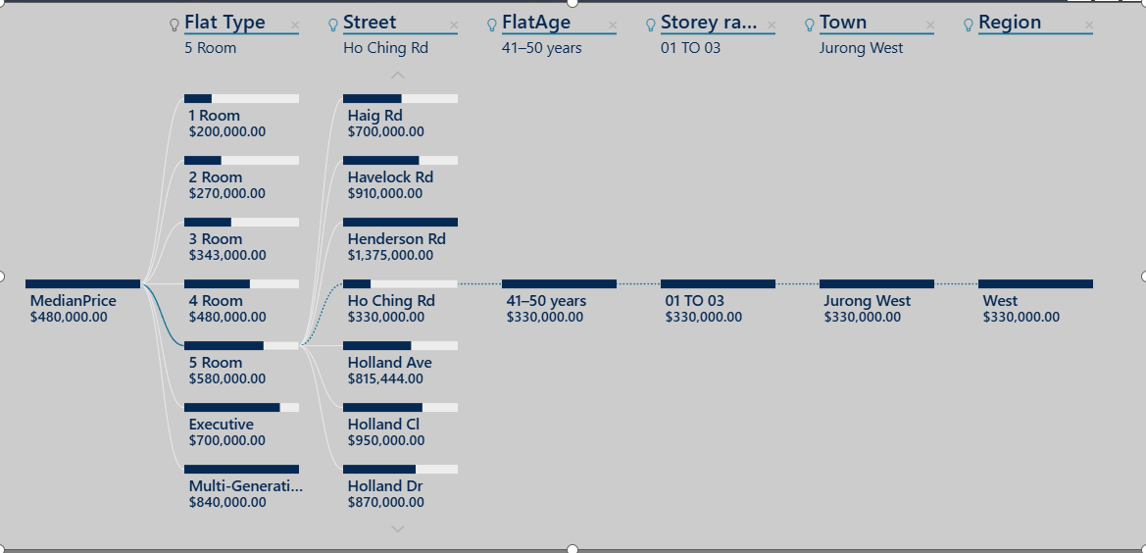
Flat Price Analysis (Decomposition Tree)
Highest Resale Price for 5 room flat
Lowest Resale Price for 5 room flat
• Highest prices:
Newer, larger, higher-floor flats in prime towns
• Lowest prices:
Older, smaller, lower-floor flats in non-central areas

Slide 22
Conclusions
Key Takeaways:
• HDB resale prices have shown long-term appreciation despite short-term fluctuations.
• Flats, located at the Central Region, with a higher storey level and a younger age, tend to command a higher resale price.
• Market movements align closely with macroeconomic and policy shifts. .

Slide 23
Recommendations
Recommendations:
• Home Buyers : Consider outer towns, older flats, or lower floors for more affordable options.
• Policymakers: Support balanced development and monitor high-demand areas to maintain affordability.
• Analysts: Include flat age, size, floor, and macroeconomics factors (e.g. recession periods) when analyzing or forecasting prices.

Slide 24
Thank You

