Slide 1
EduGenie
Google Gemini Powered Intelligent Learning Assistant
Final Capstone & Internship Project Presentation
Author / Presenter: Technical Intern
Technology Stack: FastAPI • Google Gemini • Vanilla JS • Pytest
Date: September 24, 2026

Slide 2
1. Problem Statement & Motivation
Addressing Fundamental Gaps in Digital Learning
• Information Overload: Students struggle with overly dense textbooks and technical jargon.
• Lack of Immediate Personalized Tutoring: Learners cannot easily clarify foundational doubts 24/7.
• Passive vs. Active Recall: Most platforms offer static reading without immediate comprehension testing.
• Cloud API Fragility: Cloud-only tools crash or fail when API quotas, rate limits, or network drops occur.
• The Need: A lightweight, fault-tolerant educational assistant bridging cloud intelligence with local determinism.

Slide 3
2. Proposed Solution: EduGenie
An Intelligent, Modular, and Fault-Tolerant Learning Companion
• Smart Q&A: Instant, concise factual answers for academic queries.
• Concept Simplification: Complex science and algorithms simplified with relatable real-world analogies.
• Passage Summarizer: High-yield executive revision notes extracted from dense text.
• Interactive Quiz Engine: 3 multiple-choice questions with real-time browser grading and score tracking.
• Career & Learning Roadmaps: Beginner-to-advanced curriculum guides with timelines and curated resources.
• Zero-Downtime Guarantee: Built-in deterministic offline generators and health monitoring.

Slide 4
3. System Architecture & Tech Stack
Three-Tier High-Performance Architecture
• Frontend Tier: Pure HTML5, Modern CSS (Glassmorphism), Vanilla JS (Zero heavy bundle overhead).
• Backend Tier: FastAPI ASGI framework running on Uvicorn (port 8000), Pydantic schema validation.
• Cloud AI Tier: Google Gemini API (gemini-1.5-flash & gemini-1.5-pro) via official Google GenAI SDK.
• Local AI Tier: HuggingFace Transformers support for MBZUAI/LaMini-Flan-T5-783M CPU inference.
• Fallback Tier: Deterministic offline knowledge corpus ensuring complete offline functionality.

Slide 5
4. Core Modules & Endpoints
Modular Endpoint Design and Purpose
• GET /qa?question= : Answers general knowledge & academic questions with precise facts.
• POST /explain : Deconstructs topics with student analogies (Supports cloud Gemini or local LaMini).
• POST /summarize : Condenses lengthy textbooks into 4 high-yield bullet takeaways.
• POST /quiz : Generates strictly validated 3-MCQ JSON schema with 4 options and exact answer matching.
• GET /learn/recommendations : Outputs milestone roadmaps with estimated hours and curated links.
• GET /health : Dynamic system health check and active mode resolution (Demo vs. Live).

Slide 6
5. Interactive Quiz & Automated Grader
Pedagogical Active Recall with Immediate Feedback
• 3 Targeted MCQs: Distractors are carefully crafted to test actual conceptual comprehension.
• Schema Rigor: Custom JSON fence stripper and 2-pass schema validator prevent malformed outputs.
• Client-Side Grader: Instant visual feedback with emerald green for correct and crimson red for mistakes.
• Mistake Revelation: Clearly shows the exact correct answer formula when a wrong choice is made.
• Score Banner: Calculates percentage score (e.g. 2/3 - 66.7%) and provides motivational pedagogical guidance.

Slide 7
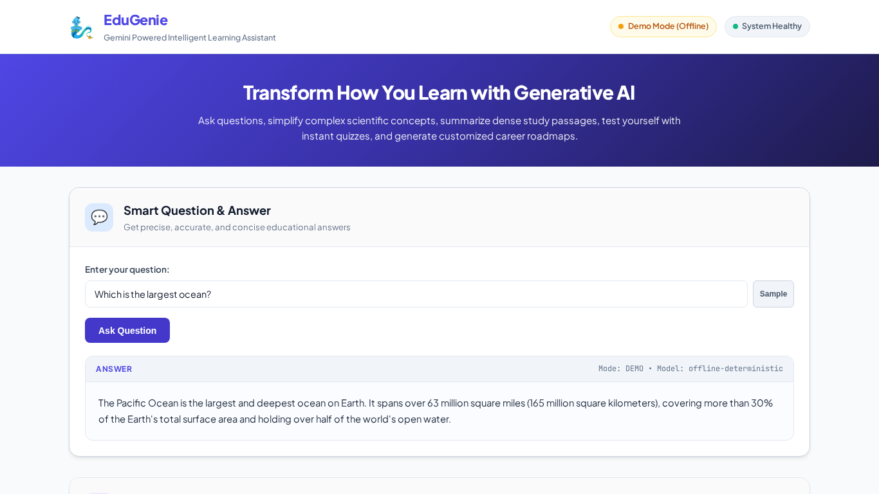
6. Live Demo Scenarios & Screenshots
Verified End-to-End Execution of Spec Scenarios
• Scenario 1: 'Which is the largest ocean?' -> Pacific Ocean response verified.
• Scenario 2: 'quantum computing' & 'binary search' -> Qubits & Phonebook analogies verified.
• Scenario 3: Industrial Revolution summary -> 4 bullet takeaways verified.
• Scenario 4: Pythagoras quiz -> Grader scored 2/3 with green/red highlights.
• Scenario 5: SQL Roadmap -> 3-stage milestone path with interactive links verified.

Slide 8
7. Automated Testing & Verification
37 Passing Tests • 100% Pass Rate • 80% Code Coverage
• Pytest Suite: 37 comprehensive test cases across API routes, modules, schema validation, and edge cases.
• AI Failure Fallbacks: Simulated API 429 rate limits, timeouts, connection drops, and invalid JSON generation.
• Input Boundary Testing: Empty string interception, sub-5-character validation, and unicode resilience.
• Cross-Device Testing: Automated Playwright execution across Desktop (1366x768) and Mobile (390x844).
• Real Evidence: All terminal logs and test reports saved to docs/evidence/.

Slide 9
8. Engineering Challenges & Solutions
Key Technical Hurdles Overcome During Development
• 1. Model Output Schema Inconsistency: Implemented clean_json_block and 2-attempt validation fallback.
• 2. Rate Limiting & Offline Reliability: Built deterministic offline generator for 100% demo uptime.
• 3. Heavy Local Model Footprint: Added configurable EXPLAIN_BACKEND=local|gemini with CPU safeguards.
• 4. Quiz Answer Index vs String Mismatch: Enforced strict exact string matching in quiz validator.
• 5. Modern Starlette TemplateResponse Syntax: Aligned context parameter signature with Starlette 1.7+.

Slide 10
9. Limitations & Future Roadmap
Pathways for Scaling and Expanding EduGenie
• Current Limitations: Stateless REST sessions, offline corpus covers curated domains, single-language English.
• Enhancement 1: Multi-turn Chatbot Memory with SQLite / PostgreSQL persistence.
• Enhancement 2: Multilingual Translation across Spanish, Hindi, French, and Mandarin.
• Enhancement 3: Voice Interaction (Speech-to-Text query input & Text-to-Speech audio explanations).
• Enhancement 4: PDF & Document Upload for automated exam paper generation from custom syllabi.

Slide 11
10. Conclusion & Q&A
Thank You! Ready for Questions & Viva Voce
• EduGenie successfully democratizes personalized AI education with lightweight, robust architecture.
• 100% Verified Deliverables: Working FastAPI backend, 37 passing tests, real screenshots, and 2 video walkthroughs.
• Links: media/Demo_Video.mp4 • media/Testing_Video.mp4 • docs/evidence/
• Open for Technical Viva & Demonstration!

