Slide 1
PocketSmart AI
Smart budget & recommendation assistant

Slide 2
Problem
Home, party and jewelry spending spreads across platforms

Slide 3
Solution
Flask planners + optional Gemini + hard budget cap

Slide 4
Architecture
Browser → Flask:5000 → recommend.py → catalogs / Gemini

Slide 5
Tech stack
Flask, Flask-CORS, google-genai, Pillow, pytest, Playwright

Slide 6
Features
Three planners, demo badge, sample-data labels, /health

Slide 7
Live demo shots
See screenshots 06, 08, 10

Slide 8
Testing
22/22 pytest, 83% coverage

Slide 9
Challenges
Spec FastAPI vs Flask; Playwright libs; ffmpeg

Slide 10
Future work
Live prices, PDF export, accounts DB

Slide 11
Conclusion
Budget invariant in code, not only in the prompt

Slide 12
Thank you
Questions? media/Demo_Video.mp4

Slide 13
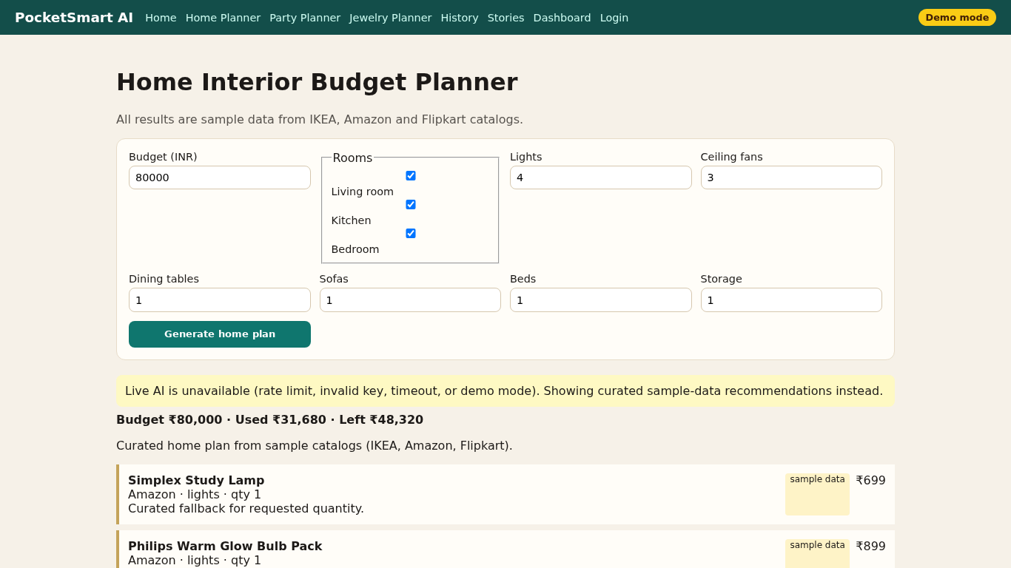
Home planner results

