Slide 1


FAKE NEWS PROJECT
By,
B.Sheebarani
Batch no:1844

Slide 2
Contents :
Problem Statement
Understandings
EDA
Visualizations
Steps
Finalized Model
Conclusion

Slide 3


Problem Statement:
This is a project related to fake news. Now a days, on social media the reach and effects of information spread occur rapidly and so amplified that distorted, inaccurate or false information acquires a tremendous potential to cause real world impacts within minutes for million of users.
The articles shared through online such as online news platforms, blogs, social media feeds and other digital formats do not conform to facts has led to many problems in various domains such as politics, sports, health, financial markets.
The dataset is given by the Flip Robo Technologies
This dataset contains large number of news headlines and news articles. And this project is to classify the news or news title is either fake or not fake.
This project is to make a predictive model that predicts whether the news is fake or not.

Slide 4

Understandings:
This is a classification model data.
The dataset is in the csv file format and it is named as train_news.csv
It have 20800 instances and 6 attributes
The dataset have missing values in it.
The dataset consist of text data and numerical data
The target column name is ‘label’. The model want to predict whether the news is fake or not fake.

Slide 5
Understandings:
6 collumns and its abbrevations:
‘Unnamed 0’: It is the serial number
‘id’: Unique id of each news article
‘headline’: It is the title of the news
‘written_by’: It represents the author of the news article
‘news’: It contains the full text of the news article
‘label’: It tells whether the news is fake (1) or not fake(0)

Slide 6
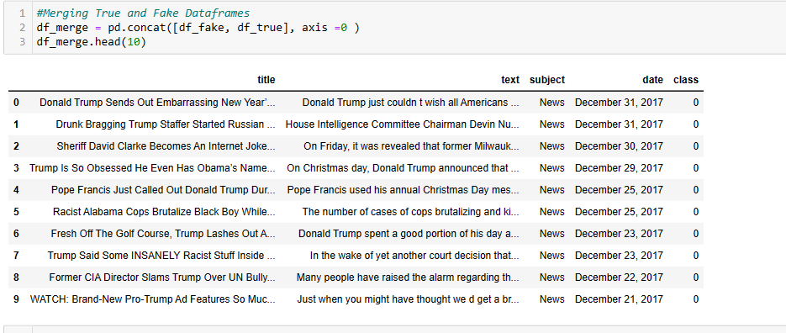
Understandings:

Slide 7
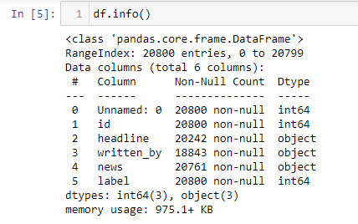
Understandings

Slide 8
EDA (Exploratory Data Analysis):
Make a duplicate copy of the dataset
Combine the ‘headline’ column and ‘news’ column and make into a single column named ‘text’.
Drop the unwanted columns
Check for null value columns and drop those columns using .dropna() method
Clean the data, remove the stopwords, make to lower case, done the stemming using porterstemmer
Take the most occurring 5000 words and make it vectorized using TfidfVectorizer.

Slide 9
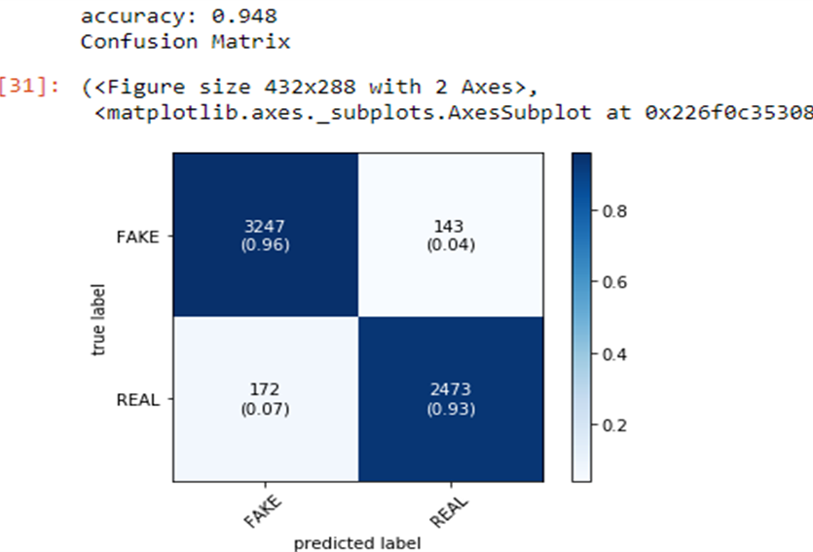
Visualization:
Logistic Regression

Slide 10
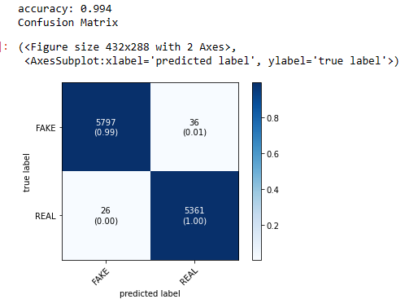
Visualization
SVC

Slide 11
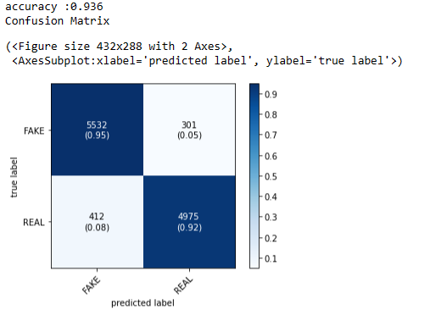
Visualization:
MultinomialNB

Slide 12
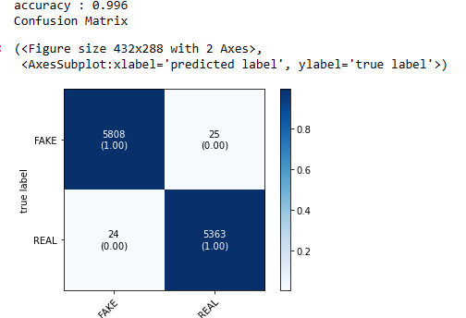
Visualisation:
PassiveAggressiveClassifier

Slide 13
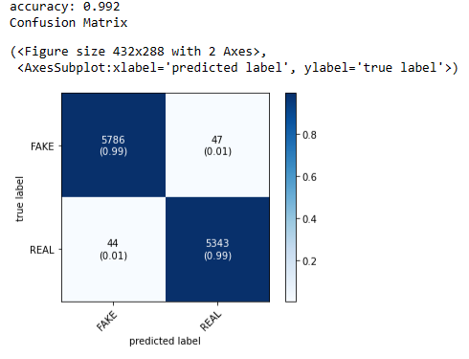
Visualization:
RandomForestClassifier

Slide 14

Visualization
Hyperparameter tuned RandomForestClassifer

Slide 15
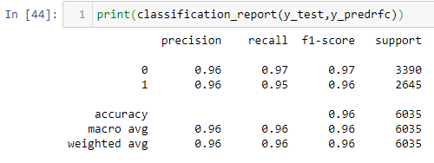
Visualization
CLASSIFICATION REPORT

Slide 16

Steps Followed In The Project:
Import the data
Combine the ‘headline’ column and ‘news’ column and make into a single column named ‘text’.
Drop the unwanted columns
Check for null value columns and drop those columns
Make the copy of the dataset
Clean the data, remove the stopwords, make to lower case, done the stemming using porterstemmer
Take the most occurring 5000 words and make it vectorized using TfidfVectorizer.
Split the data into x and y
Test the data with 5 models
Find the best model
Hyper tune the best model
Again test the model with hyper tuned parameters
Find the classification report

Slide 17
Finalized Model:
The models tested:
From the above 5 models, the best model selected is the RandomForestClassifier as it is giving good accuracy score so the hyperparameter tuning has done in the same model to improve the accuracy and it gives the best accuracy score of 99.7% and got the f1-score for 0 (not fake) as 0.97 and 1 (fake) as 0.96.
Logic Regression: 94.8%
SVC : 99.4%
Multinomial NB : 93.6%
PassiveAggressiveClassifier : 99.6%
RandomForestClassifier : 99.7%

Slide 18
Conclusion:
Created a fake news detection model that have 96.3% accuracy to calculate whether the news is fake or not.
Thus it will help many online platforms such as news platforms, blogs, social media feeds and other digital formats to avoid the spread of fake news that can lead many problems to domains such as politics, health, sports, science and financial market.
The best model I got is RandomForestClassifier.
This model is created for many online platforms that gives proper news or articles.

