Slide 1

Malignant- Comments- Classification Project

Slide 2

Exploratory Data Analysis

Slide 3
Steps
Importing the libraries needed for my project
Loading the dataset/Creating my train and test data frame
Checking the shape of the dataset
Checking the datatypes
Checking for null values if any
These data analysis steps help us to get an overview of our dataset and also help us in our preprocessing of our data.

Slide 4

Preprocessing of the data

Slide 5

Steps and Description
I have checked the correlation between the target variables.
I have studied the statistical summary of the train and test dataset.
I have done some visualization using count plots.
Then I have converted the comments in train data into lowercase.
Then I have removed punctuations , stopwords to get a clean length.
Then I have converted text into vectors using TF-IDF so that the data gets ready for model building.
I have splitted the independent and dependant variables into x and y.

Slide 6
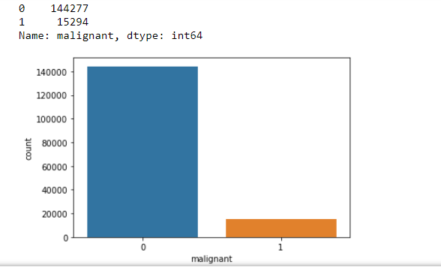
Some more preprocessing steps
Statistical summary of the dataset is studied.
Some visualization is done using count-plots,pie-plot where we can see how our data look like. I have attached some of the screenshots.

Slide 7
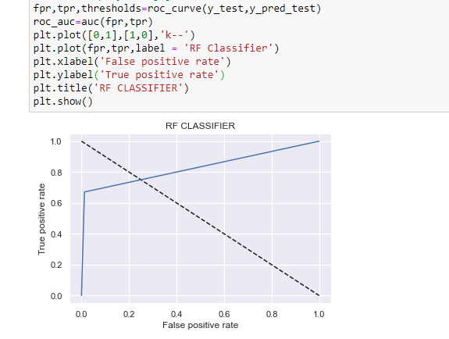
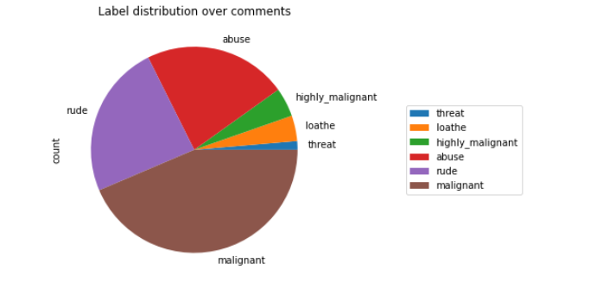
Label distribution over comments:

Slide 8
Preprocessing (contd…)
The pie-plot and count- plot are used to visualize our target variables as there are 6 target variables in our dataset.

Slide 9

Model building

Slide 10
Explanation
I have used Logistic Regression, Decision Tree Classifier, Random Forest Classifier, Ada Boost Classifier and K-Neighbours Classifier for model building and Random Forest Classifier model is showing the best accuracy where Training accuracy is 0.9988898736783678, Test accuracy is 0.954879679144385 and cross validation score is 95.66211845827077.

