Slide 1
ARRAY

Slide 2
Array
An array is a collection of items of the same variable type that are stored at contiguous memory locations. It is one of the most popular and simple data structures used in programming.
Basic terminologies of Array
Array Element: Elements are items stored in an array.
Array Index: Elements are accessed by their indexes. Indexes in most of the programming languages start from 0.

Slide 3
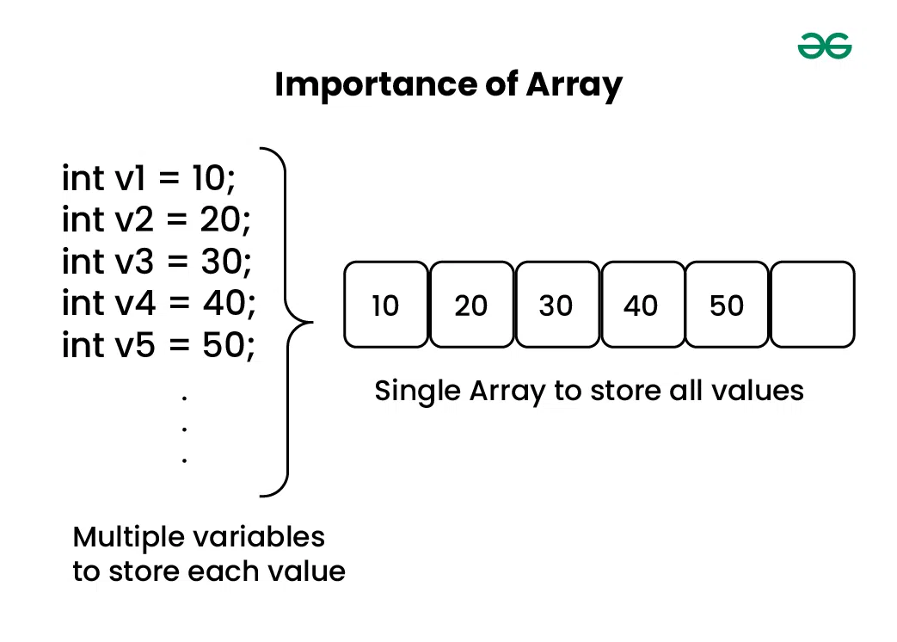

Slide 4
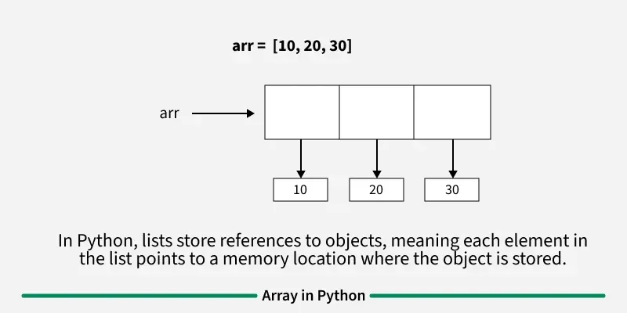
Memory representation of Array
In an array, all the elements or their references are stored in contiguous memory locations. This allows for efficient access and manipulation of elements.

Slide 5
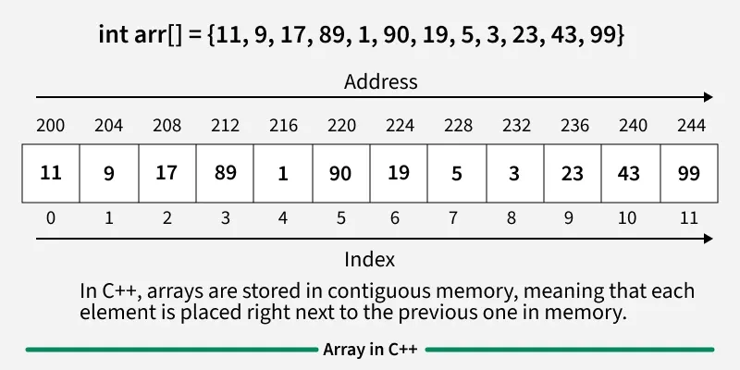

Slide 6
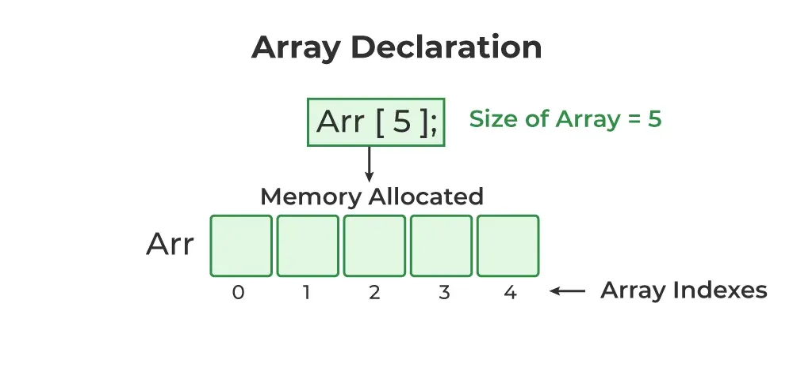
Declaration of Array
Array declaration is the process of specifying the type, name, and size of the array. In C, we have to declare the array like any other variable before using it.
// This array will store integer type element
int arr[5];
// This array will store char type element
char arr[10];
// This array will store float type element
float arr[20];

Slide 7
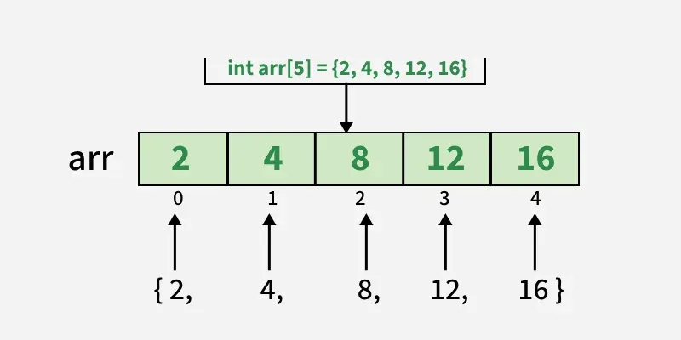
Initialization of Array
When the array is declared or allocated memory, the elements of the array contain some garbage value. So, we need to initialize the array to some meaningful values.
int arr[] = { 1, 2, 3, 4, 5 };
char arr[5] = { 'a', 'b', 'c', 'd', 'e' };
float arr[10] = { 1.4, 2.0, 24, 5.0, 0.0 };

Slide 8
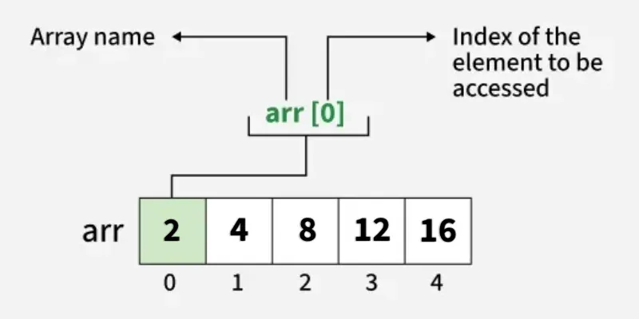
Accessing Array Elements
Array in C provides random access to its elements, which means that we can access any element of the array by providing the position of the element, called the index.

Slide 9
#include <stdio.h>
int main() {
// array declaration and initialization
int arr[5] = {2, 4, 8, 12, 16};
// accessing element at index 2 i.e 3rd element
printf("%d ", arr[2]);
// accessing element at index 4 i.e last element
printf("%d ", arr[4]);
// accessing element at index 0 i.e first element
printf("%d ", arr[0]);
return 0;
}

Slide 10
Update Array Element
We can update the value of array elements at the given index i in a similar way to accessing an element by using the array square brackets [] and assignment operator (=).
#include <stdio.h>
int main() {
int arr[5] = {2, 4, 8, 12, 16};
// Update the first value
// of the array
arr[0] = 1;
printf("%d", arr[0]);
return 0;
}

Slide 11
C Array Traversal
Array Traversal is the process in which we visit every element of the array in a specific order. For C array traversal, we use loops to iterate through each element of the array.

Slide 12
#include <stdio.h>
int main() {
int arr[5] = {2, 4, 8, 12, 16};
// Print each element of
// array using loop
printf("Printing Array Elements\n");
for(int i = 0; i < 5; i++){
printf("%d ", arr[i]);
}
printf("\n");
return 0;
}

Slide 13
Two Dimensional Array in C
The two-dimensional array can be defined as an array of arrays. The 2D array is organized as matrices which can be represented as the collection of rows and columns.

Slide 14
Declaration of two dimensional Array in C
. data_type array_name[rows][columns];
int twodimen[4][3];
int arr[4][3]={{1,2,3},{2,3,4},{3,4,5},{4,5,6}};

Slide 15
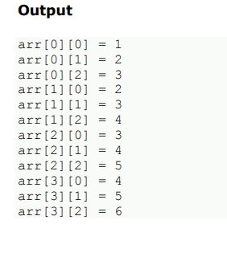
Two-dimensional array example in C
#include<stdio.h>
int main(){
int i=0,j=0;
int arr[4][3]={{1,2,3},{2,3,4},{3,4,5},{4,5,6}};
//traversing 2D array
for(i=0;i<4;i++){
for(j=0;j<3;j++){
printf("arr[%d] [%d] = %d \n",i,j,arr[i][j]);
}
}
.return 0;
}

Slide 16
Write a C program to multiply two matrices of different order. i) Write a C program to read the elements in an array and print the same in reverse order.
Write a C function to find the sum occurrence of a digit in a number.

Slide 17
Array operations(sorting, searching).

Slide 18
Searching in Arrays:
Searching involves finding a specific element within an array.
Linear Search (Sequential Search):
Binary Search

Slide 19
Check each element one-by-one from start to end until you find the target. Works on unsorted arrays.
Suitable for unsorted arrays.
Time complexity: O(n), where 'n' is the number of elements.
O(1), Worst O(n), Average O(n).

Slide 20
Write a C program to read N numbers into an array and perform Linear search.

Slide 21


#include <stdio.h>
int main() {
int A[5] = {7, 3, 9, 2, 5};
int key, i, found = 0;
printf("Enter element to search: ");
scanf("%d", &key);
for (i = 0; i < 5; i++) {
if (A[i] == key) { // check if element matches
printf("Element %d found at position %d\n", key, i + 1);
found = 1;
break; // stop when found
}
}
if (!found)
printf("Element %d not found in the array\n", key);
return 0;
}

Slide 22
Binary Search
Binary Search is a fast searching technique used only on sorted arrays. It divides the array into halves repeatedly to find the required element.
Repeatedly divides the search interval in half. It compares the target value with the middle element of the array. If they match, the search is complete. If the target is smaller, the search continues in the lower half; otherwise, it continues in the upper half.

Slide 23

#include <stdio.h>
int main() {
int A[6] = {2, 4, 6, 8, 10, 12}; // sorted array
int key, low = 0, high = 5, mid, found = 0;
printf("Enter element to search: ");
scanf("%d", &key);
while (low <= high) {
mid = (low + high) / 2;
if (A[mid] == key) {
printf("Element %d found at position %d\n", key, mid + 1);
found = 1;
break;
}
else if (A[mid] < key)
low = mid + 1; // search right half
else
high = mid - 1; // search left half
}
if (!found)
printf("Element %d not found in the array\n", key);
return 0;
}

Slide 24
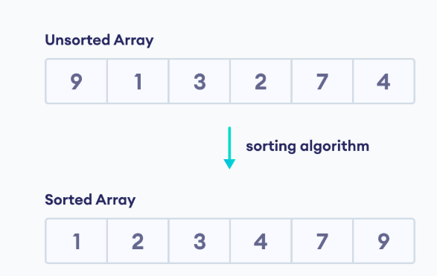
Sorting
A sorting algorithm is used to arrange elements of an array/list in a specific order. For example,

Slide 25
1.Bubble Sort
It is a simple sorting algorithm that repeatedly swaps adjacent elements if they are in the wrong order. It performs multiple passes through the array, and in each pass, the largest unsorted element moves to its correct position at the end.

Slide 27
Working of Bubble Sort
1. First Iteration (Compare and Swap)
Starting from the first index, compare the first and the second elements.
If the first element is greater than the second element, they are swapped.
Now, compare the second and the third elements. Swap them if they are not in order.
The above process goes on until the last element

Slide 28
2. Remaining Iteration
The same process goes on for the remaining iterations.
After each iteration, the largest element among the unsorted elements is placed at the end.
In each iteration, the comparison takes place up to the last unsorted element.
The array is sorted when all the unsorted elements are placed at their correct positions.

Slide 29
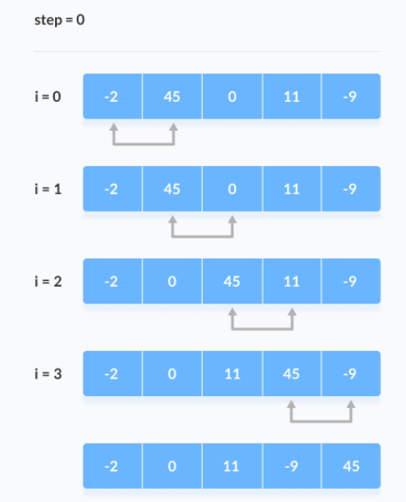

Slide 30
#include <stdio.h>
int main() {
int a[5] = {5, 3, 8, 1, 2};
int i, j, temp;
for (i = 0; i < 5 - 1; i++) {
for (j = 0; j < 5 - i - 1; j++) {
if (a[j] > a[j + 1]) { // swap
temp = a[j];
a[j] = a[j + 1];
a[j + 1] = temp;
}
}
}
printf("Sorted array: ");
for (i = 0; i < 5; i++)
printf("%d ", a[i]);
return 0;
}

Slide 31
Selection Sort
It is a comparison-based sorting algorithm that repeatedly selects the smallest (or largest) element from the unsorted part of the array and swaps it with the first unsorted element. This process continues until the array is fully sorted.

Slide 32
First we find the smallest element and swap it with the first element. This way we get the smallest element at its correct position.
Then we find the smallest among remaining elements (or second smallest) and swap it with the second element.
We keep doing this until we get all elements moved to correct position.

Slide 33
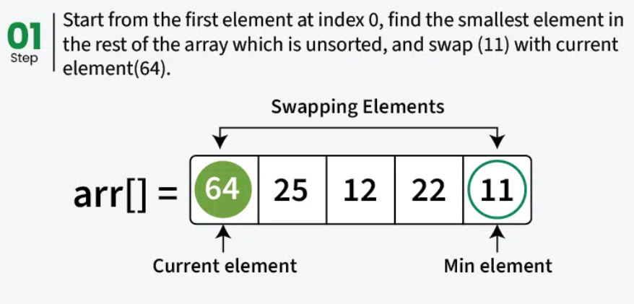

Slide 34
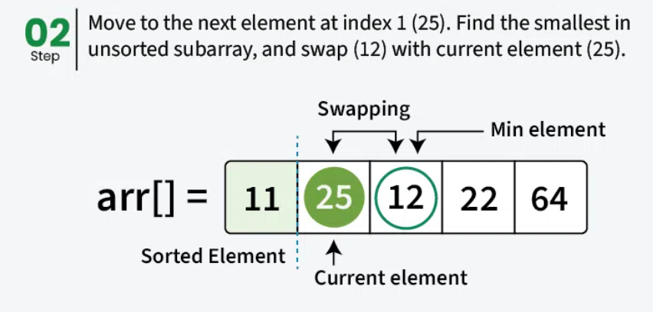

Slide 35
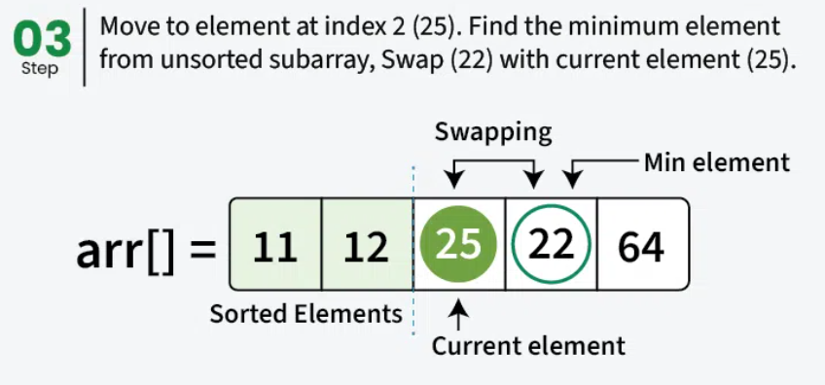

Slide 36
Strings in C
A string is an array of characters terminated by a special character '\0' (null character). This null character marks the end of the string and is essential for proper string manipulation.
#include <stdio.h>
int main() {
// declaring and initializing a string
char str[] = “Hello World";
// printing the string
printf("The string is: %s\n", str);
return 0;
}

Slide 37
%s is the format specifier used to print a string. printf starts at the memory location of str and prints each character until it finds the terminating null character '\0'.

Slide 38
Accessing Characters
A string in C is an array of characters ending with \0.
We can access any character of the string by providing the position of the character, like in arr
#include <stdio.h>
int main() {
char str[] = “Books";
// Access first character
// of string
printf("%c", str[0]);
return 0;
}

Slide 39
Update
If v need to change the value of string to another character.

Slide 40
Update
#include <stdio.h>
int main() {
char str[] = "Geeks";
// Update the first
// character of string
str[0] = 'R';
printf("%c", str[0]);
return 0;
}

Slide 41
C String Functions
C language provides various built-in functions that can be used for various operations and manipulations on strings.
These string functions make it easier to perform tasks such as string copy, concatenation, comparison, length, etc. The <string.h> header file contains these string functions.

Slide 42
strlen()
The strlen() function is used to find the length of a string. It returns the number of characters in a string, excluding the null terminator ('\0').
#include <stdio.h>
#include <string.h>
int main() {
char s[] = "Gfg";
// Finding and printing length of string s
printf("%s", strlen(s));
return 0;
}

Slide 43
strcpy()
The strcpy() function copies a string from the source to the destination. It copies the entire string, including the null terminator.
Syntax :strcpy(dest, src);

Slide 44
#include <stdio.h>
#include <string.h>
int main() {
char src[] = "Hello";
char dest[20];
// Copies "Hello" to dest
strcpy(dest, src);
printf("%s", dest);
return 0;
}

Slide 45
strcat()
The strcat() function is used to concatenate (append) one string to the end of another. It appends the source string to the destination string, replacing the null terminator of the destination with the source string’s content.
strcat(dest, src);

Slide 46
#include <stdio.h>
#include <string.h>
int main() {
char s1[30] = "Hello, ";
char s2[] = "Geeks!";
// Appends "Geeks!" to "Hello, "
strcat(s1, s2);
printf("%s", s1);
return 0;
}

Slide 47
strcmp()
The strcmp() is a built-in library function in C. This function takes two strings as arguments, compares these two strings lexicographically and returns an integer value as a result of comparison.
strcmp(s1, s2);

Slide 48
#include <stdio.h>
#include <string.h>
int main() {
char str1[20], str2[20];
printf("Enter first string: ");
scanf("%s", str1);
printf("Enter second string: ");
scanf("%s", str2);
int result = strcmp(str1, str2);
printf("Result = %d", result); // only prints return value
return 0;
}

Slide 49
strrev()
strrev() is used to reverse the characters in a string.
#include <stdio.h>
#include <string.h>
int main() {
char name[50] = “Book";
strrev(name);
printf("Reversed string = %s", name);
return 0;
}

Slide 50
strlwr()
strlwr() converts all uppercase characters in a string to lowercase.
#include <stdio.h>
#include <string.h>
int main() {
char text[50] = "HELLO WORLD";
strlwr(text);
printf("Lowercase string = %s", text);
return 0;
}

Slide 51
Write a C program to perform following operation without using built-in functions: i) concatenate two strings ii) copy two strings iii) find length of the given string

Slide 52
#include <stdio.h>
int main() {
char str1[100], str2[100], copy[100];
int i, j;
printf("Enter first string: ");
scanf("%s", str1);
printf("Enter second string: ");
scanf("%s", str2);
// -------- FIND LENGTH --------
i = 0;
while (str1[i] != '\0')
i++;
printf("Length of first string = %d\n", i);
j = 0;
while (str2[j] != '\0')
j++;
printf("Length of second string = %d\n", j);
// -------- COPY STRING --------
int k = 0;
while (str1[k] != '\0') {
copy[k] = str1[k];
k++;
}
copy[k] = '\0';
printf("Copied string = %s\n", copy);
// -------- CONCATENATE --------
i = 0;
while (str1[i] != '\0')
i++; // go to end of str1
j = 0;
while (str2[j] != '\0') {
str1[i] = str2[j];
i++;
j++;
}
str1[i] = '\0';
printf("Concatenated string = %s\n", str1);
return 0;
}

Slide 53
Write a program in C to input a string and perform the following operations using user-defined functions: i)Find the length of the string ii)Reverse the string iii)Compare two strings

