Slide 1
CITY CAR SHARING ANALYTICS
Tech Test
Mary Sheeba THEODORE

Slide 2
UNDERSTANDING THE BUSINESS
The World of Electric Mobility
What is Free2Move?
The Two Players
Free-floating car-sharing service
Cars scattered across the city: no fixed stations
Customers find nearest car on app → unlock → drive → park anywhere
Flexible pricing: /min, /hr, /days
Customers
Service Agents
87.4% of rentals
Spontaneous short trips
12.6% of rentals
Manage fleet operations
The Challenge
The Fleet
Electric cars need charging : agents rescue dead cars
Charging stations charge overstay fees after 100%
Agents must balance rescuing dead cars vs moving full ones
Every unnecessary dispatch = operational cost
Vehicles
52 electric cars · 1 model
Rentals
45,686 over 9 months
Median trip duration
16 minutes

Slide 3
DATA QUALITY & METHODOLOGY
How We Prepared & Approached the Analysis
Data Quality
Tools Used
SQL
Initial data exploration & aggregations
218
exact duplicates dropped
Python (pandas)
Cleaning, EDA, battery analysis
12
conflicting records dropped (CHARGED flag disagreed)
Tableau
Interactive dashboards & visualisation
3
negative durations dropped (DST error)
Analytical Approach
808
short rentals (<1 min) flagged: kept
1.
EDA: usage patterns, rental duration, battery behaviour
2.
Fleet utilization: vehicle activity across 9 months
133
long rentals (>24h) flagged : kept
3.
Battery analysis: customer vs service rental charging
233
total rows removed - only 0.5% of data
4.
Sequential rental analysis: vehicle timelines via shift() to solve Task 2

Slide 4
DATA DISCOVERY
Two Operations Hidden in the Data
Not all rentals are equal : the data revealed two completely different operational worlds
Customer Rentals
Charging Mission (CHARGED = True)
87.4% of all rentals
Agent rescues dead car → drives to charger → plugs in → leaves
Pick up car
2,982
16%
NULL ❌
↓
VS
Count
Median end level
Start level
Drive
↓
Return car
Moving Mission (CHARGED = False)
CHARGELEVELSTART ✅
CHARGELEVELEND ✅
Agent moves fully charged car away from charger → avoids overstay fees
2,757
94%
NULL ❌
Both levels recorded
Count
Median end level
Start level
Key insight: CHARGELEVELSTART is NULL for ALL service rentals: agents have no start level recorded. This shaped our entire Task 2 methodology.

Slide 5
THE PROBLEM
What Problem Are We Solving?
A car is plugged in and charging. Two things are racing against each other:
Customer rents it
Battery hits 100%
VS
Overstay fees start
Agent must move it
Costs money!
No agent needed
No overstay fees
Ideal outcome!
This creates two business questions:
Q1: Operations
Q2: The Threshold
How efficiently is the fleet operated? Where are the gaps in agent scheduling, battery management and fleet utilisation?
At what battery level does the chance of a customer renting become too low, so we should send an agent instead?
Every unnecessary agent dispatch costs money. Every overstay fee costs money. Finding the right threshold saves both.

Slide 6
EXPLORATORY DATA ANALYSIS
Key Findings at a Glance
16 min
85%
31.4%
7.6%
Median rental
duration
Battery threshold
to dispatch agent
1 in 3 charging sessions need a second agent dispatch
Cars returned below 20% battery
Short urban trips,
not commutes
shorter than a metro ride
Tipping point:
48.4% agent moves
our key recommendation
Direct operational
cost to reduce
Urgent charging needed
potential revenue loss

Slide 7
QUESTION 1 : OPERATIONAL INSIGHTS
What can we say about operations?
Usage Patterns
Battery & Charging
Agent Operations
Peak demand at 16h : afternoon, not morning
Friday & Saturday busiest (+14% vs weekdays)
August drops 47% : Holiday effect
808 sub-minute rentals (509 customer · 299 agent) : zero battery change → flagged, kept
Avg consumption only 7% per trip (16 min trips)
38.6% of customers plug in : helping fleet
6.6% of cars returned below 20%: urgent need
174 repeat charging missions: inefficiency
Agents most active 7–10am (ratio 28–35%)
Almost no agents 15–18h (ratio 1–6%!)
Saturday lowest coverage (11.7%): busiest day
1 vehicle inactive after Feb 2023 (dc753ee9)
💡 Recommendation
💡 Recommendation
💡 Recommendation
Shift agent schedules to 13–17h & increase weekend coverage
Alert system for cars returned <20% + fix charger reliability
Critical misalignment : agents work mornings, customers peak afternoons

Slide 8
QUESTION 2 — BATTERY THRESHOLD
When should we dispatch an agent to move a charging car?
Results: 80–100% range (5% buckets)
A car is plugged in and charging - what happens next?
Methodology
Battery Level | Customer % | Agent % | Events
80-85% | 61.0% | 39.0% | 105
85-90% ← THRESHOLD | 51.6% | 48.4% | 159
90-95% | 58.5% | 41.5% | 390
95-100% | 61.4% | 38.6% | 1,509
1
When does a charging session begin?
Identified 2,982 charging missions :every time an agent plugged a car in → clock starts ticking
2
What happened next for that vehicle?
Customer rented (48.8%) or Agent had to move it (31.4%)
3
At what battery did each outcome happen?
Customer → CHARGELEVELSTART (exact)
Agent → CHARGELEVELEND (best estimate: median 12 min trip)
Where is the tipping point?
Send agent at 85% battery
4
Where do most decisions happen?
Before the coin flip begins : 51.6% vs 48.4% at 85-90%
79% of events above 80% → refined to 5% buckets in 80-100% range
Charging rate: 33.4%/hr → car at 60% hits 85% in ~45 min

Slide 9
LIMITATIONS & NEXT STEPS
What we couldn't do and what data would unlock better insights
Current Limitations
If We Had More Data
No location data
GPS / Location data
Cannot identify high-demand zones or optimise car positioning
Identify hotspots, optimise car placement, reduce repositioning cost
CHARGELEVELSTART missing
Individual charger data
Agent pickup battery estimated via CHARGELEVELEND - not exact
Precise charging speed per station, more accurate dispatch timing
Charging rate varies widely
Customer profiles
Std 28.6% - median used as estimate, individual chargers differ
Segment usage patterns, predict demand by user type
9 months only
Full year data
Seasonal patterns (especially Aug–Sep) incomplete for full-year view
Validate seasonality, improve August/September recommendations
No customer data
Pricing data
Cannot segment by user behaviour or identify repeat customers
Correlate rental duration with revenue, optimise pricing windows

Slide 10
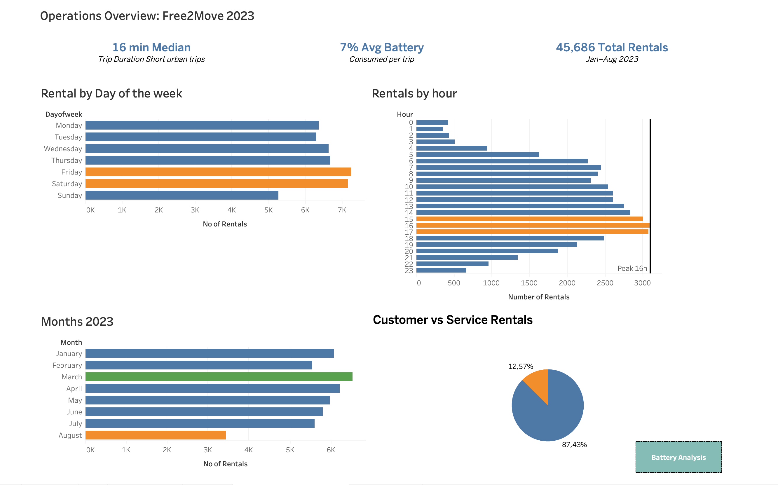
Snapshots from Tableau

Slide 11
