Slide 1
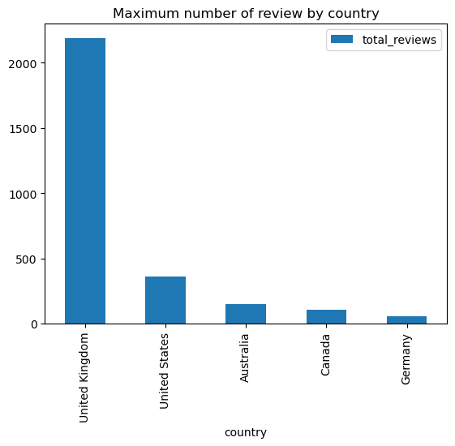
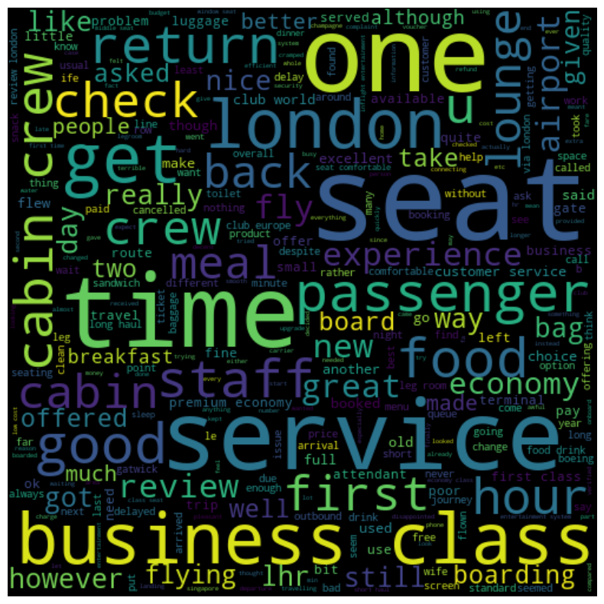
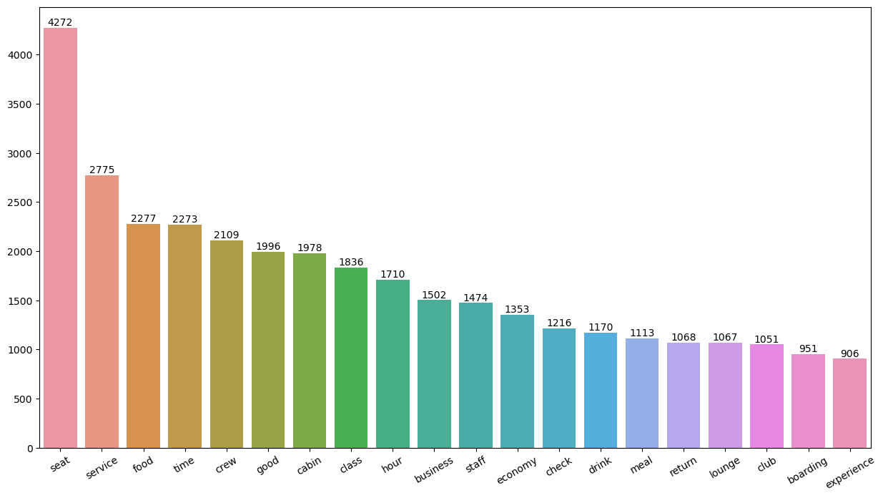
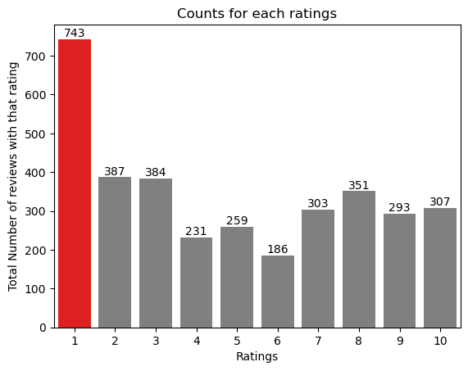
KEY METRICS AND INSIGHTS
Average Overall Rating:
4.83/10
Reviews from
68 countries
3444 Total
Reviews
Collected
What customers are happy and unsatified for different ratings:
7-10: Comfortable seats, food quality.
4-6: Long Queue.
1-3: Small screen and congested middle seat.
All customers liked Cabin crew service and staff.
Enhance Customer service on refund requests and process.

