Slide 1


PAYDAY
Team Rocket
Andrew Rutherford
Sheehan toufiq
Justin patel
Ben byrd
Suraj sequira

Slide 2
Currently there are some 5.6 million small businesses in the United States.
Small business accounting is a cumbersome task.
We think we can make this task both easy and affordable.
Payday will be a web-based small business accounting and employee management system.

Slide 3
What Payday Will Do
For Managers
Calculate your expenses, profits, and revenues
Allow you to manage employee payroll
Fill out Financial statements
Produce Printable employee pay stubs

Slide 4
What Payday Will Do
For Employees
Allow an employee to clock-in and clock-out
Produce an employee’s pay history

Slide 5
Application Design

Slide 6
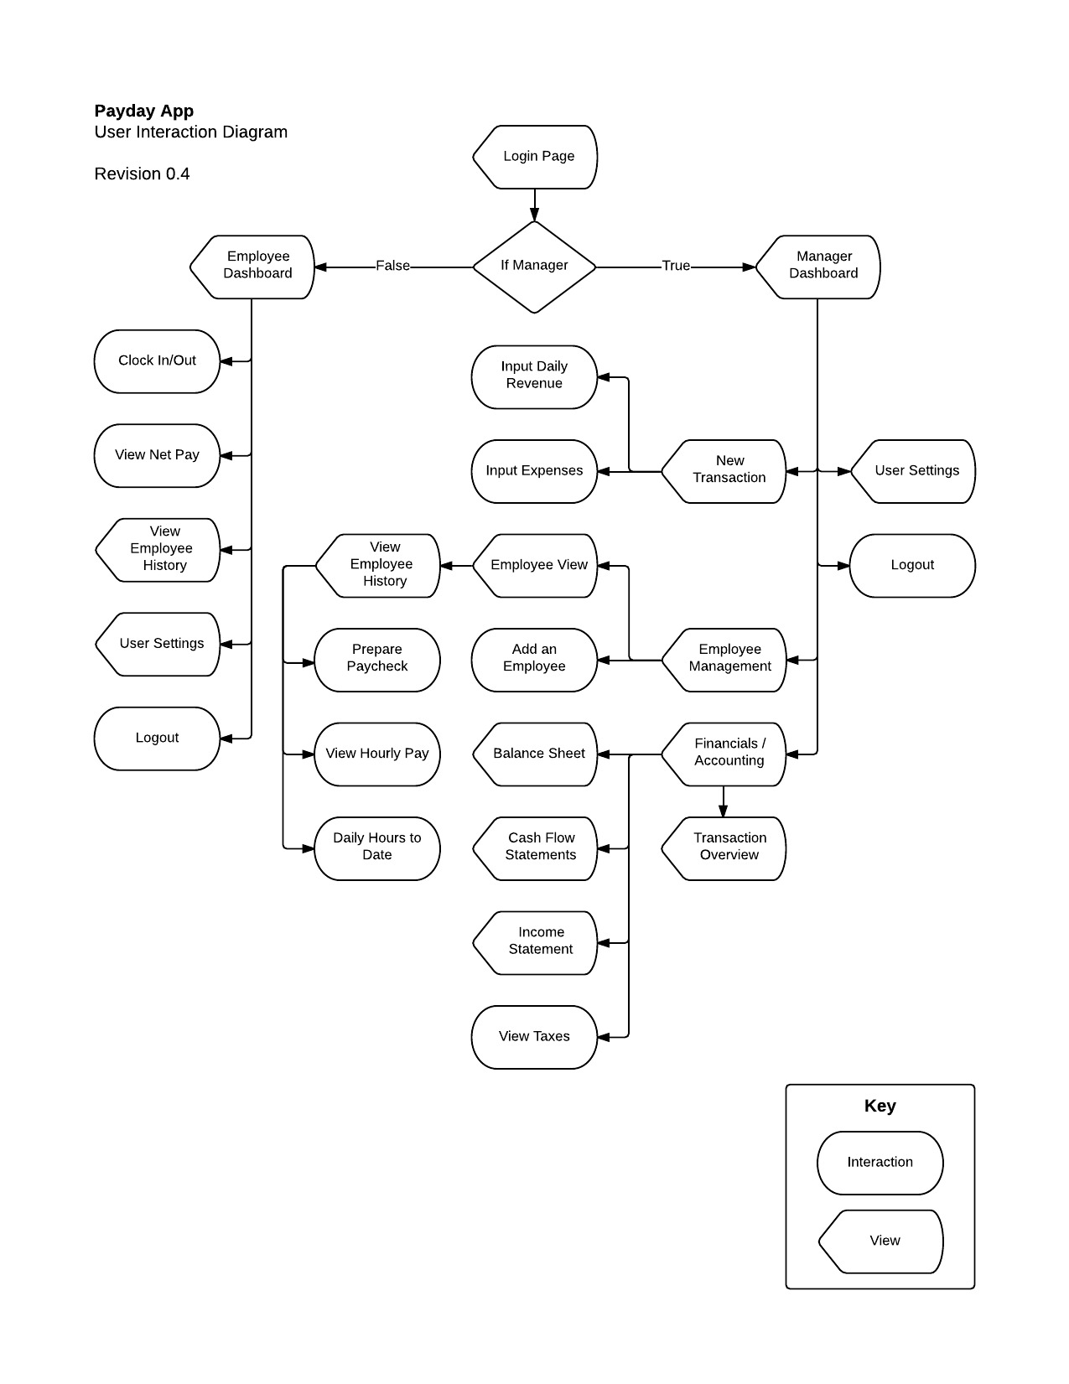
User Interface Diagram

