Slide 1
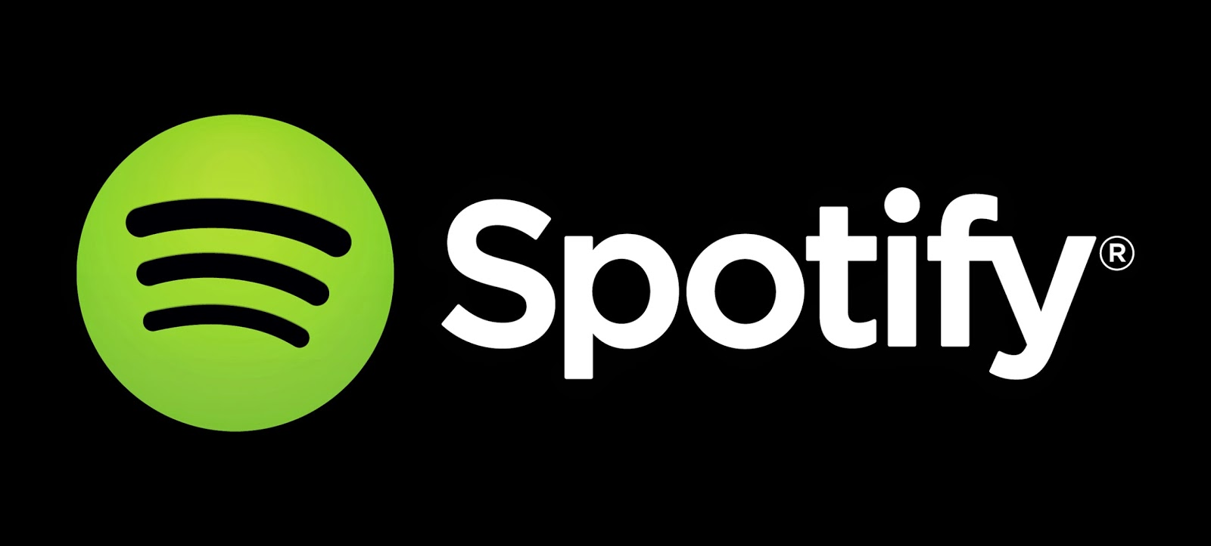
Most streamed Spotify Songs ‘23
This Photo by Unknown Author is licensed under CC BY

Slide 2
Hypothesis: Based off the data provided, I am going to examine the data based off audio features to understand trends and preferences individuals have when they choose to listen to a song.

Slide 3
Basic Data
This CSV file had 953 Rows and 24 different columns
Changed ”streams” data types from “Object” to “float64” to be able to utilize the information better.

Slide 4
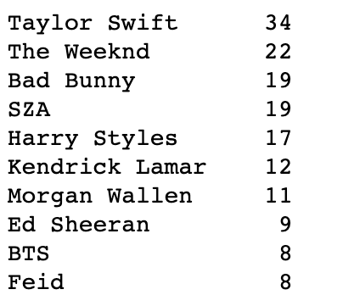
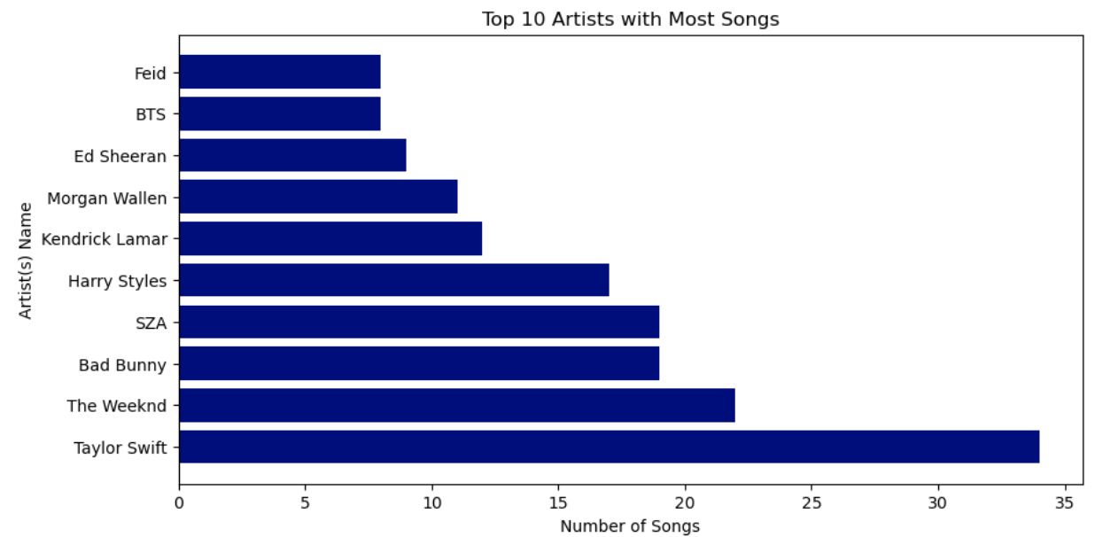
Top 10 Artists with Most Songs

Slide 5
Top 10 Artists with Most Songs
The above slide allows us to see which Artists have the Most Songs. I believe that this gives the Artist a competitive advantage as they have more songs out there than others, which increases their chances having the Most Streamed Spotify Song. The more popular of an artist also allows them to be associated with more playlist(s) and searches.
The caveat to this position for the opposing side would be that the more songs the artist has means that if an artist has one popular song that song would be streamed more often than having multiple popular songs.

Slide 6
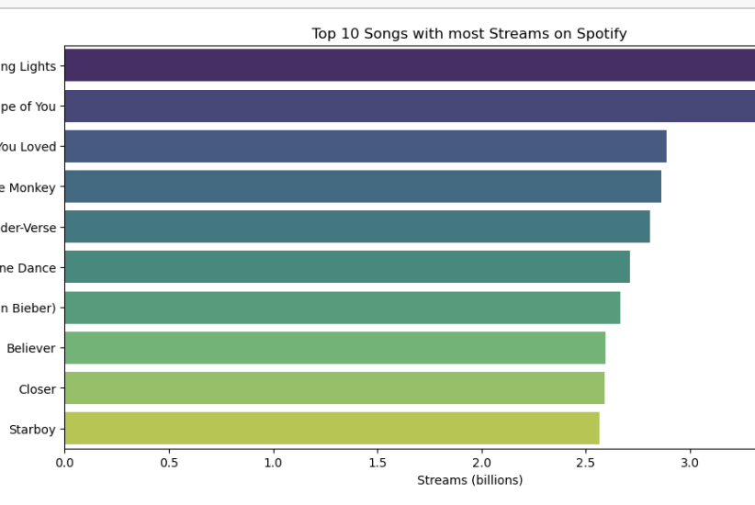
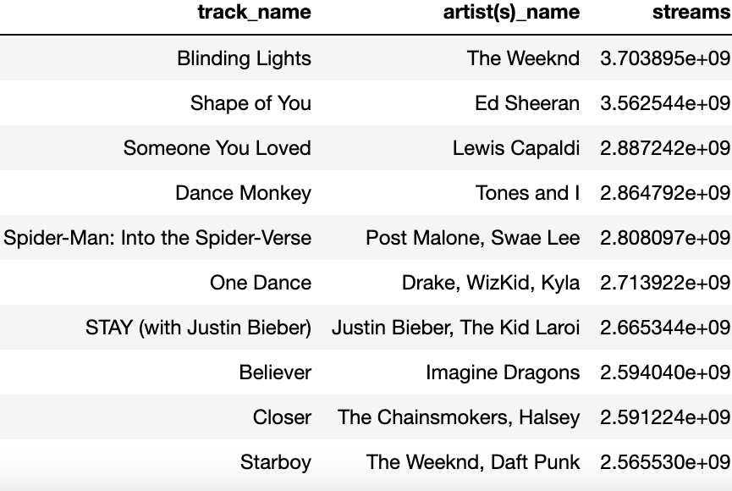
Top 10 Songs with most Streams on Spotify

Slide 7
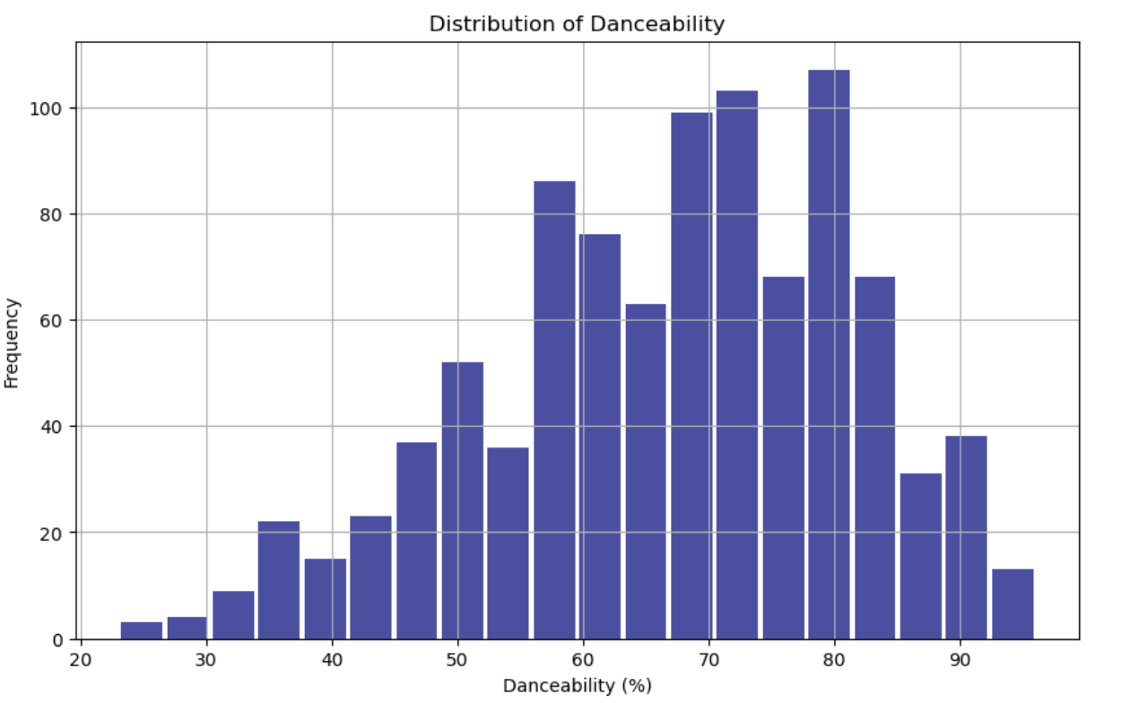
Distribution of Danceability
This graph allows us to see how much of a songs on Spotify are Danceable compared to the frequency that they are played.
This graphs allows us to see that the more Danceable a song is the more frequent it is going to be played.

Slide 8
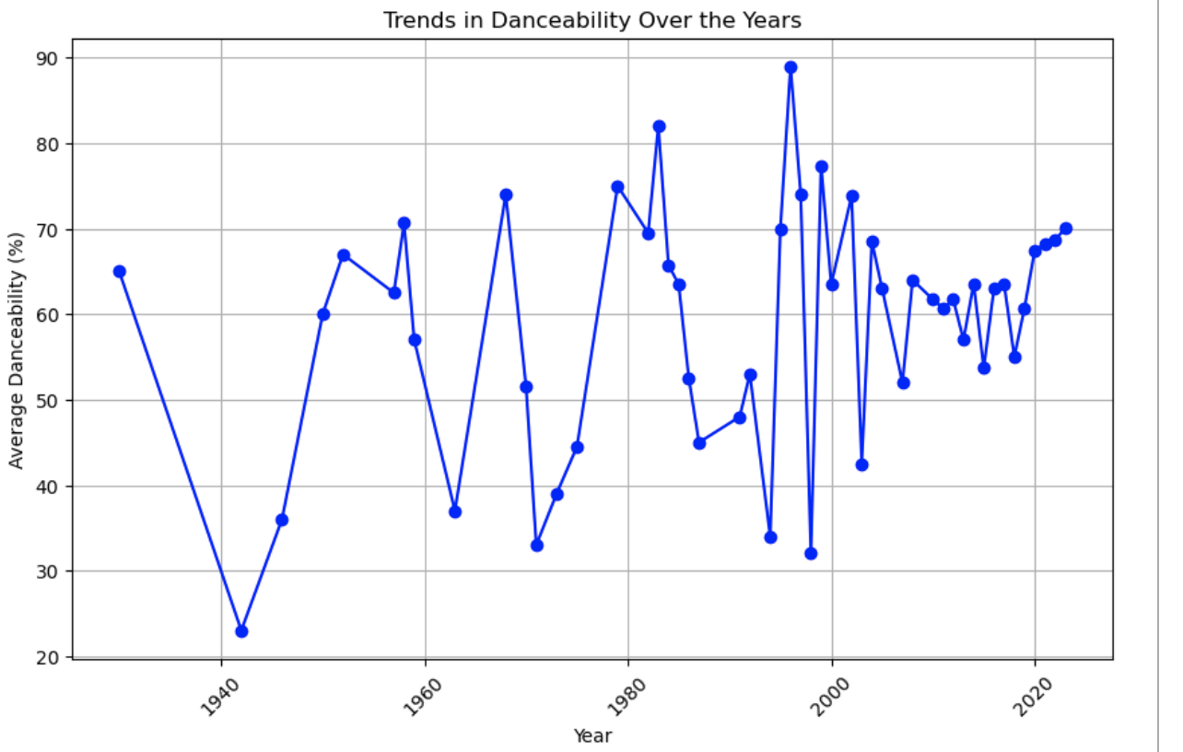
Average Danceability for each year
This graph shows how the danceability has increased through the years
Once we get into the 2000’s and onwards the Average Danceability does not dip below 50%.
This number shows that Artist think of danceable songs when they create songs to get the most streams possible
I think danceability is very important because that allows these songs to be played in public and private events.

Slide 9
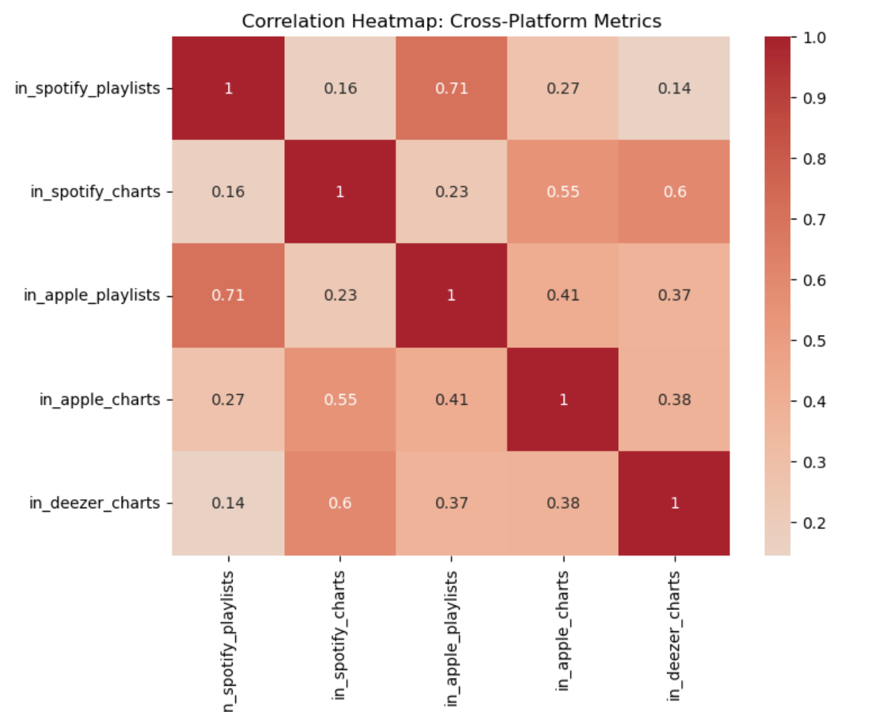
Cross-Platform Metrics
This chart allows us to see how different platforms stream the same music or very similar music
It’s noticeable that Deezer doesn’t seem as similar as Apple and Spotify.
I think this would be due to the different Artists from different countries. For example, Deezer would maybe have more French artist compared to an American artist.

Slide 10
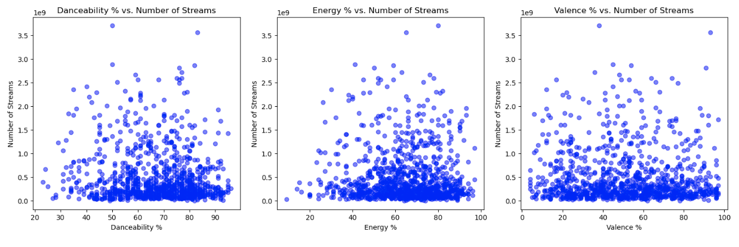
Number of streams vs. various stat descriptions
Three different graphs that are looking at various descriptions to see what individuals look for when they stream music.
Danceability looks at musical elements that include tempo, rhythm, beat, and overall regularity.
Energy measures intensity and activity. They feel fast, loud and noisy.
Valence measures musical positiveness conveyed by the track.
It is noticeable that a combination of all three (3) descriptions would make a song more popular and more likely to be streamed.

Slide 11
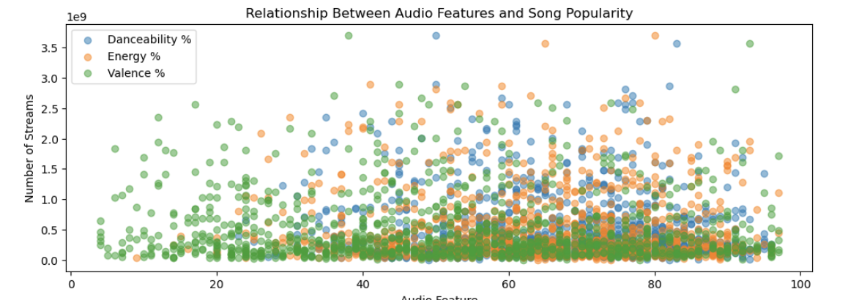
Additional information to show relationship from streams to decriptions
This scatter plot shows that the more audio features songs have (danceability, energy, and valence) the more streams it is going to have.
This also shows that individuals don’t need all the features, but they would prefer more than none.

Slide 12
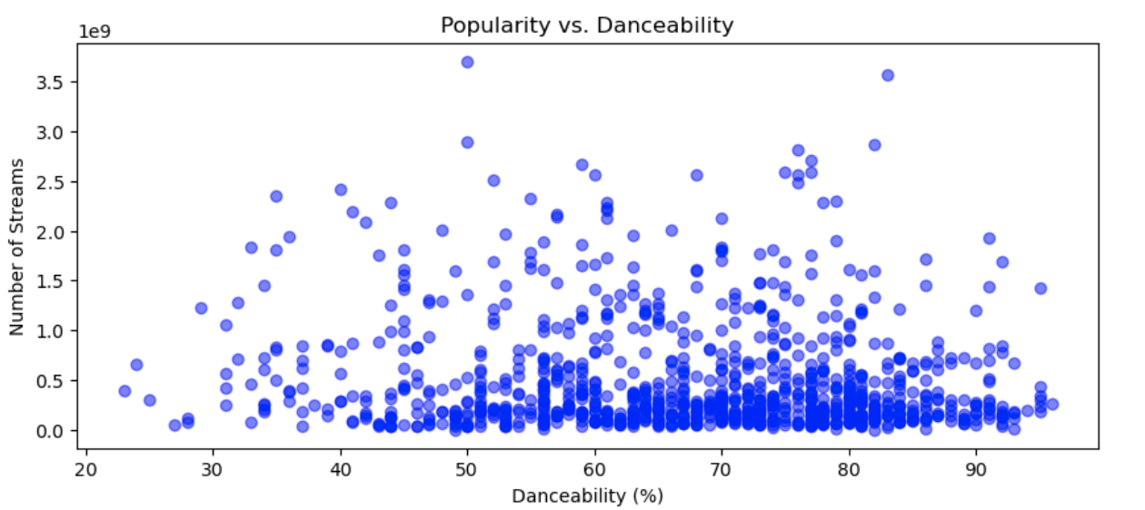
Popularity vs. Danceability
This scatter plot shows the popularity vs. danceability.
Popularity would be considered on total number of plays the track has had and how recent those plays are.
This graph tells me that a song that is considered more danceable will increase the popularity of the song and will therefore increase the number of streams

Slide 13
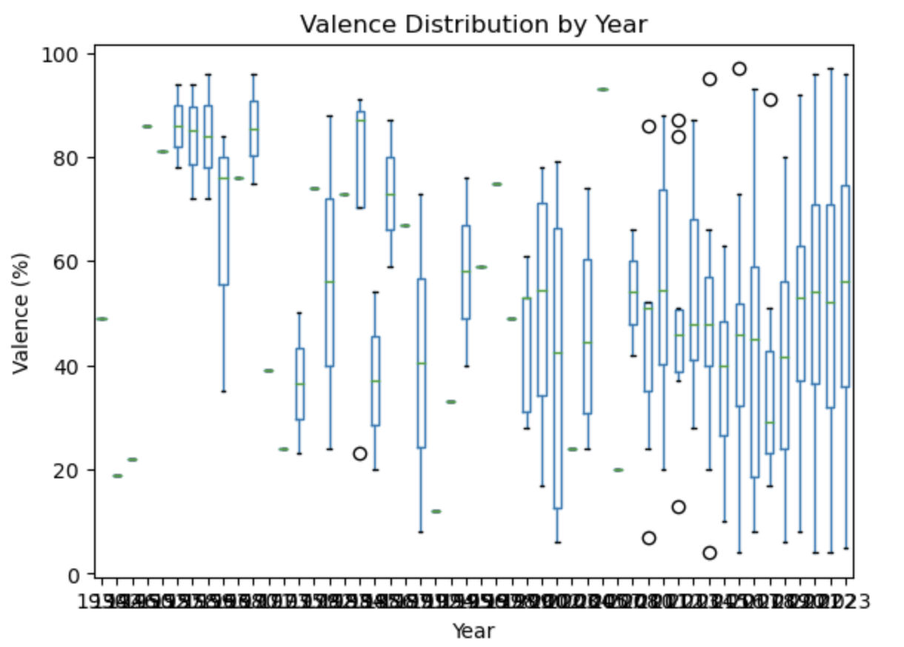
Valence Distribution by Year
Valence distribution by the year.
This graph shows how the musical positiveness varies through each year.
Starts off very strong and highly positiveness, and then starts to decrease by the year and really be in the middle.
I think this is due to some of the personal messages that get written in songs, which I think could have negative impacts on individuals which decreases streams.

Slide 14
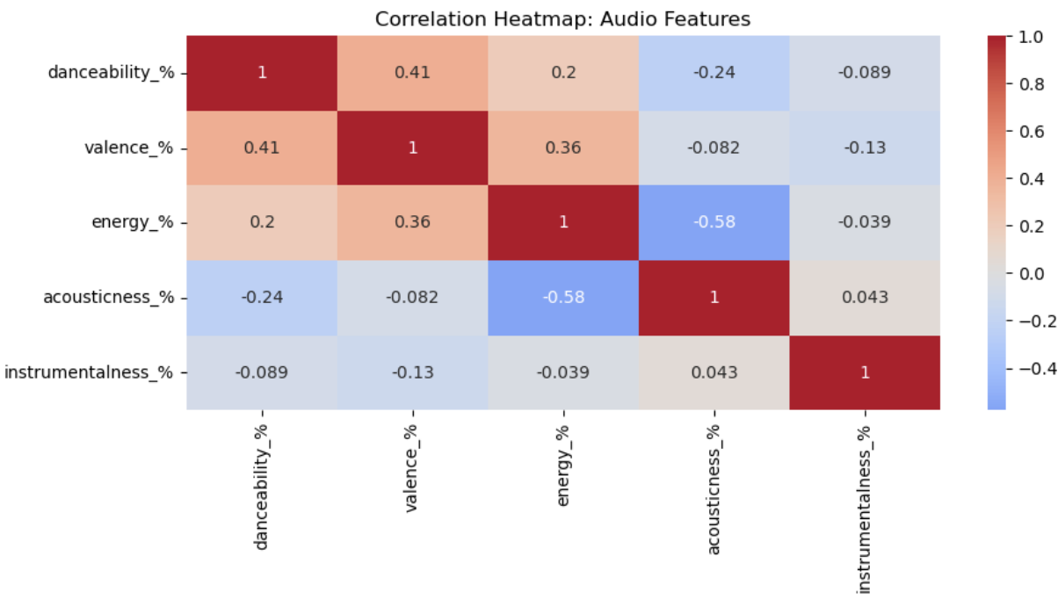
Audio features
This heatmap allows us to see how the different audio features in a song can come together.
Allows us to understand which features go better together than others.
To me doesn’t seem like a lot of audio features go well together, but if we include multiple (more than 2 features) that would change the song and how individuals would stream that song.

Slide 15
Conclusion
My conclusion would be that a lot different audio features would need to be part of one (1) song than less audio features.
The Heatmap noted to us that there isn’t enough of a correlation between two (2) different audio features to let us feel confident that two audio features will increase a stream.
When we looked at “Danceability”, “Energy”, and “Valence” we noted that there was a significant increase in streams as the amount of audio features increased.
Therefore, my conclusion would be that as the audio features within a song increase, that will increase the amount that song is streamed because with the more features, the song, has more opportunity to satisfy the listener.

