Slide 1


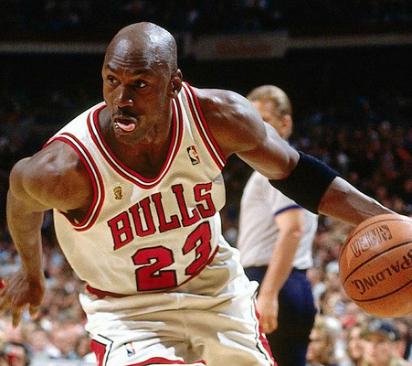

Michael Jordan
This Photo by Unknown Author is licensed under CC BY

Slide 2
Hypothesis
Based off the data provided, I am going to analyze the data to see how Michael Jordan played throughout his career. I want to see how he played in terms of efficiency based off age, points, monthly (per year), opponent, teams, and among other items.

Slide 3
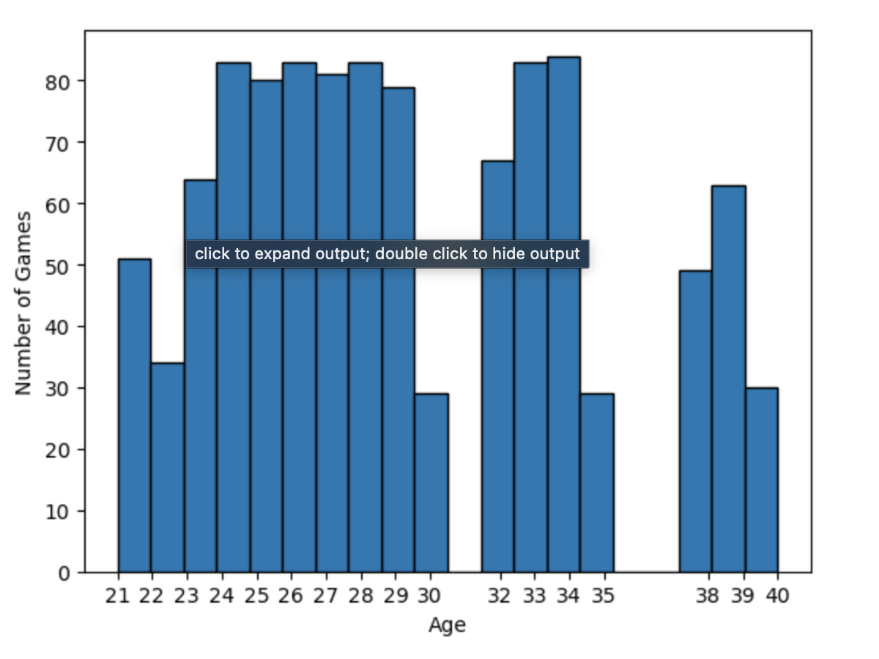
Games Played vs Age

Slide 4
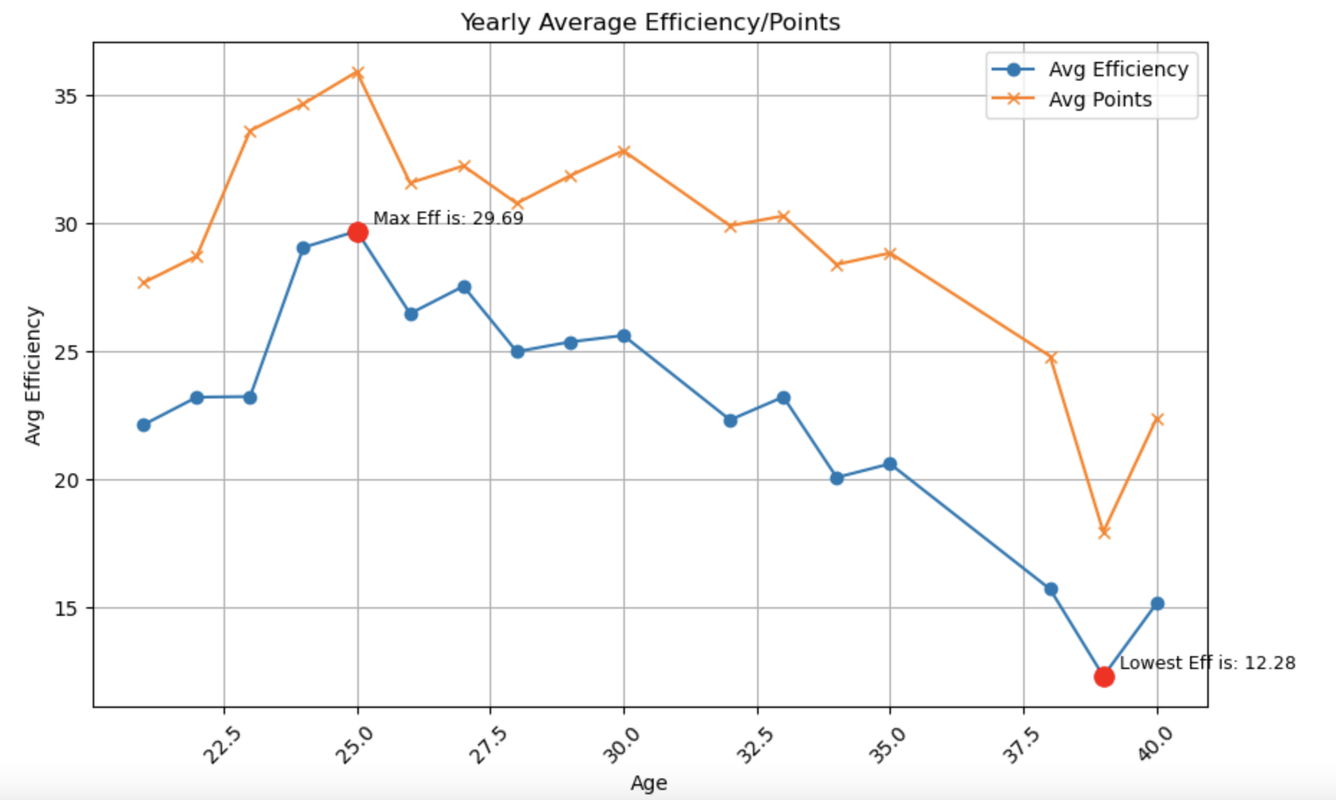
This graph shows Michael Jordan’s age to how efficient he was during that age. It also shows his average points for that age and how points and efficiency correlate.

Slide 5
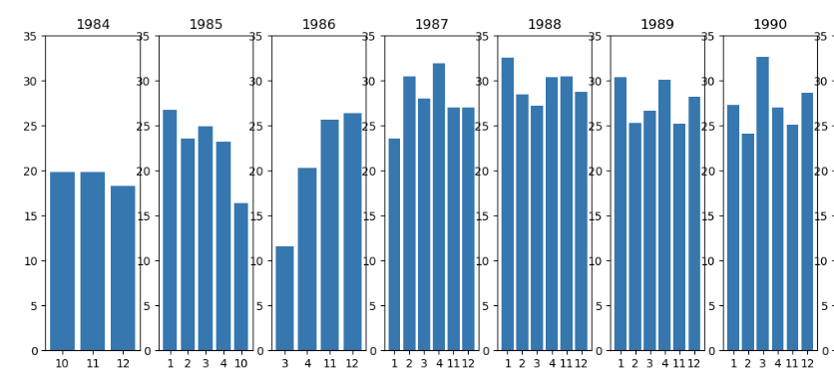
Pre-Championship
The graph to the right shows how Michael played on an efficiency level per month and shows what months he played versus when he didn’t (due to injury or other matters).

Slide 6
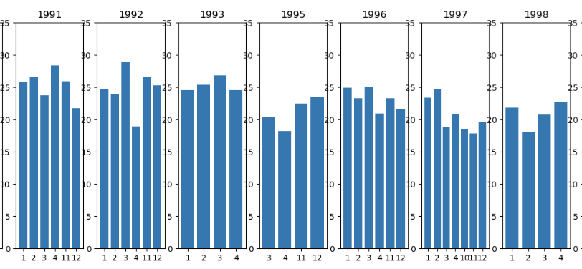
Championship
Graphs show Michael’s efficiency level monthly during the championship run he had with the Bulls.

Slide 7
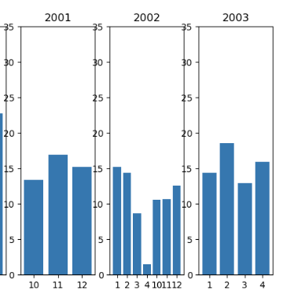
Post Championship
These graphs show Michael’s efficiency at the end of his career.

Slide 8
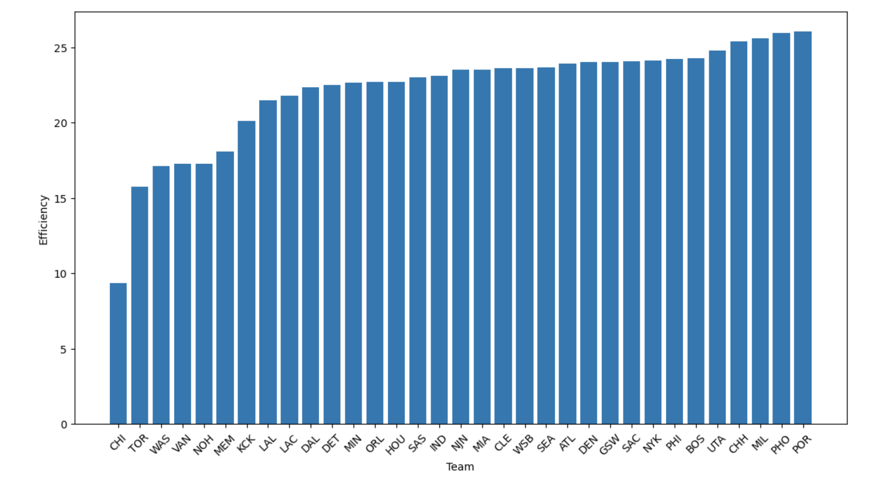
Efficiency vs Team
This bar char allows us to see which team Michael was the most efficient against versus which team he was least efficient against.

Slide 9
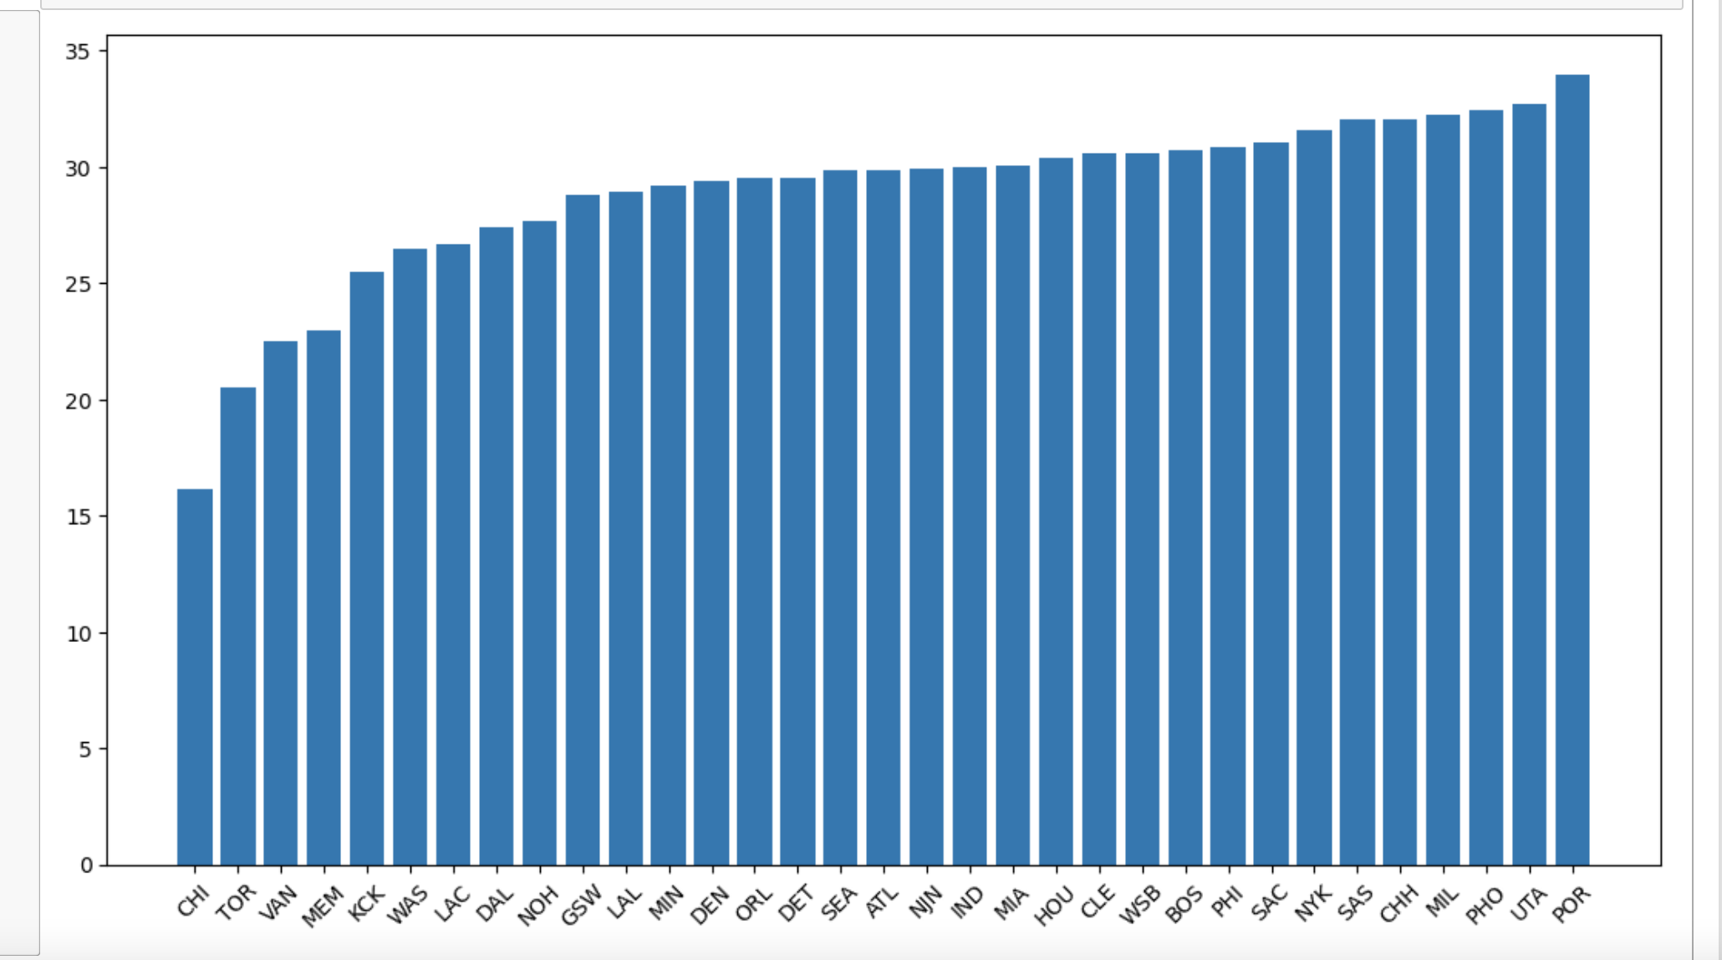
Points versus Opponent
We are able to see how Michael scored against all the various opponents he faced throughout his career.

Slide 10
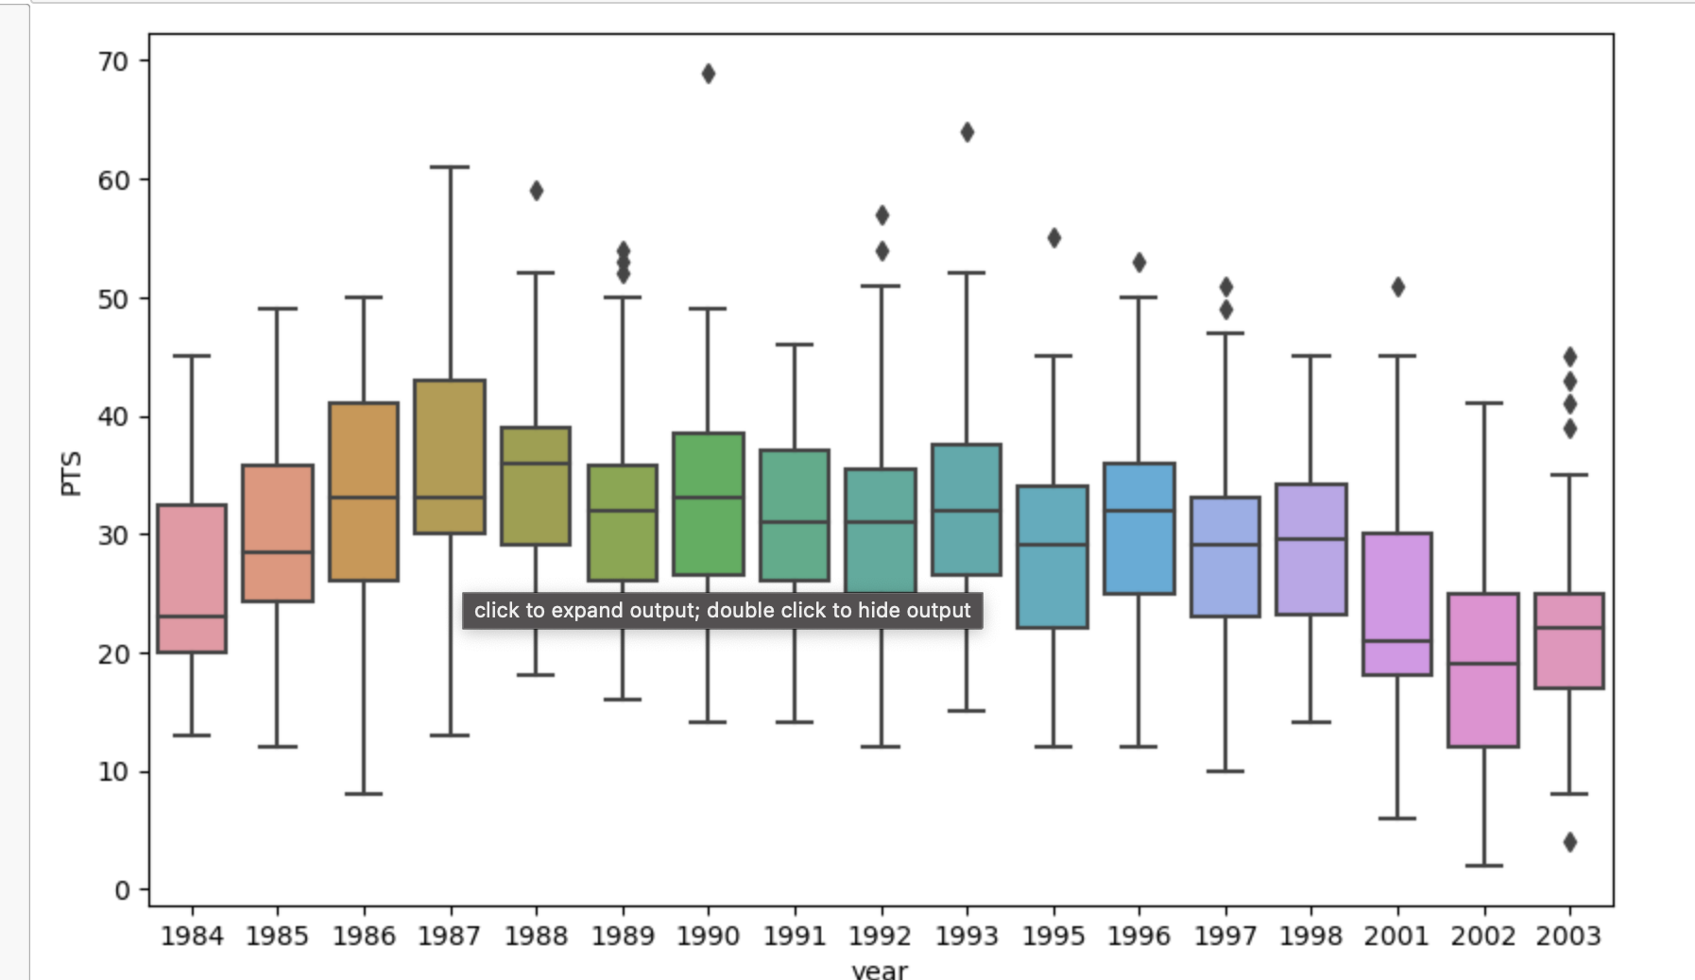
Average Points per Year
This graphs allows us to see Michael’s 25th, 50th, 75th, minimum, maximum, and outliers throughout each year.

Slide 11
Conclusion
Hypothesis: Based off the data provided, I am going to analyze the data to see how Michael Jordan played throughout his career. I want to see how he played in terms of efficiency based off age, points, monthly (per year), opponent, teams, and among other items.

