Slide 1
Spaceship Titanic
By: Sheel Shah

Slide 2
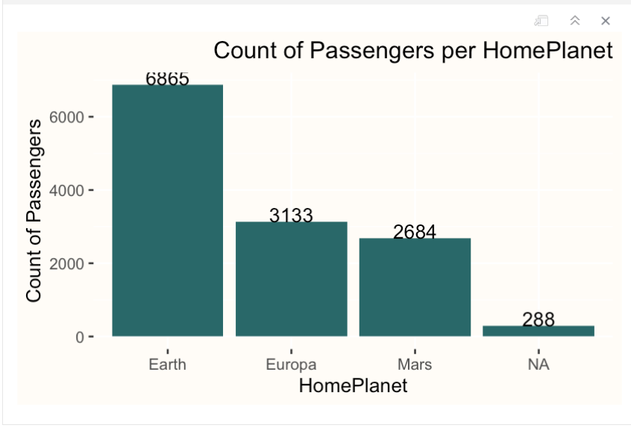
HomePlanet
This graph is showing the planet the passenger is departing from.

Slide 3
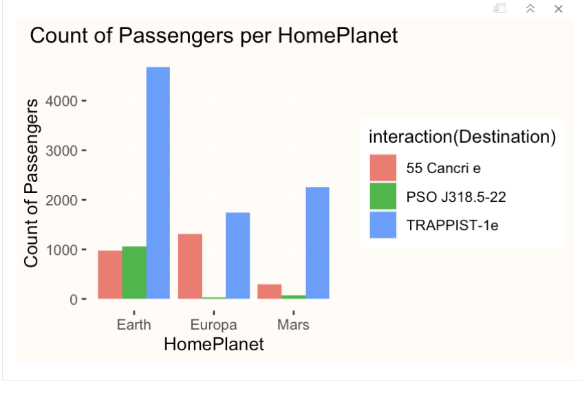
HomePlanet based off Destination
This graph is showing us where people are departing from and what their final destination is.

Slide 4
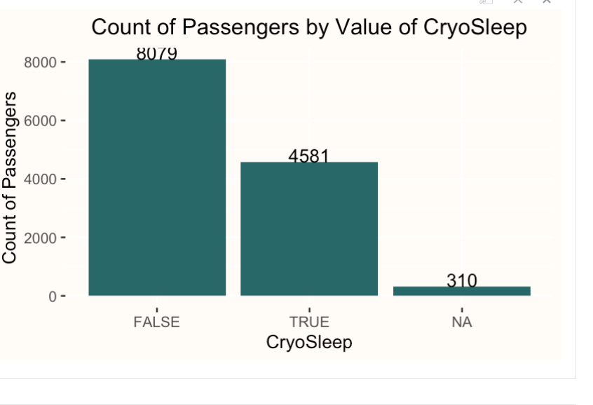
CryoSleep
This let’s us know how many passengers elected to be put into the suspended animation for the trip.

Slide 5
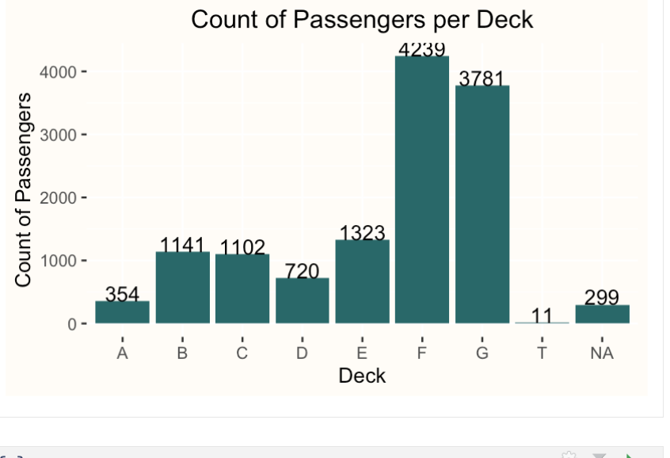
Cabin
This breaks down where each passenger was staying during the trip.

Slide 6
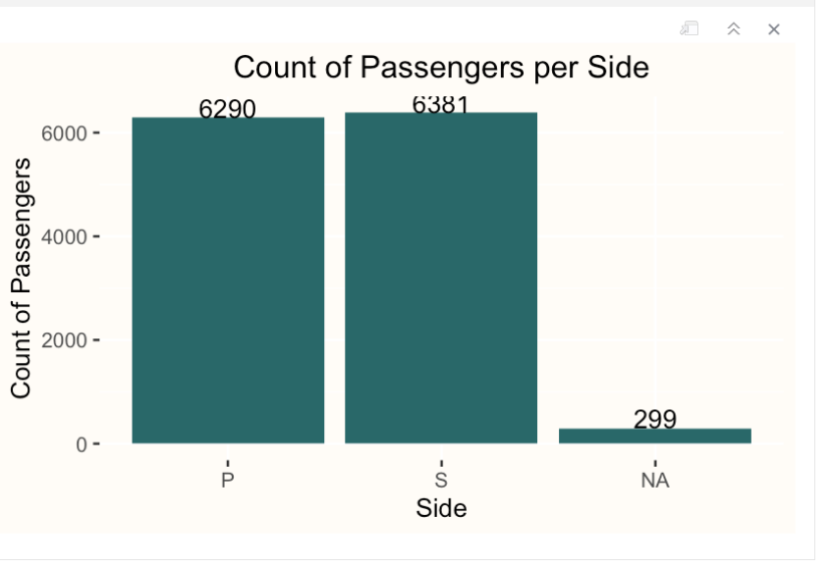
Which side are the passengers staying?
This graph allows us to understand which side the passengers are staying (Port or Starboard).

Slide 7
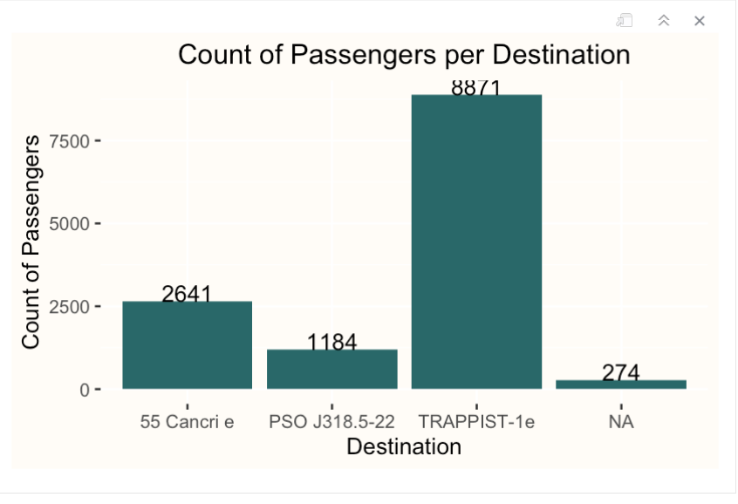
Destination
This allows us to visualize where each passenger destination is.

Slide 8
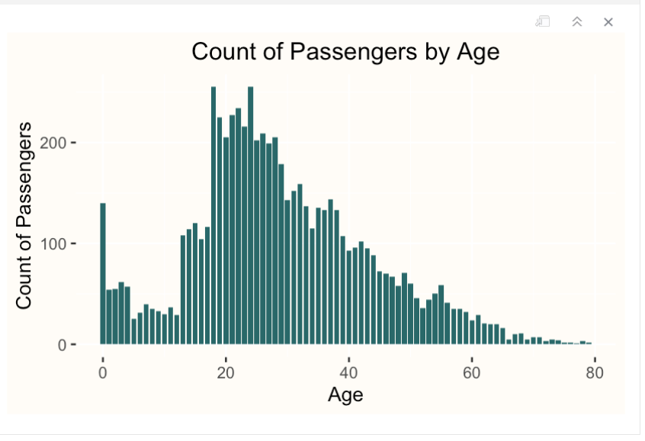
Age
This graph shows us the age range of the group.

Slide 9
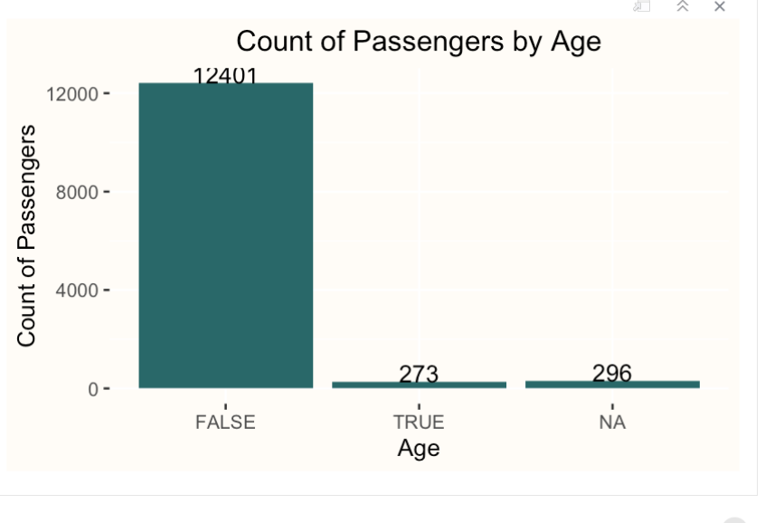
VIP
Allows us to see whether a passenger elected for VIP services.

Slide 10
Conclusion
Based off reviewing the data from the train csv file I have concluded that there is not enough information to provide a definite conclusion to determine which travelers within the test csv file were transported to an alternate dimension.
While reviewing the data – I couldn’t find anything information that was conclusive from who transported in the train file to what would trigger them to be transported.
Due to this conclusion – I have determined that none of the individuals within the test csv file transported to an alternate dimension.

