Slide 1
Lecture 12

Slide 2
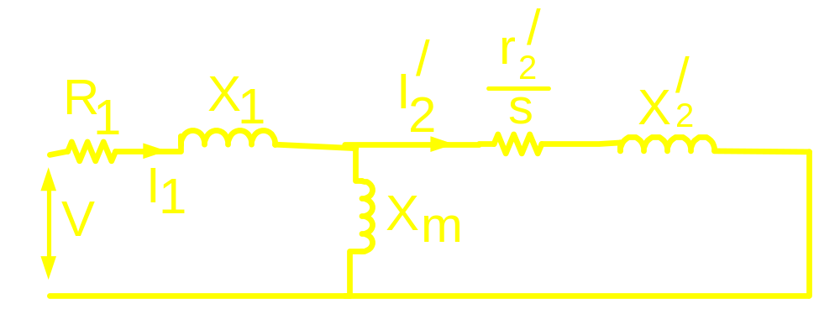

Slide 3
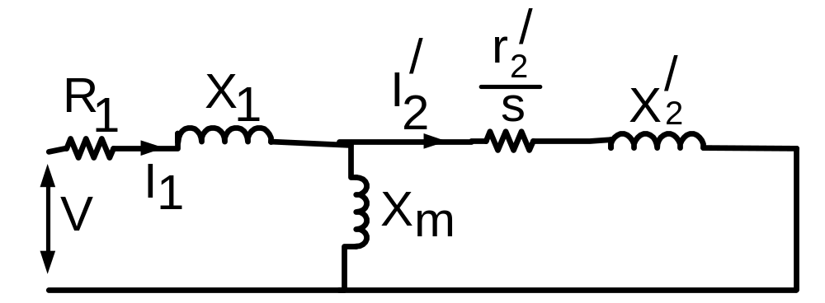
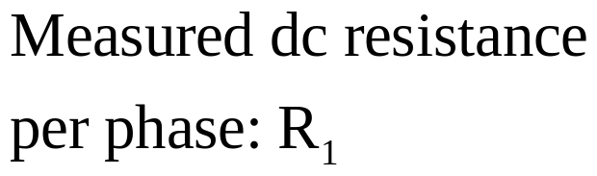
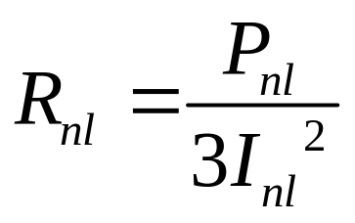
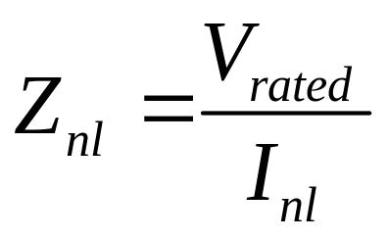
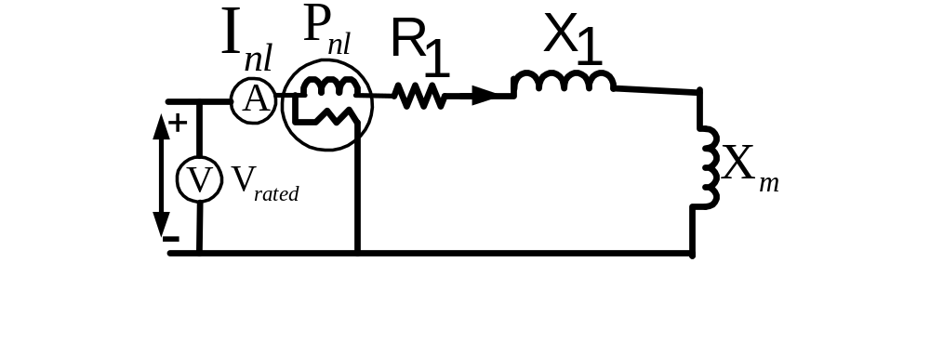
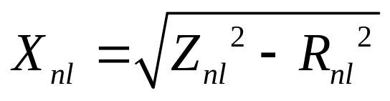
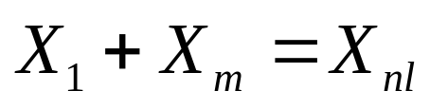
Determination of I/M parameters
No load test

Slide 4
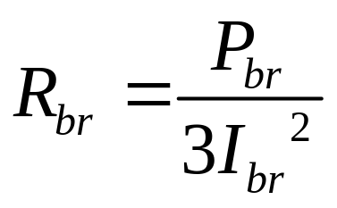
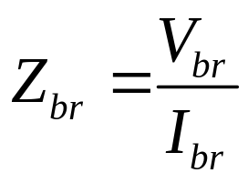
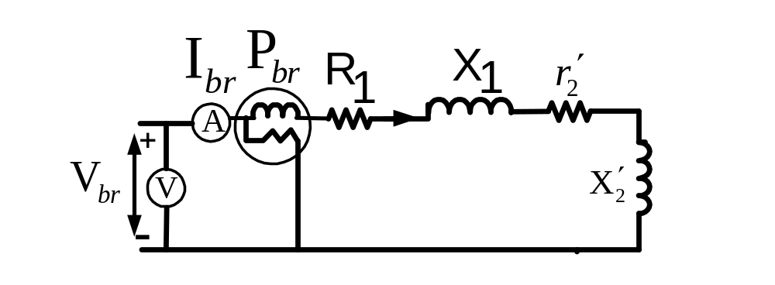

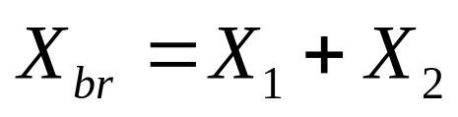
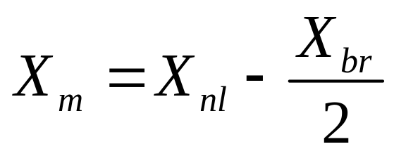
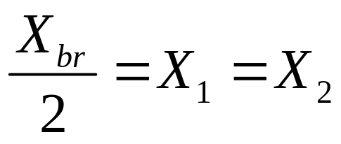
Blocked rotor test

Slide 5

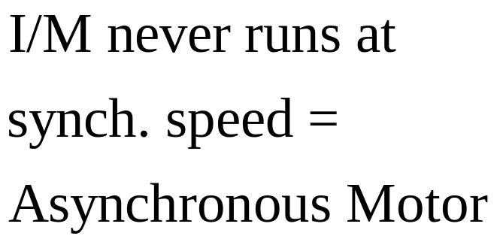



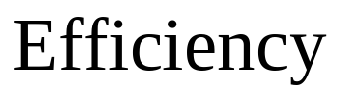

Slide 6
DC Machine

Slide 7
DC Machine:
DC Motor
DC Generator

Slide 8
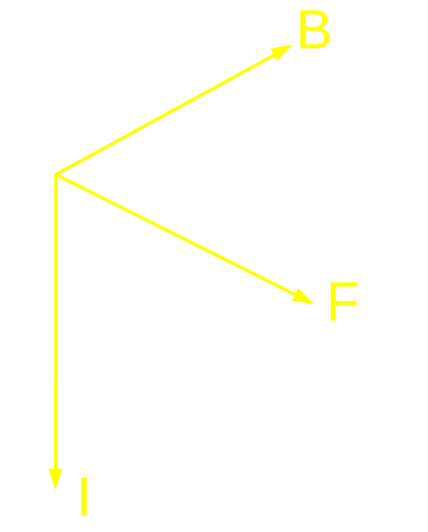
Conductor carrying current when placed
in a magnetic field experience
Mechanical force.
Fleming’s Left hand Rule

Slide 9
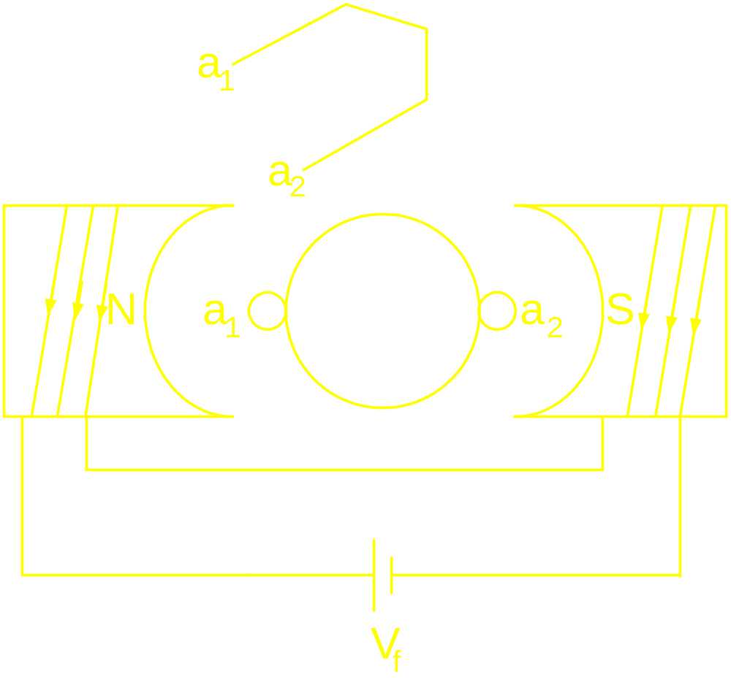
DC M/C : Principle of Operation
Field
winding
Armature
Armature
Conductor

Slide 10
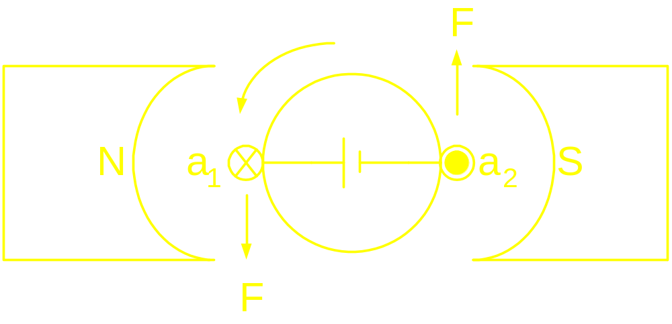
DC M/C : Principle of Operation

Slide 11
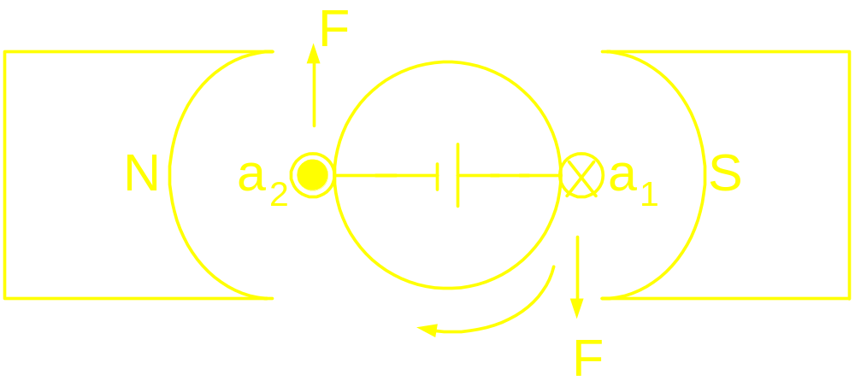
DC M/C : Principle of Operation

Slide 12
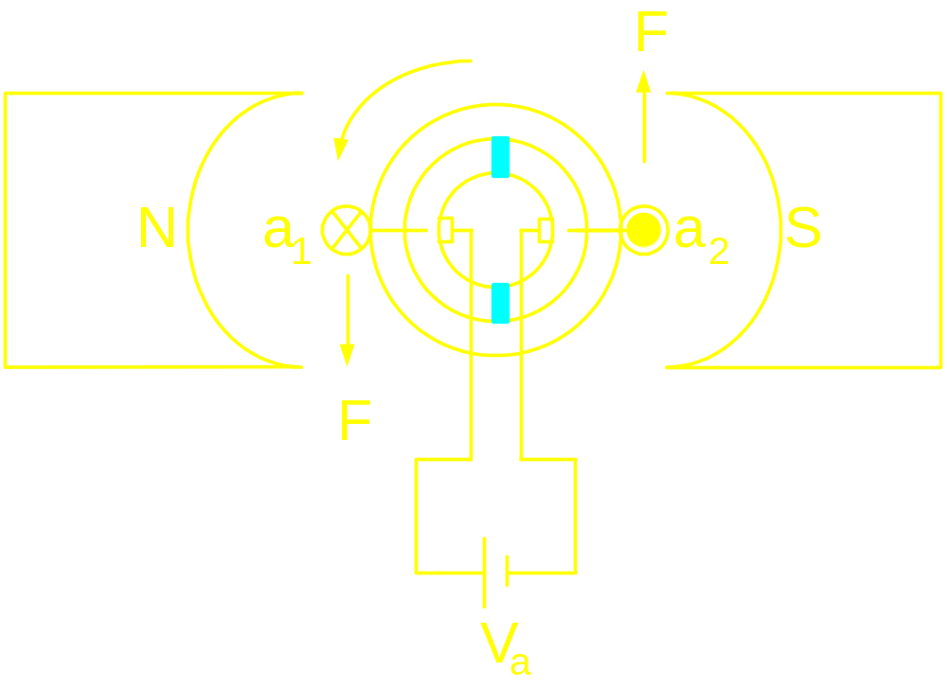
DC M/C : Principle of Operation
Commutator
&
Brush

Slide 13
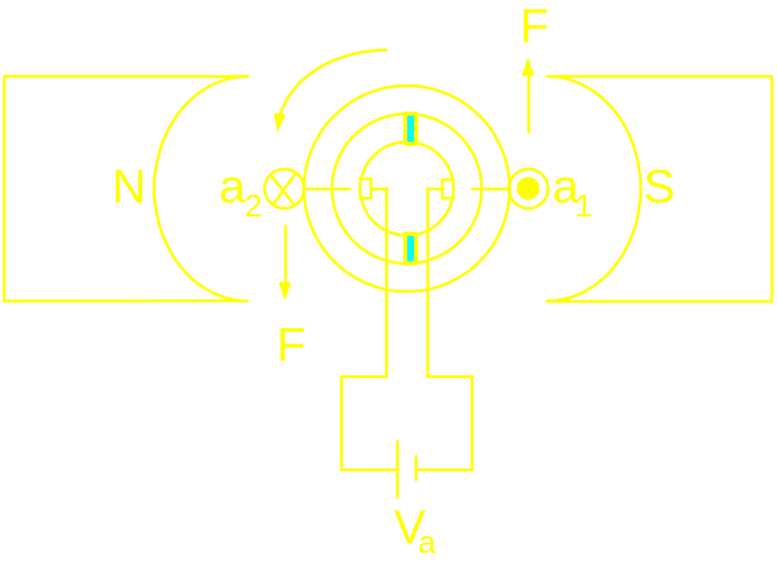
DC M/C : Principle of Operation

Slide 14
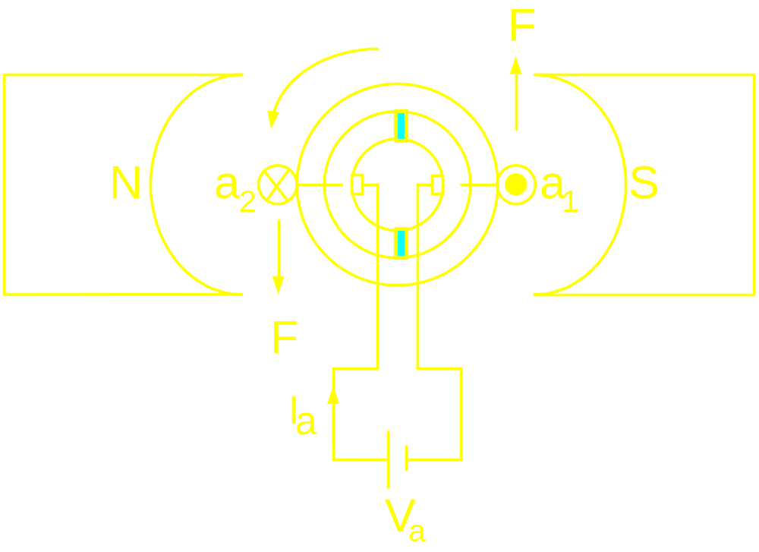
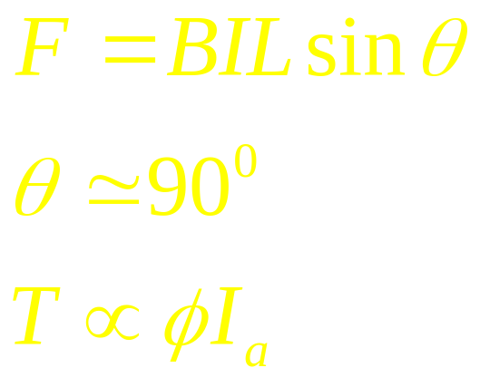
DC M/C : Principle of Operation

Slide 15
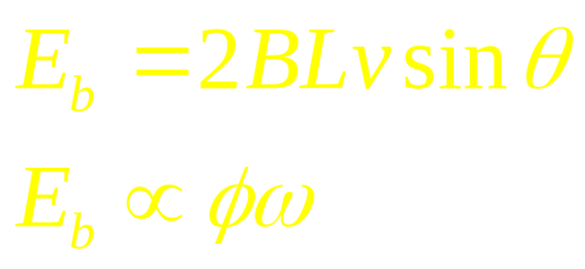
Contradiction from Faraday’s Law
Fleming’s right hand rule
assigns the polarity of
induced voltage, E

Slide 16
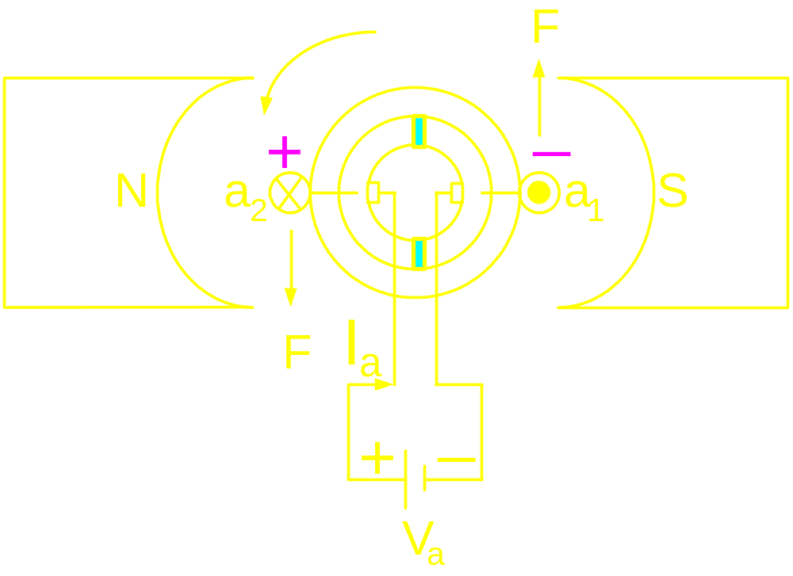
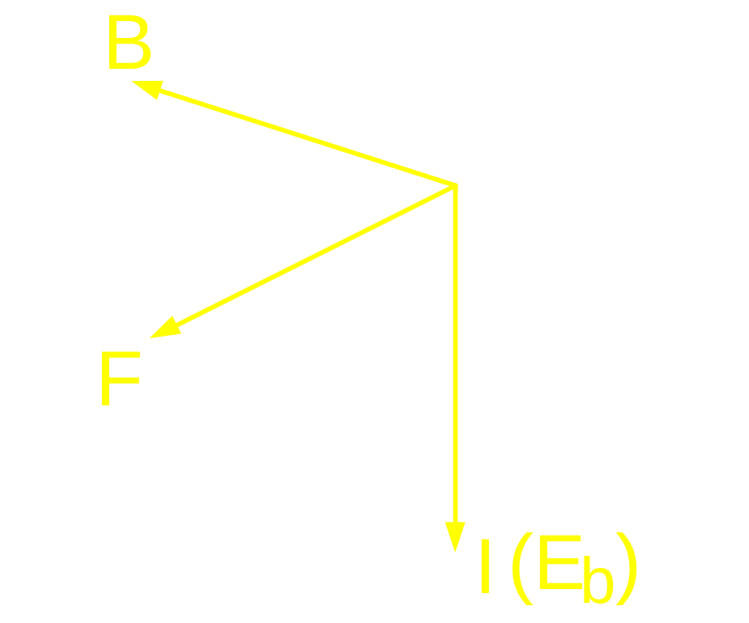
DC M/C : Principle of Operation
Fleming’s right
Hand rule

Slide 17
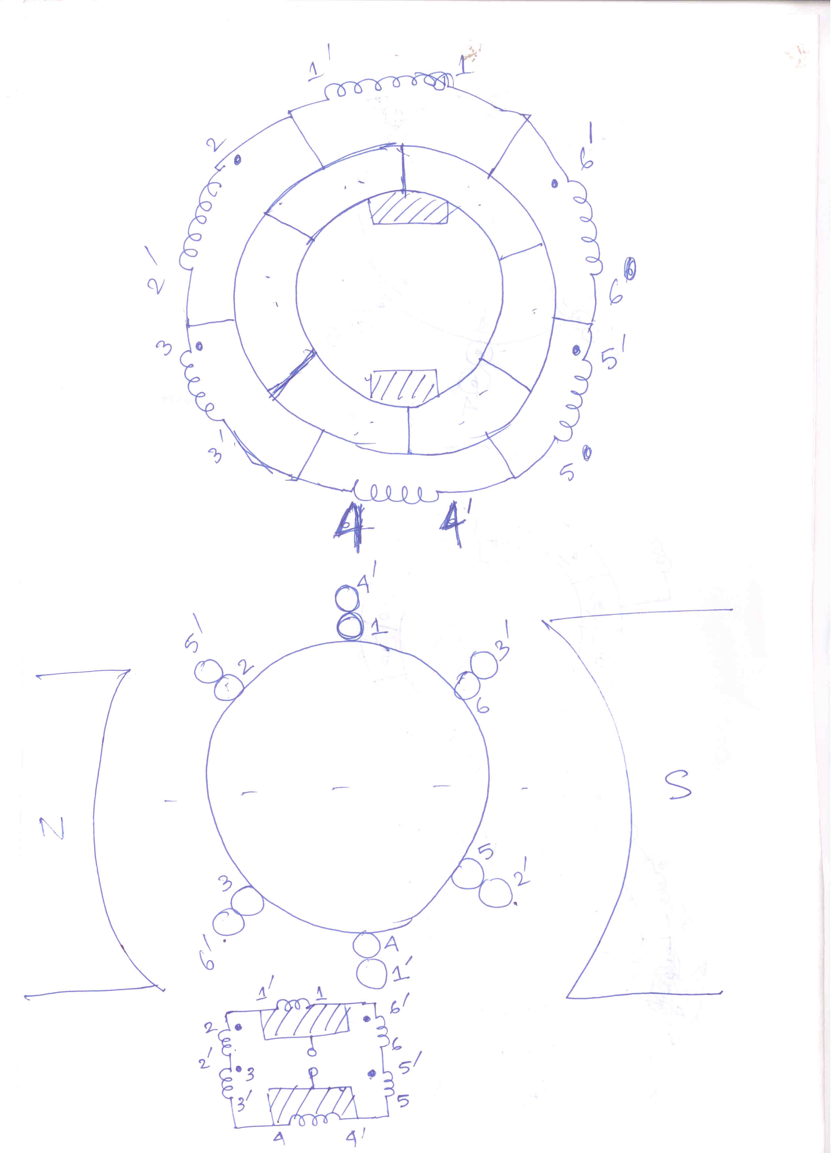

Slide 18
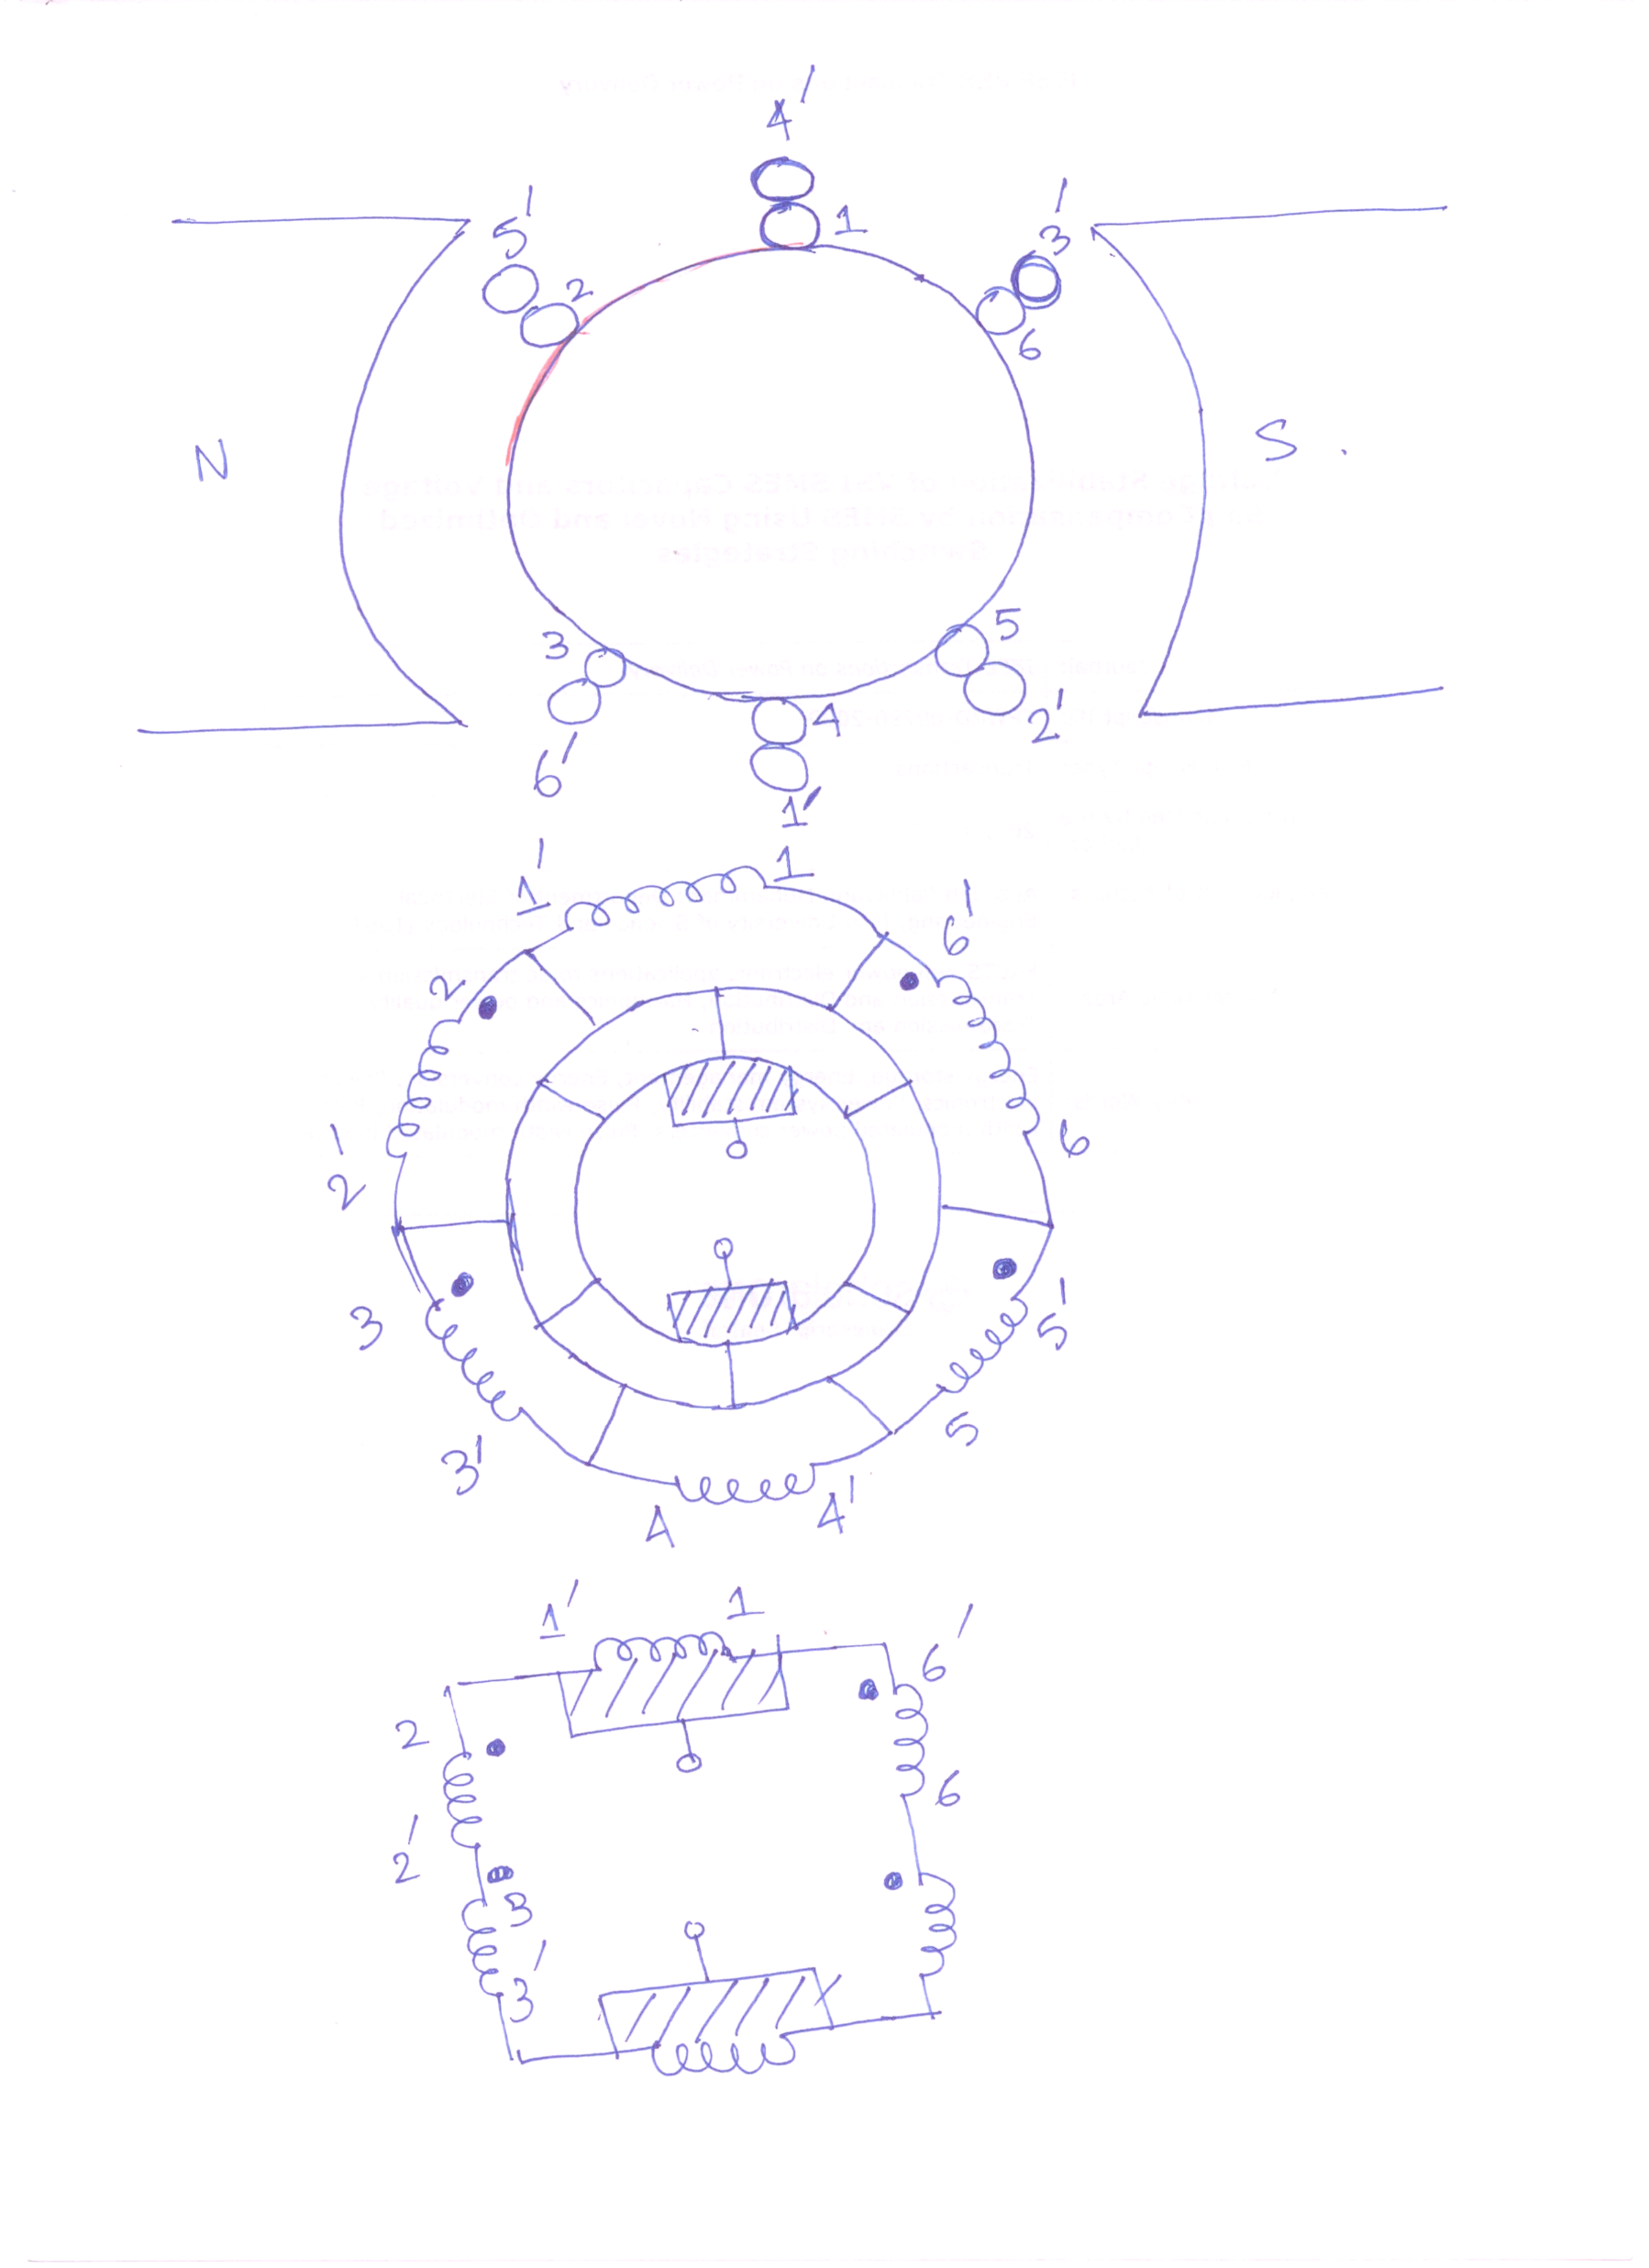

Slide 19
DC Machine: Steady state model and behaviour

Slide 20
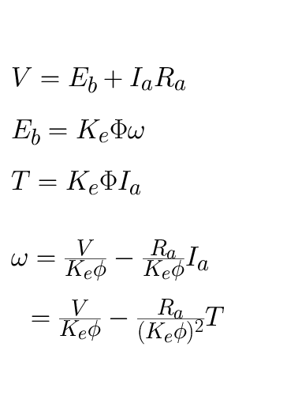
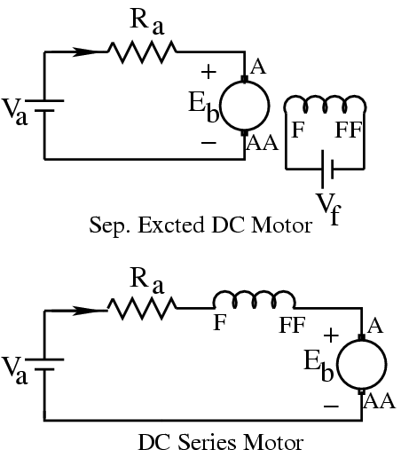
Speed-Torque Characteristics
_
+
I
a
a
_
+
I
a

Slide 21
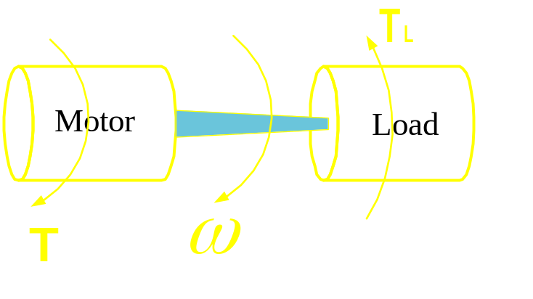
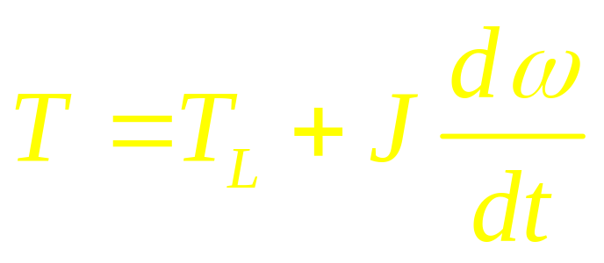
Feed back between electrical and
mechanical world

Slide 22
DC Machine: Torque vs. speed
Characteristics

Slide 23
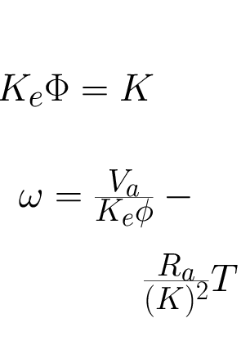
For Sep. Excited Motor:
a

Slide 24
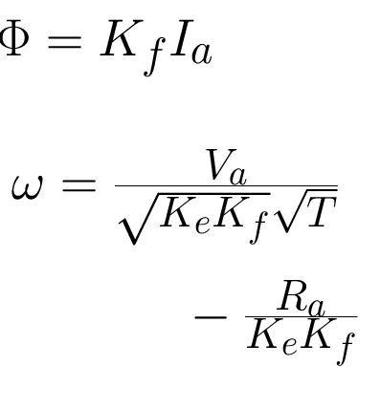
For Series Motor:
a

Slide 25
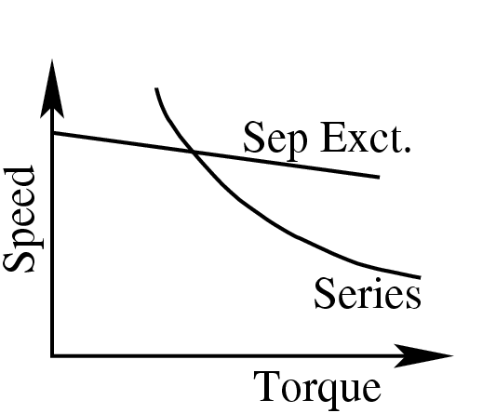
Speed – Torque Characteristic

