Slide 1
Lecture 7

Slide 2
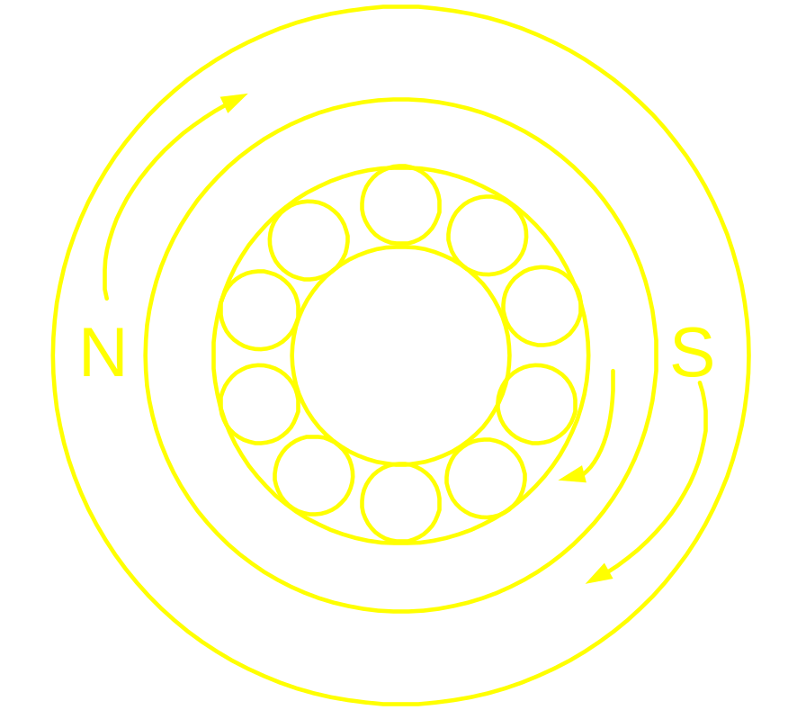
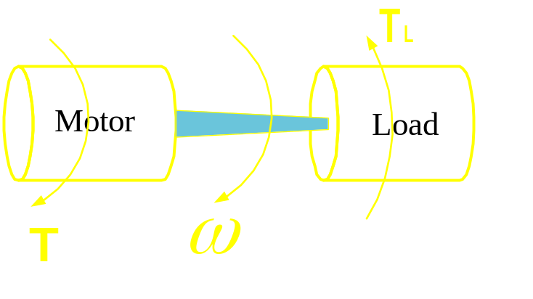
Induction Motor on absolutely no load
no friction windage and no load losses

Slide 3
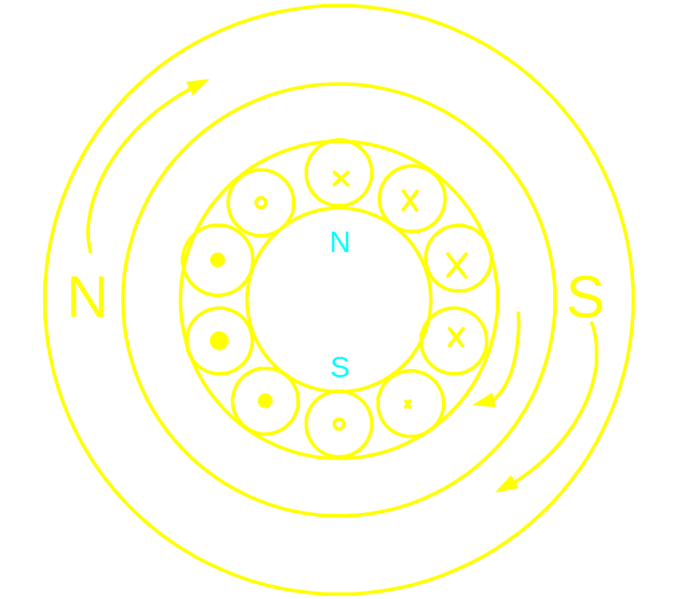
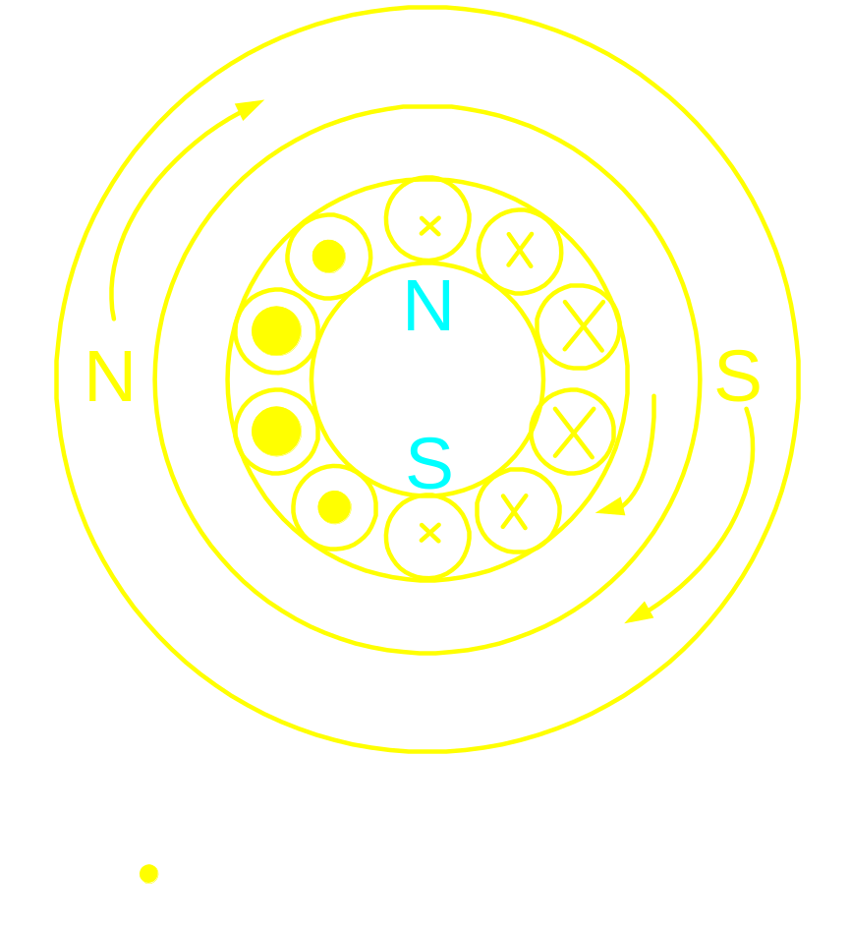
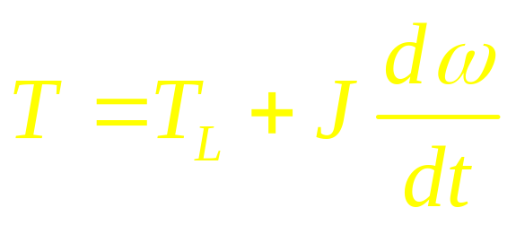
Induction Motor on load

Slide 4
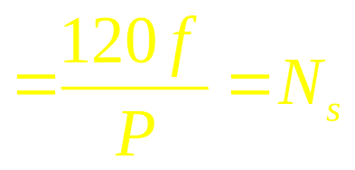
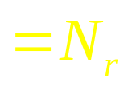
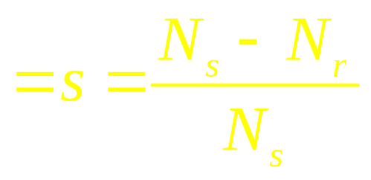
Speed of the stator field = Synchronous speed
Rotor speed
Slip
Slip, s is proportional to the load on the shaft

Slide 5
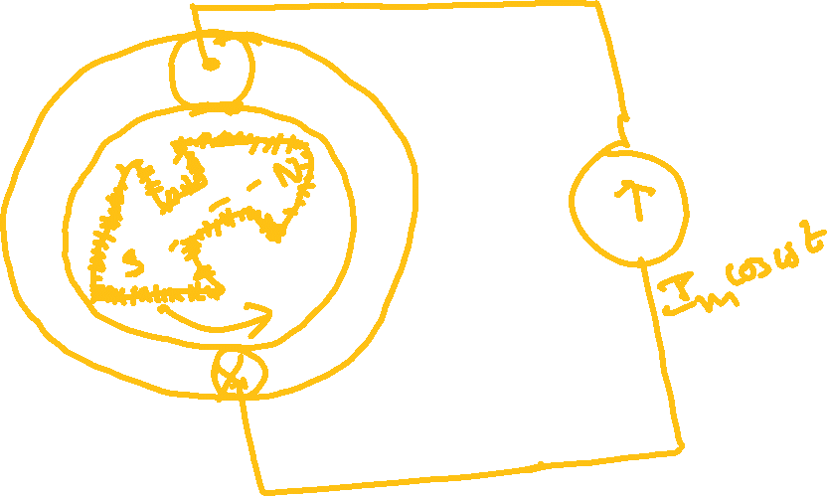



Slide 6
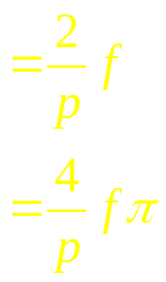
In one cycle of the current waveform, the
resultant mmf wave makes one revolution in
a 2 pole machine
In one cycle of the current waveform, the
resultant mmf wave makes 2/p revolutions in
a p pole machine
If the frequency of the current is f,
Revolution made in one sec
Angle traversed in one sec
rad

Slide 7
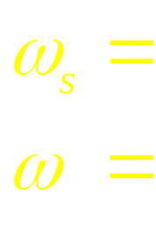
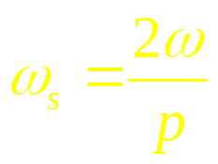
Speed of rot mag field in rad/sec
frequency of current in rad/sec

Slide 8
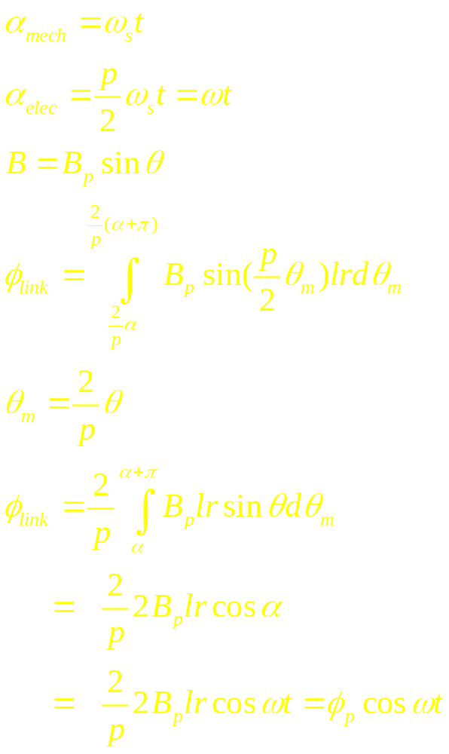
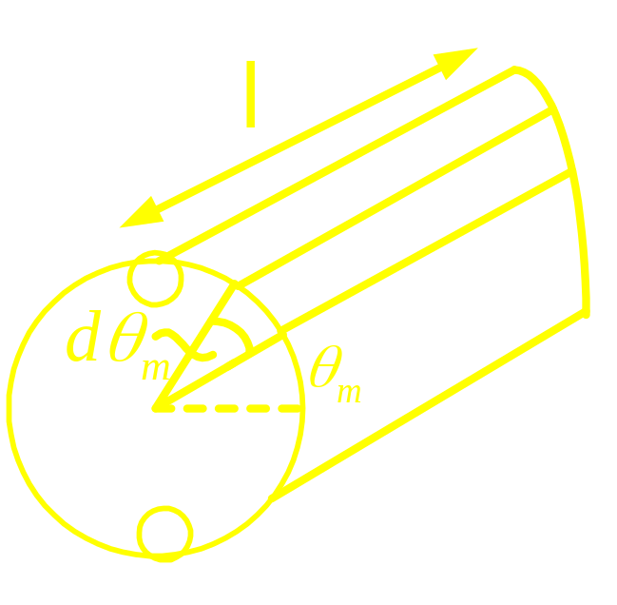
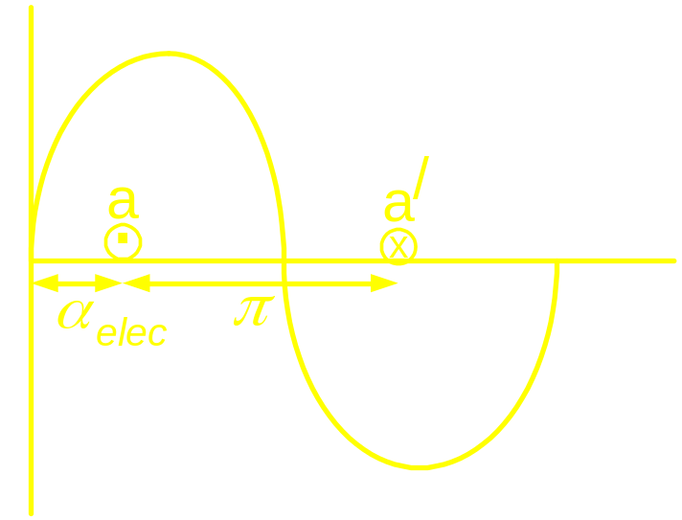
elec
elec
_
_
_

Slide 9
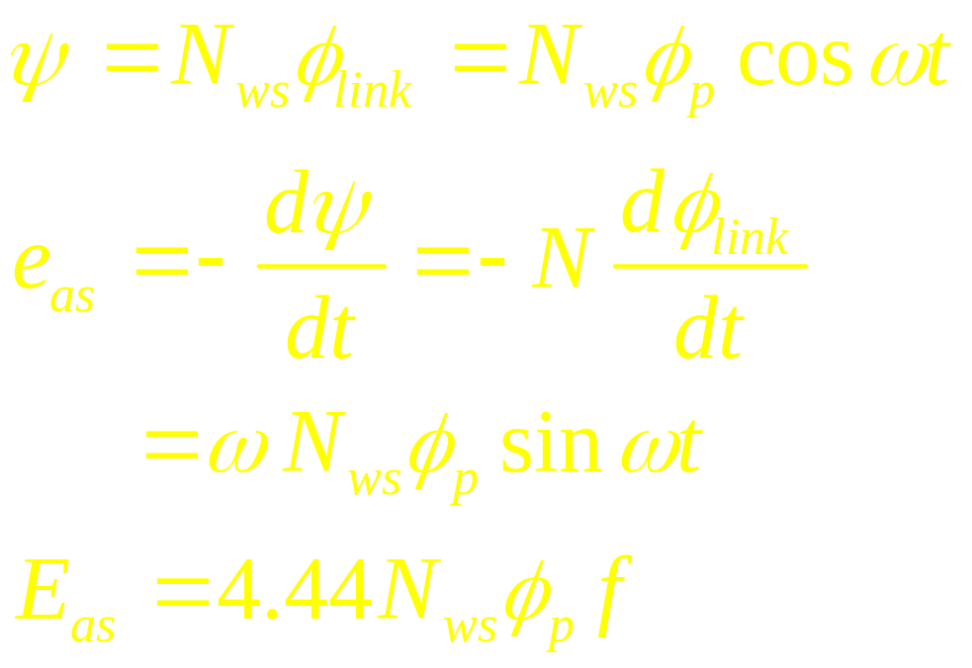

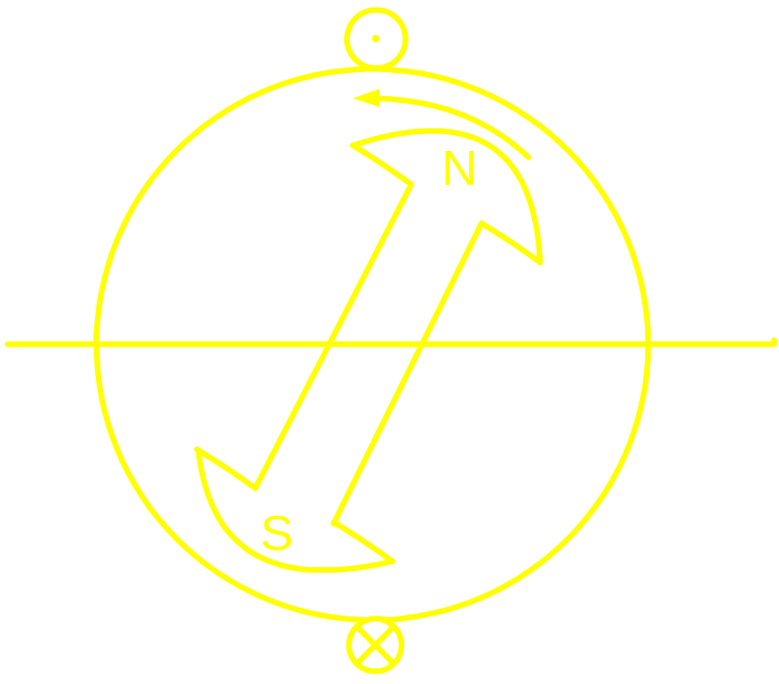

Slide 10
