Slide 1
EE 238
Power Engineering - II

Slide 3
Transformer

Slide 4
Transformer :
Machine to transform
levels of voltage and
current but not power or
volt-ampere.

Slide 5
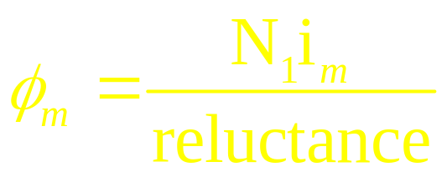
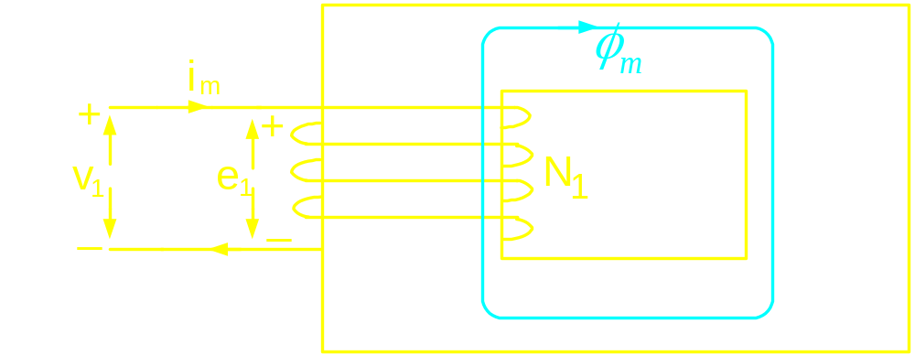
From ampere’s law:
Core
Winding
N₁ = no. of turns of the coil
i_{m} = current in the coil
Direction of flux
given by right
hand thumb
rule

Slide 6
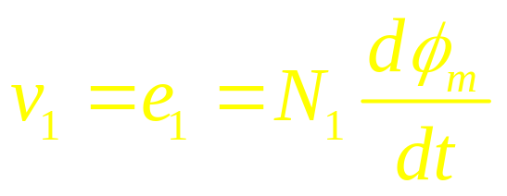
From Faraday’s law:
Magnitude of core flux is determined by the induced voltage and hence
applied voltage in case of an ideal
transformer.
For an ideal
transformer,
i_{m} = 0

Slide 7

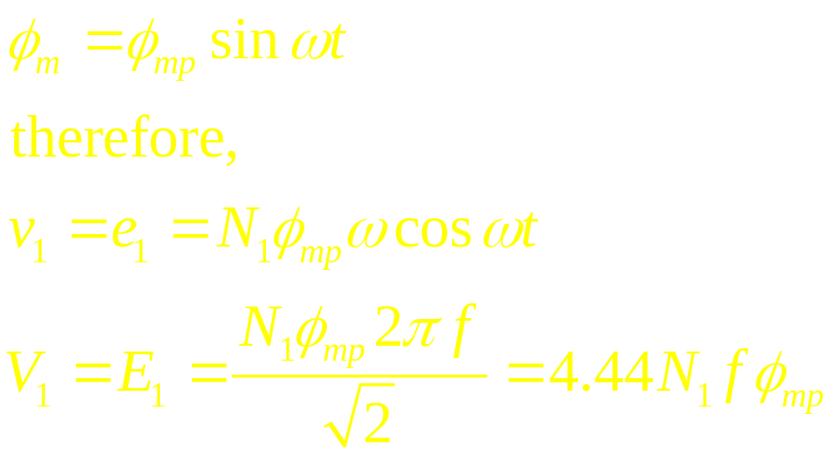
If v is sinusoidal, is also a sinusoid riding
on a dc component. In reality as the system
is lossy, at steady state dc componet will die
down to zero.
Let us assume,

Slide 8
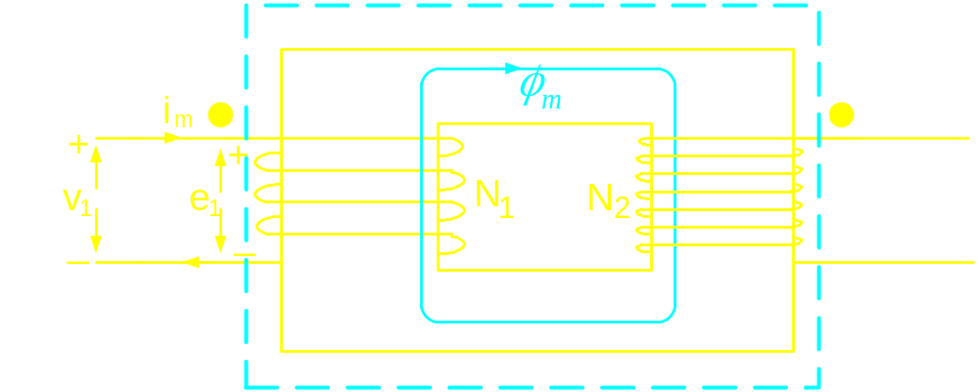
Dot convention
Gives information regarding the sense of winding:
current entering both the “dots” set fluxes which aid
each other

Slide 9
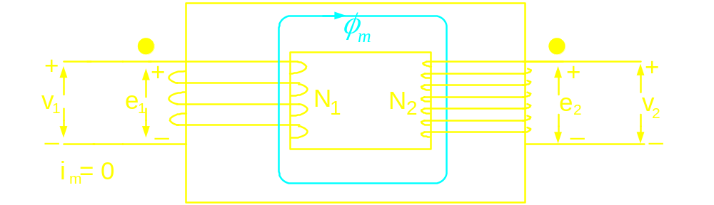
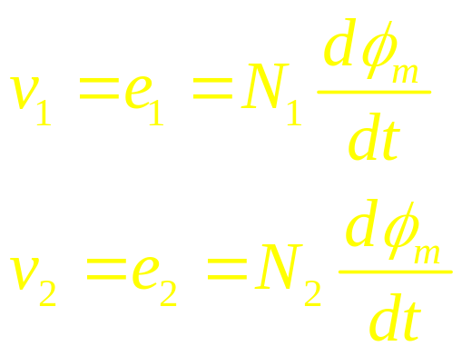
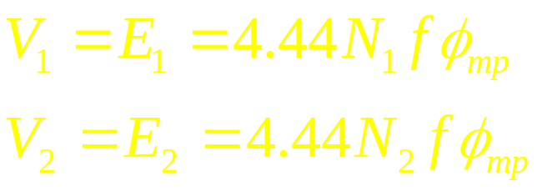
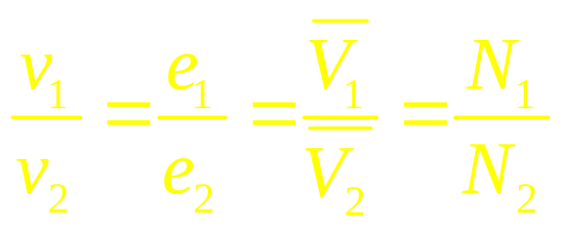
Voltage induced in winding 2
Ideal transformer: Recluctance of core material is zero
Therefore,
Polarity of induced voltage is given by
Lenz’s law : “dotted” terminals gets ‘
similar polarity

Slide 10
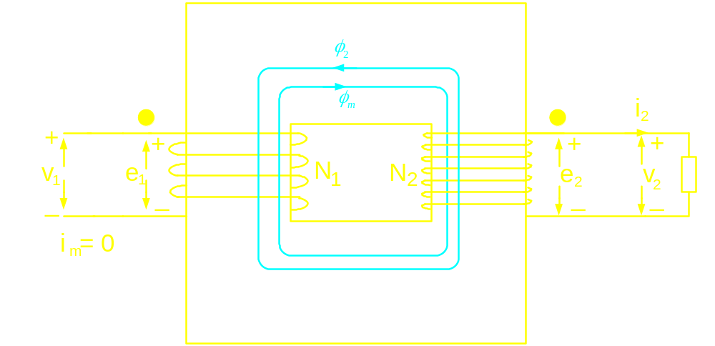
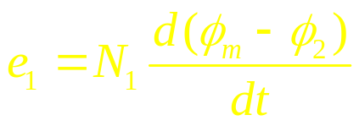
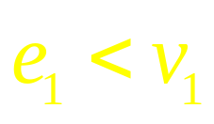


Ideal Transformer on load
v₁ being the applied voltage
remains same, but
Therefore,
Hence a current flows from v1 to “dot” terminal
of winding 1.
Flow of current in N₁ sets a flux in the core

Slide 11
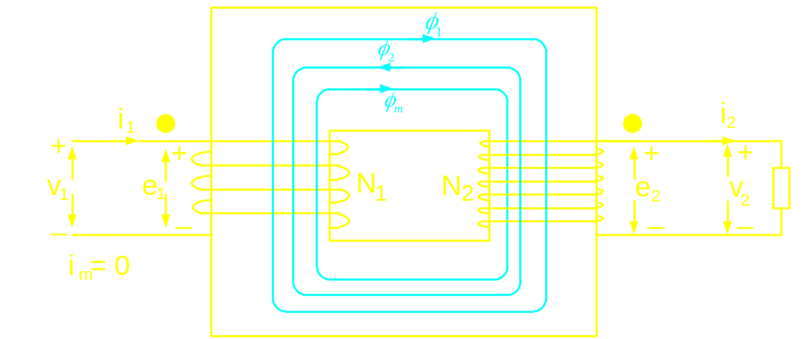
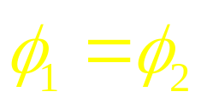
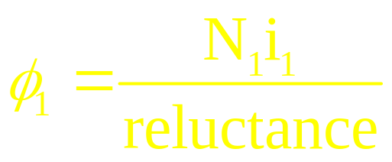
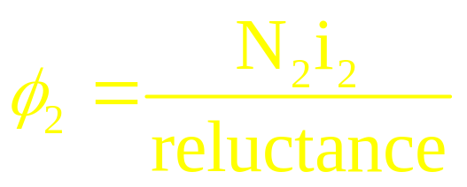
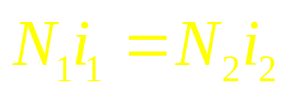
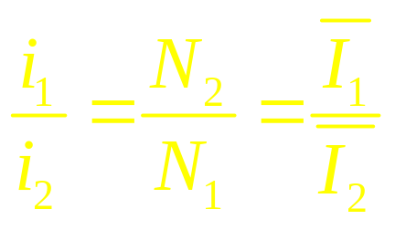
Ideal Transformer on load
Steady state will reach when,
Therefore at steady state
Power factors at both the sides remain the
same

Slide 12
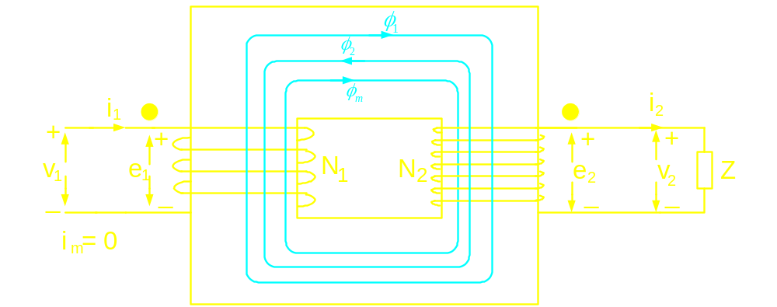
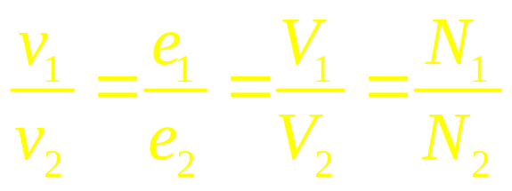
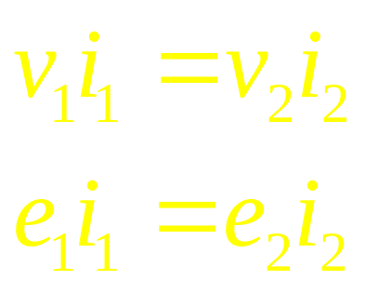
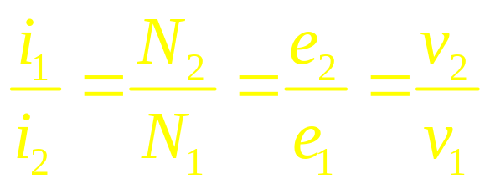
Ideal Transformer on load
Therefore,
Volt-amperes at both the sides are
same

Slide 13
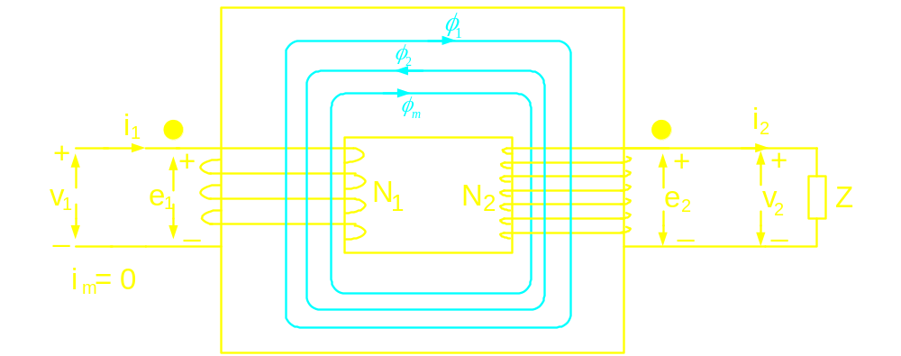
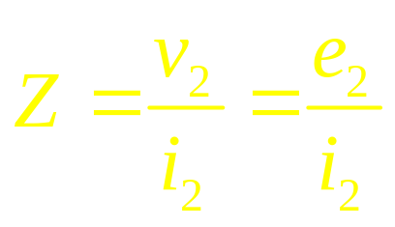
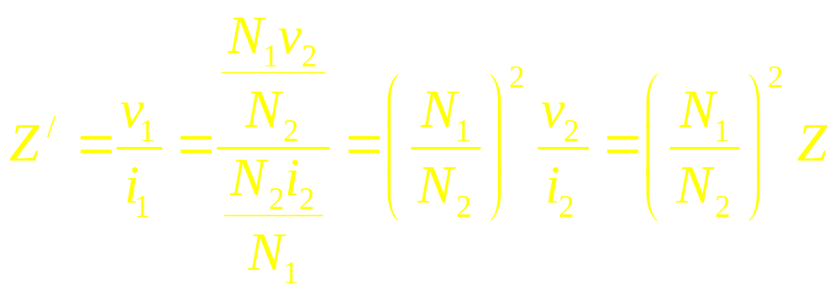
Ideal Transformer on load
Impedance seen by winding-2,
Impedance seen by winding-1,

Slide 14
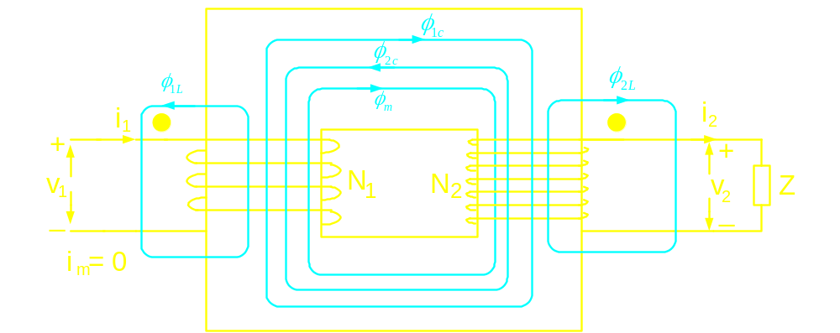
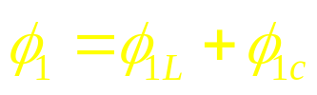
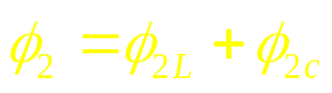
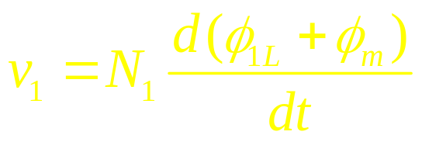
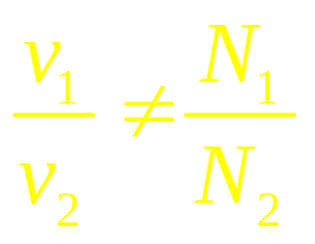
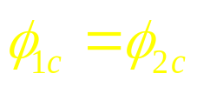
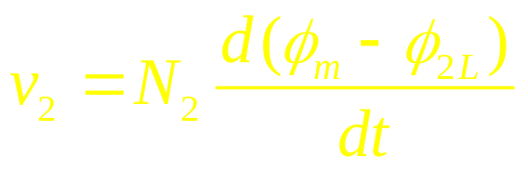
Flux pattern in a realistic transformer

Slide 15
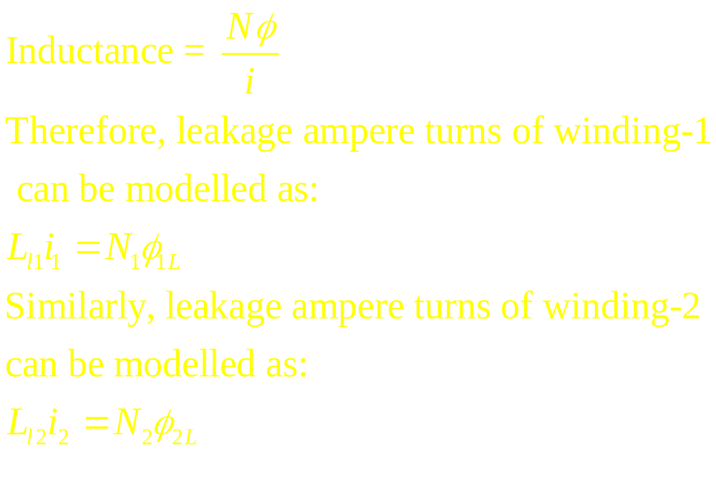
Moreover, winding-1 of a practical transformer will have a resistance
component: R₁
winding-2 of a practical transformer will have a resistance
component: R₂

Slide 16
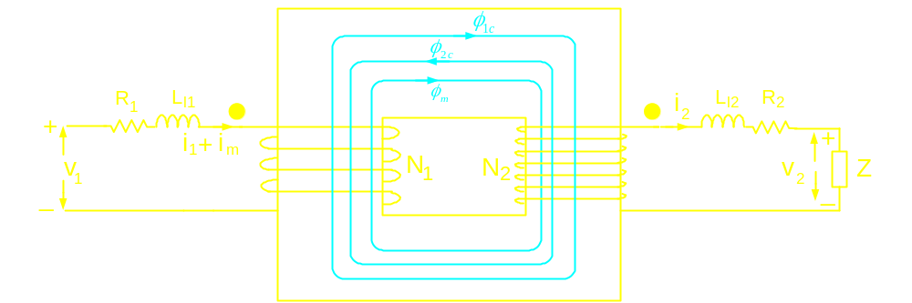
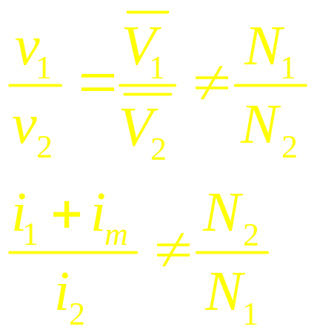
Circuit model of a realistic transformer

Slide 17
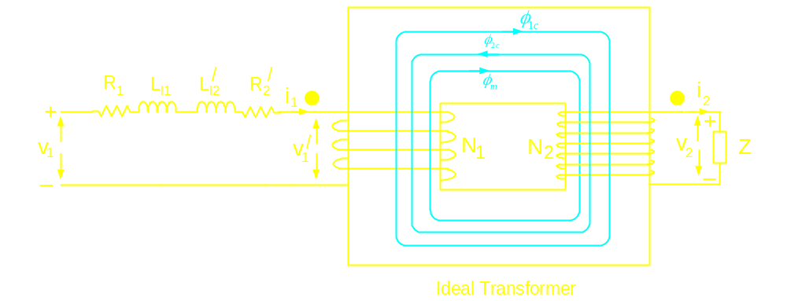

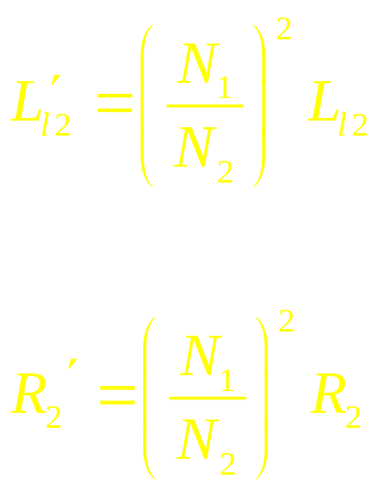
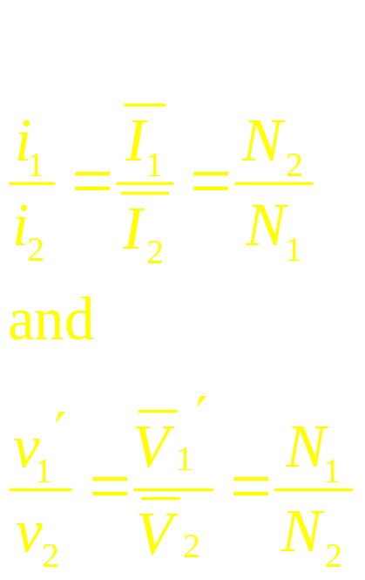

Circuit model of a realistic transformer

Slide 18
Losses in a transformer:
Iron Loss: Hysteresis Loss
Eddy current Loss
- Function of voltage for a given frequency
modelled by incorporating a resistance in
parallel to the source
Copper loss: Ohmic loss incurred in the windings
modelled by R₁ and R₂
To account for the magnetizing current: Incorporation of inductance in parallel to the source.

Slide 19
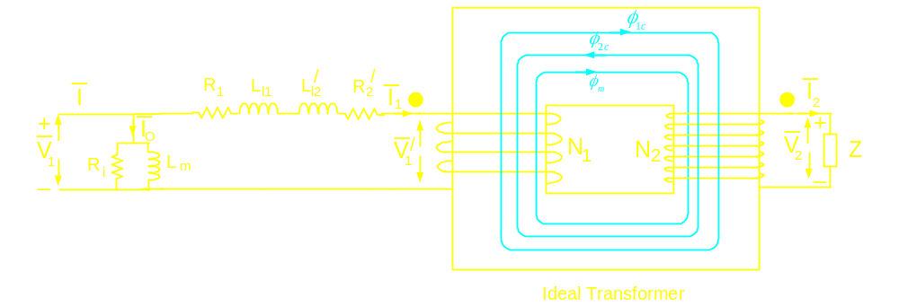
Complete circuit model of the transformer
I_{o} = No load current of the transformer,
accounts for no load loss and magnetizing
current

Slide 20
Applications of transformer:
Voltage matching
Voltage boosting for power transmission
Impedance matching
Isolation – voltage and current sensing

