Slide 1


Internet and Web Technologies
Lecture 1: Asynchronous Communication
Sheema Firdous (PhD AI [cont.], MSc AI, MPhil CS)
sfirdous@oncampus.global

Slide 2
Learning Outcomes
Understanding how Asynchronous communication works
Asynchronous communication in JavaScript
JSON use case

Slide 3

Asynchronous Communication?

Slide 4
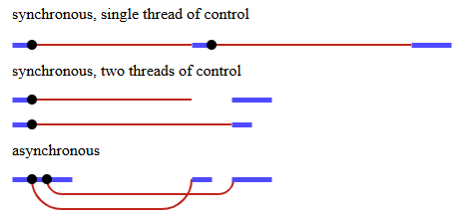
Asynchronous Communication
An asynchronous model allows multiple things to happen at the same time.
When we start an action, our program continues to run.
When the action finishes, the program is informed and gets access to the result.

Slide 5

Asynchronous Communication in JavaScript

Slide 6
Asynchronous Communication in JavaScript
JavaScript can execute other tasks without waiting for time-consuming operations to finish.
It uses Callbacks, Promises, and Async/Await mechanisms to manage operations that complete at different times and handle their results.
The Event Loop coordinates asynchronous tasks, allowing JavaScript to process completed operations and execute their callbacks without blocking the main thread.
Non-Blocking Execution
Handling Async Operations
Concurrency

Slide 7

Accessing JSON
Fetch API
HTTP request
JSON file
JS Object
XMLHTTP Request
Creates HTTP request
JSON file
Process when request completes
Create HTTP requests
Await > Parse JSON
data
Async/ Awaits
Async function

Slide 8
References
BOOK: Eloquent JavaScript (2024) [OPEN ACCESS: https://eloquentjavascript.net/]
https://dev.to/wisdomudo/how-to-handle-json-data-in-javascript-asynchronous-guide-2omp

