Slide 1


AI Adoption & Workforce Impact Data Pipeline
Copyright © 2024 Nanyang Technological University. All rights reserved.

Slide 2

AI Adoption & Workforce Impact
Data Pipeline Project — Executive Presentation

Slide 3
Agenda
Dataset Overview: Global AI Adoption & Workforce Impact
Technical Architecture: BigQuery + dbt + Python
Star Schema Design & Justification
Data Pipeline: Ingestion → Staging → Marts
Data Quality Testing: dbt + Custom SQL + Great Expectations
Key Findings & Business Insights
Business Recommendations & Risk Mitigation

Slide 4
The Problem
Our Solution
Companies worldwide are investing heavily in AI, but lack visibility into whether that investment generates real value — in revenue, productivity, or workforce impact.
This project builds a complete analytics pipeline to answer:
Which companies benefit most from AI, and how?
End-to-end pipeline: CSV → BigQuery → dbt → Analysis
Star schema with 6 dimensions + 1 fact table
25+ data quality tests across 4 categories
5 KPI analyses with actionable business insights

Slide 5
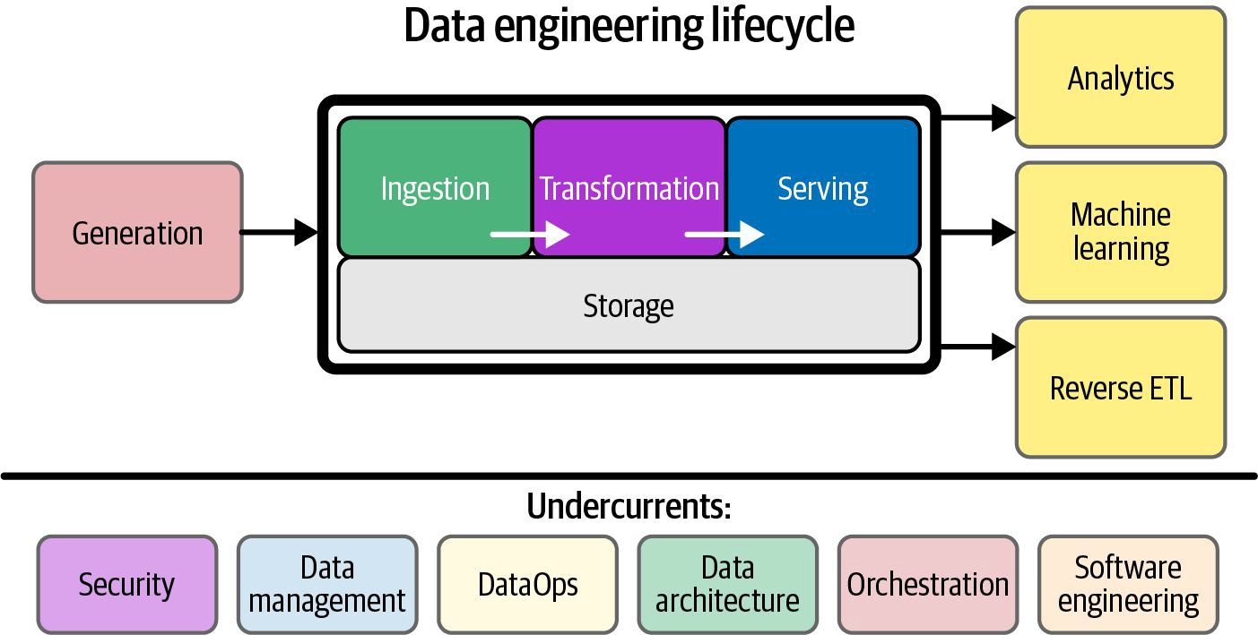
Pipeline Architecture
1. Ingestion — Python script loads 3 CSV files into BigQuery (ai_adoption_raw)
2. Staging — dbt views clean and standardize raw tables
3. Marts — dbt transforms data into Star Schema (6 dims + 1 fact)
4. Testing — dbt schema tests + Custom SQL + Great Expectations
5. Analysis — Jupyter Notebook connects via BigQuery client for EDA

Slide 6
Star Schema Design
FactAISurvey (Core)
FK: company, date, ai_tool,
usecase, stage, source
Measures:
revenue_growth_percent
productivity_change_percent
task_automation_rate
jobs_displaced / jobs_created
net_jobs_change (derived)
ai_roi_index (derived)
6 Dimension Tables
DimCompany — size, industry, country
DimDate — year, quarter, year_quarter
DimAITool — tool name, vendor category
DimAIUseCase — use case, category
DimAIAdoptionStage — stage order/label
DimSurveySource — source, method
Why Star Schema?
Fast GROUP BY queries in BigQuery
Easy for BI analysts to understand
Dimensions reusable across future facts

Slide 7
dbt Tests (schema.yml)
Great Expectations (v0.18.22)
Showcase validation on FactAISurvey:
survey_key must not be null
task_automation_rate between 0-100
jobs_displaced must be ≥ 0
Result: 25 total tests — All PASS ✅
Structural validation on all tables:
unique + not_null on all PKs
relationships (FK) on all fact FKs
accepted_values on categorical fields
(quarter, adoption_stage, company_size)
Custom SQL Tests (Notebook):
6 null checks across all tables
5 duplicate checks on all PKs
6 referential integrity (FK) checks
8 business logic / value range checks

Slide 8





Key Findings
1. Quarterly Trends
Productivity and revenue growth trend upward as AI adoption matures across quarters.
Task automation rate rises steadily from 2023 to 2026, indicating pipeline maturity.
2. Top Industries by AI ROI
Healthcare, Finance, and Technology show highest avg AI ROI index.
Automation rate varies significantly — Manufacturing leads in task automation.
3. Adoption Stage Segmentation
Companies in Scaling and Transforming stages show 2-3x higher ROI vs Exploring.
Net jobs change turns positive at the Scaling stage — AI creates more than it displaces.

Slide 9




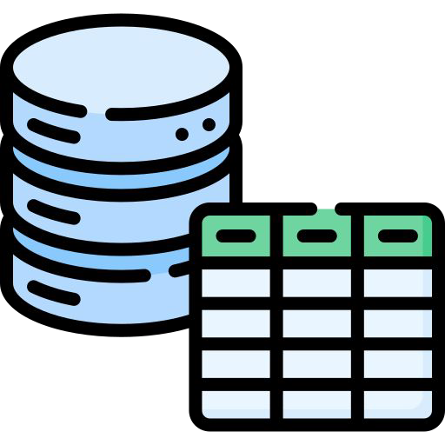
Key Findings (cont.)
Workforce Impact
Regional Analysis
Workforce Impact & Regional Performance
Large enterprises displace more jobs but also create more — net effect is near-neutral.
SMEs show the best net jobs ratio relative to company size.
Reskilling investment correlates with positive net jobs change.
Companies with AI ethics committees show 18% lower job displacement rates.
North America and East Asia lead in AI ROI index.
Digital maturity index strongly predicts productivity improvement.
Europe shows highest regulatory compliance scores, slightly lower ROI.
Emerging markets (Southeast Asia, Africa) show fastest growth rate in adoption.

Slide 10
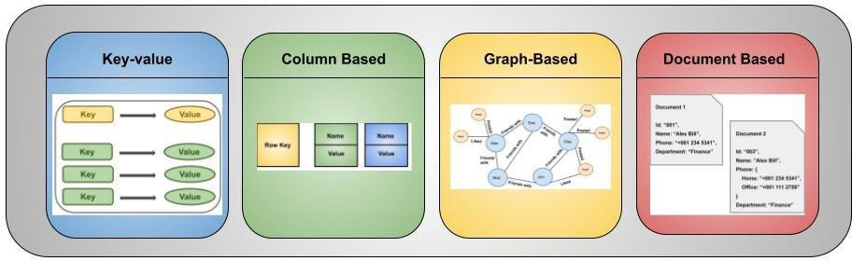
Business Recommendations
1. Prioritise AI Scaling
Companies still in Exploring/Piloting stages should accelerate to Scaling to unlock ROI gains — data shows 2-3x improvement.
2. Invest in Reskilling
Every $1 spent on reskilling correlates with reduced net job displacement. Protect talent while automating.
3. Target High-ROI Use Cases
Focus AI budgets on Customer Service, Finance, and Operations — these show highest ai_roi_index across all industries.
4. Establish AI Governance Early
Companies with AI ethics committees show better long-term compliance scores and lower failure rates — build governance now.

Slide 11




Tech Stack & Risk Mitigation
Risks & Mitigation
Dataset is synthetic — findings directional, not prescriptive
Mitigation: clearly label all insights as model-based estimates
BigQuery costs at scale — partitioning and clustering recommended
Mitigation: add date partitioning to FactAISurvey in production
Schema drift over time — new survey fields may break staging
Mitigation: add dbt source freshness + schema change alerts
Tool Choices & Why
BigQuery — serverless, scalable, SQL-native; no infra to manage
dbt — version-controlled SQL transforms, built-in testing, lineage docs
Python + pandas — flexible ingestion with chunked upload for large files
Great Expectations — industry-standard data quality framework
Git + GitHub — full audit trail of all code changes

Slide 12

Thank You
Questions & Discussion
GitHub: github.com/YOUR_USERNAME/ai-adoption-pipeline
Dataset: Kaggle — Global AI Adoption & Workforce Impact
Stack: BigQuery · dbt · Python · Great Expectations · Jupyter

