Slide 1




Basic Flow
Extraction
Processing
Manufacturing
Extraction of Raw Materials
Process raw materials into Processed Materials
Requires 2 units of raw material to produce 1 processed material
Duration occurs at different rates for region, depending on the demand.
Manufacture Processed Materials into Chips
1 processed material produces 2 chips
Duration occurs at different rates for region, depending on the demand.
Assembly
Assemble Chips into Devices
3 Chips is needs to assemble 1 device
Duration occurs at different rates for region, depending on the demand.)
Distribution
Devices are distributed at different rates for region, depending on the demand.
This process does not incur costs, and gives profits instead
This process incurs costs.
This process incurs costs.
This process incurs costs.
This process incurs costs.
1 raw material is extracted at a rate of ~ exponential (30 d)
Raw Material
Processed Material
Chip
Device

Slide 2
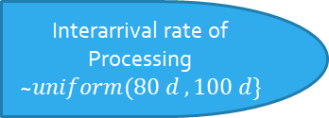

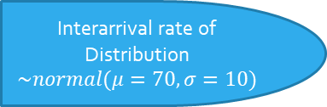
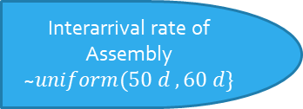
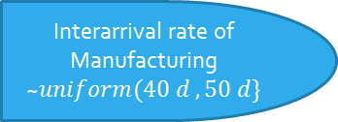
Basic Flow
Initialize
Interarrival rate of Manufacturing ~$uniform(40 d , 50 d\}$
Interarrival rate of Distribution $$\sim normal(μ=70,σ=10)$$
Interarrival rate of Extraction ~$exponential(30 days\}$
Manufacturing
Arrival
Extraction
2 chips produced
>3 Chips?
>2 Raw Materials?
Finish
Interarrival rate of Processing ~$uniform(80 d , 100 d\}$
Interarrival rate of Assembly ~$uniform(50 d , 60 d\}$
Processing
Assembly

Slide 3
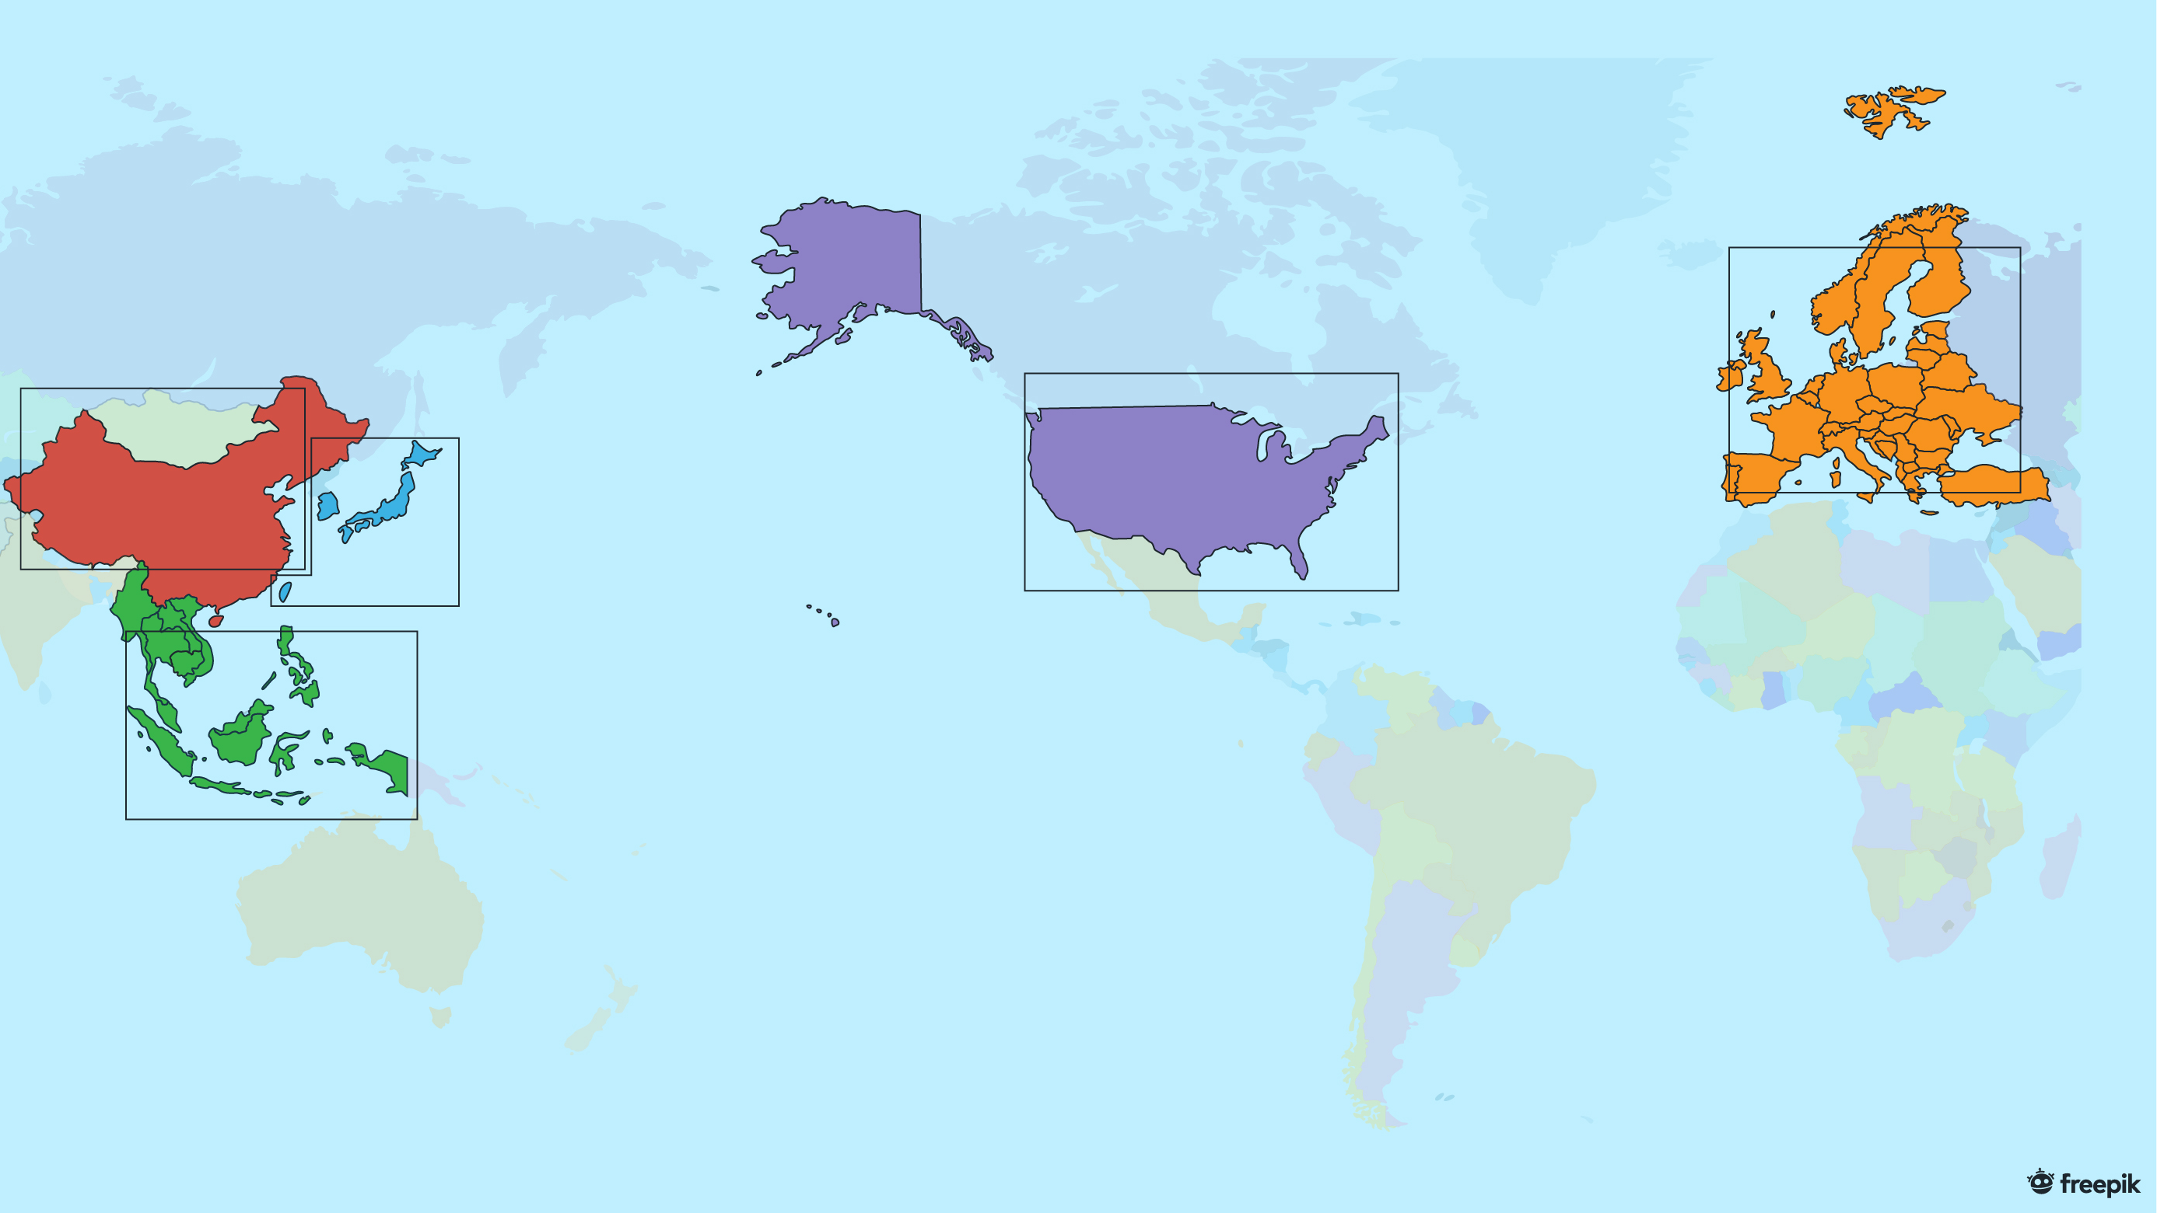
China
East Asia
Europe
United States of America
Southeast Asia
Simulator Semiconductor Supply Chain Network (Past)

Slide 4
Processing
China
Manufacturing
Extraction
Extraction
Processing
East Asia
Distribution
Assembly
Processing
Manufacturing
Assembly
Distribution
Manufacturing
Europe
Distribution
Distribution
United States of America
Extraction
Assembly
Distribution
Southeast Asia
Simulator Semiconductor Supply Chain Network (Past)

Slide 5
China
East Asia
Europe
United States of America
Southeast Asia
Simulator Semiconductor Supply Chain Network (Future)

Slide 6
Processing
China
Manufacturing
Extraction
Processing
East Asia
Extraction
Processing
Distribution
Manufacturing
Assembly
Processing
Manufacturing
Assembly
Manufacturing
Europe
Distribution
Distribution
Distribution
United States of America
Extraction
Assembly
Distribution
Southeast Asia
Simulator Semiconductor Supply Chain Network (Future)

Slide 7
Breakdown of processes done by each Country
China
Extraction
Processing (Future Simulation only)
Manufacturing (Future Simulation only)
Assembly
Distribution
Southeast Asia
Extraction
Assembly
Distribution
East Asia
Processing
Manufacturing
Distribution
America
Extraction
Processing
Manufacturing
Assembly
Distribution
Europe
Processing
Manufacturing
Distribution

Slide 8
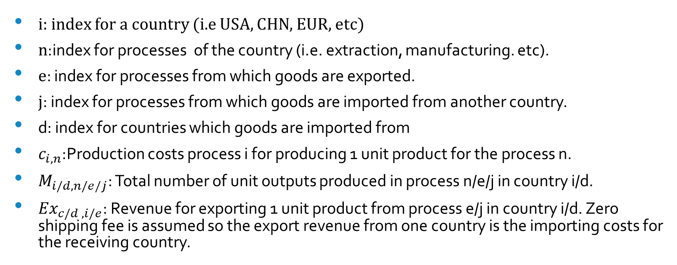

$$Profit_{i}=−\sum_{all n}{c_{i,n}M_{i,n}}+\sum_{all e}{{Ex}_{i,e}M_{i,e}}−\sum_{all j}{{Ex}_{d,j}M_{d,j}}$$
Equation for Profit
Total Production Costs
Total Export Revenue
Total Import Costs
i: index for a country (i.e USA, CHN, EUR, etc)
n:index for processes of the country (i.e. extraction, manufacturing. etc).
e: index for processes from which goods are exported.
j: index for processes from which goods are imported from another country.
d: index for countries which goods are imported from
$c_{i,n}$:Production costs process i for producing 1 unit product for the process n.
$M_{i/d,n/e/j}$: Total number of unit outputs produced in process n/e/j in country i/d.
${Ex}_{c/d , i/e}$: Revenue for exporting 1 unit product from process e/j in country i/d. Zero shipping fee is assumed so the export revenue from one country is the importing costs for the receiving country.

Slide 9
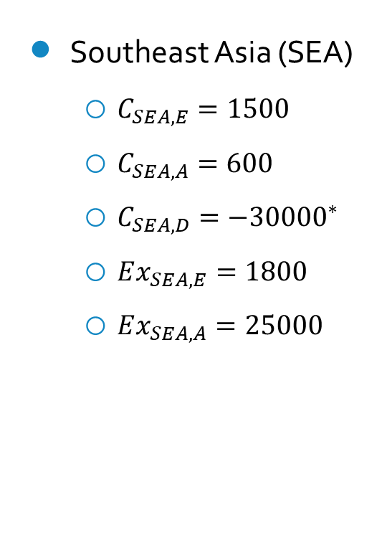
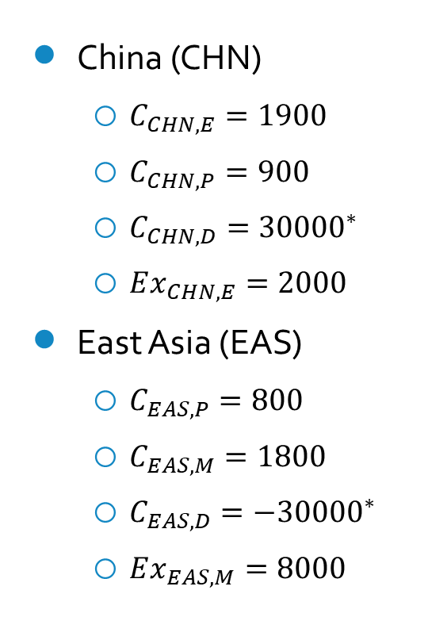
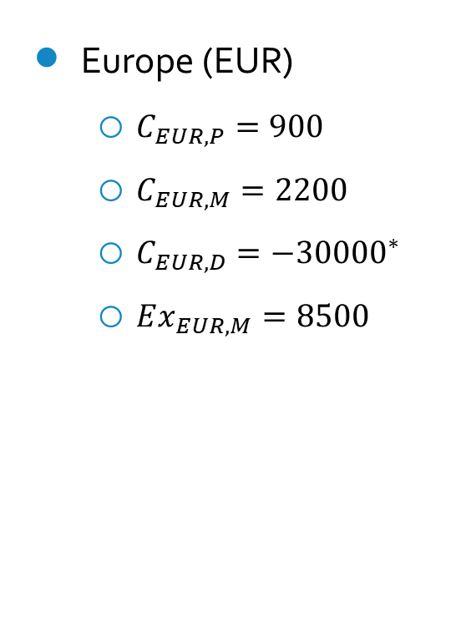
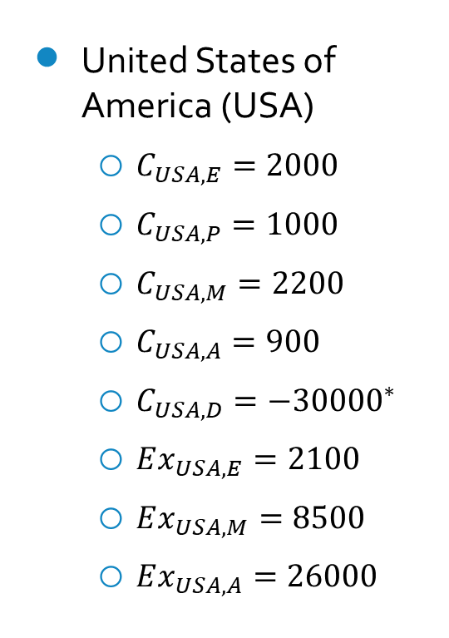
Breakdown of Production costs and Export Revenues for Past Simulation
China (CHN)
$C_{CHN,E}=1900$
$C_{CHN,P}=900$
$C_{CHN,D}={30000}^{∗}$
$Ex_{CHN,E}=2000$
East Asia (EAS)
$C_{EAS,P}=800$
$C_{EAS,M}=1800$
$C_{EAS,D}=−{30000}^{∗}$
$Ex_{EAS,M}=8000$
Southeast Asia (SEA)
$C_{SEA,E}=1500$
$C_{SEA,A}=600$
$C_{SEA,D}=−{30000}^{∗}$
$Ex_{SEA,E}=1800$
$Ex_{SEA,A}=25000$
United States of America (USA)
$C_{USA,E}=2000$
$C_{USA,P}=1000$
$C_{USA,M}=2200$
$C_{USA,A}=900$
$C_{USA,D}=−{30000}^{∗}$
$Ex_{USA,E}=2100$
$Ex_{USA,M}=8500$
$Ex_{USA,A}=26000$
Europe (EUR)
$C_{EUR,P}=900$
$C_{EUR,M}=2200$
$C_{EUR,D}=−{30000}^{∗}$
$Ex_{EUR,M}=8500$
*Note: Process cost for Distribution is negative as each country gains revenue from distribution

Slide 10
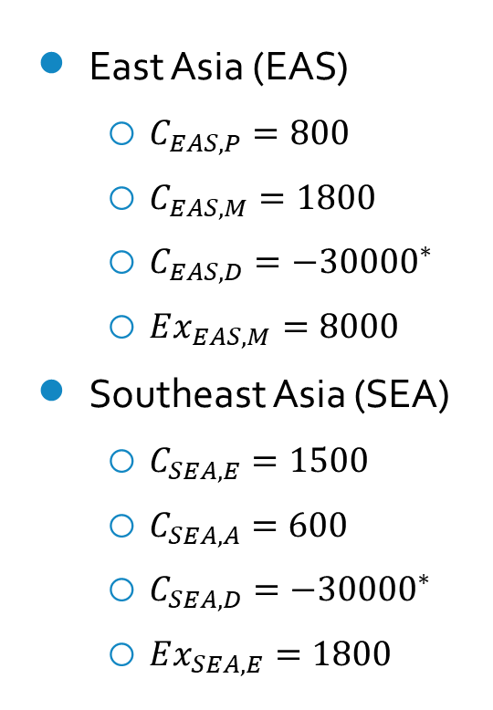
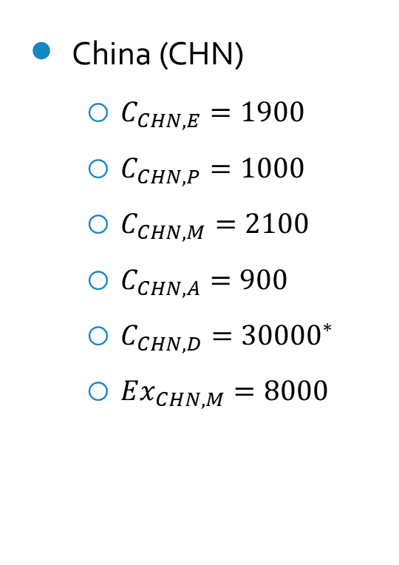
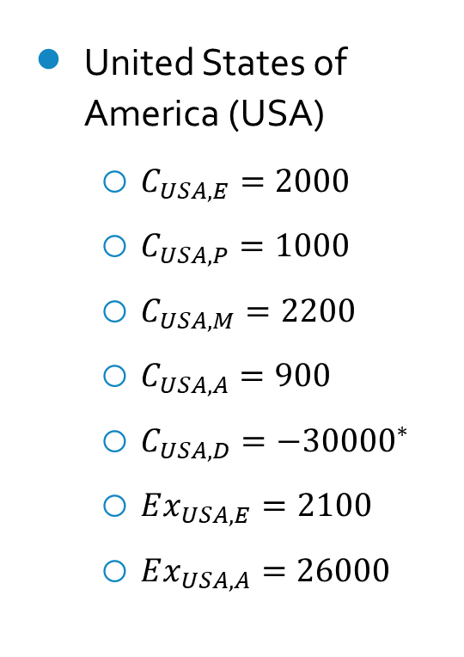
Breakdown of Production costs and Export Revenues for Future Simulation
China (CHN)
$C_{CHN,E}=1900$
$C_{CHN,P}=1000$
$C_{CHN,M}=2100$
$C_{CHN,A}=900$
$C_{CHN,D}={30000}^{∗}$
$Ex_{CHN,M}=8000$
East Asia (EAS)
$C_{EAS,P}=800$
$C_{EAS,M}=1800$
$C_{EAS,D}=−{30000}^{∗}$
$Ex_{EAS,M}=8000$
Southeast Asia (SEA)
$C_{SEA,E}=1500$
$C_{SEA,A}=600$
$C_{SEA,D}=−{30000}^{∗}$
$Ex_{SEA,E}=1800$
United States of America (USA)
$C_{USA,E}=2000$
$C_{USA,P}=1000$
$C_{USA,M}=2200$
$C_{USA,A}=900$
$C_{USA,D}=−{30000}^{∗}$
$Ex_{USA,E}=2100$
$Ex_{USA,A}=26000$
Europe (EUR)
$C_{EUR,P}=900$
$C_{EUR,M}=2200$
$C_{EUR,D}=−{30000}^{∗}$
$Ex_{EUR,M}=8500$
*Note: Process cost for Distribution is negative as each country gains revenue from distribution

