Slide 1
Twitter Hate Speech Analysis
Milestone Four
Colin Green & Sean Zhang

Slide 2
Feature selection
Univariate Analysis, Feature Importance using Extra Trees and Recursive Feature Elimination
Created 3 different datasets for each type (small (approx. 250 features), medium (approx. 900 features), and large (approx. 1500-2500 features)
Benchmarked each data set using logistic regression and random forest
Additional attempt using the top ranked features based on TF-IDF count.

Slide 3

Benchmarks

Slide 4
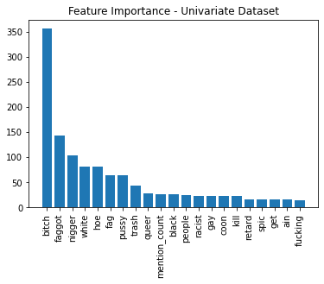
Univariate (medium - 920) – Top Features

Slide 5
Comparison with full Dataset

Slide 6
From previous milestone

Slide 7
Model Performance

Slide 8
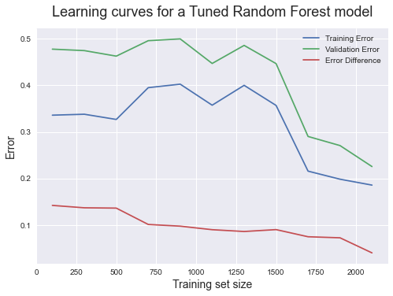
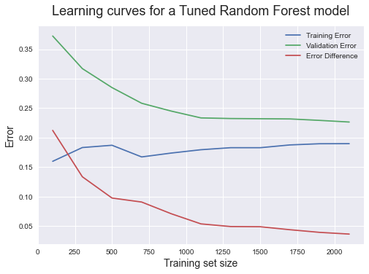
Learning curves – Random Forest
Full TF-IDF
Univariate

Slide 9
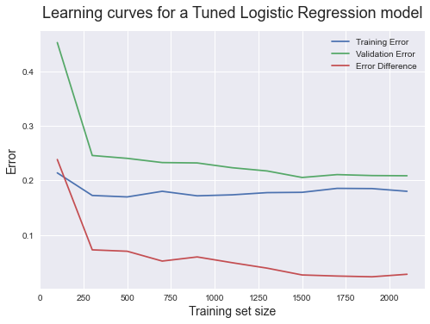
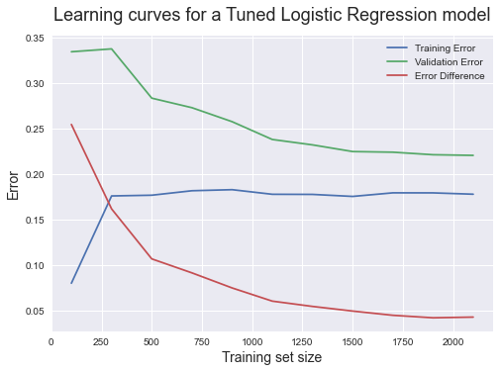
Learning Curves – Logistic Regression
Full TF-IDF
Univariate

