Slide 1

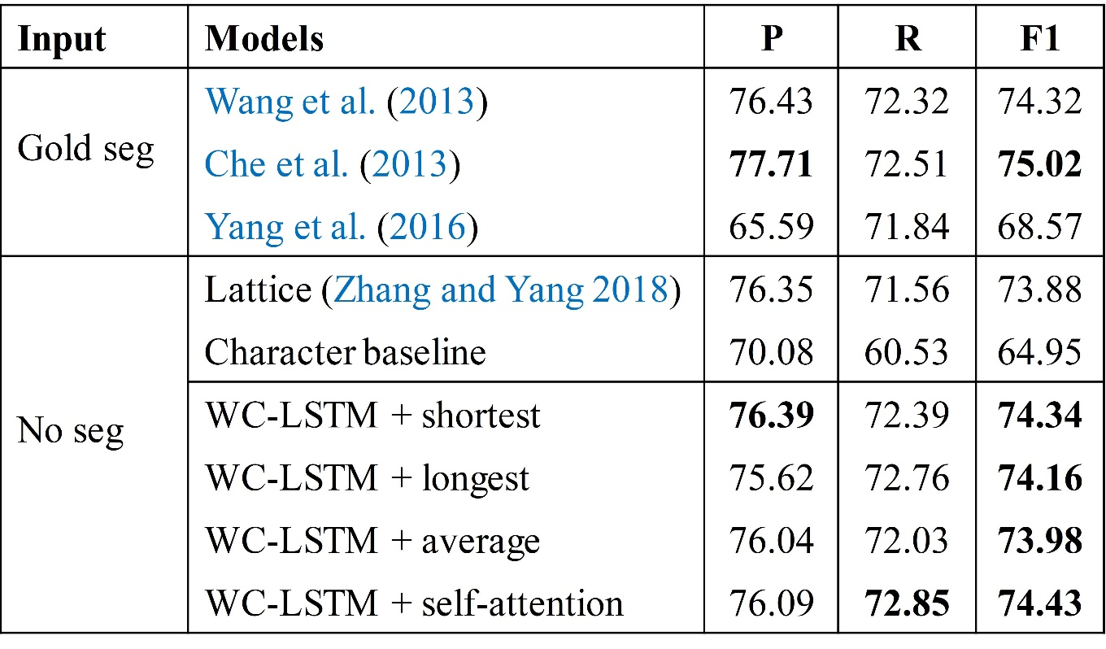
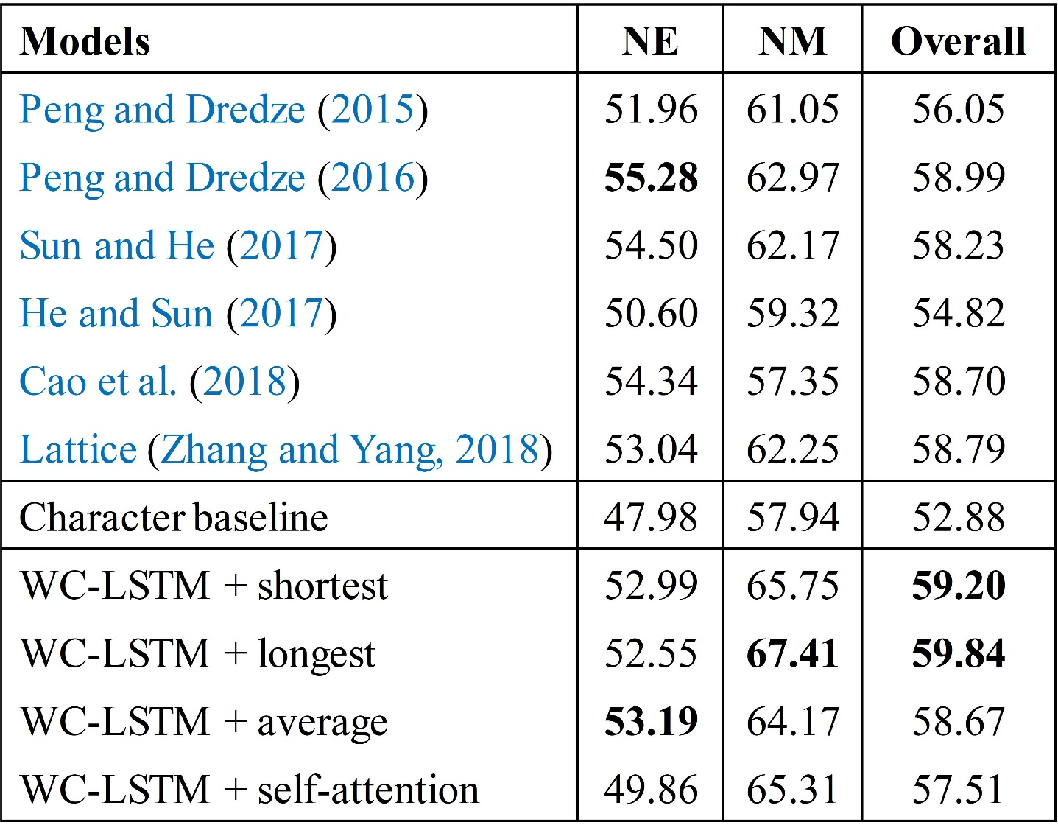
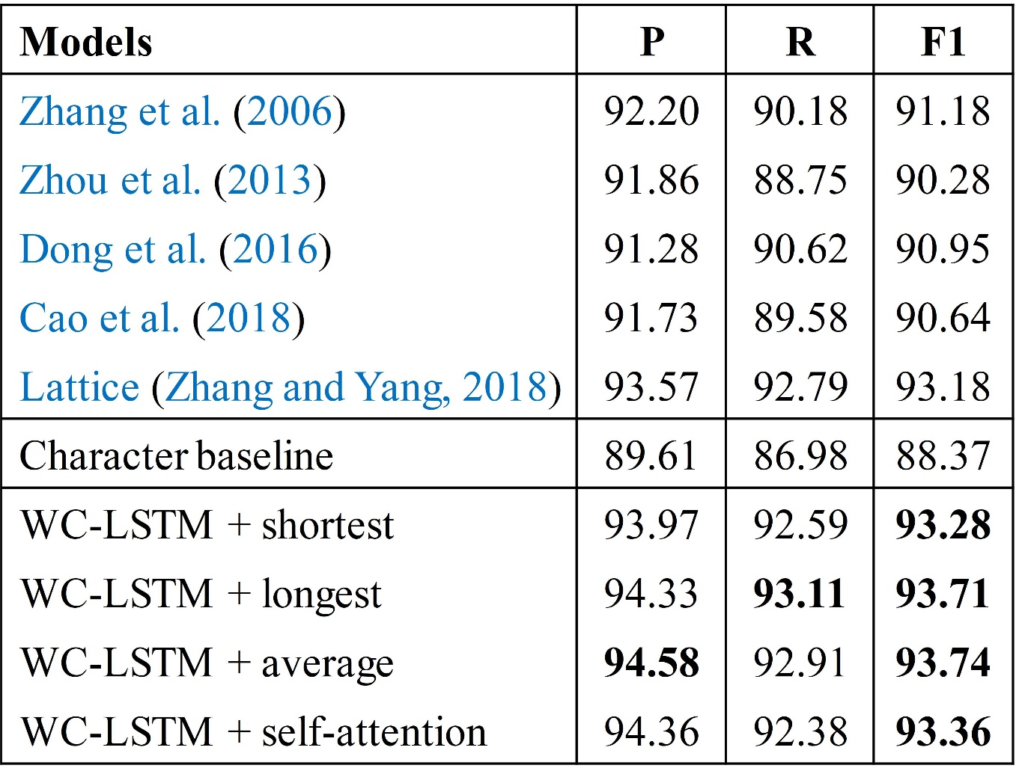
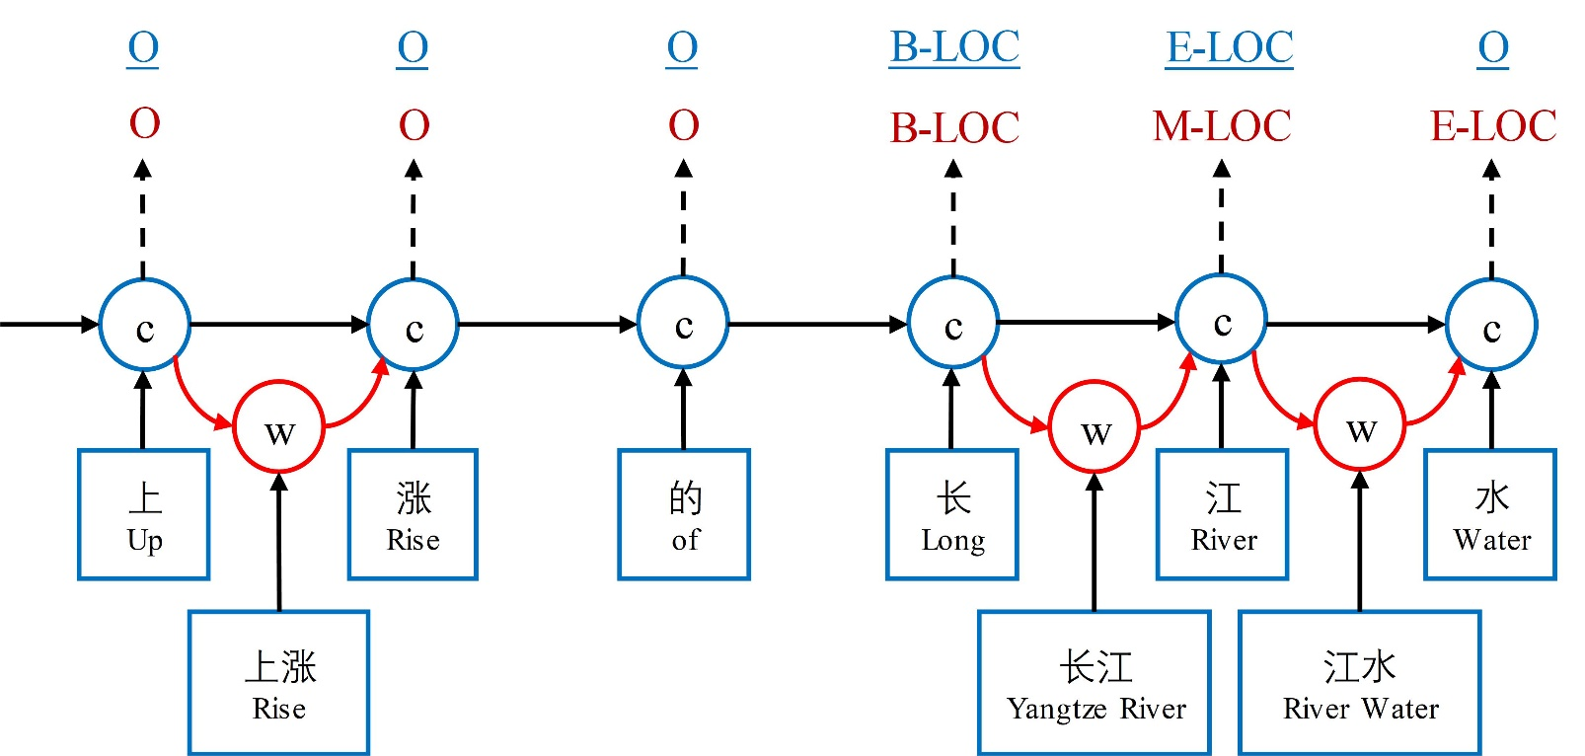
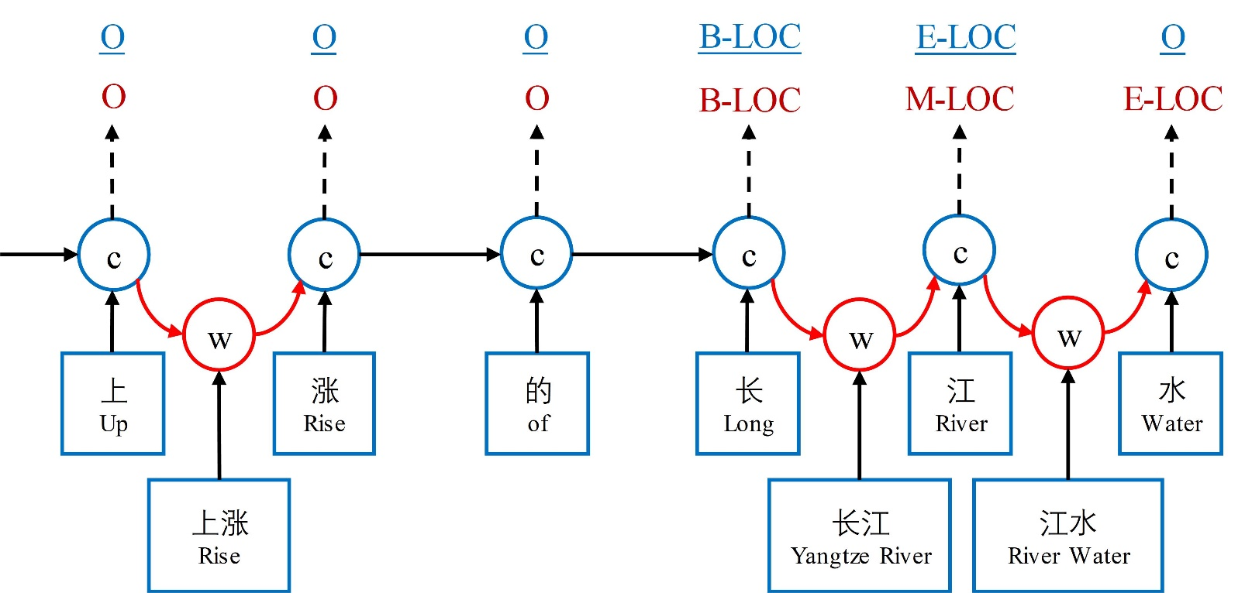
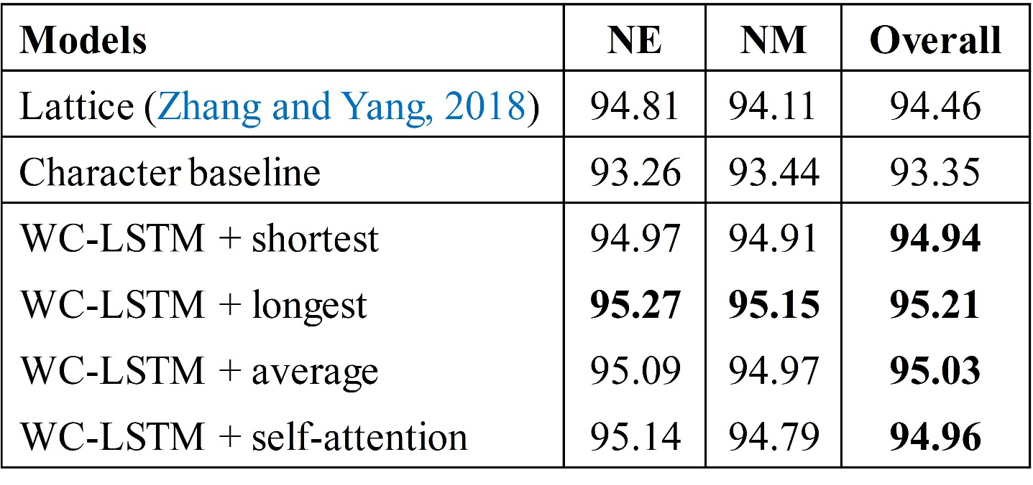
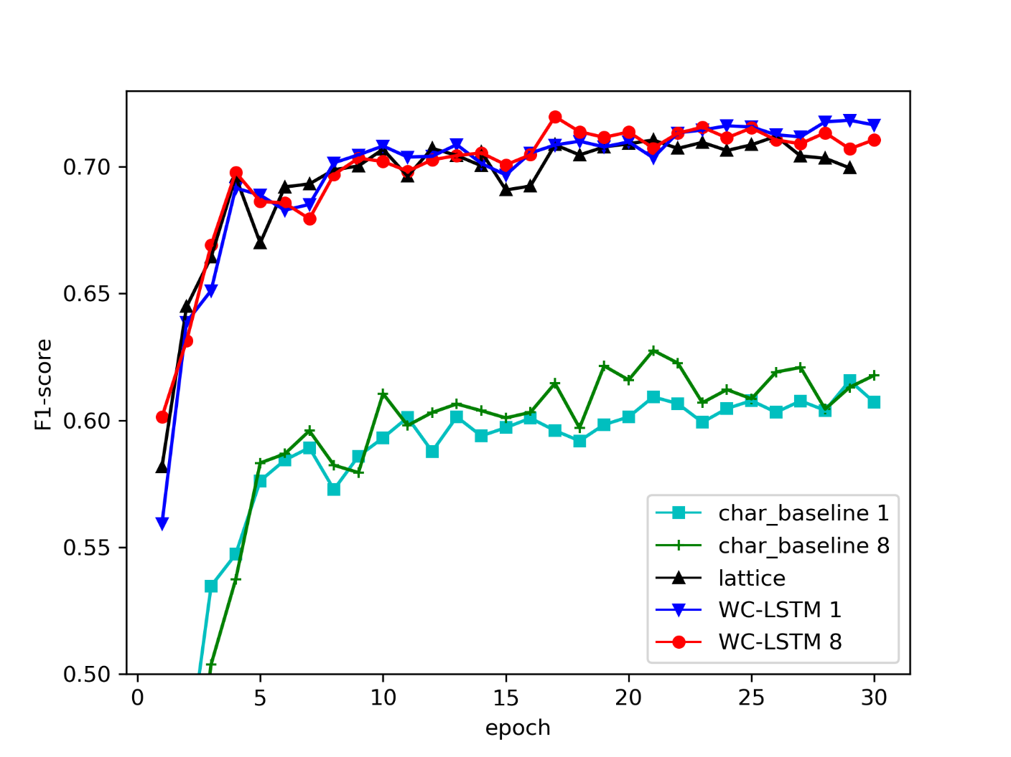
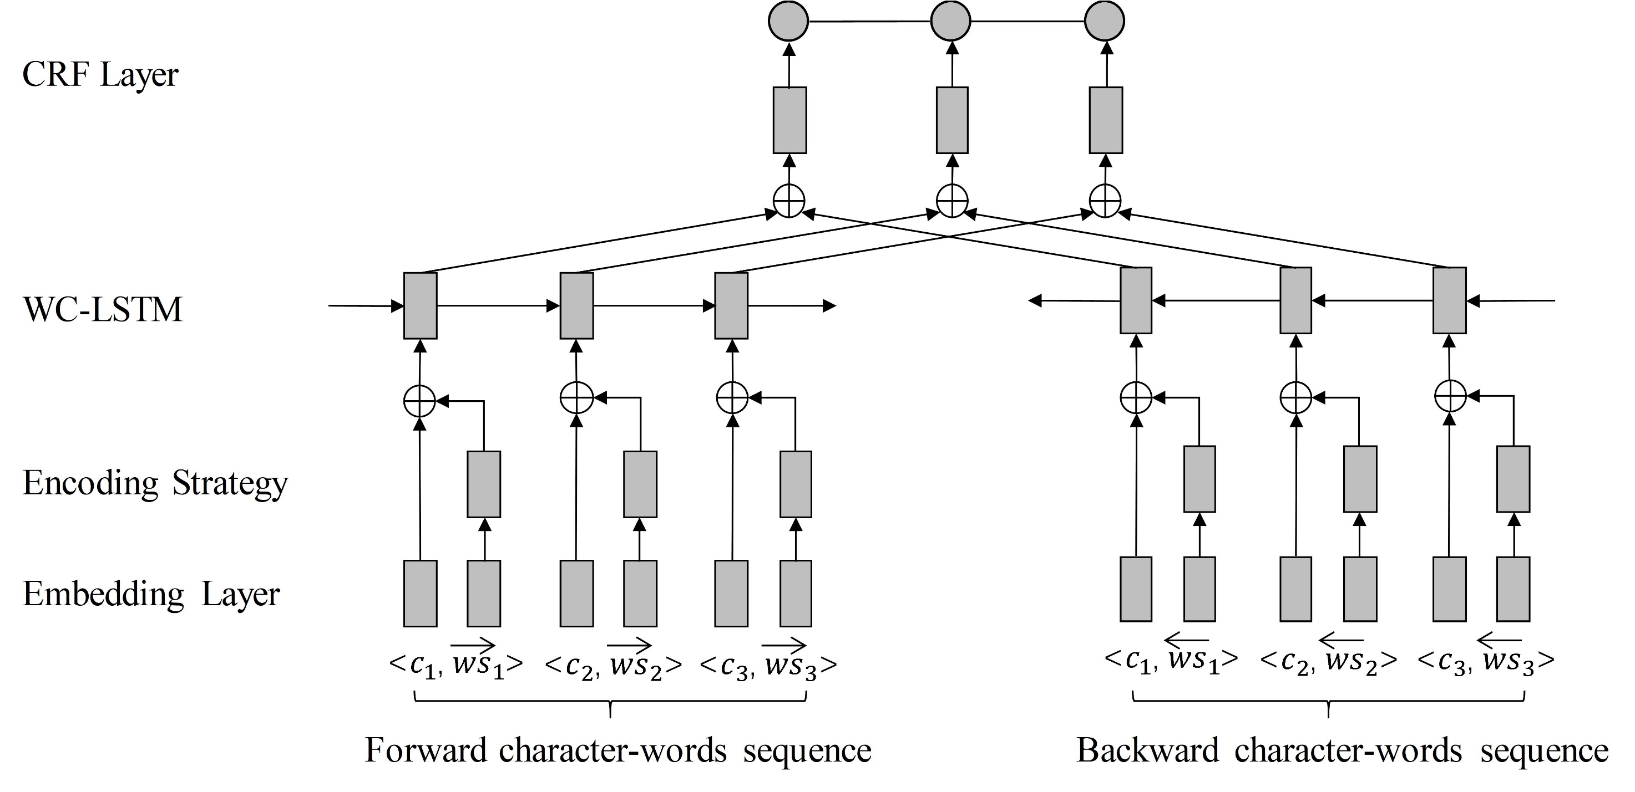
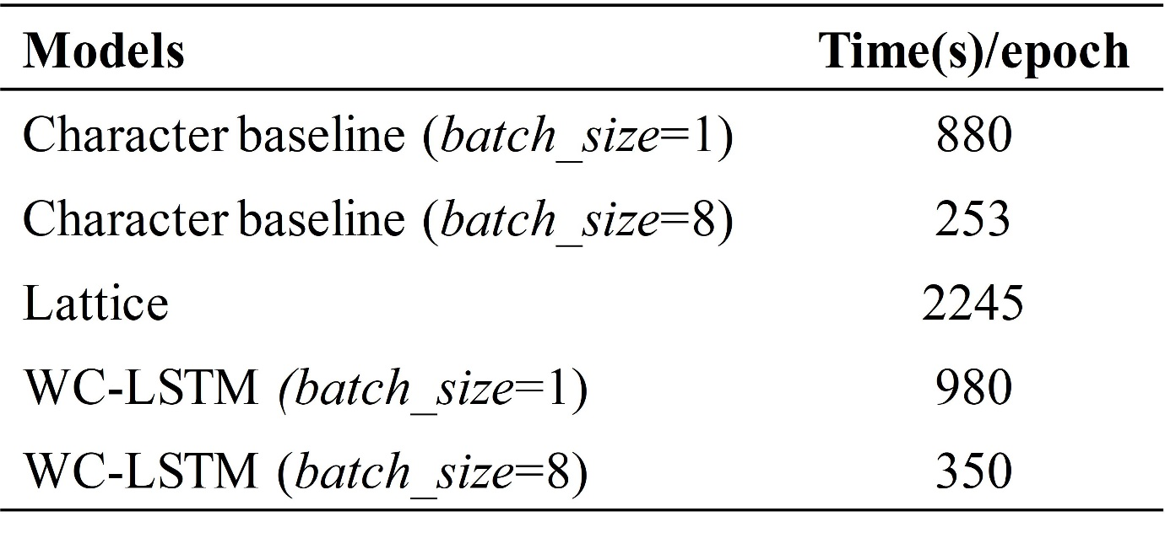
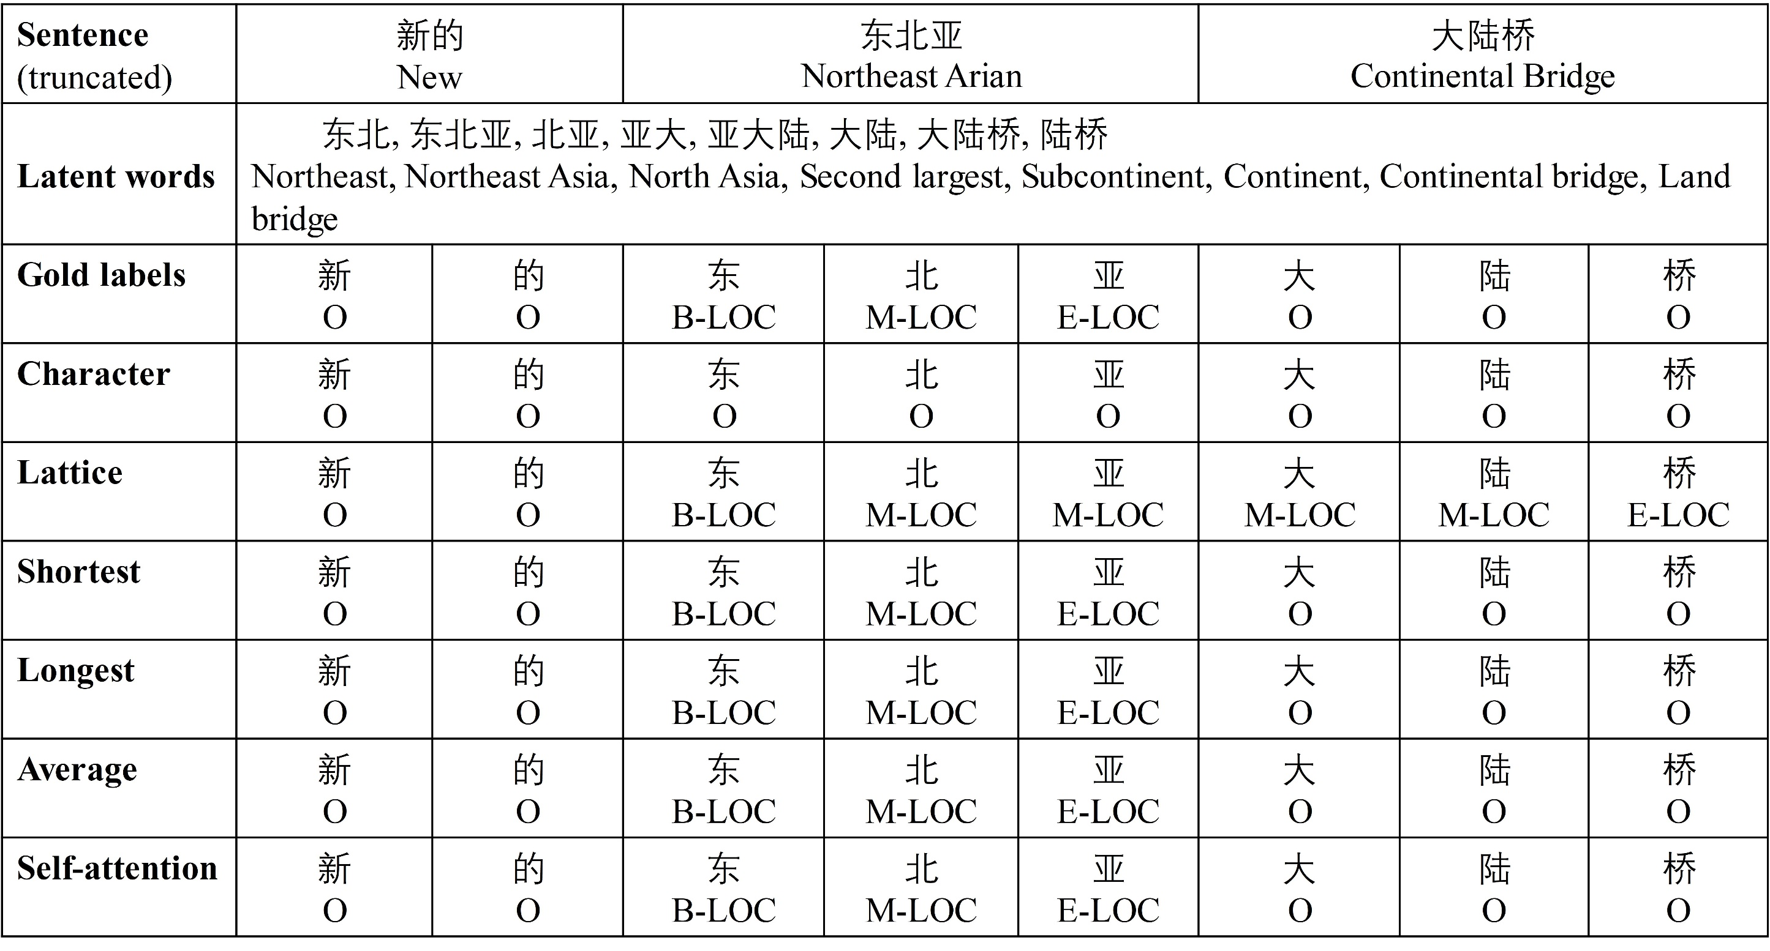
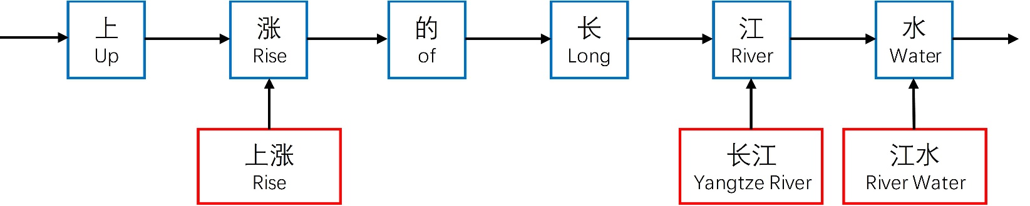
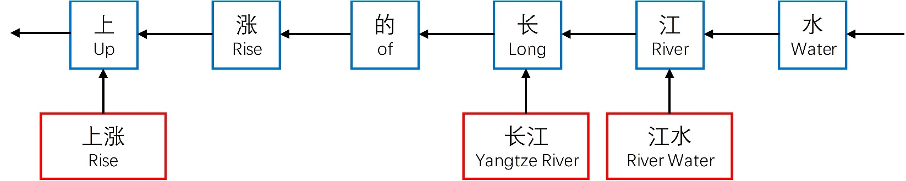
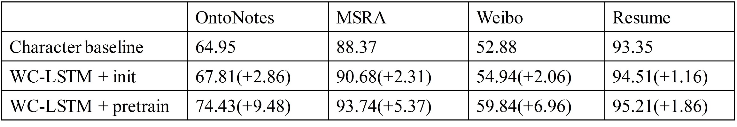
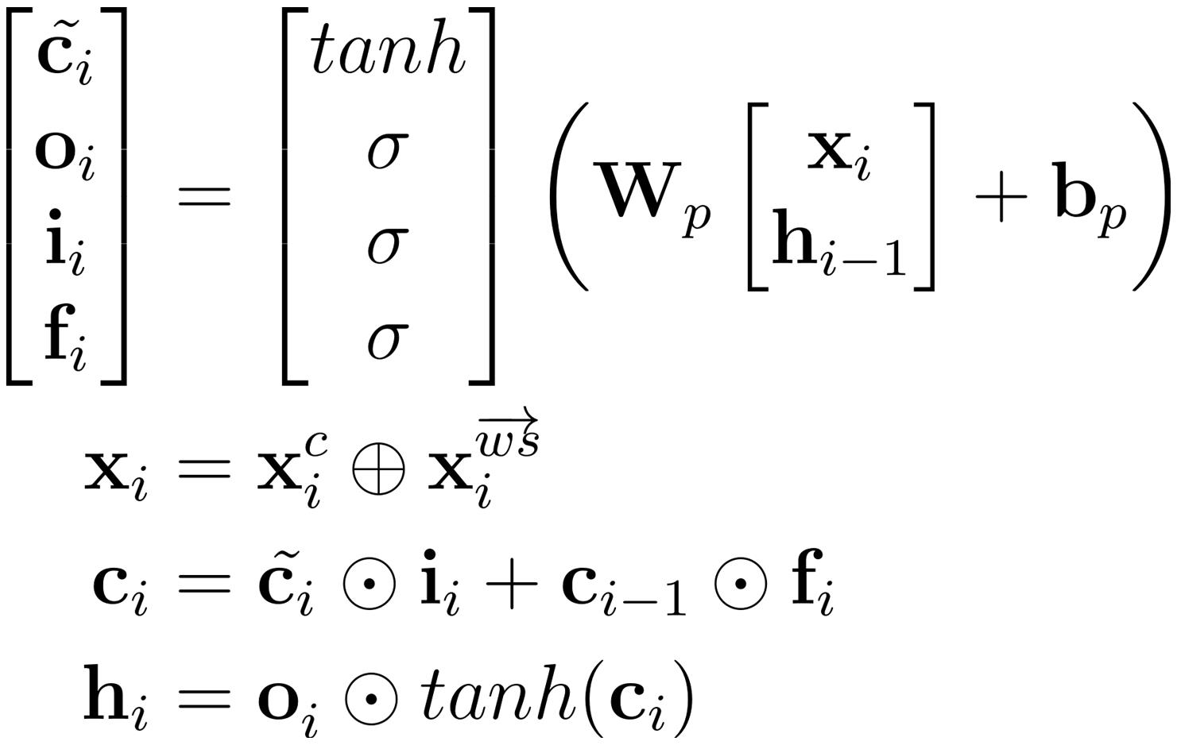
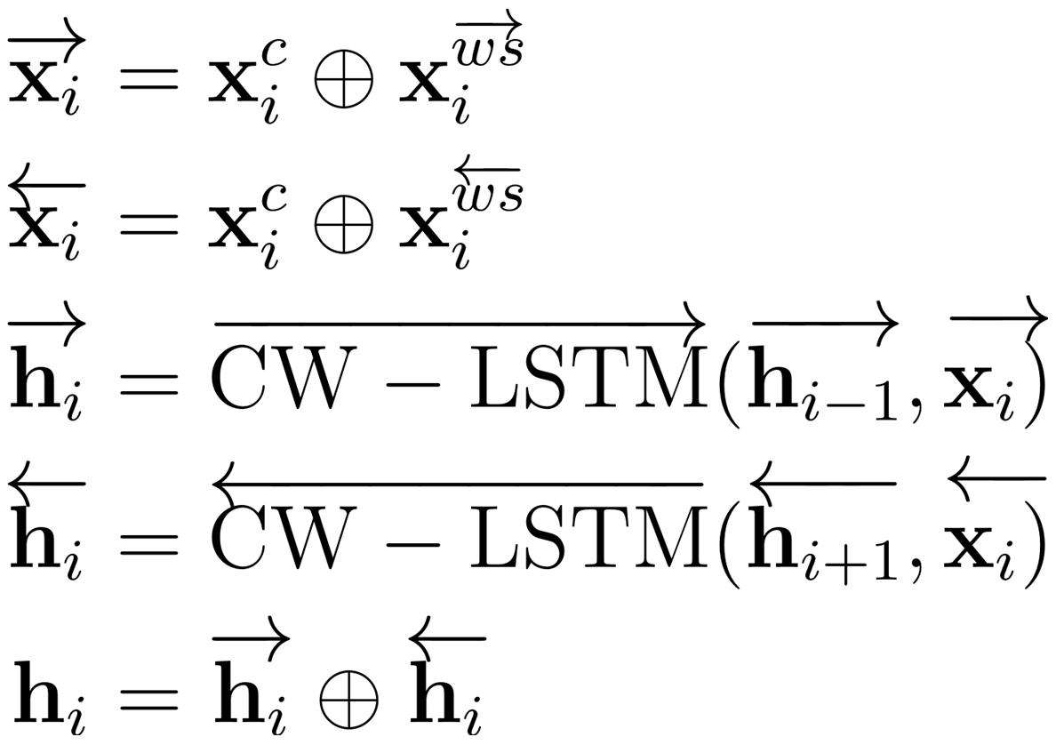
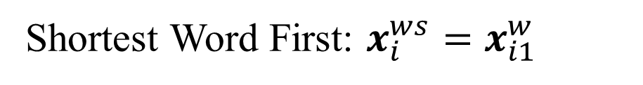
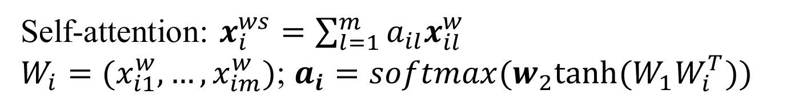
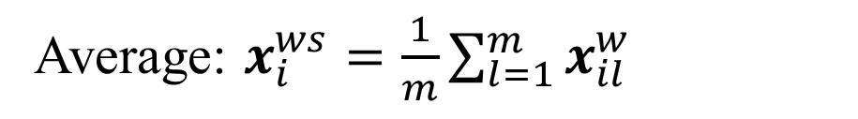
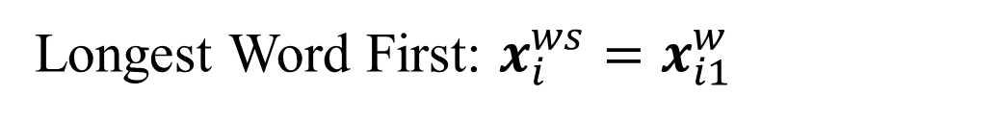
An Encoding Strategy Base Word-Character LSTM for Chinese NER
Wei Liu^{1,2*}, Tongge Xu^{2,1}, Qinghua Xu^{1,2}, Jiayu Song², Yuran Zu²
¹Hefei Innovation Research Institute, Beihang University
²School of Computer Science and Technology, Beihang University
*Email : liuwei1206@buaa.edu.cn
Introduction
Experiments
Named Entities Recognition(NER) is a key component for Information Retrieval, Question Answering, Knowledge Graph, etc. Most existing Chinese NER methods are character-based to avoid segmentation errors, consequently, they neglect the word information in character sequence. A recently proposed lattice model has demonstrated that words in character sequence can provide rich word boundary information for character-based Chinese NER model to make more accurate predictions. However, their way using a shortcut path to integrate word information between characters may cause the lattice model to degenerate into a partial word-based model, which will suffer from word segmentation errors. Furthermore, the lattice model can not be trained in batches due to its DAG structure. In this paper, we propose a novel word-character LSTM to add word information into the start or end character of the word, alleviating the influence of word segmentation errors while obtaining word boundary information. We also introduce four different strategies to encode words information into a fixed-size representation for efficient batch training. Experiments on benchmark datasets show that our proposed model outperforms other state-of-the-art models.
We conduct experiments on four benchmark datasets, including OntoNote4.0, MSRA, Weibo NER, and Chinese resume dataset, to demonstrate the effectiveness of our proposed method.
Results on OntoNote4.0
Results on Weibo
(a) Origin Lattice model
(b) Degraded lattice model in extreme cases
Results on MSRA
Results on Chinese Resume
Method
The comparison of our methods and the lattice model in terms of training time and convergence speed.
Case study
Character-words sequence
We represent a Chinese sentence as a character-words sequence, in which each word is assigned to its end and start character in forward and backward sequence respectively. Hence, the word information is subtly integrated into character sequence.
Words encoding strategy
The number of words assigned to each character is different, which is not conducive to batch training. So we introduce four different strategies to encode any number of words into a fixed-dimension information.
How to choose encoding strategy ?
Sufficient training dataset
Formal text: self-attention
Informal text: average
Insufficient training dataset
Inner nested entities: shortest word first
Flat entities: longest word first
Shortest Word First: $x_{i}^{ws}=x_{i1}^{w}$
Longest Word First: $x_{i}^{ws}=x_{i1}^{w}$
Lexicon or pre-trained embedding ?
Average: $x_{i}^{ws}=\frac{1}{m}\sum_{l=1}^{m}{x_{il}^{w}}$
Self-attention: $x_{i}^{ws}=\sum_{l=1}^{m}{a_{il}x_{il}^{w}}$
$W_{i}=(x_{i1}^{w},…,x_{im}^{w})$; $a_{i}=softmax(w_{2}tanh⁡(W_{1}W_{i}^{T}))$
Word-Character LSTM
After obtaining fixed-size word information, we concatenate each character embedding with the corresponding word information.
Conclusion
In this paper, we propose a new method to utilize word information in character sequence for Chinese NER. Four encoding strategies are introduced to extract fixed-sized but different information for batch training. By using WC-LSTM to extract features from the character vector and word vector, our model can effectively exploit word boundary information and mitigate the influence of word segmentation errors. Experiments on datasets in different domains show that our model is more efficient and faster than the lattice model and also outperforms other state-of-the-art models.
In the future, we would like to see whether our methods can be applied to other Chinese NLP tasks.

