Slide 1
Real-Time Badminton Tracking on Edge Devices
A Lightweight ROI-based Architecture
Chapter 1: Motivation, Trends & The Edge Dilemma
Master's Thesis Oral Defense Presentation
Target Hardware: NVIDIA Jetson Nano 4GB (10W MAXN Mode) | Standard: 30.0 FPS Zero-Drop Ingestion
Key Milestone: 96.12% Precision, 30 FPS Real-Time, Verified Across 146 Tournament Clips & Amateur Courts

Slide 2
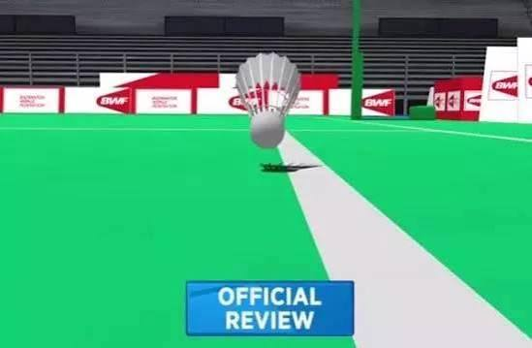
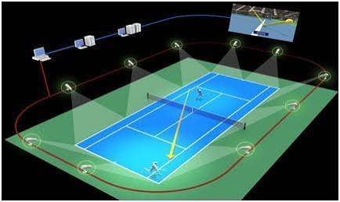
CHAPTER 1 : INTRODUCTION
Motivation & The Accessibility Gap (Why Edge AI for Badminton?)
01 / MASSIVE POPULARITY
02 / THE PROHIBITIVE COST
03 / OUR RESEARCH MISSION
Democratizing Badminton AI
What If We Could Track With:
1. ONE Standard Camera
(Single monocular broadcast view)
2. ONE Accessible Edge Device
(NVIDIA Jetson Nano ~$100 in lab)
3. Standalone Real-Time AI
(Zero-drop 30 FPS processing)
★ The Vision:
Enable portable, low-cost Hawk-Eye tracking in ANY sports venue, empowering amateur players with elite-level sports science!
#1 Ball Sport in Taiwan
> 3 Million active players (9.4% population share), surpassing Basketball (2.1M) & Table Tennis (1.7M).
Why Track Trajectories?
• Weakness discovery & shot patterns
• Automated line-call judging
• Objective tactical coaching
Commercial Hawk-Eye Dilemma
Cost: > $30,000+ USD (~NT$ 1M+)
Requires 8-12 synchronized high-speed cameras, optical fiber, & high-end servers.
The Accessibility Gap:
Extremely high barriers prevent adoption in general badminton venues, school gyms, and amateur clubs.

Slide 3
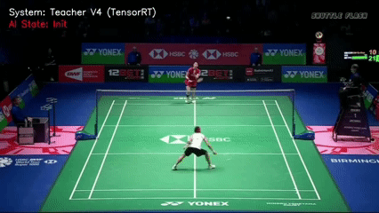
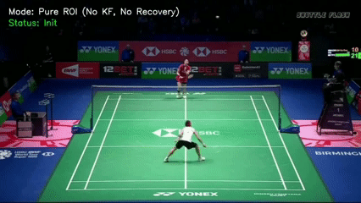
CHAPTER 1 : INTRODUCTION
Background & Trends : The Edge Dilemma (Why Naive Baselines Fail)
Full-Frame Deep Model
TrackNetV4 on Jetson Nano
1,100 ms / frame (< 1 FPS)
Knowledge Distillation (KD)
Shrinks network parameters
0.9 FPS → 4.8 FPS (Still Laggy)
Region of Interest (Mini-ROI)
Cuts image workload (128x128)
Successfully reaches 30 FPS!
Native TrackNetV4 (Full Frame) | 0.9 FPS
❌ 1.1s latency causes >75% hardware frame drop; buffer overflows immediately.
TrackNetV4 + KD + Naive ROI | 30.0 FPS
⚠️ 30 FPS reached, BUT: Tail-Lag on smashes, Glare Lock on floor, & Hit Inversion Overshoot!
💡 Core Dilemma: Reaching 30 FPS is only half the battle. Real-world edge tracking demands robust physical & optical defenses!

