Slide 1
Exploring possibilities for 2-butanol production in A. woodii by exchange of the Adh4 promoter
Thomas Hackl

Slide 2
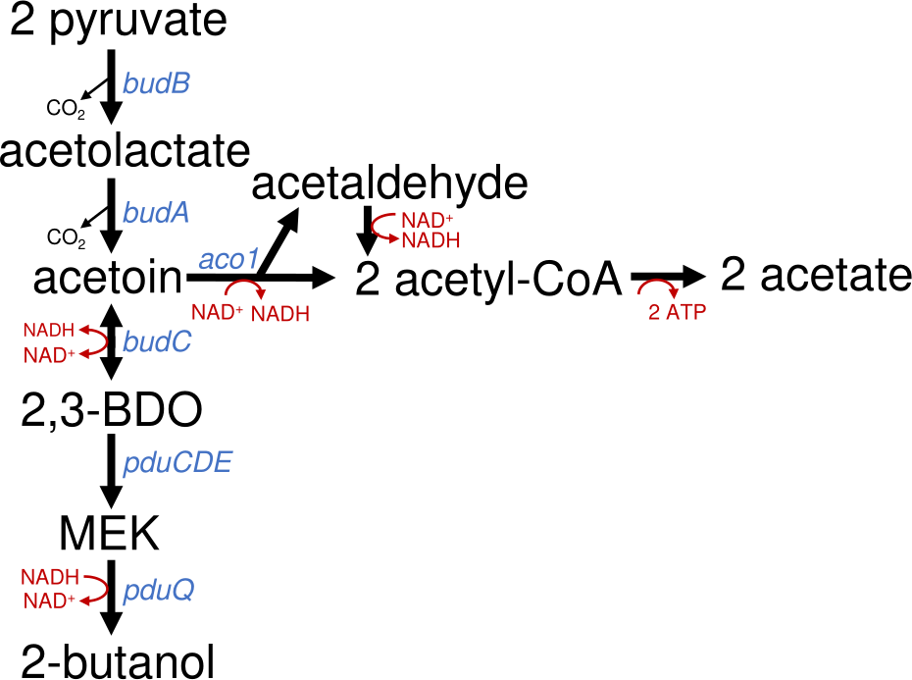
Background of the Project
Enable A. woodii to produce 2-butanol from 2,3-butanediol
Understand why the pathway stops at MEK
Context:
Biotech alternative to fossil chemicals
Higher energy density than ethanol
Microbial production still rare
Coupled to CO₂ fixation (WLP)
Introduction | Workflow | Results | Discussion

Slide 3
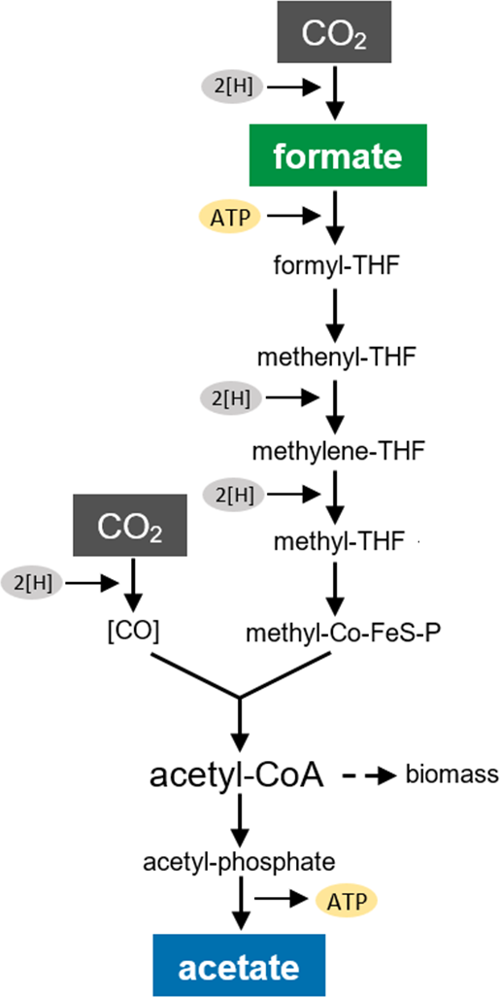
Acetobacterium woodii
Anaerobic, acetogenic bacterium
Fixes CO₂ via the Wood-Ljungdahl pathway
Grows well anaerobically, quite robust
Easy to genetically modify
No harmful byproducts, safe to handle
Introduction | Workflow | Results | Discussion

Slide 4
Aim of the Work
Increase the expression of Adh4 by replacment of the native promoter with a stronger one
Test if 2-butanol is produced when 2,3-butanediol and another diol are used as cosubstrates
Test if hydrogen shifts redox balance toward 2-butanol.
Introduction | Workflow | Results | Discussion

Slide 5
CRISPR-Cas System
CRISPR = Clustered Regularly Interspaced Short Palindromic Repeats
Developed by Emmanuelle Charpentier & Jennifer Doudna (published in 2012)
Awarded the 2020 Nobel Prize in Chemistry
Adaptive immune system of bacteria and archaea
Cas proteins (e.g. Cas9) cut DNA at specific sites
Enables precise genome editing (knockout, knock-in)
Revolutionizing molecular biology, medicine & biotechnology
Introduction | Workflow | Results | Discussion

Slide 6
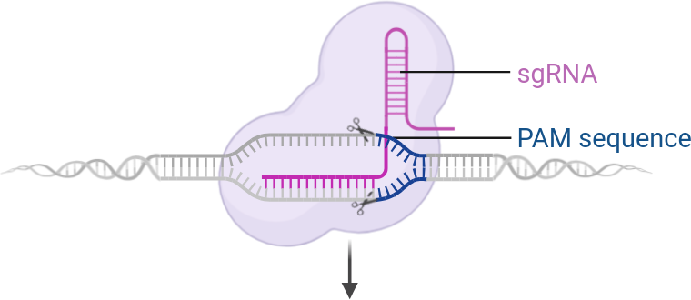
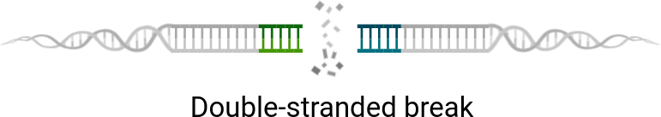
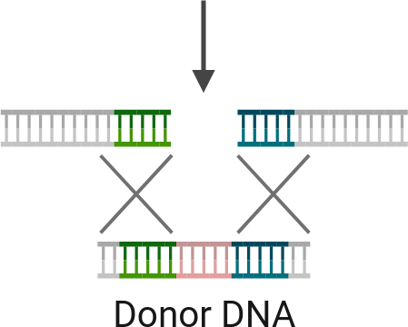

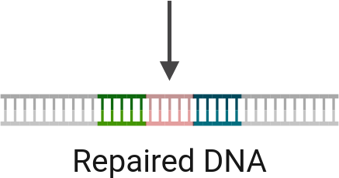
© Biorender.com
Introduction | Workflow | Results | Discussion

Slide 7
Golden Gate Cloning
Fast and efficient DNA assembly
Uses Type IIS enzymes (e.g. Esp3I)
Cuts outside recognition sites → custom overhangs
Enables seamless & directional ligation
Great for modular constructs
Introduction | Workflow | Results | Discussion

Slide 8
Experimental Workflow
Plasmid assembly
Transformation of plasmid in A. Woodii
Phenotype testing
Introduction | Workflow | Results | Discussion

Slide 9
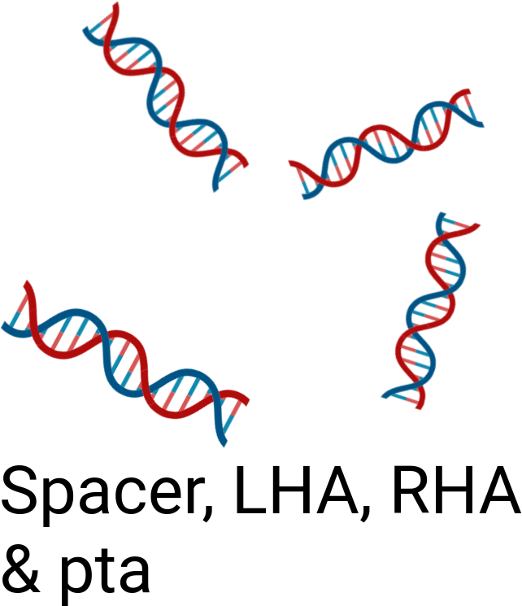
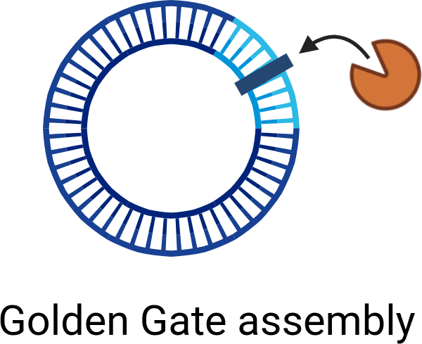
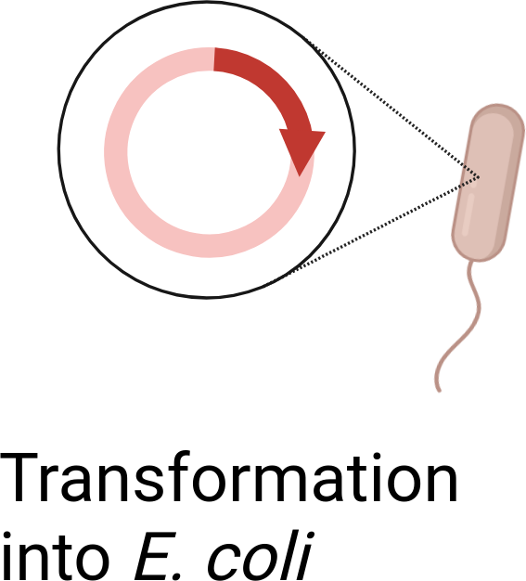
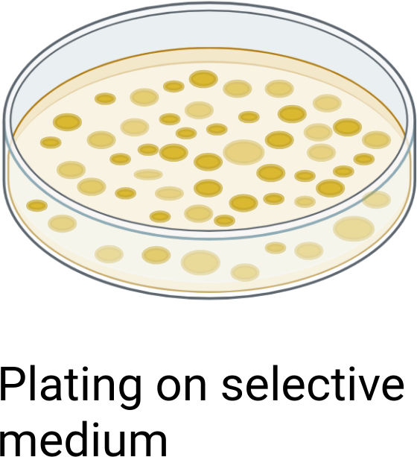
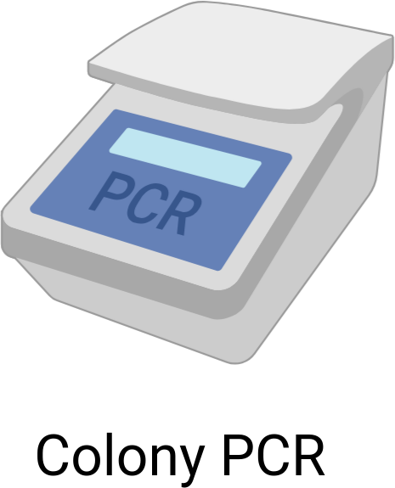
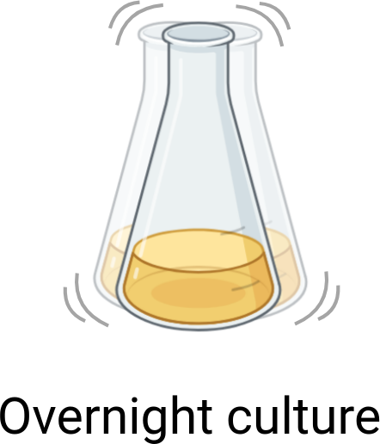
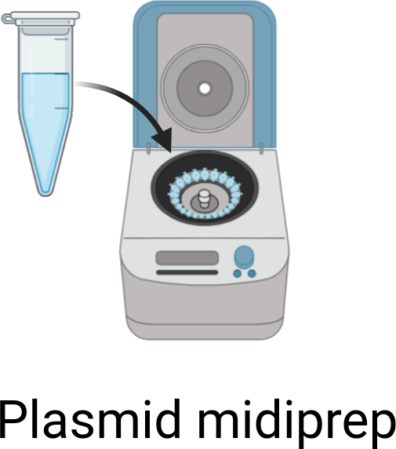


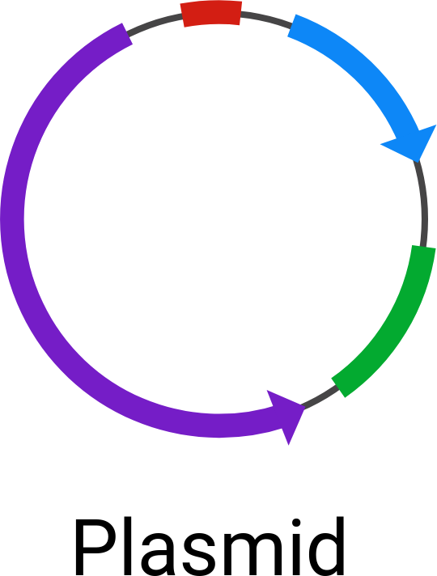
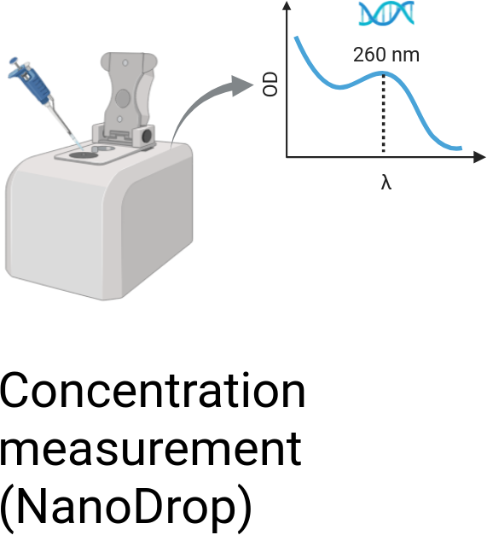

Construction of the Plasmid via Golden Gate
© Biorender.com
Introduction | Workflow | Results | Discussion

Slide 10
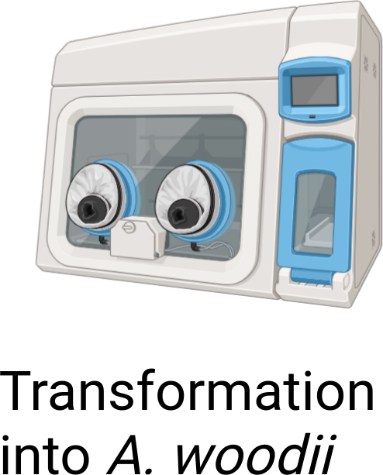
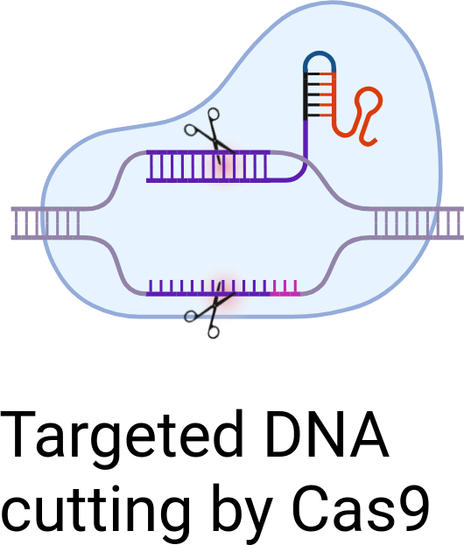
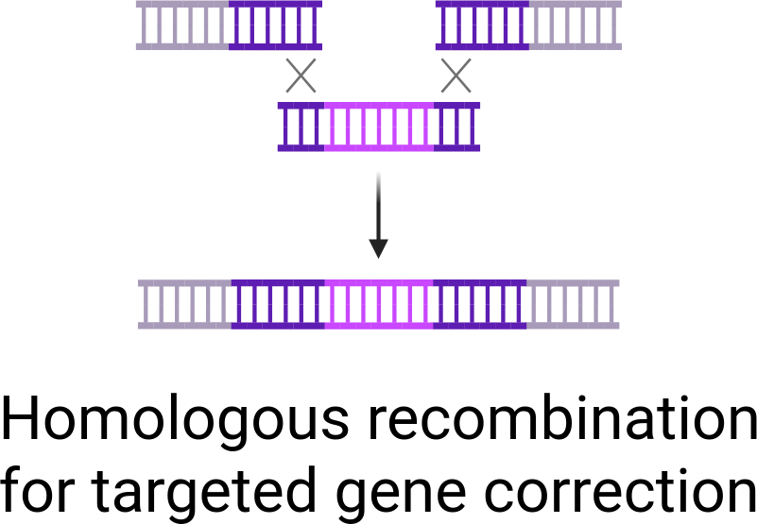
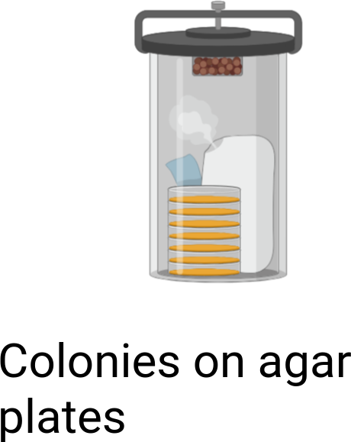
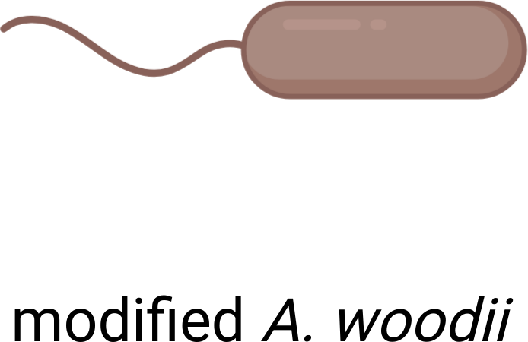
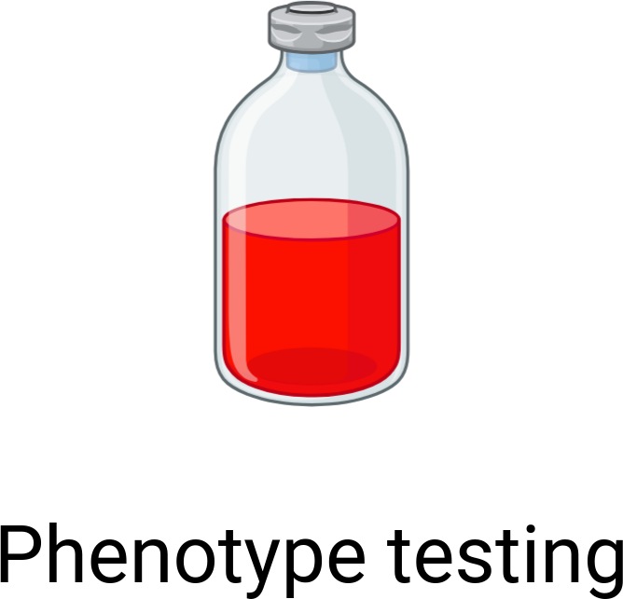
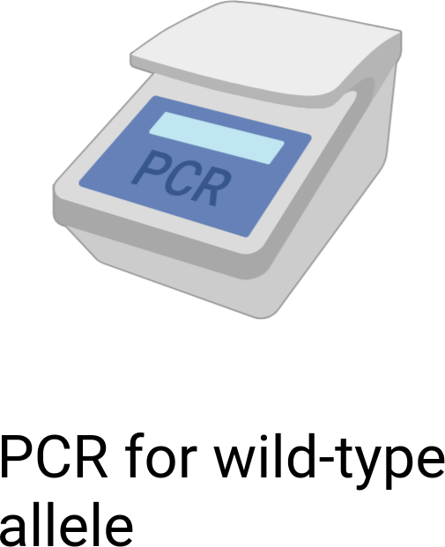
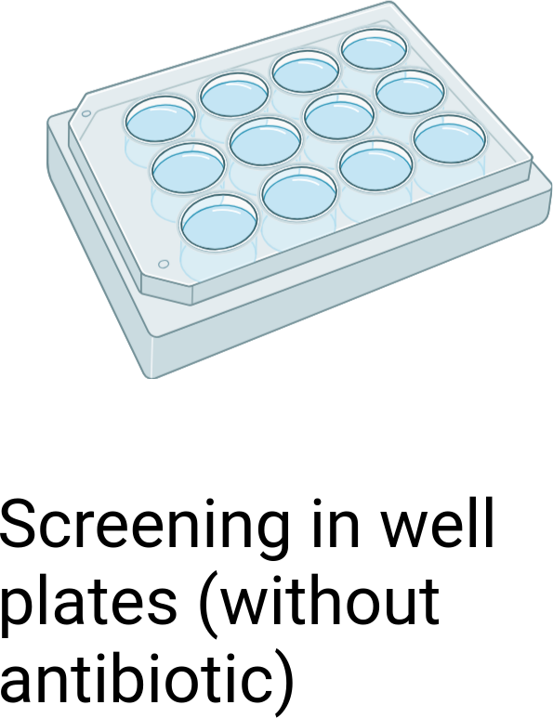
Transformation into A. woodii and Colony Screening
© Biorender.com
Introduction | Workflow | Results | Discussion

Slide 11
Serum Bottle Experiments
Strain | Substrates
TU2.0 (WT) | 2,3-Butanediol / 2,3-Butanediol + 1,2-Propanediol
TU2.0_Ppta | 2,3-Butanediol / 2-Butanone + 1,2-Propanediol + H₂
Analytics: OD₆₀₀ and HPLC were performed for all cultures.
Introduction | Workflow | Results | Discussion

Slide 12
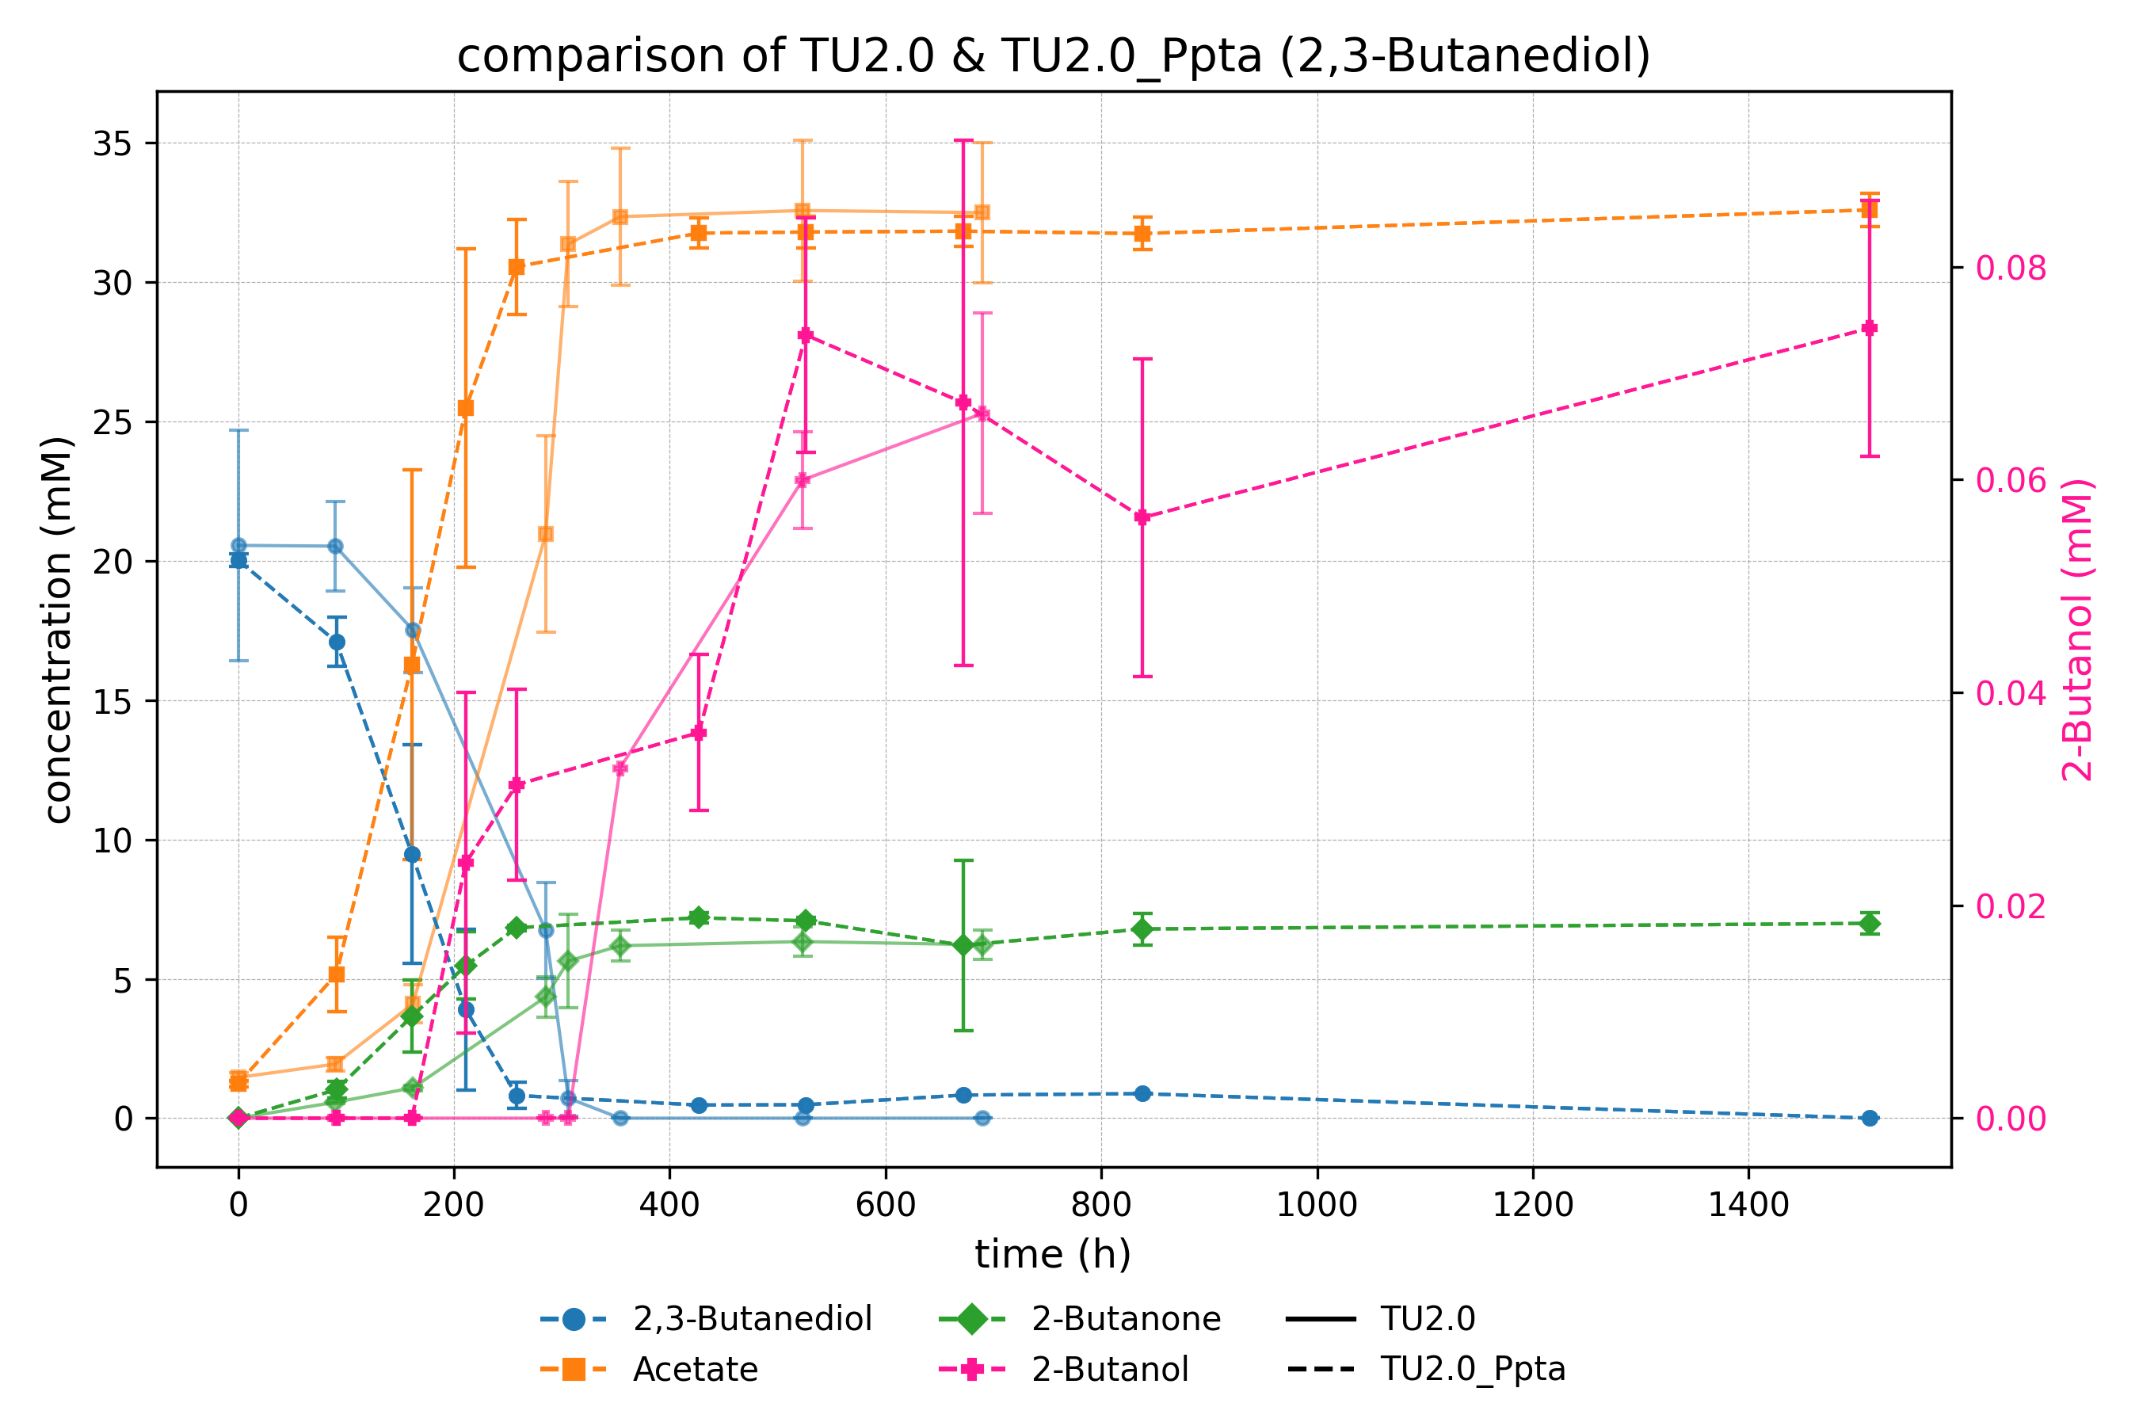
Introduction | Workflow | Results | Discussion

Slide 13
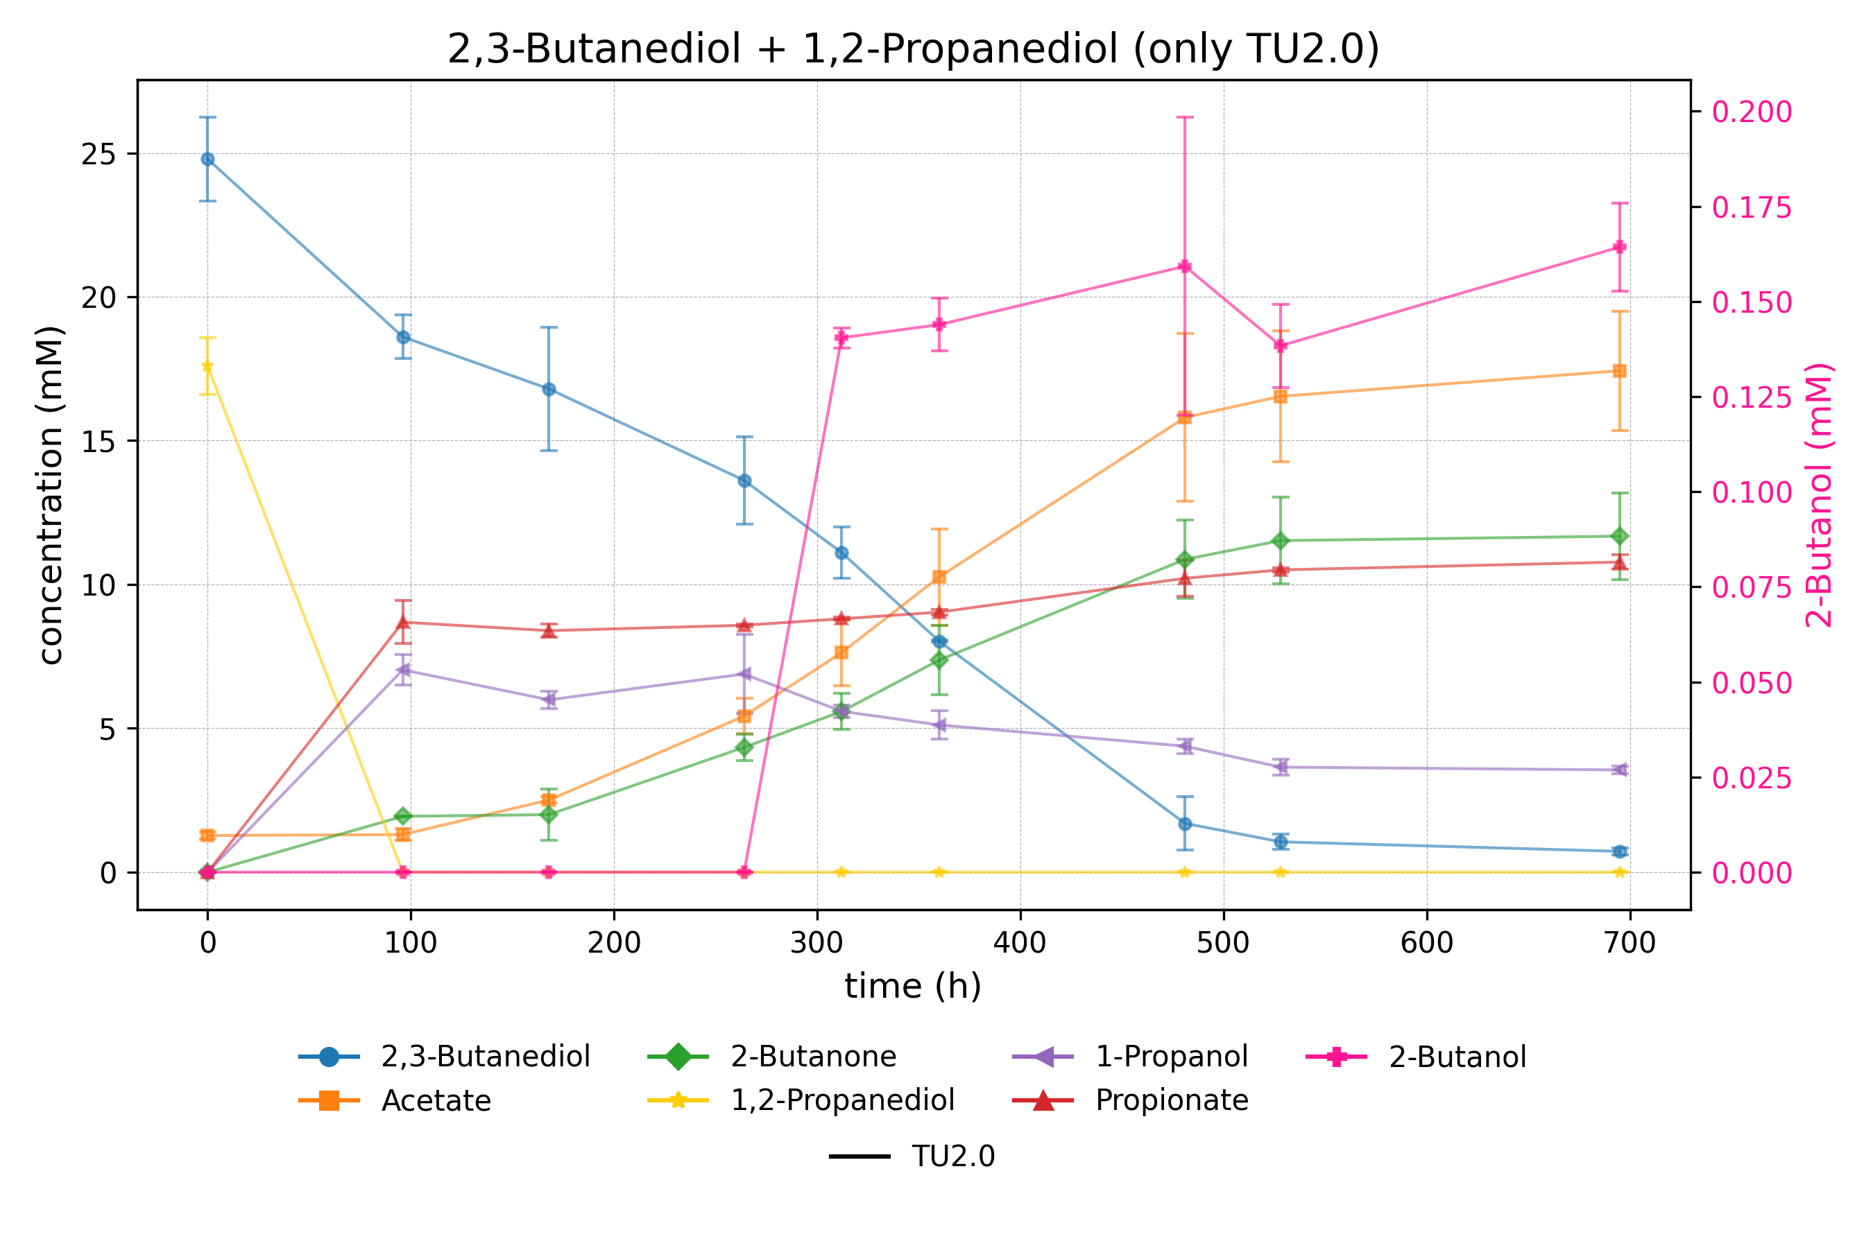
Introduction | Workflow | Results | Discussion

Slide 14
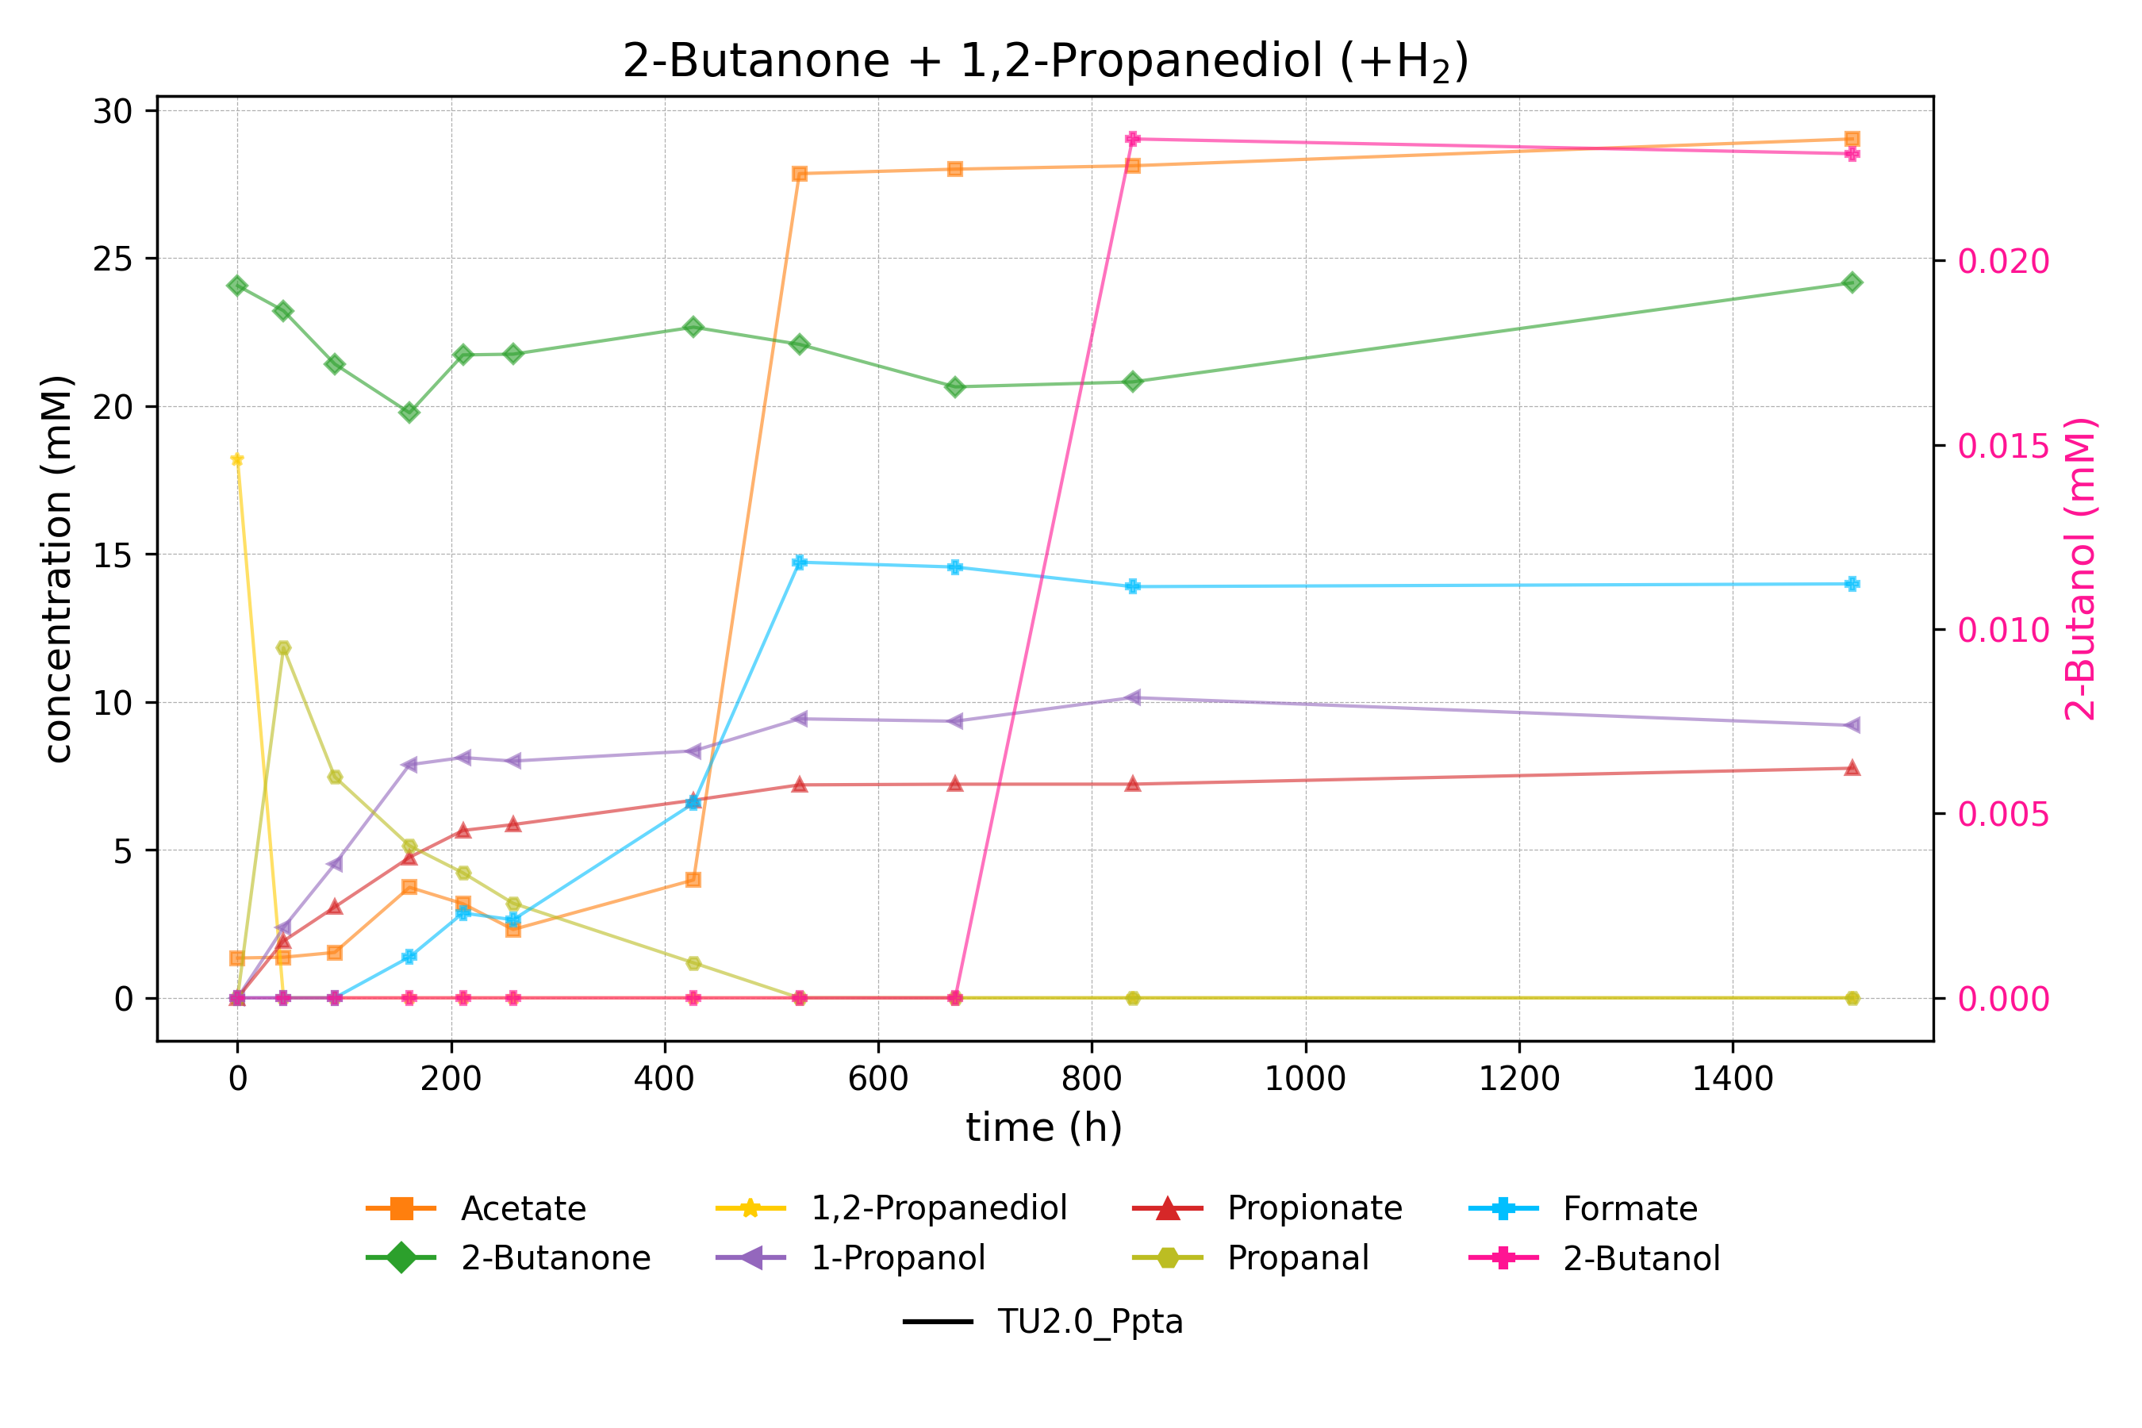
Introduction | Workflow | Results | Discussion

Slide 15
Successes and Setbacks
Successful genetic engineering of A. woodii: Replacement of the native adh4 promoter with the pta promoter from C. Ljungdahlii
The promoter exchange didn’t have any effect on 2-butanol production
MEK was reduced to 2-butanol in increased amounds in the presence of 1,2-propanediol
Hydrogen doesn’t shift the reaction toward 2-butanol
Introduction | Workflow | Results | Discussion

Slide 16
Outlook and Further Improvements
Focus on NADH availability, not promoter strength
Replace Adh4 with a more selective alcohol dehydrogenase
Improve NADH regeneration (e.g. via FDH)
Test alternative redox conditions (e.g. formate, CO)
Introduction | Workflow | Results | Discussion

Slide 17
Thanks for joining
Big thanks to Klara for the amazing supervision!
Thanks to Vincent for all the behind-the-scenes help!
And thanks to Dr. Stefan Pflügl for letting me be part of the team!

