Slide 1
Exploring possibilities for 2-butanol production in A. woodii by exchange of the Adh4 promoter
Thomas Hackl

Slide 2
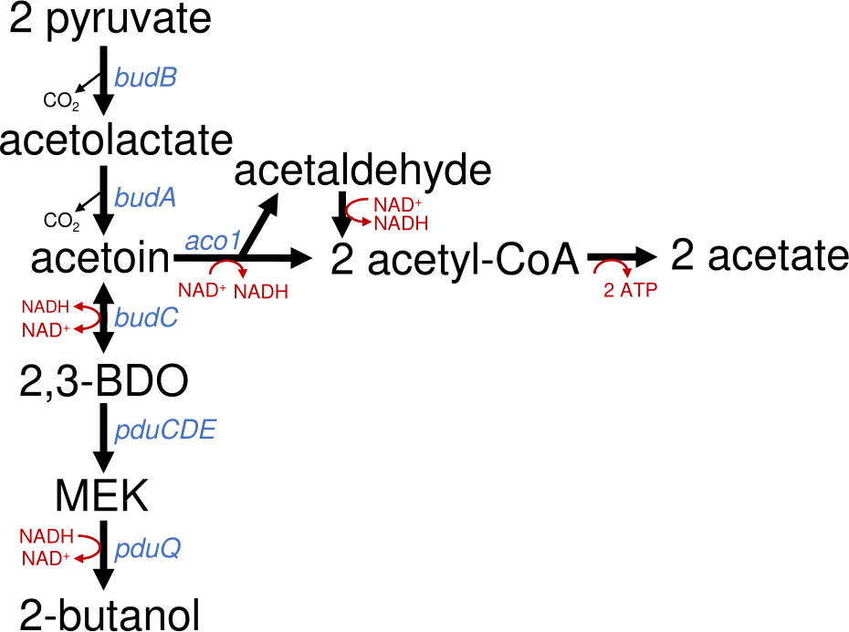
Background of the Project
Enable A. woodii to produce 2-butanol from 2,3-butanediol
Understand why the pathway stops at MEK
Context:
Biotech alternative to fossil chemicals
Higher energy density than ethanol
Microbial production still rare
Coupled to CO₂ fixation (WLP)
Introduction | Workflow | Results | Discussion

Slide 3
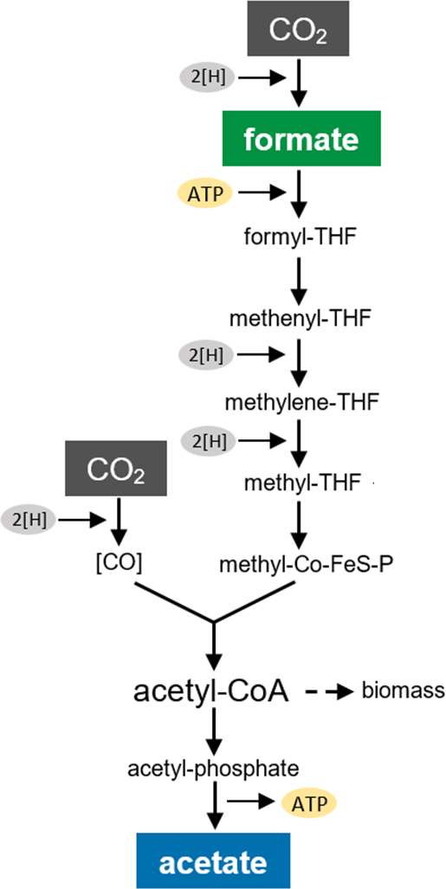
Acetobacterium woodii
Anaerobic, acetogenic bacterium
Fixes CO₂ via the Wood-Ljungdahl pathway
Grows well anaerobically, quite robust
Easy to genetically modify
No harmful byproducts, safe to handle
Introduction | Workflow | Results | Discussion

Slide 4
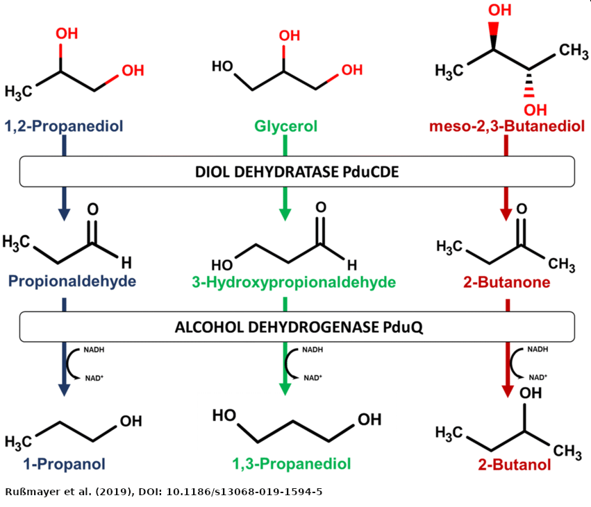
Aim of the Work
Increase the expression of Adh4 by replacment of the native promoter with a stronger one
Test if 2-butanol is produced when 2,3-butanediol and another diol are used as cosubstrates
Test if hydrogen shifts redox balance toward 2-butanol.
Introduction | Workflow | Results | Discussion

Slide 5
CRISPR-Cas System
CRISPR = Clustered Regularly Interspaced Short Palindromic Repeats
Adaptive immune system of bacteria and archaea
Cas proteins (e.g. Cas9) cut DNA at specific sites
Developed by Emmanuelle Charpentier & Jennifer Doudna (published in 2012)
Awarded the 2020 Nobel Prize in Chemistry
Enables precise genome editing (knockout, knock-in)
Revolutionizing molecular biology, medicine & biotechnology
Introduction | Workflow | Results | Discussion

Slide 6
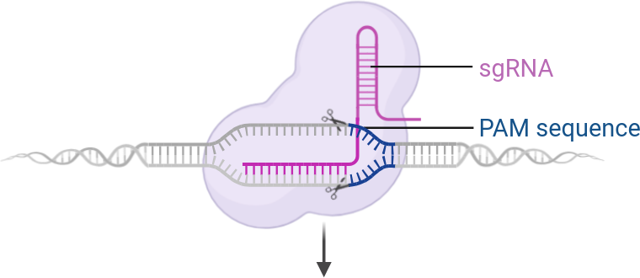
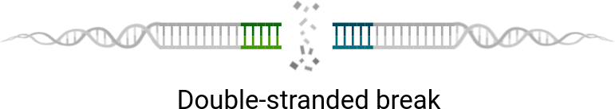
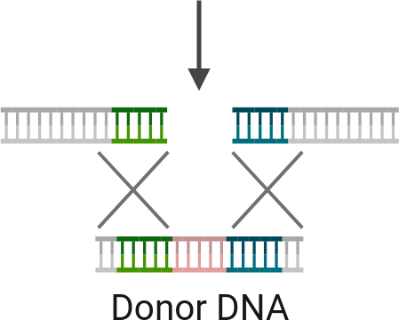

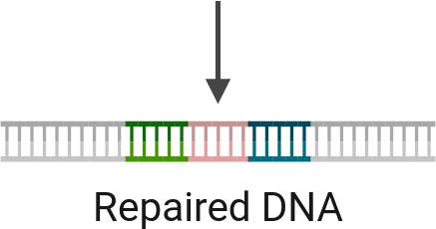
© Biorender.com
Introduction | Workflow | Results | Discussion

Slide 7
Golden Gate Cloning
Fast and efficient DNA assembly
Uses Type IIS enzymes (e.g. Esp3I)
Cuts outside recognition sites → custom overhangs
Enables seamless & directional ligation
Great for modular constructs
Introduction | Workflow | Results | Discussion

Slide 8
Experimental Workflow
Plasmid assembly
Transformation of plasmid in A. Woodii
Phenotype testing
Introduction | Workflow | Results | Discussion

Slide 9
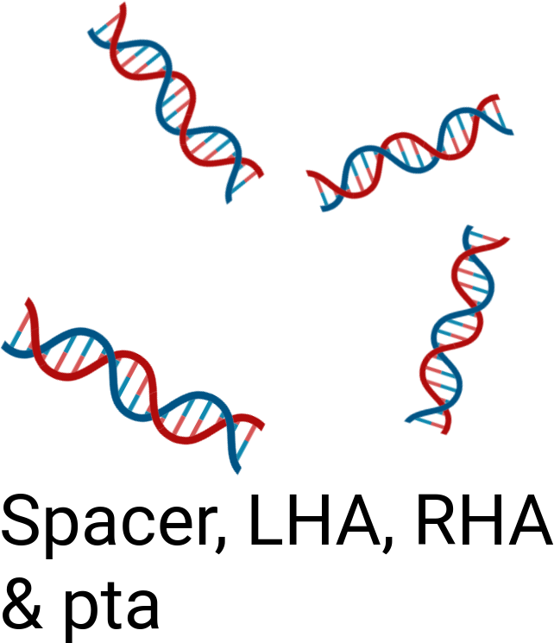
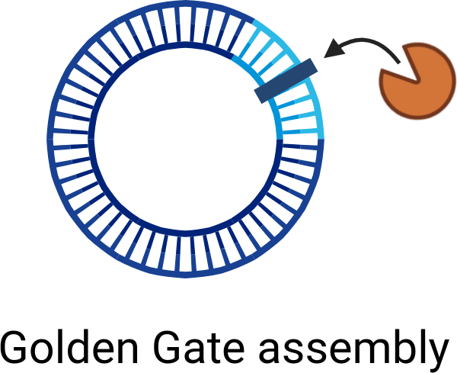
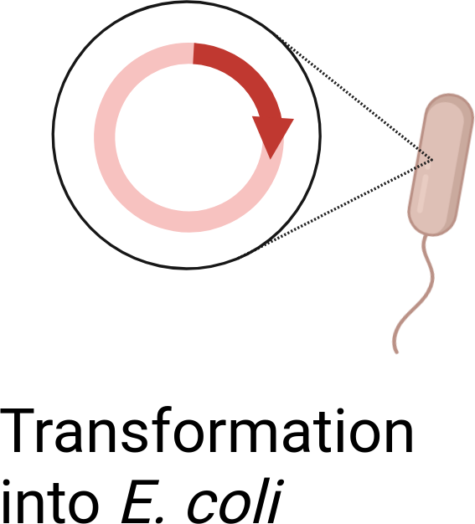
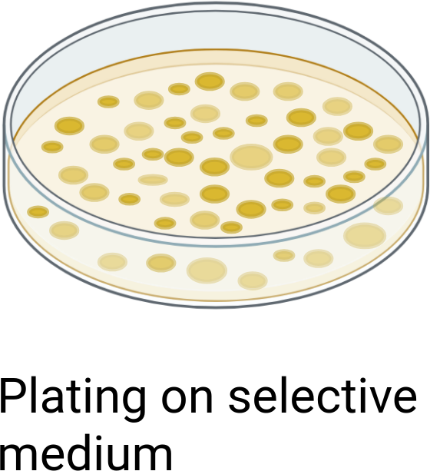
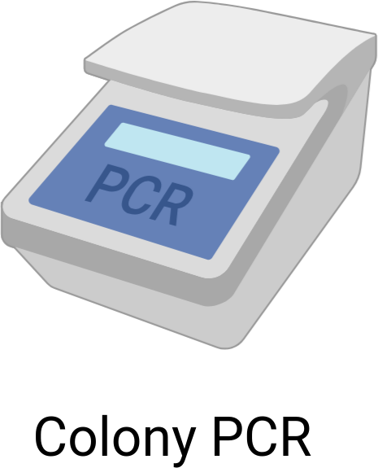
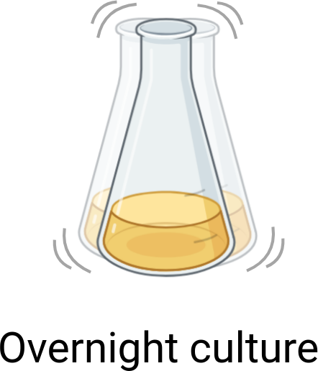
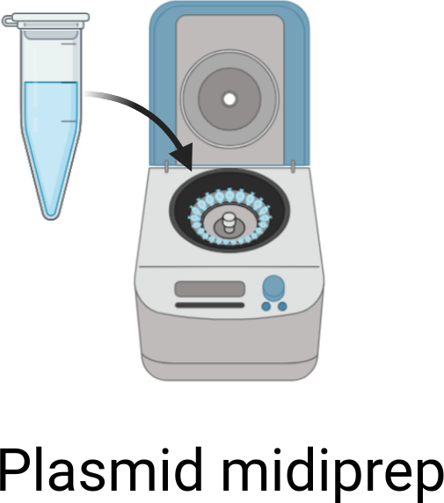


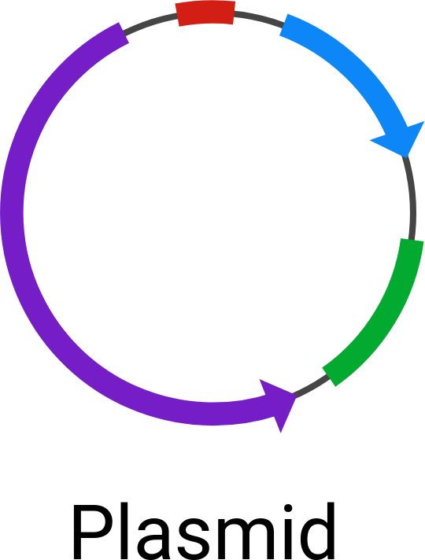
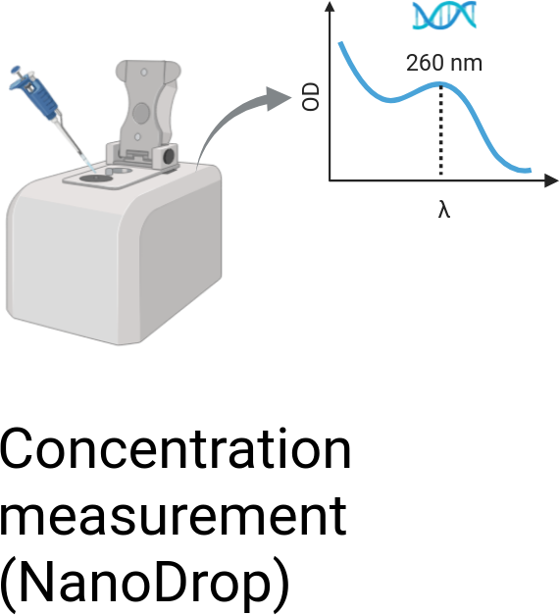

Construction of the Plasmid via Golden Gate
© Biorender.com
Introduction | Workflow | Results | Discussion

Slide 10
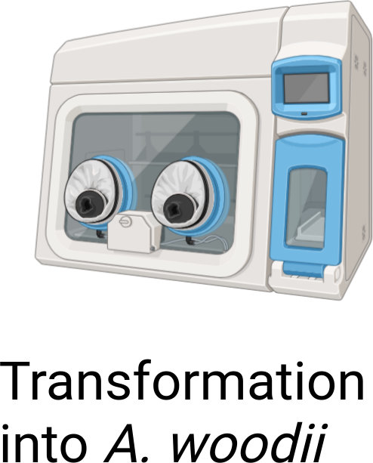
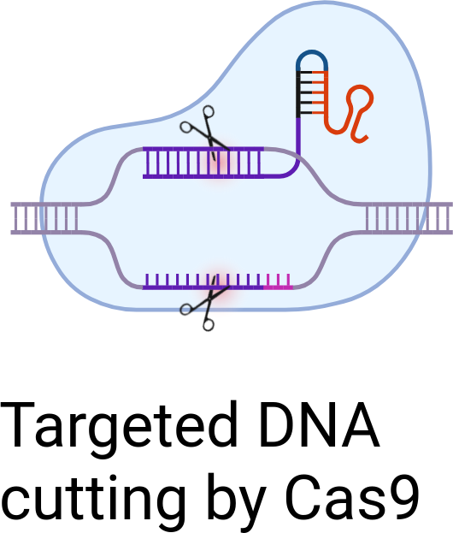
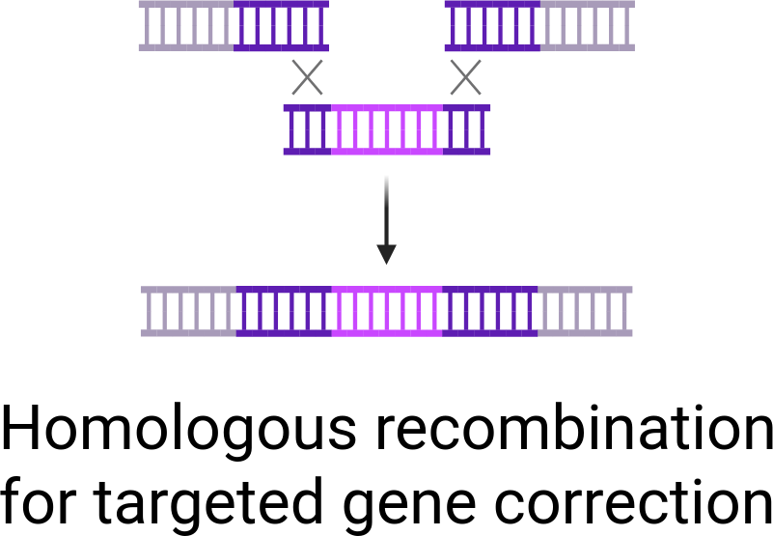
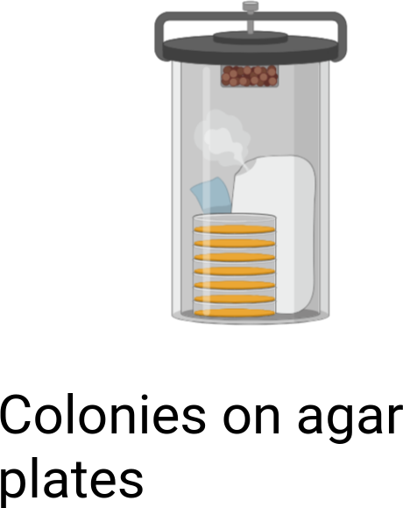
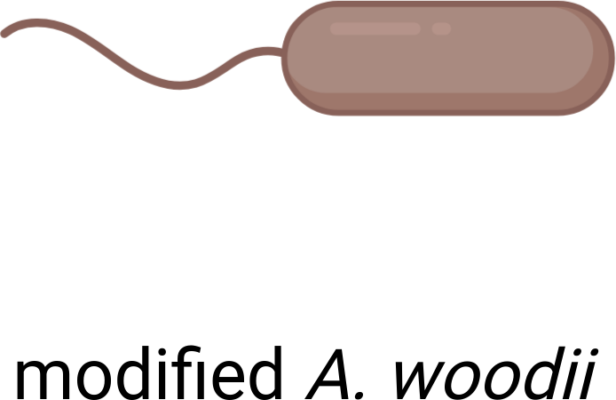
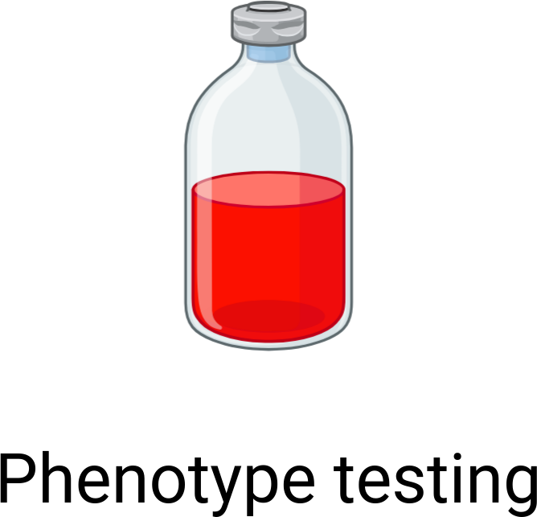
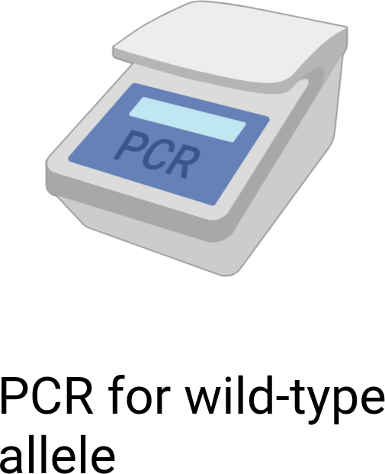
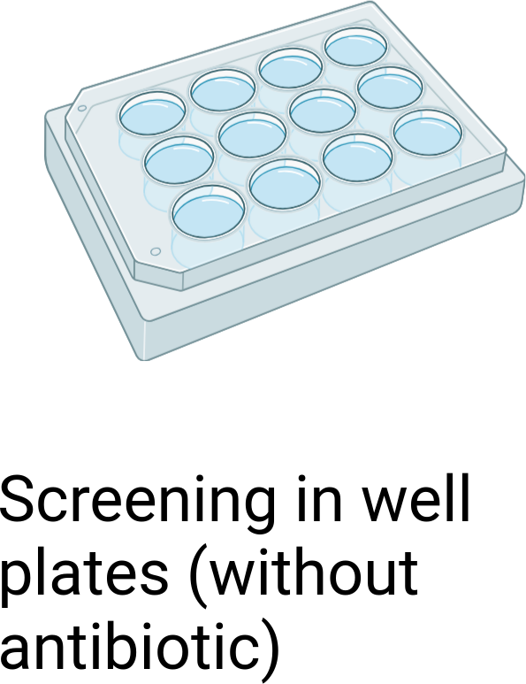
Transformation into A. woodii and Colony Screening
© Biorender.com
Introduction | Workflow | Results | Discussion

Slide 11
Serum Bottle Experiments
Strain | Substrates
TU2.0 (WT) | 2,3-Butanediol / 2,3-Butanediol + 1,2-Propanediol
TU2.0_Ppta | 2,3-Butanediol / 2-Butanone + 1,2-Propanediol + H₂
Analytics: OD₆₀₀ and HPLC were performed for all cultures.
Introduction | Workflow | Results | Discussion

Slide 12
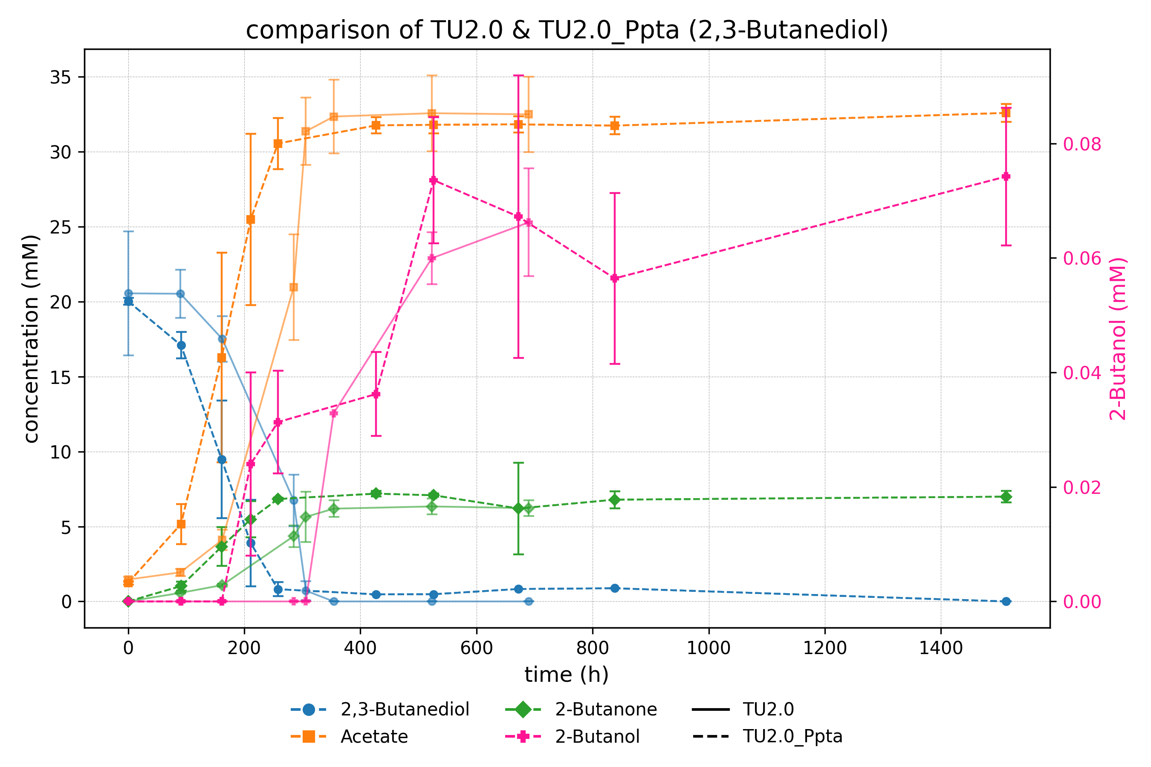
Introduction | Workflow | Results | Discussion

Slide 13
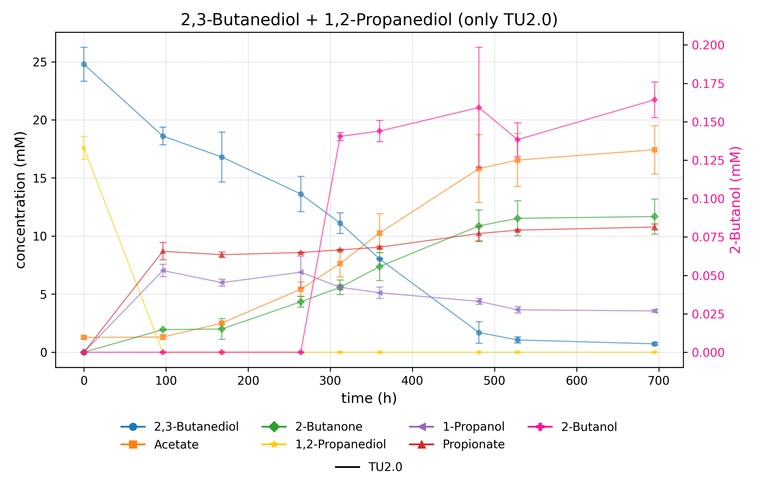
Introduction | Workflow | Results | Discussion

Slide 14
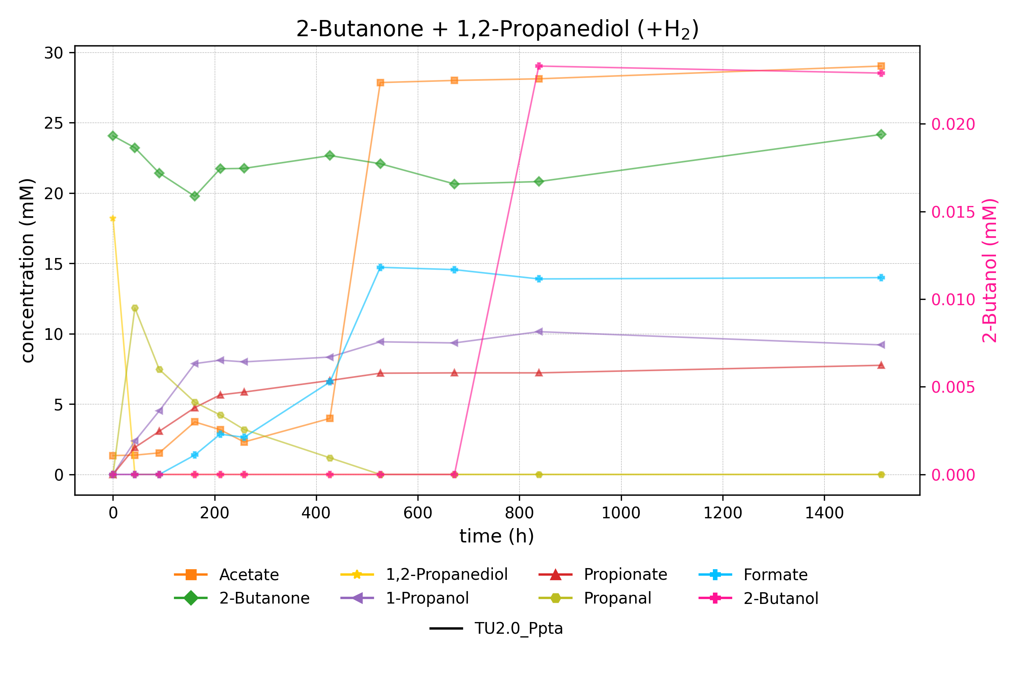
Introduction | Workflow | Results | Discussion

Slide 15
Successes and Setbacks
Successful genetic engineering of A. woodii: Replacement of the native adh4 promoter with the pta promoter from C. Ljungdahlii
The promoter exchange didn’t have any effect on 2-butanol production
MEK was reduced to 2-butanol in increased amounds in the presence of 1,2-propanediol
Hydrogen doesn’t shift the reaction toward 2-butanol
Introduction | Workflow | Results | Discussion

Slide 16
Outlook and Further Improvements
Focus on NADH availability, not promoter strength
Replace Adh4 with a more selective alcohol dehydrogenase
Improve NADH regeneration (e.g. via FDH)
Test alternative redox conditions (e.g. formate, CO)
Introduction | Workflow | Results | Discussion

Slide 17
Thanks for joining
Big thanks to Klara for the amazing supervision!
Thanks to Vincent for all the behind-the-scenes help!
And thanks to Dr. Stefan Pflügl for letting me be part of the team!

