Slide 1
Exploring possibilities for 2-butanol production in A. woodii by exchange of the Adh4 promoter
Thomas Hackl

Slide 2
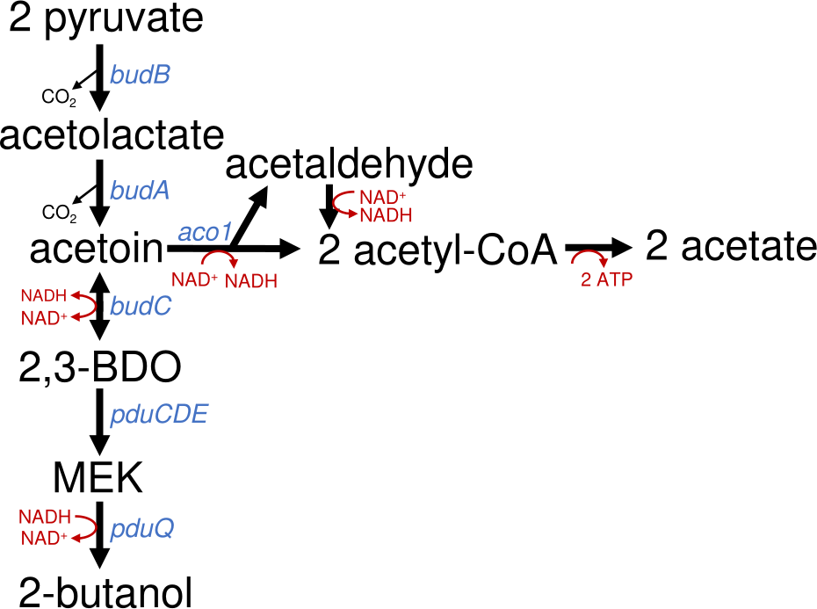
Background of the Project
Enable A. woodii to produce 2-butanol from 2,3-butanediol
Understand why the pathway stops at MEK
Context:
Biotech alternative to fossil chemicals
Higher energy density than ethanol
Microbial production still rare
Coupled to CO₂ fixation (WLP)

Slide 3
Acetobacterium woodii
Anaerobic, acetogenic bacterium
Fixes CO₂ via the Wood-Ljungdahl pathy
Produces acetyl-CoA, but 2-butanol synthesis is energetically limited
Grows well anaerobically, quite robust
Easy to genetically modify
No harmful byproducts, safe to handle

Slide 4
CRISPR-Cas System
CRISPR = Clustered Regularly Interspaced Short Palindromic Repeats
Developed by Emmanuelle Charpentier & Jennifer Doudna (published in 2012)
Awarded the 2020 Nobel Prize in Chemistry
Adaptive immune system of bacteria and archaea
Cas proteins (e.g. Cas9) cut DNA at specific sites
Enables precise genome editing (knockout, knock-in)
Revolutionizing molecular biology, medicine & biotechnology

Slide 5
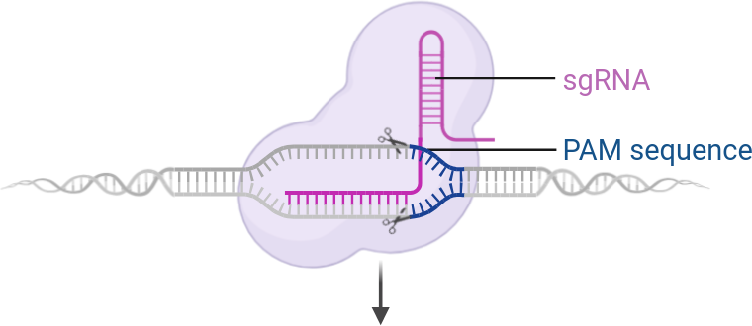
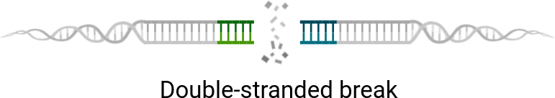
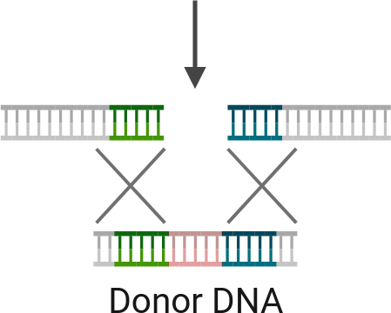

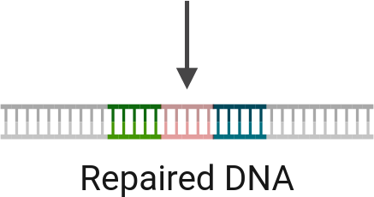
© Biorender.com

Slide 6
Golden Gate Cloning
Fast and efficient DNA assembly
Uses Type IIS enzymes (e.g. Esp3I)
Cuts outside recognition sites → custom overhangs
Enables seamless & directional ligation
Great for modular constructs

Slide 7
Aim of the Work
Increase the expression of adh4 by replacment of the native promoter with a stronger one
Test if 2-butanol is produced when 2,3-butanediol and another diol are used as cosubstrates
Test if hydrogen shifts redox balance toward 2-butanol.

Slide 8
Experimental Workflow
Plasmid Assembly
Annealing of spacer1/2
PCR of promoter, lha and rha
Golden Gate assembly of spacer and promoter plasmids
Transformation into E. Coli
Midiprep isolation of promoter plasmid
Transformation of promoter plasmid in A. Woodii
Functional Testing

Slide 9
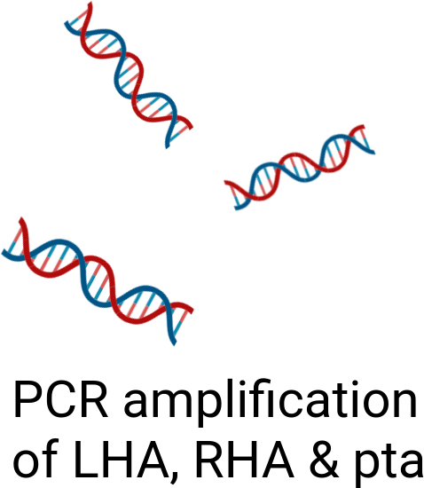
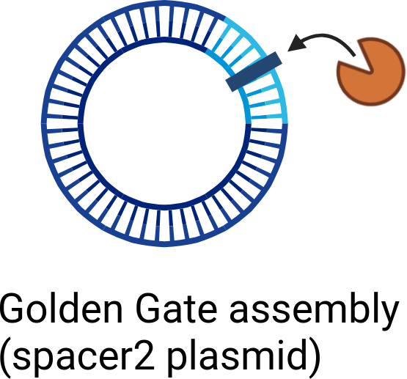
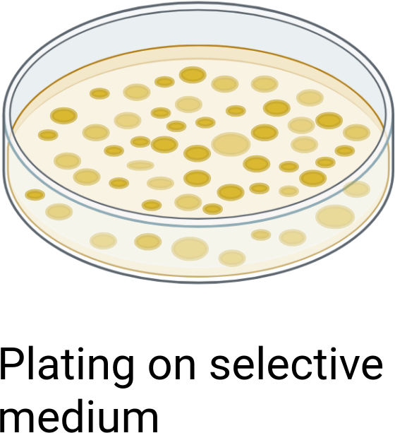
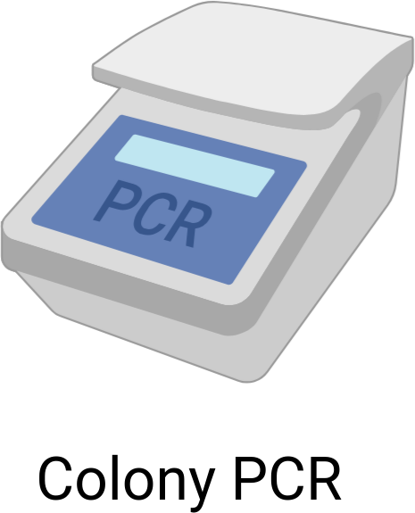
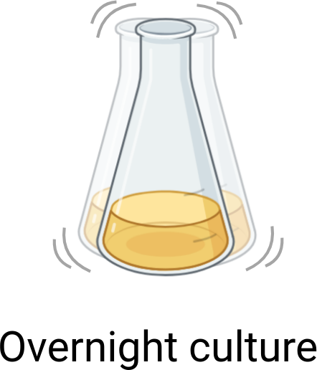
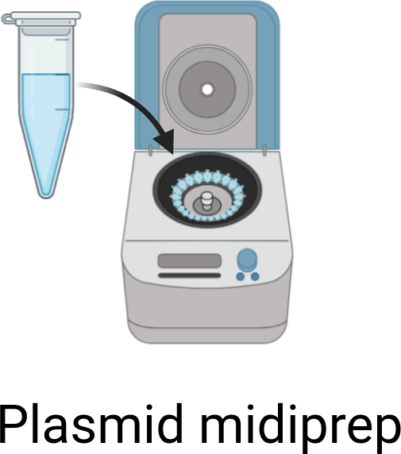


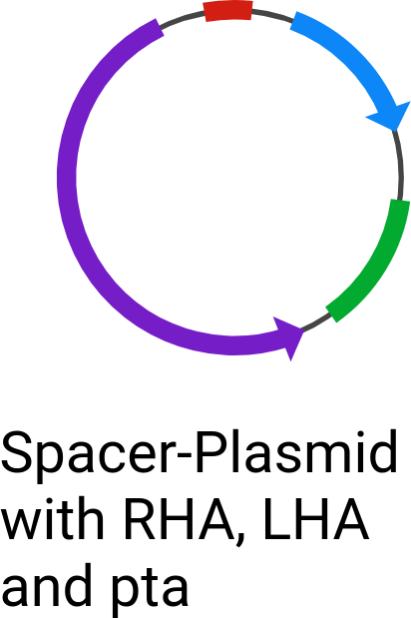
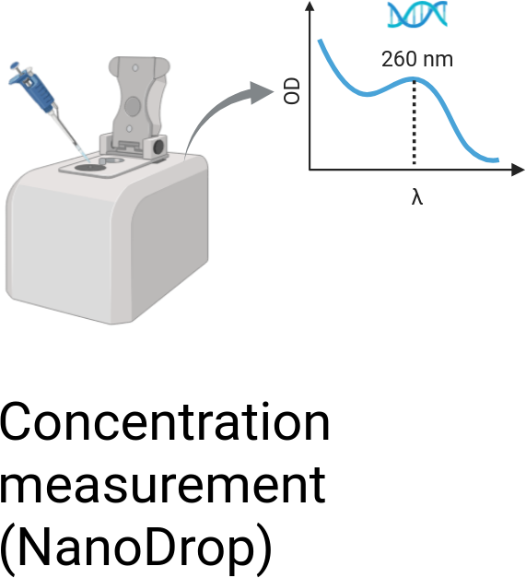
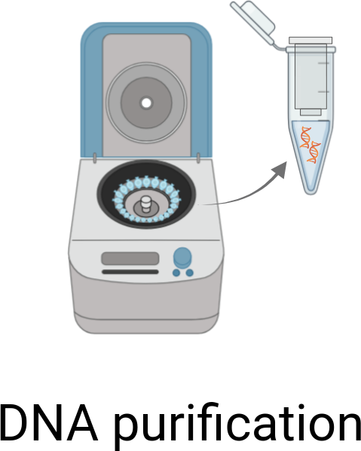

Construction of the PTA-Plasmid via Golden Gate
© Biorender.com

Slide 10
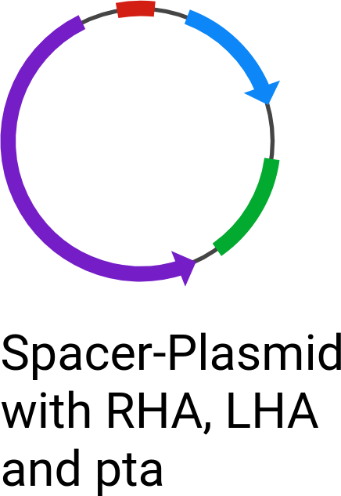
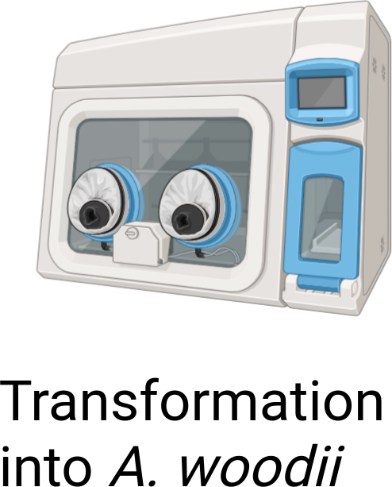
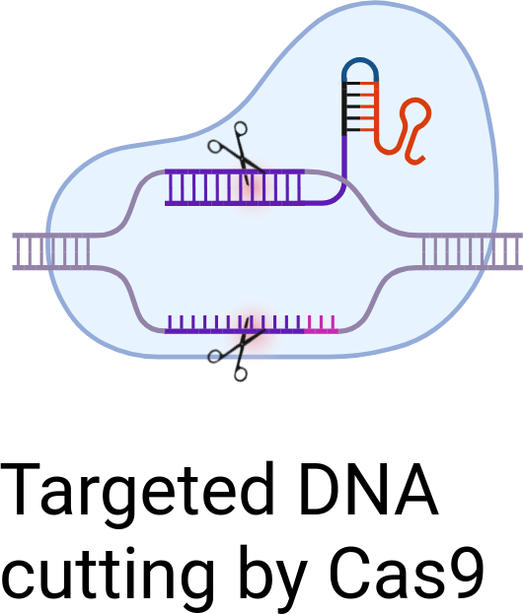
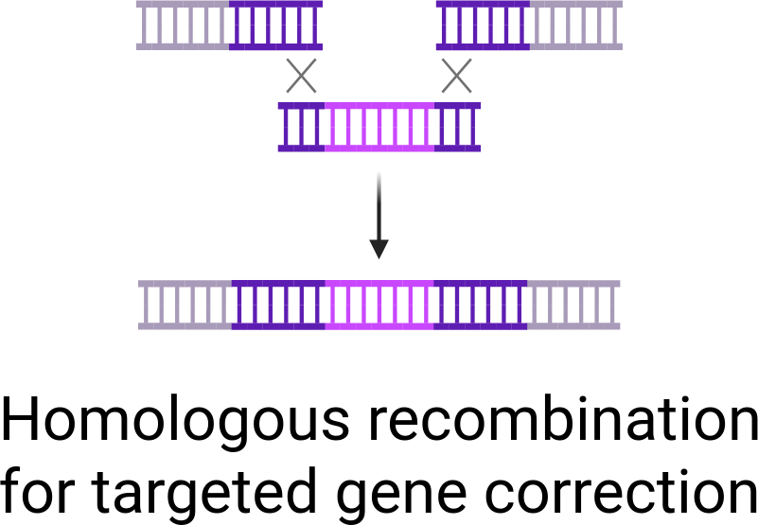
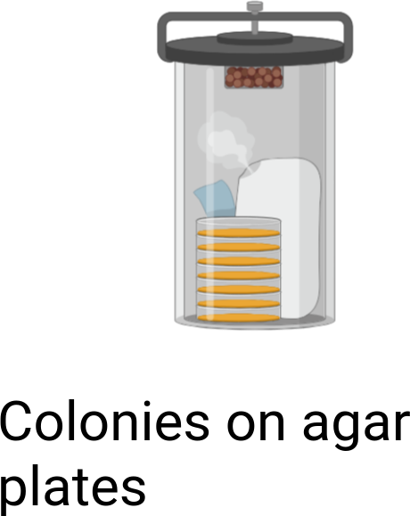
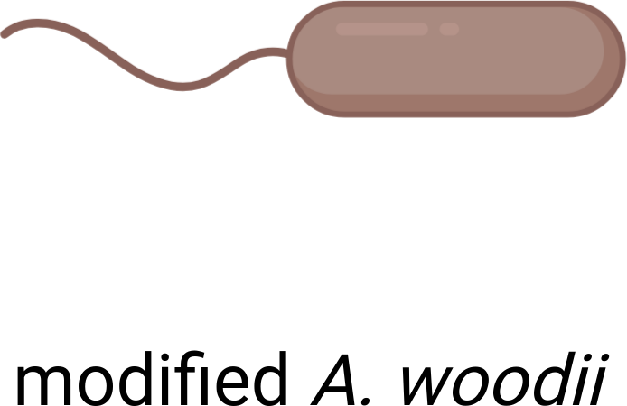
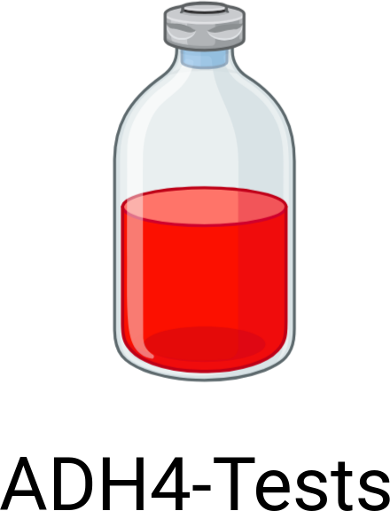
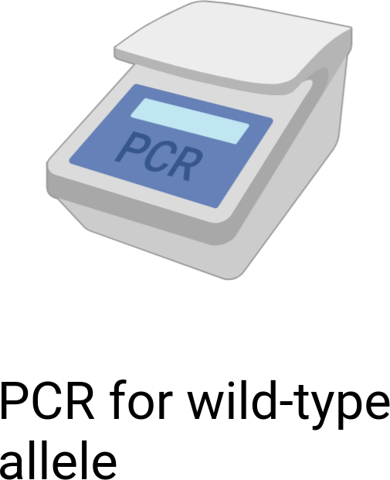
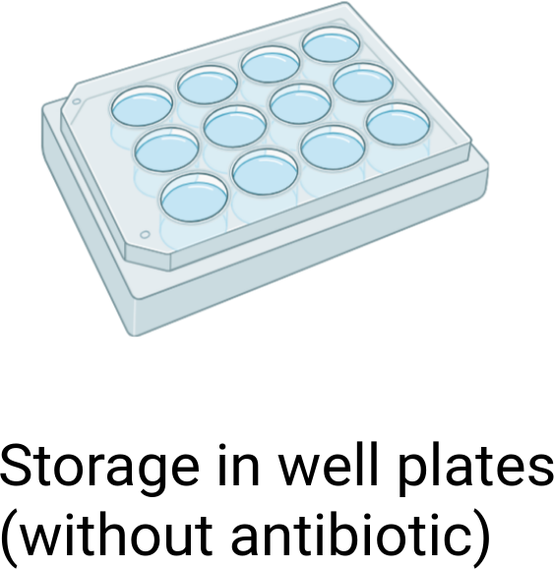
Transformation into A. woodii and Colony Screening
© Biorender.com

Slide 11
Serum Bottle Experiments
Strain | Substrates
TU2.0 (WT) | 2,3-Butanediol / 2,3-Butanediol + Methanol / 2,3-Butanediol + 1,2-Propanediol / 2,3-Butanediol + Ethylene glycol
Δaco1 (KO) | same as TU2.0
TU2.0_Ppta | 2,3-Butanediol / 2,3-Butanediol + Methanol
Δaco1_Ppta | same as TU2.0_Ppta
TU2.0_Ppta (H₂) | 2,3-Butanediol / 2,3-Butanediol + Methanol / 2-Butanone + 1,2-Propanediol
Measurements: OD₆₀₀/₆₆₀ and HPLC were performed for all cultures.

Slide 12
HPLC Analysis

Slide 13
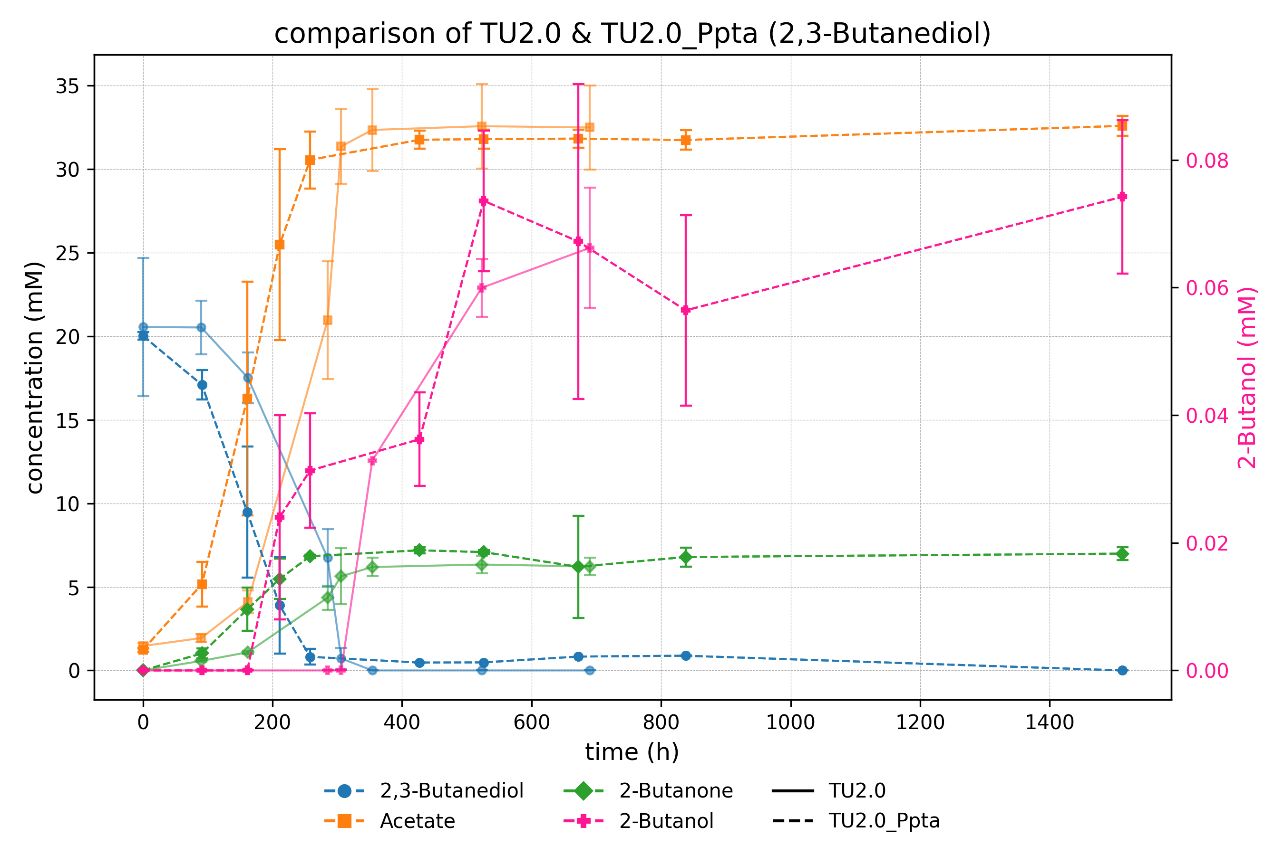

Slide 14
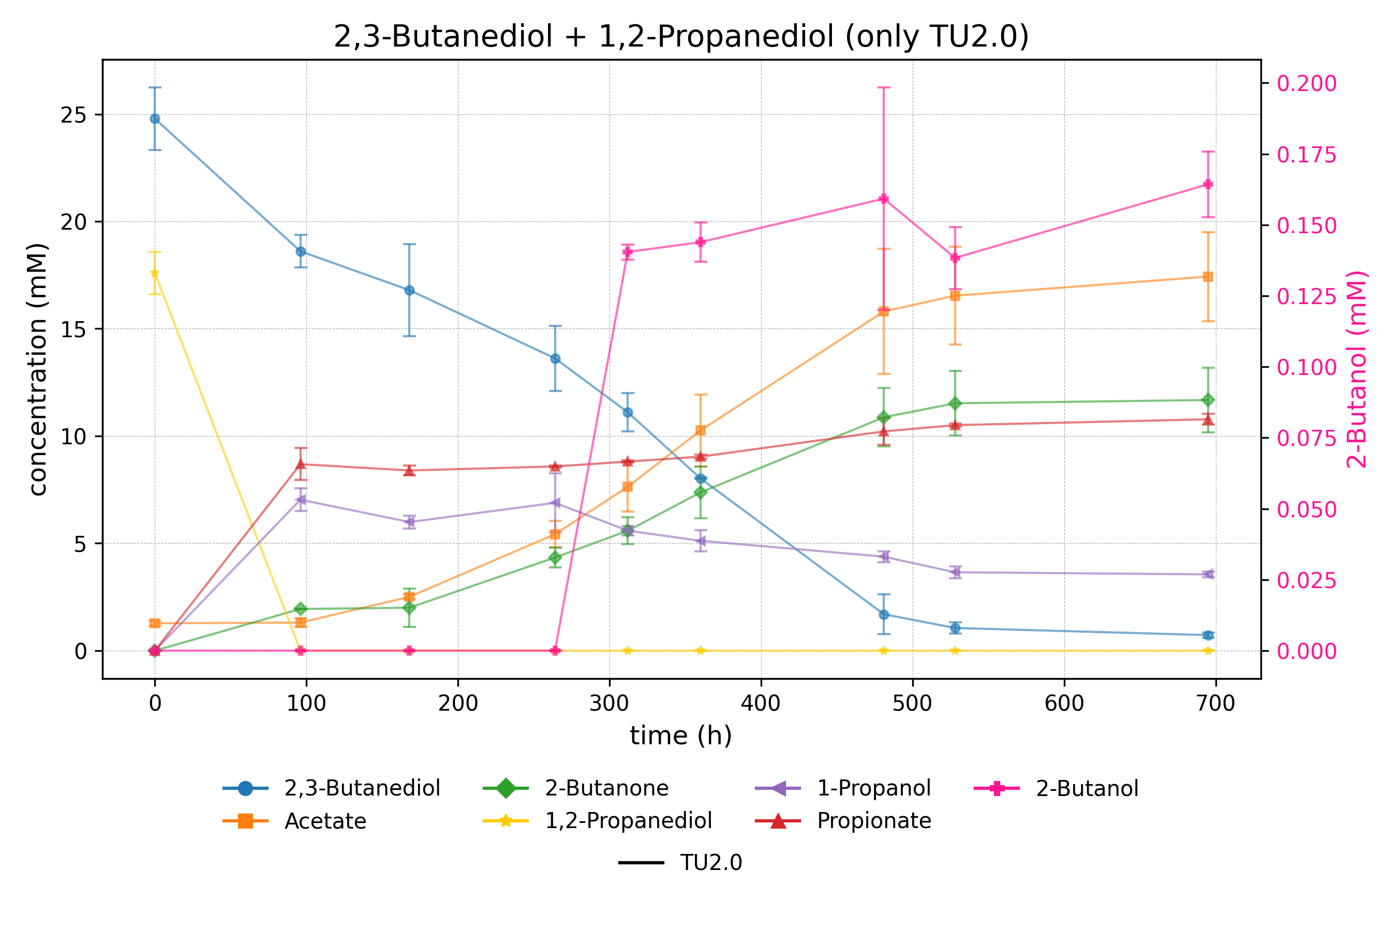

Slide 15
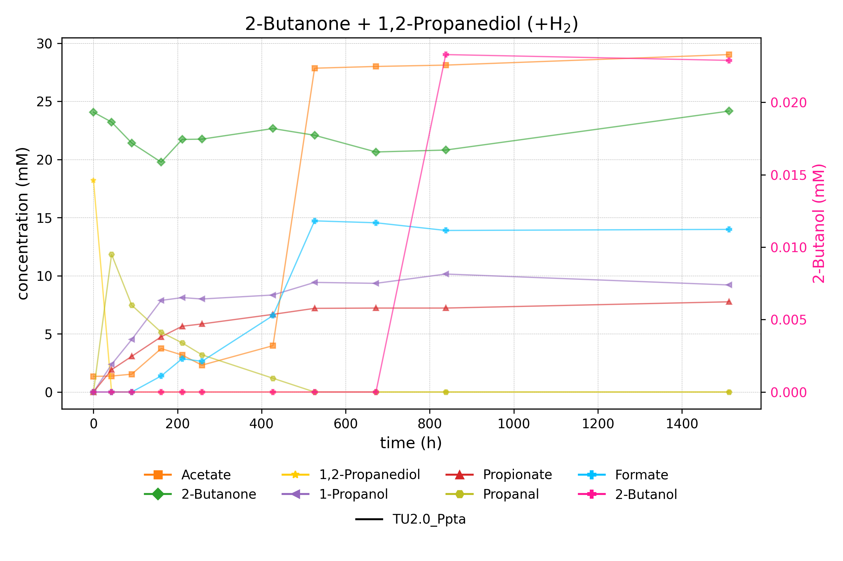

Slide 16
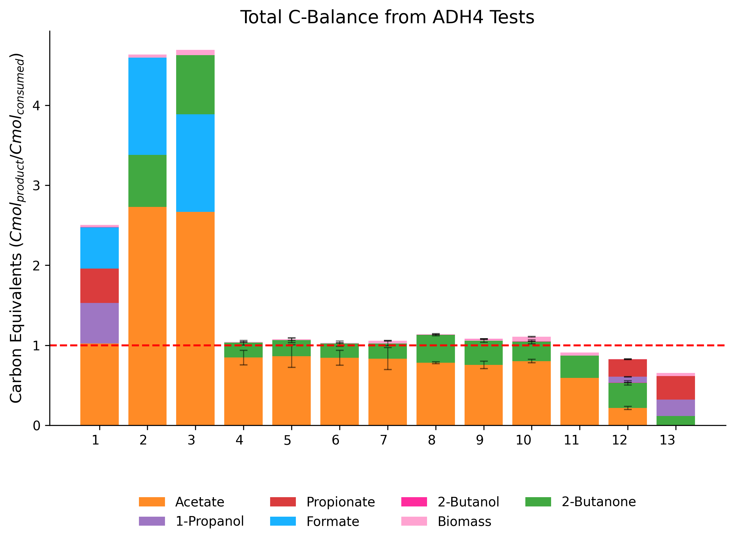

Slide 17
Successes and Setbacks
Successful genetic engineering of A. woodii: Replacement of the native adh4 promoter with the pta promoter from C. ljungdahlii
Increased expression of adh4 confirmed
adh4 expression was induced in the presence of 1,2-propanediol
Redox shift toward 2-butanol by hydrogen could not be confirmed
2-butanol was produced, but not in higher amounts than with the native promoter

Slide 18
Outlook and Further Improvements
Focus on NADH availability, not promoter strength
Replace Adh4 with a more selective alcohol dehydrogenase
Improve NADH regeneration (e.g. via FDH)
Test alternative redox conditions (e.g. formate, CO)

Slide 19
Thanks for joining
Big thanks to Klara for the amazing supervision!
Thanks to Vincent for all the behind-the-scenes help!
And thanks to Dr. Stefan Pflügl for letting me be part of the team!

