Slide 1
Exploring possibilities for 2-butanol production in A. woodii by exchange of the Adh4 promoter
HACKL Thomas

Slide 2
Acetobacterium woodii
Anaerobic, acetogenic bacterium
Uses the Wood-Ljungdahl pathway for CO₂ fixation and acetyl-CoA production
Well studied for acetogenesis but energetically challenging for 2-butanol synthesis
Our project tests its potential and limitations for 2-butanol production

Slide 3
CRISPR-Cas System
CRISPR = Clustered Regularly Interspaced Short Palindromic Repeats
Adaptive immune system of bacteria and archaea
Cas proteins (e.g., Cas9) precisely cut DNA at specific sites
Enables precise genome editing (gene knockout, knock-in)
2020 Nobel Prize in Chemistry awarded to Emmanuelle Charpentier & Jennifer Doudna for developing CRISPR-Cas9
Revolutionizing molecular biology, medicine & biotechnology

Slide 4
Golden Gate Cloning
Uses Type IIS restriction enzymes (e.g., Esp3I) that cut outside their recognition sites
Enables seamless and directional assembly of multiple DNA fragments in a single reaction
Custom overhangs created for precise ligation without extra bases
Efficient and fast cloning method for modular DNA assembly
Widely used in synthetic biology and genetic engineering

Slide 5
Aim of the Work
Replace the native promoter with the pta promoter from Clostridium ljungdahlii
Increase the expression of adh4
Test if the presence of 1,2-propanediol triggers adh4 expression

Slide 6
Construction of the PTA-Plasmid via Golden Gate

Slide 7
Transformation into A. woodii and Colony Screening

Slide 8
ADH4 Activity Screening
Strain | Substrates
TU2.0 | 2,3-Butanediol / 2,3-Butanediol + Methanol / 2,3-Butanediol + 1,2-Propanediol / 2,3-Butanediol + Ethylene glycol
Δaco1 | same as TU2.0
TU2.0_Ppta | 2,3-Butanediol / 2,3-Butanediol + Methanol
Δaco1_Ppta | same as TU2.0_Ppta
TU2.0_Ppta (H₂) | 2,3-Butanediol / 2,3-Butanediol + Methanol / 2-Butanone + 1,2-Propanediol
Measurements: OD₆₀₀/₆₆₀ and HPLC were performed for all cultures.

Slide 9
HPLC Analysis

Slide 10
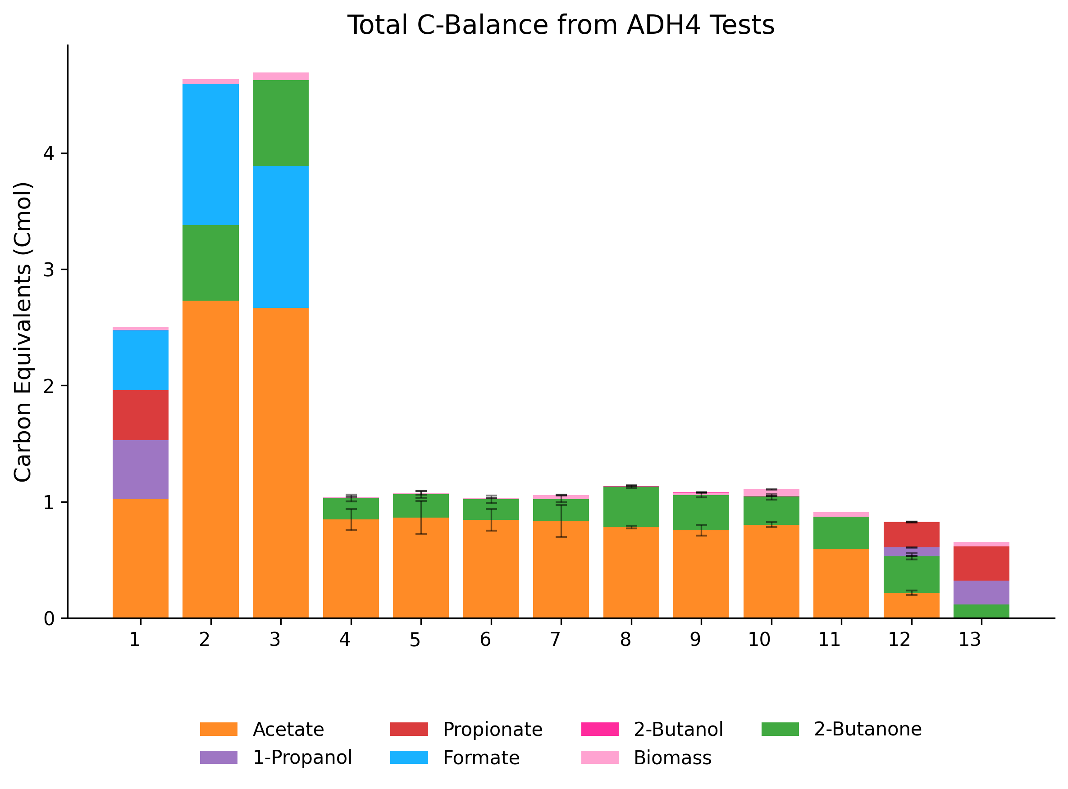

Slide 11
Successes and Setbacks

Slide 12
Outlook and Further Improvements

