Slide 1
Exploring possibilities for 2-butanol production in A. woodii by exchange of the Adh4 promoter
Thomas Hackl

Slide 2
Acetobacterium woodii
Anaerobic, acetogenic bacterium
Uses the Wood-Ljungdahl pathway for CO₂ fixation and acetyl-CoA production
Well studied for acetogenesis but energetically challenging for 2-butanol synthesis
Our project tests its potential and limitations for 2-butanol production

Slide 3
CRISPR-Cas System
CRISPR = Clustered Regularly Interspaced Short Palindromic Repeats
Adaptive immune system of bacteria and archaea
Cas proteins (e.g., Cas9) precisely cut DNA at specific sites
Enables precise genome editing (gene knockout, knock-in)
2020 Nobel Prize in Chemistry awarded to Emmanuelle Charpentier & Jennifer Doudna for developing CRISPR-Cas9
Revolutionizing molecular biology, medicine & biotechnology

Slide 4
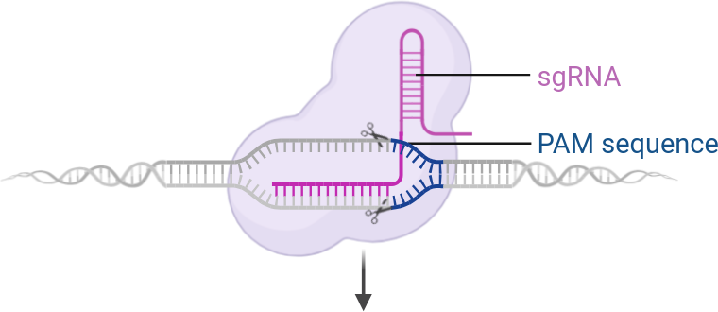
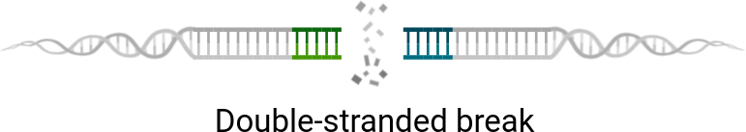
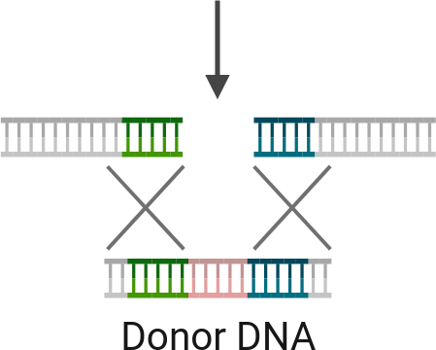

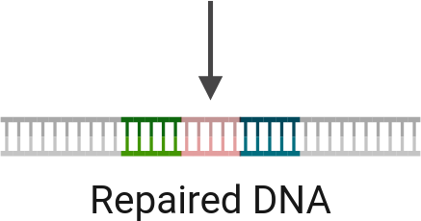
© Biorender.com

Slide 5
Golden Gate Cloning
Uses Type IIS restriction enzymes (e.g., Esp3I) that cut outside their recognition sites
Enables seamless and directional assembly of multiple DNA fragments in a single reaction
Custom overhangs created for precise ligation without extra bases
Efficient and fast cloning method for modular DNA assembly
Widely used in synthetic biology and genetic engineering

Slide 6
Aim of the Work
Replace the native adh4 promoter with the pta promoter from Clostridium ljungdahlii and the rso5 promoter from A. woodii
Increase the expression of adh4
Test if the presence of 1,2-propanediol triggers adh4 expression
Test if hydrogen shifts redox balance toward 2-butanol.

Slide 7
Experimental Workflow
Annealing spacer1/2 and amplification of pta, rso5, lha and rha
Construction of spacer plasmid and transformation into E. coli
Construction of promoter plasmid and transformation into E. coli
Midiprep isolation of promoter plasmid
Transformation of promoter plasmid into A. woodii
Functional test of adh4 activity

Slide 8
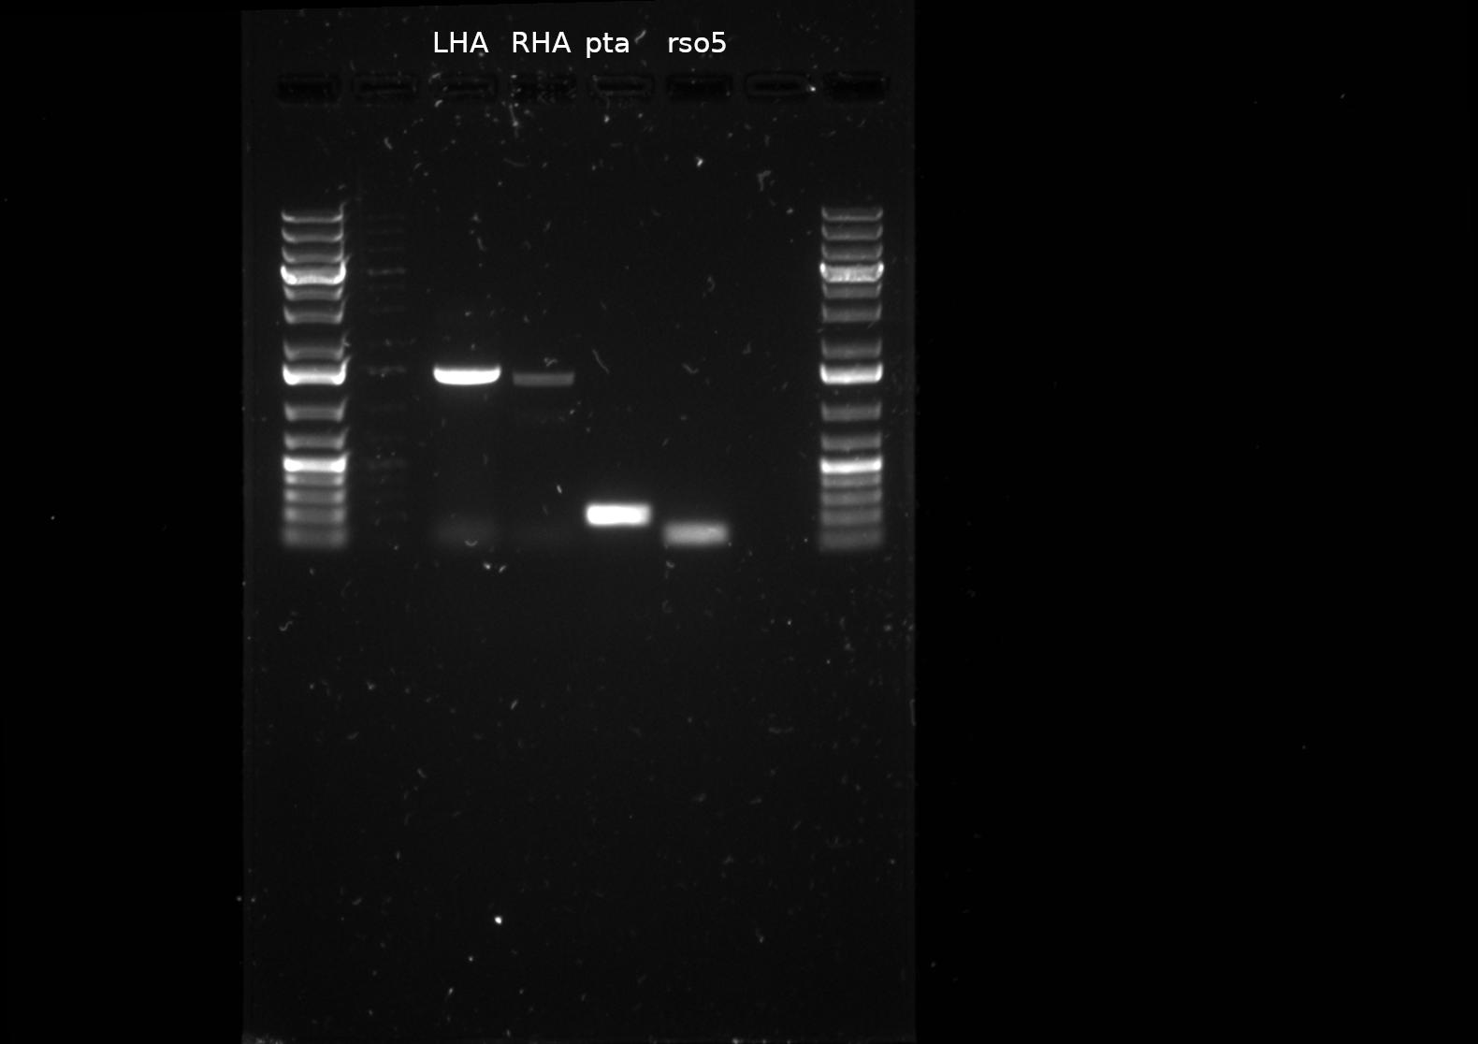

Slide 9
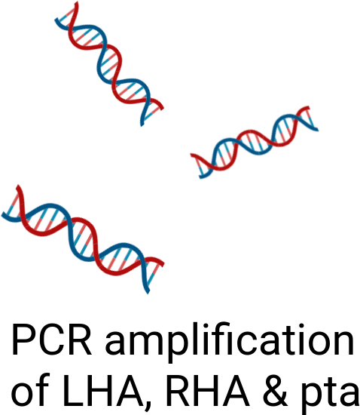
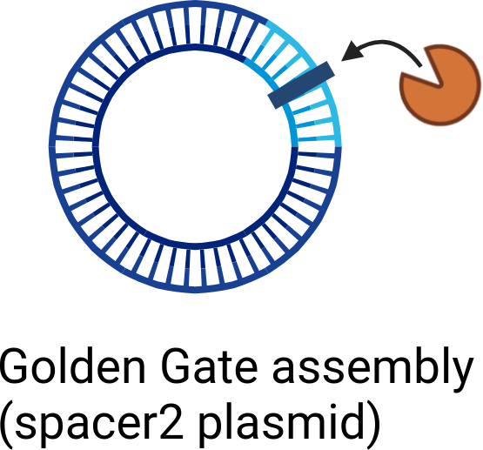
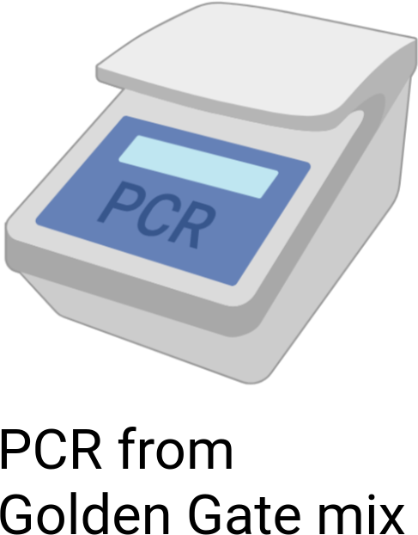
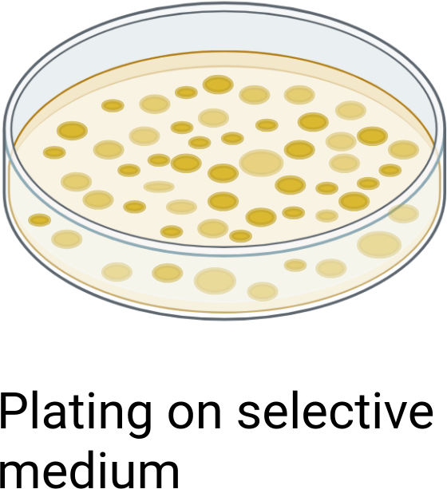
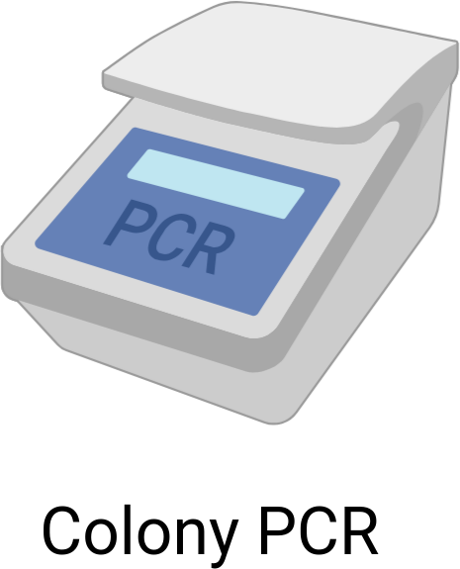
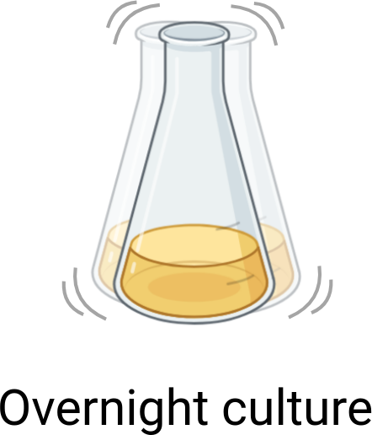
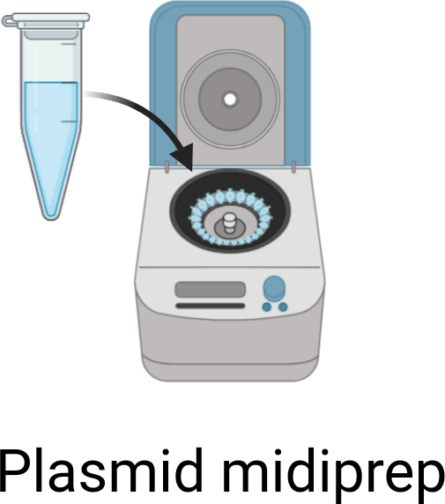


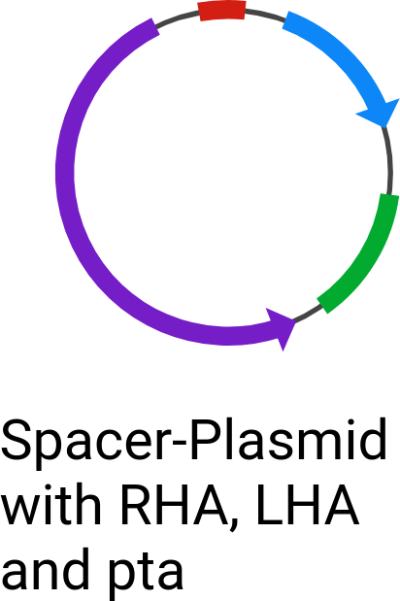
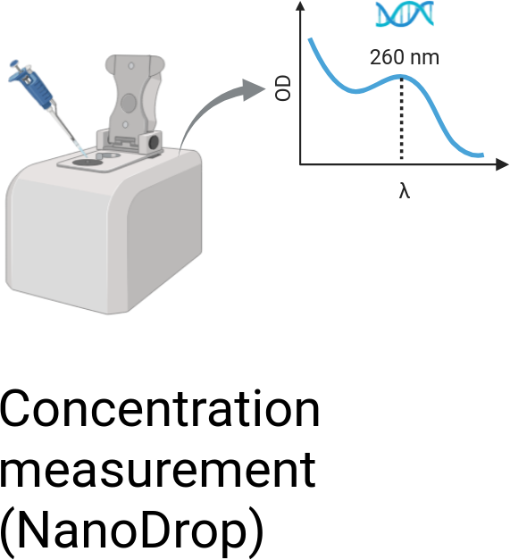
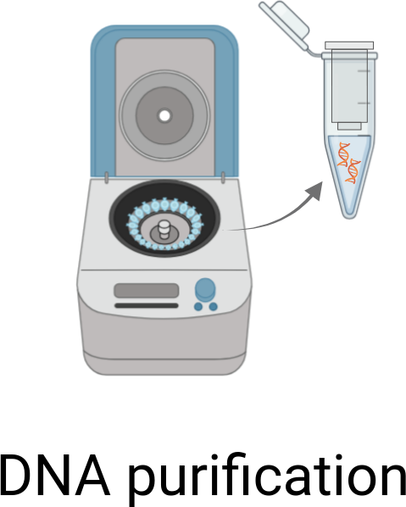

Construction of the PTA-Plasmid via Golden Gate
© Biorender.com

Slide 10
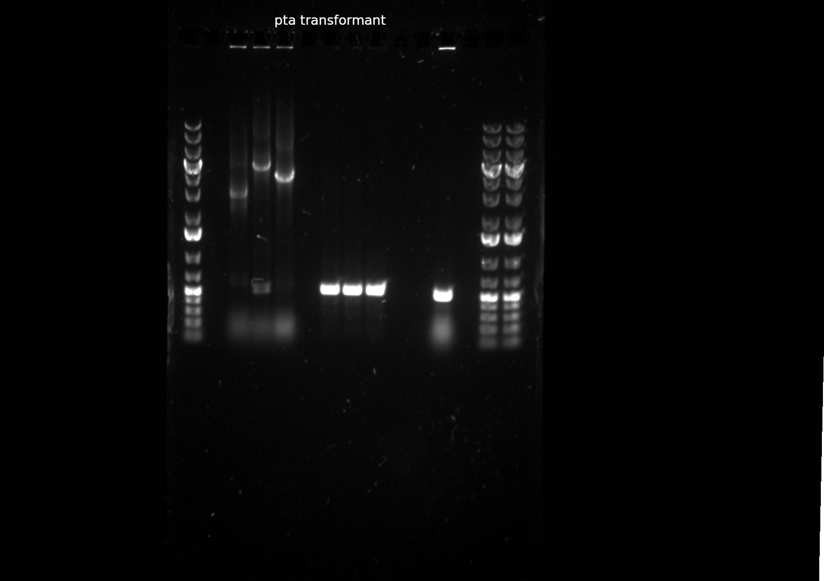

Slide 11
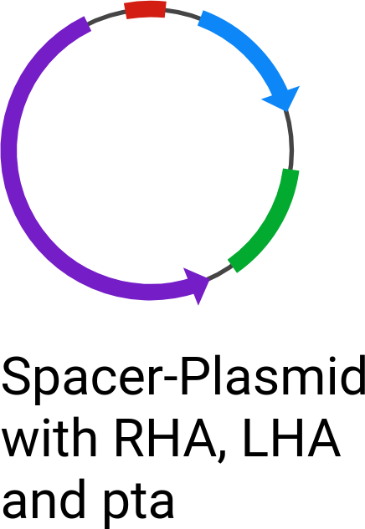
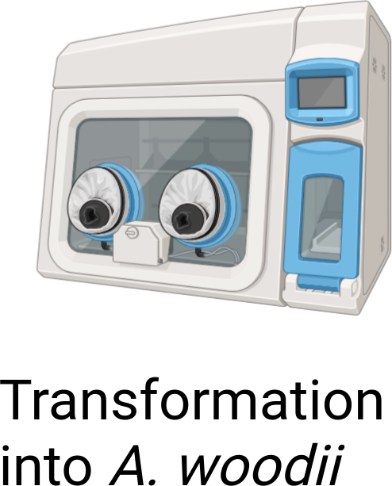
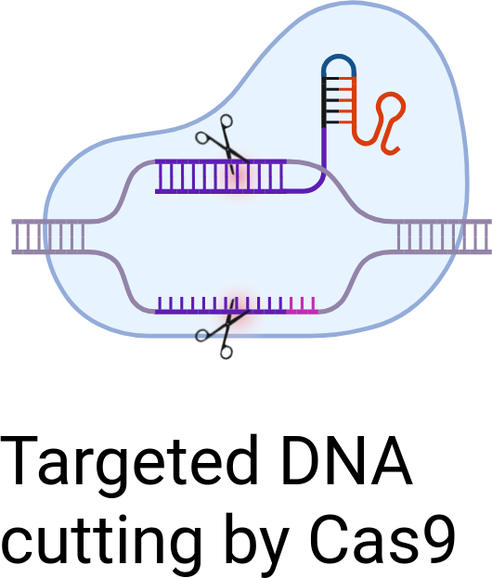
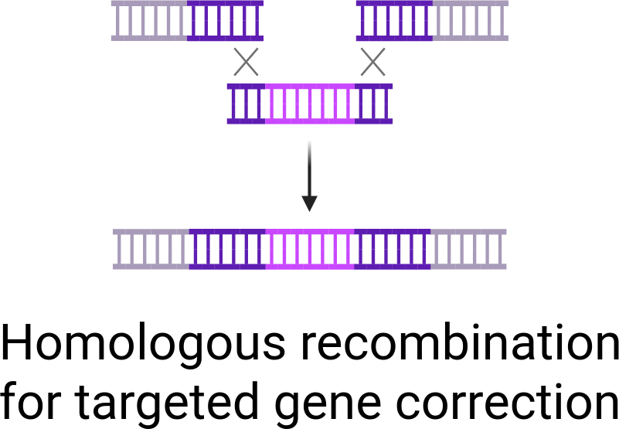
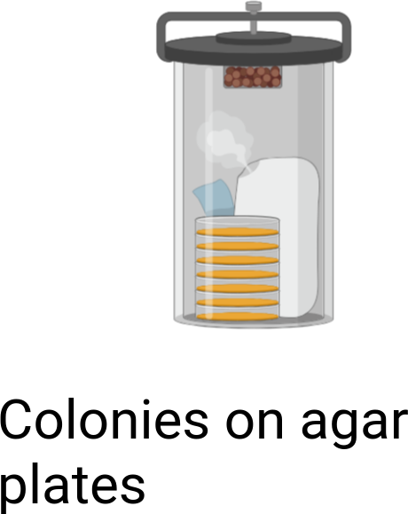
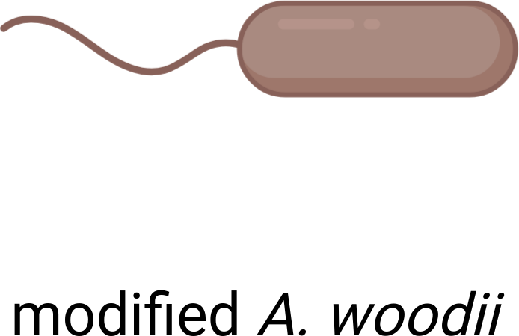
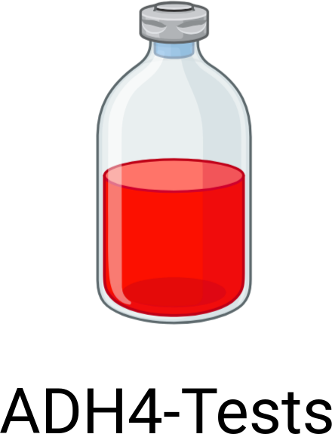
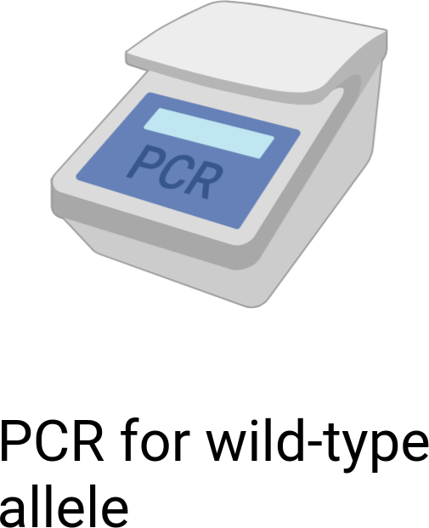
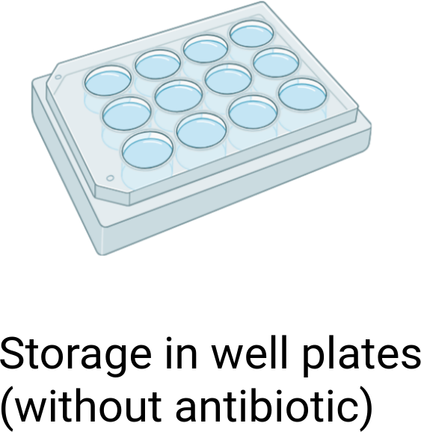
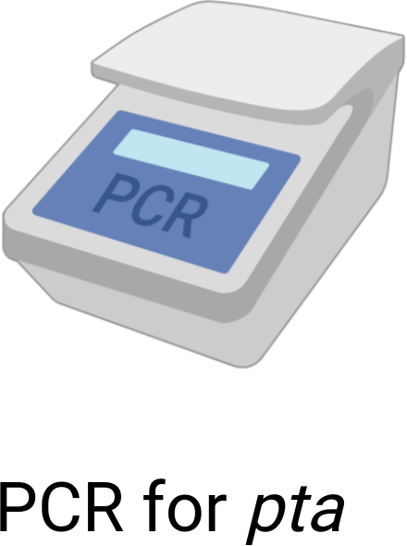
Transformation into A. woodii and Colony Screening
© Biorender.com

Slide 12
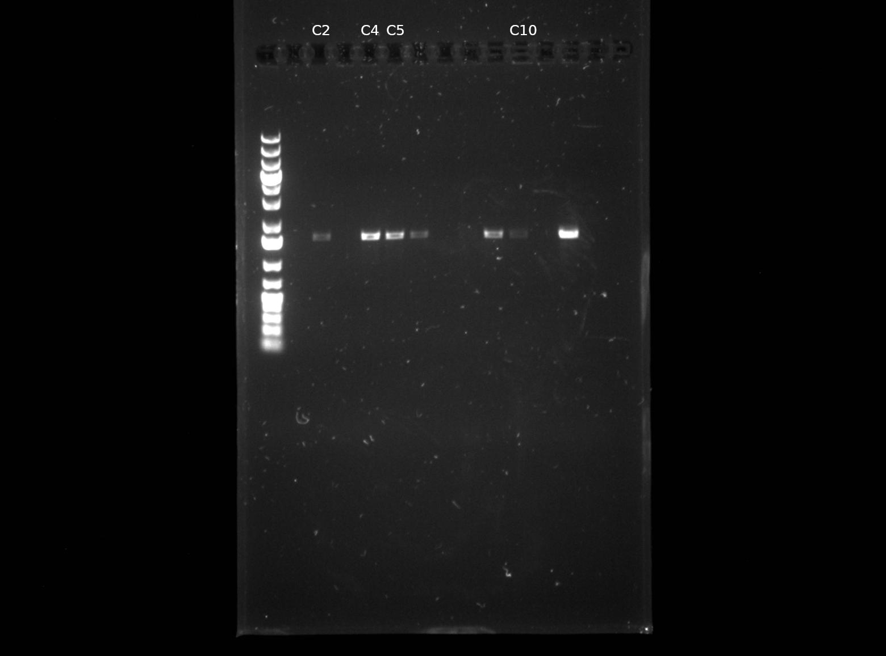

Slide 13
ADH4 Activity Screening
Strain | Substrates
TU2.0 | 2,3-Butanediol / 2,3-Butanediol + Methanol / 2,3-Butanediol + 1,2-Propanediol / 2,3-Butanediol + Ethylene glycol
Δaco1 | same as TU2.0
TU2.0_Ppta | 2,3-Butanediol / 2,3-Butanediol + Methanol
Δaco1_Ppta | same as TU2.0_Ppta
TU2.0_Ppta (H₂) | 2,3-Butanediol / 2,3-Butanediol + Methanol / 2-Butanone + 1,2-Propanediol
Measurements: OD₆₀₀/₆₆₀ and HPLC were performed for all cultures.

Slide 14
HPLC Analysis

Slide 15
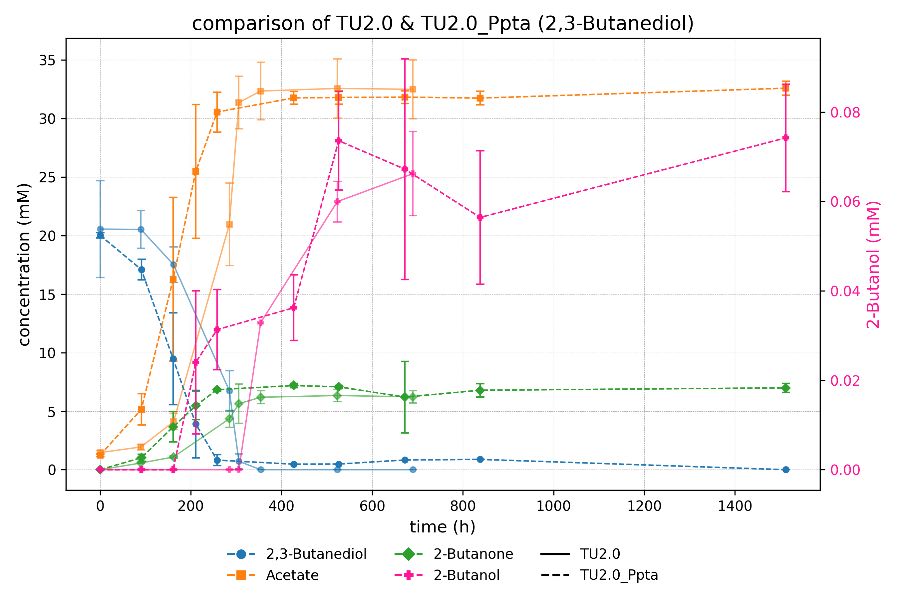

Slide 16
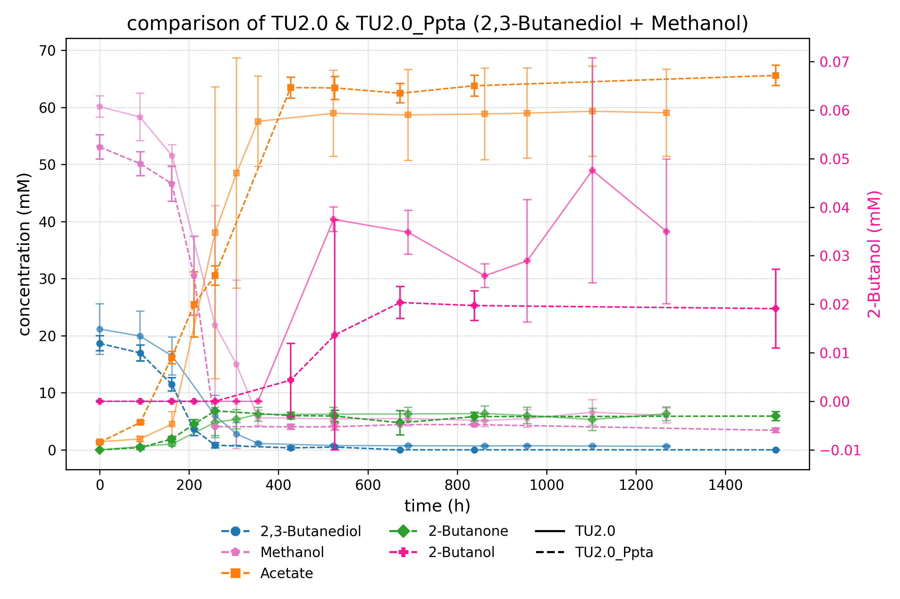

Slide 17
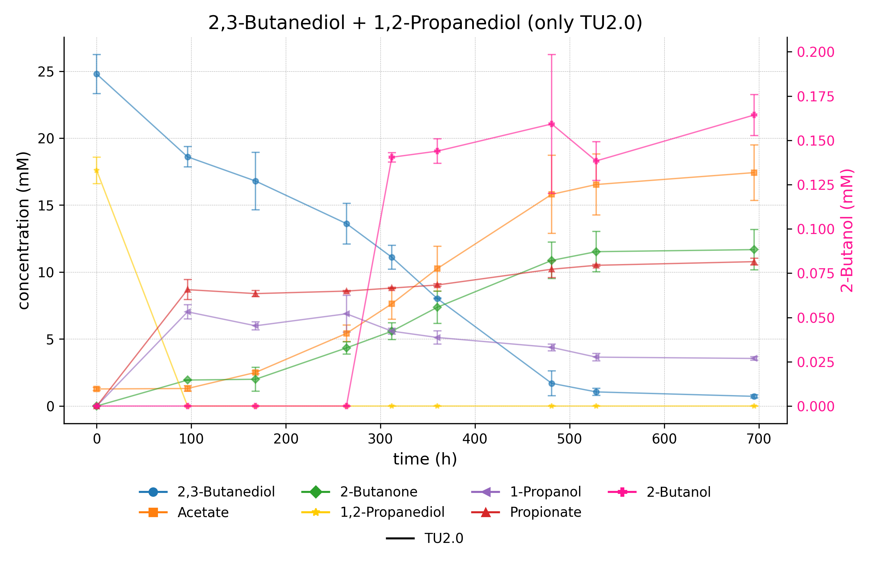

Slide 18
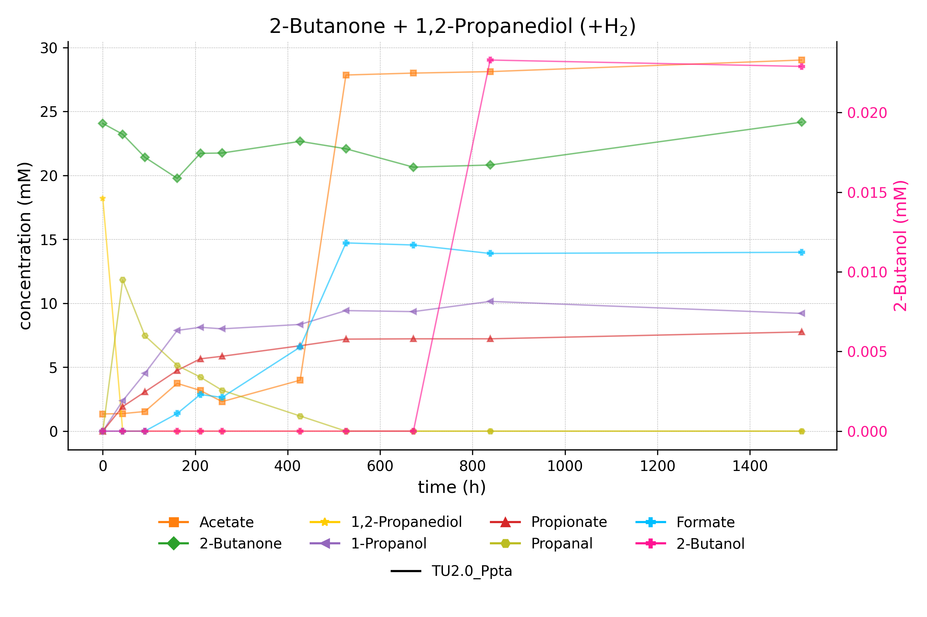

Slide 19
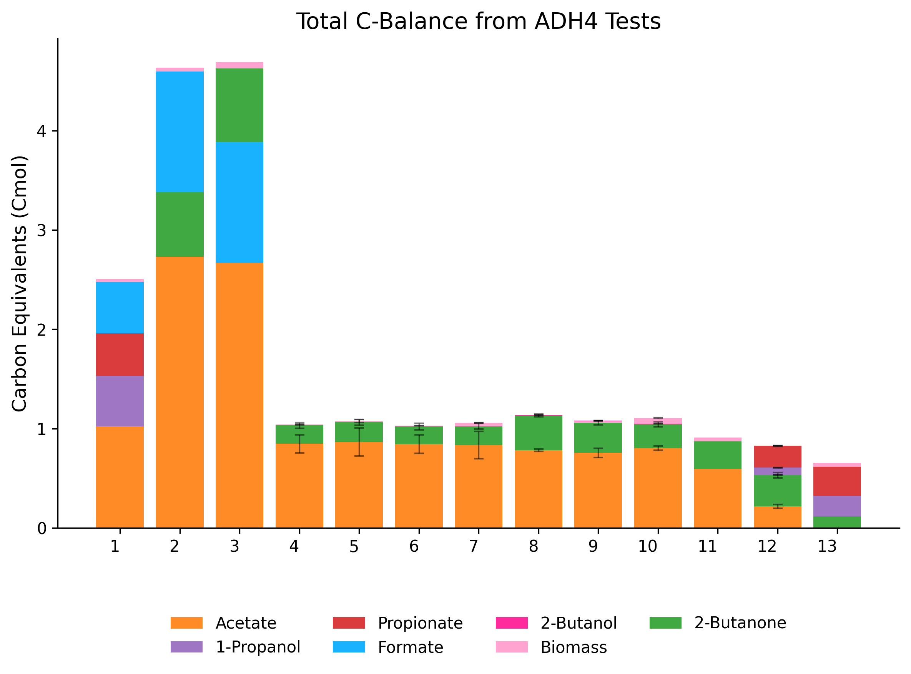

Slide 20
Successes and Setbacks
Replace the native adh4 promoter with the pta promoter from Clostridium ljungdahlii and the rso5 promoter from A. woodii
Increase the expression of adh4
Test if the presence of 1,2-propanediol triggers adh4 expression
Test if hydrogen shifts redox balance toward 2-butanol.

Slide 21
Outlook and Further Improvements
Focus on NADH availability, not promoter strength
Replace Adh4 with a more selective alcohol dehydrogenase
Improve NADH regeneration (e.g. via FDH)
Knockout of competing NADH-consuming pathways
Test alternative redox conditions (e.g. formate, CO)

Slide 22
Thanks for joining
Big thanks to Klara for the amazing supervision!
Thanks to Vincent for all the behind-the-scenes help!
And thanks to Dr. Stefan Pflügl for letting me be part of the team!

