Slide 1
Exploring possibilities for 2-butanol production in A. woodii by exchange of the Adh4 promoter
Thomas Hackl

Slide 2
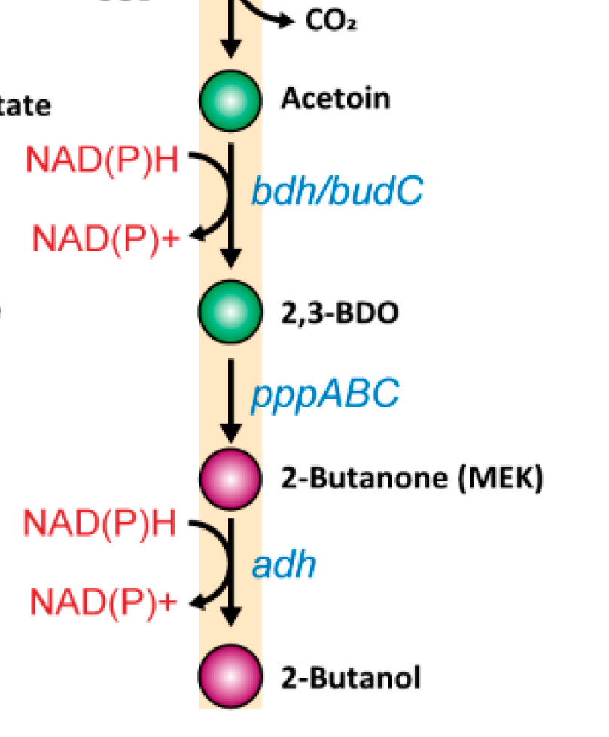
Background of the Project
Biotech alternative to fossil chemicals
Higher energy density than ethanol
Microbial production still rare
Better optimized via genetic engineering
Linked to CO₂ fixation (WLP)

Slide 3
Acetobacterium woodii
Anaerobic, acetogenic bacterium
Fixes CO₂ via the Wood-Ljungdahl pathy
Produces acetyl-CoA, but 2-butanol synthesis is energetically limited
Grows well anaerobically, quite robust
Easy to genetically modify
No harmful byproducts, safe to handle

Slide 4
CRISPR-Cas System
CRISPR = Clustered Regularly Interspaced Short Palindromic Repeats
Developed by Emmanuelle Charpentier & Jennifer Doudna (published in 2012)
Awarded the 2020 Nobel Prize in Chemistry
Adaptive immune system of bacteria and archaea
Cas proteins (e.g. Cas9) cut DNA at specific sites
Enables precise genome editing (knockout, knock-in)
Revolutionizing molecular biology, medicine & biotechnology

Slide 5
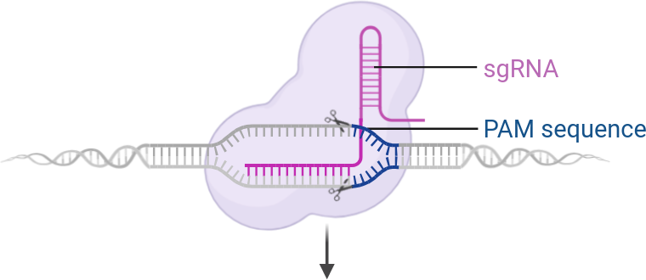
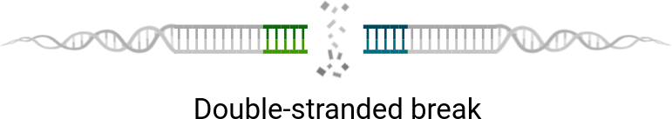
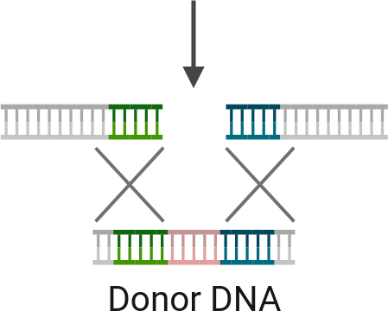

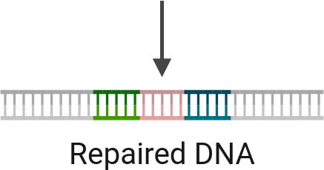
© Biorender.com

Slide 6
Golden Gate Cloning
Fast and efficient DNA assembly
Uses Type IIS enzymes (e.g. Esp3I)
Cuts outside recognition sites → custom overhangs
Enables seamless & directional ligation
Great for modular constructs

Slide 7
Aim of the Work
Replace the native adh4 promoter with the pta promoter from Clostridium ljungdahlii and the rso5 promoter from A. woodii
Increase the expression of adh4
Test if the presence of 1,2-propanediol triggers adh4 expression
Test if hydrogen shifts redox balance toward 2-butanol.

Slide 8
Experimental Workflow
Annealing spacer1/2 and amplification of pta, rso5, lha and rha
Construction of spacer plasmid and transformation into E. coli
Construction of promoter plasmid and transformation into E. coli
Midiprep isolation of promoter plasmid
Transformation of promoter plasmid into A. woodii
Functional test of adh4 activity

Slide 9
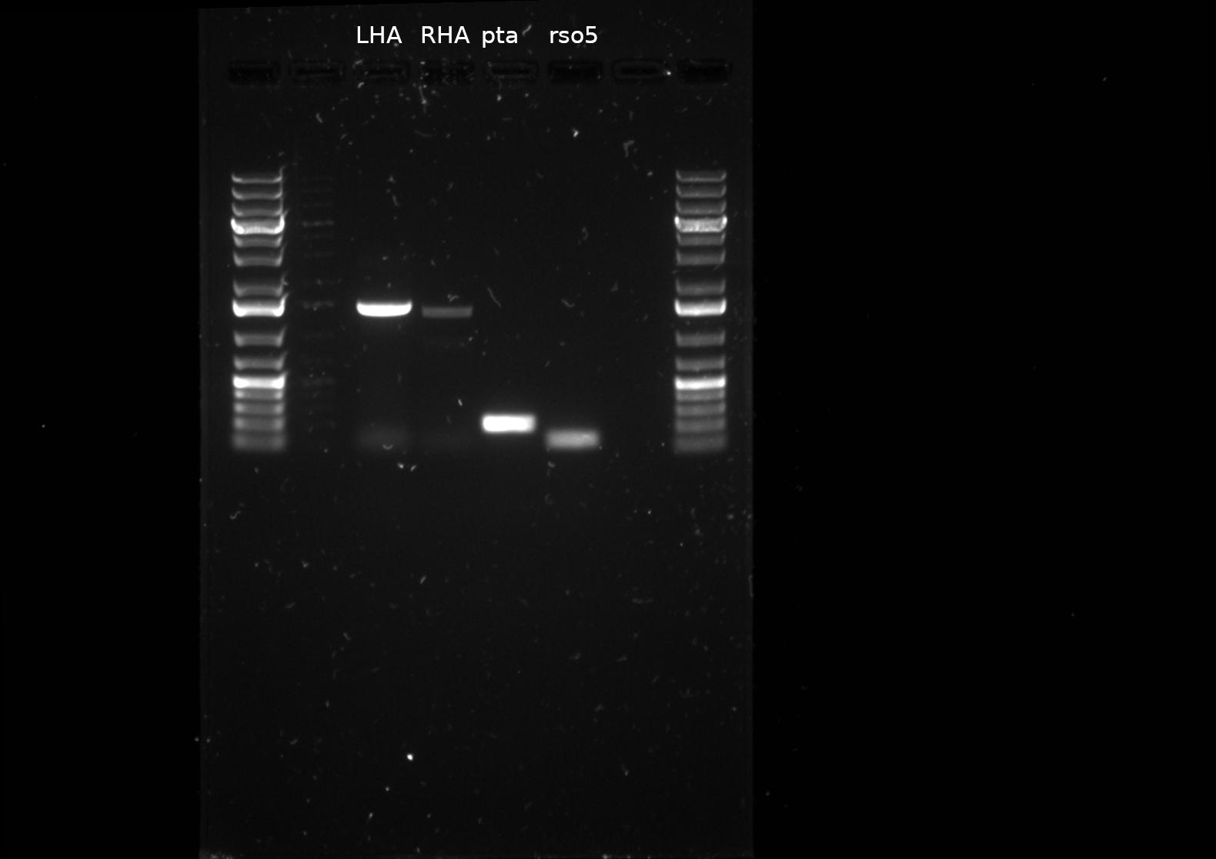

Slide 10
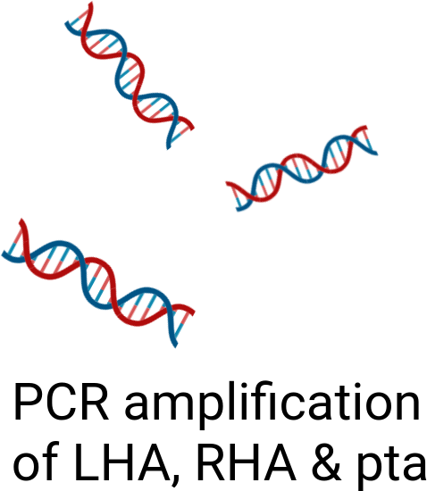
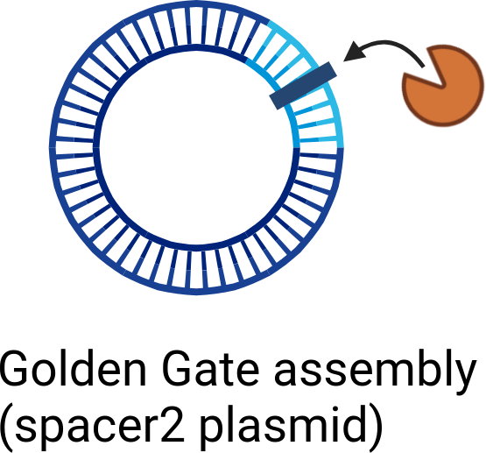
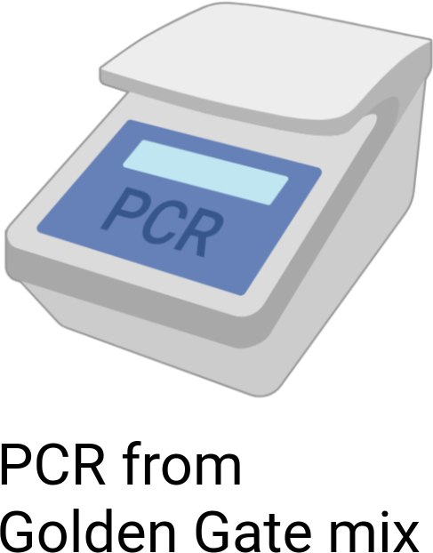
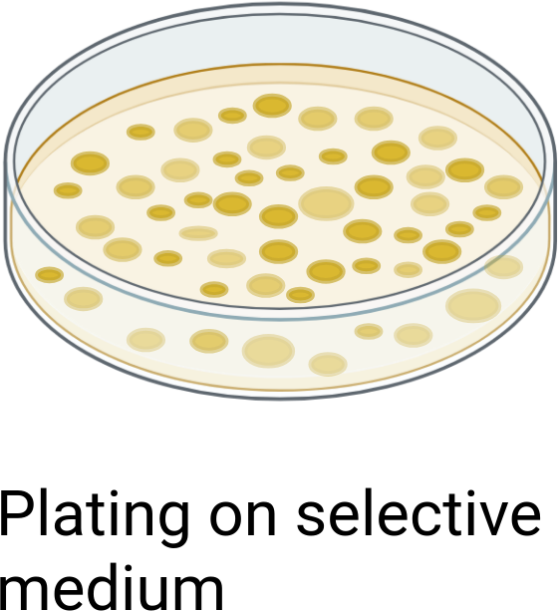
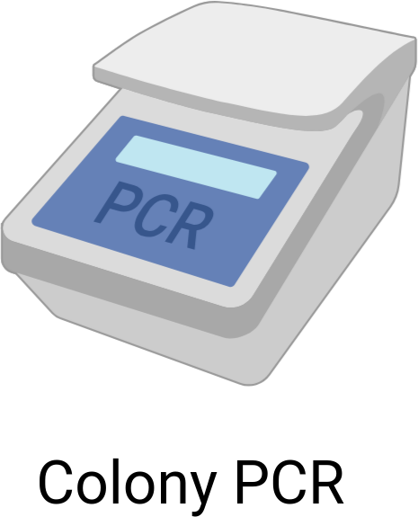
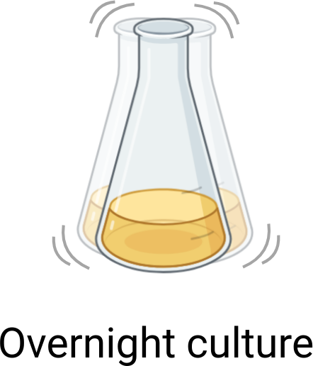
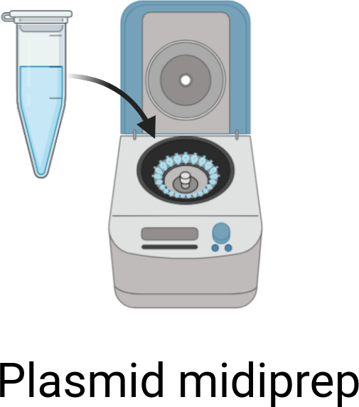


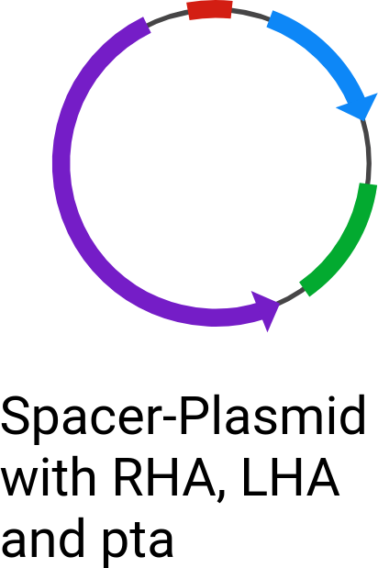
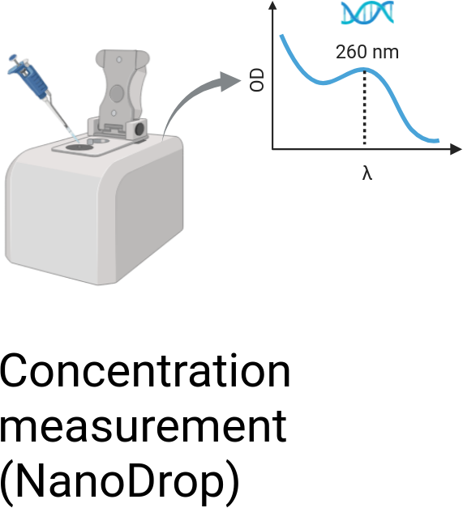
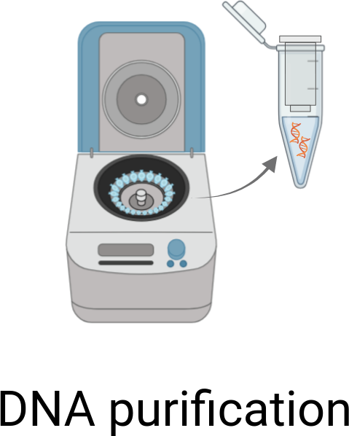

Construction of the PTA-Plasmid via Golden Gate
© Biorender.com

Slide 11
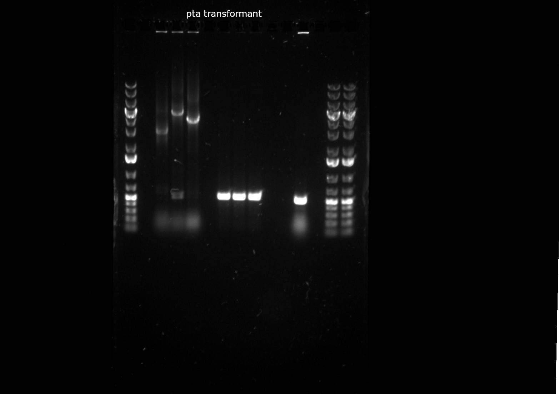

Slide 12
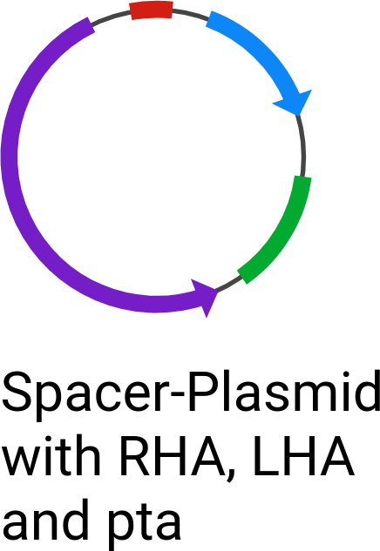
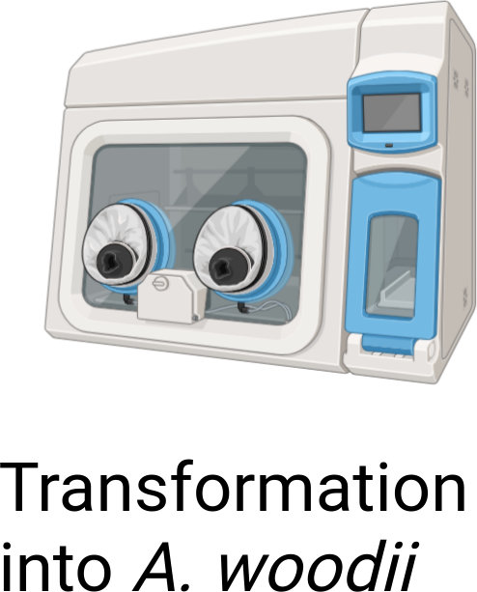
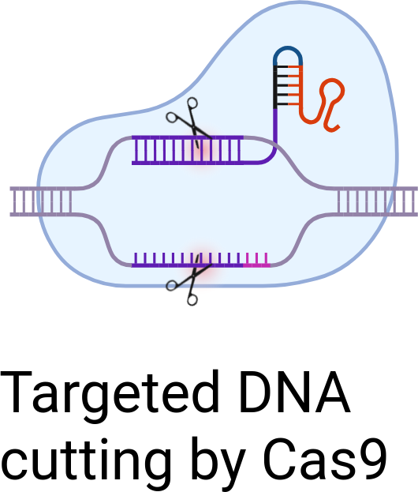
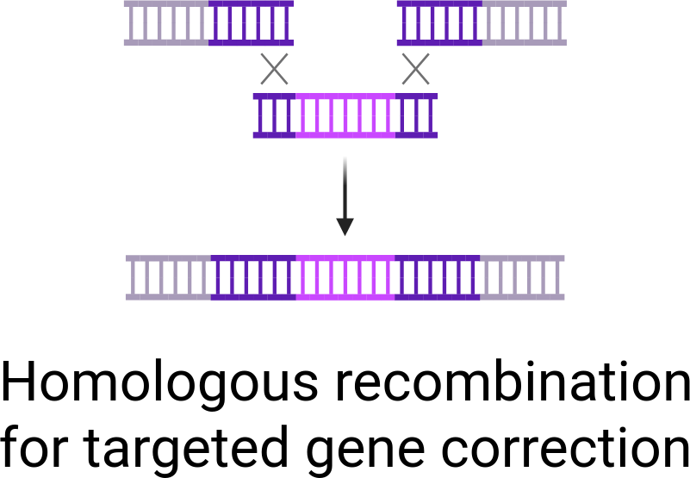
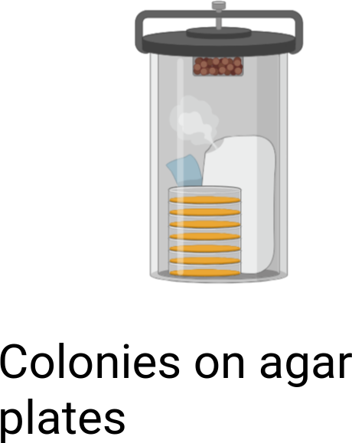
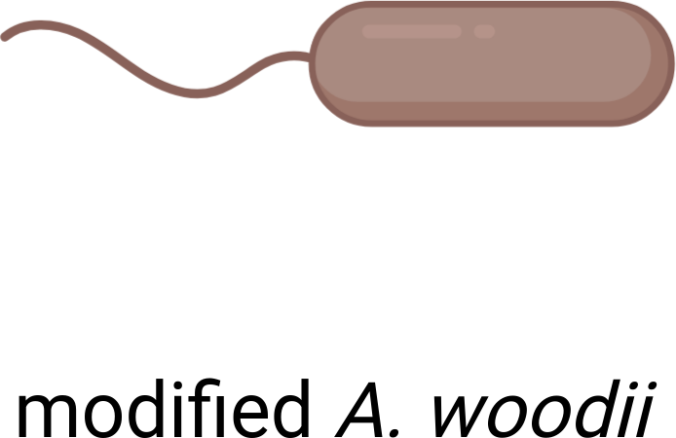
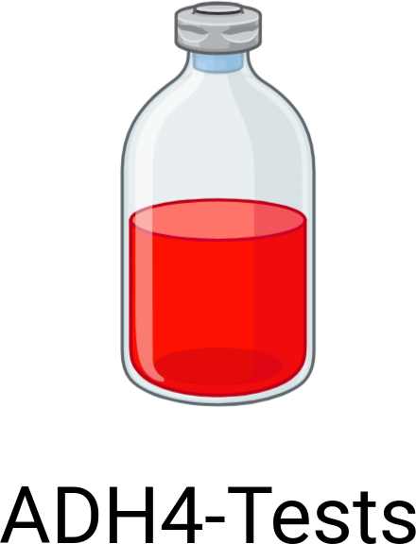
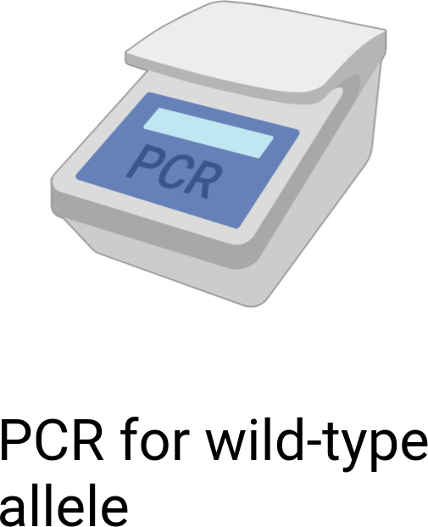
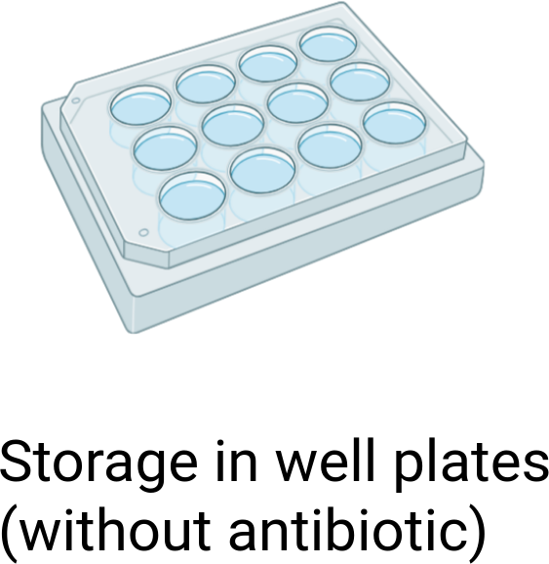
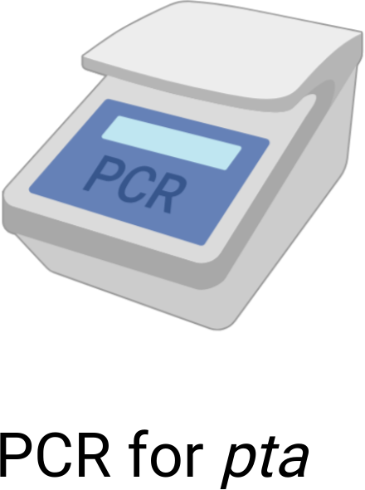
Transformation into A. woodii and Colony Screening
© Biorender.com

Slide 13
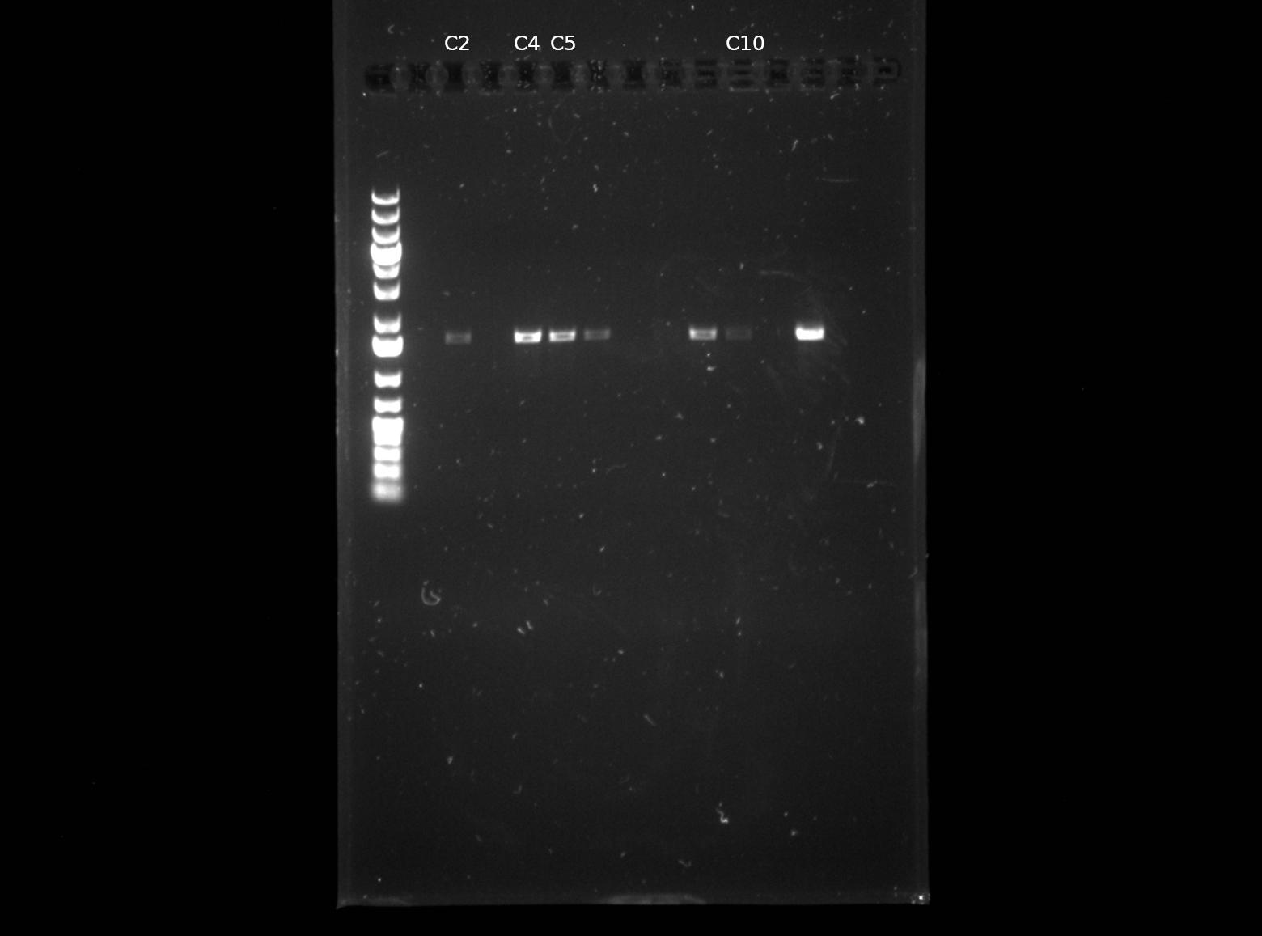

Slide 14
ADH4 Activity Screening
Strain | Substrates
TU2.0 | 2,3-Butanediol / 2,3-Butanediol + Methanol / 2,3-Butanediol + 1,2-Propanediol / 2,3-Butanediol + Ethylene glycol
Δaco1 | same as TU2.0
TU2.0_Ppta | 2,3-Butanediol / 2,3-Butanediol + Methanol
Δaco1_Ppta | same as TU2.0_Ppta
TU2.0_Ppta (H₂) | 2,3-Butanediol / 2,3-Butanediol + Methanol / 2-Butanone + 1,2-Propanediol
Measurements: OD₆₀₀/₆₆₀ and HPLC were performed for all cultures.

Slide 15
HPLC Analysis

Slide 16
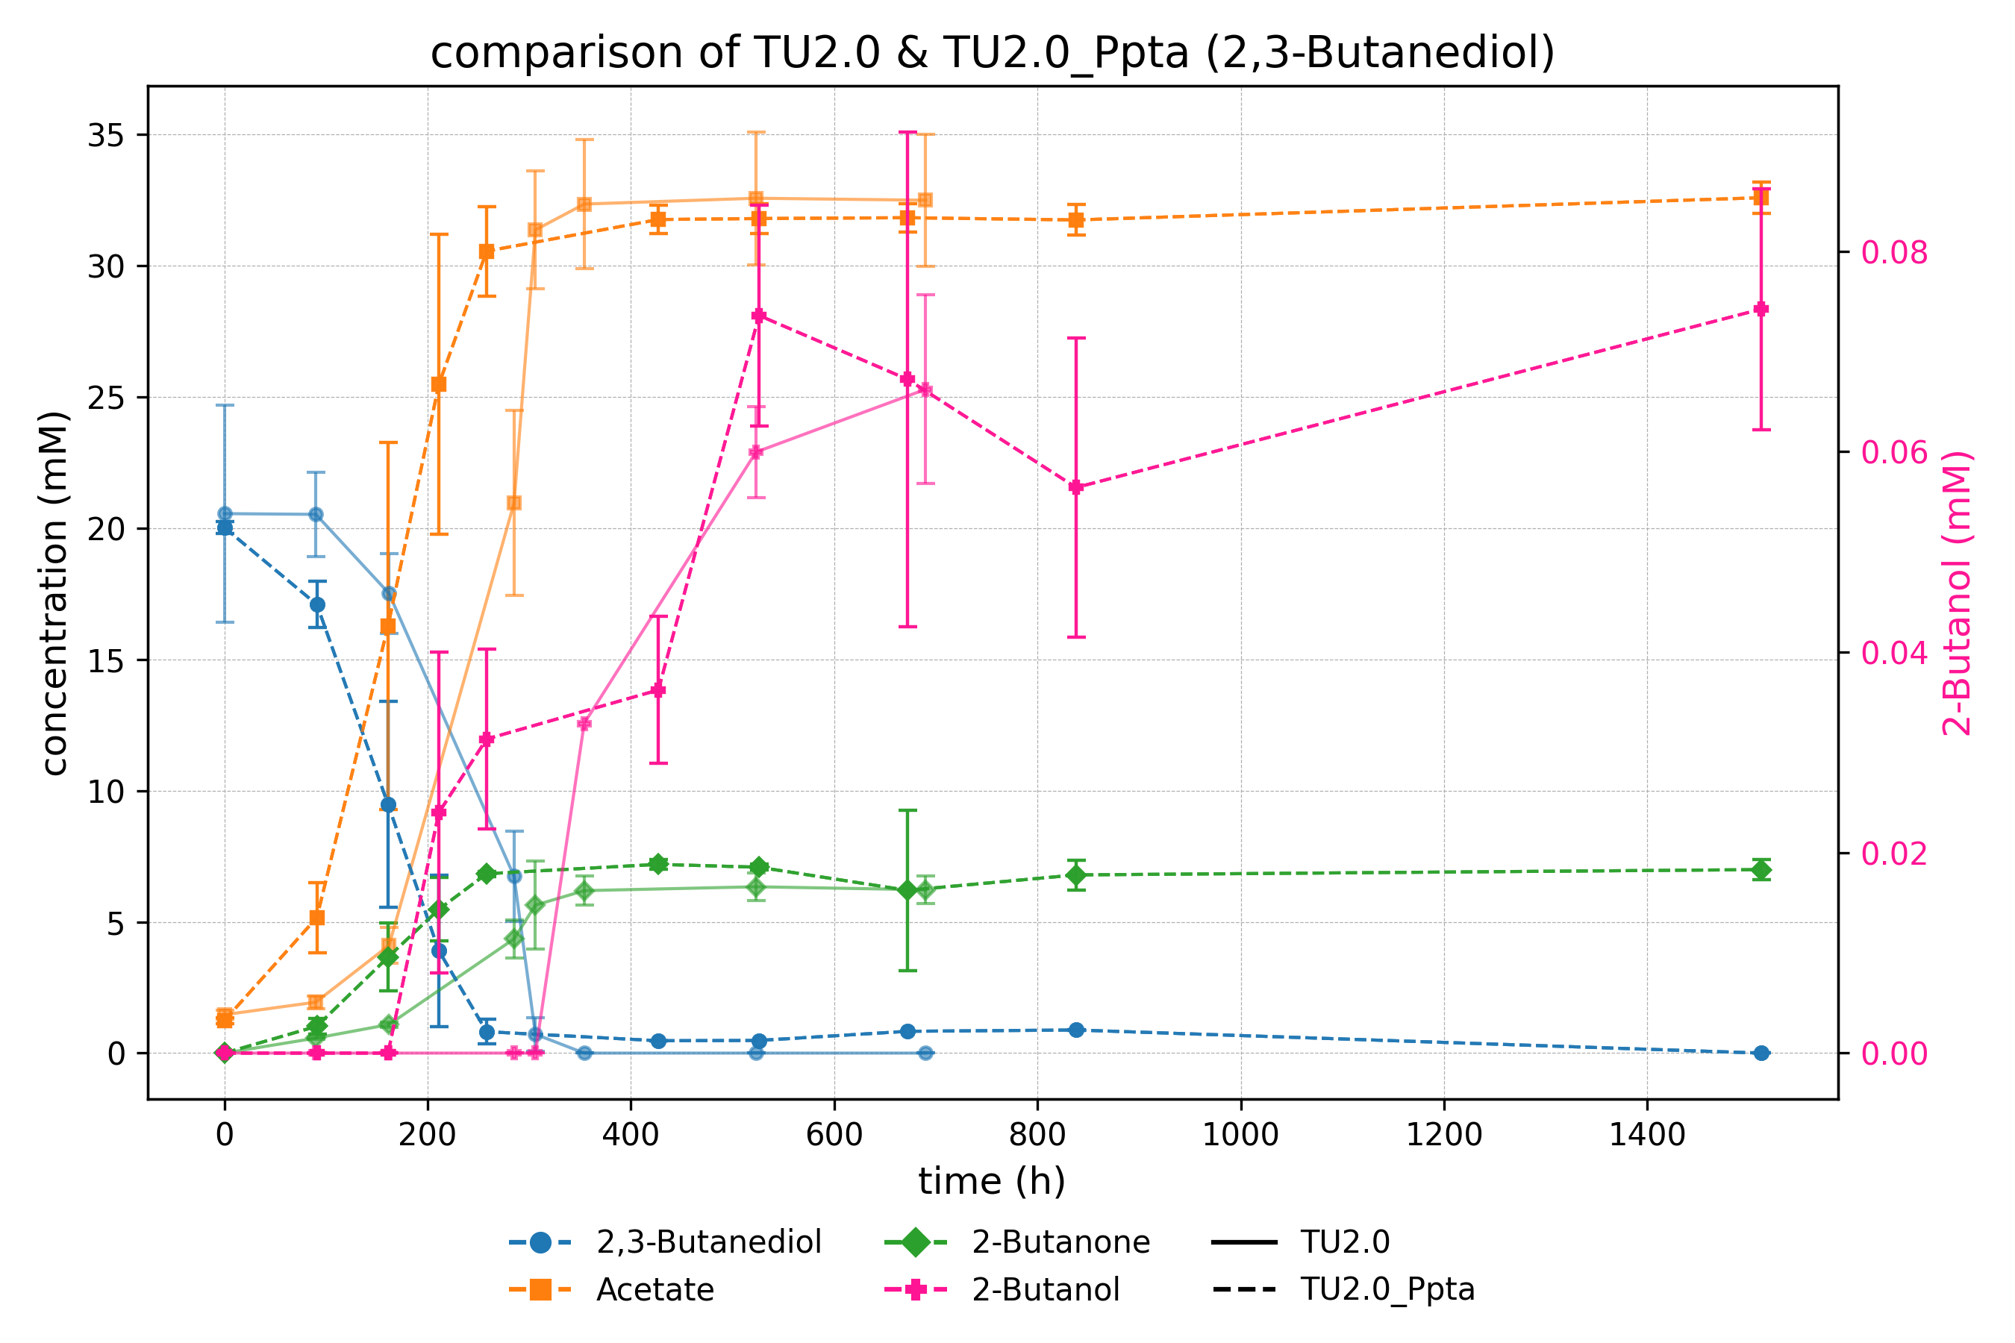

Slide 17
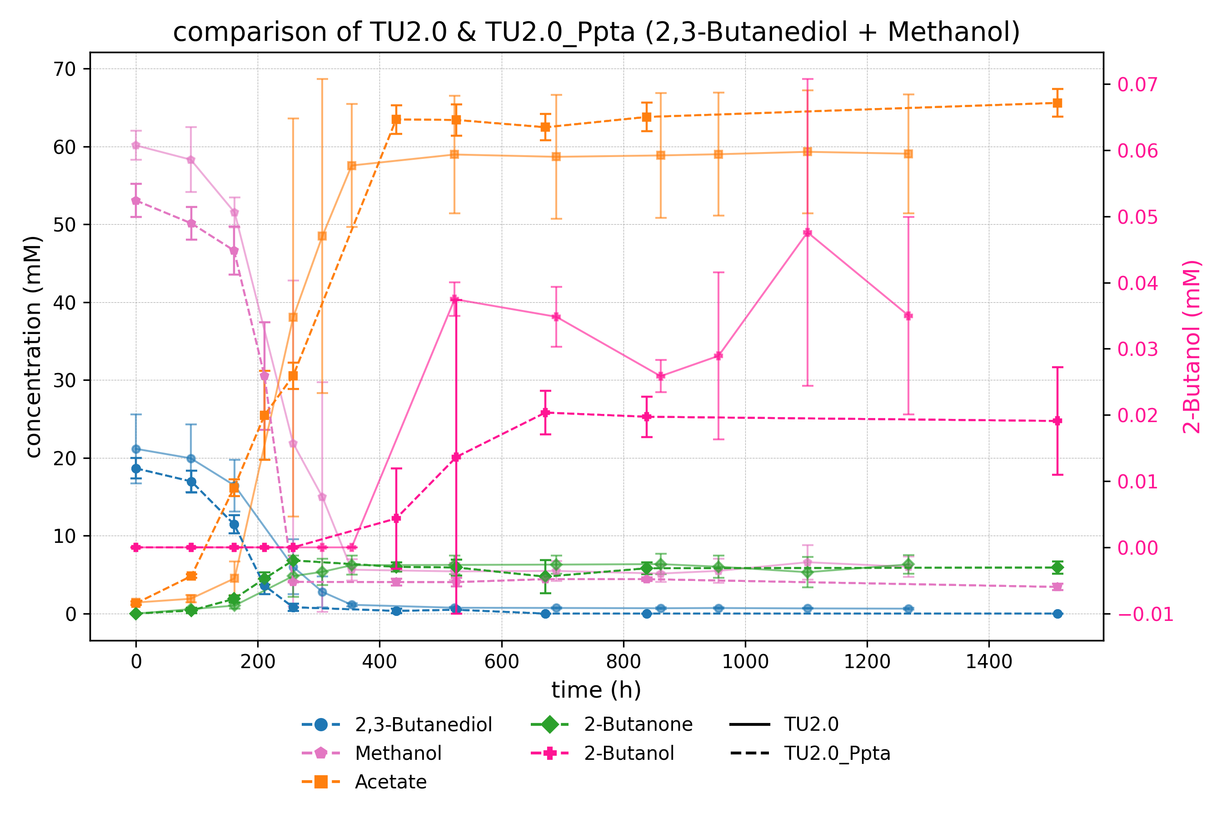

Slide 18
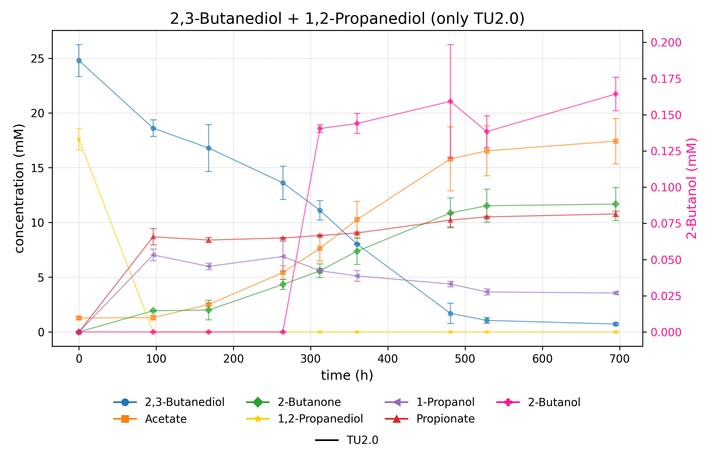

Slide 19
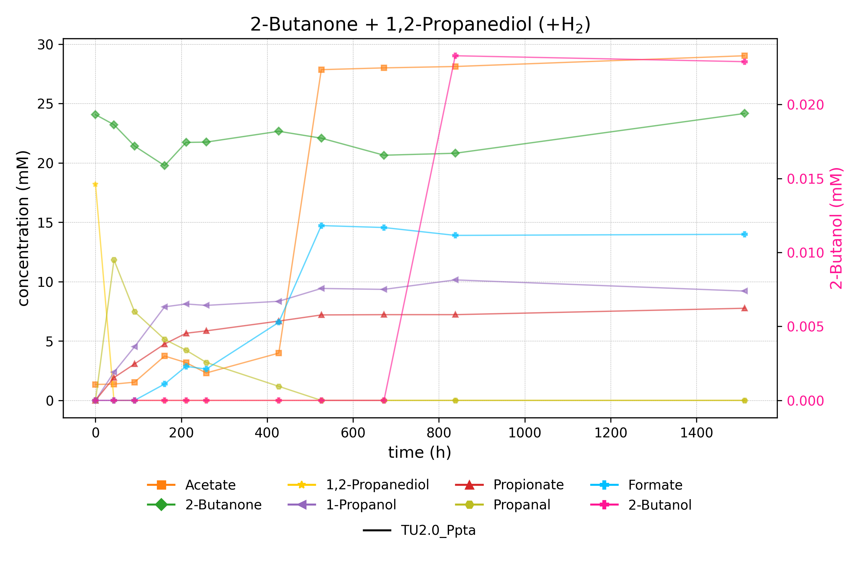

Slide 20
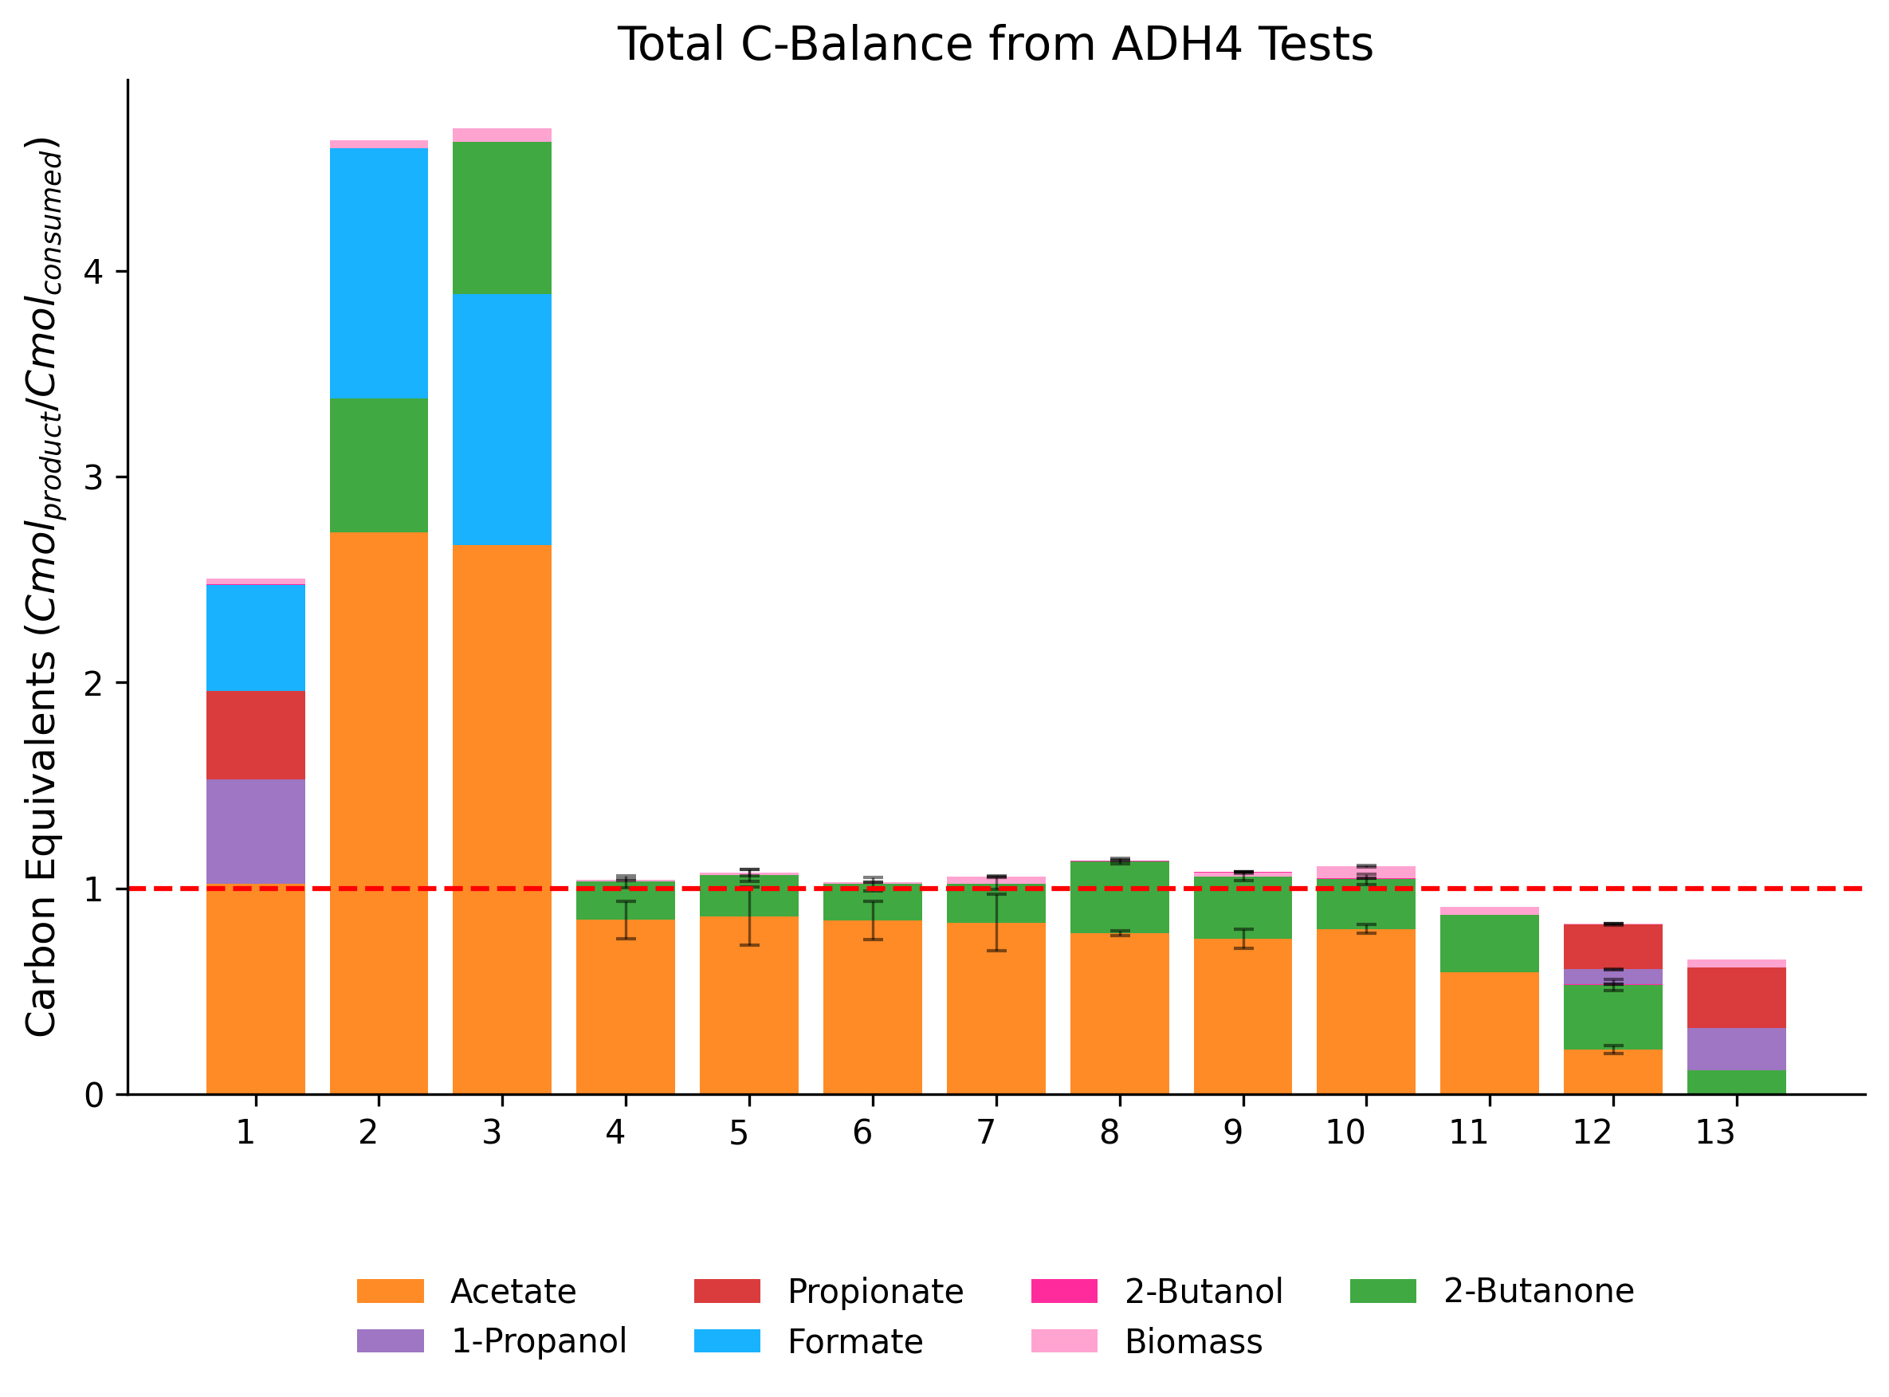

Slide 21
Successes and Setbacks
Replace the native adh4 promoter with the pta promoter from Clostridium ljungdahlii and the rso5 promoter from A. woodii
Increase the expression of adh4
Test if the presence of 1,2-propanediol triggers adh4 expression
Test if hydrogen shifts redox balance toward 2-butanol.

Slide 22
Outlook and Further Improvements
Focus on NADH availability, not promoter strength
Replace Adh4 with a more selective alcohol dehydrogenase
Improve NADH regeneration (e.g. via FDH)
Knockout of competing NADH-consuming pathways
Test alternative redox conditions (e.g. formate, CO)

Slide 23
Thanks for joining
Big thanks to Klara for the amazing supervision!
Thanks to Vincent for all the behind-the-scenes help!
And thanks to Dr. Stefan Pflügl for letting me be part of the team!

