Slide 1
Digital Portfolio
STUDENT NAME: J. Sheerin banu
REGISTER NO :24524U09103
NMID: 34B9EC73ED18BAAF9FFC44ACDF81334F8
DEPARTMENT: Bachelor of computer application
COLLEGE: Karan arts and science college
University: Thiruvalluvar University

Slide 2
PROJECT TITLE
Digital Registration Page for Students

Slide 3


AGENDA
Problem Statement
Project Overview
End Users
Tools and Technologies
Portfolio design and Layout
Features and Functionality
Results and Screenshots
Conclusion
Github Link
3/21/2024 Annual Review

Slide 4

PROBLEM STATEMENT
Managing student registrations manually using paper forms is time-consuming, error-prone, and inefficient. Educational institutions require a simple and user-friendly digital solution to collect and validate student details such as name, email, phone number, gender, date of birth, address, and chosen course.

Slide 5

PROJECT OVERVIEW
This project aims to develop a Student Registration Form using HTML, CSS, and JavaScript that provides:
A clean and responsive interface for students to enter their details.
Basic validation to ensure all required fields are filled correctly.
Instant feedback to users about successful or incomplete submissions.

Slide 6

WHO ARE THE END USERS?
Students – who will fill out the registration form.
Educational Institutions – who will use the system to collect structured student data.
Teachers/Admin Staff – who can validate and maintain student registration records.

Slide 7

TOOLS AND TECHNIQUES
HTML5 → for structure and layout.
CSS3 → for styling and responsive design.
JavaScript → for form validation and interactivity.
Browser → to run and test the application (Google Chrome, Edge, Firefox).
Code Editor → Visual Studio Code / Sublime Text / Notepad++.

Slide 8
POTFOLIO DESIGN AND LAYOUT
Header: Title of the project.
Form Section: Input fields for student details (Name, Email, Phone, DOB, Gender, Address, Course).
Buttons: Register (Submit form) and Reset (Clear inputs).
Validation: Alerts user if fields are missing or incorrect.
Responsive Layout: Works across desktop and mobile screens.
8

Slide 9
FEATURES AND FUNCTIONALITY
✅ User-friendly registration form.
✅ Collects essential student details.
✅ Real-time form validation (checks for empty fields, email format, phone number length).
✅ Stylish and responsive design using CSS.
✅ Alert messages for successful or failed submission.
✅ Can be extended to save data in databases or display it in a table.

Slide 10
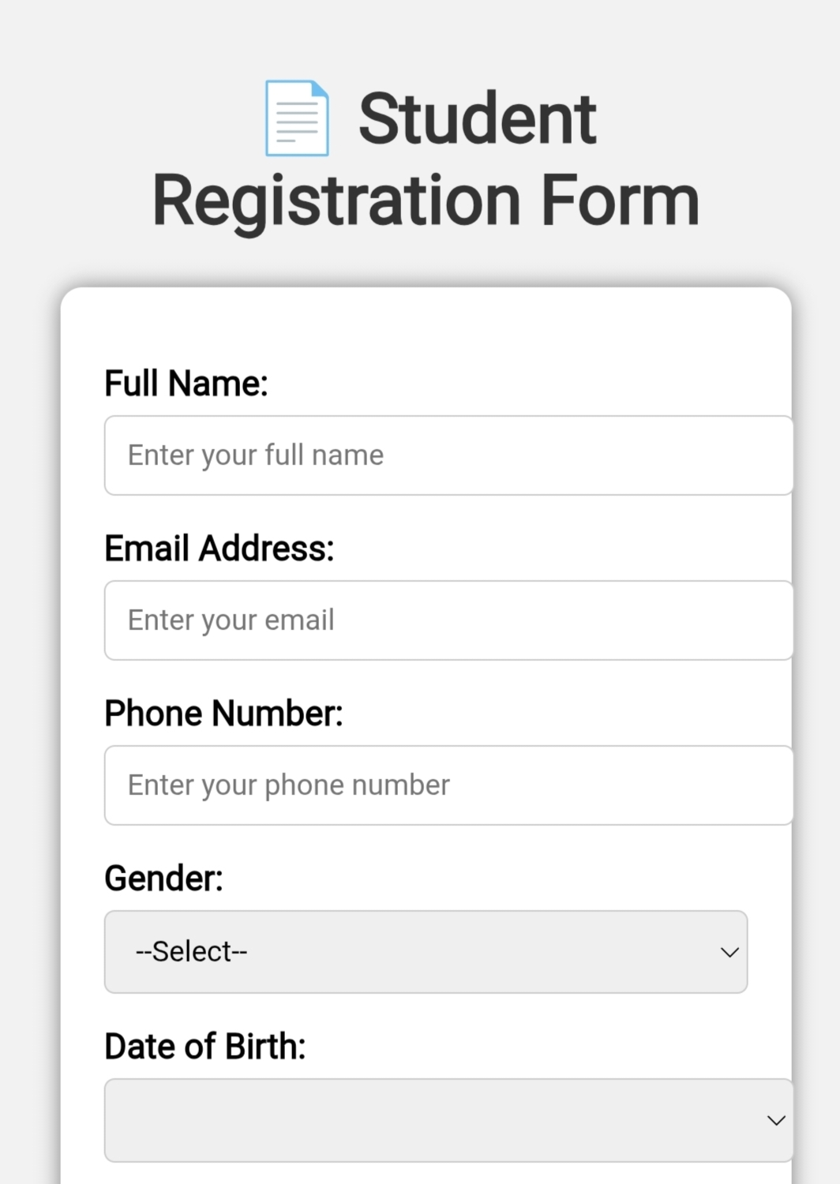
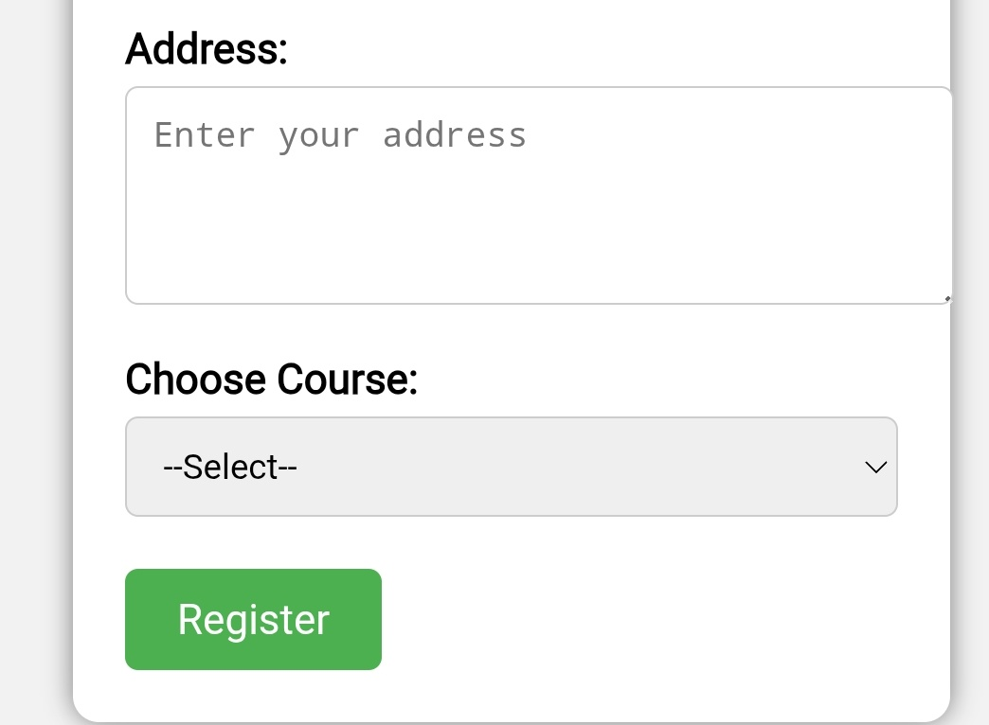

RESULTS AND SCREENSHOTS
3/21/2024 Annual Review
10

Slide 11
CONCLUSION
The Student Registration Form project successfully demonstrates how front-end web technologies can be used to design interactive and validated forms.
It eliminates the need for paper-based registration, ensures accuracy in data collection, and provides an easy-to-use interface for students.
This project can be further enhanced by connecting it to a backend database (MySQL, Firebase, etc.) to store student records securely.
11

