Slide 1
Digital Portfolio
STUDENT NAME: SHEERIN BANU V
REGISTER NO AND NMID: 34624U09089
DEPARTMENT: BACHELOR OF COMPUTER APPLICATION
COLLEGE: MMES WOMENS ARTS AND SCIENCE COLLEGE\THIRUVALLUVAR UNIVERSITY

Slide 2
NEXT YOU

Slide 3


AGENDA
Problem Statement
Project Overview
End Users
Tools and Technologies
Portfolio design and Layout
Features and Functionality
Results and Screenshots
Conclusion
Github Link
3/21/2024 Annual Review

Slide 4

PROBLEM STATEMENT
Identify the Problem: Clearly state the main issue.
Define the User: Specify who is affected by this problem
Explain Limitations: Show why current solutions aren't good enough.
Describe the Impact: Explain the negative consequences of the problem.
Justify the Solution: State why this project is necessary.

Slide 5

PROJECT OVERVIEW
Summarize the Solution: Provide a high-level description of what the project is and what it aims to achieve.
Define Project Goals: State the main objectives and what the project will accomplish.
Specify Scope: Clearly outline the boundaries of the project, including what is and isn’t included.
List Key Deliverables: Identify the primary outputs, results, or products that the project will produce.
Mention the Timeline: Briefly outline the main phases or key milestones of the project's development.

Slide 6
PROJECT OVERVIEW
Project Goal: What is the main objective or purpose of the project?
Scope: What work is included in the project, and what is specifically excluded?
Key Deliverables: What are the tangible outputs or results that the project will produce?
Target Audience: Who will the project serve or be used by?
High-Level Timeline: What are the major phases or milestones of the project, and when are they expected to be completed?

Slide 7

WHO ARE THE END USERS?
User Identification: Categorize the different types of people who will interact with the product (e.g., administrator, basic user, customer).
User Needs: Detail the specific needs, goals, and pain points of each user group that the project aims to address.
User Scenarios: Describe typical situations or tasks that end users will perform with the product.
Demographics: Provide relevant demographic information, such as age, technical proficiency, and professional role.
Feedback Loop: Explain how you will collect and use feedback from these users to improve the project.

Slide 8
TOOLS AND TECHNIQUES
Selection: Choose the right tool for the specific task to ensure efficiency and quality.
Safety: Always follow safety guidelines to prevent injury and accidents.
Maintenance: Keep your tools in good condition so they perform reliably.
Practice: Develop your skill through consistent use to improve your technique.
Adaptation: Be flexible and willing to adjust your methods to fit different situations.

Slide 9
POTFOLIO DESIGN AND LAYOUT
Quality over Quantity: Showcase only your best work, not every project you've ever done.
Show Your Process: Include sketches and early ideas to demonstrate your problem-solving skills.
Clean, Simple Layout: Use a minimalist design to keep the focus on your work.
Tailor to Your Audience: Customize your portfolio for the specific job or client you want to attract.
Tell a Story: Provide context for each project by explaining your role and the outcome.
9

Slide 10
FEATURES AND FUNCTIONALITY
Advance to the next slide: Move forward in your presentation.
Trigger animations: Control when content appears on the current slide.
Reveal hidden content: Show information on the same slide piece by piece.
Control multimedia: Play or pause videos and audio with a click.
Jump to any slide: Navigate non-sequentially to a different part of your presentation.

Slide 11
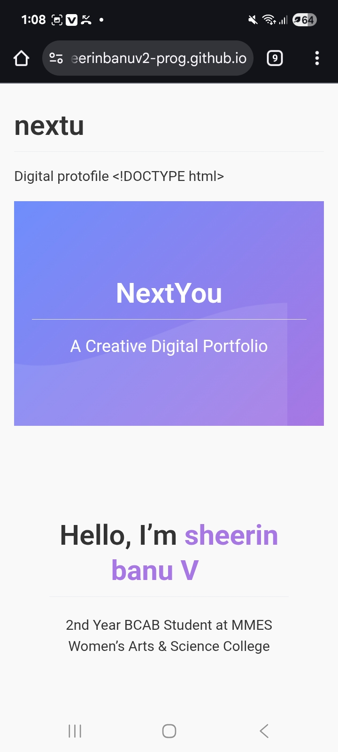
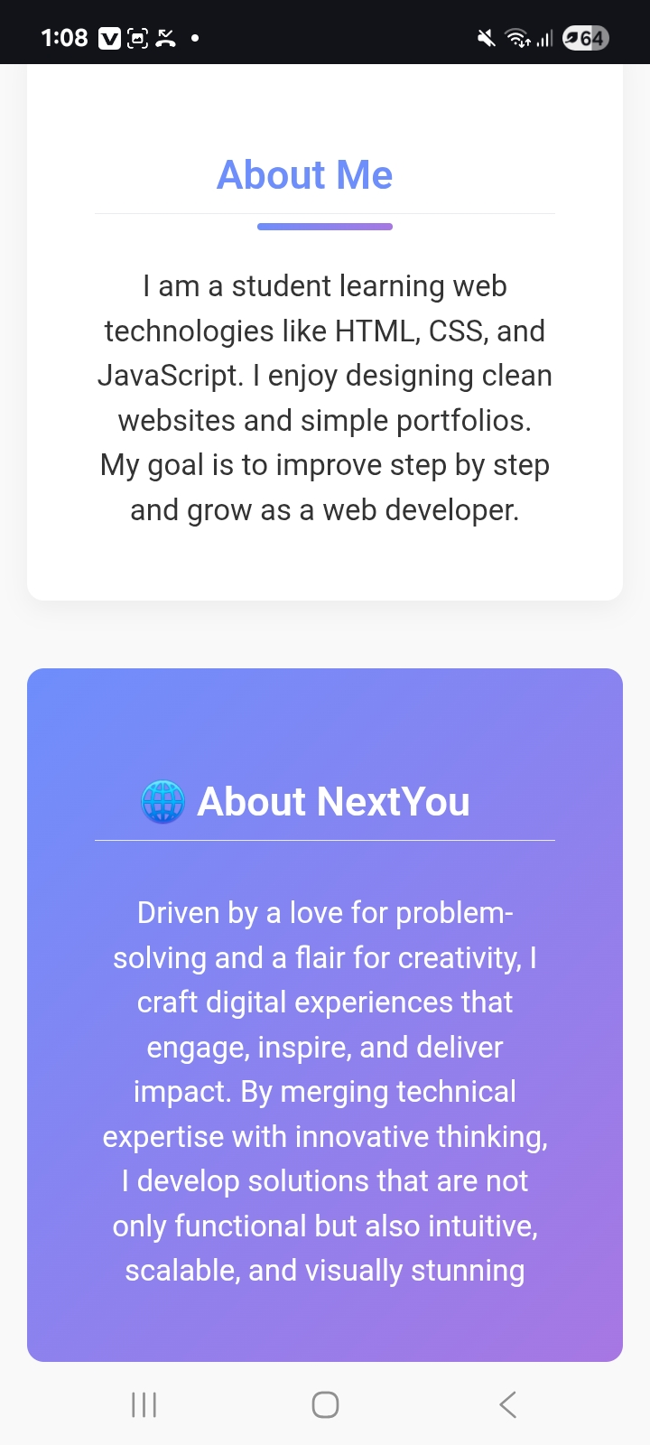
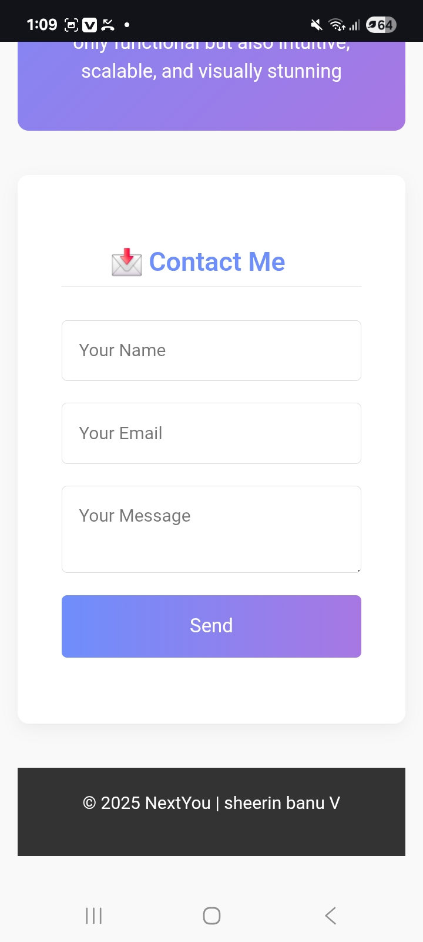
RESULTS AND SCREENSHOTS
3/21/2024 Annual Review
11

Slide 12
CONCLUSION
https://sheerinbanuv2-prog.github.io/nextu/
12

