Slide 1

CLUSTERING: Mental Health disorders in Research Paper ABSTRACTS
DTi/ELG 5125:
Group 9 (Sheryl, Lenish & Lakshika)

Slide 2

AGENDA
Introduction
Data Extraction and Cleaning
Feature Engineering and Clustering
Results & Key Insights
Conclusion

Slide 3

introduction
Mental health research produces a vast amount of literature, making it challenging to quickly identify relevant studies.
Our project focuses on automating the clustering of mental health research abstracts from PubMed.

Slide 4
Use cases
Topic Discovery
Trend Analysis
Research gaps

Slide 5
Data Collection & Preprocessing
Data Source:
Preprocessing:
Web scraping abstracts using Python libraries (requests, BeautifulSoup)
Cleaning text (removing non-alphanumeric characters, stopwords)
Partitioning abstracts into 150-word segments
Output:
CSV file with 200 partitions per disorder, each labeled accordingly
PubMed abstracts

Slide 6
Feature Engineering & Clustering
Feature Engineering:
BERT Embeddings (contextually aware)
Clustering Algorithms Evaluated:
K-Means
BERT + GloVe
GloVe Embeddings (no contextual awareness)
Gaussian Mixture Model (GMM)
Hierarchical - Agglomerative
Alignment Algorithm:
Hungarian Algorithm

Slide 7
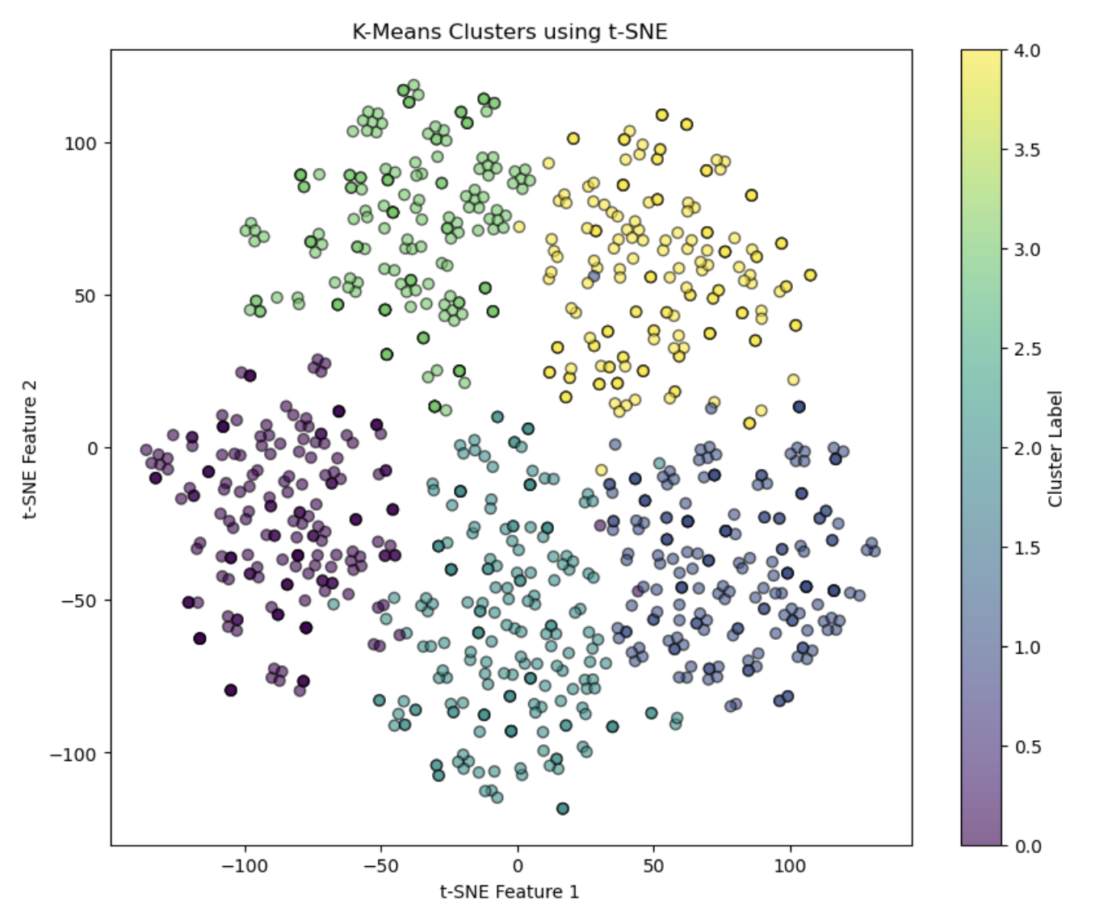
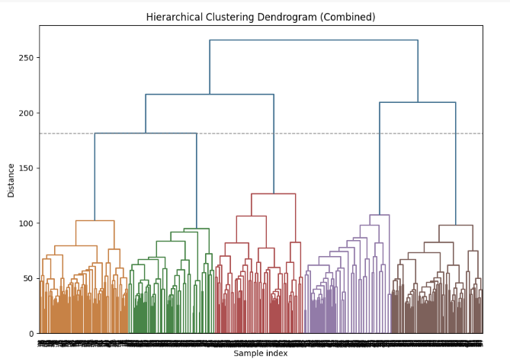
RESULTING CLUSTERS

Slide 8
Kappa/coherence
Embedding | KMeans | Agglomerative | GMM
BERT | 0.9537 / 0.7066 | 0.9375 / 0.7066 | 0.6625 / 0.7066
GloVe | 0.2788 / 0.7052 | 0.2812 / 0.7052 | 0.2788 / 0.7052
BERT + GloVe | 0.9550 / 0.6883 | 0.9313 / 0.6883 | 0.6412 / 0.6883
Champion Model : BERT + GloVe embeddings x KMeans

Slide 9
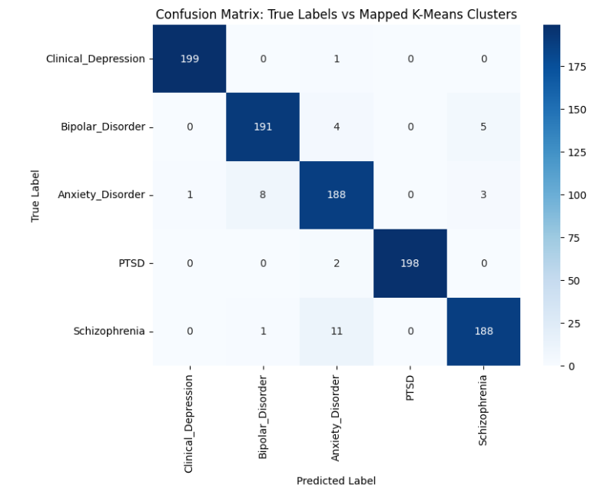
confusion matrix: K-Means Clusters

Slide 10
ERROR ANALYSIS & insights

Slide 11
reasons
Schizophrenia → Anxiety Disorder (11 cases)
Shared symptoms and cognitive disturbances.
Anxiety Disorder → Bipolar Disorder (8 cases)
Abstracts often use "mood disorder" for both conditions.
Bipolar Disorder → Schizophrenia (5 cases)
Some abstracts discuss both disorders in comparative studies.
Co-occurring anxiety symptoms.
Mood instability & restlessness are common in both disorders.
Psychotic features overlap.

Slide 12
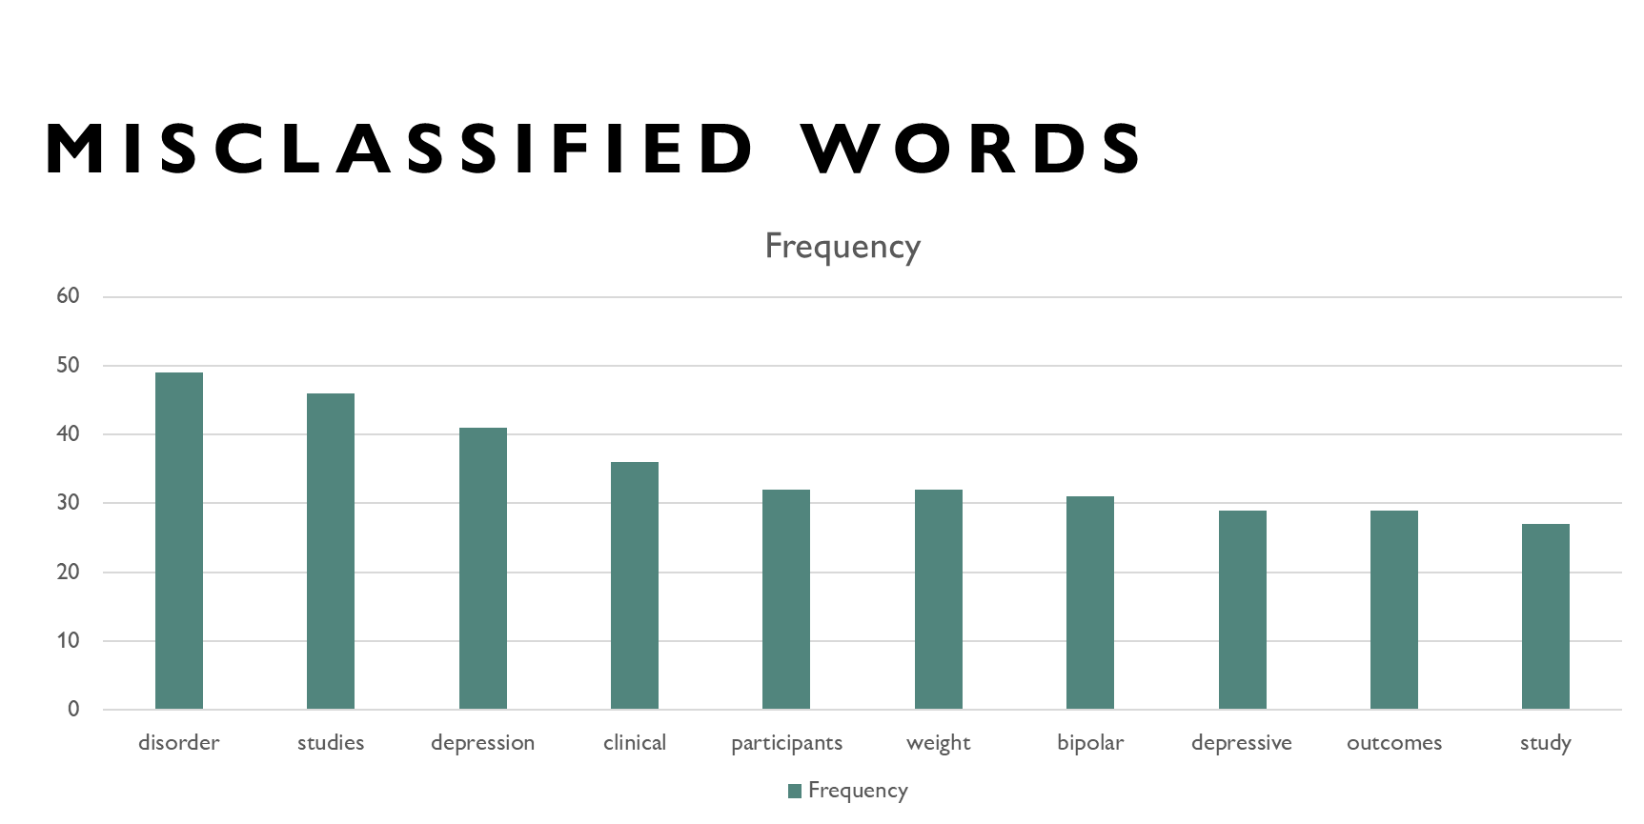

Slide 13
Summary
Data preprocessing and cleansing (1000 abstracts) 200 partitions per category, 150 words per partition
Feature Engineering (BERT & GloVe embeddings)
Applying models Hierarchical Clustering, K-Means and GMM
Error Analysis (Confusion Matrix and Misclustered Abstracts)
Performance Evaluation (Kappa Score and Silhouette)
Visualizations

Slide 14
Thankyou!

