Slide 1

CHALLENGES IN HEALTHCARE DATA ANALYSIS
BIOMEDICAL SIGNAL ANALYSIS
GENOMIC DATA ANALYSIS FOR
PERSONALIZED MEDICINE
-- BY
ANJALI GUPTA
SHEETAL GUPTA

Slide 2

HEALTHCARE DATA ANALYSIS
Healthcare data analysis involves collecting, analyzing, and interpreting large volumes of healthcare data.
It aims to derive actionable insights to improve patient care, enhance operational efficiency, and drive organizational performance.
Health care analytics uses both historic and current data to produce actionable insights and optimize outcomes within the health care industry.
Health care data analysts contribute to better patient care, streamlined health care processes, and well-assessed health care institutions by acquiring, combining, and analyzing data from multiple sources.

Slide 3
Key Applications of Healthcare Data Analysis
Improving patient outcomes:- Identifying high-risk patients, predicting disease outbreaks, optimizing treatment plans, and personalizing care.
Enhancing operational efficiency:- Streamlining administrative processes, reducing costs, optimizing resource allocation, and improving supply chain management.
Supporting population health management:- Analyzing health trends, identifying at-risk populations, and developing targeted prevention programs.
Driving research and innovation:- Discovering new treatments, evaluating drug efficacy, and understanding disease patterns.
Fraud detection and prevention:- Identifying suspicious claims and preventing healthcare fraud

Slide 4


Clinical
Data
patient medical records
Diagnoses
treatment
lab results
imaging data
Financial
Data
Claims data,
billing information,
healthcare costs
Types
of
data
Operational
Data
Patient demographics
appointment scheduling
resource utilization
patient-generated
Data
Wearable device data
patient surveys
social media data

Slide 5
Techniques
Descriptive Analytics:- This technique involves analyzing historical healthcare data to summarize and understand what has happened in the past. It helps in identifying patterns, trends, and insights, such as patient demographics or common diseases in a region.
Diagnostic Analytics:- This goes a step further by exploring the reasons behind certain outcomes or issues in healthcare. It identifies the root causes of problems, such as why a particular treatment is not effective or why certain patients have higher readmission rates.
Predictive Analytics:- This technique uses historical data and statistical models to forecast future trends and outcomes in healthcare. For example, it can predict which patients are at risk of developing chronic diseases based on their medical history and lifestyle factors.
Prescriptive Analytics:- This is the most advanced form of analytics, where data is used to recommend specific actions that can lead to desired outcomes. In healthcare, it might suggest personalized treatment plans for patients or optimal resource allocation in hospitals to improve patient care.

Slide 6
CHALLENGES IN HEALTHCARE ANALYSIS
{1} Data Quality and Standardization
In healthcare, inconsistent data formats from different systems can cause data quality issues, like errors and missing information. Without standardized formats, it's hard to integrate and compare data. Protecting patient privacy is crucial but can clash with the need for data sharing, and there’s always a risk of cyberattacks
{2} Data Privacy and Security
Protecting patient privacy in healthcare is crucial but often conflicts with the need to share data. There’s a constant risk of cyberattacks and unauthorized access to sensitive information. Additionally, complying with regulations makes managing data even more challenging.
{3} Lack of Skilled Workforce
There's a shortage of data scientists with the expertise needed for healthcare data analysis. Additionally, analysts must have a deep understanding of healthcare to draw meaningful conclusions from the data

Slide 7
{4} Data Volume and Complexity
Healthcare generates massive amounts of data, making it difficult to manage without advanced analytics tools. Much of this data is unstructured, like clinical notes and images, which are hard to analyze. Additionally, integrating data from various sources, such as EHRs, insurance claims, and wearable devices, adds to the complexity.
{5} Organizational Challenges
Transitioning to data-driven decision-making can meet resistance from healthcare professionals. Moreover, proving the return on investment in data analytics is tough, often resulting in limited funding for such initiatives.

Slide 8

BIOMEDICAL SIGNALS
Biomedical signals are measurable physical quantities generated by biological systems, which carry information about the state and function of the organism.These signals are essential for understanding physiological processes, diagnosing diseases, and monitoring patient health.
Types of Biomedical Signals:
Bioelectric Signals :- Generated by the electrical activity of tissues and organs. Examples like Electrocardiogram (ECG), Electroencephalogram (EEG), Electromyogram (EMG), Electrooculogram (EOG).
Bioacoustic Signals :- Produced by the mechanical vibrations of biological systems. Examples like Phonocardiogram (PCG), speech signals, lung sounds.
Biomagnetic Signals :- Generated by the electrical activity of tissues and organs, producing magnetic fields. Examples like Magnetoencephalogram (MEG), magnetocardiogram (MCG).
Biomechanical Signals: :- Related to the mechanical properties of biological tissues. Examples like Blood pressure, airflow, force measurements.

Slide 9
Key steps in biomedical signals
Signal Acquisition: Collecting raw biomedical signals using sensors or medical devices, such as ECG or EEG machines.
Preprocessing: Cleaning the signals by removing noise, artifacts, and unwanted components to enhance signal quality.
Feature Extraction: Identifying and extracting relevant characteristics or patterns from the processed signals that are important for analysis.
Signal Classification: Categorizing the extracted features to identify specific conditions, diseases, or abnormalities.
Interpretation and Decision-Making: Analyzing the classified data to make clinical decisions, diagnose conditions, or monitor patient health.

Slide 10
Application of Biomedical signals
Cardiology: Analyzing ECG, PCG signals for heart disease diagnosis and monitoring.
Neurology: Analyzing EEG, EMG signals for brain and muscle disorders.
Respiratory: Analyzing respiratory signals for sleep apnea, asthma diagnosis.
Biomechanics: Analyzing gait analysis, force measurements for orthopedic applications.
Biomedical imaging: Processing medical images (MRI, CT, ultrasound) for analysis and diagnosis.

Slide 11
Challenges in Biomedical Signal Analysis
Noise and artifacts: Noise refers to unwanted interference, like electrical disturbances, that contaminates biomedical signals.Artifacts are distortions in the signal caused by external factors, such as patient movement or sensor issues, which can obscure critical data.
Non-stationarity: Biomedical signals often change over time due to factors like physical activity or emotional stress. Non-stationary signals require adaptive analysis methods to accurately interpret the varying characteristics.
Low signal-to-noise ratio: This challenge requires advanced filtering and amplification techniques to extract meaningful information from the signal.
Individual variability: Biomedical signals can differ significantly between individuals due to factors like age, genetics, or health conditions.
Ethical considerations: Security measures must be in place to protect patient data from breaches and unauthorized access, maintaining trust and compliance with regulations.

Slide 12
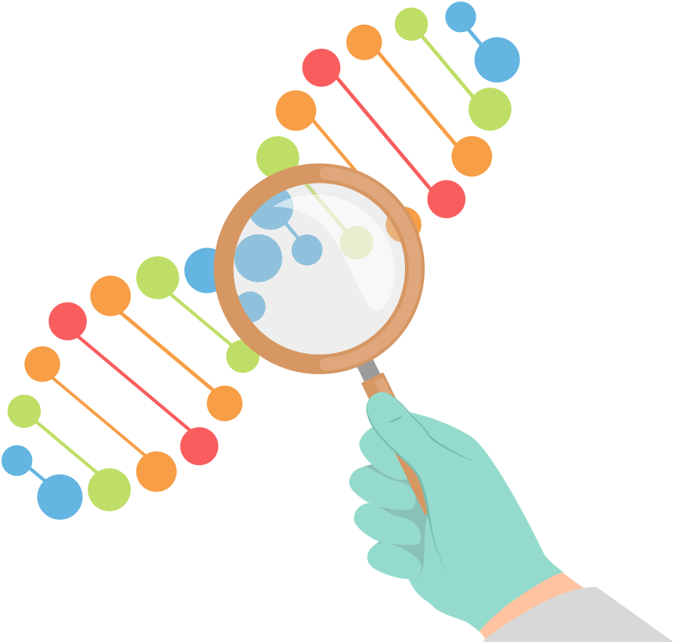
GENOMIC DATA ANALYSIS
Genomic data analysis is the process of examining and interpreting data derived from an organism's genome, which is its complete set of DNA, including all of its genes. This analysis involves identifying the structure, function, and variation of genes and understanding how these elements contribute to biological processes, health, and disease. Genomic data analysis is used in fields like personalized medicine, where it helps tailor medical treatments to an individual's genetic makeup, as well as in research to explore the genetic basis of diseases, evolutionary biology, and population genetics

Slide 13
HOW GENOMIC DATA ANALYSIS WORK ?
Genome Sequencing: Determining the complete DNA sequence of an individual.
Data Generation: Creating vast amounts of genetic data through sequencing and other biological experiments.
Data Cleaning and Preprocessing: Removing errors and inconsistencies from the data.
Data Analysis: Applying computational tools and algorithms to identify patterns and relationships within the data.
Interpretation: Translating the findings into actionable insights for clinical use.

