Slide 1
OAuth-Authentication/Authorization
Presented By:
Chandan Kumar
Piyush Rungta

Slide 2
Authentication
Authentication is the process of verifying the identity of a user by obtaining his identity in form of credentials and using those credentials to verify the user's identity.
If the credentials are valid, the authorization process starts. Authentication process always proceeds to Authorization process

Slide 3
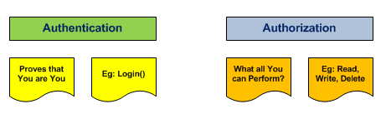
Authorization
Authorization is the process of allowing an authenticated users to access the resources by checking whether the user has access rights to the system. Authorization helps you to control access rights by granting or denying specific permissions to an authenticated user.

Slide 4
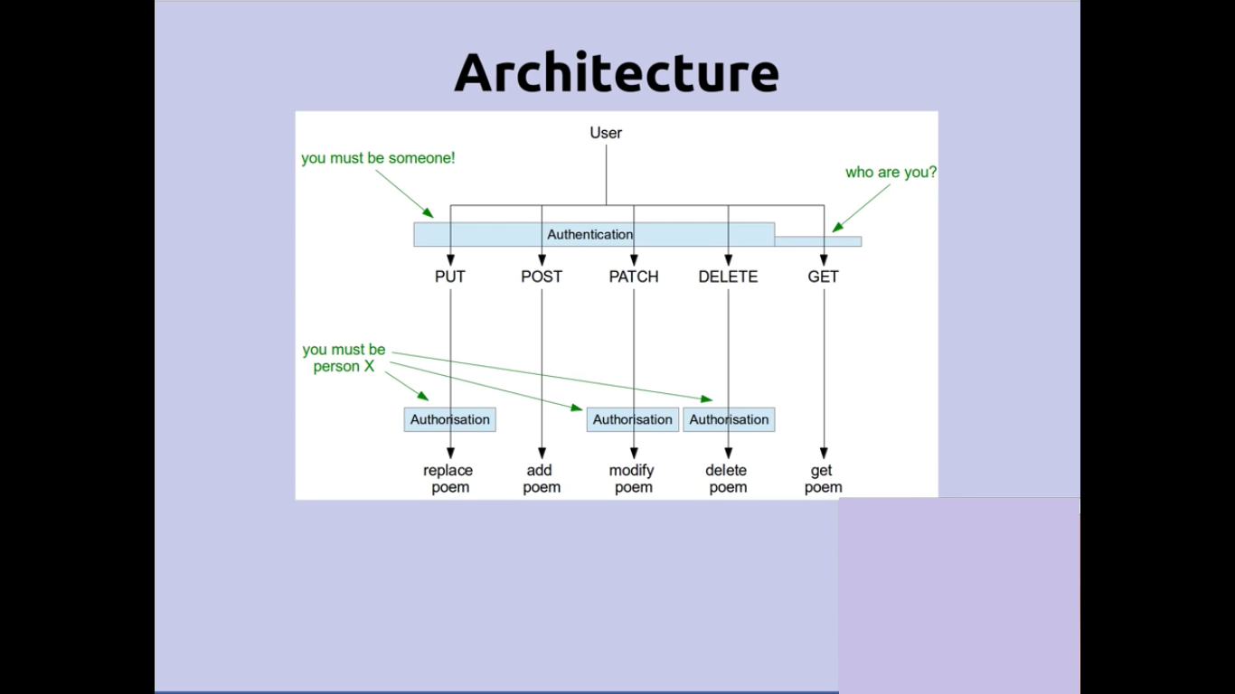

Slide 5
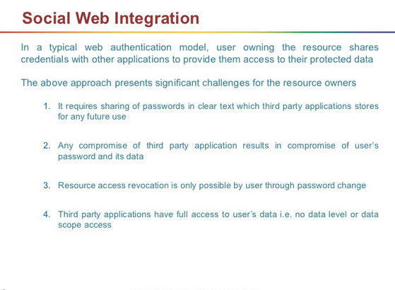

Slide 6
A Question to non-technical people in Xebia. Have you ever Login With Facebook/Twitter/Google feature on any of the site.
https://www.freecharge.in/desktop/login

Slide 7
Oauth
OAuth is an open standard for authorization that enables client applications to access server resources on behalf of a specific Resource Owner. OAuth also enables Resource Owners (end users) to authorize limited third-party access to their server resources without sharing their credentials.
For example, a Gmail user could allow LinkedIn or Flickr to have access to their list of contacts without sharing their Gmail username and password.

Slide 8
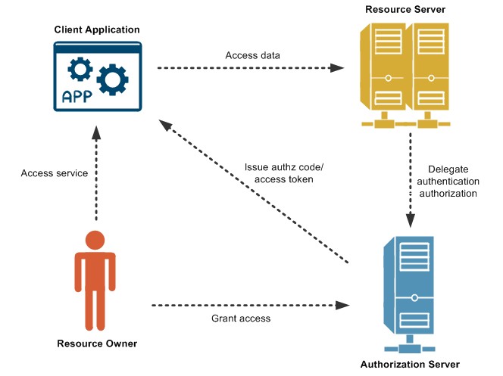

Slide 9
Oauth 2.0 Terminology
Resource owner - The user who authorizes an application to access their account.
The application’s access to the user’s account is limited to the “scope” of the authorization granted
A (e.g. read or write access).
Resource server - A server which sits in front of protected resources (for example “tweets”, users’ photos, or personal data) and is capable of accepting and responding to protected resource requests using access tokens.
Client - An application which accesses protected resources on behalf of the resource owner (such as a user). The client could be hosted on a server, desktop, mobile or other device.
Authorization server - A server which issues access tokens after successfully authenticating a client
Grant Type - A grant is a method of acquiring an access token.
Client Id – Represent Identity of a Client
Client Secret : A key to identify identity of a client.
Scope permission (Read, Write, Trust)
Access token - A token used to access protected resources(Gate Pass).

Slide 10
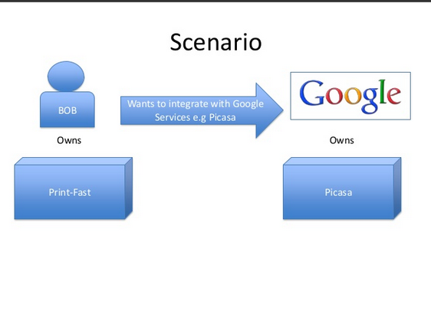

Slide 11
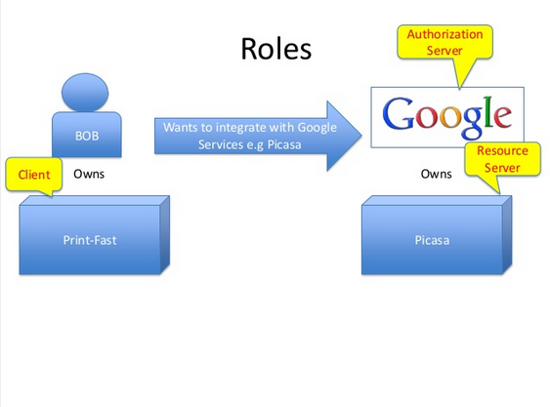

Slide 12
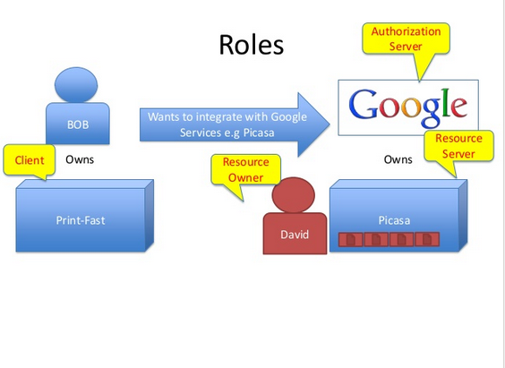

Slide 13
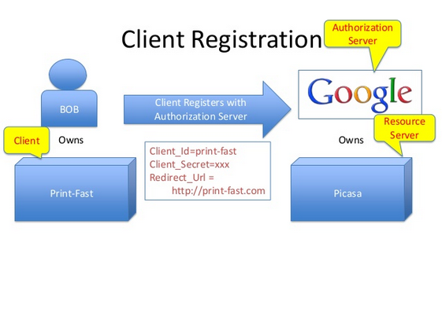

Slide 14
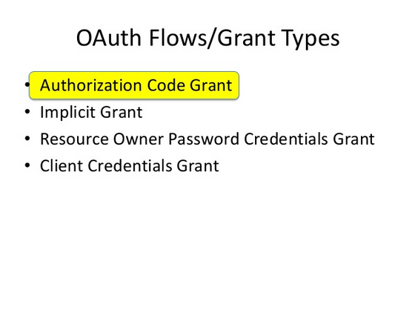

Slide 15
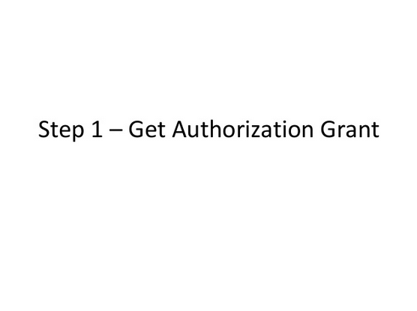

Slide 16
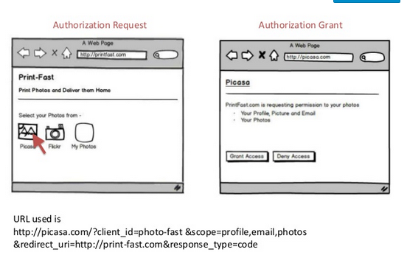

Slide 17
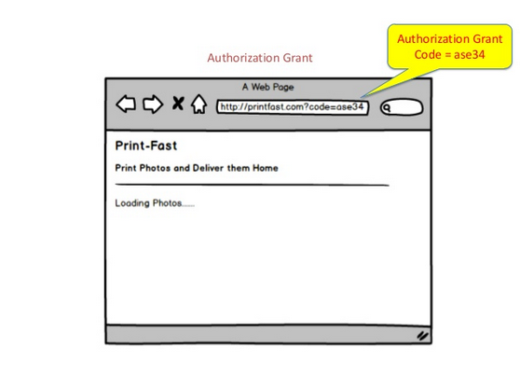

Slide 18
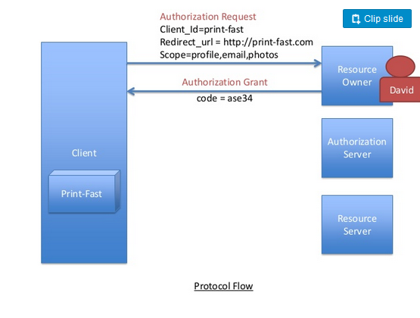

Slide 19
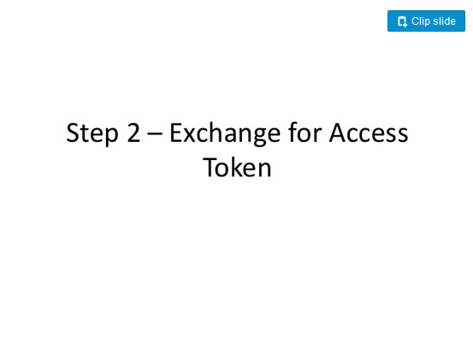

Slide 20
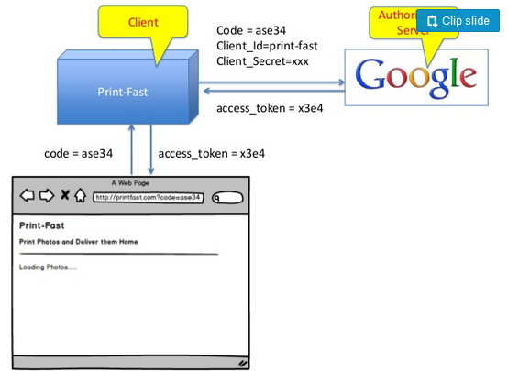

Slide 21
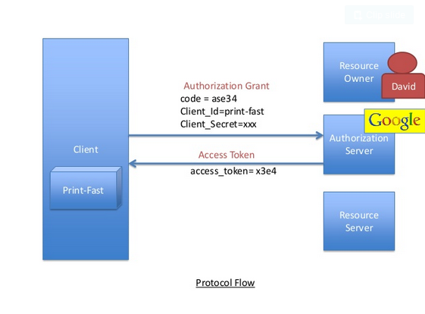

Slide 22
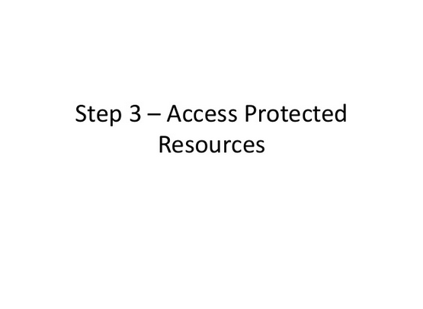

Slide 23
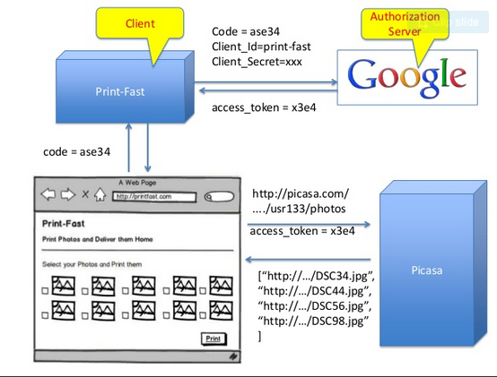

Slide 24
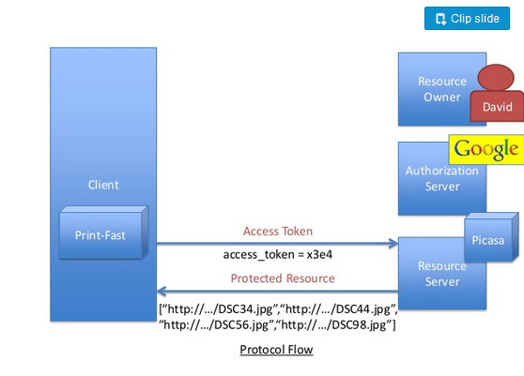

Slide 25


Slide 26
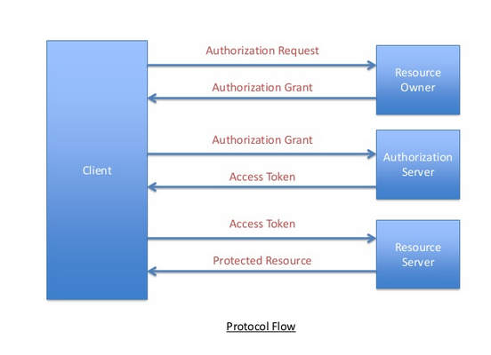

Slide 27


Slide 28
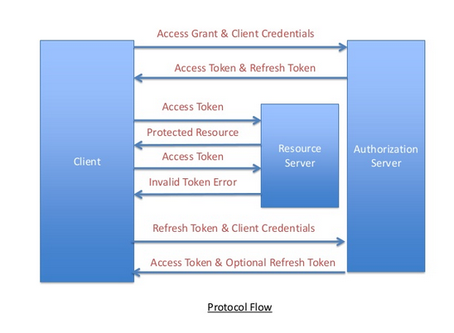

Slide 29
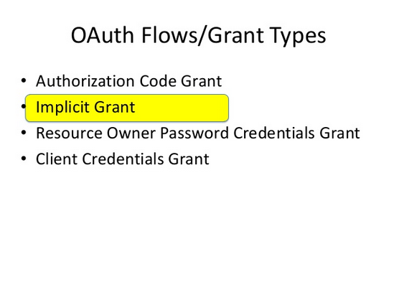

Slide 30
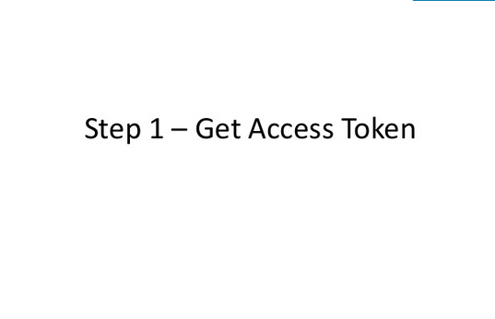

Slide 31
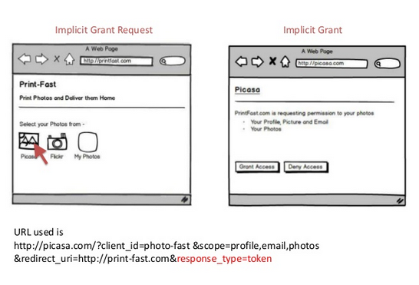

Slide 32
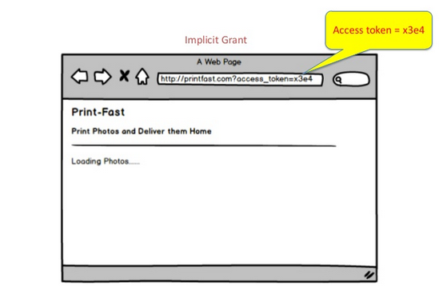

Slide 33
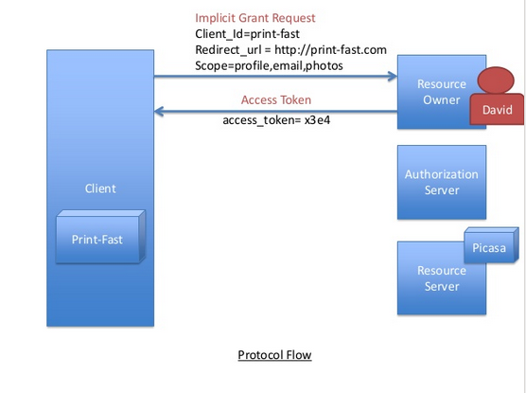

Slide 34
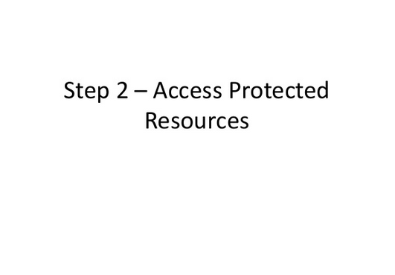

Slide 35
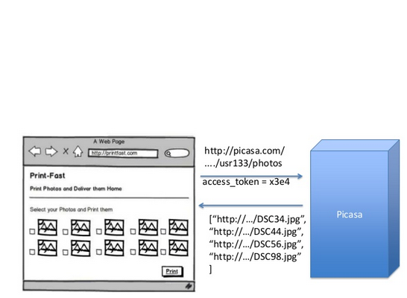

Slide 36
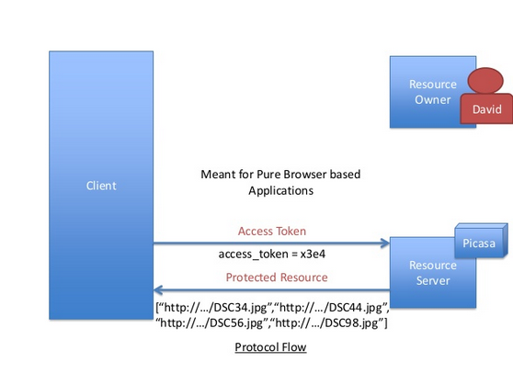

Slide 37


Slide 38
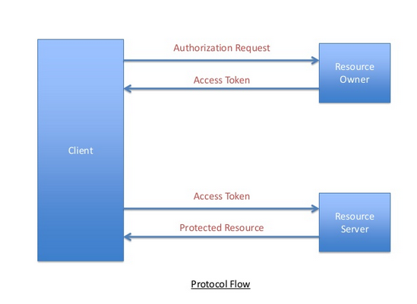

Slide 39
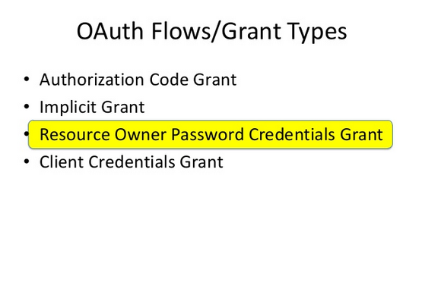

Slide 40
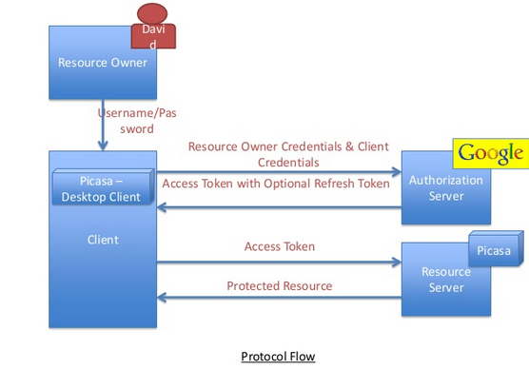

Slide 41
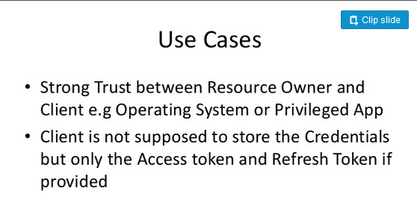

Slide 42
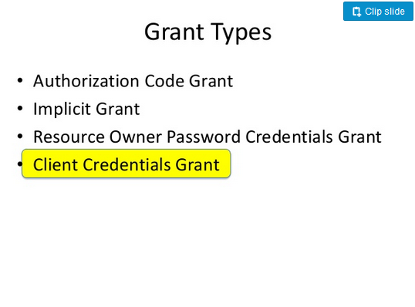

Slide 43
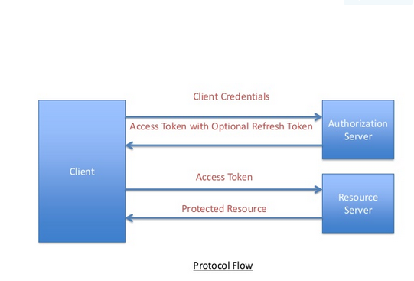

Slide 44
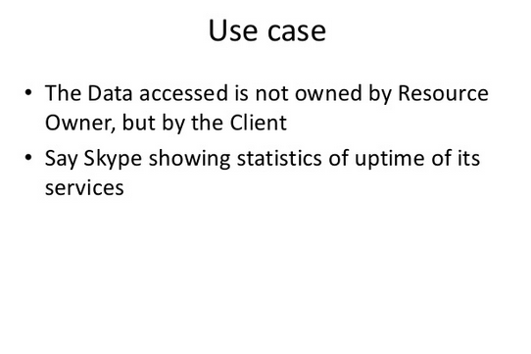

Slide 45
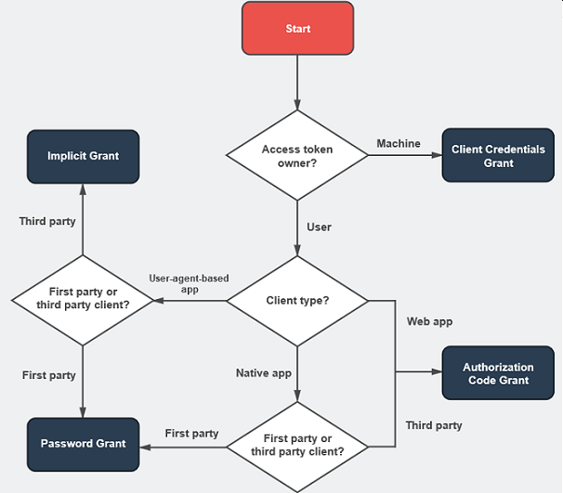
Which Grant Type ?

Slide 46
Oauth 2.0
Transport-Dependent. Most security defenses are delegated to HTTPS/TLS. A typo, an improper TLS configuration, a failure to properly validate a certificate, or vulnerabilities in an underlying library can lead to a man-in-the-middle (MiTM) attack, compromising all OAuth communications.
Centered around bearer tokens. These are easy for integration but not great for security. Bearer tokens do not provide internal security mechanisms. They can be copied or stolen but are easier to implement.
Much easier to work with. OAuth 2.0 is much more usable, but much more difficult to build securely.
Much more flexible. OAuth 1.0 only handled web workflows, but OAuth 2.0 considers non-web clients as well.
Better separation of duties. Handling resource requests and handling user authorization can be decoupled in OAuth 2.0.

Slide 47
Oauth- Pros and Cons
Pros | Cons
Ease of usage | Lack of market saturation
Time Saving | Phishing
Networking | Many eggs in one basket
Privacy | Data misuse
Security
Control
Traffic

Slide 48
Future of Oauth 2.

Slide 49
Questions?

Slide 50
Thanks.

