Slide 1

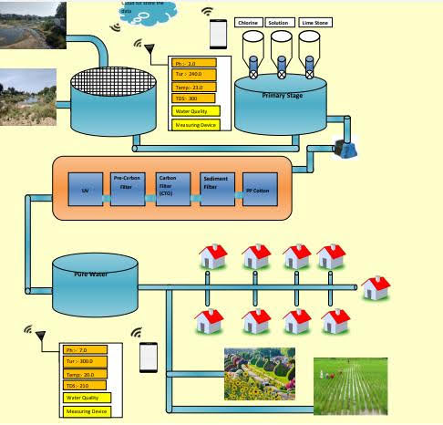
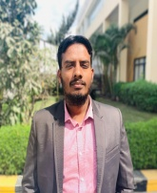
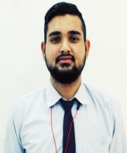
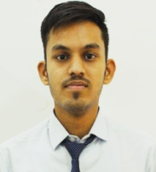
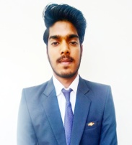
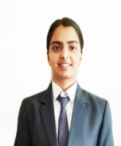
GEETANJALI INSTITUTE OF TECHNICAL STUDIES, UDAIPUR
(Affiliated by RTU, Kota And Approved by AICTE, New Delhi )
Department of Electronics & Communication Engineering
INTELLIGENT WASTE WATER TREATMENT SYSTEM
Team :- Water Squad
Mr. Latif Khan
Mohammad Ateek Samma
Shubham Vagrecha
Lokesh Bhatt
Sheetal Sharma

