Slide 1
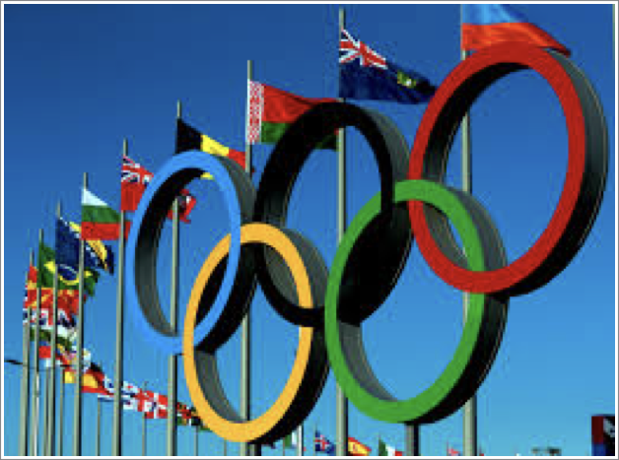
Olympics Analysis

Slide 2
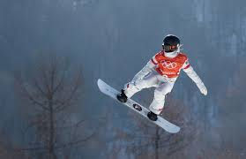
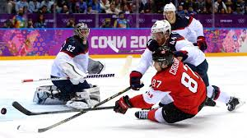
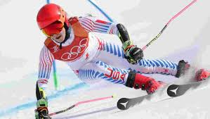
International Sporting Event
Summer and Winter Games
Occurs every 4 years
Winter games occur 2 years after Summer games
Hosted all across the world
Over 13K athletes participate in 33 different sports
Winners receive Gold, Silver and Bronze medal
Host countries get opportunities to showcase themselves to the world

Slide 3
Data Understanding
Dataset in CSV format.
Athletes’ details, participation from 1896 - 2016
Sex, Age, Height, Weight, Nationality(NOC), Sport, Event,Year etc
A lot of nulls. Needs handling.
Technically, a mix of Numerical and Categorical data

Slide 4
Data Processing
Load data and required libraries
Handle the categorical variables
Use dummies for Gold,Silver,Bronze Medals, Gender, and NOC wherever needed
Remove NAs/NaN

Slide 5
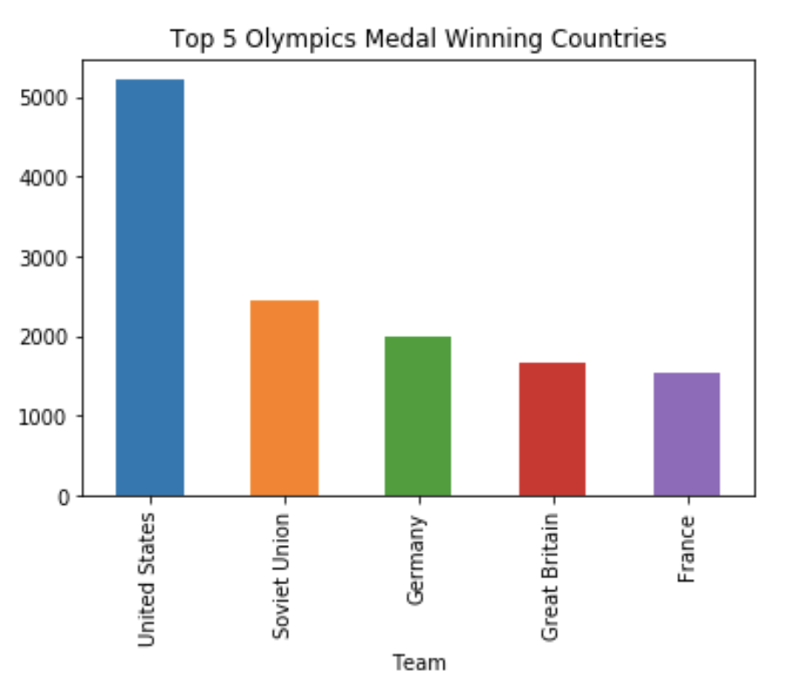
Visuals

Slide 6
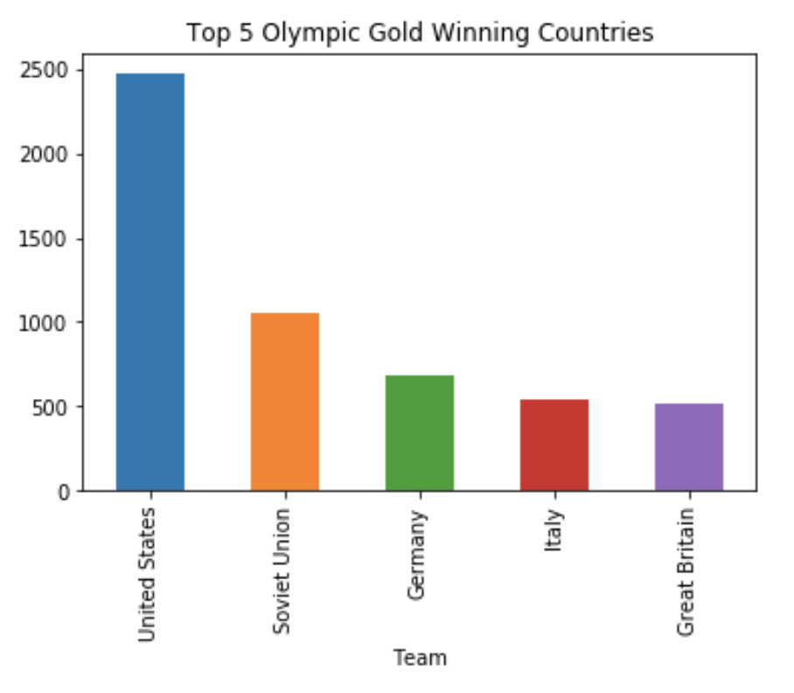
Visuals

Slide 7
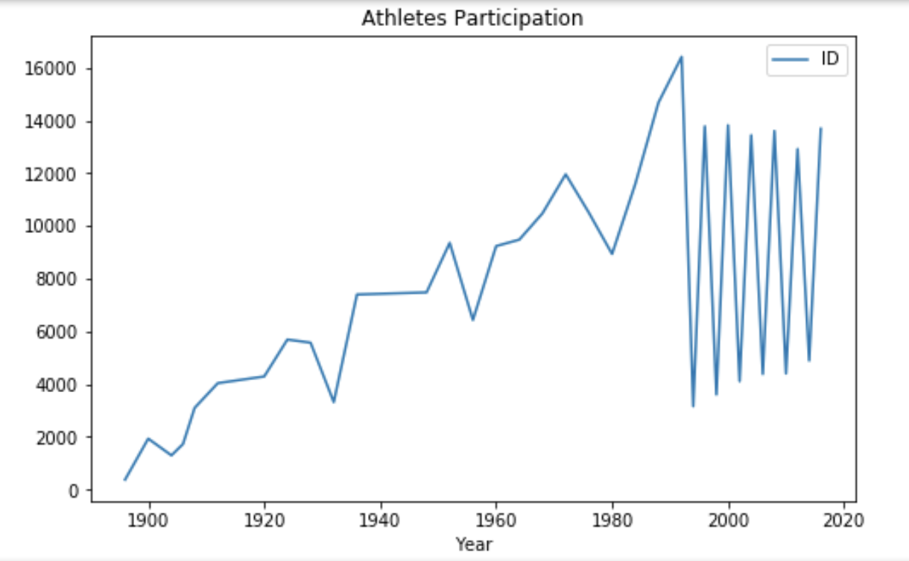
Visuals
Till 1992, Summer and Winter games held in the same year.
Winter games occur 2 years after Summer games

Slide 8
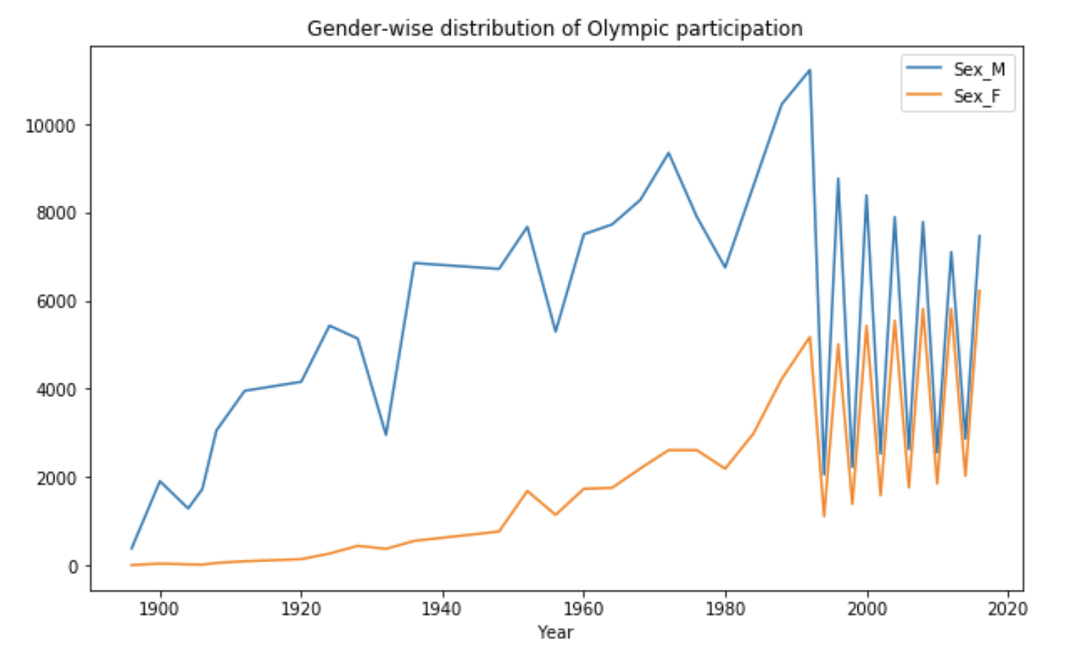
Visuals
Till 1992, Summer and Winter games held in the same year.
Winter games occur 2 years after Summer games

Slide 9
Sports that are not USA dominated
Table 1
Sport | NOC | TotalMedals
Fencing | ITA | 359.0
Ice Hockey | CAN | 348.0
Gymnastics | URS | 288.0
Hockey | NED | 255.0
Cycling | GBR | 182.0
Water Polo | HUN | 172.0
Cross Country Skiing | NOR | 164.0
Canoeing | GER | 163.0
Equestrianism | GER | 143.0
Sailing | GBR | 143.0
Volleyball | URS | 141.0
Football | BRA | 136.0
Speed Skating | NED | 117.0
Alpine Skiing | AUT | 114.0
Baseball | CUB | 112.0

Slide 10
Top 10 Olympic Players
Table 1
Name | Gold | TotalMedals
Michael Fred Phelps, II | 23 | 28
Larysa Semenivna Latynina (Diriy-) | 9 | 18
Nikolay Yefimovich Andrianov | 7 | 15
Takashi Ono | 5 | 13
Borys Anfiyanovych Shakhlin | 7 | 13
Ole Einar Bjrndalen | 8 | 13
Edoardo Mangiarotti | 6 | 13
Natalie Anne Coughlin (-Hall) | 3 | 12
Sawao Kato | 8 | 12
Dara Grace Torres (-Hoffman, -Minas) | 4 | 12

Slide 11
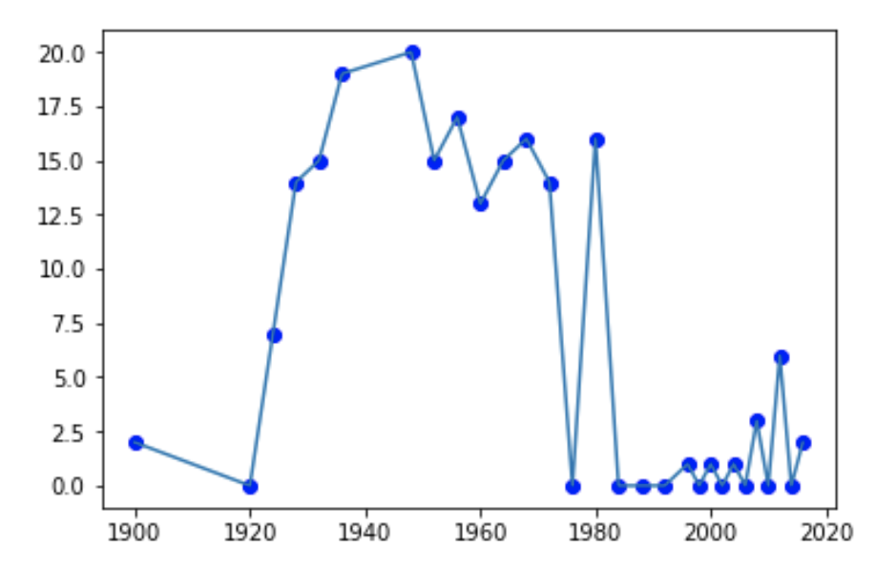
India at the Olympics - over all years
Unique sports - 'Hockey', 'Shooting', ‘Wrestling’,'Boxing', 'Weightlifting',
'Badminton', 'Tennis', 'Athletics', ‘Alpinism'

Slide 12
Effect of Sex, Age, Weight, Height
It is a general assumption that some sports require the tallest players or the heaviest/lightest players
Used Logistic Regression technique to find the probabilities of Winning or Losing a medal given Age, Sex, Height , Weight of the player
Model 1
Totalmedals = -0.80388 - 0.51334 * patient is male
AIC: 3457.2
Model 2
Totalmedals = -3.721504 - 0.769833*Male + 0.012683*Weight + 0.014531*Height - 0.025226*Age
AIC: 2975.2. (Better fit)

Slide 13
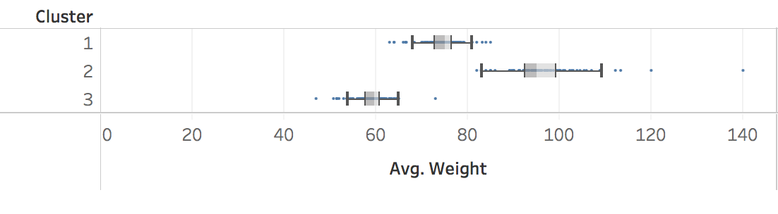
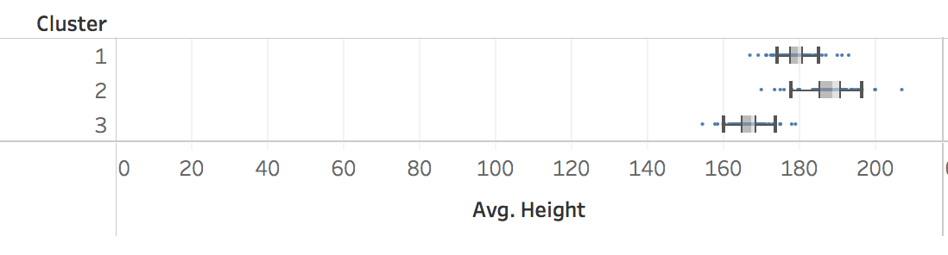
Clusters of Athletes
Clear demarcation of weights - Sports like weightlifting have a great influence of weight
Not the same with height. Some Sports like Gymnastics require more agility than height and weight.

Slide 14
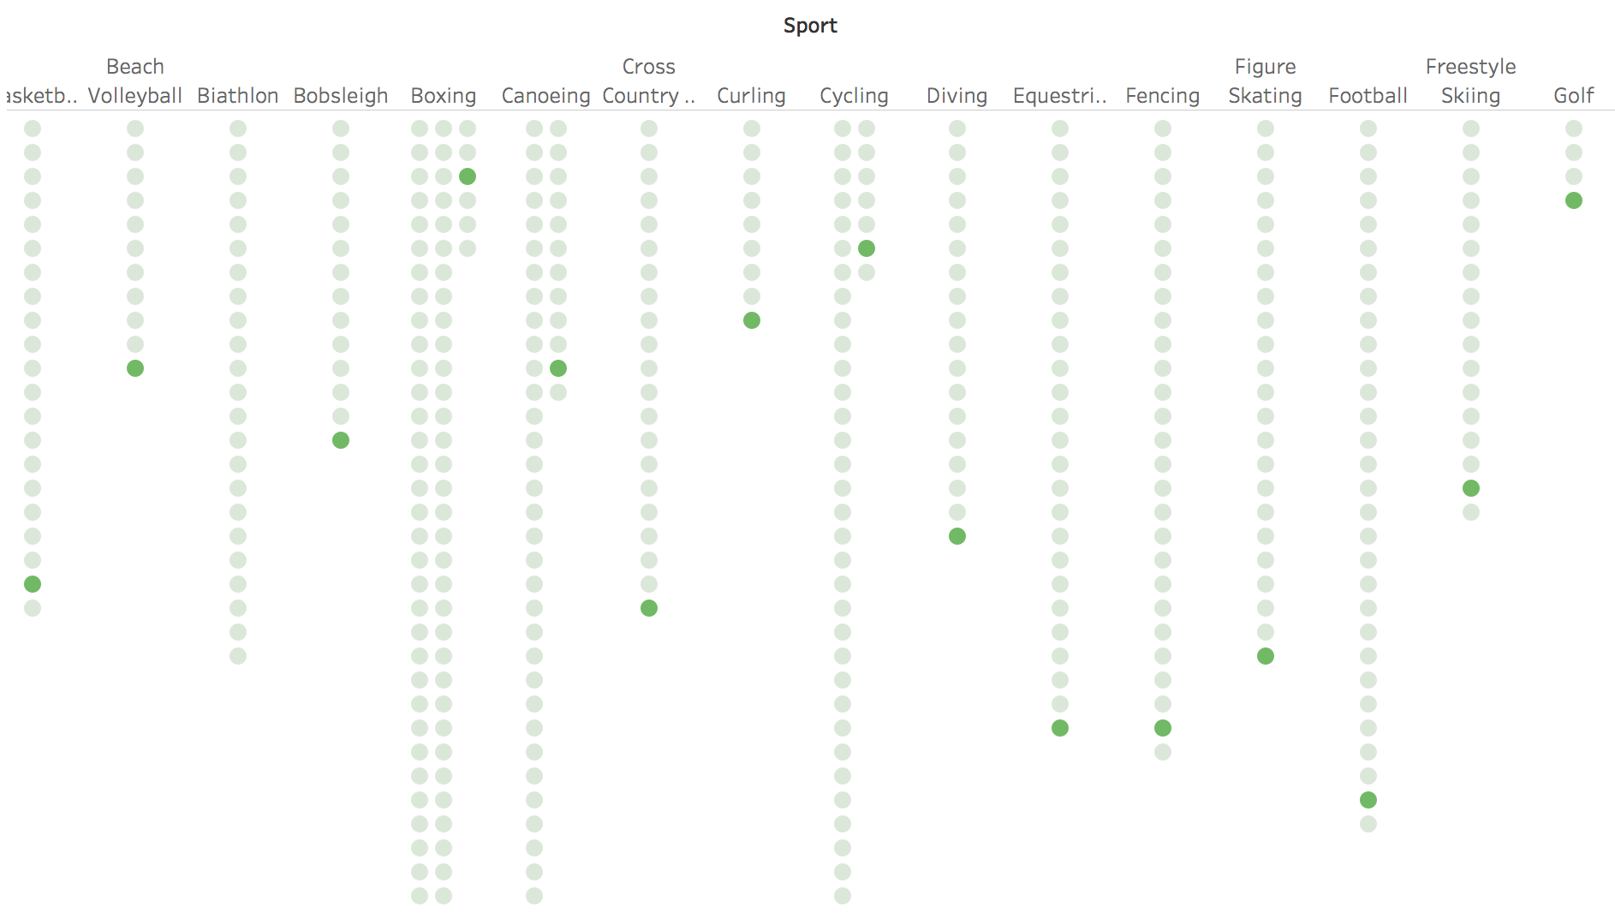
Snapshot of USA participation

Slide 15
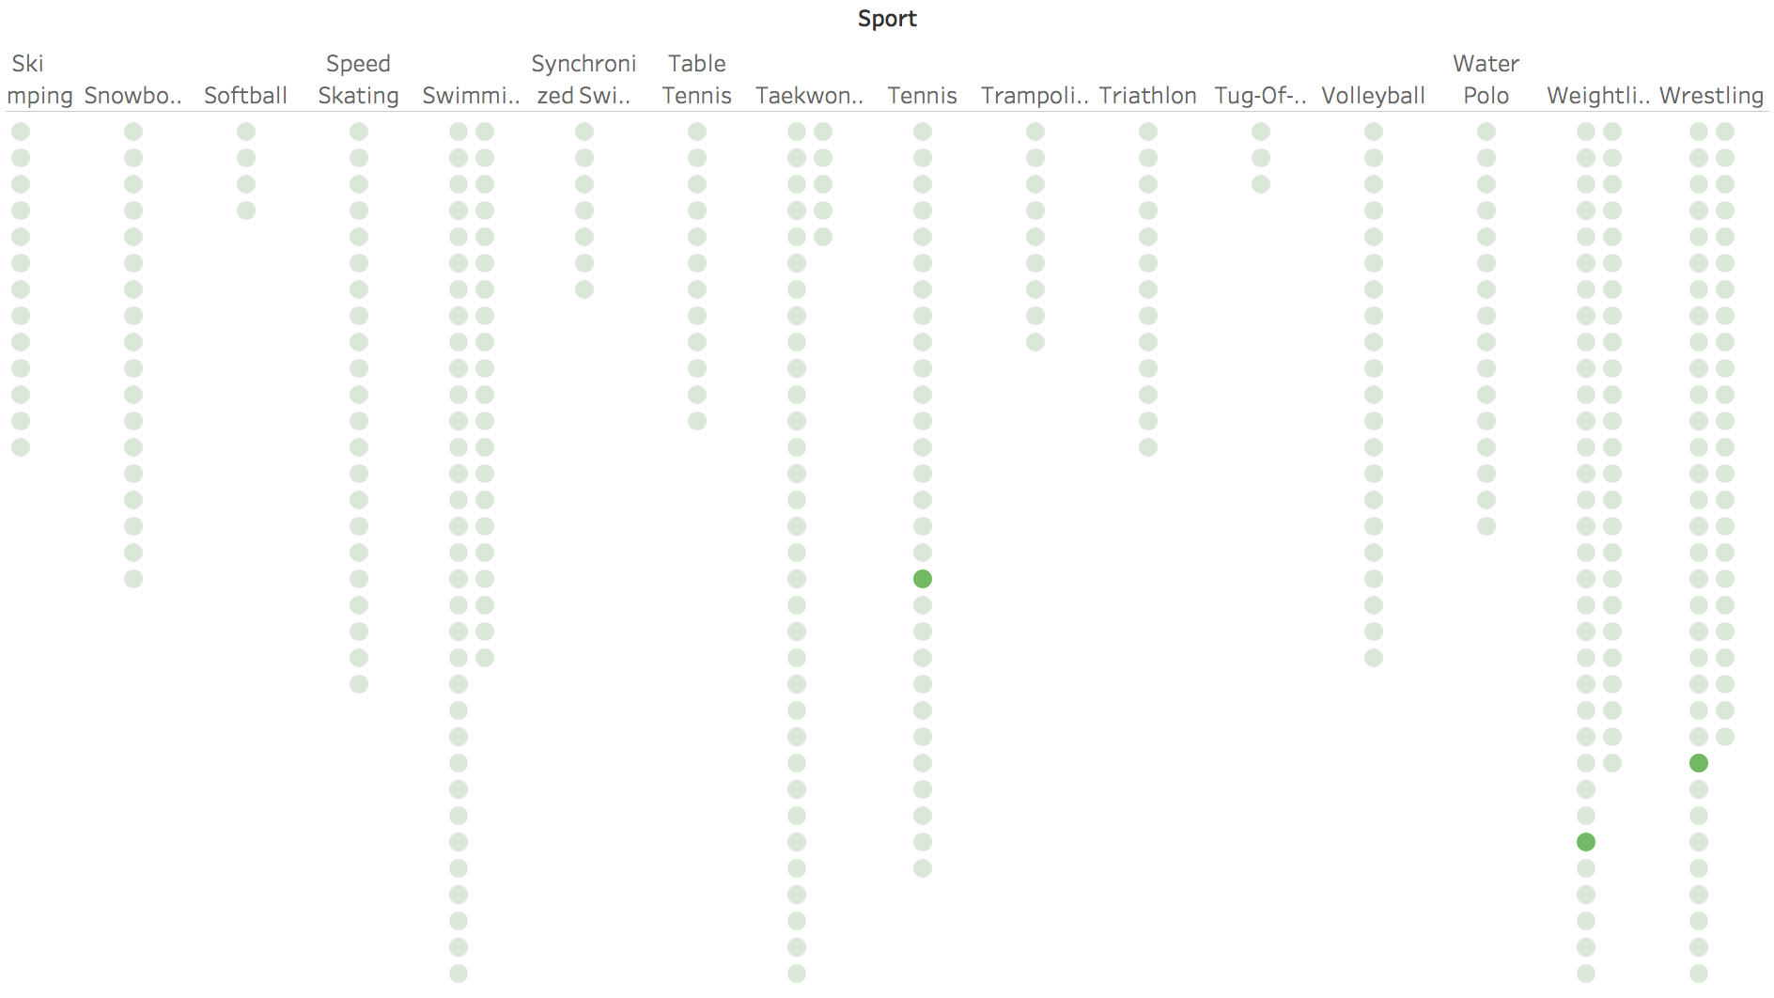
Snapshot of India participation

Slide 16
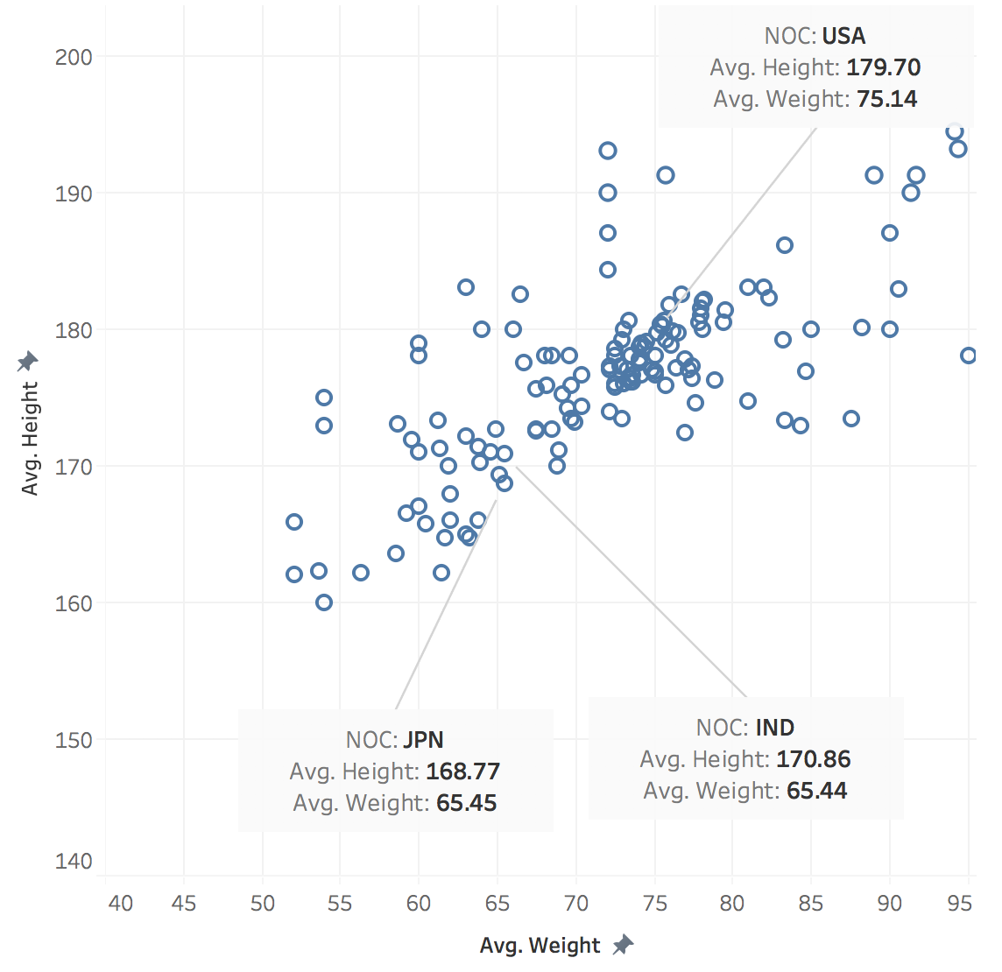
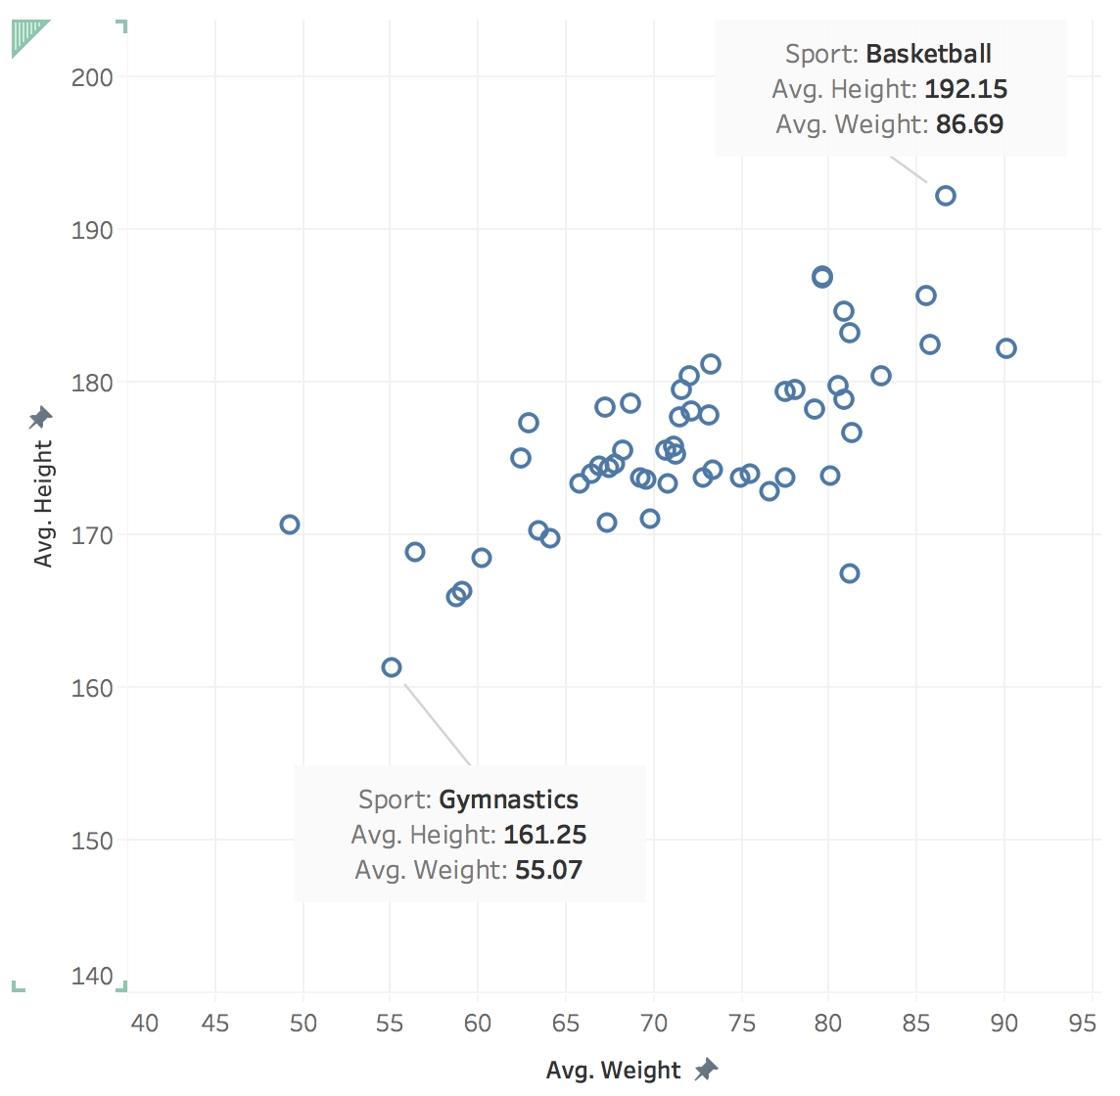
Comparison

Slide 17
Summary
A lot of factors affect the performance of athletes in Olympics
Olympic Games are truly designed to pick up the best amongst all
Of all the factors, below are the ones that we analysed to have impacted
Height and weight
Gender
Participation in the number of unique Sports
Other factors affecting are -
Trainings offered to the participants
Budget offered to the Olympic Committee
Cultural inclination and mindset towards sports in general

Slide 18
Future Work
Often people mention GDP as an important factor when it comes to winning a medal in Olympics.
The higher the GDP, the more chances of winning.
Combine the existing data with GDP data and regress on the GDP variable - to statistically prove/reject the impact of a country’s GDP on probability of winning or losing

Slide 19
Thank You!

