Slide 1

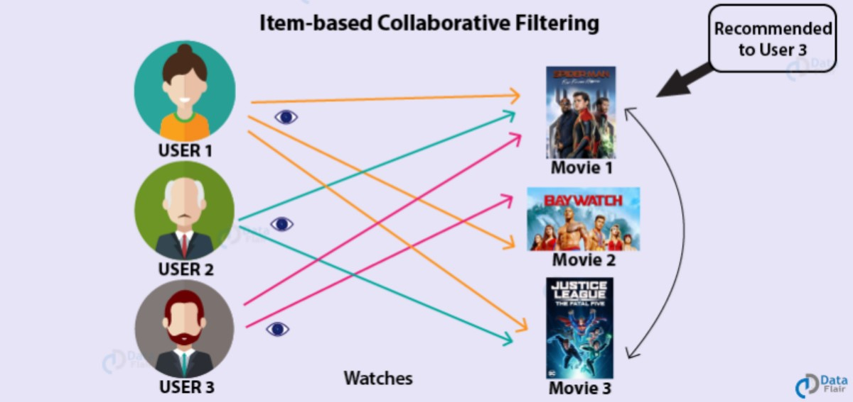
Accredited by NAAC with ‘A+’ Grade
Movie Recommendation
System
Presented by: Sheetal Malhotra (96101) B. Tech CSE with AIML, VII SEM
Submitted to :
Ms. Priyanka Gupta

Slide 2
Contents
Accredited by NAAC with ‘A+’ Grade
Introduction
Problem Statement
Objectives
Data Collection
Data Preprocessing
Model Selection & Algorithm
Model Training
Evaluation Metrics
Interface and Sample Output
Challenges Faced
Future Work
Conclusion

Slide 3
Introduction
Accredited by NAAC with ‘A+’ Grade
A recommendation system is a type of information filtering system designed to predict user preferences and suggest items accordingly. These systems leverage data analytics and algorithms to analyze user behavior, preferences, and interactions with various items (e.g., movies, products, etc.).
Importance of Recommendation Systems:
Enhancing User Experience: By providing personalized suggestions, recommendation systems improve user satisfaction and engagement. Users are more likely to discover relevant content, leading to increased retention and usage.
Driving Revenue: In e-commerce and streaming platforms, effective recommendations can significantly boost sales and viewership. Personalized recommendations encourage users to explore more products or content, leading to higher conversion rates.
Navigating Information Overload: With vast amounts of data available, users often face the challenge of information overload. Recommendation systems help filter out noise and present users with tailored options.

Slide 4
Problem Statement
Accredited by NAAC with ‘A+’ Grade
In the era of digital entertainment, users are overwhelmed with a vast array of movies to choose from. A personalized recommendation system can enhance user experience by suggesting movies tailored to individual preferences.
This project aims to build an intelligent Movie Recommendation System using collaborative filtering techniques. This system will analyze user ratings and preferences to suggest movies that users are likely to enjoy.

Slide 5
Objectives
Accredited by NAAC with ‘A+’ Grade
The primary objective of this project is to develop a robust Movie Recommendation System that accurately predicts user ratings for movies, thereby enabling personalized recommendations. Key goals include:
User-Centric Recommendations: To provide tailored movie suggestions based on individual user preferences and past ratings.
Utilization of Collaborative Filtering: To implement collaborative filtering techniques, specifically the SVDpp algorithm, to leverage user-item interaction data for improved recommendations.
Performance Evaluation: To assess the model’s effectiveness using RMSE and MAPE metrics, ensuring the reliability and accuracy of the recommendations generated.
Through this project, I aim to enhance the movie discovery experience, making it more engaging and efficient for users.

Slide 6
Data Collection
Accredited by NAAC with ‘A+’ Grade
I considered two datasets for this project: TMDB and MovieLens.
TMDB Dataset:
Contains extensive metadata about movies.
Useful for content-based recommendations.
MovieLens Dataset:
Includes user ratings for a wide variety of movies.
Ideal for collaborative filtering techniques.
Dataset Selection
After comparing the TMDB and MovieLens datasets, I chose the MovieLens dataset for my project due to its:
Rich User Rating Data
Proven Use in Research
Comprehensive Coverage

Slide 7
Data Pre-Processing
Accredited by NAAC with ‘A+’ Grade
The dataset includes various files with details such as user ratings, movie titles, and genres, providing a rich source of information for analysis.
Cleaning the Data: I focused on:
Removing Duplicates
Handling Missing Values
Data Transformation:
Created a user-item interaction matrix where rows represent users and columns represent movies. This matrix serves as the foundation for collaborative filtering techniques.
Feature Engineering: Selected relevant features to enhance the model's ability to make accurate predictions based on user behavior and movie attributes.
This thorough data collection and preprocessing phase set the stage for effective model training and improved recommendation accuracy.

Slide 8
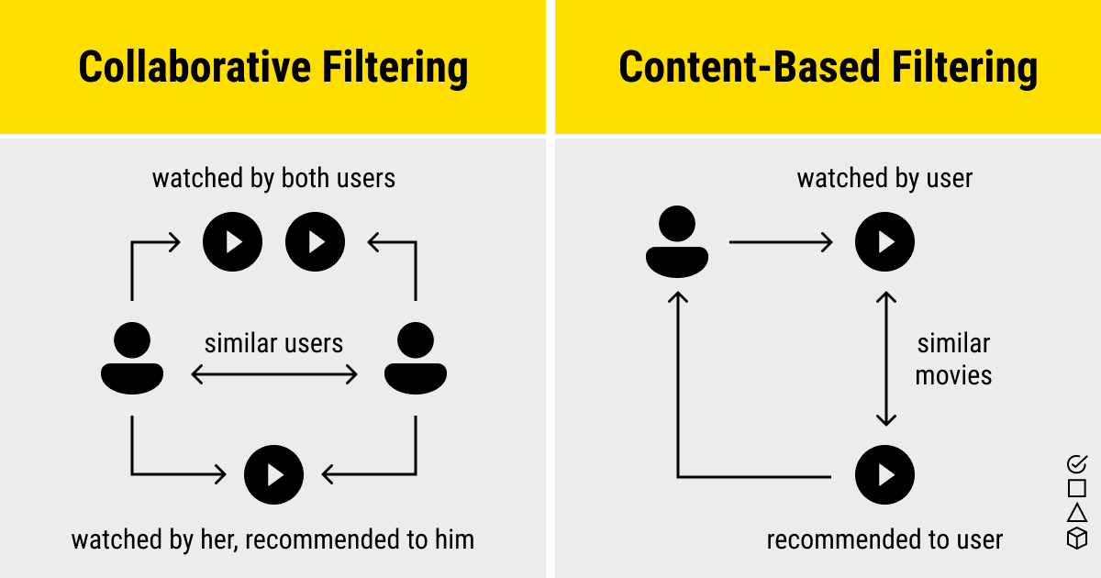
Collaborative Filtering
Accredited by NAAC with ‘A+’ Grade
Overview of Recommendation Systems
Content-Based Filtering:
Recommends items similar to those the user has liked in the past.
Relies on item features (e.g., genres, directors for movies).
Collaborative Filtering:
User-Based Collaborative Filtering:
Recommends items that similar users have liked.
Considers user-user similarities based on their ratings.
Item-Based Collaborative Filtering:
Recommends items similar to those the user has liked.
Focuses on item-item similarities based on user ratings.

Slide 9
Model Selection
Accredited by NAAC with ‘A+’ Grade
I employed collaborative filtering techniques to build the movie recommendation system. I specifically focused on the following models:
SVD (Singular Value Decomposition): This model is effective for matrix factorization, where it decomposes the user-item interaction matrix into lower-dimensional matrices. This allowed me to capture the latent features associated with both users and movies, improving the recommendation quality.
SVD++: An enhancement over SVD, SVD++ incorporates implicit feedback from users (such as views or clicks) along with explicit ratings. This model captures the nuances of user preferences more effectively by considering both rated and unrated items, leading to better recommendations.

Slide 10
Accredited by NAAC with ‘A+’ Grade
KNN (K-Nearest Neighbors): I explored KNN for its ability to find similarities between users or items based on rating patterns. This model helped in generating recommendations based on the preferences of similar users or the popularity of similar movies.
Hybrid Approach: I also considered a hybrid approach combining collaborative filtering with content-based filtering, leveraging both user preferences and movie features. This strategy aimed to mitigate the cold-start problem for new users and items.
By evaluating these models based on performance metrics like RMSE and MAPE, I selected the most effective model to deliver personalized recommendations tailored to user preferences.

Slide 11
Model Training
Accredited by NAAC with ‘A+’ Grade
The training and evaluation process was crucial for optimizing the recommendation system's performance. Here's how I approached it:
Data Splitting: I divided the dataset into training and test sets using a stratified sampling technique. This ensured that the distribution of ratings was preserved in both sets, providing a robust evaluation framework.
Model Training: Each model was trained on the training dataset. I utilized libraries such as Surprise and XGBoost, implementing cross-validation techniques to fine-tune hyperparameters. This step was vital for enhancing model accuracy and reducing overfitting.

Slide 12
Evaluation Metrics
Accredited by NAAC with ‘A+’ Grade
To ensure the effectiveness of my recommendation system, I implemented a rigorous model evaluation process. This included:
I utilized several key metrics to assess the performance of the recommendation model, including:
Root Mean Square Error (RMSE)
Mean Absolute Percentage Error (MAPE).
Train-Test Split: I divided the dataset into training and testing sets, typically using an 80-20 split. The training set was used to fit the model, while the testing set evaluated its predictive capabilities.
Performance Analysis: After evaluating the model using RMSE and MAPE, I conducted a thorough analysis of the results. I identified strengths and weaknesses, which guided potential improvements in the recommendation algorithms and data preprocessing techniques.

Slide 13
Interface
Accredited by NAAC with ‘A+’ Grade
Creating a user-friendly interface was essential for making the recommendation system accessible and engaging. Here are the key features I implemented:
Streamlit Framework: I utilized Streamlit to build an interactive web application. This framework enabled me to create a responsive interface that facilitates seamless user interactions without requiring extensive coding.
Simple Navigation: Key functionalities, such as inputting preferences and viewing recommendations, were featured.
Dynamic Input Options: Users can input their preferences through a straightforward form.
Real-time Recommendations: The application processes user inputs and generates real-time movie recommendations. This feature enhances user engagement, as users can see immediate results based on their preferences.

Slide 14
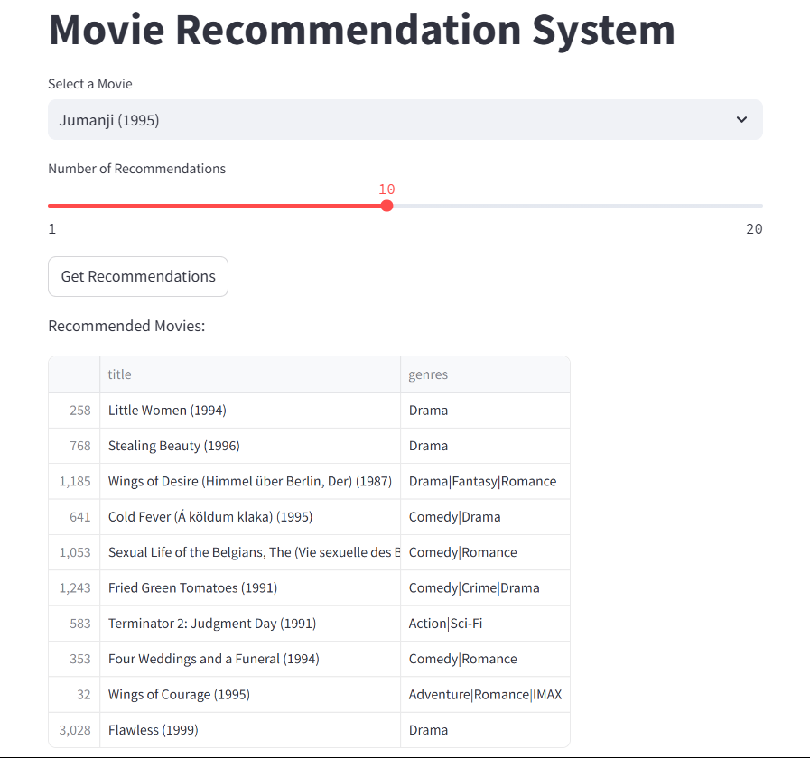
Sample Output
Accredited by NAAC with ‘A+’ Grade

Slide 15
Challenges Faced
Accredited by NAAC with ‘A+’ Grade
Throughout the development of the movie recommendation system, I encountered several challenges that impacted the project's trajectory:
Data Sparsity: The MovieLens dataset presented a sparsity issue, where many users had rated only a few movies. This made it difficult to generate accurate recommendations for new or less popular films.
Scalability: As the dataset increased in size, I faced performance issues during model training and evaluation. Ensuring the system remains efficient and responsive while handling larger datasets is crucial for future improvements.
Cold Start Problem: New users and movies posed a challenge in generating initial recommendations due to a lack of available data. Implementing strategies like content-based filtering could help mitigate this issue.

Slide 16
Future Work
Accredited by NAAC with ‘A+’ Grade
Looking ahead, there are several avenues for enhancing the recommendation system:
Enhanced Feature Engineering: Exploring additional features, such as user demographics and movie genres, can improve the personalization of recommendations.
Integration of Deep Learning: I plan to investigate deep learning techniques for better capturing complex user-item interactions, potentially leading to improved recommendation accuracy.
Real-Time Recommendations: Developing capabilities for real-time recommendations based on user behavior and preferences can enhance user experience and engagement.
User Interface Improvements: Enhancing the user interface to make it more interactive and visually appealing will encourage user engagement and feedback.
By addressing these challenges and pursuing future enhancements, I aim to create a more robust and effective movie recommendation system that meets user needs and expectations

Slide 17
Conclusion
Accredited by NAAC with ‘A+’ Grade
In conclusion, the movie recommendation system project successfully demonstrated the application of collaborative filtering techniques to predict user ratings and provide tailored movie suggestions. Key accomplishments include:
Model Development: I utilized the SVDpp algorithm for collaborative filtering, which effectively captured user-item interactions and generated recommendations for users based on their historical preferences.
Performance Metrics: The system was evaluated using RMSE and MAPE, showing satisfactory accuracy and predictive capabilities in recommending movies, enhancing user experience.
User-Friendly Interface: The Streamlit-based web interface facilitated easy interaction, allowing users to obtain personalized movie recommendations with just a few clicks.
This project not only showcases the practical application of recommendation systems but also highlights the potential for further research and improvement in this domain. Thank you for your attention!

Slide 18

Accredited by NAAC with ‘A+’ Grade

