Slide 1
UNIT-III
Preprocessor and File handling in C:

Slide 2
File Handling in C

Slide 3
What is a File?
A file is a collection of related data that a computers treats as a single unit.
Computers store files to secondary storage so that the contents of files remain intact when a computer shuts down.
When a computer reads a file, it copies the file from the storage device to memory; when it writes to a file, it transfers data from memory to the storage device.
C uses a structure called FILE (defined in stdio.h) to store the attributes of a file.

Slide 4
Steps in Processing a File
Create the stream via a pointer variable using the FILE structure: FILE *p;
Open the file, associating the stream name with the file name.
Read or write the data.
Close the file.

Slide 5
The basic file operations
fopen - open a file- specify how its opened (read/write) and type (binary/text)
fclose - close an opened file
fread - read from a file
fwrite - write to a file
fseek/fsetpos - move a file pointer to somewhere in a file.
ftell/fgetpos - tell you where the file pointer is located.

Slide 6
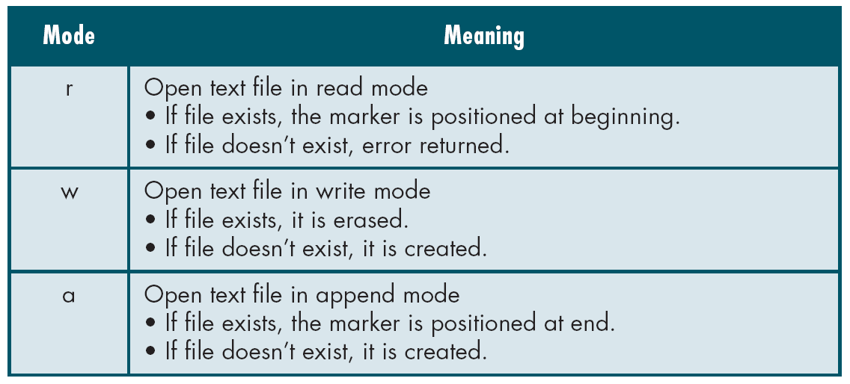
File Open Modes

Slide 7
Additionally,
r+ - open for reading and writing, start at beginning
w+ - open for reading and writing (overwrite file)
a+ - open for reading and writing (append if file exists)

Slide 8
File Open
The file open function (fopen) serves two purposes:
It makes the connection between the physical file and the stream.
It creates “a program file structure to store the information” C needs to process the file.
Syntax: FILE *filepointer;
filepointer=fopen(“filename”, “mode”);

Slide 9
More On fopen()
The file mode tells C how the program will use the file.
The filename indicates the system name and location for the file.
We assign the return value of fopen to our pointer variable:
FILE *fileData;
fileData = fopen(“test.txt”, “w”);

Slide 10
Use of fopen()
# include<stdio.h>
#include<conio.h>
void main()
{
FILE *fileData;
clrscr();
//….
fileData = fopen(“test.txt”,”w”);
//….
getch();
}
Internal file variable
External file
Write operation mode

Slide 11
Closing a File
When we finish with a mode, we need to close the file before ending the program or beginning another mode with that same file.
To close a file, we use fclose and the pointer variable.
Declaration for fclose() : int fclose(FILE *stream)
Syntax used:
fclose(fileData);
This method returns zero if the stream is successfully closed. On failure, EOF is returned.

Slide 12
Use of fclose()
# include<stdio.h>
#include<conio.h>
void main()
{
FILE *fileData;
clrscr();
//….
fileData = fopen(“test.txt”,”w”);
//….
fclose(fileData);
getch();
}
Opening a file
Closing a file

Slide 13
Read and write a character
Functions used in reading and writing a single character in form of bytes are:
putc() – Writes a character to file.
getc() – Reads a character from file.

Slide 14
putc()
The C library function putc() writes a single character to the output file, pointed to by file pointer.
If successful, non-negative value is returned. On error, the function returns EOF.
Declaration:
int puts(char c , FILE *stream)
Syntax :
putc(identifier,fileData)

Slide 15
Use of putc()
# include<stdio.h>
#include<conio.h>
void main()
{
FILE *fileData;
char ch=‘A’;
clrscr();
fileData = fopen(“test.txt”,”w”);
putc(ch,fileData);
fclose(fileData);
getch();
}
Declaring identifier(e.g char)
Opening a file in write mode
write single char to file
Closing a file

Slide 16
getc()
The C library function getc() reads the next character (an unsigned char) from the specified stream and advances the position indicator for the stream.
Declaration:
int getc(FILE *stream)
Syntax:
identifier = getc (fileData);

Slide 17
Use of getc()
# include<stdio.h>
#include<conio.h>
void main()
{
FILE *fileData;
char ch;
clrscr();
fileData = fopen(“test.txt”,”r”);
ch=getc(fileData);
fclose(fileData);
getch();
}
Declaring identifier(e.g char)
Opening a file in read mode
Read single char from file
Closing a file

Slide 18
Read and write formatted data
Formatted data is processed data(char, int, float,..) are written and read from a file.
Formatting notations are used to reperesent data.
%d – int
%c – char
%f – float …
Functions used in reading and writing formatted char and numbers in form of string are:
fprintf() – Writes a formatted character or number to file.
fscanf() – Reads a formatted character or number from file.

Slide 19
fprintf()
The C library function fprintf() sends formatted output to a stream.
If successful, the total number of characters written is returned otherwise, a negative number is returned.
Declaraction:
int fprintf(FILE *stream, const char *format, ...)
Syntax:
fprintf (fileData,“formatting string",variables);

Slide 20
Use of fprintf()
# include<stdio.h>
#include<conio.h>
void main()
{
FILE *fileData;
char ch=‘A’;
int i=12;
float f=23.45;
clrscr();
fileData = fopen(“test.txt”,”w”);
fprintf(fileData,”%d %c %f”,i,ch,f);
fclose(fileData);
getch();
}
Declaring identifier
Opening a file in write mode
write formatted data to file
Closing a file

Slide 21
fscanf()
The C library function fscanf() reads formatted input from a stream.
This function return the number of input items successfully matched and assigned, which can be fewer than provided for, or even zero in the event of an early matching failure.
Declaration:
int fscanf(FILE *stream, const char *format, ...)
Syntax:
fscanf (fileData,“formatting strings",identifiers);

Slide 22
Use of fscanf()
# include<stdio.h>
#include<conio.h>
void main()
{
FILE *fileData;
char ch;
int i;
float f;
clrscr();
fileData = fopen(“test.txt”,”r”);
fscanf(fileData,”%d %c %f”,i,ch,f);
printf(“the value of i = %d ch= %c and f=%f”,i,ch,f);
fclose(fileData);
getch();
}
Declaring identifier
Opening a file in read mode
reading formatted data from file
Closing a file

Slide 23
Example of Reading and Writing Files together
#include <stdio.h>
void main ( )
{
FILE *outfile, *infile ;
int b = 5, f ;
float a = 13.72, c = 6.68, e, g ;
outfile = fopen (“data.txt", "w") ;
fprintf (outfile, “ %f %d %f ", a, b, c) ;
fclose (outfile) ;
infile = fopen (“data.txt", "r") ;
fscanf (infile,"%f %d %f", &e, &f, &g) ;
printf (“ %f %d %f \n ", a, b, c) ;
printf (“ %f %d %f \n ", e, f, g) ;
fclose(infile);
}
Declaring identifier
Opening a file in write mode
Writing formatted text to the file ‘data.txt’
Closing outfile.
Opening the file in read mode ‘data.txt’
Reading formatted text from the file ‘data.txt’
Closing infile.

Slide 24
End of File(EOF)
EOF indicates "end of file".
The value of EOF is -1.
If you're typing at the terminal and you want to provoke an end-of-file, use CTRL-D (unix-style systems) or CTRL-Z (Windows). Then after all the input has been read, getc() will return EOF, and hence getc() != EOF will be false, and the loop will terminate.
A function feof(fileData) can also be used to read till end of the file.

Slide 25
Use of EOF
#include <stdio.h>
void main()
{
FILE *fileData;
int c ;
char filename[40] ;
printf(“Enter file to be displayed: “);
gets( filename ) ;
fileData = fopen( filename, “r”);
c = getc( fileData ) ;
while ( c != EOF )
{
putchar(c);
c = getc ( fileData );
}
fclose( fileData );
}
Loop to terminate with EOF or -1

Slide 26
Use of feof()
#include <stdio.h>
#include<conio.h>
void main()
{
char ch;
FILE *fileData;
clrscr();
fp=fopen(“test.txt","r");
while(!feof(fp))
{
ch=getc(fp);
printf("\n%c",ch);
}
getch();
}
Loop to terminats with feof ()

Slide 27
Read and write block of data
Read and writes block of data from/to stream.
Arrays are used to store the block of data to write or read.
It uses binary stream to read and write data to a file.
Functions used in read and write block of data in form of bytes are:
fwrite() – Writes block of data to file.
fread() – Reads block of from file.

Slide 28
fwrite()
Declaration:
size_t fwrite(const void *ptr, size_t size, size_t n, FILE*stream);
Writes an array of n elements, each one with a size of size bytes, from the block of memory pointed by ptr to the current position in the stream.
The position indicator of the stream is advanced by the total number of bytes written.
Writes them sequentially to stream as bytes.
fwrite appends a specified number of equal-sized data items to an output file.
ptr = Pointer to any object; the data written begins at ptr
size = Length of each item of data
n =Number of data items to be appended
stream = file pointer

Slide 29
Use of fwrite()
Example:
#include <stdio.h>
void main()
{
char a[10]={'1','2','3','4','5','6','7','8','9','a'};
FILE *fileData;
fileData=fopen(“test2.txt","w");
fwrite(a,1,10,fileData);
fclose(fileData);
}
Writing block of data.

Slide 30
fread ()
size_t fread(void *ptr, size_t size, size_t n, FILE *stream);
Read block of data from stream.
Reads an array of n elements, each one with a size of size bytes, from the stream and stores them in the block of memory specified by ptr.
The position indicator of the stream is advanced by the total amount of bytes read.
The total amount of bytes read if successful is (sizeXcount).
fread reads a specified number of equal-sized data items from an input stream into a block.
ptr = Points to a block into which data is read
size = Length of each item read, in bytes
n = Number of items read
stream = file pointer

Slide 31
Use of fread()
#include <stdio.h>
void main()
{
FILE *fileData;
char buffer[11];
fileData = fopen(“test2.txt”, “r”);
buffer[10] = 0;
fread(buffer, 1, 10, fileData);
fclose(fileData);
printf("first 10 characters of the file:\n%s\n", buffer);
}
Reading block of data.

Slide 32
Additional Functions
fflush()
fseek()
ftell()

Slide 33
fflush()
If the given stream was open for writing (or if it was open for updating and the last i/o operation was an output operation) any unwritten data in its output buffer is written to the file.
When a file is closed, either because of a call to fclose or because the program terminates, all the buffers associated with it are automatically flushed.
Syntax:
fflush (fileData);

Slide 34
fseek()
This function sets the file position indicator for the stream pointed to by stream or you can say it seeks a specified place within a file and modify it.
SEEK_SET Seeks from beginning of file
SEEK_CUR Seeks from current position
SEEK_END Seeks from end of file
Syntax :
fseek(fileData, 6, SEEK_SET);

Slide 35
ftell()
"ftell" returns the current position for input or output on the file
Syntax:
ftell(fileData)
e.g
printf("The file pointer is at byte %ld\n", ftell(stream));

Slide 36
Summary
What is a File?
C uses a structure called FILE and function ref. defined in stdio.h.
Steps in Processing a File
Opening
Reading/Writing
Closing
File opening modes
r, w, a (r+,w+,a+)
Basic file operations.
fopen().
putc()
getc()
fprintf()
fscanf()
fread()
fwrite()
fclose()
Additional Functions
fflush()
fseek()
ftell()

