Slide 1

Companies Dataset Analysis
Presented by: Sheetal Gautam

Slide 2

Introduction
This report provides an in-depth analysis of a dataset containing information about various companies. The main aim is to understand the structure of the data, handle missing values, and prepare it for meaningful insights. The analysis is conducted using Python with the help of libraries like Pandas.

Slide 3
Data Loading & Preview
The dataset is loaded using the pandas library. The function `pd.read_csv()` reads the CSV file into a DataFrame. Using `df.head()` helps us preview the first five rows of the dataset, which gives a quick overview of its contents.
Example code:
df = pd.read_csv("companies_data.csv") df.head()

Slide 4
Dataset Structure Summary
`df.info()` provides a concise summary including the number of entries, column names, data types, and non-null values. `df.describe()` generates statistical summaries such as mean, median, standard deviation, etc., for numerical columns.
These functions help us identify the types of data we’re dealing with and any immediate anomalies.

Slide 5
🧹 Handling Missing Values
To ensure our analysis is accurate, it's crucial to deal with missing data. `df.isnull().sum()` is used to count missing values in each column. `df.dropna()` removes any rows that contain missing values. The cleaned dataset is stored in a new variable `df_clean`.
Code example:
df_clean = df.dropna()

Slide 6
Unique Values Analysis
`df.nunique()` returns the number of unique entries in each column. This is especially helpful in understanding categorical variables such as company names or locations.

Slide 7
Clean Dataset Review & Conclusion
After data cleaning, we use `df_clean.head()` to verify the first few rows of the cleaned dataset. At this point, the dataset is free from missing values and ready for further analysis or visualization.

Slide 8
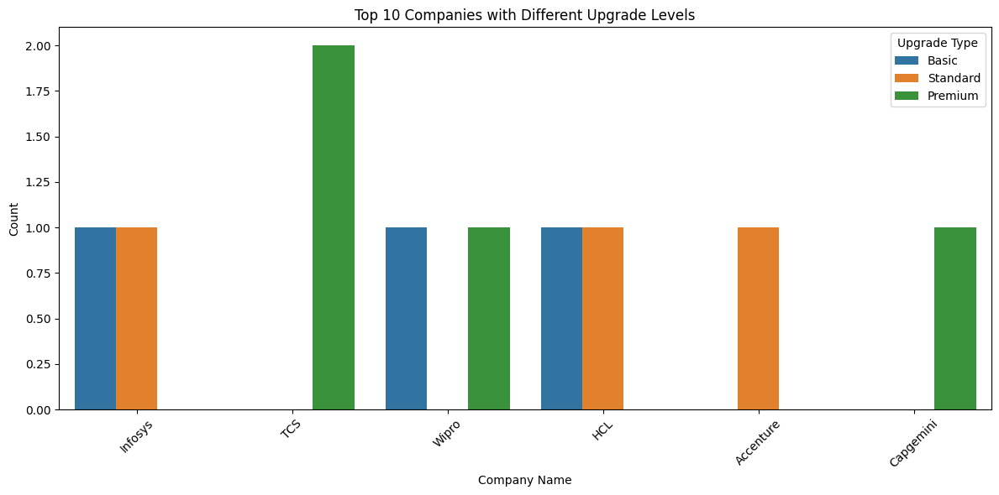

Slide 9
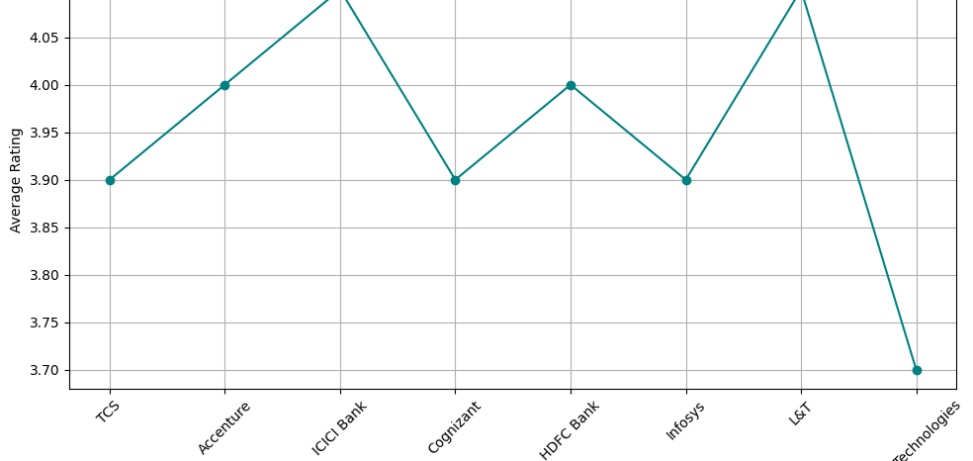
This line graph shows the average ratings of various companies.
Highest Ratings: ICICI Bank and L&T
Good Ratings (~4.0): Accenture, HDFC Bank
Average Ratings (~3.9): TCS, Cognizant, Infosys
Lowest Rating (~3.7): Technologies (last entry) It helps compare company reputations based on average ratings.

Slide 10
Conclusion
This report highlights the initial steps in data analysis—loading, understanding, and cleaning a dataset. Proper handling of missing and duplicate data ensures a more robust foundation for deriving insights in further stages.

Slide 11
Thank you

