Slide 1
CRICKET SPORT CENTER
ISM 6362 Big Data and Cloud Tools
SPORT
Group Project: Cricket
Sheetal Murali
Sunku Ganga Mahesh,
Abhi Munjal

Slide 2

TABLE OF CONTENTS
Objectives
Architecture Design
01
02
03
Analysis
04
ML Model
05
Evaluation
06
Reporting

Slide 3


OBJECTIVES
Analyze match data to provide detailed player performance metrics, including Total run rates, wicket counts, required run rate etc.
Utilize customer data to evaluate match popularity and predict future sales.
Develop a scalable and efficient data pipeline architecture using AWS services and Databricks for both batch and stream processing.

Slide 4
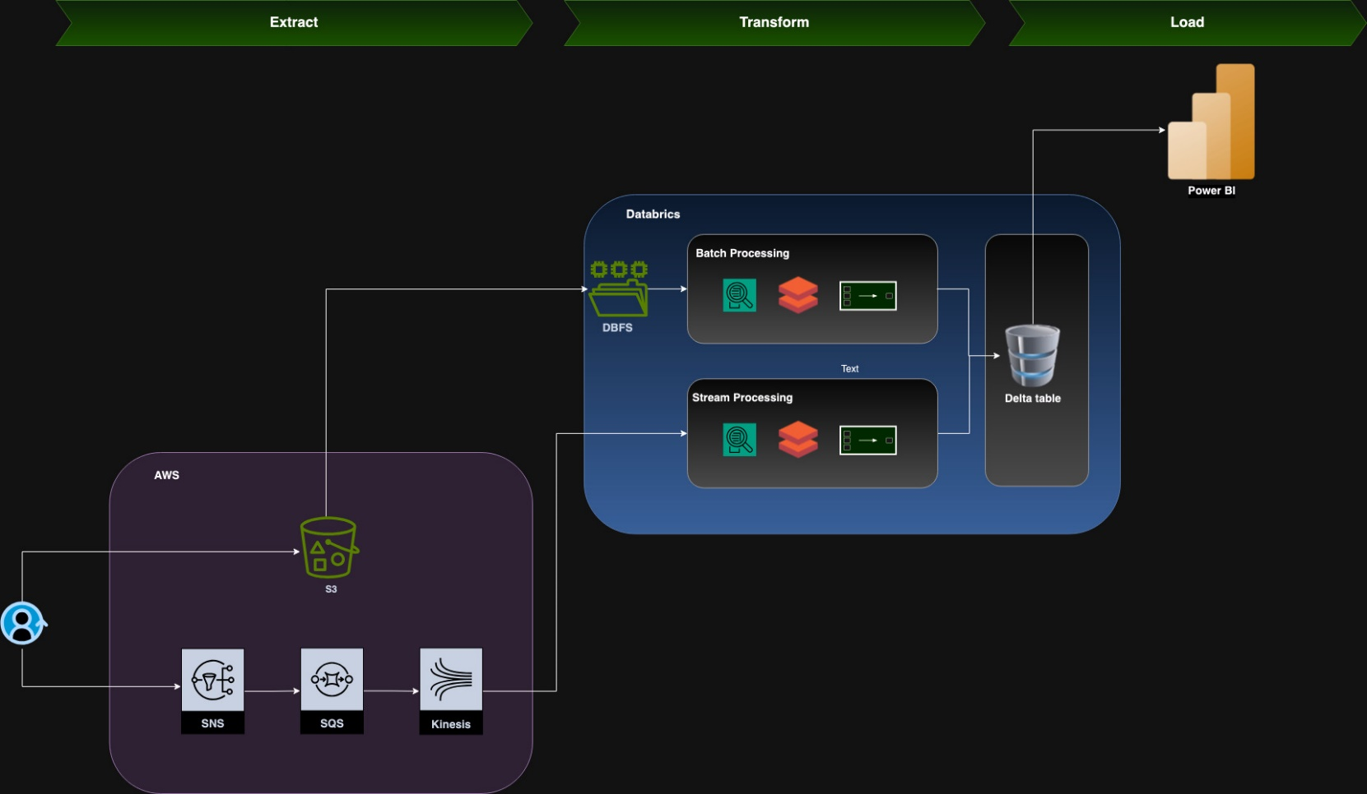
Architecture Design

Slide 5
ANALYSIS : [METRICES]
Batch Processing [All matches]
Stream Processing [ball-by-ball]
Top 5 strikers
Top 5 Bowlers
Team Association
Balls bowled for total score
Total runs & total Wickets
Cumulative Runs
Cumulative Wickets
Runs per over
Partnership runs
Economy rate

Slide 6
Overview of Machine Learning Model
Model Type: Regression
Objective: Predict the total sales price attributed to customers during the ICCCricket World Cup using customer demographics and match-related factors.
Key Features:
Input Features: Age, gender, income, education, and match-related factors.
Target Variable: Total sales price (monetary value generated from each customer).
Training Process:
Data Splitting: 10% data for validation and 30% for testing using train-validation split.
Automated ML: Azure AutoML was employed to train and select the best regression model.
Tools Used: Azure Machine Learning Studio, Databricks for data preprocessing, and Azure Blob Storage for data management.

Slide 7
Model Performance - amusing_kumquat_l (3)
Model Selection:
Best Model: Azure AutoML selected the amusing_kumquat_l (3) model based on its superior performance in various evaluation metrics.
Key Metrics:
Root Mean Squared Error (RMSE): 503.5878
R² Score: 0.1793806
Mean Absolute Error (MAE): 306.3583
Explained Variance: 0.1793909
Evaluation Insights:
Accuracy: Reasonable prediction accuracy with room for improvement.
Spearman Correlation: 0.3790979 indicating a weak positive relationship between predicted and actual sales prices.
Visuals:
Predicted vs. True Plot: Demonstrates alignment (or lack thereof) between predicted sales prices and actual values.
Residuals Histogram: Displays the distribution of prediction errors, highlighting areas of significant error.

Slide 8
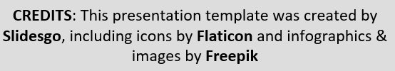
WHOA!
Thank You!

