Slide 1
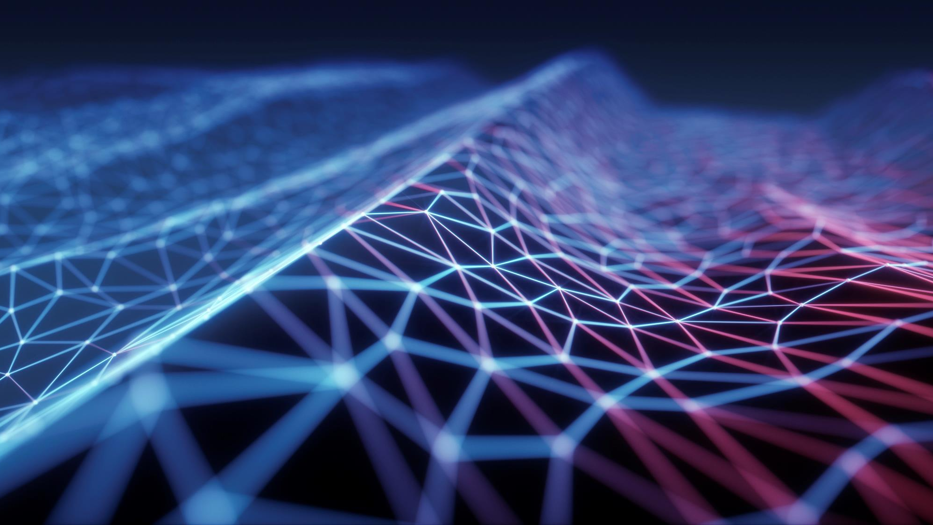
Broken Practices by programmers
Code for human not for computer sheetal singh

Slide 2
Few Most Expensive Software Errors
# NASA’s Mars Climate Orbiter | Cost: $ 125 million | Y1998 | Orbiter lost in Space
Reason: Engineers failed to make simple conversion between Imperial Units to Metric Units
# Ariane 5 Flight 501 | Cost: $ 370 million | Y1996 | Rocket self destructed after 37 sec
Reason: Software tried to cram a 64-bit number into 16-bit space
#Soviet Early-Warning System’s False Alarm | Cost: A Probable Nuclear War | Y 1983
Reason: Software raised alarm that US had launched 5 nuclear missiles. Lt. Col. Stanislaus Petrov, a calm and logical man, made the decision not to respond.

Slide 3

WHY?
Majority of the work is of maintenance
We spent more time in reading code rather coding
Fixing existing code cost much more than writing clean code
Production Issue
People prefer to write own code rather modifying existing code

Slide 4
Few Popular quotes
Time heals everything… except bad code.
Any fool can write code that a computer can understand. Good programmers write code that humans can understand. By Martin Fowler

Slide 5
CLEAN CODE PRINCIPLES
DRY Don’t Repeat Yourself
KISS Keep It Simple and Stupid
SOLID Principles
RASAP Refactor As Soon As Possible
Don’t Reinvent The Wheel

Slide 6
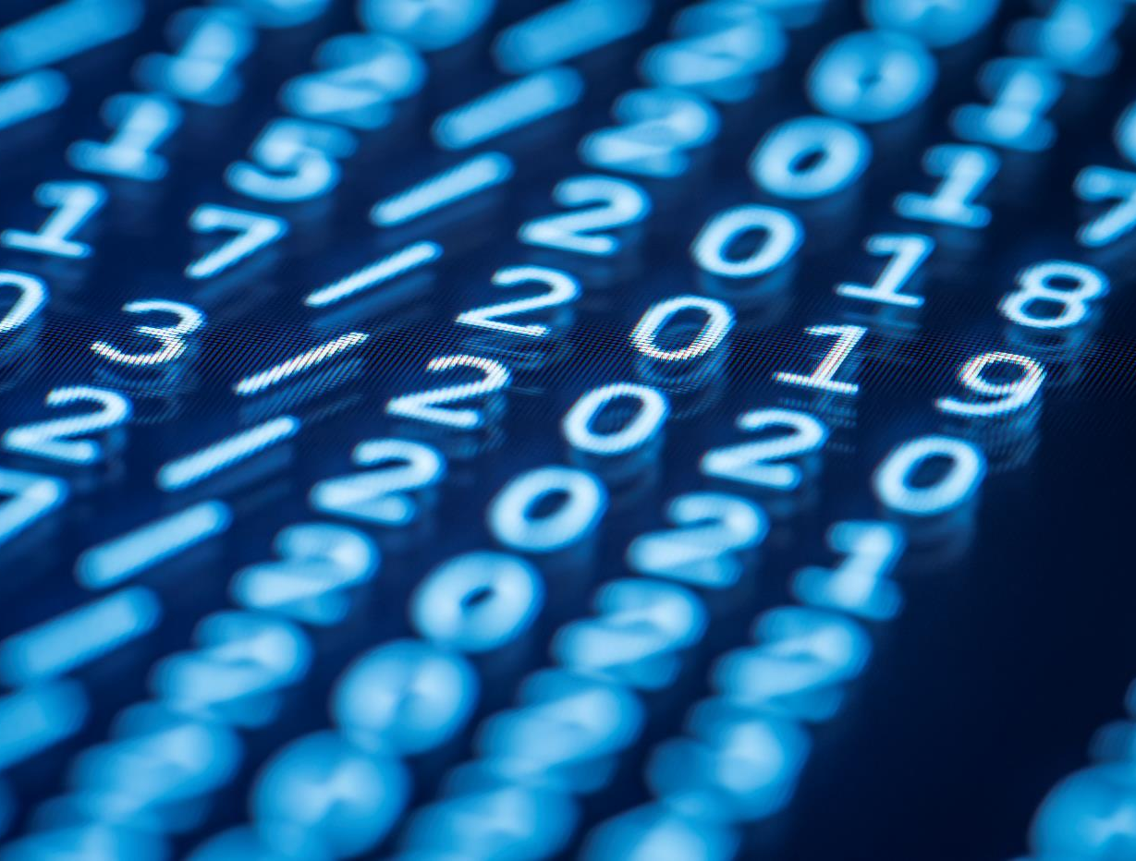
Thank You
Sheetal singh

