Slide 1
Anaphora Resolution
Nobal Niraula
4th Oct 2010
<number>

Slide 2
Agenda
Introduction to Anaphora and Anaphora Resolution (AR)
Types of Anaphora
Process of Anaphora Resolution
Tools
Issues
<number>

Slide 3
Contents of this presentation
Ruslan Mitkov, School of Languages and European Studies University of Wolverhampton, Stafford Street, UK
ANAPHORA RESOLUTION: THE STATE OF THE ART
Outstanding Issues in Anaphora Resolution
<number>

Slide 4
Introduction to Anaphora
Anaphora in Etymology
Ancient Greek : Anaphora = αναϕορα (Anajora)
ανα (Ana) → back in an upward direction
ϕορα (Jora ) → the act of carrying back upstream
Example:
The Empress hasn't arrived yet but she should be here any minute.
she →Anaphor
The Empress (NP) → Antecedent
Empress (N) is NOT the antecedent !
Coreferent → Both The Empress and she refer to the same REAL WORLD ENTITY
<number>

Slide 5
Catafora
Catafora
when the “anaphor” precedes the “antecedent”
Because she was going to the post office, Julie was asked to post a small parcel
<number>

Slide 6
Anaphora Resolution (AR)
Anaphora Resolution(AR) is the process of determining the antecedent of an anaphor.
Anaphor – The reference that points to the previous item
Antecedent –The entity to which anaphor refers
Needed to derive the “Correct Interpretation” of a text
Is a complicated problem in NLP !
<number>

Slide 7
Applications of Anaphora Resolution
Natural Language Interfaces
Machine Translation
Automatic Abstracting
Information Extraction
<number>

Slide 8
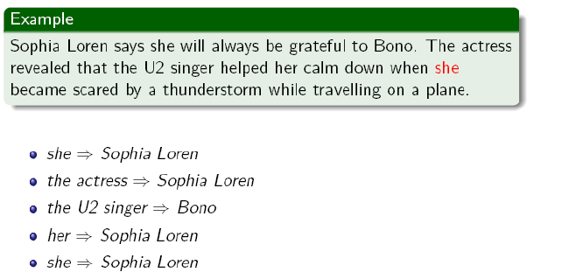
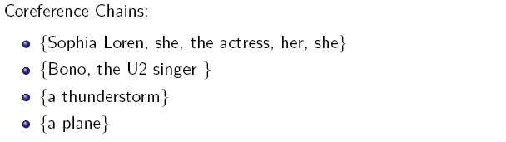
Coreferential chain
when the anaphor and more than one of the preceding (or following) entities (usually noun phrases) have the same referent and are therefore pairwise coreferential
<number>
Notes:
<number>

Slide 9
AR VS Coreference Resolution
Anaphora Resolution
System has to determine antecedents of anaphors
Coreference Resolution
Identify all coreference CHAINS
the task of AR is considered successful, if any of the preceding entities in the coreferential chain is identified as an antecedent.
<number>

Slide 10
Types of Anaphora (1)
Pronominal anaphora
The most widespread type of anaphora
Realized by anaphoric pronouns
Computational Linguists from many different countries attended the tutorial. They took extensive notes.
Not all pronouns in English are anaphoric
Example
It is raining.
It is non-anaphoric
<number>

Slide 11
Types of Anaphora (2)
Definite noun phrase anaphora
when the antecedent is referred by a definite noun phrase representing either same concept (repetition) or semantically close concepts (e.g. synonyms, superordinates).
Example
Computational Linguists from many different countries attended the tutorial. The participants found it hard to cope with the speed of the presentation.
<number>

Slide 12
Types of Anaphora (3)
One-anaphora
One-anaphora is the case when the anaphoric expression is realized by a "one" noun phrase.
Example:
If you cannot attend a tutorial in the morning, you can go for an afternoon one.
Some are easier than others.
The red ones went in the side pocket.
<number>

Slide 13
Intrasentential VS Intersentential
Intrasentential anaphors
Referring to an antecedent which is in the same sentence as the anaphor
Intersentential anaphors
Referring to an antecedent which is in a different sentence from that of the anaphor
<number>

Slide 14
Process of AR (1)
Possibilities: identifying anaphors which have noun phrases, verb phrases, clauses, sentences or even paragraphs/discourse segments as antecedents
Most of the AR systems deal with : identifying anaphors which have noun phrases as their antecedents
<number>

Slide 15
Process of AR (2)
Typical Process
Candidates
All noun phrases (NPs) preceding an anaphor are initially regarded as potential candidates for antecedents
Search scope
Most approaches look for NPs in the current and preceding sentence.
Antecedents which are 17 sentences away from the anaphor have already been reported !
<number>

Slide 16
Anaphora Resolution Tools
GUITAR
http://cswww.essex.ac.uk/Research/nle/GuiTAR/gtarNew.html
Uses Charniak’s parser
Input Minimally Associated XML format (MAS-XML)
Output in XML
Java
BART
http://www.bart-coref.org/
John Hopkins University Tool for AR
Uses Charniak’s parser
Comes up with Machine learning model
Can take Input as XML. Output XML
MARS
http://clg.wlv.ac.uk/demos/MARS/index.php
Built on Mitkov principle
Uses certain linguistic rules
If your data has noises, don’t use it.
Java-RAP (pronouns)
http://aye.comp.nus.edu.sg/~qiu/NLPTools/JavaRAP.html
Working on Lipin and Leass rules (1994)
Uses Charniak’s parser
<number>

Slide 17
Anaphora Resolution Tools
OPEN NLP
http://opennlp.sourceforge.net
CherryPicker: A Coreference Resolution Tool
http://www.hlt.utdallas.edu/~altaf/cherrypicker.html
Reconcile - Coreference Resolution Engine
http://www.cs.utah.edu/nlp/reconcile/
<number>

Slide 18
BART - Demo
Why BART ?
Open Source
It is beautiful (Beautiful Anaphora Resolution Toolkit) ☺
It works ! ☺
http://www.bart-coref.org
<number>

Slide 19
Current Status
Where do we stand today?
Domain-specific and linguistic knowledge are not needed
Knowledge-poor anaphora strategies have developed
By emergence of cheaper and more reliable corpus-based NLP tools such as POS taggers, Sallow parsers, and other NLP resources (ontologies)
Use of modern approaches
Machine Learning
Genetic Algorithms
<number>

Slide 20
Outstanding Issues (1)
Accuracy of Pre-processing is still TOO low
Pre-processing stage
Morphological Analysis / POS tagging -- fair
Name Entity Reorganization – still a challenge
Best performing NER 96 % when trained and tested on news about a SPECIFIC topic and 93 % when trained on news about topic and tested on news about other topic
Unknown word recognition
NP extraction – have a long way to go
NP chunking 90%-93% recall and precision
Gender recognition – still a challenge
Identification of pleonastic pronouns
Parsing
Best Accuracy in robust parsing of unrestricted texts = 87 %
How accurate an AR algorithm we make, it won’t perform well until the accuracy of pre-pressing improves
<number>

Slide 21
Outstanding Issues(2)
Majority of Anaphora resolution systems do not operate in fully automatic mode.
Fully automatic AR is more difficult than previously thought
54.65 % in MARS
It was as high as 90 % for perfectly analyzed inputs
<number>

Slide 22
Outstanding Issues(3)
Need for Annotated Corpora
Needed for training Machine Learning Algorithms or statistical approaches
Corpora annotated with anaphoric or coreferential links are not widely available
Annotation tool
Annotation scheme
<number>

Slide 23
Outstanding Issues(4)
Evaluation in Anaphora Resolution
Factors (constraints and preferences)
Mutually dependent
Most people still work mainly on pronoun resolution
Multilingual Context
Service to Research Community
Sharing software, experience, data
There are just 3 demos for AR ;)
<number>

Slide 24
Pessimistic / Optimistic View
“NLP in general is very difficult but after working hard on Anaphora Resolution we have learned that it is particularly difficult”~ Mitkov
"A pessimist sees the difficulty in every opportunity; an optimist sees the opportunity in every difficulty”~Winston Churchill
“All we have to do is work more and HOPE for SLOW but STEADY progress. We just have to be PATIENT !” ~ Mitkov
<number>

Slide 25
AR in Tutoring
Some papers
AR in multi-person dialogue
Haven’t found any paper specific to Tutoring
<number>

Slide 26
Reference
Massimo Poesio Slides: Anaphora Resolution for Practical Tasks, University of Trento
<number>

