Slide 1
Introduction to iOS

Slide 2
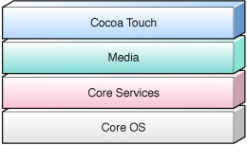
iOS Technologies
Set of layers,
from fundamental services on which all applications rely,
to higher-level layers that contain more sophisticated services and technologies.

Slide 3
Cocoa Touch
An object-oriented library of tools that contains many of the objects and methods needed to develop applications for iPhone, iPod, and iPad.
The tools are packaged as frameworks
These frameworks define the appearance of the app, and makes user interface development simple.
Provides the basic app infrastructure and support for key technologies such as :
multitasking, touch-based input, push notifications, and many high-level system services. .
By providing these tools to programmers, it takes the tedium out of writing applications.
Cocoa Touch is based on the Mac OS X Cocoa API toolset and, like it is primarily written in the Objective-C language.

Slide 4
Cocoa Touch Layer
UIApplication : a centralized point of control and coordination
Address Book UI Framework
EventKit UI Framework
viewing and editing calendar-related events
MessageUI.framework – email support
MapKit.framework
iAd Framework
Notification Center Framework
Social Framework
for accessing the user’s social media accounts
PushKit Framework (registration support for VoIP apps)
GameKit.framework -- peer to peer support
UIKit Framework:

Slide 5
The UIKit framework (UIKit.framework) contains Objective-C/swift programming interfaces that provide the key infrastructure for implementing graphical, event-driven applications in iOS.
Every application in iOS uses this framework to implement its core set of features:
Application management
Cut, copy, and paste support
Graphics and windowing support
Support for handling touch and motion-based events
User interface management
Objects representing the standard system views and controls
Support for text and web content
Integration with other applications on the system through URL schemes
Support for the Apple push notification service; see “Apple Push Notification Service”
Accessibility support for disabled users
In addition to providing the fundamental code for building your application, UIKit also incorporates support for some device-specific features, such as the following:
Accelerometer data
The built-in camera (where present)
The user’s photo library
Device name and model information
Battery state information
Proximity sensor information
Remote control information from attached headsets

Slide 6
Media Layer
the graphics, audio, and video technologies geared toward creating the best multimedia experience available on a mobile device.
these technologies were designed to make it easy to build applications that look and sound great.
Graphics Technologies
Quartz: The Core Graphics framework
contains the interfaces for the Quartz 2D drawing API. Quartz is the same advanced, vector-based drawing engine that is used in Mac OS X.
Core Animation: The Quartz Core framework
contains the Core Animation interfaces- complex animations and visual effects.
Core Image
advanced support for manipulating video and still images in a nondestructive manner.
OpenGL ES: OpenGL ES framework
provides tools for drawing 2D and 3D content.
It is a C-based framework that works closely with the device hardware to provide high frame rates for full-screen game-style applications.
Audio Technologies
AV Foundation, Core Audio, OpenAL
Video Technologies
Support for full-screen video playback through the Media Player framework.
Supports the playback of movie files with the .mov, .mp4, .m4v, and .3gp filename extensions and using the following various compression standards.

Slide 7
AirPlay
stream audio and video content to Apple TV and stream audio content to third-party AirPlay speakers and receivers
Metal
provides extremely low-overhead access to the A7 GPU, enabling incredibly high performance for your sophisticated graphics rendering and computation tasks.
Image I/O
provides interfaces for reading and writing most image formats.
TextKit
family of UIKit classes used to perform fine typography and text management.

Slide 8
Core Services Layer
provides the fundamental system services that all applications use.
Even if not used directly, many parts of the system are built on top of them.
Core Foundation and Foundation frameworks
contains individual technologies to support features such as location, iCloud, social media, and networking
AddressBook.framework
CoreData.framework :
for managing the data model of a Model-View-Controller application – uses SQLite
CoreFoundation.framework
set of C-based interfaces that provide basic data management and service features for applications: Collection data types, Bundles, String management, Date and time management, URL and stream, Threads and run loops, Port and socket communication
Closely related to the Foundation framework ( objective-c) . Use Toll-free bridging when mixing between types
CoreLocation.framework
Foundation.framework
provides Objective-C wrappers to many of the features found in the Core Foundation framework
CFNetwork.framework
Set of high-performance, C-based interfaces that provide object-oriented abstractions for working with network protocols
Simplify tasks such as communicating with FTP and HTTP servers or resolving DNS hosts.
Based, both physically and theoretically, on BSD sockets

Slide 9
Some of the high-level features available in the Core Services layer:
Peer-to-Peer Services (Bluetooth
Cloud Storage
Block Objects
Data Protection (using the built-in encryption )
File-Sharing Support
Grand Central Dispatch
In-App Purchase
SQLite
XML Support

Slide 10
Core OS Layer
Accelerate Framework
digital signal processing (DSP), linear algebra, and image-processing
Core Bluetooth Framework
Local Authentication Framework
use Touch ID to authenticate the user
Network Extension Framework
support for configuring and controlling Virtual Private Network (VPN) tunnels.
ExternalAccessory.framework
support for communicating with hardware accessories attached to an iPhone or iPod touch device through the 30-pin dock connector
Security.framework
provides interfaces for managing certificates, public and private keys, and trust policies
System
The system level encompasses the kernel environment, drivers, and low-level UNIX interfaces of the operating system
manages the virtual memory system, threads, file system, network, and interprocess communication
Accessing low-level features of the operating system through the LibSystem library. (C-based interfaces)

Slide 11
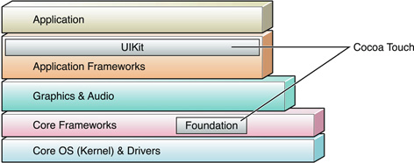

Slide 12
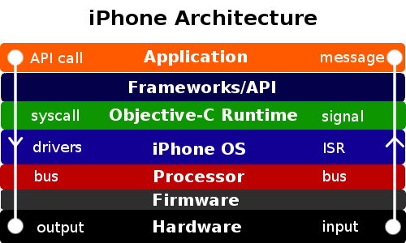
Copyright the Coffee Desk

Slide 13
iPhone Core Application Architecture

Slide 14
iPhone application is built using the UIKit framework
Has essentially the same core architecture.
UIKit provides the key objects needed to run the application and to coordinate the handling of user input and the display of content on the screen.
Differences between applications:
How they configure these default objects
where they incorporate custom objects to augment their application’s user interface and behavior.
Customizations may happen at the highest levels of the application.
UIKit framework manages the majority of the application’s key infrastructure.
An iPhone application receives events continuously from the system using the UIApplication object, but responding to the events is the responsibility of the custom code.

Slide 15
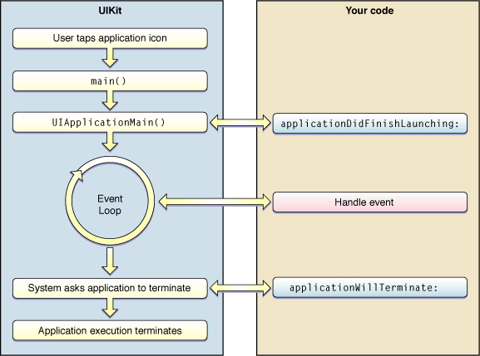
Application life cycle

Slide 16
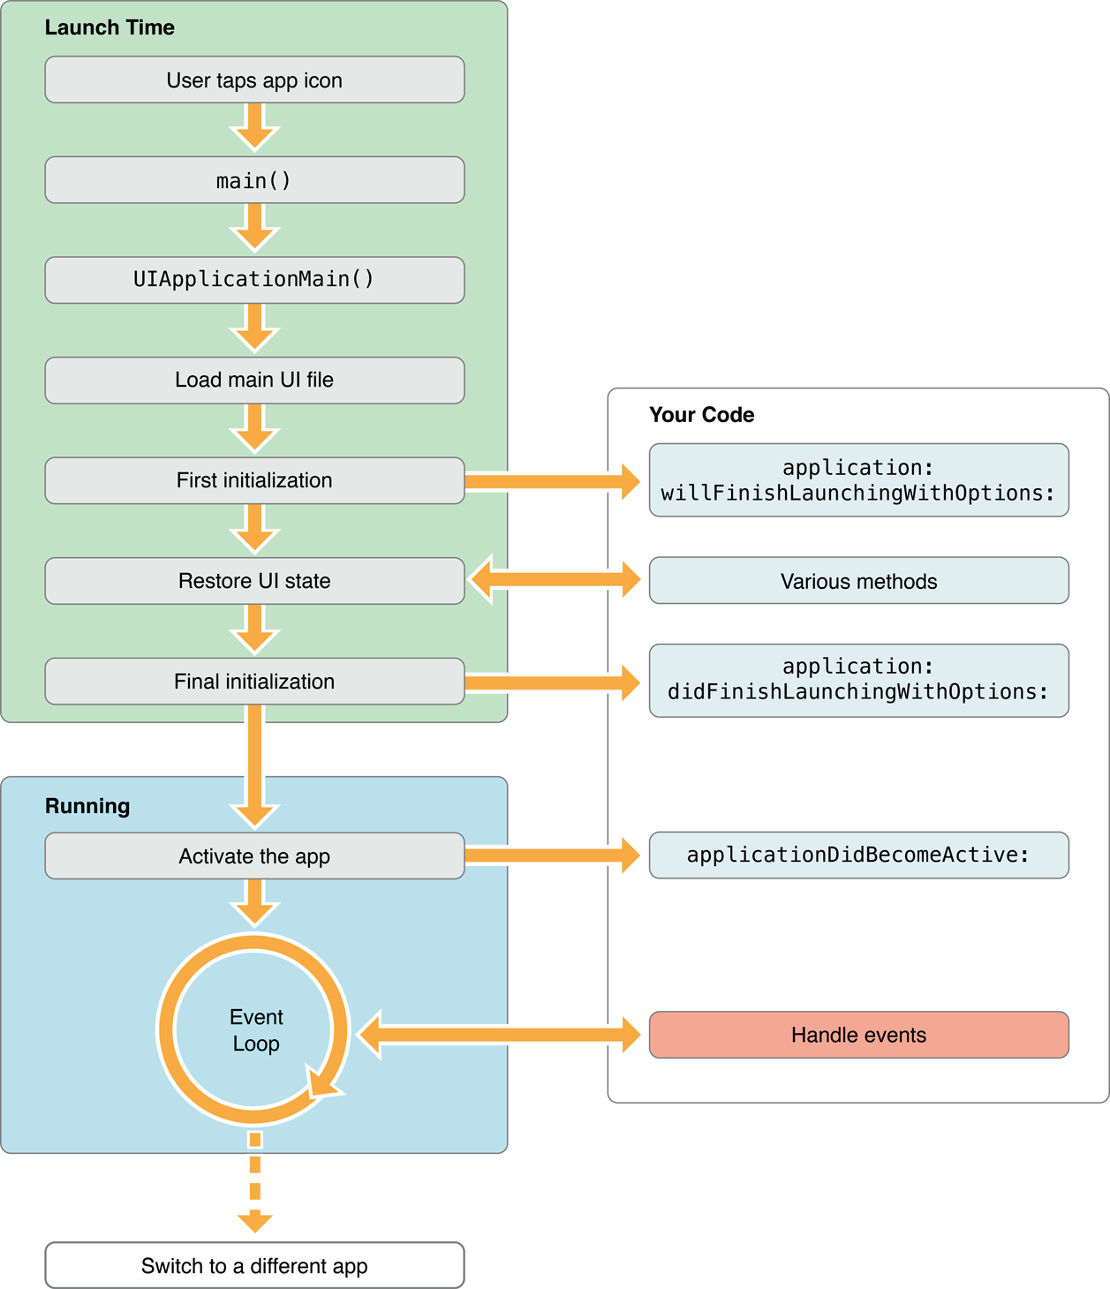

Slide 17
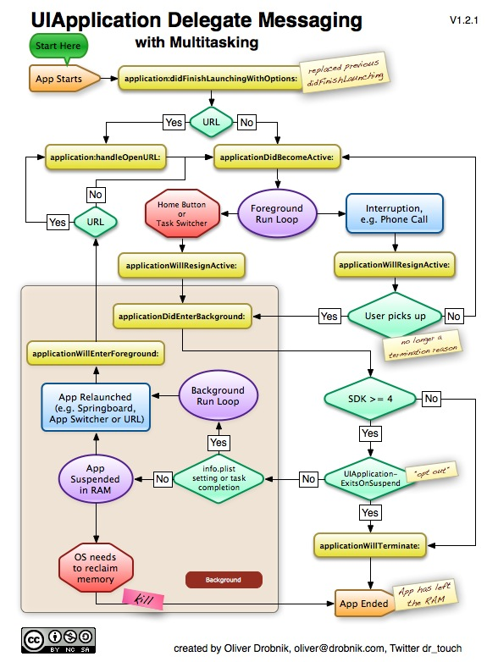

Slide 18
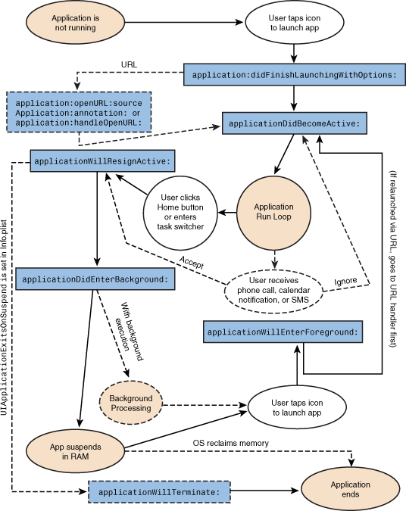

Slide 19
Methods of your application delegate called during state transitions:
application:didFinishLaunchingWithOptions:
launchOptions: A dictionary indicating the reason the application was launched (if any). The contents of this dictionary may be empty in situations where the user launched the application directly.
Called during the initial startup sequence followed by either the applicationDidBecomeActive: or applicationDidEnterBackground:
NSApplicationDidFinishLaunchingNotification can be added in any class to listen to the same event
applicationDidBecomeActive:
applicationWillResignActive:
Called when the user presses the Home button or the system launches another application
applicationWillEnterForeground:
The application is about to enter the foreground.
UIApplicationWillEnterForegroundNotification notification is also available for tracking when your application reenters the foreground.
applicationWillTerminate:
The application is about to be terminated and purged from memory entirely.
Use this method to perform any final clean-up tasks, such as freeing shared resources, saving user data, invalidating timers, and storing enough application state to reconstitute the application’s interface when it is relaunched.
applicationDidEnterBackground:

Slide 20
Methods of your application delegate called during state transitions ( Swift)
func application(_ application: UIApplication, didFinishLaunchingWithOptions launchOptions: [UIApplicationLaunchOptionsKey : Any]? = nil) -> Bool
application(_:willFinishLaunchingWithOptions:)
func applicationDidEnterBackground(_ application: UIApplication)
func applicationDidBecomeActive(_ application: UIApplication)

Slide 21
The UIApplicationMain function at the heart of the preceding listing takes four parameters and uses them to initialize the application.
argc and argv,
The class of the application object ( UIApplication by default),
The class of the application delegate ( loaded from template).
The Application Delegate
Monitors the high-level behavior of the application
A custom object that you provide.
Delegation is a mechanism used to avoid sub-classing complex UIKit objects, such as the default UIApplication object. Instead of subclassing and overriding methods, you use the complex object unmodified and put your custom code inside the delegate object. As interesting events occur, the complex object sends messages to your delegate object. You can use these “hooks” to execute your custom code and implement the behavior you need.

Slide 22
The Event-Handling Cycle
After the UIApplicationMain function initializes the application, it starts the infrastructure needed to manage the application’s event and drawing cycle, which is depicted in Figure 1-2.
As the user interacts with a device, iPhone OS detects touch events and places them in the application’s event queue.
The event-handling infrastructure of the UIApplication object takes each event off the top of this queue and delivers it to the object that best suited to handle it.
For example, a touch event occurring in a button would be delivered to the corresponding button object.
Events can also be delivered to controller objects and other objects indirectly responsible for handling touch events in the application.

Slide 23
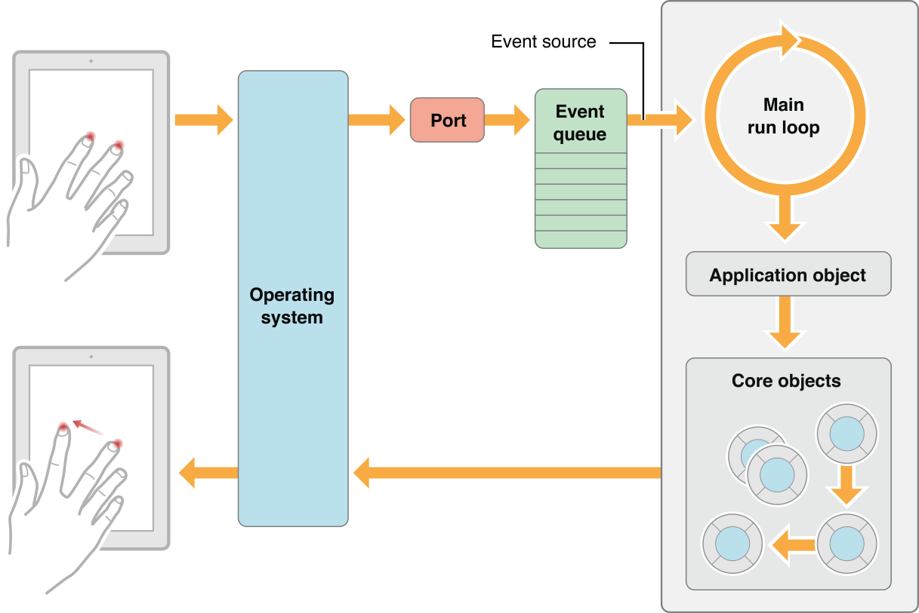
The Event-Handling Cycle

Slide 24
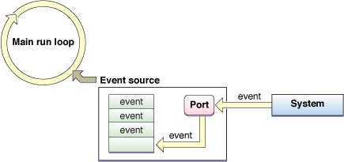
- A run loop monitors sources of input for a given thread of execution.
- When an input source has data to process, the run loop wakes up the thread and dispatches control to the handler for that input source.
- When the handler finishes, control passes back to the run loop, which processes the next event or puts the thread to sleep if there is nothing more to do.
- Can install own input sources, including ports and timers, on a run loop using the NSRunLoop class of the Foundation framework.

Slide 25
Event Delivery
The singleton UIApplication object managing the application takes an event from the top of the queue and dispatches it for handling – typically to the window currently the focus for user events—
The UIWindow object representing that window sends the event to an initial object for handling.
That object is different for touch events and motion events.
Touch events.
The window object uses hit-testing and the responder chain to find the view to receive the touch event.
Calls hitTest:withEvent: on the top-most view of the view hierarchy;
proceeds by recursively calling pointInside:withEvent: on each view in the view hierarchy that returns YES, proceeding down the hierarchy until it finds the subview within whose bounds the touch took place. That view becomes the hit-test view.
If the hit-test view cannot handle the event, the event travels up the responder chain until the system finds a view that can handle it.
A touch object is associated with its hit-test view for its lifetime, even if the touch represented by the object subsequently moves outside the view.

Slide 26
Event Delivery (Cont)
Motion events.
The window object sends the motion event to the first responder for handling.
Although the hit-test view and the first responder are often the same view object, they do not have to be the same.
The UIApplication object and each UIWindow object dispatches events in the sendEvent: method.
Because these methods are funnel points for events coming into an application, you can subclass UIApplication or UIWindow and override the sendEvent

Slide 27
Responder Objects and the Responder Chain
A responder object is an object that can respond to events and handle them.
UIResponder is the base class for all responder objects, also known as, simply, responders.
It defines the programmatic interface not only for event handling but for common responder behavior.
UIApplication, UIView, and all UIKit classes that descend from UIView (including UIWindow) inherit directly or indirectly from UIResponder - their instances are responder objects.
The first responder is the responder object in an application (usually a UIView object) that is designated to be the first recipient of events other than touch events.
A UIWindow object sends the first responder these events in messages, giving it the first shot at handling them.
To receive these messages, the responder object must implement canBecomeFirstResponder to return YES; it must also receive a becomeFirstResponder message (which it can invoke on itself).
The first responder is the first view in a window to receive the following type of events and messages:
Motion events—via calls to the UIResponder motion-handling methods
Action messages—sent when the user manipulates a control (such as a button or slider) and no target is specified for the action message
Editing-menu messages—sent when users tap the commands of the editing menu
The first responder also plays a role in text editing.
A text view or text field that is the focus of editing is made the first responder, which causes the virtual keyboard to appear.

Slide 28
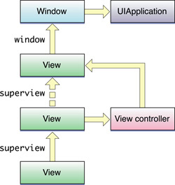
The responder chain in iPhone OS

Slide 29
Regulating Event Delivery
UIKit gives applications programmatic means to simplify event handling or to turn off the stream of events completely.
Turning off delivery of touch events.
By default, a view receives touch events, but you can set its userInteractionEnabled property to NO to turn off delivery of events.
A view also does not receive events if it’s hidden or if it’s transparent.
Turning off delivery of touch events for a period.
An application can call the UIApplication method beginIgnoringInteractionEvents and later call the endIgnoringInteractionEvents method.
Turning on delivery of multiple touches.
By default, a view ignores all but the first touch during a multi-touch sequence.
If you want the view to handle multiple touches you must enable this capability for the view.
You do this programmatically by setting the multipleTouchEnabled property of your view to YES, or in Interface Builder by setting the related attribute in the inspector for the related view.
Restricting event delivery to a single view.
By default, a view’s exclusiveTouch property is set to NO, does not block other views in a window from receiving touches.
If you set the property to YES, you mark the view so that, if it is tracking touches, it is the only view in the window that is tracking touches. Other views in the window cannot receive those touches.
A view that is marked “exclusive touch” does not receive touches that are associated with other views in the same window.
If a finger contacts an exclusive-touch view, then that touch is delivered only if that view is the only view tracking a finger in that window.
If a finger touches a non-exclusive view, then that touch is delivered only if there is not another finger tracking in an exclusive-touch view.
Restricting event delivery to subviews. A custom UIView class can override hitTest:withEvent: to restrict the delivery of multi-touch events to its subviews.

Slide 30
iPhone SDK
The SDK comes with all of the interfaces, tools, and resources needed to develop applications from an Intel-based Macintosh computer.
The system interfaces are delivered in special packages called frameworks.
A framework is a directory that contains a dynamic shared library and the resources (such as header files, images, helper applications, and so on) needed to support that library.
To use frameworks, you link them into your application project just as you would any other shared library.
Some other technologies are delivered in the form of standard shared libraries.
Key components of the SDK include the following:
Xcode Tools - provides the tools that support application development, including the following key applications:
Xcode - an integrated development environment that manages your application projects and lets you edit, compile, run, and debug your code.
Interface Builder - a tool to use to assemble the user interface visually. The interface objects you create are then saved to a special resource file format and loaded into your application at runtime.
Instruments - a runtime performance analysis and debugging tool. To gather information about application’s runtime behavior and identify potential problems.

Slide 31
iPhone SDK
iPhone Simulator - a Mac OS X application that simulates the iPhone technology stack, allowing to test iPhone applications locally on an Intel–based Macintosh computer.
iPhone Reference Library- the SDK includes the reference documentation for iPhone OS by default.
Debug an attached device.
Development on an actual device requires signing up for Apple’s paid iPhone Developer Program and configuring a device for development purposes.

Slide 32
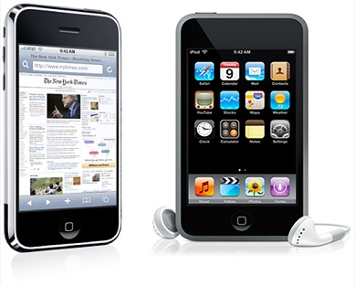
iPhone

Slide 33
Objective-C
defines a small but powerful set of extensions to the ANSI C programming language that enables sophisticated object-oriented programming.
Objective-C is the native language for Cocoa programming—
it’s the language that the frameworks are written in, and the language that most applications are written in.
You can also use some other languages—such as Python and Ruby—to develop programs using the Cocoa frameworks.
Objective-C rests on a foundation of ANSI C
You can freely intermix straight C code with Objective-C code.
The code can call functions defined in non-Cocoa programmatic interfaces, such as the BSD library interfaces in /usr/include.
You can mix C++ code with your Cocoa code and link them into the same executable.

Slide 34
Swift
Swift is Apple’s brand new programming language
Swift is an innovative programming language for Cocoa and Cocoa Touch
Swift is a successor to the C and Objective-C languages. It includes:
low-level primitives such as types,
flow control, and operators.
Provides object-oriented features such as classes, protocols, and generics.
A playground is a new type of file that allows you to test out Swift code, and see the results of each line in the sidebar.

Slide 35
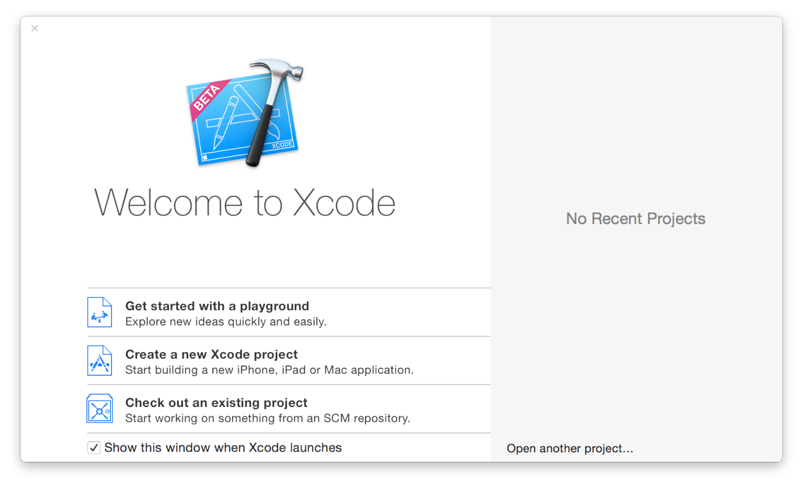

Slide 36
Creating an iPhone Project (Old SDK Versions)
SDK has templates for application types that you can choose from:
Navigation-Based Application
An application that presents data hierarchically, using multiple screens.
The Contacts application is an example of a navigation-based application.
OpenGL ES Application
An application that uses an OpenGL ES–based view to present images or animation.
Tab Bar Application
An application that presents a radio interface that lets the user choose from several screens.
The Clock application is an example of a tab bar application.
Utility Application
An application that implements a main view and lets the user access a flip-side view to perform simple customizations.
The Stocks application is an example of a utility application.
View-Based Application
An application that uses a single view to implement its user interface.
Window-Based Application
This template serves as a starting point for any application, containing an application delegate and a window.
Use this template when you want to implement your own view hierarchy.

Slide 37
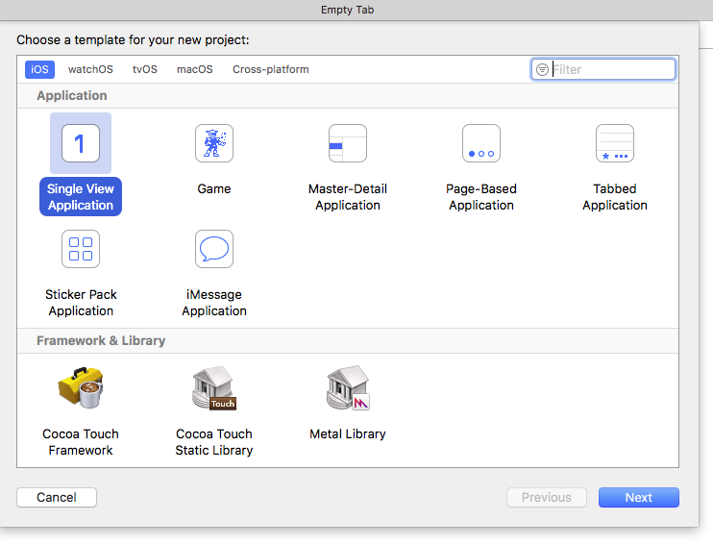
Creating an iPhone Project (New SDK Versions)

Slide 38
Master-Detail Application
Usually based around lists and tables, master-detail applications let users drill their way through a hierarchical interface.
offer a tree-structured collection of interface choices, each choice sliding to a new screen or presenting, in the case of the iPad, in a separate detail view.
The bars at the top of the navigation screens include an integrated Back button,letting users return to previous screens with a single tap .On the iPad,split views automatically accommodate themselves to match device orientations

Slide 39
OpenGLGame/Game
When programming with OpenGLES,all you need is a view to draw in to and a timer that offers an animation heartbeat.TheOpenGLGametem-
Page-Based Application
Create a book-style application by choosing this page view controller-based template.
Since iOS 5 ,the page view controller allows users to navigate through an electronic “book”using familiar touch-based gestures.
May not be in the latest iOS

Slide 40
Single View Application
This simple template provides a basic starting point for a primary view controller, offering storyboards for both iPhone and iPad distribution.Choose this style when you’re looking for an app that centers on a primary view rather than one that needs a specialized container style, such as a navigation controller, tab bar controller, split view controller, page view controller, and so on.
Tabbed Application
Apple’s iPod and YouTube applications offer typical examples of tab bar applications.
In these applications, users can choose from a series parallel screens by tapping buttons in a bar at the bottom of the application.

Slide 41
Utility Application
The simplest style of application,
The template creates a two-sided single-view presentation like the ones you see in the Stocks and Weather application.
May not be in the latest iOS
Empty Application
The window-based application essentially offers the same template as the Single View one but without the storyboards.
An application delegate and a customizable window, and that’s about it.
May not be in the latest iOS

Slide 42
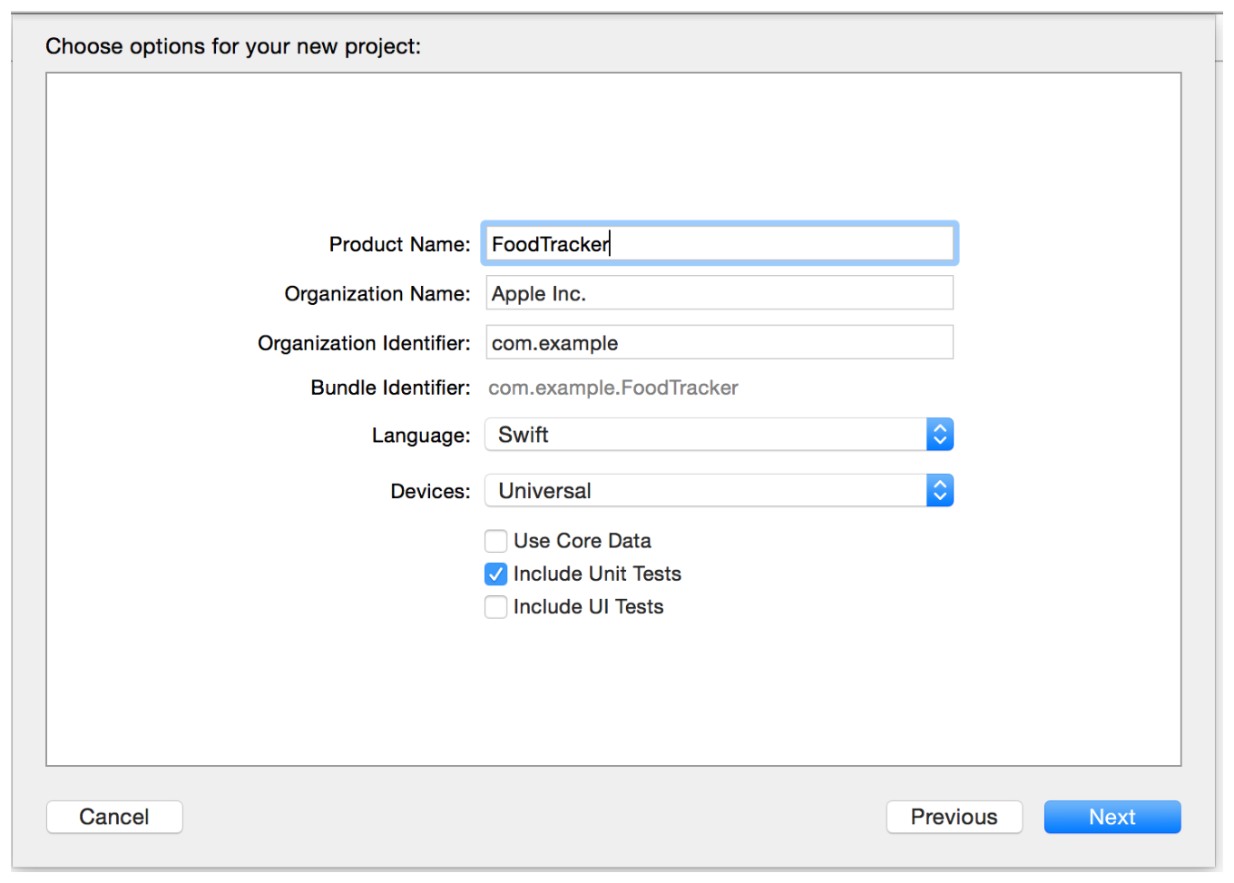

Slide 43
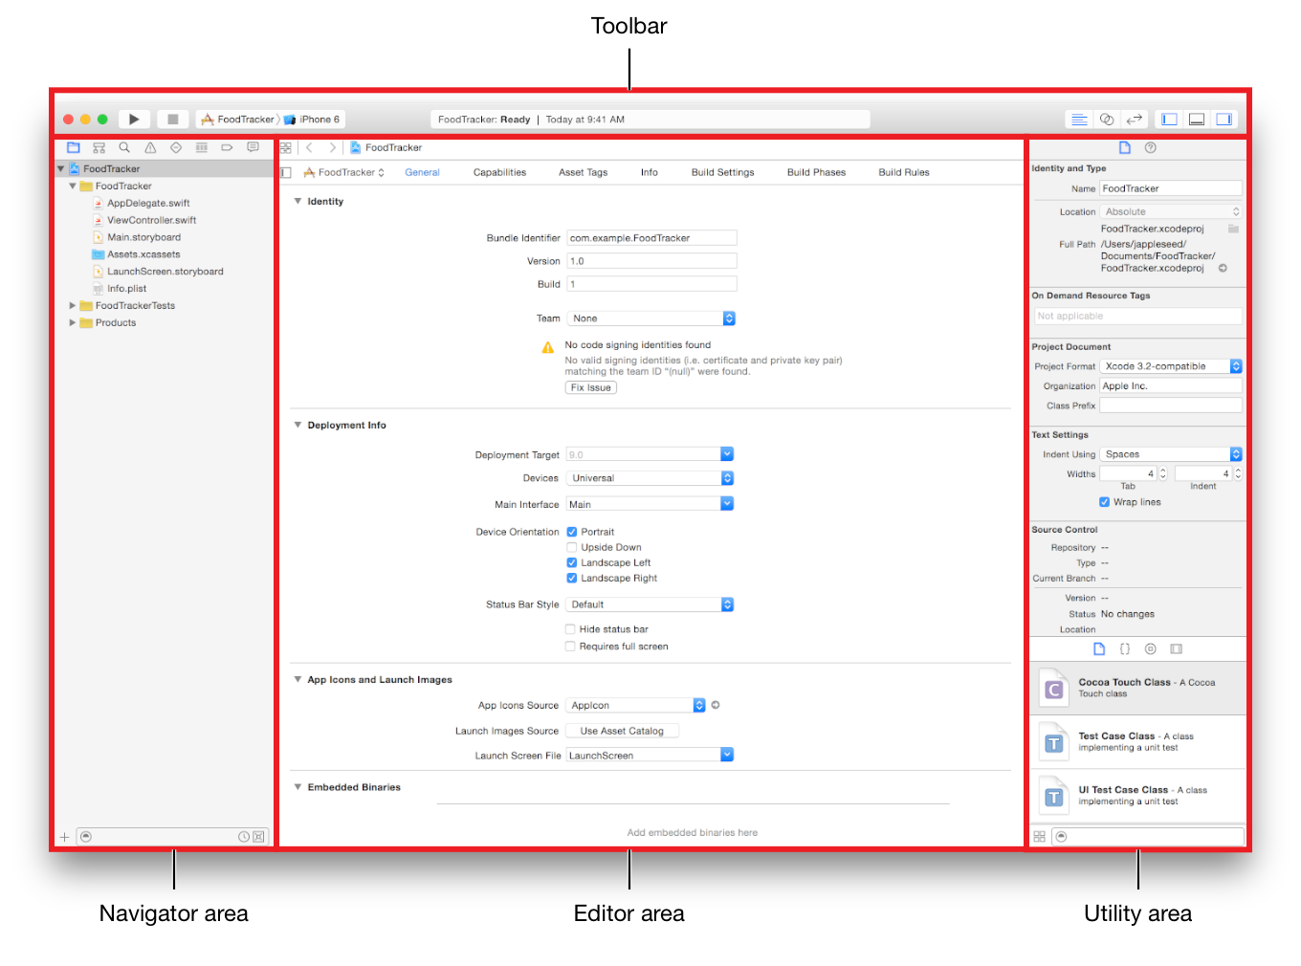

Slide 44
Design Patterns
main patterns that are commonly used in most applications:
Delegation
Model View Controller
Target-Action

Slide 45
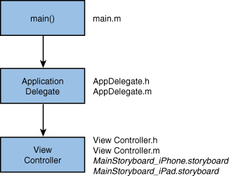
Main files in a Single View App Template

Slide 46
Delegation
Delegation is a pattern where one object periodically sends messages to another object specified as its delegate to ask for input or to notify the delegate that an event is occurring.
Use it as an alternative to class inheritance for extending the functionality of reusable objects.
In the HelloWorld example, the application object tells its delegate that the main start-up routines have finished and that the custom configuration can begin.
Want the delegate to create an instance of a controller to set up and manage the view.
For an input text field, it will tell its delegate (which is usually the same controller) when the user has tapped the Return key.
Delegate methods are typically grouped together into a protocol.
A protocol is basically just a list of methods.
If a class conforms to a protocol, it guarantees that it implements the required methods of a protocol. (Protocols may also include optional methods.)
The delegate protocol specifies all the messages an object might send to its delegate.

Slide 47
Model-View-Controller
The Model-View-Controller (or “MVC”) design pattern sets out three roles for objects in an application:
Model objects
represent data such as Circles and Squares in a drawing application.
In HelloWorld, the model is very simple—just a string—and it’s not actually used outside of a single method, so strictly speaking it’s not even necessary. It’s the principle that’s important here.
the model can be simple or more complicated and accessed from a variety of locations.
View objects
know how to display data (model objects) and may allow the user to edit the data.
May need a main view to contain several other views
For example: a text field to capture information from the user, a second text field to display text based on the user’s input, and a button to let the user tell us that the secondary text should be updated.
Controller objects
mediate between models and views.
For example: the controller object takes the data from the input text field, stores it in a string, and updates a second text field appropriately.
Where the update is initiated as a result of an action sent by the button.

Slide 48
Target-Action
The target-action mechanism enables a view object that presents a control— such as a button or slider—in response to a user event (such as a click or a tap) to send a message (the action) to another object (the target)
The target can interpret the message and handle it as an application-specific instruction.
For example, when a button is tapped, the button tells the controller to update its model and view based on the user’s input.

Slide 49
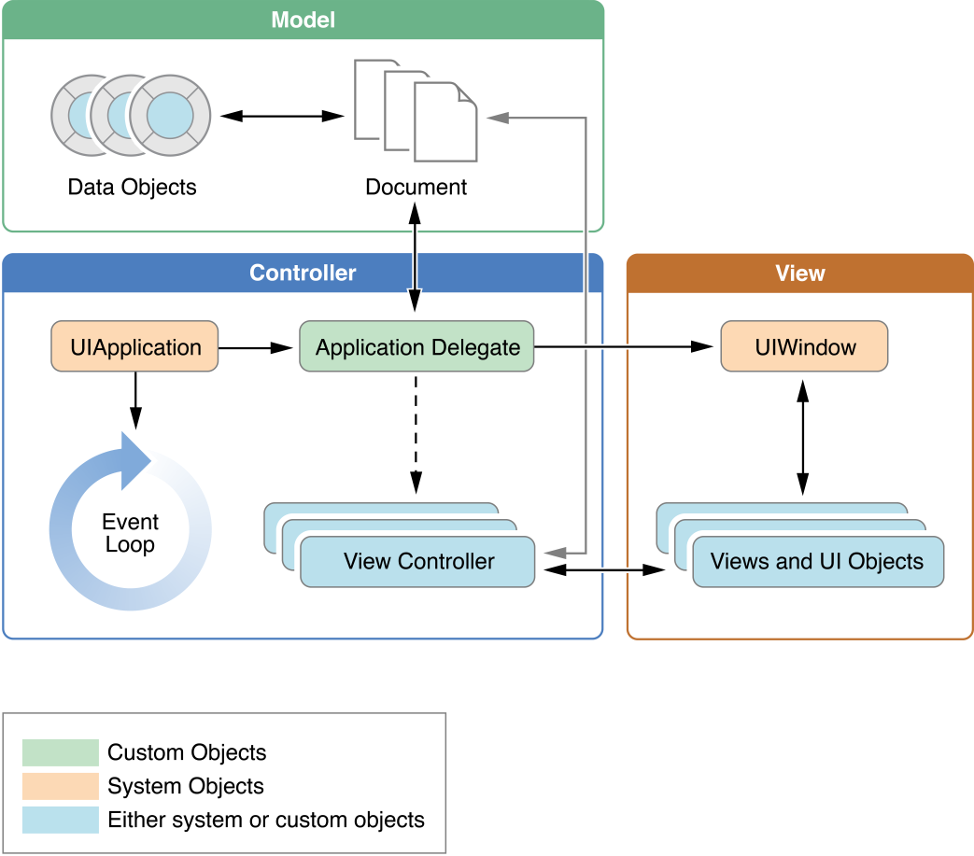
The Structure of an App
Key objects in an iOS app

Slide 50
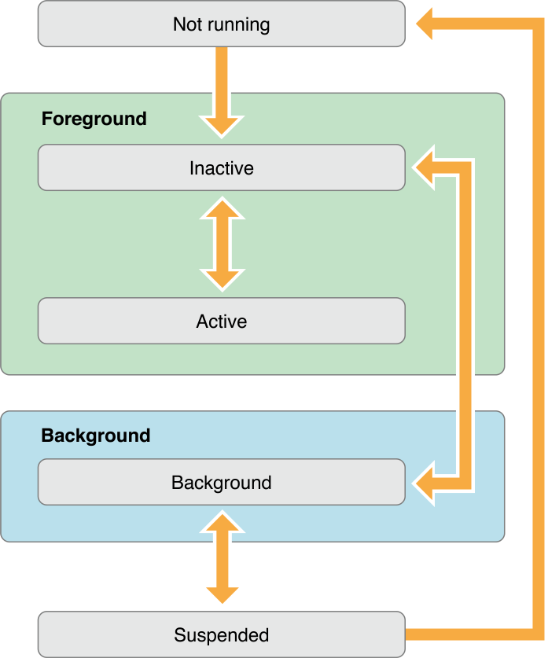
Execution States for Apps
State changes in an iOS app

Slide 51
The Application Sandbox
For security reasons, iPhone OS restricts an application (including its preferences and data) to a unique location in the file system.
This restriction is part of the security feature known as the application’s “sandbox.”
The sandbox is a set of fine-grained controls limiting an application’s access to:
files, preferences, network resources, hardware, and so on.
In iPhone OS, an application and its data reside in a secure location that no other application can access.
When an application is installed, the system computes a unique opaque identifier for the application.
Using a root application directory and this identifier, the system constructs a path to the application’s home directory.
An application’s home directory could be depicted as having the following structure:
/ApplicationRoot/ApplicationID/
During the installation process, the system creates the application’s home directory and several key subdirectories, configures the application sandbox, and copies the application bundle to the home directory.
The use of a unique location for each application and its data simplifies backup-and-restore operations, application updates, and un-installation.

Slide 52
The Virtual Memory System
iPhone OS uses essentially the same virtual memory system found in Mac OS X to manage program memory.
Each program has its own virtual address space,
but (unlike Mac OS X) its usable virtual memory is constrained by the amount of physical memory available.
The iPhone OS does not write volatile pages to disk when memory gets full.
In this case, the virtual memory system frees up volatile memory, as needed, to make sure the running application has the space it needs.
It does this by removing memory pages that are not being used and that contain read-only contents, such as code pages.
If memory continues to be constrained, the system may also send notifications to the running applications, asking them to free up additional memory.
All applications should respond to this notification and do their part to help relieve the memory pressure.

Slide 53
The Application Bundle
When building an application, Xcode packages it as a bundle.
A bundle is a directory in the file system that groups related resources together in one place.
An iPhone application bundle contains:
The application executable
Any resources used by the application :
Icon.png: the application icon (57x57 pixels)
Default.png: the 480 x 320 pixel image to display when an application is launched
Icon-Settings.png: the 29 x 29 pixel icon used to represent your application in the Settings application
localized reources: en.lproj, fr.lproj, es.lproj
Settings.bundle: contains property lists and other resource files to configure and display your preferences
Info.plist : property list defining key values for the application, such as bundle ID, version number, and display name.
MainWindow.nib

Slide 54
Loading Resources
To load view controllers (and their corresponding views) from a storyboard, use the UIStoryboard class.
To load an image, use the methods of the UIImage class.
To load string resources, use the NSLocalizedString and related macros defined in Foundation framework.
To load the contents of a property list, use the dictionaryWithContentsOfURL: method of NSDictionary, or use the NSPropertyListSerialization class.
To load binary data files, use the methods of the NSData
To load audio and video resources, use the classes of the Assets Library, Media Player, or AV Foundation frameworks.

Slide 55
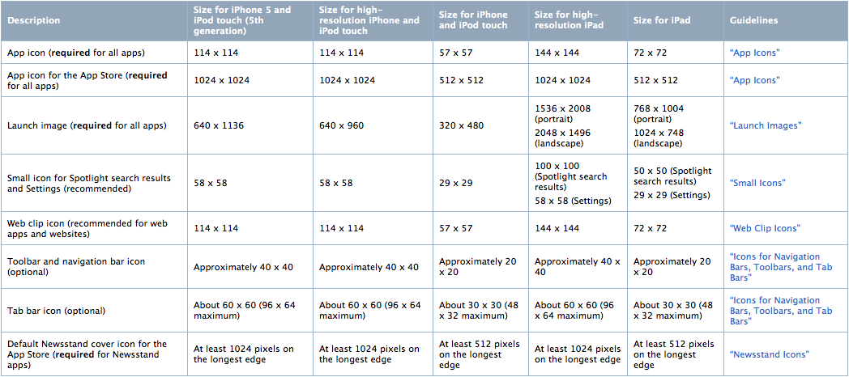

Slide 56
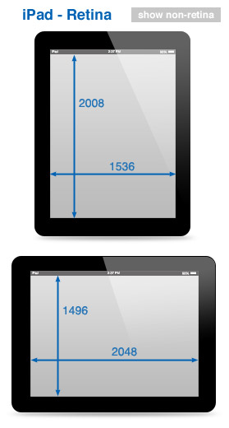
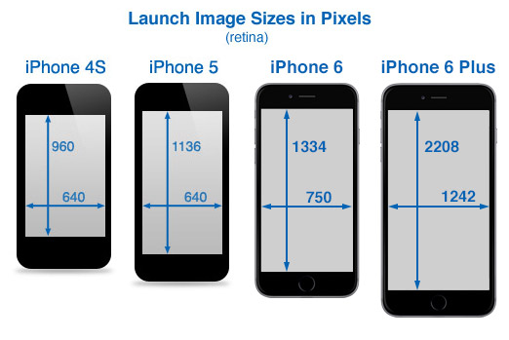

Slide 57
Launch image orientation modifiers
Modifier | Description
- PortraitUpsideDown | Specifies an upside-down portrait version of the launch image. A file with this modifier takes precedence over a file with the -Portrait modifier for this specific orientation.
- LandscapeLeft | Specifies a left-oriented landscape version of the launch image. A file with this modifier takes precedence over a file with the -Landscape modifier for this specific orientation.
- LandscapeRight | Specifies a right-oriented landscape version of the launch image. A file with this modifier takes precedence over a file with the -Landscape modifier for this specific orientation.
- Portrait | Specifies the generic portrait version of the launch image. This image is used for right-side up portrait orientations and takes precedence over the Default.png image file (or your custom-named replacement for that file). If a file with the -PortraitUpsideDown modifier is not specified, this file is also used for upside-down portrait orientations as well.
- Landscape | Specifies the generic landscape version of the launch image. If a file with the -LandscapeLeft or -LandscapeRight modifier is not specified, this image is used instead. This image takes precedence over the Default.png image file (or your custom-named replacement for that file).
(none) | If you provide a launch image file with no orientation modifier, that file is used when no other orientation-specific launch image is available. For apps running on systems earlier than iOS 3.2, you must name this file Default.png.

Slide 58
UIApplicationDelegate Protocol
Controlling Application Behavior
– applicationDidFinishLaunching:
– application:didFinishLaunchingWithOptions:
– applicationWillTerminate:
– applicationDidReceiveMemoryWarning:
– applicationSignificantTimeChange:
Opening a URL Resource
– application:handleOpenURL:
Managing Status Bar Orientation
– application:willChangeStatusBarOrientation:duration:
– application:didChangeStatusBarOrientation:
Responding to a Change in Active Status
– applicationWillResignActive:
– applicationDidBecomeActive:
Controlling Application Appearance
– application:willChangeStatusBarFrame:
– application:didChangeStatusBarFrame:
Handling Remote Notifications
– application:didReceiveRemoteNotification:
– application:didRegisterForRemoteNotificationsWithDeviceToken:
– application:didFailToRegisterForRemoteNotificationsWithError:

Slide 59
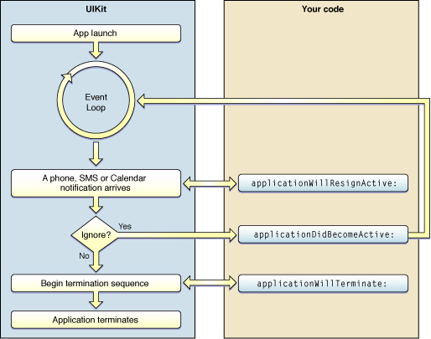
The flow of events during an interruption

Slide 60
Low-Memory Warnings
iPhone OS notifies the front most application whenever the amount of free memory dips below a safe threshold.
If the application receives this warning, it must free up as much memory as it can by releasing objects it does not need or clearing out memory caches that it can easily recreate later.
UIKit provides several ways to receive low-memory warnings, including the following:
Implement the applicationDidReceiveMemoryWarning: method of the application delegate.
Override the didReceiveMemoryWarning method in your custom UIViewController subclass.
Register to receive the UIApplicationDidReceiveMemoryWarningNotification notification.
Upon receiving any of these warnings, the handler method should respond by immediately freeing up any unneeded memory.
View controllers should purge any views that are currently offscreen, and the application delegate should release any data structures it can or notify other application objects to release memory they own.
If the custom objects have known purgeable resources, they may register for the UIApplicationDidReceiveMemoryWarningNotification and release their purgeable resources directly.

Slide 61
Communicating with Other Applications
Use URL scheme to communicate with another application.
In most cases URLs are used simply to launch another application and have it display some information that is relevant to your own application.
For example, if the application manages address information, it can send a URL containing a given address to the Maps application to show that location.
Apple provides built-in support for the http, mailto, tel, and sms URL schemes. It also supports http–based URLs targeted at the Maps, YouTube, and iPod applications.
Applications can register their own custom URL schemes as well.
To communicate with an application,
create an NSURL object with some properly formatted content
pass it to the openURL: method of the shared UIApplication object.
The openURL: method launches the application that has registered to receive URLs of that type and passes it the URL.
When the user subsequently quits that application, the system often relaunches your application but may not always do so.
The decision to relaunch an application is made based on the user’s actions in the handler application and whether returning to your application would make sense from the user’s perspective.
Example:
NSURL *myURL = [NSURL URLWithString:@"todolist://www.acme.com?Quarterly%20Report#200806231300"];
[[UIApplication sharedApplication] openURL:myURL];

Slide 62
Description | iPhone / iPod | iPhone / iPod Retina | iPad Dimensions
Screen Dimensions | 320 x 480 | 640 x 960 | 768 x 1024 1024 x 768
Screen Dimensions - Status bar | 320 x 460 | 640 x 920 | 768 x 1004 1024 x 748
Status Bar | 320 x 20 | 640 x 40 | 768 x 20 1024 x 20
Application icon | 57 x 57 | 114 x 114 | 72 x 72
App Store icon | 512 x 512 | 512 x 512 | 512 x 512
Small icon for Spotlight search results and Settings | 29 x 29 | 58 x 58 | 50 x 50 for Spotlight search results 29 x 29 for Settings
Document icon (recommended for custom document types) | 22 x 29 | 44 x 58 | 64 x 64 & 320 x 320
Web clip icon (recommended for web applications and websites) | 57 x 57 | 114 x 114 | 72 x 72
Toolbar and navigation bar icon (optional) | ~ 20 x 20 | ~ 40 x 40 | ~ 20 x 20
Tab bar icon (optional) | ~ 30 x 30 | ~ 60 x 60 | ~ 30 x 30
Launch image | 320 x 480 | 640 x 960 | 768 x 1004 1024 x 748
UINavigation Bar | 320 x 44 | 640 x 88 | 768 x 44 1024 x 44

