Slide 1
View Controllers
iPhone

Slide 2
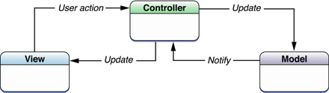
Model-View-Controller (MVC) paradigm
Many Cocoa technologies and architectures are based on MVC and require that the application custom objects play one of the MVC roles.

Slide 3
View Controllers
A type of controller object to present and manage a set of views.
The main job of a view controller is to load and unload its view as needed.
View controller objects are descendants of the UIViewController class, which is defined in the UIKit framework.
3 types of view controllers:
  Custom view controller (Content view controller) : responsible for managing all of the views in a single view hierarchy
  Container view controller: controller of controllers
  Modal view controller

Slide 4
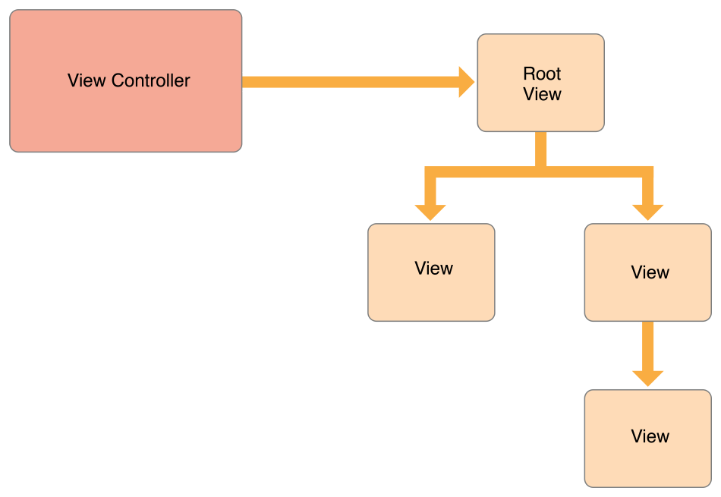
(View Management)

Slide 5
View Controllers
The job of each view controller object is two-fold:
responsible for coordinating interactions between the application’s visual presentation (the custom views) and the application’s data model (the custom objects).
responsible for handling changes to the views that comprise its view layer.
  When the user rotates a device from a portrait to a landscape orientation, the view controller is responsible for reorienting the views accordingly.
A view controller is the sole owner of its view and any associated subviews.
It is responsible for creating those views and for releasing them at the appropriate times, including during low-memory conditions and when the view controller itself is released.
View controllers are responsible for the presentation of their views and for adapting that presentation to match the underlying environment.

Slide 6
View Controllers
instances of the UIViewController class
Manage the structure of the user interface and the presentation of views within that interface.
Applications have a limited amount of space in which to display content. Rather than display new windows, an application uses view controllers to swap out the views in the current window.
The type of the view controller and the way that view controller is presented determine the type of animation that is used to display the new views.
Each view controller object can be thought of as a self-contained unit.
  handles the creation and destruction of its own views,
  resizes and lays out its views
  handles their presentation on the screen, adjusts the contents
  coordinates interactions between the views and other objects in your application.
The view controller may manage all of the views on its own or use helper objects to manage subsets of views.
The view controller is always in charge of presenting the overall view hierarchy and is ultimately responsible for the views.

Slide 7
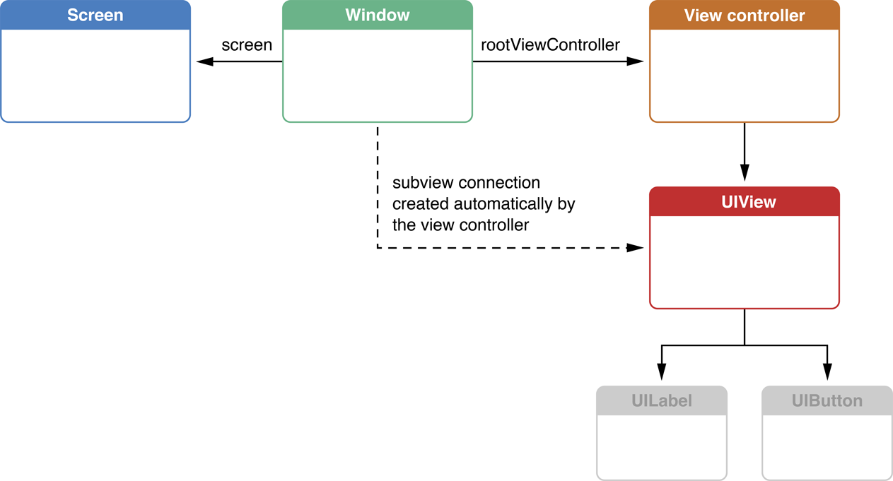
A view controller attached to a window automatically adds its view as a subview of the window

Slide 8
User Interactions
View controllers are descendants of the UIResponder class and are inserted into the responder chain between the managed root view and its superview, which typically belongs to a different view controller.
If the view controller’s view does not handle an event, the view controller has the option of handling the event or it can pass the event to the superview.

Slide 9
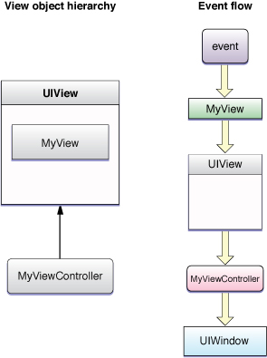
Handling Events
If the view does not handle an event, it is passed along to the parent view. Because the generic view does not handle events, it passes those events along to its view controller first.

Slide 10
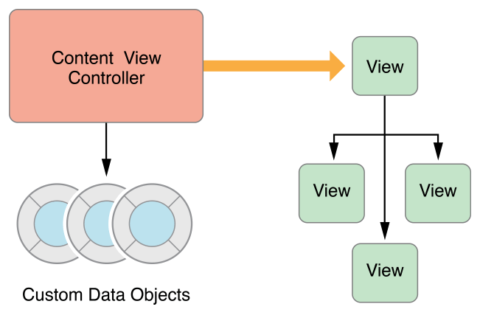
(Data Marshaling)
A view controller mediates between data objects and views

Slide 11
var view: UIView! { get set }
represents the root view for the view controller’s view hierarchy. The default is nil.
init(nibName nibNameOrNil: String?, bundle nibBundleOrNil: Bundle?)
nibNameOrNil: name of the nib file without the extension. If nil, the nibName property is set to nil.
nibBundleOrNil: The bundle in which to search for the nib file.
If no .xib is found, UIViewController will call - (void)loadView on itself.
loadView’s implementation MUST set the view property in the UIViewController.
viewDidLoad is called when UIViewController is initialized. ( but bounds is not set yet)

Slide 12
func viewWillAppear(_ animated: Bool)
  Just before the view appears on screen
  When this is called, the bounds has been set.
A view is usually loaded once, but it might appear and disappear many times.
func viewWillDisappear(_ animated: Bool)
  When the view disappears from the screen
Also:
func viewDidAppear(_ animated: Bool)
func viewDidDisappear(_ animated: Bool)
func viewDidLoad()
  Called after the controller’s view is loaded into memory.
Also:
  var isViewLoaded: Bool
  var viewIfLoaded: UIView? { get }

Slide 13
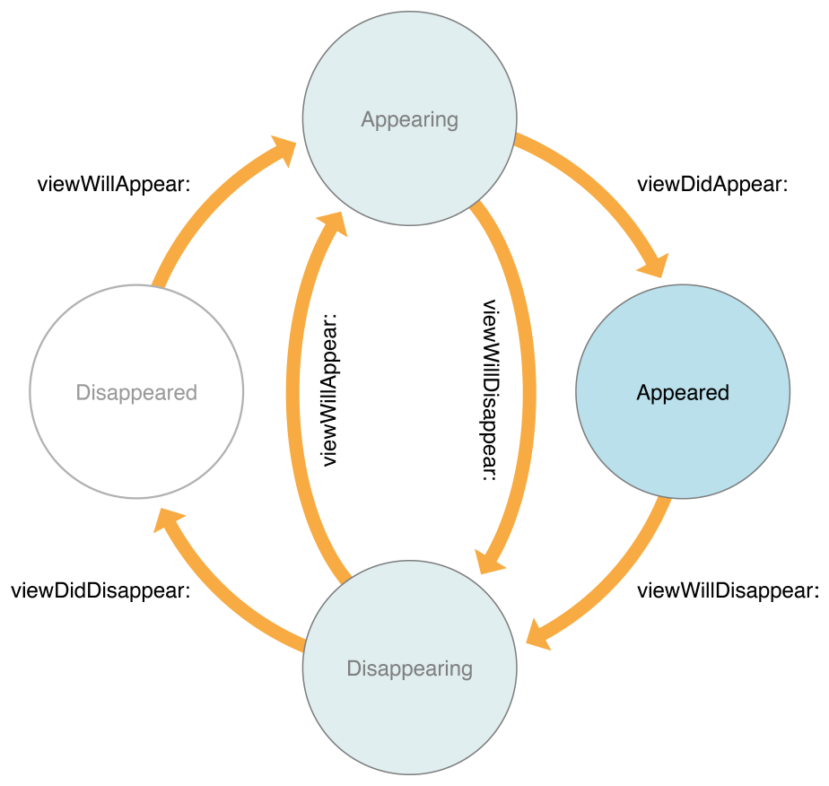
The View Controller Lifecycle

Slide 14
Assign a view
Manually
  implement the loadView method and use it to assign a root view object to the view property.
Using a nib file
  Initialize the view controller object using the init(nibName:bundle:) method.
Using storyboard
  func instantiateViewController(withIdentifier identifier: String) -> UIViewController
  on a UIStoryboardobject

Slide 15
Reacting to device rotation
As of iOS 8, all rotation-related methods are deprecated.
viewWillTransition(to:with:)
  Notifies the container that the size of its view is about to change.
  When the interface orientation changes, UIKit calls this method on the window’s root view controller.
Rotation notifications: (called when there is a rotation)
willRotate(to:duration:),
willAnimateRotation(to:duration:), and
didRotate(from:)
override the preferredInterfaceOrientationForPresentation
The viewWillLayoutSubviews method is also called after the view is resized and positioned by its parent.
When a view controller is displayed on screen, its root view is typically resized to fit the available space.
  configure the autoresizing properties using the autoresizesSubviews and autoresizingMask properties of each view.

Slide 16
In iOS6+
shouldAutorotateToInterfaceOrientation: deprecated.
By default, an app and a view controller’s supported interface orientations are set to:
  iPad : UIInterfaceOrientationMask.all
  iPhone:UIInterfaceOrientationMaskAllButUpsideDown
- (BOOL)shouldAutorotate;
var supportedInterfaceOrientations: UIInterfaceOrientationMask
  A bit mask specifying which orientations are supported.
  See “UIInterfaceOrientationMask” for valid bit-mask values.
  The value returned by this method must not be 0.
var preferredInterfaceOrientationForPresentation: UIInterfaceOrientation;
  Returns the interface orientation to use when presenting the view controller.

Slide 17
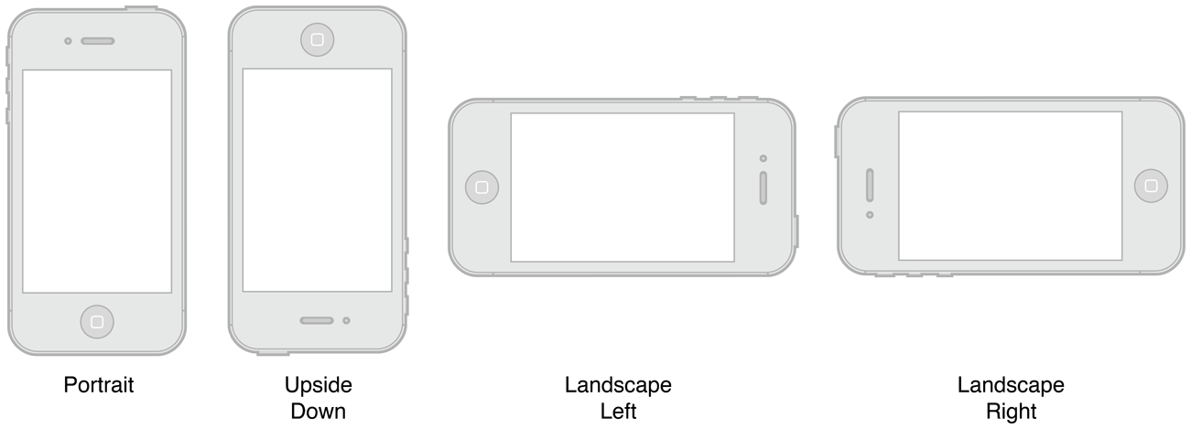
You should always choose the orientations your view supports at design time
However you can always override the supportedInterfaceOrientations method:
(NSUInteger) supportedInterfaceOrientations {
return UIInterfaceOrientationMaskPortrait | IInterfaceOrientationMaskLandscapeLeft;
}
Or temporarily disable automatic rotation, by overriding the shouldAutorotate method on the topmost view controller.
If the layout code needs to know the current orientation of the device, it can read the app object’s statusBarOrientation property to determine the current orientation or register for the rotation events on the UIDevice class.

Slide 18
As of iOS 8, all rotation-related methods are deprecated. Instead, rotations are treated as a change in the size of the view controller’s view and are therefore reported using the:
viewWillTransitionToSize:withTransitionCoordinator: method.
You can override the preferredInterfaceOrientationForPresentation for a view controller that is intended to be presented full screen in a specific orientation.
When a rotation occurs for a visible view controller, the
willRotateToInterfaceOrientation:duration:, willAnimateRotationToInterfaceOrientation:duration:, and didRotateFromInterfaceOrientation: methods
are called during the rotation. The viewWillLayoutSubviews method is also called after the view is resized and positioned by its parent.

Slide 19
For Container View Controllers
Here are the essential methods you might need to call:
addChildViewController:
- removeFromParentViewController
- willMoveToParentViewController:
didMoveToParentViewController:
var childViewControllers: [UIViewController]
  An array of view controllers that are children of the current view controller
These methods are not intended to be called by clients of the container class.

Slide 20
Configuring the Initial View Controller at Launch
When using main nib window or storyboard, iOS automatically does a lot of work
to set up the app. When the app calls the UIApplicationMain function,
iOS performs the following actions:
It instantiates the app delegate based on the class name you passed into the
UIApplicationMain function.
It creates a new window attached to the main screen.
If the app delegate implements a window property, iOS sets this property to the new window.
It loads the main storyboard referenced in the app’s information property list file.
It instantiates the main storyboard’s initial view controller.
It sets the window’s rootViewController property to the new view controller
It calls the app delegate’s application:didFinishLaunchingWithOptions: method.
Your app delegate is expected to configure the initial view controller
(and its children, if it is a container view controller).
It calls the window’s makeKeyAndVisible method to display the window.

Slide 21
Edit Mode in a View Controller
The same view controller can be used both to display and to edit content.
When the editing mode is toggled, the custom view controller performs the necessary work to transition its view from a display mode to an editing mode (or vice versa).
Need to override the setEditing:animated: method, for custom view controllers
The point of using the setEditing:animated: method is so that you can make small changes to existing views not to swap the entire view
To toggle between modes modify the value of the view controller’s editing property
Or by adding editButtonItem to the navigation bar ( in a navigation model)

Slide 22
Memory Management
(Resource Management)
The UIViewController class provides some automatic handling of low-memory conditions through its didReceiveMemoryWarning method, which releases unneeded memory.
Prior to iOS 6, when a low-memory warning occurred, the UIViewController class purged its views if it knew it could reload or recreate them again later.
If this happens, it also calls the viewWillUnload and viewDidUnload methods to give the code a chance to clean up ( relinquish ownership of any objects that are associated with the view hierarchy, including objects loaded from the nib file, objects created in the viewDidLoad method, and objects created lazily at runtime and added to the view hierarchy.
On iOS 6+, views are never purged and these methods are never called. If the view controller needs to perform specific tasks when memory is low, it should override the didReceiveMemoryWarning method.

Slide 23
Presenting a View Controller’s View
There are several options for displaying the view associated with a view controller:
Display the view directly by adding it to a window using the addSubview: method.
Display the view indirectly using one of the following techniques:
  Present the owning view controller modally using the present(_:animated:completion: ) method.
  Push the owning view controller onto the navigation stack of a navigation controller object.
    pushViewController(_:animated:)
  Make the owning view controller the root view controller of a tab in a tab bar interface.
  On iPad, present the view controller using a popover.

Slide 24
rootViewController property of UIWindow
  The root view controller for the window.
  var rootViewController: UIViewController? { get set }
Provides the content view of the window.
Assigning a view controller to this property (either programmatically or using Interface Builder) installs the view controller’s view as the content view of the window.
If the window has an existing view hierarchy, the old views are removed before the new ones are installed.
The default value of this property is nil.

Slide 25
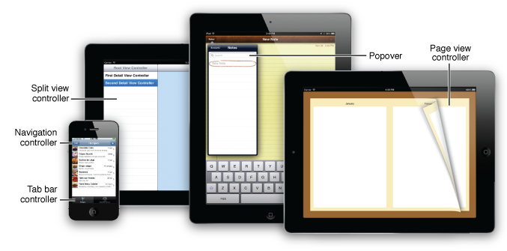

Slide 26
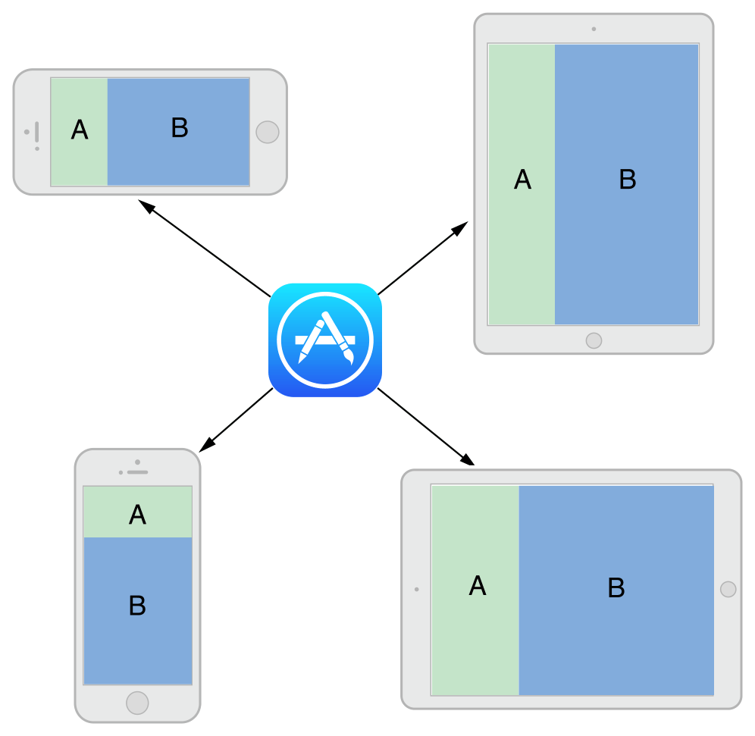
An adaptive interface is one that makes the best use of the available space.
Being adaptive means being able to adjust your content so that it fits well on any iOS device.
Auto Layout: define rules (known as constraints) that govern the layout of the view controller’s views.
Traits describe the environment in which the view controllers and views must operate. Traits make high-level decisions about the interface.
The Adaptive Model
(Adaptivity)

Slide 27
Content View Controller
Presents content on the screen using a view or a group of views organized into a view hierarchy.
A content view controller usually knows about the subset of the app’s data that is relevant to the role the controller plays in the app.
Here are common examples where to use content view controllers:
  To show data to the user
  To collect data from the user
  To perform a specific task
  To navigate between a set of available commands or options, such as on the launch screen for a game
Content view controllers are the primary coordinating objects for your app because they know the specific details of the data and tasks your app offers the user.
Each content view controller object created is responsible for managing all the views in a single view hierarchy.
The one-to-one correspondence between a view controller and the views in its view hierarchy is the key design consideration.
You should not use multiple content view controllers to manage the same view hierarchy.
Also, you should not use a single content view controller object to manage multiple screens’ worth of content.

Slide 28
Modal View Controllers
Any view controller can be presented modally by an application
To present a view controller modally, do the following:
  Create the view controller to present.
  Set the var rootViewController: UIViewController? { get set } property of the view controller to the desired value.
    .fullscreen , .PageSheet, .formSheet, .currentContext, .custom, .overFullScreen, .blurOverFullScreen
  Assign a delegate object where appropriate. (The delegate is used primarily by system view controllers to notify the code when the view controller is ready to be dismissed. )
  Call the present(_:animated:completion: ) method of the current view controller, passing in the view controller to present modally.
  Call dismiss(animated:completion:) Dismisses the modal view controller that was presented by the receiver.

Slide 29
In iOS 5.x,modal presentations can use four transition styles:
  Slide—This transition style slides a new view over the old.
  Fade—This transition style dissolves the new view into visibility.
  Flip—This transition style turns a view over to the “back” of the presentation.
  Curl—This transition style makes the primary view curl up out of the way to reveal the new view beneath it.
iPad offers three more presentation styles:
  Full Screen—A full-screen presentation is the default on the iPhone, where the new modal view completely covers both the screen and any existing content. This is the only presentation style that is legal for curls—any other presentation style raises a runtime exception, crashing the application.
  Page Sheet—In the page sheet, coverage defaults to a portrait aspect ratio, so the modal view controller completely covers the screen in portrait mode and partially covers the screen in landscape mode, as if a portrait-aligned piece of paper were added to the display.
  Form Sheet—The form sheet display covers a small center portion of the screen, allowing you to shift focus to the modal element while retaining the maximum visibility of the primary application view.

Slide 30
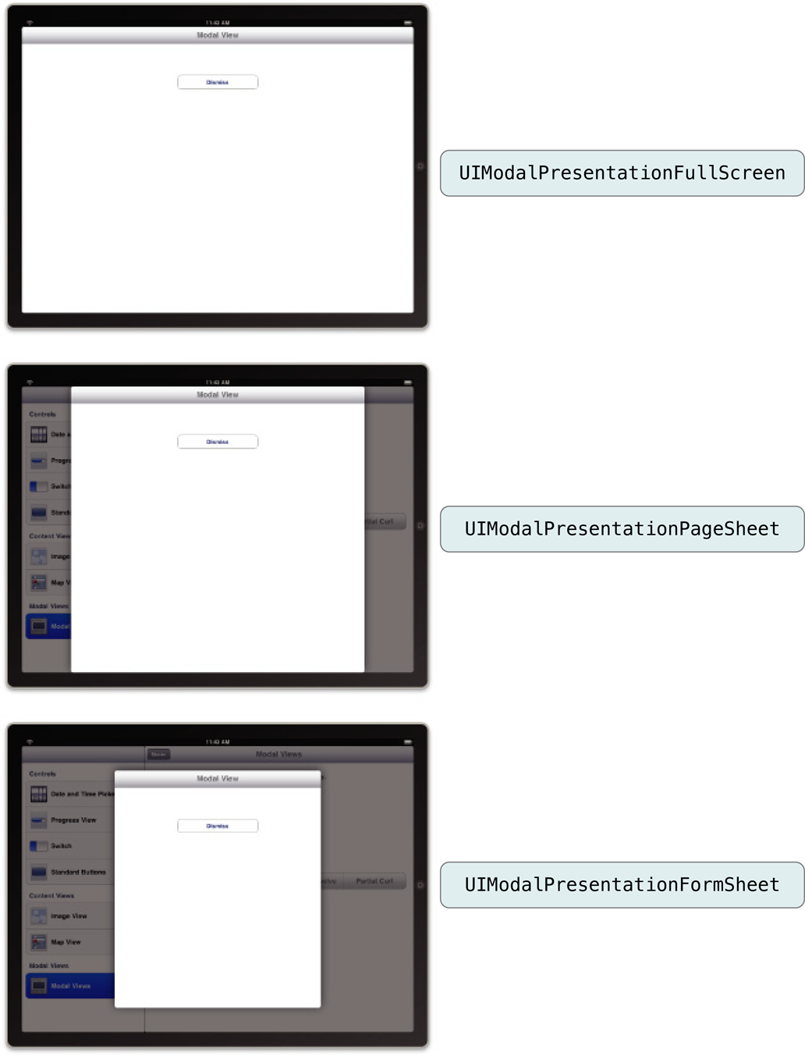

Slide 31
case fullScreen
A presentation style in which the presented view covers the screen.
case pageSheet
A presentation style that partially covers the underlying content.
case formSheet
A presentation style that displays the content centered in the screen.
case currentContext
A presentation style where the content is displayed over another view controller’s content.
case custom
A custom view presentation style that is managed by a custom presentation controller and one or more custom animator objects.
case overFullScreen
A view presentation style in which the presented view covers the screen.
case overCurrentContext
A presentation style where the content is displayed over another view controller’s content.
case blurOverFullScreen
A presentation style that blurs the underlying content before displaying new content in a full-screen presentation.
case popover
A presentation style where the content is displayed in a popover view.
case none
A presentation style that indicates no adaptations should be made.

Slide 32
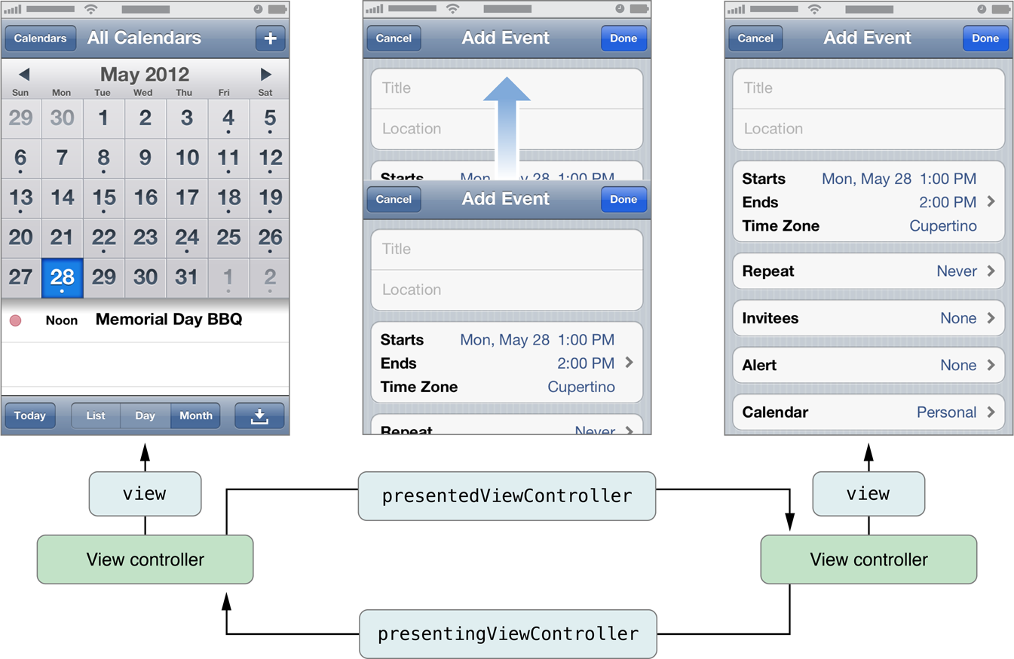
How View Controllers Present Other View Controllers (iOS 5.0 and later)

Slide 33
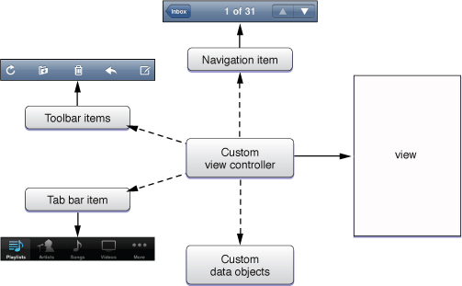
Anatomy of a View Controller

Slide 34
The Load Cycle
When the view is referenced for the first time in the controller’s view property.
If the view is not currently in memory, the view controller calls its loadView method.
The loadView method does one of the following:
  If you override this method, your implementation is responsible for creating all necessary views and assigning a non-nil value to the view property.
  If you do not override this method, the default implementation uses the nibName and nibBundle properties of the view controller to try to load the view from the specified nib file.
  If the specified nib file is not found, it looks for a nib file whose name matches the name of the view controller class and loads that file.
  If no nib file is available, the method creates an empty UIView object and assigns it to the view property.
The view controller calls its viewDidLoad method to perform any additional load-time tasks.

Slide 35

Valid State Transitions

Slide 36
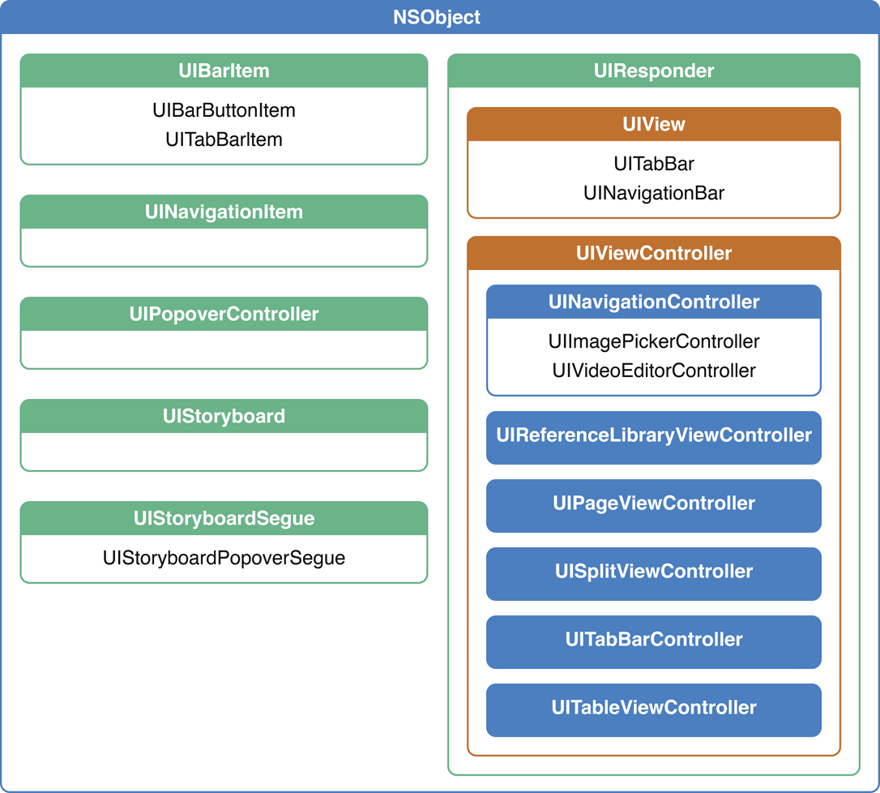
A Taxonomy of View Controllers

Slide 37
For content view controllers, the most common parent classes are as follows:
Use UITableViewController specifically when the view controller’s main view is a table.
Use UICollectionViewController specifically when the view controller’s main view is a collection view.
Use UIViewController for all other view controllers.

