Slide 1
Chat Application
Sheetal Singh

Slide 2
Features
Login
Register
Facebook Login
Add Profile Image during register
Recent chats
List of available users
Custom message data(Pictures, Location and Text)
Timestamp
Logout

Slide 3
Technologies used
Xcode
Firebase – Mobile Backend for APIs, provides authentication and also as hosting platform
Cocoapods – Dependency manager for swift
Backendless – Mobile Backend and API Services Platform

Slide 4
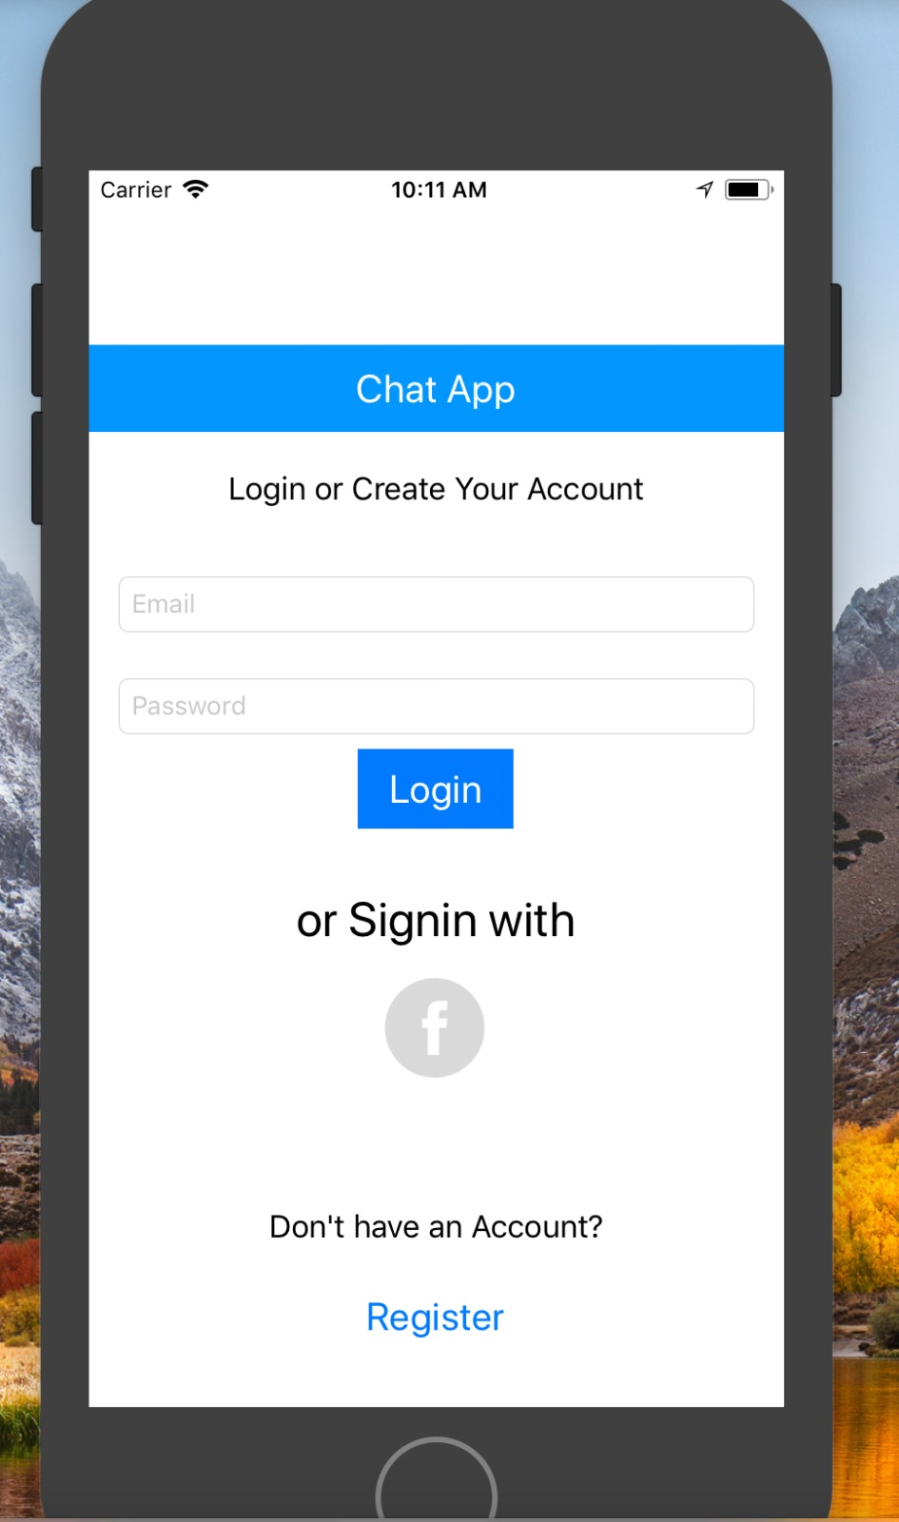
Login screen
Notes:
Login is done using facebook and also through custom username and password

Slide 5
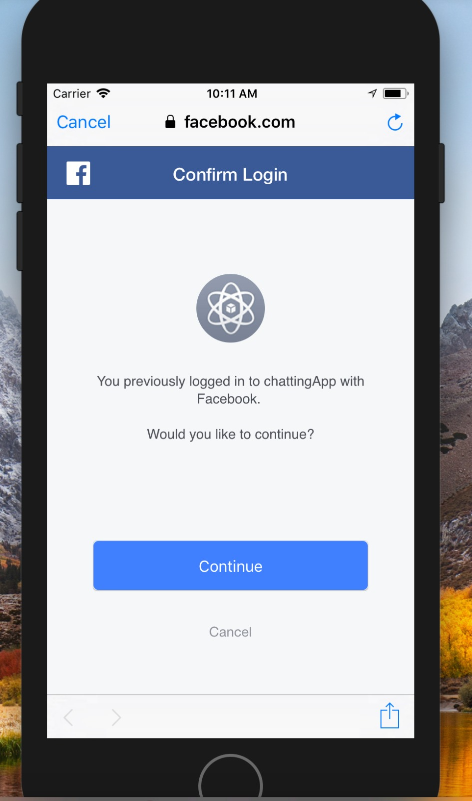
FACEbook login

Slide 6
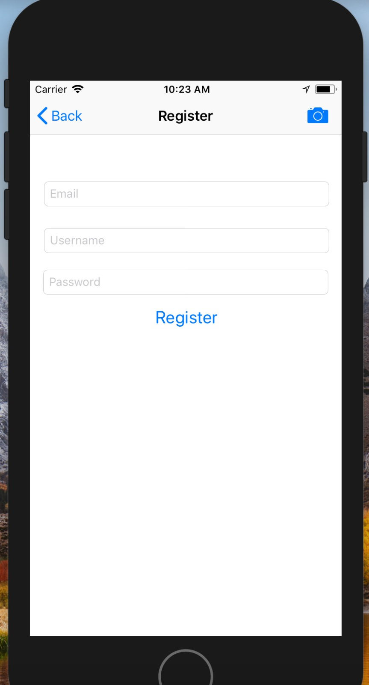
REGISTER SCREEN
Add profile picture

Slide 7
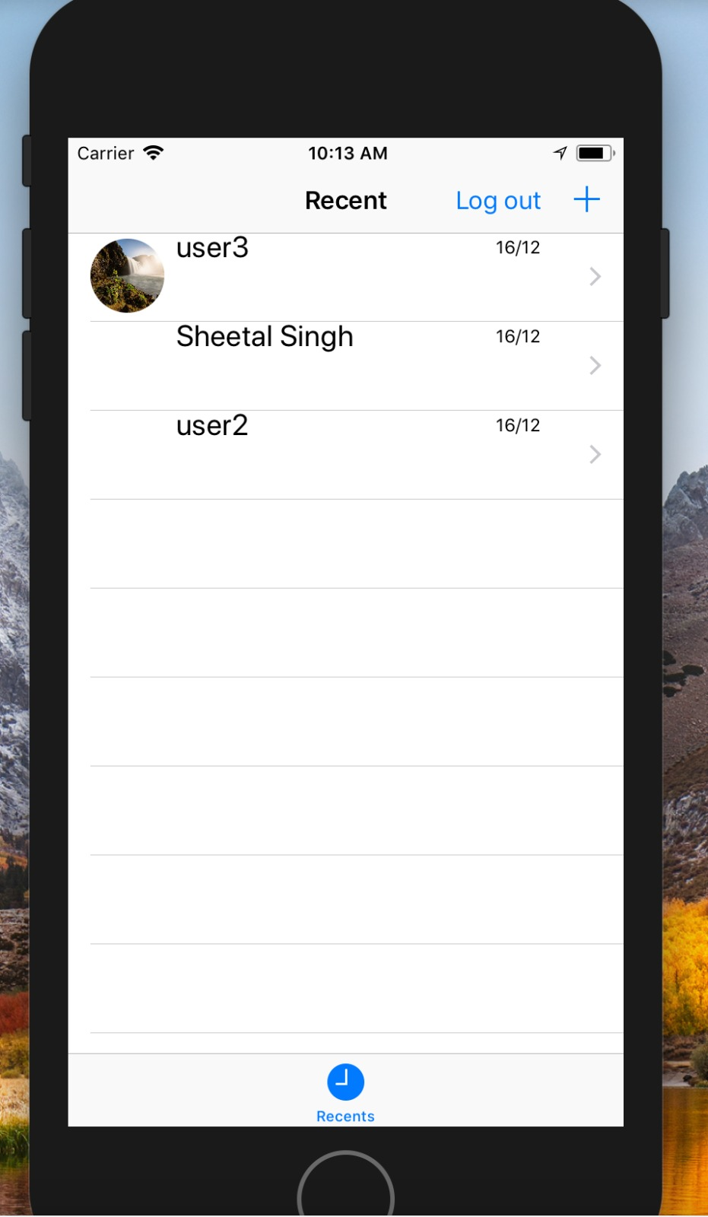
Recent chats

Slide 8
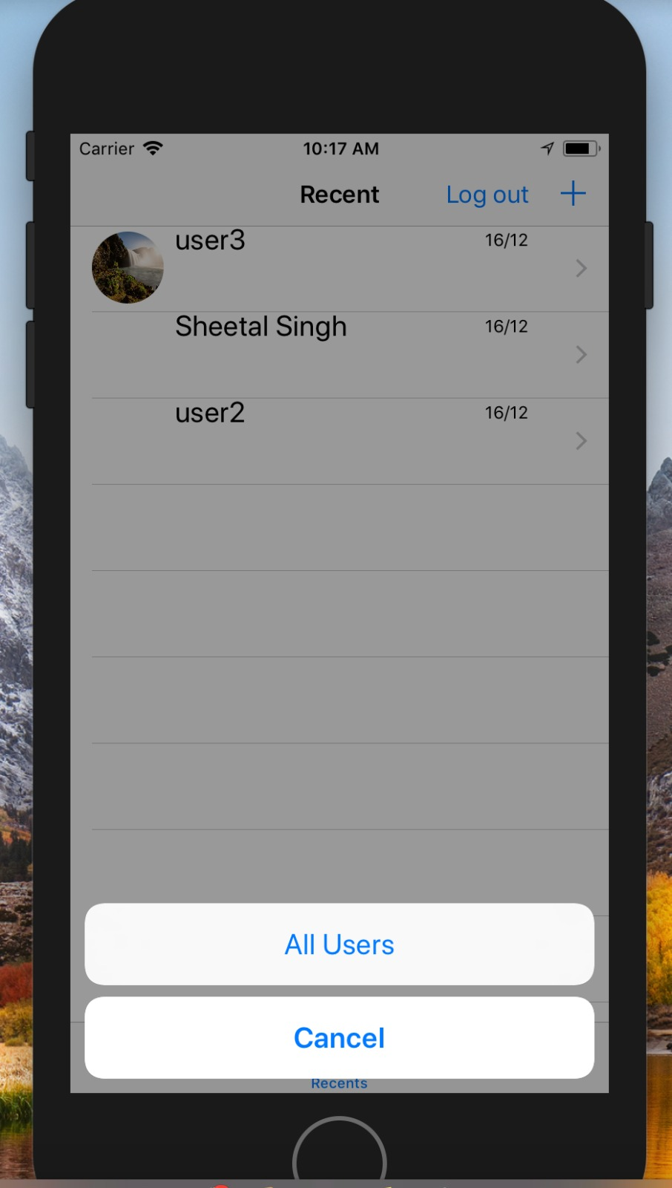
Add users to chat

Slide 9
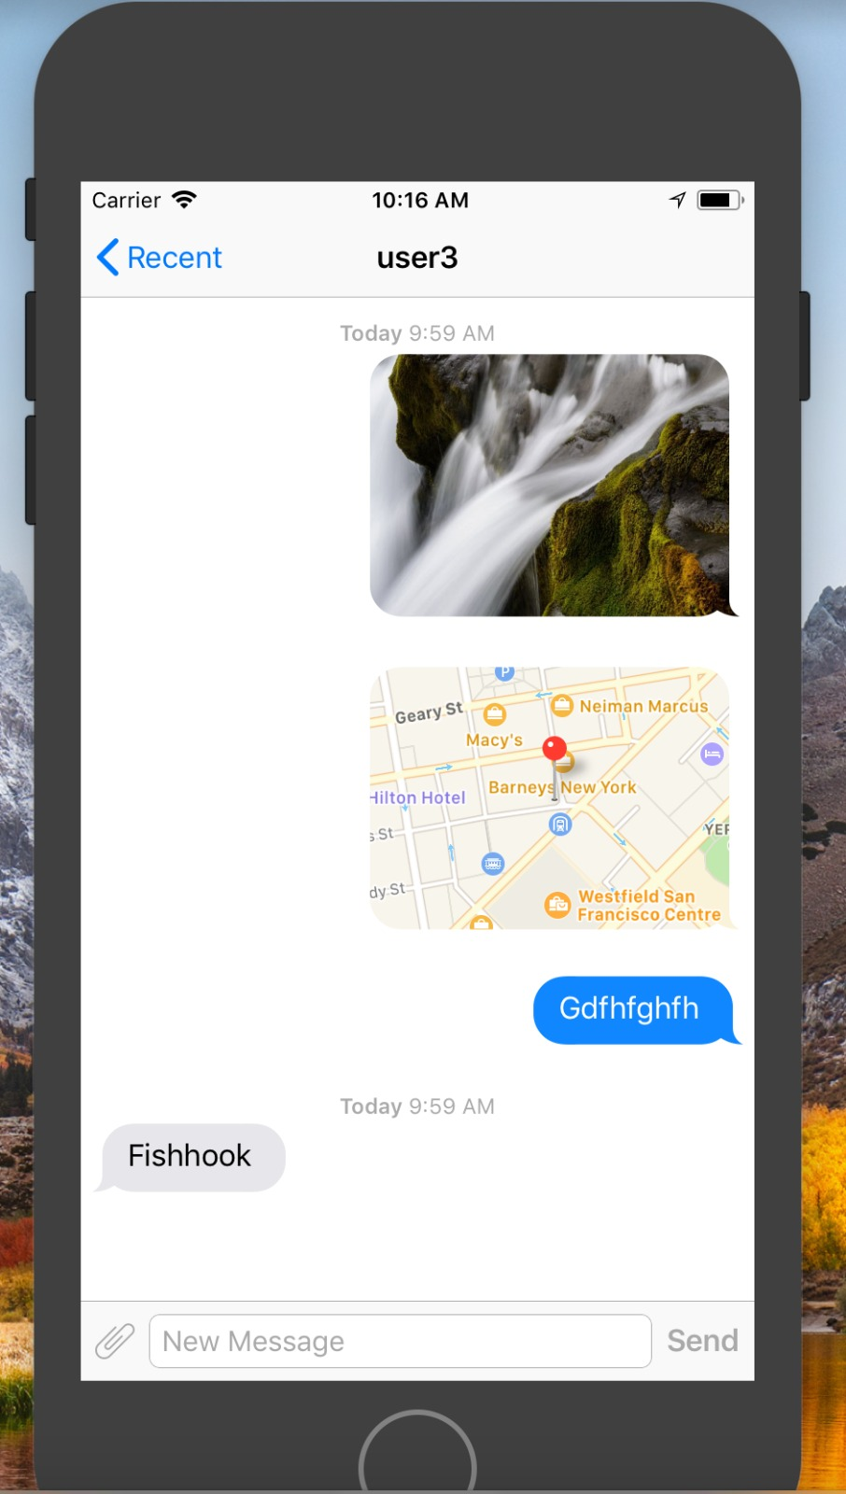
Chat window

Slide 10
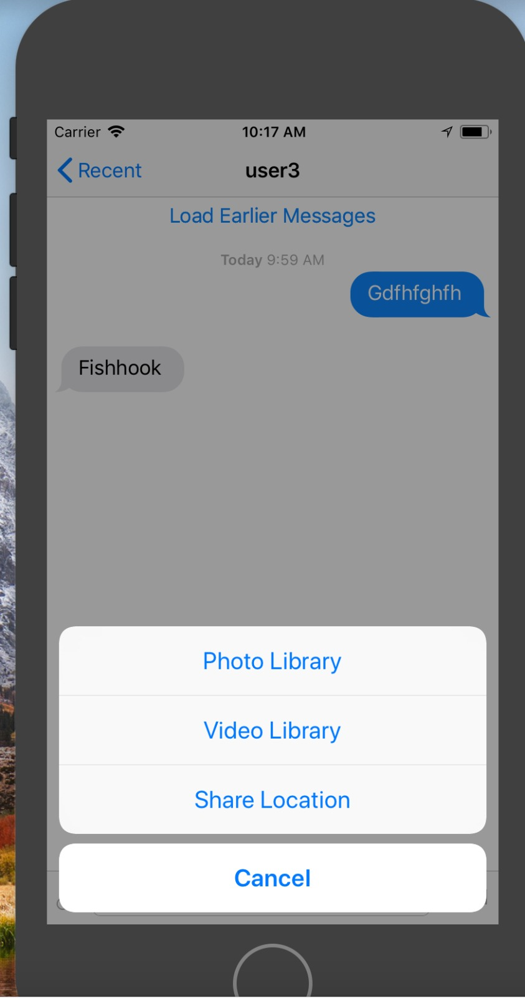
Various messages

