Slide 1
WeCollaborate A learning management system to register and learn courses online
Team Members:
Jhansi
Sheetal
Zhan
Menglu

Slide 2
Technologies used for the project
HTML5
CSS3
Bootstrap
JQuery
JavaScript
AngularJS
PHP

Slide 3
Database tables
course_ customer
review_id
customer_id(PK)
course_id(PK)
course
course_id(PK)
course_cat
course_title
course_desc
course_price
course_image
course_keywords
course_video
Course_instructor
customer
customer_id(PK)
customer_ip
customer_name
customer_password
customer_email
customer_username
customer_image
review
review_id(PK)
rating
reviews
cart
id(PK)
ip_add
qty
customer_id
category
cat_id(PK)
cat_title

Slide 4
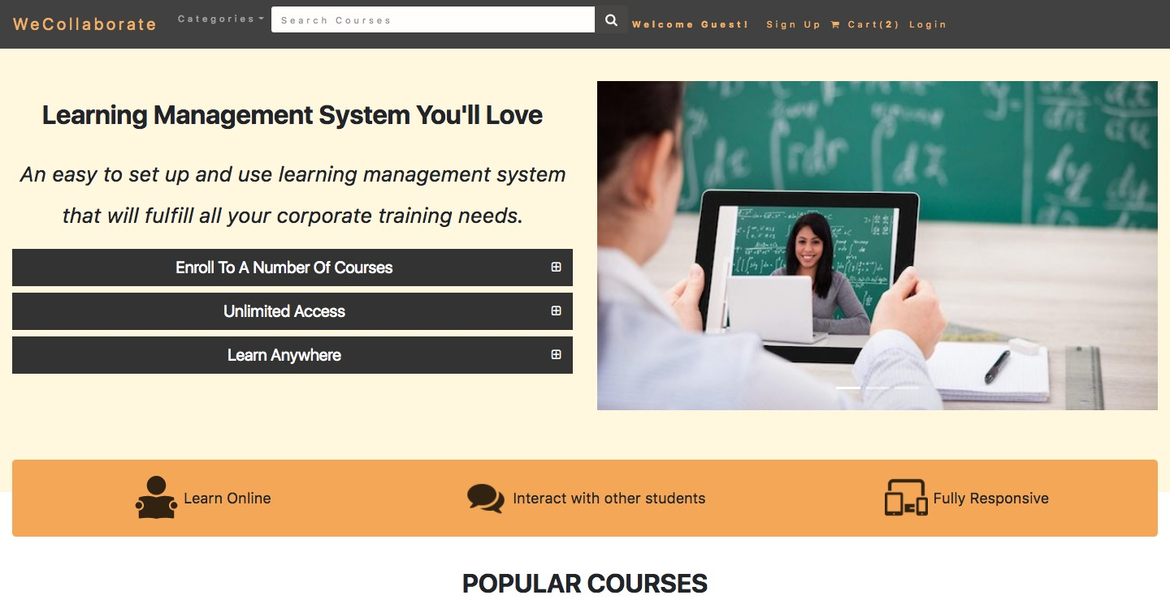
Homepage

Slide 5
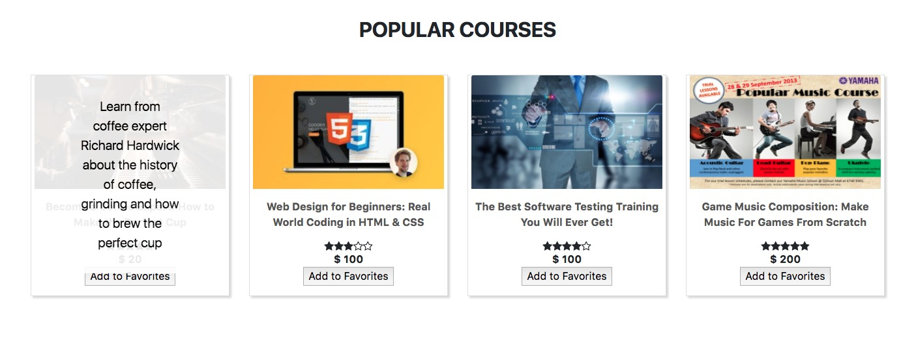
Homepage continued…

Slide 6
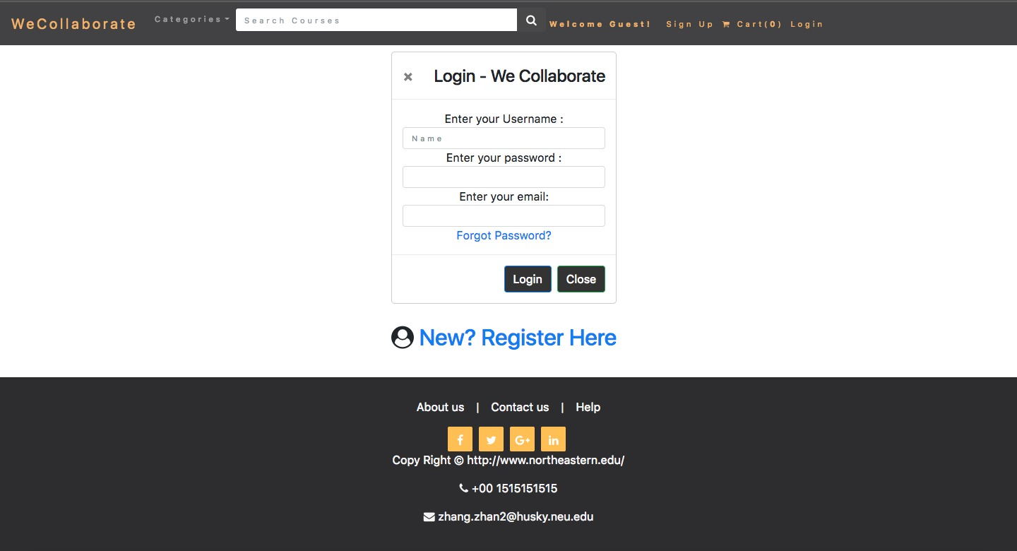
Login

Slide 7
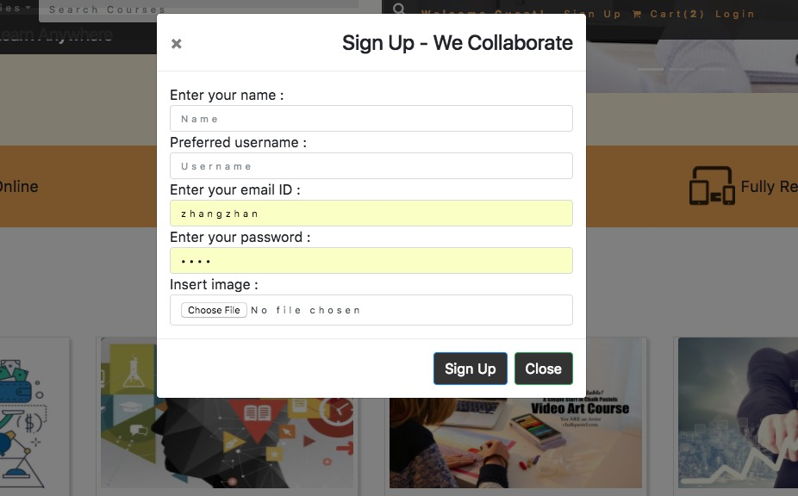
Signup

Slide 8
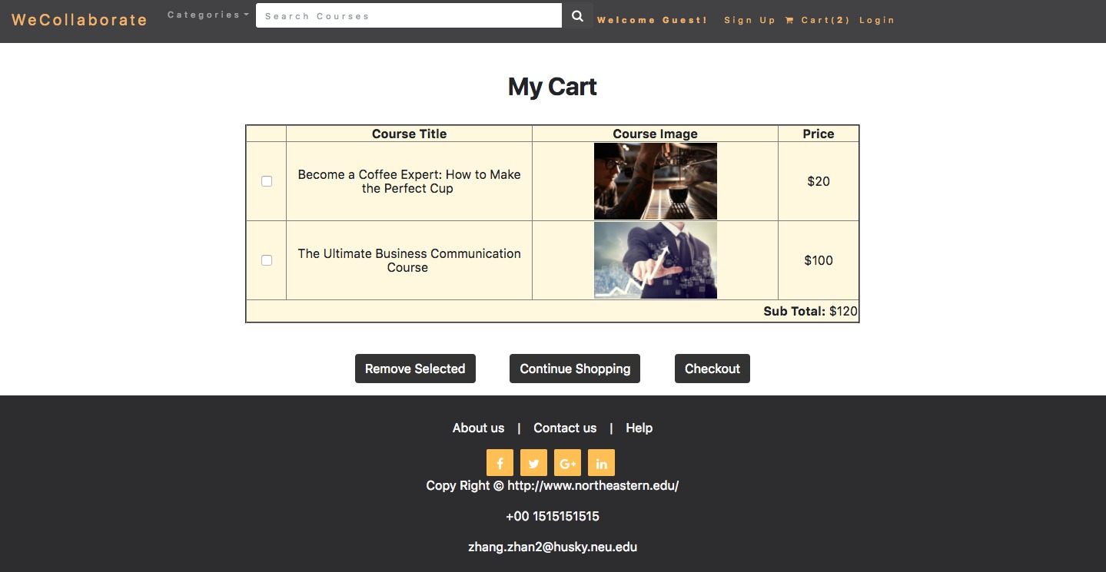
Cart

Slide 9
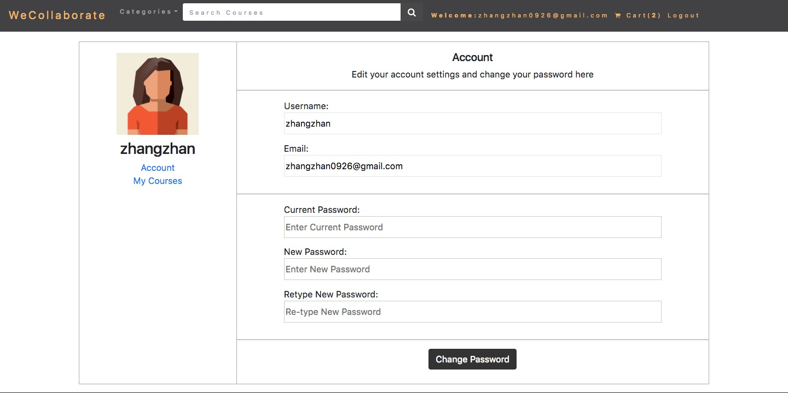
Profile Page

Slide 10
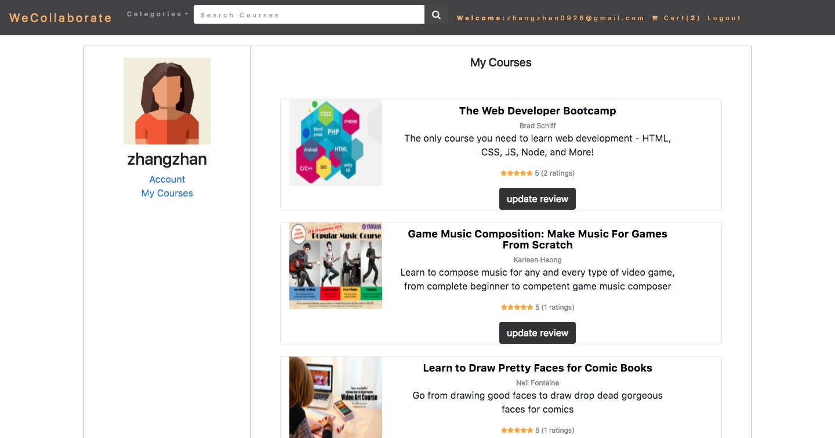
My Courses

Slide 11
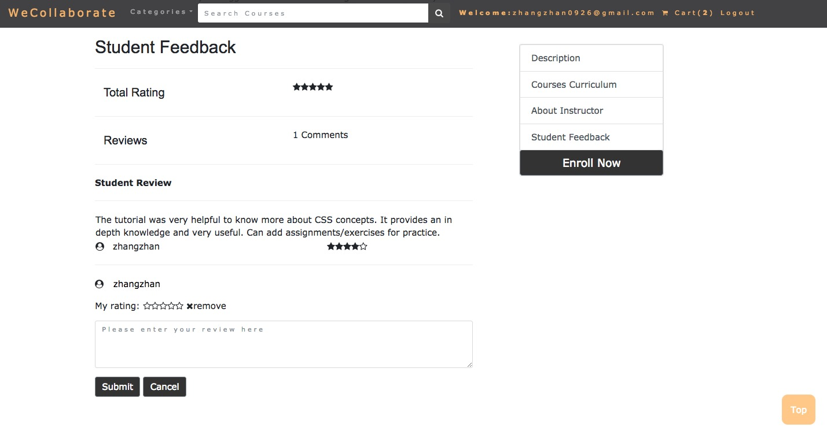
Student Feedback for courses

Slide 12
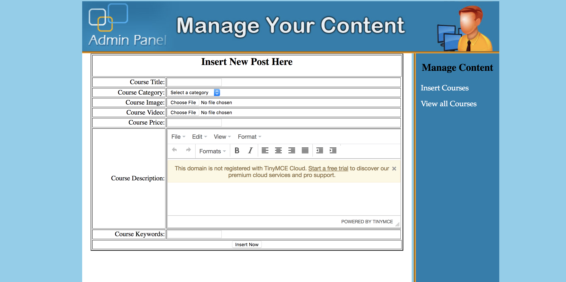
Admin Page to add courses into database table

Slide 13
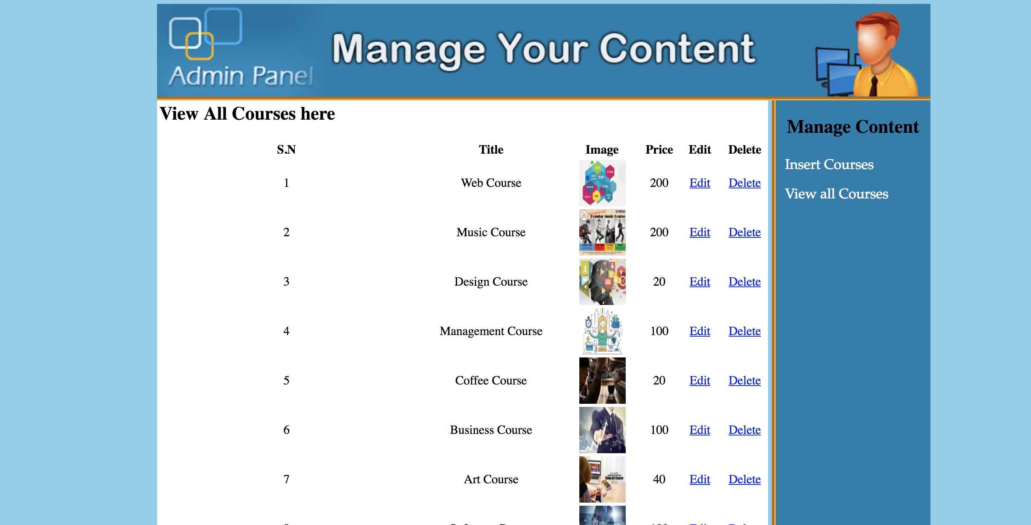
Admin page to edit or delete courses from database table

