Slide 1
HOUSE PRICES : ADVANCED REGRESSION TECHNIQUES
Sheetal Gangarapu
Disha Bhatnagar

Slide 2
Overview
Goal: To predict the final price of each house of residential homes in Ames, Iowa by using regression techniques.
Data Characteristics:
79 Explanatory variables
1 Target variable: SalePrice
1460 observations

Slide 3
Exploratory Data Analysis
We have noticed the relationship of the following factors with respect to the response variable as well as among the independent variables.
Distribution
Skewness
Correlation

Slide 4
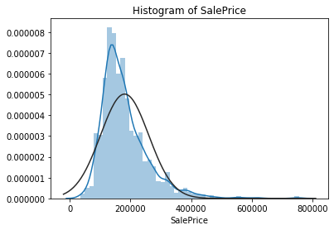
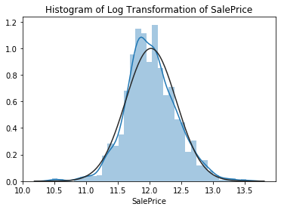
Distribution of Target Variable
We observe that the target variable SalePrice has a right-skewed distribution. Hence, we need to log transform this variable to make it normally distributed which helps in better modelling.

Slide 5
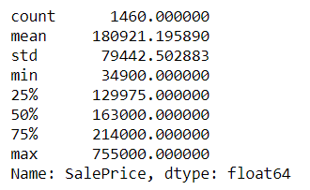
Summary of Target Variable
The summary of SalePrice is
Most of the values fall in a range of $130,000 to $215,000.
Skewness
SalePrice – 1.88287575
Log SalePrice – 0.1213350
Kurtosis
SalePrice – 6.53628286
Log SalePrice – 0.8095319

Slide 6
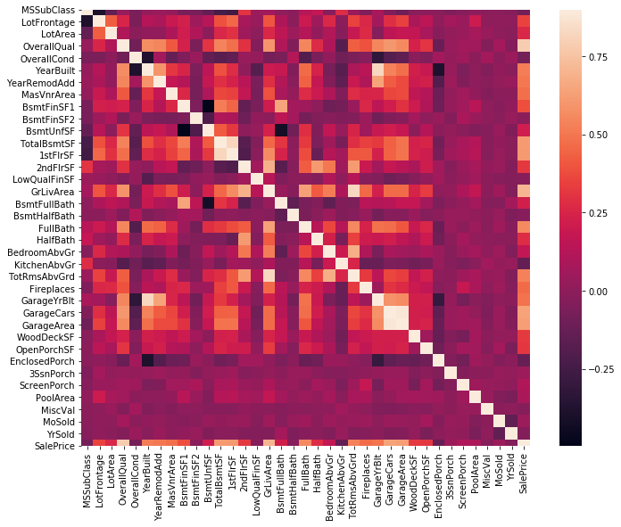
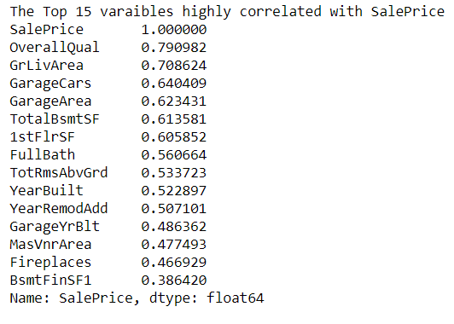
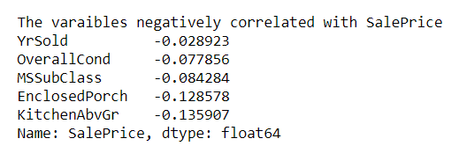
Correlation

Slide 7
Data Cleaning
Normalizing Response Variable
Variable Treatment
Missing Value Treatment
Continuous Variable
Categorical Variable
Outlier Treatment

Slide 8
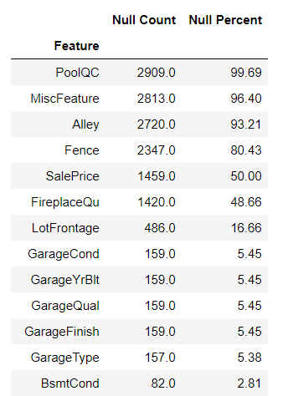
Missing Value Imputation
Numerical Variables – For missing values, we used the median of the corresponding variable
Categorical Variables – For missing values, while imputing we take care of two things:
Check if the variable has missing value because the house doesn’t have a particular component
For other cases, we just use the most frequent occurring category (mode)

Slide 9
Feature Engineering
Transformed some of the numerical variables that are really categorical
Standardized the numeric variables
Label Encoded some of the categorical variables that may contain information in their ordering set
Added TotalSF feature: sum(TotalBsmtSF, 1stFlrSF, 2ndFlrSF)
Split the data into a training set and a test set to run a model.

Slide 10
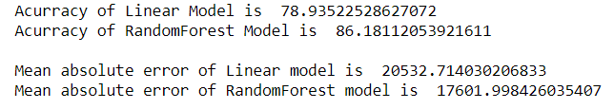
Current Experiments
Linear Regression
To predict home prices
To find out what features add value to a home
Random Forest
Main hyperparameters
n_estimators: number of trees in the forest
max_features: number of features to consider when looking for best split
Deeper trees with smaller max_features performs better

Slide 11
Future Exploration
Ridge/Lasso Regression: Regularization reduces the magnitude of the features’ coefficients to improve the accuracy of a model.
Gradient Boosting: It uses weak prediction models and combines them to make a strong “learner”.
In addition, we are planning to compare the different models to get our best performing model to predict the house price of the test dataset.

Slide 12

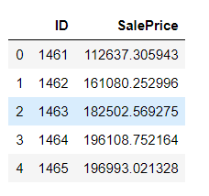
Evaluation
Prediction of SalePrice
Best Model w.r.t Root Mean Square Error

Slide 13

THANK YOU!

