Slide 1
Homezilla
Sheethal Heremagalur Sridhar
UIN: 667590662

Slide 2
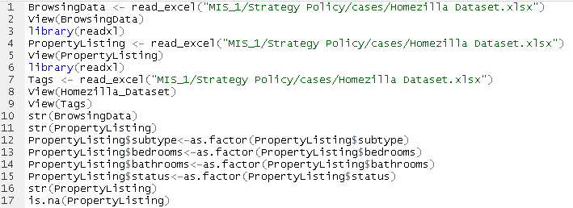
Data Transformation of 62 Properties’ Dataset
Before Analysing the Property Dataset converting the variables into their suitable types is important for further Univariate Analysis.

Slide 3
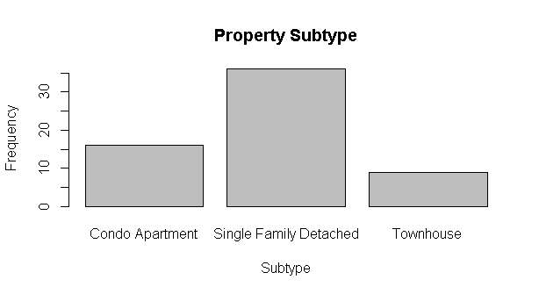
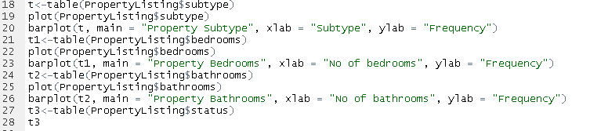
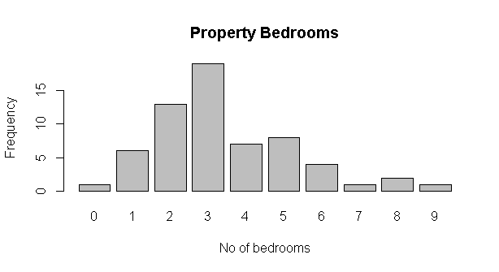
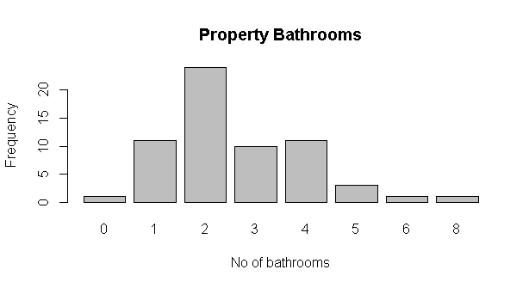

Slide 4
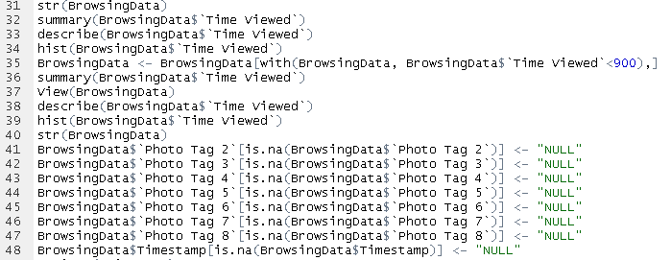
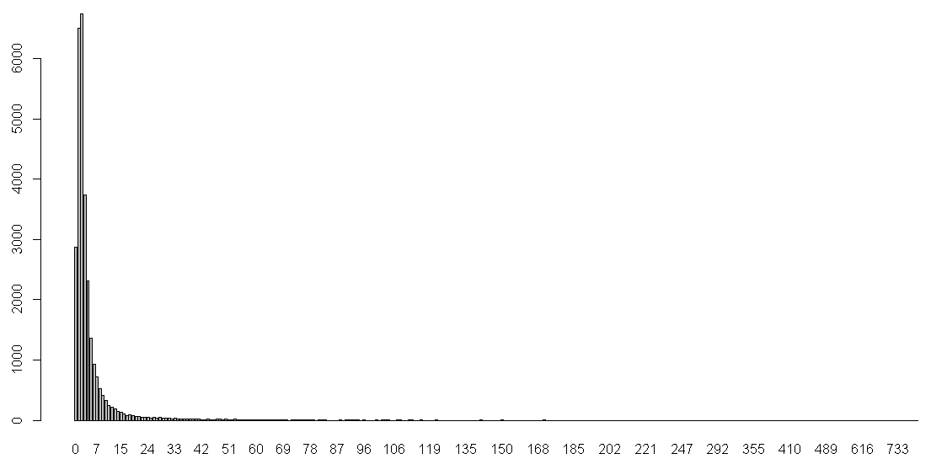
Data Cleaning
Removing the Outliers and setting a limit for Time Viewed as 900

Slide 5
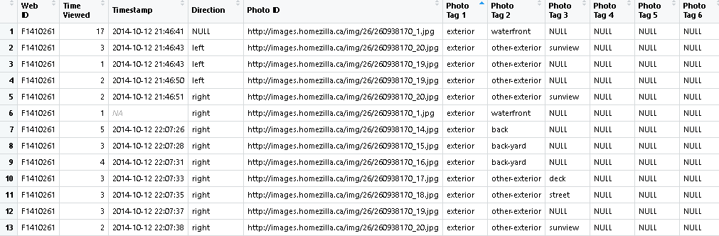
Replacing NA values with NULL for the relevant fields needed for our analysis

Slide 6
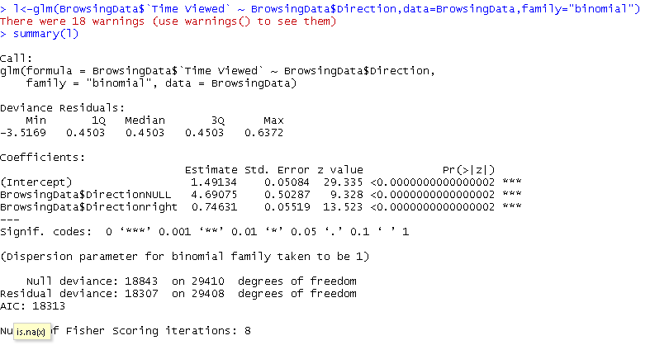
Logistic Regression with just the Direction as Independent variable

Slide 7
Importance of the Sequence of Photos
The sequence of the pictures make a significant impact, we can come to this conclusion by analysing the data of those customers who viewed pictures for less than 3 seconds (Unsuccessful)
Had the first few images been more attractive to the customers they would be locked in.
Time viewed for such images would be more than 3 seconds and the interest of the customers in the property would increase.
The first few images must display the best features of the property to captivate the customers.

Slide 8
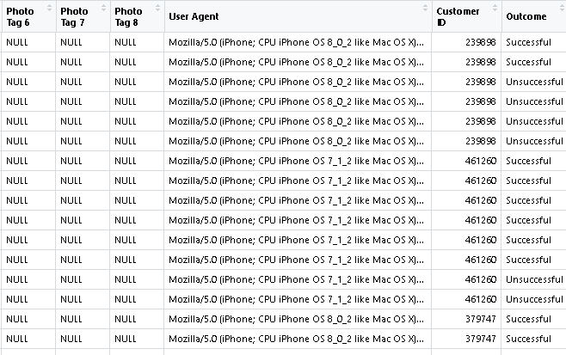
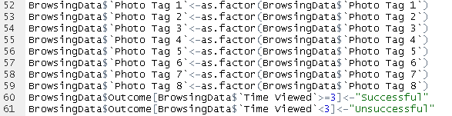
Categorizing into 2 levels Successful and Unsuccessful based on the company assumption that TimeViewed>=3 is a Success
TimeViewed<3 is a Failure

Slide 9
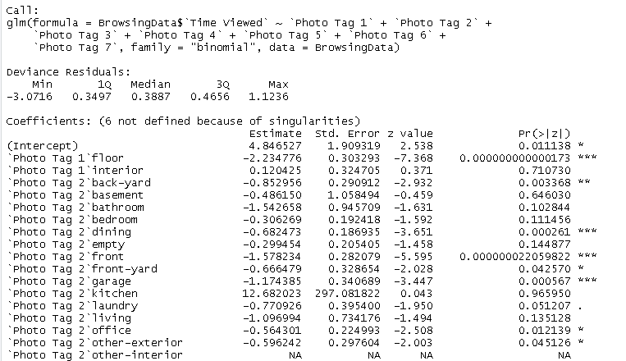
Logistic Regression with Photo Tags as Independent variables

Slide 10
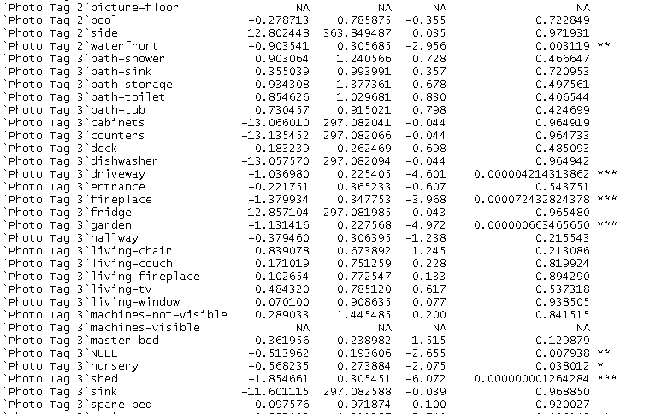

Slide 11
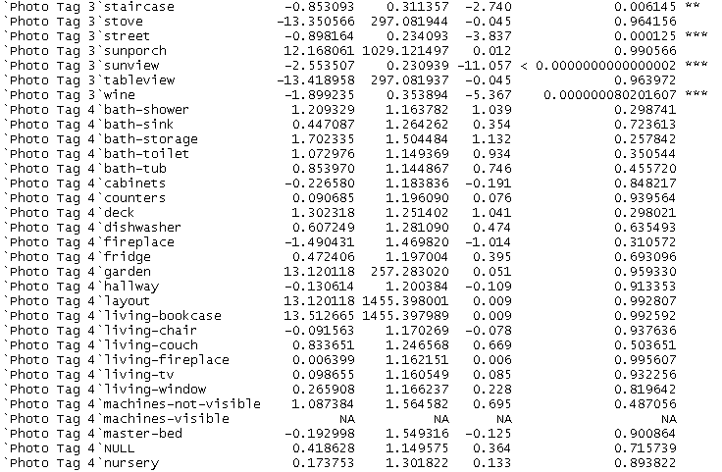
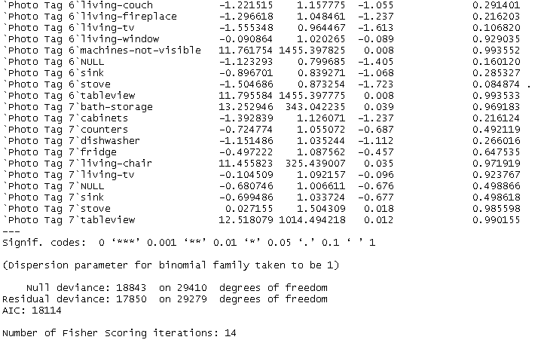

Slide 12
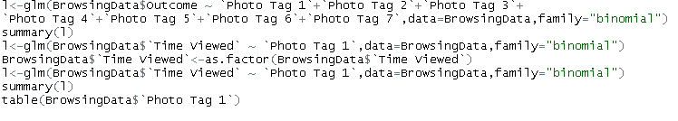
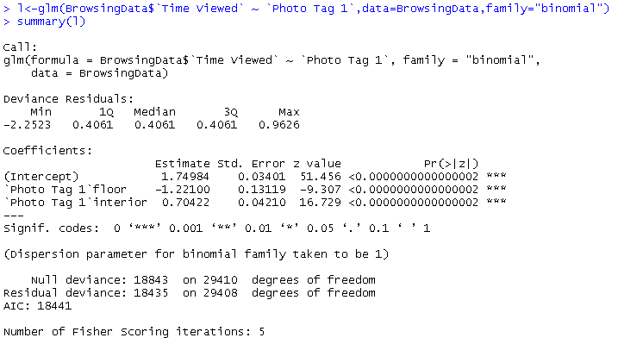
Similar Logistic Regression can be done keeping Outcome as the Dependent Variable
Looking at the odds that Time Viewed is high because of the variation in Photo Tag 1 only

Slide 13

Based on the levels of Photo Tag1 and results of logistic regression we can come to the conclusion that pictures which showed the interiors of the house had the highest views compared to the exterior or floor.

Slide 14
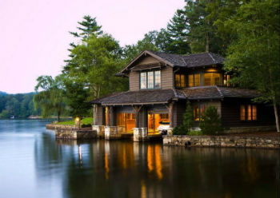
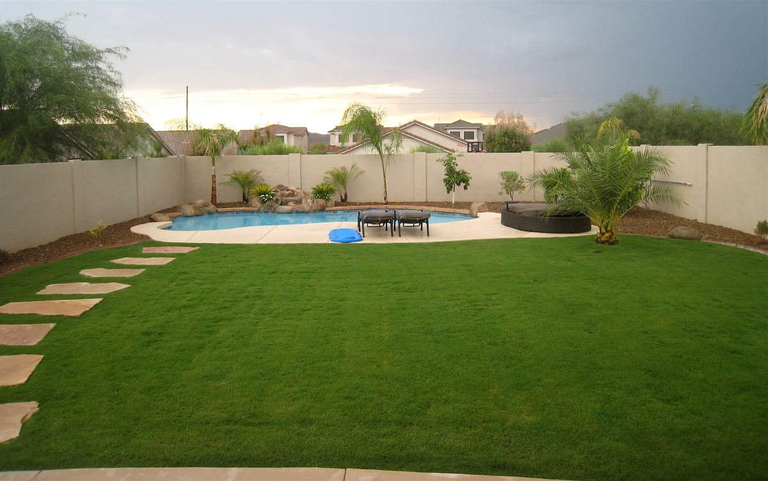
The Photos which were most attractive
Based on the highest viewed property with
Web Id - F1410261
With waterfront of the house being the first picture and backyard being the 15th picture gained the most views.
Total time viewed by all customers – 3203 seconds

Slide 15
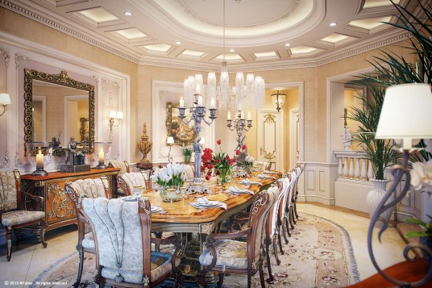
The Photos which were most attractive
Based on the highest viewed property with
Web Id - V1084582
With dining area being the first picture.
Total time viewed by all customers – 1785 seconds

Slide 16
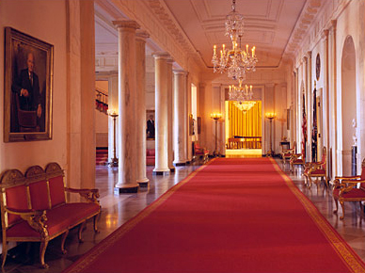
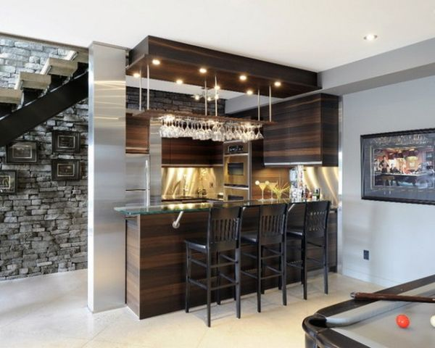
The Photos which were most attractive
Based on the highest viewed property with
Web Id - V1083368
With hallway area being the second picture and wine area being the 20th picture.
Total time viewed by all customers – 1782 seconds

Slide 17
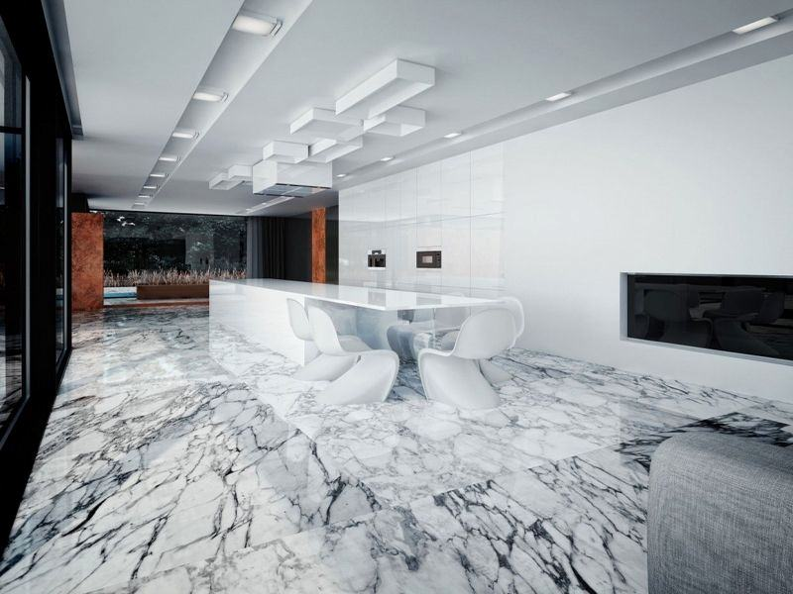
The Photos which were most attractive
Based on the highest viewed property with
Web Id - V1081085
With floor area being the 19th picture.
Total time viewed by all customers– 1499 seconds
The type of the pictures and the sequencing play an important role for the property to be sold. Although , the most attractive properties tried to captivate the customers until the last image.

